Slide 1


Slide 2
Disclosure to Participants
Notice of Requirements For Successful Completion
  Please refer to learning goals and objectives
  Learners must attend the full activity and complete the evaluation in order to claim continuing education credit/hours
Conflict of Interest and Financial Relationship Disclosures:
  None
Non-Endorsement of Products:
  Accredited status does not imply endorsement by AADE, ANCC, ACPE or CDR of any commercial products displayed in conjunction with this educational activity
Off-Label Use:
  None

Slide 3
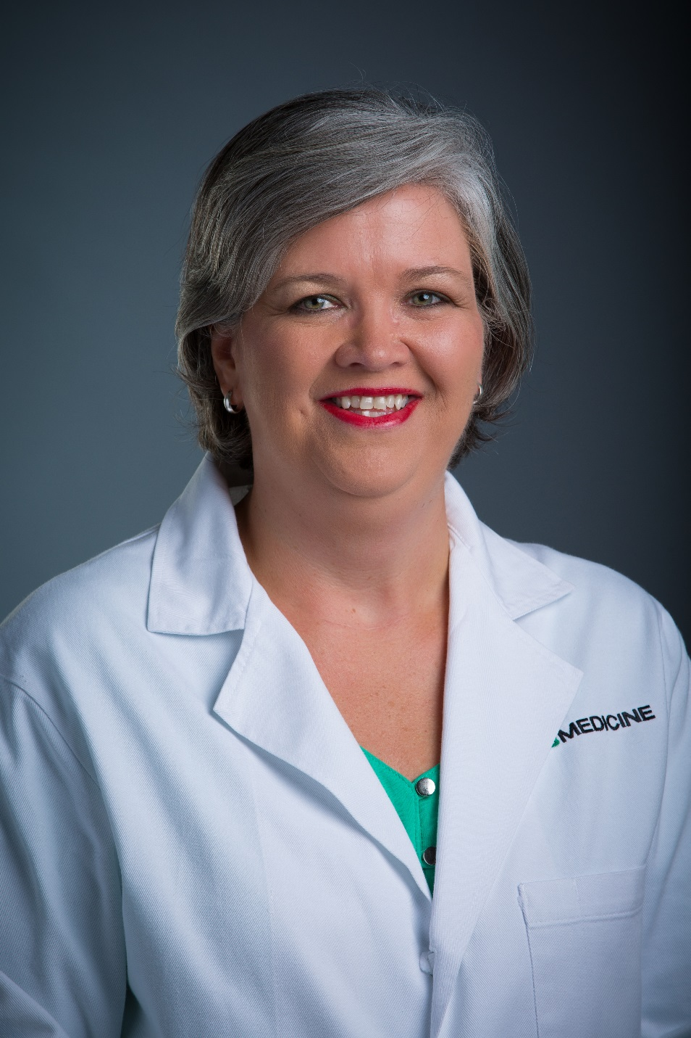
Donna P. Stevens
DNP, FNP-C, BC-ADM, CDE
Nurse Practitioner
Inpatient Glycemic Management Team
UAB Hospital
Birmingham, AL

Slide 4

Inpatient Diabetes Management:
Navigating Rough Seas and Reaching the Harbor Safely

Slide 5
Objectives
At the conclusion of the presentation, the learner will:
  Describe one approach to glycemic management of hospitalized patient with hyperglycemia or diabetes.
  Compare and contrast glycemic control for those who keep their pump verses those who convert to subcutaneous insulin during the hospital stay
  List the basic criteria for eligibility of safely wearing an insulin pump during the hospitalization

Slide 6
Objectives
  Create and adjust insulin pump settings based on insulin requirements and glycemic patterns
  Utilize strategies learned to improve glycemic control in special population such as those with renal failure, cystic fibrosis, and steroid-induced hyperglycemia.
  Utilize strategies learned to improve glycemic control of those who are transitioning from intravenous to subcutaneous insulin or those who have developed DKA while hospitalized and are awaiting ICU transfer

Slide 7
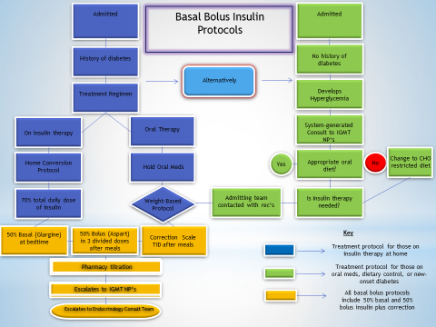
Insulin Protocols with Tiered System and NP Run Glycemic Management Team

Slide 8

Inpatient Glycemic Management Team
Glucose reading above 300
One glucose reading below 40 or two readings of 40-69 within 24 hours
Those on an insulin pump
Those on tube feeding or TPN protocol
Those who are difficult to control
  Type 1 DM
  Steroid-induced hyperglycemia
Patients at Spain Rehabilitation Center for Psychiatric Medicine who have diabetes
Those with CFRD

Slide 9
2016: AADE Position Paper
Role of the CDE in Inpatient Diabetes Management
Research suggests that early and aggressive intervention to control hyperglycemia in hospitalized patients could significantly reduce morbidity, mortality, length of stay, and medical costs.
In 2012, 25% of the total $176-billion burden in direct medical costs for diabetes were related to hospitalizations.
Guidelines for inpatient management of diabetes have been published to provide standards of care for health care professionals.

Slide 10
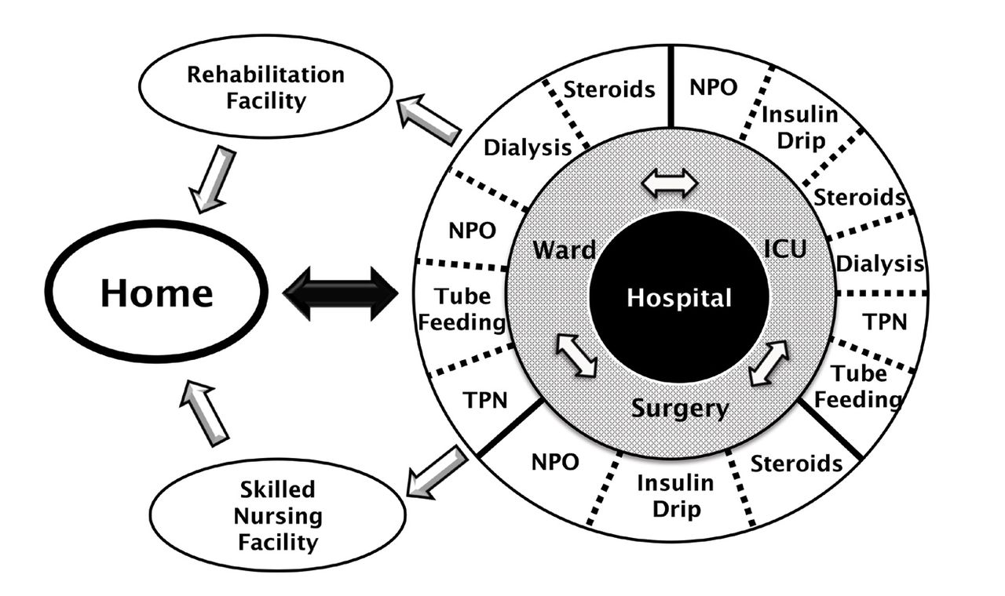
Challenges of Inpatient Diabetes Management:
Notes:
For patients with diabetes, a single hospitalization may involve multiple transitions. Each transition requires a careful approach to insulin therapy. Patients may be admitted to a ward or to the ICU or proceed directly to surgery. They may then receive different levels of care with overlapping or sequential interventions such as NPO status, enteral nutrition by tube feeding, or total parenteral nutrition (TPN); medications such as steroids that may worsen glycemic control; and dialysis. Patients transition back to an outpatient setting, either directly to their home or to an intermediate setting such as a rehabilitation or skilled-nursing facility. The clinical situation may shift frequently, with numerous opportunities for breakdowns in communication among teams and various care providers at all levels.

Slide 11
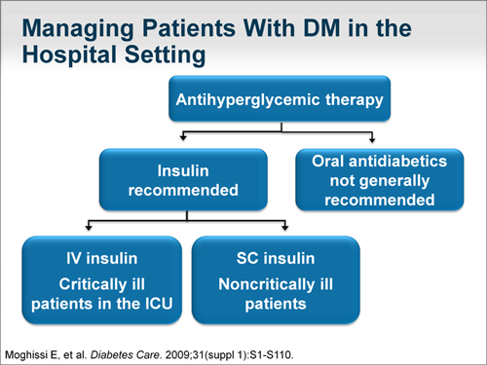

Slide 12
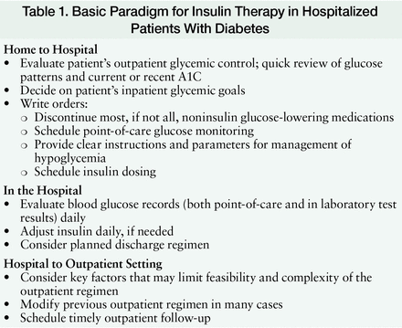

Slide 13
Considerations for Hospitalized Patients with Hyperglycemia (in the Non-ICU Setting)
Type of diabetes
Number of years present and any co-morbidities
Medications used to treat diabetes
Diet at home and whether compliant
Diabetes control at home
Medications or therapies that affect glycemic control
Risks for hypoglycemia
Factors that could affect intake
Coordination of care

Slide 14
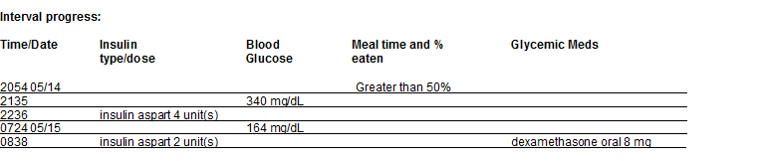
Coordination of Care

Slide 15

Now….into the rough water
Pumps
DKA While Hospitalized
Conversion from IV to SQ
CKD / PD / HD
Steroid-Induced Hyperglycemia
CFRD
Tube Feedings / TPN

Slide 16
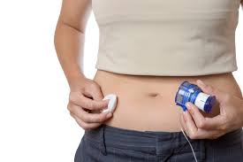


Insulin Pumps In the Hospital Setting
Is the patient awake and alert?
What is your policy re: insulin pumps? Who will assess and monitor the patient? What orders / protocols are in place?

Slide 17
Insulin Pump Settings
How They are Derived?
Type of Insulin
Basal Rate
Insulin to Carbohydrate Ratio
Insulin Sensitivity or Correction Factor
Active Insulin Time

Slide 18
Basic Information Needed
Total daily dose of insulin (TDD)
Renal function
Knowledge of Rule of 500 (450) and Rule of 1700 (1500 or 1800)
Patient needs to know how to count carbohydrates
Patient needs to be awake, alert and able to operate his/her own pump
Patient needs supplies and insulin

Slide 19
Rule of 500
Take the number 500 (or 450) and divide it by TDD to get ICR
The ICR is the number GRAMS of CARBS that 1 unit of insulin will cover.
Example: 1 serving = approximately 15 grams of carbs (17 to be exact)
Suppose that the TDD of insulin is 70 units
500 divided by 70 or 500 / 70 = 7.1. The ICR is 1:7
About 2 units of insulin needed for each serving (about 15 grams) of carbs
You plan to eat 60 grams of carbs
60 grams divided by 7 (your ICR) OR 60 / 7 = 8.5.
You will administer 8 or 9 units of insulin to cover that meal.

Slide 20
Rule of 1700 (Or 1800 Or 1500)
Tells you how many mg/dl the glucose will fall with each unit of insulin administered
1700 and divide by TDD to get CF or SF
  Example:
  TDD of insulin is 70 units per day
  1700 divided by 70 OR 1700 / 70 = 24.2 or 24
  My target glucose level is 100. My glucose is 240
  240 -100 = 140
  140 divided by 24 OR 140 / 24 = 5.8 or 6
  I need 6 units of insulin to correct my glucose level

Slide 21
Let’s put it all together
My ICR is 1:15, CF is 1:40 and target is 110
  I am going to eat a ham sandwich, an apple, and drink a glass of unsweetened tea. My pre-prandial glucose level is 180.
  2 bread servings and 1 apple = 3 carb servings (45 grams)
  45 grams divided by ICR 15 = 3 units for meal insulin
  My glucose level is 180-my target of 110 = 70. 70 divided by 40 = 1.75 or 2
  I will take 3 + 2 = 5 units of insulin to cover my carb intake and to bring my glucose level to target

Slide 22
Case Study: Insulin Pump
Mrs. W. has a history of DM Type 1. At home, she uses an insulin pump for management of diabetes. She does not have her pump; it is at home. She cannot tell me her pump settings. She follows with Dr. Johnson in Jasper, AL. Phoned his office and spoke with the nurse. She states that her medication list indicates that she takes 40 units of basal insulin per day through her pump. She monitors 4-5 times per day.

Slide 23
Pump arrives and here are the settings…..
Total Basal Rate 40.05
12 a - 1.55 units/hr
11 a - 1.8 units/hr
8 p - 1.7 units/hr
Bolus settings:
ICR 1:7
CF 1:25
Target 101-120
AIT 3 hours

Slide 24
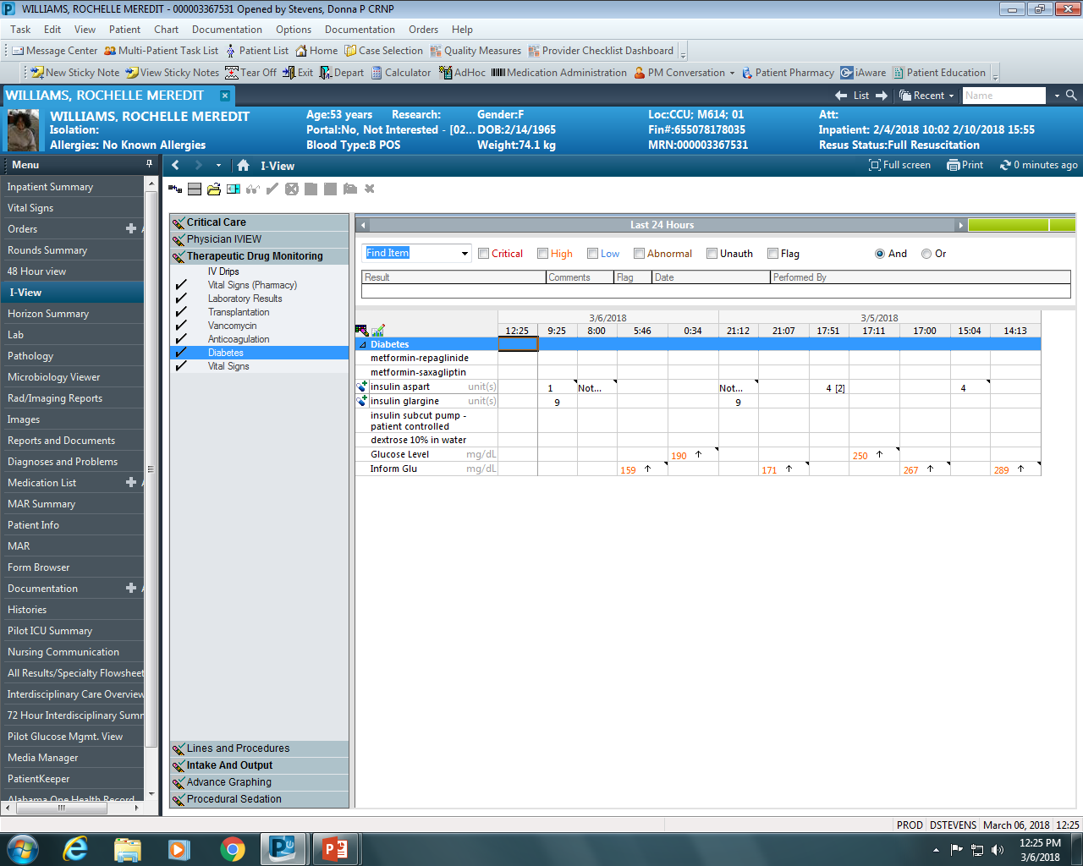
Glucose levels and insulin administration for the past 24 hours
As you can see here, the patient has not been receiving 40 units of basal insulin per day (about ½ of that amount). When speaking with her, she states that she has lost over 20 pounds during the hospital stay and her diet has been a lot more restrictive than what she would eat at home.

Slide 25
Basal Rate
Should be about ½ of the TDD
She was mostly receiving basal insulin and her levels were within the target range
Basal insulin dose (Glargine) will need to be about 19-20 units
Pattern of basal rates shows a lower basal rate at night; so I know that her new basal rate needs to be lower to avoid hypoglycemia
I know that 1 units/hr x 24 = 24 units so I use 1.0 units/hr for two of the settings and then decrease the number at night; I decided to administer 0.7 units so that my total basal rate is about 20 units.

Slide 26
Insulin to Carbohydrate Dose (ICR)
The Rule of 500
  500 divided by the TDD = ICR
  Her previous ICR was 1:7…she is getting about ½ of her previous dose of insulin. So, I chose on a carb ratio of 1:14
  The higher the number, the lower the dose of insulin that the patient will receive.
  Example: You eat 45 grams of carbs…..45 divided by 14 = 3 units
…….45 divided by 7 = 6 units
To increase the amount of insulin, lower the number
To decrease the amount of insulin, increase the number

Slide 27
Correction Factor or Sensitivity Factor
The Rule of 1700 (or 1500 if has renal impairment…or 1800 if you want to be more aggressive)
1700 divided by 40 = 42.5 – I rounded this number to 45

Slide 28
Target and Active Insulin Time
Target is usually 100-120 or so; sometimes 90 up to 140 depending on the patient. For this patient, I just left it where it was.
Active time is usually set at the duration of time of the insulin that you are using; in this case it was Aspart insulin – if the creatinine is within normal range.

Slide 29
New Pump Settings:
Total Basal Rate 20.7 units/24 hours
12 a – From 1.55 to 0.7 units/hr
11 a – From 1.8 to 1.0 units/hr
8 p – From 1.7 to 1.0 units/hr
Bolus settings
ICR From 1:7 to 1:14
CF From 1:25 to 1:45
Target 101-120
AIT 4 hours

Slide 30
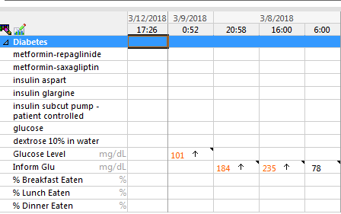
After restarting the insulin pump with new settings:

Slide 31
Converting Pump Settings To Basal Bolus Orders
Basal rate:
Total Basal rate = 18.6
12 a - 10 a - 0.6 units/hr
10 a – 12a - 0.9 units/hr Glargine 19 units or 9 units BID
Bolus settings:
Target 12 a - 6 a – 140 mg/dl
6 a - 11 a – 90 mg/dl
11 a -12 a – 150 mg/dl
ICR 1:8 - On 3 CHO diet = 3 x 15 = 45 divided by 8 = 5.625 or 6
CF 1:30 ---We have correction scales that have a 1:60, 1:40, 1:20 and 1:10 CF

Slide 32
New Orders:
Glargine 18 units nightly or 9 units BID
Nutritional Novolog 6 units TID with meals
Moderate Novolog Insulin correction scale (has CF of 1:40)

Slide 33
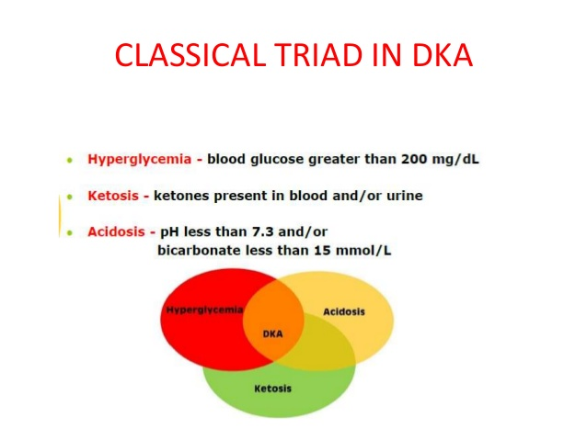

DKA In The Hospital Setting

Slide 34
DKA in the Hospital Setting
Occurs during transitions of care or when insulin doses are held
CMS “Never Event”
Sometimes there is a delay in transfer to higher level of care due to bed availability
Development of a streamlined safe and effective treatment plan for patients who are waiting to go to ICU

Slide 35
Diabetic Ketoacidosis (DKA)
Occurs when the body does not have enough insulin to prevent ketosis (burning of fat for fuel).
  Mostly seen in those with Type 1 DM, but can also be seen in ketosis prone type 2 DM
As a result, ketones (acids) build up and lead to metabolic acidosis
Electrolyte imbalances can occur
Severe volume depletion occurs
DKA can develop in a matter of hours to 1-2 days

Slide 36

DKA Causes
  Non-compliance with insulin
  Iatrogenic Causes
Stressful precipitating event that results in increased catacholamines, cortisol, glucagon.
  Infection (pneumonia, UTI)
  Alcohol, drugs
  Stroke
  Myocardial Infarction
  Pancreatitis
  Trauma
  Medications (steroids, thiazide diuretics)

Slide 37
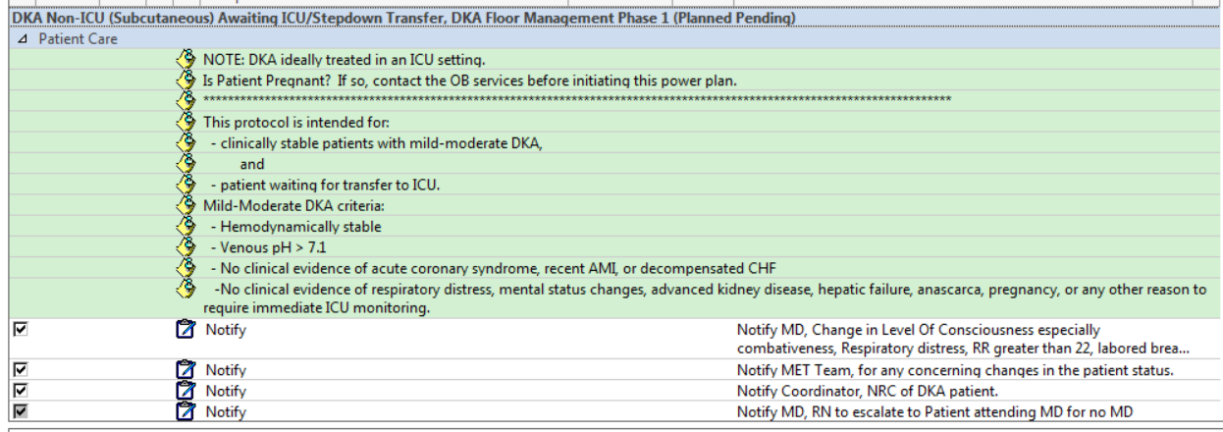
DKA Order Set Criteria

Slide 38
DKA Treatment
Correction of fluid loss with intravenous fluids
  NS 500 ml/hr x 2 hrs then 1/2NS at 250 ml/hr unit – phase 1
  D51/2NS at 150 ml/hr – phase 2
Correction of hyperglycemia with insulin
  Monitoring Q2h
  Aspart 0.3/kg units SQ then 0.2 units/kg Q2h – phase 1
  Aspart 0.1 units/kg Q2h – phase 1
Correction of electrolyte disturbances, particularly potassium loss
  KCL 20 meq IV Q2h prn K+ 4-5.1
  KCL 40 meq IV Q2h prn K+ <4

Slide 39
DKA Treatment
Correction of acid-base balance
  Electrolytes Q4h
  Urine Ketones and A1C
  Beta Hydroxybuterate level
Clear Liquids
Telemetry Monitoring
Diabetes Education Consult

Slide 40
DKA resolution
The guidelines from the American Diabetes Association (ADA) state that DKA is resolved when:
1. the blood glucose is less than 200 mg/dl
2. the bicarbonate is equal to or greater than 18 mEq/l
3. the venous pH is greater than 7.3.

Slide 41
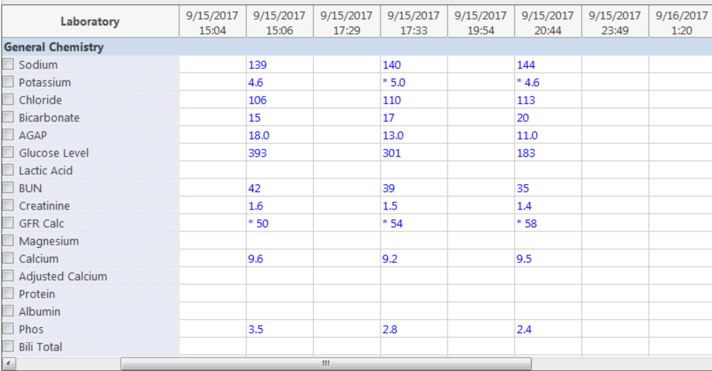
This patient presented in mild DKA. There was no ICU bed available and he was started on the DKA SQ Protocol.

Slide 42
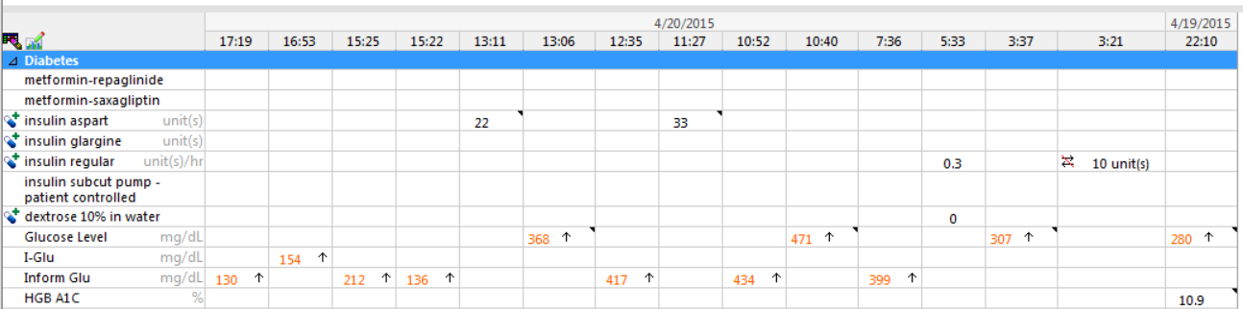
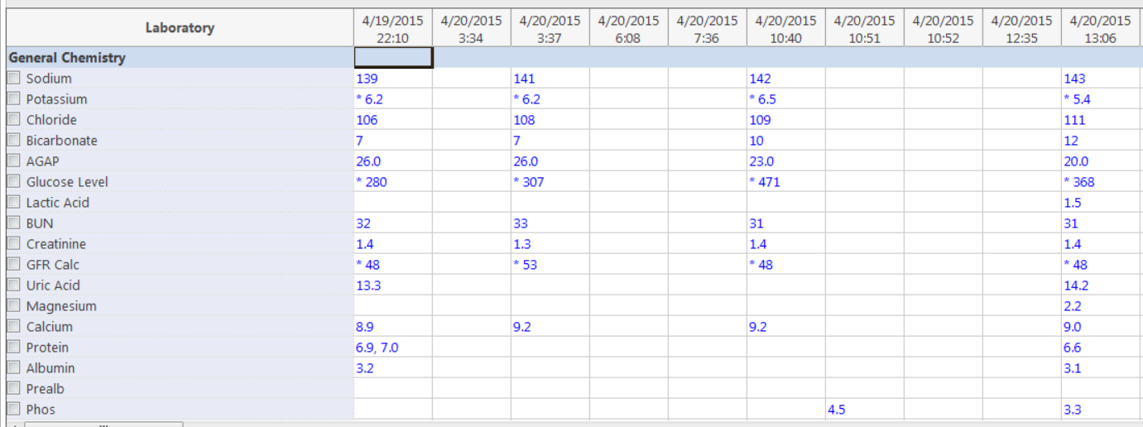
Another patient was in the ED and there was no bed available in ICU.
Notes:
Regular insulin was given SQ and then the SQ protocol was initiated. Look right to left on the top chart and left to right on the bottom chart. First, note that Regular insulin was administered IV at 0321 on 4/19. At that time, the anion gap was 26 with glucose level of only 280. Afterwards, the gap stayed the same but the glucose level went up. Why? Because Regular insulin half-life is only 5-10 minutes; not enough to control the glucose level if it is rising. Now, look at the top. After two doses of SQ insulin, the glucose is coming down.

Slide 43

Transition From A Drip to SQ Insulin

Slide 44
Transitioning from IV to SQ insulin
Why was the insulin drip initiated?
  DKA
  Uncontrolled Diabetes
  Steroid-Induced Hyperglycemia
  Other Complications: MI, Pneumonia, Sepsis
  Critical illness
Does the insulin dose need to be adjusted?
  No – convert to home basal bolus insulin
  Yes – convert using the insulin drip rate

Slide 45
Transitioning from IV insulin
IV insulin drip is discontinued
  Basal insulin should be given at least 2-4 hours prior to discontinuing insulin drip
  If patient will be transitioned back to an insulin pump, the pump should be initiated 30 minutes to 1 hour prior to discontinuing the insulin drip.
One approach is to take the insulin drip rate for the past 3-4 hours (with stable glucose levels) and get the average. Then multiply the average x 24 then x 80% or 0.80. Give ½ as basal insulin and ½ as bolus insulin.
Might be able to restart home regimen
Notes:
This needs to go to Critical Care

Slide 46
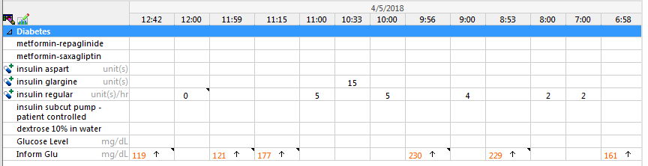
Administer basal insulin 2 hours before turning off insulin drip.

Slide 47

Patients with Renal Impairment

Slide 48
Persons With Renal Failure:
Those with chronic kidney disease not yet on renal replacement therapy
Those with acute kidney injury (AKI)
Those on peritoneal dialysis (PD)
Those on hemodialysis (HD)
Renal Transplant recipients with steroid-induced hyperglycemia
Those transitioning from one dialysis modality to another

Slide 49
Approaches
Hemodialysis:
  Consider reducing basal insulin by 15% the day after a dialysis session
  Administer basal bolus with 30-40% basal and 60-70% bolus insulin and give basal insulin in the am rather than the pm
Peritoneal Dialysis:
  NPH dose at the start of a dialysis session
  Basal bolus 50% Detemir and 50% bolus. If the glucose > 180 mg/dl prior to dinner, a second dose of detemir was given 25% of the nocturnal dose was given in the am

Slide 50
Another Approach
Utilize residual renal function for KT/V (clearance)
Training 5 days/week during the day and are discharged home on night-time PD
PET Test performed to assess what kind of transporter they are and a 24 hours urine to assess for residual renal function
They are placed on a prescription for dialysis after about 2 weeks

Slide 51
General Practice at Our Facility
Patients starting PD continue on their home regimen unless glucose levels >250 mg/dl during dialysis
We try not to make too many adjustments in the initiation and training period unless glucose levels run above 250 mg/dl
After on a set regimen, insulin dosing is established and titrated

Slide 52
Hospitalized Patients on PD
In the hospital, our goals are:
  Do Not treat glucose levels ordered with nightly labs
  Do Not to treat early am glucose levels (0700)
  To be mindful of whether they are coming in with peritonitis or with volume overload.
Notes:
Those with infection may need a lower glucose concentration
Those with volume overload may be dialyzed with a high concentration glucose bath to pull extra fluid.
Adjust insulin dosages based on the concentration of glucose in dialysis fluid (dineal)

Slide 53
Peritoneal Dialysis Case Study
73 yo M with PMH of orthotopic cardiac transplant in 1992, HTN, TIA and recent CVA s/p right carotid endarterectomy, DMII, and ESRD. While hospitalized, peritoneal dialysis was initiated. Following the hospitalization, he was transferred to the acute rehab hospital for inpatient rehabilitation.
At home, he was taking Novolog 75/25 insulin 60 units BID (before he was on peritoneal dialysis)
During the hospital stay, PD was initiated

Slide 54
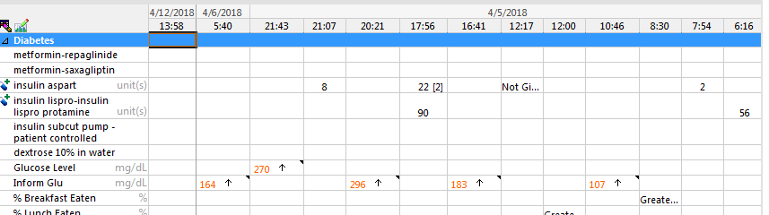
I chose to compartmentalize his insulin. He was on basal bolus insulin while hospitalized and required Glargine 20 units daily and Nutritional Novolog 10 units with breakfast and 16 units with lunch and dinner.
I started 75/25 insulin 60 units daily, Novolog 16 units with dinner, and 75/25 - 60 units at the start of PD with 2% dineal solution and titrated the dose.
I was going to increase his insulin to 100 units (given in 2 injections) on this date but he regained renal function and his PD was discontinued.
He transitioned back to 75/25 insulin 60 units BID

Slide 55

Steroid Induced Hyperglycemia

Slide 56
Principles of Treating Steroid Induced Hyperglycemia
Reasons for Use of Steroids
  Treatment of Illnesses such as Asthma or COPD, Arthritis, Gout, Lupus, Myasthenia Gravis and Others
  Actual or Prophylactic Medication for an Allergic reaction
  Prevention of organ transplant rejection

Slide 57
Pathophysiology of Steroid-Induced Hyperglycemia
Increase in insulin resistance with increased glucose production and inhibition of the production and secretion of insulin by pancreatic β-cells
Corticosteroids increase endogenous glucose production, increment in gluconeogenesis and antagonizing the metabolic actions of insulin
Enhance the effects of other counterregulatory hormones, such as glucagon and epinephrine, which increase the endogenous synthesis of glucose
Also been shown that the expression of the nuclear receptor peroxisome proliferator-activated receptor α is necessary for the increment in endogenous glucose production induced by corticosteroids
Corticosteroids reduce peripheral glucose uptake at the level of the muscle and adipose tissue
Costicosteroids also inhibit the production and secretion of insulin from pancreatic β-cells and induce β-cell failure indirectly by lipotoxicity

Slide 58
Types of Steroids and Effect on Glucose
Prednisone Cortisone Dexamethasone Hydrocortisone
5 mg = 25 mg = 0.75 mg = 20 mg
Prednisone or Methylprednisolone
  Insulin resistance begins when dose administered and increases. It peaks at 8-12 hours and then the effect wears off
Dexamethasone
  Rapid onset and prolonged duration of action. Effect can last for 48 hours after the last dose
Hydrocortisone
  Immediate onset if administered IV. Effect lasts about 8 hours

Slide 59
Steroid-Induced Hyperglycemia
Dependent on whether patient has DM Type 1, DM Type 2, or Steroid-Induced Hyperglycemia
Prednisone or Methylprednisolone vs Hydrocortisone vs Dexamethasone
Several approaches to treatment were found in the literature and a few are outlined in the next slides
Notes:
**Key is knowing the onset of action, peak time, and duration of action of the steroid and pairing it with insulin based on the onset, peak time, and duration of action.

Slide 60
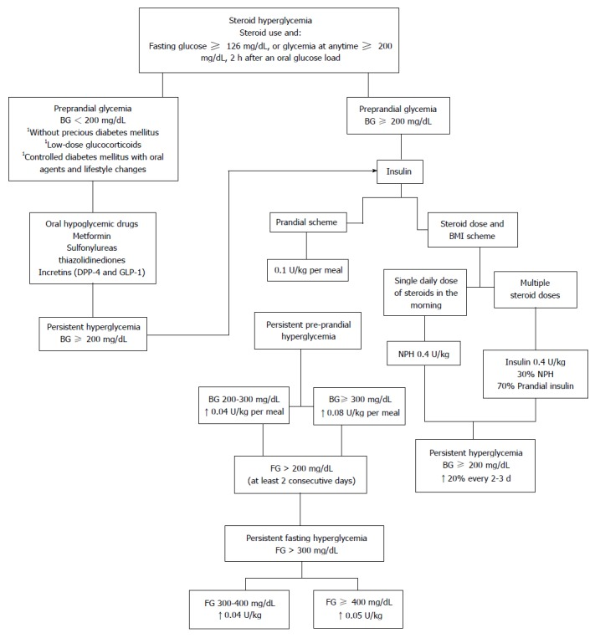
This group utilized the same approach no matter which steroid was being utilized. Next slide shows cropped view of insulin dosing

Slide 62
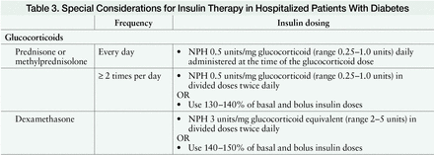
An approach using NPH

Slide 63
An Approach Using NPH, Regular and Glargine
NPH along with prednisolone and methylprednisolone
Regular human insulin along with hydrocortisone
Glargine along with dexamethasone as “correctional insulin.” The dose of correctional insulin should be based on the dose of the administered glucocorticoid and weight of the patient.
  For patients having preexisting diabetes mellitus given glucocorticoids, we recommend using correctional insulin over and above the background basal-bolus insulin regimen.
  For patients not having preexisting diabetes and developing GCIH, just the correctional insulin dose along with the administered glucocorticoid would suffice.

Slide 64
Our Practice - Prednisone
NPH 1 unit/mg of Prednisone or Methylprednisolone up to 20 mg then ½ mg/mg of Prednisone up to 40 mg
Example: Prednisone 30 mg = 24 or 26 units of NPH administered SQ when Prednisone of Methylprednisolone is administered orally or intravenous
If given BID; administer NPH BID
If given TID, administer NPH BID

Slide 65

Look right to left to see the pattern of hyperglycemia with oral Prednisone 10 mg. Glucose levels peaked at 1727 and then went down overnight.

Slide 66
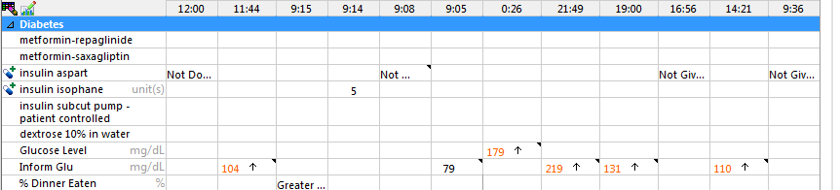
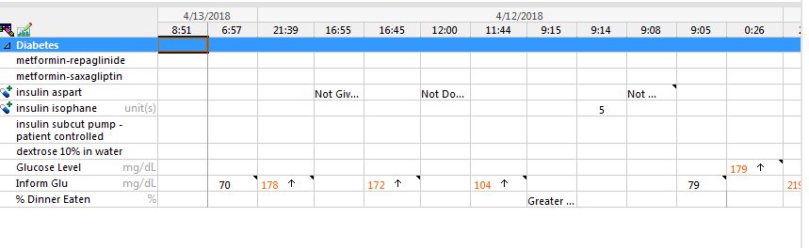
Glucose level peaked 12 hours after Prednisone was administered.
Hyperglycemia due to steroid-effect blunted with low-dose NPH

Slide 67
Our Practice - Dexamethasone
Type of DM | Dose of Prednisone or Methylprednisolone | Dose of Dexamethasone | Dos of NPH
Steroid-Induced or EGFR <30 or advanced liver disease | 10 mg BID or more frequent 20 mg BID or more frequent 30 mg BID or more frequent 40 mg BID or more frequent 50 mg BID or more frequent >60 mg BID or more frequent | 4-11 mg/d 12-17 mg/d 18-23 mg/d 24-29 mg/d 30-35 mg/d > 36 | 2 units BID 3 units BID 4 units BID 6 units BID 8 units BID 10 units BID
Type 1 DM or Type 2 DM with eGFR 30-45 or CFRD, or poor nutrition | 10 mg BID or more frequent 20 mg BID or more frequent 30 mg BID or more frequent 40 mg BID or more frequent 50 mg BID or more frequent >60 mg BID or more frequent | 4-11 mg/d 12-17 mg/d 18-23 mg/d 24-29 mg/d 30-35 mg/d > 36 | 3 units BID 5 units BID 8 units BID 10 units BID 12units BID 15 units BID
Well Nourished Type 2 with eGFR >45 | 10 mg BID or more frequent 20 mg BID or more frequent 30 mg BID or more frequent 40 mg BID or more frequent 50 mg BID or more frequent >60 mg BID or more frequent | 4-11 mg/d 12-17 mg/d 18-23 mg/d 24-29 mg/d 30-35 mg/d > 36 | 5 units BID 10units BID 15 units BID 20 units BID 25 units BID 30 units BID
Immediate Post-Transplant not on IV Insulin or Type 2 with Morbid Obesity or consistent BG >300 | 10 mg BID or more frequent 20 mg BID or more frequent 30 mg BID or more frequent 40 mg BID or more frequent 50 mg BID or more frequent >60 mg BID or more frequent | 4-11 mg/d 12-17 mg/d 18-23 mg/d 24-29 mg/d 30-35 mg/d > 36 | 8 units BID 15 units BID 20 units BID 30 units BID 30 units BID 30 units BID
Notes:
This protocol was evidence based but has not been tested on our facility

Slide 68
Dexamethasone Treated With NPH
Slide will be added before my presentation at AADE 18

Slide 69

Cystic Fibrosis Related Diabetes

Slide 70
CFRD Treatment Recommendations
Should ideally be seen quarterly by a specialized multidisciplinary team with expertise in diabetes and CF. (ADA-E; Consensus)
Should receive ongoing DSME from diabetes education programs that meet national standards for DSME. (ADA-E; Consensus)
Should be treated with insulin therapy. (ADA-A; USPSTF-B)
Oral diabetes agents are not as effective as insulin in improving nutritional and metabolic outcomes in CFRD and are not recommended outside the context of clinical research trials. (ADA-A; USPSTF-D)
Should perform SMBG at least three times a day. (ADA-E; Consensus)

Slide 71
Should strive to attain plasma glucose goals as per the ADA recommendations for all people with diabetes
  higher or lower goals may be indicated for some patients
  individualization is important. (ADA-E; Consensus)
A1C measurement is recommended quarterly for patients with CFRD. (ADA-E; Consensus)
For many patients with CFRD, A1C treatment goal is <7%
  higher or lower goals may be indicated for some patients
  individualization is important. (ADA-B; USPSTF-B)
CFF evidence-based guidelines for nutritional management are recommended for patients with CFRD. (ADA-E; Consensus)
Patients with CFRD should be advised to do moderate aerobic exercise for at least 150 min per week. (ADA-E; Consensus)

Slide 72
One Approach
Low-dose basal insulin
Rapid acting insulin per ICR with each meal
Correction insulin no more than every 4 hours
No carbohydrate restrictions
May be on nocturnal feedings and daily meals
  Basal bolus insulin plus NPH with feeding
  BID basal insulin

Slide 73
CFRD Case Study
Mr. T has a history of Cystic Fibrosis and CFRD x 1 year. At home he takes Glargine 15 units nightly and Novolog 4 units with meals BID plus a correction scale. He monitors AC and HS
He was admitted with a CF exacerbation.

Slide 74
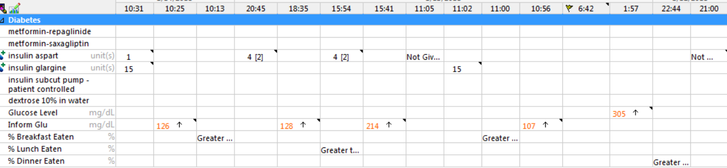
As you can see, he is eating and not receiving insulin each time resulting in hyperglycemia.

Slide 75

Tube Feedings
Total Parenteral Nutrition

Slide 76
Types of Feedings / TPN
Feedings
  Continuous
  BRIK Feedings
  Nocturnal Feedings
TPN
  Continuous
  Nocturnal

Slide 77
Published Recommendation
Total Parenteral Nutrition
  1 unit of Regular insulin per 12-15 g of carbohydrate in TPN bag
Enteral nutrition (Tube Feeding)
  70/30 insulin Q8h
  Rapid acting insulin every 4 hours
  D10W if enteral nutrition is stopped

Slide 78
One Approach
BRIK Feedings
  Basal bolus insulin
Continuous Feedings
  BID NPH
  Q6h monitoring with correction insulin
  80% basal 20% bolus ratio

Slide 79
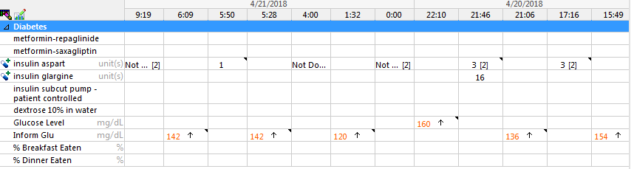
Mr. R with DM Type 2 for 5 years. At home, he takes Metformin-repaglinide 500mg / 1 mg BID. He monitors TID and they run in the 150 - 155 range. BRIK feedings Q4h and is NPO due to recent surgery for oral cancer.
As you can see, he received Glargine insulin and then had nutritional insulin if he ate took more than 50% of his feeding and correction insulin to correct glucose levels.

Slide 80

Mrs. G has no history of diabetes and was on no medications at home for management of diabetes. She was transferred to the stepdown unit due to difficulty weaning from ventilator. She is on a continuous tube feeding diet.

Slide 81

Total Parenteral Nutrition
Regular insulin added to TPN formulation and Q6h accuchecks with correction insulin. When TPN infusing, insulin infusing. When TPN is off, insulin is off.
Another Option is BID Glargine or NPH and Q6h correction
Hang D10W if TPN interrupted to avoid reactive hypoglycemia

Slide 82


Slide 83



