Slide 1


Slide 2
Obesity: multi-faceted and multi-disciplinary strategies for managing it with diabetes

Slide 3

Katherine S. O’Neal
PharmD, MBA, BCACP, CDE, BC-ADM, AE-C, CLS
Associate Professor and Clinical Pharmacist
The University of Oklahoma Health Sciences Center
College of Pharmacy
Department of Medicine
OU Physicians General Internal Medicine
Oklahoma City, OK
Member, Harold Hamm Diabetes Center

Slide 4

Patricia Davidson
DCN, RDN, LDN, CDE, FAND
Associate Professor
West Chester University-PA
West Chester, PA

Slide 5
Disclosure to Participants
Notice of Requirements For Successful Completion
  Please refer to learning goals and objectives
  Learners must attend the full activity and complete the evaluation in order to claim continuing education credit/hours
Conflict of Interest (COI) and Financial Relationship Disclosures:
  Presenter: Katherine S. O’Neal, PharmD, MBA, BCACP, CDE, BC-ADM, AE-C – No COI/Financial Relationships to disclose
  Presenter: Patricia Davidson, DCN, RDN, LDN, CDE, FAND – No COI/Financial Relationships to disclose
Non-Endorsement of Products:
  Accredited status does not imply endorsement by AADE, ANCC, ACPE or CDR of any commercial products displayed in conjunction with this educational activity
Off-Label Use:
  Participants will be notified by speakers to any product used for a purpose other than for which it was approved by the Food and Drug Administration.

Slide 6
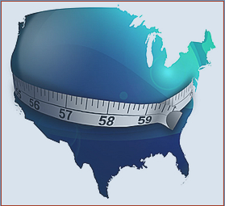
Objectives
Describe the economic, clinical and humanistic impact of obesity
Describe the pathogenesis and significance of obesity in diabetes
Compare and contrast key strategies to manage obesity

Slide 7
The Impact…
Economic
Clinical
Humanistic

Slide 8
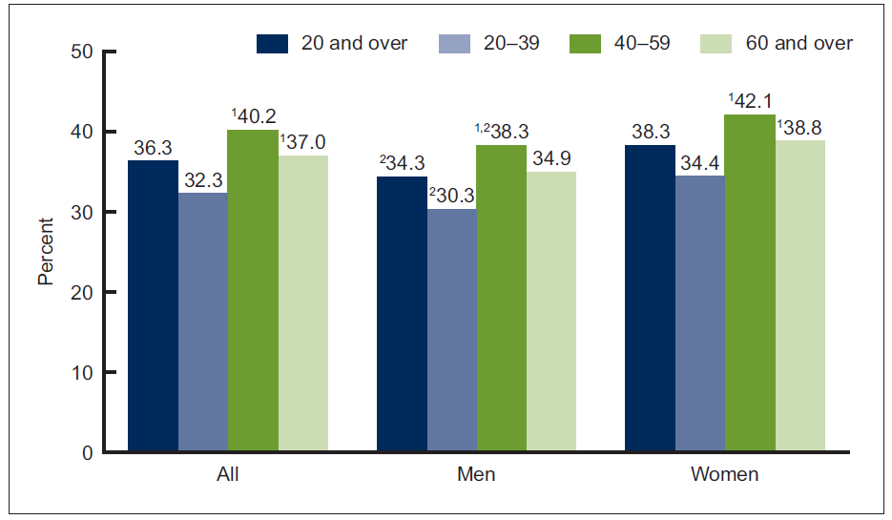
Statistics
In 2014, the prevalence of obesity in adults was 36% and 17% in children
Centers for Disease Control and Prevention. Ogden CL, et al. National Center for Health Statistics. 2015

Slide 9
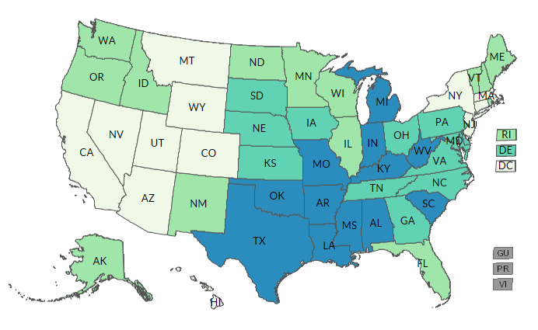
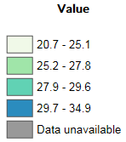
2011 Obesity Prevalence
Centers for Disease Control and Prevention

Slide 10
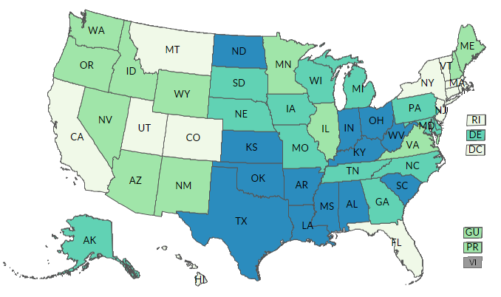
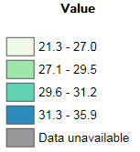
2014 Obesity Prevalence
Centers for Disease Control and Prevention

Slide 11
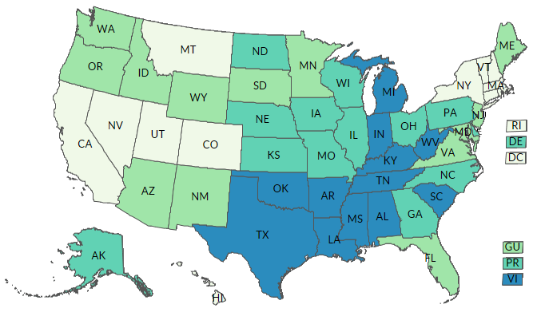

2016 Obesity Prevalence
Centers for Disease Control and Prevention

Slide 12
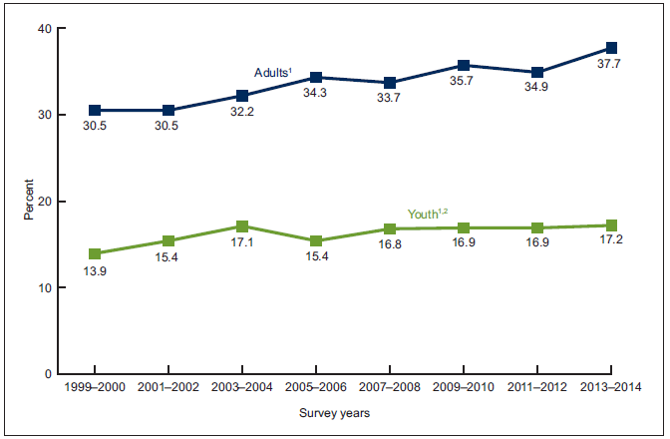
Trend
Centers for Disease Control and Prevention. Ogden CL, et al. National Center for Health Statistics. 2015

Slide 13
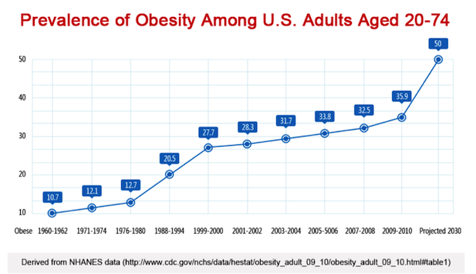
~40% increase
Centers for Disease Control and Prevention. Ogden CL, et al. National Center for Health Statistics. 2015

Slide 14
Economic Burden
In 2000, obesity costs the US $117 billion dollars. This has increased to up to $210 billion per year
Obese adults spend 42% more on direct healthcare costs than adults who are healthy weight
People with a BMI of 30-35 are 2x more likely to be prescribed medications for chronic conditions
www.Stateofobesity.org

Slide 15
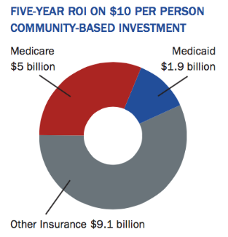
Cost Savings Potential
www.Stateofobesity.org; Urban Institute, The New York Academy of Medicine 2008

Slide 16
Clinical Burden
Arthritis
Congestive heart failure
Coronary heart disease
Depression
Diabetes
Dyslipidemia
Eating disorders
GERD
Hirsutism
Hypertension
Obstructive airway disease
Polycystic ovary disease
Sleep apnea
National Center for Chronic Disease Prevention and Health Promotion, 2008
Klein S, et al. Diabetes Care 2004;27(8):2067-2073; Stevens VJ, et al. Ann Intern Med 2001;134:1-11; Datillo AM, et al. Am J Clin Nutr 1992;56:320-8; Bray G. Medical consequence of obesity. Journal of Clinical Endocrinology and Metabolism. 2004;89(6):2583.

Slide 17
Obesity and Hypertension
Swedish Obesity Study, up to 55% of overweight individuals had hypertension at baseline
Estimated that weight control would eliminate 48% of hypertension in white individuals and 28% in black individuals
Bray G. Medical consequence of obesity. Journal of Clinical Endocrinology and Metabolism. 2004;89(6):2583.

Slide 18
Weight Gain and Diabetes Risk
A 20kg weight gain increases the risk of diabetes 15-fold
Up to 65% of those with type 2 diabetes can be attributed to overweight
Bray G. Medical consequence of obesity. Journal of Clinical Endocrinology and Metabolism. 2004;89(6):2583.

Slide 19
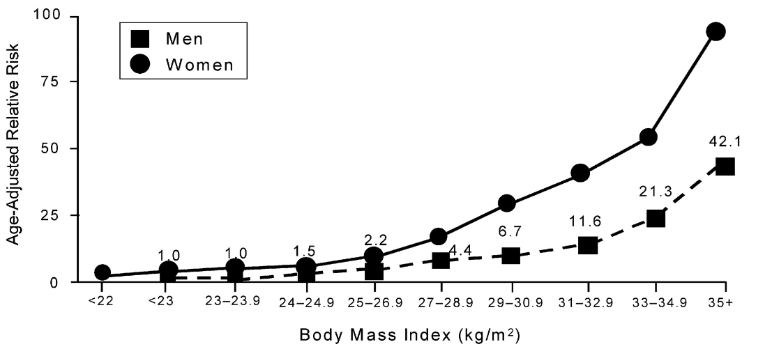
BMI and Diabetes Risk
Risk increases 40 fold
Chan J. Diabetes Care. 1994;17:961; Colditz G. Ann Intern Med. 1995;122; Bray G. Medical consequence of obesity. Journal of Clinical Endocrinology and Metabolism. 2004;89(6):2583.

Slide 20
Humanistic Burden
Systematic review of 20 studies concluded that HRQoL improves with weight loss and is maintained with sustained weight loss
Physical functioning improvements were more commonly statistically significant over mental health improvements on the SF-36
HRQoL: Health related quality of life; SF-36; Medical Outcomes Study Short Form; Kroes M. Impact of weight change on quality of life in adults. Current Medical Research and Opinion. 2016;32(485).

Slide 21
HRQoL In General Population
Objective | Examine effects of obesity on HRQoL in adults without chronic heath conditions
Participants | 13,646 individuals age 18 and older who completed the 2000 Medical Expenditure Panel Survey
Surveys | SF-12, EuroQol EQ-5D Index, and EQ Visual Analogue Scale (EQ VAS)
Results | SF-12 physical functioning, EQ-5D and EQ VAS were significantly lower the higher BMI (P<0.0001); people with severe obesity had the worse HRQoL scores
HRQoL: Health related quality of life; SF-36: Medical Outcomes Study Short Form; Jia H. The impact of obesity on health-related quality of life in the general adult US population. Journal of Public Health. 2005;27(2):156.

Slide 22
Look AHEAD
Objective | Examine effects of lifestyle intervention compared with diabetes support and education on depression, antidepressant use, and HRQoL in overweight/obese individuals with type 2 diabetes
Participants | 5,145 individuals with type 2 diabetes age 45 to 76 and BMI ≥25 mg/kg² over a mean of 9.6 years
Surveys | Beck Depression Inventory (BDI) and SF-36
Results | Lifestyle intervention group lost 6% of weight (P<0.0001), over trial duration had significantly lower BDI scores (P<0.001), and SF-36 physical functioning scores significantly better (P<0.001)
HRQoL: Health related quality of life; SF-36: Medical Outcomes Study Short Form; Look AHEAD. Diabetes Care. 2014;37:1544.

Slide 23
Weight Classification
Category | Children BMI kg/m² | Adult BMI kg/m²
Normal Weight | 5 – 85% | 18.5 – 24.9
Overweight | 85 – 95% | 25 – 29.9
Obese Class I | ≥95% | 30 – 34.9
Obese Class II |  | 35 – 39.9
Obese Class III |  | ≥40
Waist circumference:
M > 37-40 inches (Asian >33) F > 31.5-35 inches (Asian >29)
Consider measuring both BMI and waist circumference to assess risk
Centers for Disease Control and Prevention; National Heart, Lung, and Blood Institute 2008 Clinical Guidelines on the Identification, Evaluation and Treatment of Overweight and Obesity; 2013 AHA/ACC/TOS Guidelines

Slide 24
Pathogenesis
Obesity and Diabetes Connection

Slide 25
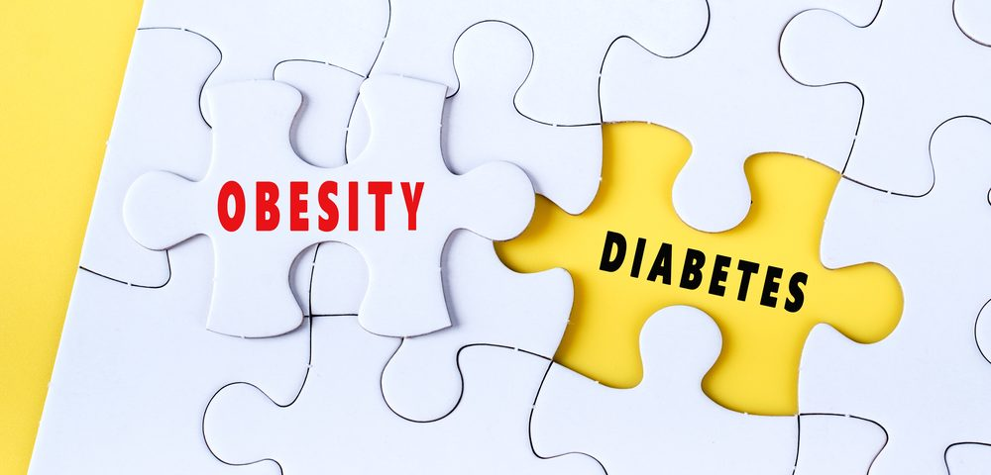
The Impact of Obesity and Diabetes
Global affecting about 70%
35% of the US population
Prediabetes in 2015 was 33.9% of US adults

Slide 26
Pathogenesis of Obesity/Diabetes
What is obesity?
What is diabetes?
How are obesity and diabetes related?
Genetic
Hormone levels + body composition + energy metabolism
Modulation of metabolism by adipose tissues
Notes:
Correcting the systemic disorder of type 2 diabetes to reduce microvascular and cardiovascular risks requires not only glycemic control but also management
of blood pressure and lipids

Slide 27
Pathogenesis Continued
Can alter the natural history of T2DM
Visceral fat key role/ concern
(β-cells)
Pro-inflammatory
TNF-α
Pro-thrombotic
Proinsulin resistant environment ⇡NEFA’s
⇣Adiponectin
Notes:
Adipose tissues modulate metabolism by releasing non-esterified fatty acids (NEFAs), glycerol, hormones (e.g., leptin and adiponectin), and proinflammatory cytokines (such as interleukin [IL]-6, and insulin growth factor [IGF]-1)
The expansion of adipose tissue in obese patients is associated with changes in the release of numerous adipokines from adipocytes, as well as from macrophages and other cells that populate adipose tissue.

Slide 28
Pathogenesis Summarized
Insulin Resistance
Immune Dysfunction
Oxidative Stress
Autonomic Dysfunction
Inflammation
Thrombosis
VSM proliferation
Vascular Dysfunction
&
Atherogenesis
Metabolic Abnormalities
TG, HDL, HTN, Glucose, Renal

Slide 29

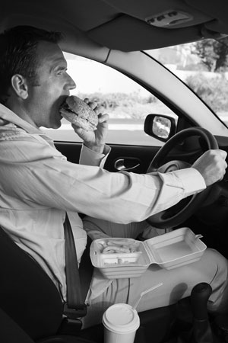
How Did We Get Here?
Dietary Habits
Increased consumption of sugar sweetened beverages
Continued low consumption of fruits and vegetables
Increased frequency of meals eaten away from home

Slide 30


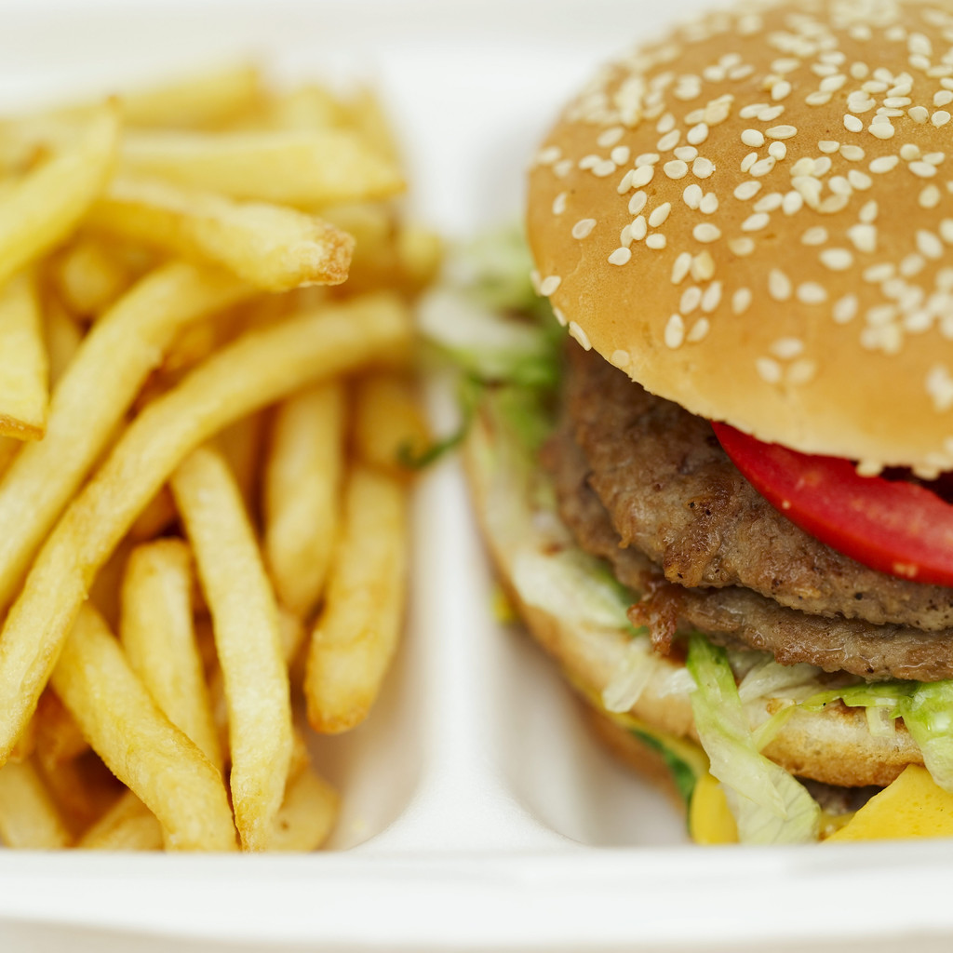
Nature/Nurture
Genetics are estimated to explain about 30-40% of BMI variance
Certain groups highly susceptible
Environmental factors are estimated to explain about 60- 70% of BMI variance
Notes:
The question is – how much is nature vs nurture.
Animal studies are experimental and human studies are observational- meaning there is no genome manipulation. Human studies use experimental designs that include families, twin and adoption. Family studies evaluate how the disease runs in families- comparing the prevalenceof the disease in first degree relatives of both those with obesity and those without. If there is more in the family with the disease – it is considered familial but this does not mean it is because of genotype –it could be environmental.
In contrast Twin and adoption studies, known as natural studies estimate the extent the traits or shared genes play as well as environment.
From these types of studies Genetics explains about 30-40% of the BMI variance, that certain groups are more highly susceptiable and the environment explains up to 70% of the BMI variance.

Slide 31
Microbiota Importance
Pathogenesis – linked to inappropriate activation of GI immune system toward the gut microbiota in genetically susceptible hosts & influenced by environmental factors
Chronic low-grade
inflammation is
associated with obesity
and metabolic
dysfunction (insulin
resistance)
Gut microbiota (diet-induced changes in microbiota composition) contribute to low-
grade inflammation
Notes:
Overall gut bacteria have been thought to be a crucial mediator of obesity and diabetes pathogenesis. This novel proposed model, known as the ‘metagenome hypothesis’, is based on the fact that humans host
10¹⁴ bacteria in the gut and is a “microbial organ” performs a variety of physiological functions, from protective to metabolic regulation, including an active part in glucose and lipid metabolism. T2D is a metabolic disease characterized by a state of insulin resistance and low-grade inflammation.Microbial ecology can be an important regulator of energy homeostasis and glucose metabolism. Research has identified26 differentially abundant clusters when comparing those with diabetes to subjects with normal glucose tolerance.

Slide 32
Hormone Regulation and Relationship
Insulin
Inflammation, Insulin Resistance, Glucose excursions
Leptin, Ghrelin
Appetite Regulation
GLP-2 Regulation of Energy Storage
Gut Barrier integrity
Notes:
research have demonstrated that modulation of gastrointestinal peptides by fermentable carbohydrates (i.e., prebiotics, or starchesresistant to host digestion, namely, resistant starches) is an important area of research allowing us to delineate he gut-to-brain and the gut-to-peripheral organs axis
fermented in the cecum and colon.
The link between fermentable carbohydrates and the modulation of gut peptides involved in energy and glucose homeostasis was first described in 1987 by Goodlad et al. Since 1996, the first evidence that microbial fermentation waslinked with the endogenous production of gut peptides in humans was With the ingestion of lactulose or the
intracolonic administration of SCFAs in healthy volunteers In 2003, another study reported that dietary oligofructose
(20 g per day) in humans was associated with a significant increase in plasma GLP-1 following a meal- following this pilot study other studies have demonstrated -demonstrated that treatment of healthy volunteers with 16 g/d of prebiotics (oligofructose) for 2 weeks promoted satiety and reduced hunger and prospective food consumption
In addition impact of gut microbiota fermentation of inulin-type fructans on appetite sensations have correlated with higher plasma GLP-1 and PYY levels. Others have also noted that along with gut peptide changes there are modest changes in viseral fat mass, circulating ghrelin. More recently, interventional studies have also demonstrated improvements in gut barrier integrety.

Slide 33
Dysbiosis and Energy and Macronutrient Imbalances
Enhanced absorption of nutrients
Enhanced SCFA production and lipogenesis
Reduced activity of fasting-induced adipose factor
Reduced activity of amp-activated protein kinase
Inflammation and intestinal permeability
Hyperactivity of the endocannabinoid system

Slide 34
Interaction of Diet and Gut Microbiota Summarized
Diet Manipulation
Host
Metabolism
Beneficial Bacteria
Microbiota
Modulation
Composition
SCFA
Decrease
Appetite in the brain
Lipogenesis
Inflammation
Oxidative stress
Adiposgenesis
Adipocyte number /size
Increase
GLP-1
PYY
Intestinal Transit
Notes:
Several non-digestible carbohydrates are fermented by the gut microbiota, including inulintype
fructans, glucans, galactans, arabinoxylans, resistant starches, pectins and their oligosaccharides, all of which
have been shown to modulate the gut microbiota
beneficial effects of prebiotics on gut barrier function, inflammation and insulin resistance in obesity requires a functional GLP-1 receptor and protects against obesity by increasing the release of gut hormones, such as GLP-1 and GLP-2
Food intake is the main and most direct factor that influences the gut microbiota- Dietary fibers are
key modulators of gut microbiota, but the complexity and uniqueness of the intestinal microbiota is a result of
all food intake, along with other environmental factors
Thus, although some studies reliably found links between gut microbiota fermentation, SCFAs, gut peptides and appetite regulation, further studies are needed to delineate.

Slide 35
Key Strategies to Manage Obesity:
Lifestyle and Behavioral Interventions

Slide 36
Obesity-Diabetes Treatment Pyramid
Metabolic Surgery
Pharmacotherapy
Lifestyle Modification
Diet
Physical Activity
Notes:
There are number of pyramids you have seen depicting the dietary components. Have you ever thought about using Obesity treatment pyramid as the clinical approach.
The clinical approach to obesity can be viewed as a pyramid consisting of several levels of therapeutic options. All patients should be involved in an effort to change their lifestyle behaviors to decrease energy intake and increase physical activity. Lifestyle modification also should be a component of all other levels of therapy. Pharmacotherapy can be a useful adjunctive measure for properly selected patients. Bariatric surgery is an option for patients with severe obesity, who have not responded to less-intensive interventions. The number of obese patients who require a specific level of treatment decreases as one moves up the pyramid.

Slide 37
What Does the Research Tell Us?
DPP
Look Ahead

Slide 38
Realistic and Reasonable Goals For Weight Loss
8-10% reduction in weight in first 6 months
Most weight loss occurs in first 12 weeks of program
Secondary goal: To sustain momentum and maintain weight loss

Slide 39
Discrepancies in Expectations
Patients’ beliefs | Physicians’ beliefs | Clinical guidelines
Expected weight loss goals and BMI | Expected weight loss goals and BMI | Expected weight loss goals and BMI
24-38% loss of initial weight | 14% loss of initial weight | 5-7% loss of initial weight
Gender differences for BMI and weight loss goals | Gender differences for BMI | No gender differences for BMI
Lent, Mane et al. (2016). Obesity Science & Practice, 2(2), 154-161; Dutton, Perri, Dancer-Brown, Goble, and Van Vessem. (2010). Eating Behaviors, 11(2), 74-78; Dutton, Perri, Stine, Goble, & Van Vessem. (2010). Preventive Medicine, 50(4), 186-188.

Slide 40
Treatment Based on BMI and Metabolic Control
Treatment * BMI Cutoff for Asian Americans | 25.0–26.9 (23.0–26.9*) | 27.0–29.9 | 30.0–34.9 (27.5–32.4*) | 35.0–39.9 (32.5–37.4*) | ≥ 40 (≥ 37.5*)
Diet, PA, and Behavioral
Pharmaco-therapy
Metabolic Surgery
Diabetes Care 2018;41(Suppl. 1):S65–S72 | https://doi.org/10.2337/dc18-S007
Notes:
Expert Committee Recommendations:
Routine assessment of BMI for age
Categorize risk
Match risk w/ intervention
Level 4: consider your setting, options/resources
Potential for better outcomes if more realistic approach

Slide 41
DSMES to Address Obesity in Diabetes
Environment Systematic Change
Food
PA
Broaden Opportunity
Level playing field
Health Disparities
Flexibility
Community Features
Community Needs

Slide 42
Dietary Recommendations
Kcal restrictions-1200-1500/day to promote weight loss
Nutrient distribution seems less important to overall kcal reduction
Low carb > wt loss in short-term; no difference in losses long-term
Fat, Fiber, and Protein all shown to be helpful in satiety.
Protein important in maintaining lean body tissue during weight loss
Meal replacements-may be helpful in LCD and altering appetite expectations

Slide 43
Treatment for Severely Obese
More potent intervention (e.g. HPLC) → greater weight loss & BMI
Both interventions w/ relapse at follow-up
[Severe] obesity is a chronic condition & requires ongoing support/treatment even if metabolic control good.
Diabetes Care 2018;41(Suppl. 1):S65–S72 | https://doi.org/10.2337/dc18-S007

Slide 44
The Bottom Line…
Reduced-calorie diets alone and as adjunct to other interventions- result in clinically meaningful weight loss and improvement in metabolic parameters.
Notes:
“Reduced-calorie diets result in clinically meaningful weight loss regardless of which macronutrient they emphasize.”

Slide 45
Maintenance
Attendance at group sessions strongly predicted weight loss
Continued contact with participants after weight loss is associated with less regain
These findings together point to behavioral factors rather than macronutrient metabolism as the main influences on weight loss
Diabetes Care 2018;41(Suppl. 1):S65–S72 | https://doi.org/10.2337/dc18-S007

Slide 46
Four Components of Successful Weight Loss and Diabetes Management
Weight loss goal
Low calorie diet
Regular physical
activity
Monitoring
weight loss
Notes:
As you have we have discussed – the treatment of obesity is complicated. But what is clear is that Dietary changes, goal setting , physical activity as well as monitoring are important components for successful weight loss- but what Is not clear is what are the best interventions and is it different for everyone.

Slide 47
Key Strategies to Manage Obesity:
Pharmacotherapy and Surgical Interventions

Slide 48
Pharmacotherapy Indications
Failure to achieve a minimum of 5% weight loss after 6 months of lifestyle intervention
BMI ≥30 kg/m²
BMI 27 – 29.9 kg/m² with at least 1 indication for increased risk of CVD
MUST BE ADJUNCT TO LIFESTYLE CHANGES!
National Institutes of Health Clinical Guidelines; 2013 AHA/ACC/TOS Guidelines for the management of overweight and obesity in adults

Slide 49
Pharmacotherapy Options
Orlistat (Alli/Xenical)
Lorcaserin (Belviq)
Phentermine/topiramate ER (Qsymia)
Naltrexone ER/bupropion ER (Contrave)
Liraglutide (Saxenda)

Slide 50
Orlistat (Alli/Xenical)
Mechanism of Action | Inhibits gastric and pancreatic lipase blocking GI absorption of fat (25% 60mg and 30% 120mg)
Adverse Effects | Oily spotting, flatus, discharge, fatty stool, fecal urgency, fecal incontinence
Dose | 60 mg three times daily (OTC); 120 mg three times daily (prescription)
Results | Meta-analysis demonstrated a weight loss ranging from 2.3kg to 2.9kg; various metabolic improvements (TC and LDL)
Caution | Use with low-fat diet, supplement with vitamin A, D, E, and K, cholelithiasis, hepatic injury
Cost | ~$53 (OTC); ~$700 (Prescription)
Alli/Xenical prescribing information; Lexi-Comp

Slide 51
Lorcaserin (Belviq)
Mechanism of Action | Serotonin agonist leading to increased alpha-melanocortin stimulating hormone release leading to satiety and decreased food intake
Adverse Effects | Headache, dizziness, fatigue, nausea, dry mouth, constipation
Dose | 10 mg twice daily (Immediate release); 20 mg once daily (extended release) (If 5% body weight not lost after 12 weeks, discontinue)
Results | BLOOM study-47.5% participants lost 5% weight and 7.7% lost 10% weight (P<0.001), BLOOM-DM, 37.5% lost at least 5% weight (P<0.001), improvements in blood pressure and lipid panel (TC, LDL, and TG)
Caution | Serotonin syndrome
Cost | ~$317
Belviq prescribing information; Lexi-Comp

Slide 52
Phentermine/Topiramate ER (Qsymia)
Mechanism of Action | Anticonvulsant: increases energy burn and decreases caloric intake; sympathomimetic: stimulates norepinephrine to suppress appetite
Adverse Effects | Paresthesia, dizziness, insomnia, xerostomia, tachycardia, elevated blood pressure, bicarbonate reductions
Dose | 3.75 mg/23 mg once daily for 14 days, titrate to 7.5 mg/46 mg for 12 weeks. If at least 3% weight not lost, discontinue or titrate to 11.25 mg/69 mg for 14 days, then titrate to 15 mg/92 mg
Results | CONQUER study-48% of patients at full dose lost 10% body weight and saw improvements in lipid panel (TG, HDL, and LDL), glucose control and blood pressure
Caution | Kidney stones
Other | Associated with birth defects; REMS program: monthly pregnancy test and use of contraception; pharmacy must be registered, use with alcohol
Cost | ~$239
Qsymia prescribing information; Lexi-Comp

Slide 53
Naltrexone ER/Bupropion ER (Contrave)
Mechanism of Action | Opioid receptor antagonist; dopamine and norepinephrine reuptake inhibitor
Adverse Effects | Nausea, constipation, headache, vomiting, dizziness, insomnia
Dose | 8 mg/90 mg in the morning for 1 week, titrated to 8 mg/90 mg twice daily for 1 week, then to 16 mg/180 mg in the AM and 8 mg/90 mg in the evening for 1 week, and then 16 mg/180 mg twice daily
Results | COR-I, COR-II, COR-BMOD, and COR-DM trials demonstrated a weight loss range of up to 15% (P<0.0001), 44-80.4% lost 5% weight, 18.5% lost 10%, and 18.9% lost 15% (P<0.0001)
Caution | Suicidal behavior or concomitant use with antidepressants
Cost | ~$333
Contrave prescribing information; Lexi-Comp

Slide 54
Liraglutide (Saxenda)
Mechanism of Action | GLP-1 agonist slowing gastric emptying and decreasing food intake
Adverse Effects | Nausea, vomiting, hypoglycemia, diarrhea, constipation, headache, increased heart rate
Dose | 0.6 mg once daily for 1 week, titrate by 0.6 mg daily at weekly intervals until 3 mg is reached; if 4% weight not lost at 16 weeks, discontinue therapy
Results | SCALE trials demonstrated up to 63.2% lost 5% weight, 33% lost 10% and 14% lost 15% body weight (P<0.0001). Participants (81%) were able to maintain the initial 5% weight loss
Caution | Antibody formation, gallbladder disease, and pancreatitis
Cost | ~$288
Saxenda prescribing information; Lexi-Comp

Slide 55
Herbals
Chromium
  Likely safe
  Dose 200 mcg/day
  A/E: GI related
  Insufficient level of evidence
Bitter orange
  Likely safe in foods (GRAS); Possibly unsafe as a supplement
  Dose 32 – 80 mg/day
  A/E: cardiovascular related, photosensitivity
  Insufficient level of evidence
  Drug interactions: amiodarone, antidepressants, calcium channel blockers
Hoodia
  Insufficient evidence for safety and efficacy
  Dose 1 g twice daily before meals
  No known drug interactions
Natural Medicines Comprehensive Database

Slide 56
Surgical Options
Laparoscopic adjustable gastric banding (LAGB)
Laparoscopic sleeve gastrectomy (LSG)
Laparoscopic Roux-en-Y gastric bypass (RYGB)
Laparoscopic biliopancreatic diversion (BPD), BPD/duodenal switch (BPD-DS)
Garvey WT, et al. American Association of Clinical Endocrinologists and American College of Endocrinology Clinical Practice Guidelines for Comprehensive Medical Care of Patients with Obesity – Executive Summary. 2016.

Slide 57
Eligibility Criteria
Eligible if 1 of 3 criteria met:
  BMI ≥40 without coexisting medical problems
  BMI ≥35 with ≥1 obesity related comorbidities (type 2 diabetes, hypertension, hyperlipidemia, obstructive sleep apnea, asthma, arthritis)
  BMI 30-34.9 with diabetes or metabolic syndrome
Garvey WT, et al. American Association of Clinical Endocrinologists and American College of Endocrinology Clinical Practice Guidelines for Comprehensive Medical Care of Patients with Obesity – Executive Summary. 2016.

Slide 58
Surgery Risks/Benefits
Risks:
Disruption of diet
Gallstone disease
Food impaction
Band displacement
Internal hernia
Drug absorption
Benefits:
Weight loss (30-40kg)
Improvement of cardiometabolic factors
Improvement of chronic conditions
Garvey WT, et al. American Association of Clinical Endocrinologists and American College of Endocrinology Clinical Practice Guidelines for Comprehensive Medical Care of Patients with Obesity – Executive Summary. 2016.

Slide 59
Summary of Goals and Approaches to Increase Success
Goals:
Prevent further weight gain
Promote weight loss and measures for maintenance
Modify risk factors
Reduce risk of co-morbid conditions and death
Approaches:
Lifestyle changes are critical
Drug therapy can be added on as adjunct therapy
When appropriate, surgical options can be considered

Slide 60
Case Study

Slide 61

Meet PJ
47 yo male
Dx: Type 2 Diabetes, HTN, Neuropathy,
Hx of pancreatitis
Meds: HCTZ 25 mg daily, Metformin
1000 mg twice daily, Amitriptyline 100 mg daily
SH: 1-2 beers daily, former smoker, evening trips to ice cream shop
Physical activity: no exercise, desk job
Client states he has been told to lose weight and to watch his carbohydrates

Slide 62
Metabolic & Anthropometric History
Wt: 86.4 kg (210 lb)
Ht: 177.8 cm (70”)
BMI: 30.1 (obese)
WC: 104 cm (41 “)
BP: 146/94 mm HG
Fasting laboratory values
  TC: 270 mg/dl
  TG: 300 mg/dl
  LDL: 140 mg/dl
  HDL: 30 mg//dl
  FBG: 130 mg/dl
  HbA1c: 6.9%
All other labs WNL

Slide 63
PJ’s History
Appetite and intake “is good”. For > 3 months, has been gaining
weight specifically in the abdomen.
Told he needs lose weight. Attempts to follow a low fat diet and
decrease the carbohydrates. Inquires about the benefit of low
glycemic index diet or vegetarian diet.
Lives alone and prepares his own meals. Eats out at least once a
day. Every evening goes to the nearby ice cream shop for dessert.
Has no time to exercise regularly because of work.
Denies increased thirst or frequency of urination.
Family history of diabetes

Slide 64
Usual Day
Breakfast at home: 8 oz fruit juice, 1 cup instant cinn/sugar oatmeal, 1 banana, 8 oz whole milk (~90g CHO)
Lunch at Fast Food: 1/4 lb cheeseburger (no bun), French fries with 4 pkts ketchup, 22 oz reg cola (~155g CHO)
Dinner at home: 1 cup instant white rice, 1 cup corn, 4 oz fried shrimp, 2 tsp butter, 12 oz regular beer (~105g CHO)
Snacks: 1 cup reduced fat ice cream, 1 oz walnuts, 2 oz low-fat cheese, 6 saltine type crackers (~75g CHO)
Additional beverages: 12 oz reg cola (~40g CHO), water occasionally, 20 oz sugar sweetened mango tea (~50g CHO)

Slide 65
Initial Assessment
Macronutrient Distribution
  CHO 69% (515g)
  PRO 15% (114g)
  FAT 15% (53g)
Usual daily calories 2983-3230
Type of fat – SFA ~15.0 % Type of protein – primarily animal
Type of CHO: high Gl/GL, Fiber – 22 g (7 g/1000 cal)
Weight – obese
Lifestyle
  Physical activity - none
  Dietary pattern - sugar sw drinks & convenience foods
60
Notes:
Take a moment and review the dietary recall of the client. After reviewing the case study we will now use the case study to identify key diagnosis(es) from the nutrition assessment for the nutrition intervention.

Slide 66
How would you prioritize PJ’s lifestyle modifications?
Target a weight loss goal
Target a lower carbohydrate diet
Address lack of physical activity
Address his questions regarding alternative diets
Target a lower fat diet
Identify small modifications in dietary habits

Slide 67
Which medication would be appropriate to add on for weight management?
Orlistat (Alli/Xenical)
Lorcaserin (Belviq)
Phentermine/Topiramate ER (Qsymia)
Naltrexone ER/Bupropion ER (Contrave)
Liraglutide (Saxenda)

