Slide 1

Physical Activity, Behavior Change as Treatment for Type 2 Diabetes

Slide 2
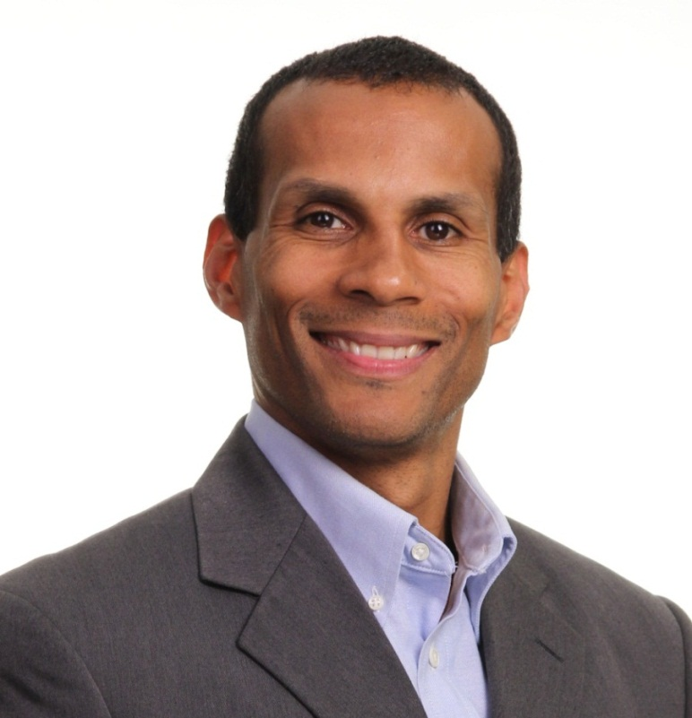
Introduction
Director of Strategic Partnerships
American Council on Exercise
San Diego, CA
MS Exercise Physiology
ACE Youth Fitness Specialist
ACE Spokesperson
MFA Education Committee Member
Anthony J Wall, MS, CPT

Slide 3
Disclosure to Participants
Notice of Requirements For Successful Completion
  Please refer to learning goals and objectives
  Learners must attend the full activity and complete the evaluation in order to claim continuing education credit/hours
Conflict of Interest (COI) and Financial Relationship Disclosures:
  Presenter: Anthony J Wall, CPT, MS - No COI/Financial Relationship to disclose
Non-Endorsement of Products:
  Accredited status does not imply endorsement by AADE, ANCC, ACPE or CDR of any commercial products displayed in conjunction with this educational activity
Off-Label Use:
  Participants will be notified by speakers to any product used for a purpose other than for which it was approved by the Food and Drug Administration.

Slide 4
Agenda
Introductions and Current Trends
Using Behavior Change to increase Physical Activity
Principles in Exercise Programming for Individuals with Type 2 Diabetes
Translating Recommendations into Action - Activity
Recap and wrap up

Slide 5
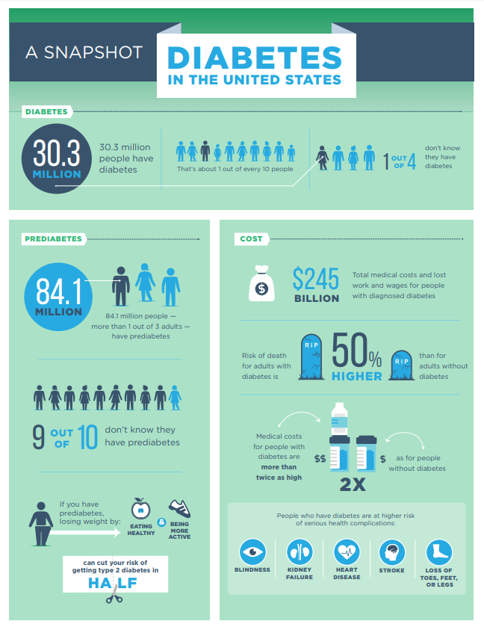
Current Trends
30.3 million people in the US have diabetes
25% of adults are unaware they have diabetes
90% of individuals with prediabetes are unaware
More than 5,000 children each year develop type 2 diabetes

Slide 6
Team Management Approach

Slide 7

Understanding Behavior Change

Slide 8
Centered on Self-Efficacy
An individual’s belief in his or her capacity to execute behaviors necessary to produce specific performance attainments.
-American Psychological Association

Slide 9
Rooted in Empathy
The ability to step into the shoes of another person, aiming to understand their feelings and perspectives, and to use that understanding to guide our actions.
-greatergood.berkeley.edu
Notes:
Rarely does a response make it better – if this is the case how do we be empathetic

Slide 10
Positive Psychology
The aim of Positive Psychology is to begin to catalyze a change in the focus of psychology from a preoccupation with only repairing the worst things in life to also building positive qualities.
-Seligman & Csikszentmihalyi
Notes:
What is in life is worth living for?

Slide 11
A Practice in Positive Psychology
Part I: Write at least 3-4 sentences describing your best possible self in the future. Within your description address topics such as family, friends, health, career and/or hobbies, imagining the best case scenario for this outcome.
Part II: Working in pairs, take turns sharing your descriptions with one another. Take brief notes after sharing your summary and after listening to your partner’s summary describing your experience.

Slide 12
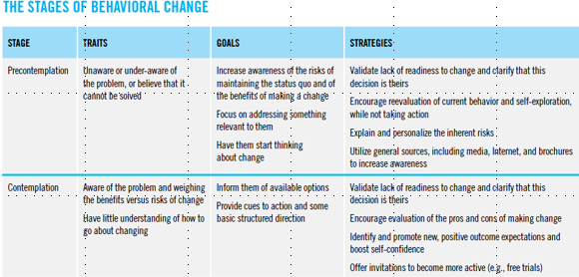
Stages of Change Model

Slide 13
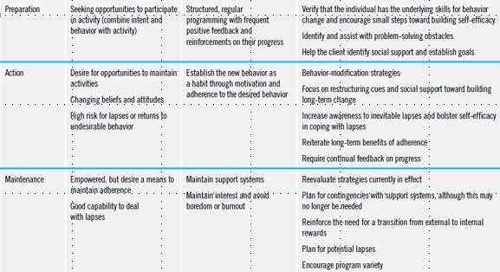
Stages of Change Model

Slide 14

Physical Activity

Slide 15
Barriers to Increasing Physical Activity
Lack of facilities
Lack of resources
Lack of time *
Low energy
Fear of hypoglycemia
Perceived effort
Physical discomfort*
Boring nature of exercise*
Notes:
428 questionnaires were given out with 406 completed.

Slide 16
Building an Exercise Program
Plan ahead; get all necessary approvals, waivers, etc.
Communicate with patient’s primary care physician
Inform participants that they will be doing physical activity
Start with walking
Build in resistance training over time

Slide 17
Starting an Exercise Program
Communicate with the client’s primary care physician
Know client’s PA interests, strengths, goals & challenges
Keep a daily log
Consider “exercise as medicine”
Invest in appropriate footwear
Explore non-traditional opportunities to increase physical activity

Slide 18
Practical Strategies to Support Clients

Slide 19
Cardio Exercise Programming (FITT)
Frequency: 4-5 days/week, preferably daily - do not go more than 2 days in a row without cardiovascular/aerobic exercise
Intensity: Zone 1 with brief periods in Zone 2 - using ACE 3-Zone Model
Time: 30-60 mins/session
Type: Low impact aerobic exercise supplemented by an increased ‘NEAT’
Notes:
Balance increased energy expenditure with decreased overall caloric intake

Slide 20
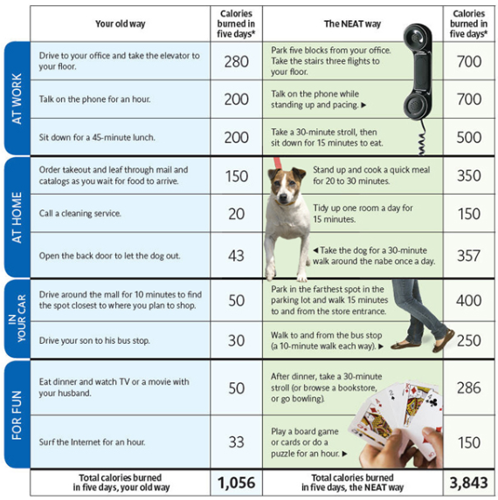
‘NEAT’ ways to increase activity
Disruption or breaking up sedentary patterns with some form of physical movement every 30 minutes can have significantly positive impact on cardiorespiratory fitness.
Notes:
https://www.ncbi.nlm.nih.gov/pmc/articles/PMC5409266/

Slide 21
Training Model: Ex Intensity & Threshold
During exercise, higher intensities increase respiratory rates linearly with the exception of two key deflection points where significant ventilatory changes occur:
VT1-First Ventilatory Threshold:
due to increased CO2 production as primary fuel utilized changes (fat CHO); corresponds with initial accumulation of blood lactate
VT2-Second Ventilatory Threshold: associated with a rapid increase in blood lactate (lactate > 4.0 mmol)

Slide 22
Training Model: Intensity Markers
Zone 1
Zone 3
Zone 2
VT1 & VT2 | Below VT1 | VT1 to just below VT2 | VT2 and Above
HR | HR < VT1 | HR > VT1 to HR < VT2 | HR > VT2
Talk Test | Can talk comfortably | Not sure if talking is comfortable | Definitely cannot talk comfortably
RPE Terms | Moderate to somewhat hard | Hard | Very hard to extremely hard
RPE (0-10) | 3 to 4 | 5 to 6 | 7 to 10

Slide 23
Self-blood Glucose Monitoring
Clients should perform SBGM before and after each PA session. If blood glucose is:
  >250 mg/dL with ketones or >300 mg/dL with no ketones present, physical activity should be postponed
  <100 mg/dL, eat a small snack consisting of 15-30 grams CHO and recheck blood glucose before exercising
  Between 100 and 250 mg/dL, physical activity can be safely performed

Slide 24
HIIT vs Continuous Moderate Exercise
HIIT programs demonstrate the following:
  Improvements in aerobic fitness *
  Improved insulin sensitivity *
  Improved fasting glucose *
  Improved HDL-C *
  Reduced blood pressure * + and resting HR +
  Improved body weight and body composition *+
  Improved HR variability (HRV)
* Kessler, Sisson & Short (2012)
  + Parpa, Michaelides & Brown (2009)
Notes:
NOTE: Heart Rate Variability (HRV) is a measure of cardiac autonomic control that is determined by the amount of short and long term variability in hear rate, and has been found to be an independent risk factor for coronary heart disease and all cause mortality. Mortality risk due to acute myocardial infarction (MI) is significantly higher (up to 5.3x higher) in people with low HRV (< 50 ms) compared with people who have high HRV (> 100 ms).
HRV – conventionally accepted term to describe variations of both instantaneous HR and R-R intervals (time between R’s in the QRS wave) … this study conducted manual measures of msec of R-R interval
HRV is lower in individuals with hypertension, dyslipidemia, and type 2 diabetes
High HRV corresponds with a high VO2max, while low HRV is an indicator of increased mortality and possible cardiac events.

Slide 25
Is HIIT Appropriate for Patients?
Improves aerobic fitness and cardiometabolic risk factors in both healthy and clinical patients for 8-12 weeks
Growing evidence that HIIT presents little danger for select clients with stable Coronary Artery Disease (CAD)
“High Intensities” for clinical clients is lower than used with “apparently healthy” clientele:
  65-75% HRmax/VO2max in clients with CAD **
  60% HRmax/VO2max in select, stable cardiac patients ***
  Recover interval is passive in some protocols ***
Notes:
1950s – “Unreasonable” to expect patients with heart disease to perform exercise
1970s – Benefits of exercise recognized by medical community
Published Guidelines do not currently recommend HIIT for CAD patients
There is growing evidence that HIIT presents little danger for selected, stable cardiac patients provided the prescribed protocols are respected (followed).
Currently have 30,000 patient-hours of training without any significant adverse events
Research is minimal … now need to study
* Kessler, Sisson & Short (2012)
** Bouri & Arshadi (2010)
*** Guiraud, et al. (2012)

Slide 26
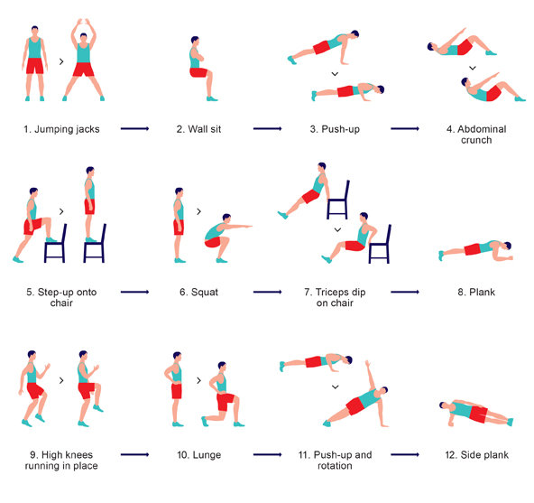
7 Minute HIIT Exercise Session
30 seconds each exercise
10 seconds rest between exercises
Images from article by Gretchen Reynolds, NY Times
Source: Klika & Jordan (2013)

Slide 27
Building Rapport

Slide 28
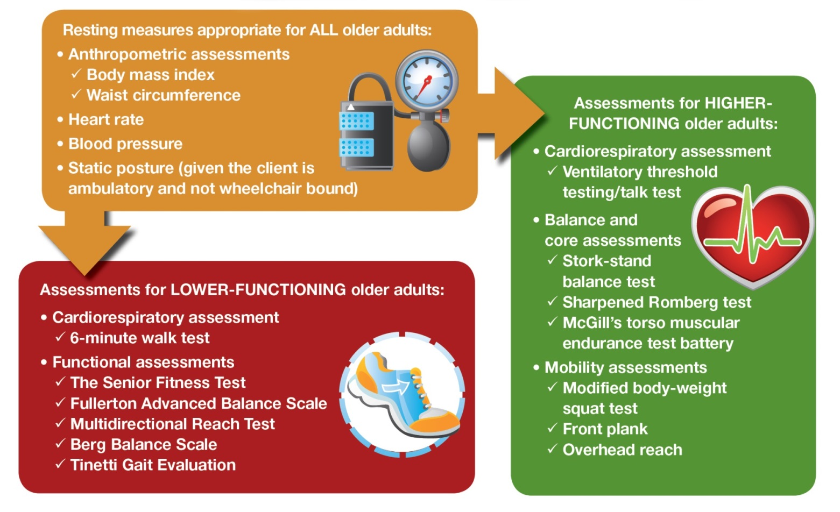
Health Related Resting Measures

Slide 29
Summary
  Each individual will present new challenges
  Adopting a healthy lifestyle is complex
  Understand behavior is complicated
  Increasing physical activity slowly with small steps
  Understand myths and assumptions
  Be client/patient centric

Slide 30

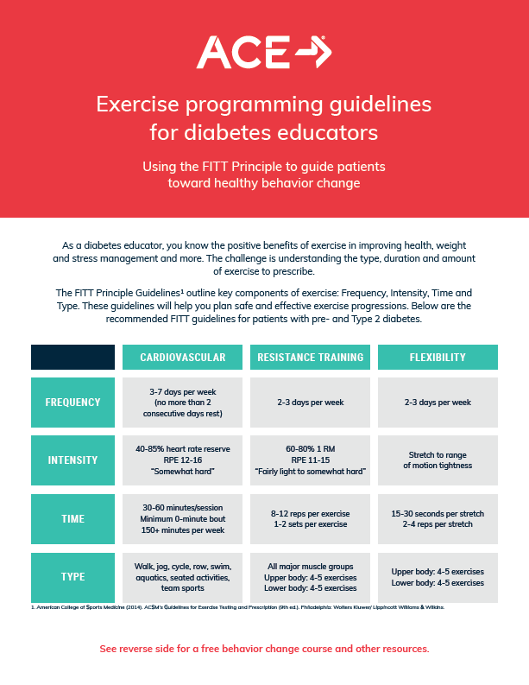
Free resources
  FITT Guidelines
  Online Course:
  Fundamentals of Coaching Behavior Change
  AADE Presentation Download:
  Physical Activity and its role in the Management of Type 2 Diabetes
  Resources for educators and patients
  Visit ACEfitness.org/Healthcare

Slide 31
References
  https://www.ncbi.nlm.nih.gov/pmc/articles/PMC5409266/
  Diabetes prevention group
  CDC
  https://www.ncbi.nlm.nih.gov/pmc/articles/PMC1742997/
  https://clinicaltrials.gov/ct2/show/NCT01701570
  https://www.acefitness.org/education-and-resources/lifestyle/blog/6852/6-things-to-know-about-non-exercise-activity-thermogenesis

