Slide 1
How To Teach Clients About Prediabetes and Diabetes
Without Triggering Disordered Eating

Slide 2
Sumner Brooks, MPH, RDN, CEDRD
EDRDpro™ Founder
Portland, OR
Megrette Fletcher, M.Ed., RD, CDE
Author
Diabetes Educator
Dover, NH

Slide 3
Disclosure to Participants
Notice of Requirements For Successful Completion
Learners must attend the full activity and complete the evaluation in order to claim continuing education credit/hours
Conflict of Interest (COI) and Financial Relationship Disclosures:
Sumner Brooks, MPH, RD, CEDRD - owner of EDRDpro. No disclosures.
Megrette Fletcher M.Ed., RD, CDE receives funds from Skelly Skills and Am I Hungry LLC
Non-Endorsement of Products:
Accredited status does not imply endorsement by AADE, ANCC, ACPE or CDR of any commercial products displayed in conjunction with this educational activity

Slide 4
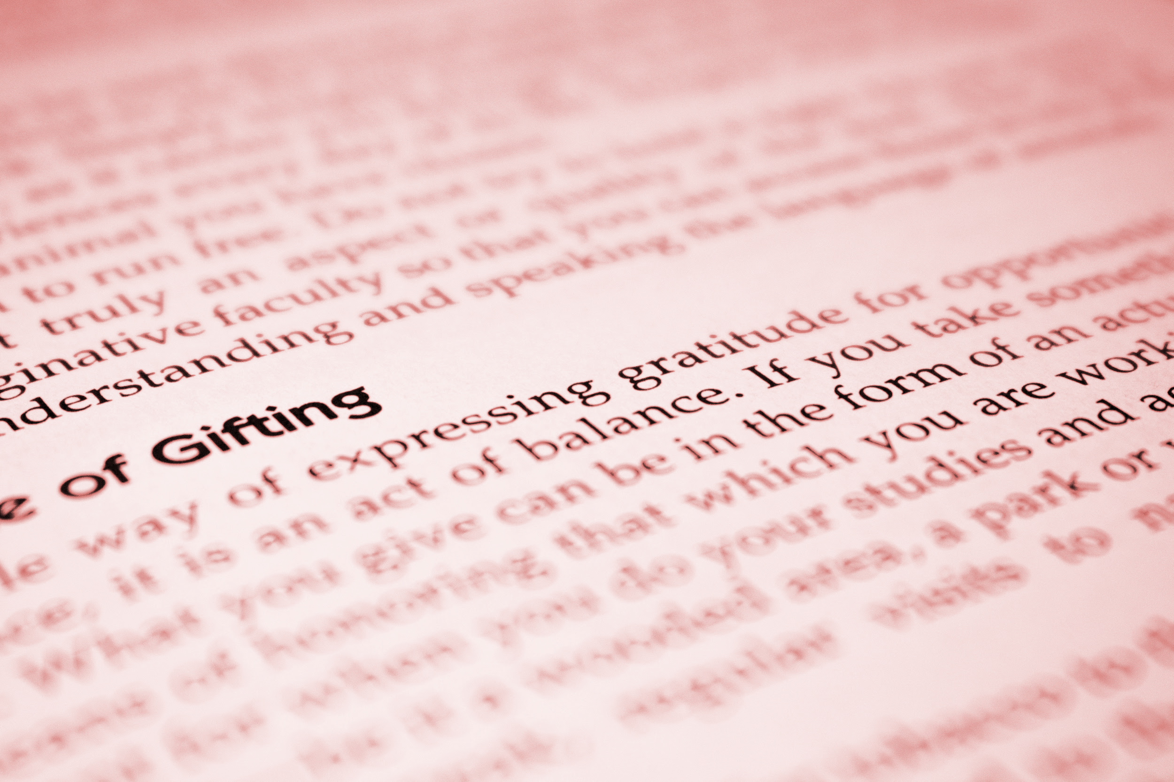
Learning Objectives
State three defects of prediabetes and diabetes
Compare and contrast two ways a weight-neutral education differs from a weight biased educational session
Recognize three warnings signs of disordered eating as it might present in prediabetes or diabetes care
Notes:
Eating Disorders background. The current call to action to move away from weight centered approach in healthcare.

Slide 5
Terms
Weight bias: negative weight related attitudes, beliefs, assumptions and judgements (Alberga, 2016)
Notes:
Thoughts and beliefs about weight. weight loss = healthy, fat = unhealthy. Taught to us from early age.
Cultural and societal beliefs.
Thinking not me? Pretty common response

Slide 6
Implicit Bias Test
Head to Harvard.edu Project Implicit to learn more about your own implicit biases
https://implicit.harvard.edu/implicit/

Slide 7
Terms
Weight stigma: social devaluation and denigration of people perceived to carry excess weight leading to prejudice, negative stereotyping and discrimination (Tomiyama, 2014)
Notes:
Weight stigma is the experienced negative stereotyping, discrimination and devaluation faced every day by people perceived to carry excess weight. It is what people experience. Examples include showing up at a public place such as a restaurant, or healthcare office that does not provide furniture that can accommodate all bodies. Its blatant bullying and shaming. It is even the experience that not all bodies are represented in the vast majority of media and advertising, as if higher weight people don’t have the same needs for clothing or items that thin people do.
Evidence informs us that there are true consequences of weight stigma including how it affects eating behavior and stress hormones that contribute to unintentional weight gain.
So common we often don’t recognize it’s happening around us unless it happens to us.
Weight stigma is walking in to a dr office and not having a seat that is comfortable. WS is not receiving the same medical intervention that a thin person would but instead you are told you first have to lose weight, when we have to proven ways to do this sustainably and healthfully. Weight stigma is not seeing your body represented in ads, pictures. Weight stigma is being afraid to exercise in public due to having been teased or bullied because of size.

Slide 8
AADE : Ahead of the curve on stigma
KUDOS to You AADE18!
New language guidance to tackle stigma acknowledges stigma contributes to stress and shame
Including Social Determinants of Health (SDH) in your strategic plan
Quick Guide for Healthcare Providers

Slide 9
Terms
Weight normative/centric paradigm: emphasis on weight and weight loss when defining health and wellbeing (Tylka et al, 2014)
Notes:
The Weight normative/weight centric paradigm is the current norm in healthcare. But not just in healthcare, in fashion, in fitness, in nearly every aspect of wellness, in social settings, in schools, this is everywhere. Weight normative very literally says, says that some weights are normal, and others are not.
It functions from the belief that if we control calories and exercise enough we will all obtain a normalish BMI. But this simply isn’t true. Weight is far more complicated than we make it out to be in healthcare and we place extreme personal responsibility on to the patient to control their weight. In fact only 5-25% of health is affected by individual behaviors, the other 75-95% of health is affected by other factors
None of what I’m saying is to point fingers or place blame.
It uses weight and/or BMI when defining health status . It is assuming, that a person living in a larger body should be trying to lose weight. It is celebrating weight loss when it may not be a sign of health at all. Isn’t it true, that without even thinking, people often assume losing weight if you live in a large body means getting healthier? But what if that weight loss was due to disordered eating, extreme restriction or over exercising, loss of appetite, or something acutely wrong/?
Data shows a weight normative approach can foster stigma, which as you’ll see, is linked to worse health outcomes and healthcare avoidance which we’ll talk about more. .
I want to take a moment, to acknowledge my appreciation for AADE. As I was browsing the conference website in preparation to come here, I came across the lovely language guidance that is now being used by your organization to reduce stigma and shame associated with being a person living with diabetes. When I read that, and I read that AADE is making a point to be very direct in tackling the stigma of language around Diabetes because you realize it causes harm and can interefere with lifestyle modifcations and healthcare I was thrilled – because that is the very same approach we are suggesting today, needs to be taken regarding weight and body size. Even if you believe, losing weight is key for health with diabetes, you can understand how shame and stigma interefere.

Slide 10
Terms
Weight neutral / inclusive paradigm: health and wellbeing are multifaceted, efforts directed toward improving health access and reducing weight stigma (Tylka et al, 2014)
Notes:
If we have new information about a medication and you find out it’s actually more likely to cause harm than benefit someone, would you still prescribe it?
What can we do instead of weight centric counseling?
The weight neutral, also called weight inclusive paradigm emphasizes viewing health and wellbeing as multifacted. It does not diagnose health based on weight or BMI, but focuses efforts on improving health access while reducing weight stigma.
Weight neutral approach is not anti weight loss. It is anti the pursuit of weight loss, since we have no evidence that there is a safe or helpful way to achieve weight loss that is sustainable beyond the short term and we have very clear evidence that the pursuit of weight loss may trigger disordered eating, negatively impact the body and mental health. Weight neutral is shift from a focus on a weight goal, to a focus on helping the individual make behavioral and lifestyle adjustments that fit within their values and wellbeing without doing harm. Weight neutral approach does not function from the belief that all bodies, if only diet and exercise can be perfected, will land within the “normal” BMI range..

Slide 11
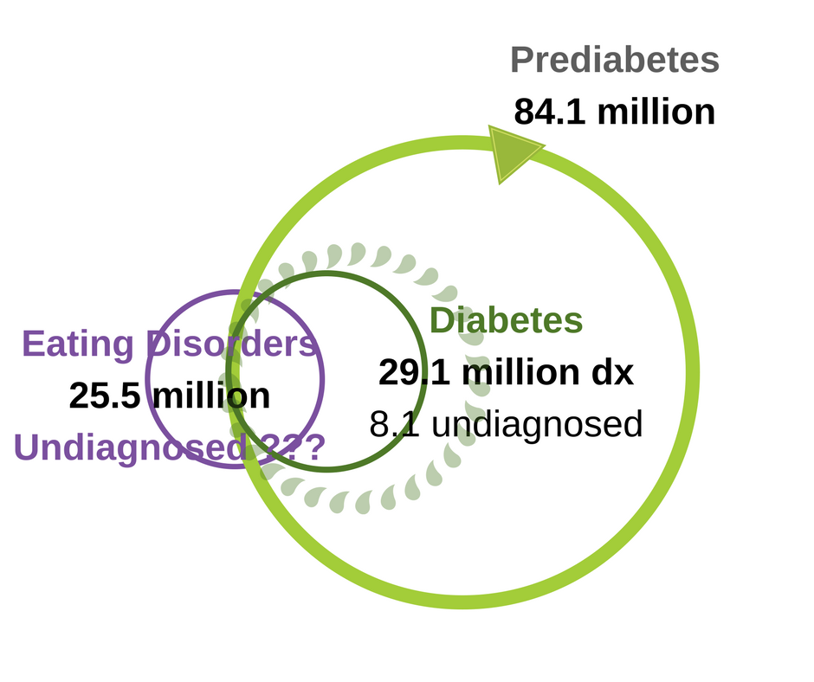
Scope of Disordered Eating in USA
Notes:
Estimated eating disorder prevalence among US adults is around 10.5% lifetime prevalence. We don’t have statistics around estimates of undiagnosed eating disorders although we do know that more eating disorders go untreated and undiagnosed that those that are being treated for many reasons, access to care and affordable treatment make getting the right treatment difficult. More people than we know of have disordered eating, calling for a paradigm shift in our approach to medical treatment and counseling as well as assessment and diagnosis of eating disorders.
We can safely assume there is great deal of overlap and that a significant number of persons with prediabetes and diabetes struggle with disordered eating. We need more studies conducted to provide the hard evidence, but it’s interesting to note that one study reported 23% of bariatric surgery candidates met the DSM-5 criteria for Binge Eating Disorder, while “a cure for diabetes” is one of the more common reasons why patients may be seeking bariatric surgery. (Marek 2014)

Slide 12
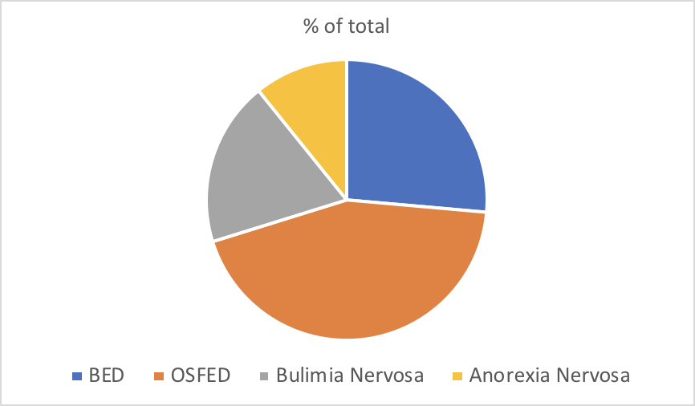
Eating Disorders Prevalence in the USA
Notes:
Eating disorders occur along a spectrum ranging from mild dysregulated eating behaviors which can ebb and flow to severe, enduring, life-threatening psychiatric disorders
Prevalence of eating disorders within the U.S. varies by type of disorder, age cohort, gender, and ethnic group among adults.
The four primary categories of eating disorders are Binge Eating Disorder (26%), OSFED (44%), other specified feeding and eating disorders, where individuals may present with behaviors and symptoms which don’t meet all specific diagnostic criteria but are certainly problematic clinically and impact quality of life. Bulimia Nervosa (19%) and Anorexia Nervosa (11%), have the highest mortality rates of eating disorders but lower prevalence compared to BED and OSFED.
Eating disorders diagnostic criteria can include restriction of calories, overexercising, binge eating, purging and other compensatory behaviors such as laxative abuse, diuretics and restrict binge cycle.
No two eating disorders look the same.
Eating disorders occur in people at a range of body weights, and low body weight is not a requirement of an eating disorder diagnosis. Disordered eating occurs along a spectrum, described as sub-clinical and can look like body image dissatisfaction, restrained eating, disinhibited eating, or emotional eating. Although disordered eating may not technically fall into a severe eating disorder diagnosis, the impact disordered eating can have on an individual’s life can be great.
Now if you’re new to learning about eating disorders, I want to pause and highlight that there is common misconception that you can “see” and eating disorder. You cannot. Sure there are some cases, where underweight is a primary sympotom of and eating disorder, but when we look here we can see all but 11% of cases don’t require low body weight as a diagnostic critera. This is critical as a whole as a medical community we begin to break down this misconception because the stigma of having an eating disorder combined with the stigma of living in a larger body keep many many people from seeking treatment and also from receiving treatment even when they try to find it.
Individuals who do not meet specific diagnostic criteria yet suffer from ED symptoms and behaviors fall in to the category of OSFED - which is by far the most common eating disorder presentation. May involve variety of ed symptoms and behaviors.
Close to 5% OF US adolescents and similar number of adults suffer from unspecified eating disorder. OSFED also includes atypical anorexia (aka anorexia at higher weight), purging disorder, ARFID, night eating syndrome, sub-clinical BN and BED with varying frequency of binge behavior)
Likely that many patients in the OSFED category never receive formal diagnosis or treatment and will not reveal their eating disorder willingly. They may not even know they have an eating disorder. What they do have is shame, low self-esteem, and a desire to achieve improved health.

Slide 13
Disordered Eating: Symptoms & Behaviors
Restriction of calories after ‘overeating’; not allowed to eat when hungry
Not able to connect eating to pleasure, satisfaction, enjoyment
Over-exercising, exercising when injured, rigid exercise routine, ‘burning off’ food
Binge eating: feeling out of control when eating, eating past comfortable fullness, remorse or shame after eating
Not able to keep certain foods in the house
Overvaluation of weight, shape, appearance
Talking about feeling “guilty” after eating
Purging: Laxative abuse, diuretic use, vomiting, exercise
Weight cycling
Tearful or emotional when asked about relationship to food / body
Loss of menses (bcp not a natural period)

Slide 14
Living in a Disordered Diet Culture
Normalized restricting
Normalized guilt – food labels “guilt free”
Normalized calorie counting
Normalized binge eating - holidays, etc
Normalized thin ideal

Slide 15
Historical Trauma
Weight Bias in Healthcare
Access to Healthcare
Weight Stigma
(Frank, 2016)
Notes:
The Bio psychosocial model of eating disorders is an often reference model in the ED field.
We need to know that eating disorders are never a choice We know that the cause/s of eating disorders are still unknown, although the bio-psychosocial model of eating disorders is a paradigm that can explain the multiple factors and conditions that can create the “perfect storm” for development of an eating disorder.
The bio-psycho-social model explains that the risk factors for eating disorders involve a range of biological, psychological and sociocultural issues.
I’d actually like to propose here that there are significant factors not addressed my this model, which you’ll see in red. And that we can do better for people, and recognize historical trauma, weight bias in healthcare, access to healthcare and weight stigma are also factors that impact EDs
To break it down for you a little further, within those risk factors, there are also predisposing factors, precipitating factors and perpetuating factors which we believe contribute to the development of chronic and enduring conditions. For example, an individual may suffer from predisposing anxiety, then social pressure during puberty leading to altered food intake can be precipitating, and the experience of food restriction in anorexia may further alter neurobiology perpetuating the disease.
Related comorbidities: anxiety, addiction, self-harm, depression, low self-directedness, low self-esteem, suicidality

Slide 16
Why are so many eating disorders never diagnosed?
Treatment for an EDO is a privilege - financial and time cost
Reluctance to seek help: coping and shame
Stereotypes: weight bias, normalized diet culture
Lack of provider awareness
Internalized weight stigma about size and eating disorders
Weight normative healthcare focuses on size/weight, may miss signs of DOE
Notes:
Why do so many eating disorders go untreated and unrecognized?
Treatment is a privilege - financial cost, time cost, can take years or decades of treatment
Individual’s reluctance to seek help - perhaps relying on the ED to cope , shame around the behaviors
Stereotypes - healthcare providers, friends, family, - “if you can’t see the ED, there is no ED”. What’s so wrong? Normalized diet culture.
Shame tied to body size and binge eating behavior - binge eating, compensatory and purging behaviors highly secretive
BED not screened for but weight is pathologized and diagnosed as “obesity”. Focus stays on weight.
Weight bias about EDs- you can “see” who has an ED
Healthcare avoidance among people at higher weights
Lack of provider awareness outside of ED specialty
Boys and Men
Disordered Eating
Stereotypes: race, ethnicity, age, size
Orthorexia, OSFED, AAN

Slide 17
Traditional Disjoint
“My therapist tells me not to talk about my weight and that my body is fine. But my doctor keeps weighing me and says that I need to lose weight.”
(Alberga et.al, 2016)
Notes:
We know that patient’s lived experience matters. When eating disorder care or psychotherapy contrasts with medical care, there is an interruption of healing. When diabetes care doesn’t align with supporting a healthy relationship to food and body, the healing is interrupted. This is not to say that eating disorder treatment is more of a priority than another condition, or the other way around but that these are at times co-occurring. We can look at the importance of aligning care , utilizing a weight neutral approach in dabetes care AND in ED recovery/relapse prevention so that whole person healing can take place.

Slide 18
Free-flowing, clean, healthy ecosystem
Notes:
Let’s segway in to our river analogy. This analogy is to help us take on awareness of the complexities a person is experiencing that impact their diabetes self-management and with that awareness, how health care providers can make a difference in a weight neutral way.
A river is complex. Even when we pull over at the view point, stop and look, want to capture that beautiful photo, we may see a beautiful, appearning-clean water, and thriving ecosystem, but really there are many many tributaries and factors that play in to the health of the river that we can’t possibly see just from one snapshot. What if snowmelt is low and water levels are dropping? What about chemicals polluting the water from a runoff 5 miles upstream that over time will kill the fish?
I’d like to make the case that we also cannot look at a person, or a person’s BMI, or even a person’s lab report and ”see their health.”
The WHO’s definition of health I believe is valid here: Dr. Lesely Williams from the Liberation Center in Phoenix Arizona spoke just two weeks ago at a conference in Portland and brought up that the World Health organization holds what I believe to be an excellent definition of health: “Health is a state of complete physical, mental, and social wellbeing and not merely the absence of disease or infirmity”
If our goal is to help people who want to become healthier get there, don’t we need to be able to see and address the factors that can’t be measured by a snapshot in time? If a person’s weight is diagnosed as the problem, don’t we need to acknowledge that prescribing weight loss is likely to do harm because we have no effective ways to tell a person to lose weight, and instead look at how to reduce stress, shame, disordered eating, mental health and improve self-compassion and access to care?

Slide 19
Interruptions in flow create an unhealthy system
Notes:
Over time, unaddressed factors that are harming the health of the river build up. If you could talk to this river, you wouldn’t just say – well get rid of all the garbage and everything will be fine. You have to address where the garbage is coming from? What are the factors related to this obstacle?
Please understand, that I am NOT equating body weight to garbage. I’m simply calling out that what we see, is often not enough information to tell us the whole picture. And, a person navigating life with a chronic health condition, or living in a larger body, or experiencing rising A1C, is not dirty. Health is not a barometer for worthiness.
If a person’s dysregulated eating has resulted in high A1C, if the disordered eating goes unrecognized and untreated and recommendations for weight loss, restriction and applied it will worsen the problem and magnify the shame.
Shame in and of itself is a major factor that we cannot see. Shame can only be uncovered when we allow someone to feel safe enough, in our clinic or exam room, …safe enough to bring some attention to their body. That is a very difficult thing for a person with an eating disorder to do.
We can view disordered eating, binge eating, restrict-binge cycle, or even chronic dieting as obstacles to regulated eating patterns that promote optimal blood glucose levels. Disordered eating, stigma, shame, can all impact ability or willingness to be active or make positive behavior changes. These are just a few examples.

Slide 20
What impacts the flow of the river?
Notes:
So many different things flow into the larger river, affecting the health and the flow of the river. Sometimes its the factors we can’t even see that have come before that are impacting the flow. What pieces of the patient’s health do providers impact? If we refer to these factors as tributaries and obstacles, we can make some sense of all the different factors at play beyond just what someone eats, if they exercise or not, or their BMI.

Slide 21
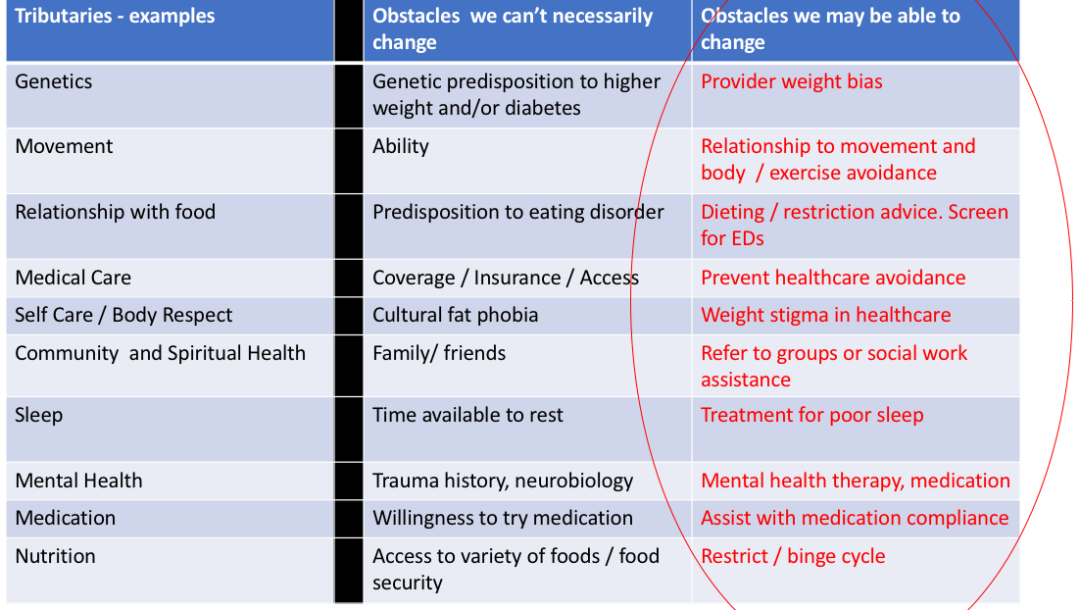
Remove the weight focus from counseling:
Notes:
Over on the left, under tributaries – these are some major factors related to a person’s behaviors, and health. You can see obstacles listed for each category- some obstacles we as providers can impact, and some that won’t ever change. I want to help you see how you can make such significant impact on all of these areas without any focus on weight, since we are
Genetics play a role in body size, risk of diabetes, and risk for an eating disorder. How a person moves impacts their diabetes – an obstacle can be their level of ability or disability, and the piece of that we may impact is their relationship to movement, their feeling of safety and comfort in where they can exercise. Having access to safe places to move, time to move.
Every single person is likely to have some obstacles to their health that we simply can’t change.

Slide 22
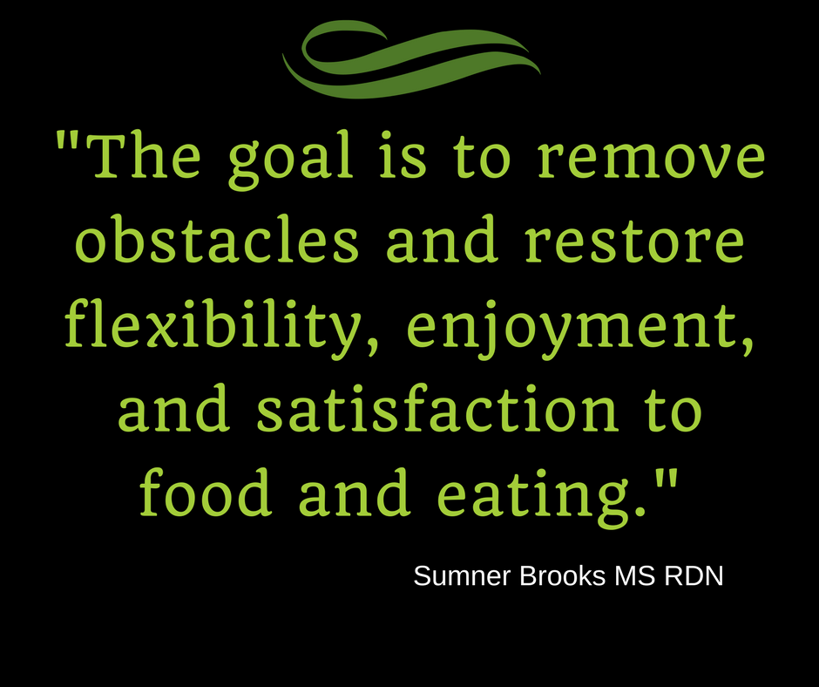
Notes:
I would actually say The “end” goal, is to remove…..
Change requires feeling worthy, being heard, and feeling validated as a person.

Slide 23
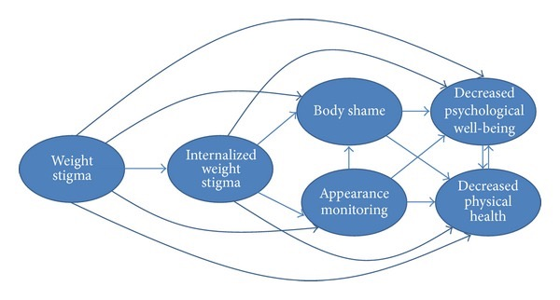
Theoretical Model of Weight Stigma:
(Tylka et. al 2014)
Notes:
Let’s recall that weight stigma is social devaluation and denigration of people perceived to carry excess weight leading to prejudice, negative stereotyping and discrimination.
This graphic illustrates the variables that may explain the links between weight stigma, internalized weight stigma and adverse health and well being. Weight stigma can be seen as a starting point of negative body image, poors self care and negative health.
When a person experiences weight stigma, they experience shame, which leads to decreased psychological well-being, which for a number of reasons can negatively impact physical health.
When a person experiences internalized weight stigma, where they believe they are to blame and their body is wrong which leads to more efforts to diet or adhere to unrealistic body and appearance standards.

Slide 24
As Defined by The World Health Organization:
Health is a “State of complete physical, mental and social well being, and not merely the absence of disease or infirmity.”
Notes:
Let’s recall that weight stigma is social devaluation and denigration of people perceived to carry excess weight leading to prejudice, negative stereotyping and discrimination.
This graphic illustrates the variables that may explain the links between weight stigma, internalized weight stigma and adverse health and well being. Weight stigma can be seen as a starting point of negative body image, poors self care and negative health.
When a person experiences weight stigma, they experience shame, which leads to decreased psychological well-being, which for a number of reasons can negatively impact physical health.
When a person experiences internalized weight stigma, where they believe they are to blame and their body is wrong which leads to more efforts to diet or adhere to unrealistic body and appearance standards.

Slide 25
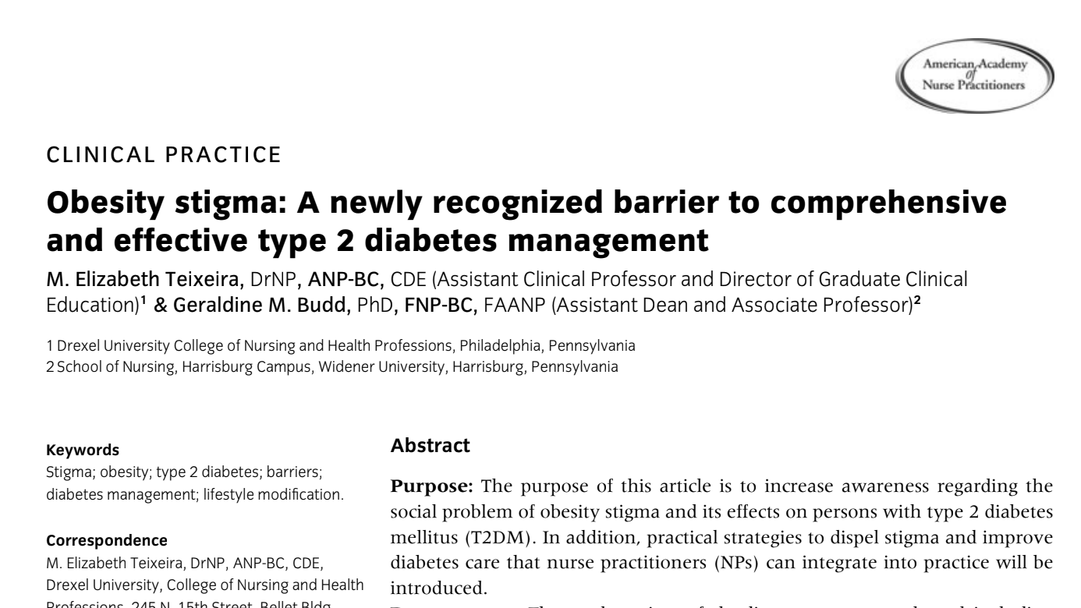
Weight Stigma:
Notes:
In 2009 a commentary published in the Journal of the American Academy of Nurse Practitioners recognized stigma as a barrier to diabetes management, highlighting healthcare avoidance as one of the biggest contributors.

Slide 26
Weight Stigma:
Health care avoidance cited as one of the biggest barriers to disease management resulting from weight stigma.
Notes:
In 2009 a commentary published in the Journal of the American Academy of Nurse Practitioners recognized stigma as a barrier to diabetes management, highlighting healthcare avoidance as one of the biggest contributors.

Slide 27
Impact of Weight Stigma on
Eating Disorders
WS predicts binge eating behavior among people at higher BMIs (Ashmore 2008)
The experience of WS is damaging and contributes to poor mental health adjustment.
(Friedman, 2005)
Notes:
Eating Disorders do not discriminate based on BMI (one problem is that not all bodies are included in the research); Anorexia can affect people at any BMI, same with ALL EDs, there is weight bias in ED treatment and in research.
One study looking at 93 obese adults who completed 3 questionnaires, found that indeed weight stigmatizing experiences predicted binge eating behavior and concludes that the psychologicial distress of weight stigma may be an important mediating factor.
Another study looked at adults seeking weight loss treatment and evaluated the relationship between experiencing weight stigma, their own beliefs about weight and psychological functioning. It underscored the particular damaging effects of weight stigma with the greatest damage seen in people who help strong antifat beliefs themselves (internalized weight stigma).

Slide 28
Weight Stigma Impacts Health Care
Women who experience weight stigma avoid seeking healthcare (Mensinger 2018)
Weight inclusive approach improves health behaviors, including physical activity frequency, uncontrolled eating, emotional eating, and overvaluation of shape and weight concerns (Mensinger 2016)
Notes:
There is new research looking at weight stigma and healthcare avoidance, although numerous studies have demonstrated this in addition to the Mensinger study we’ve referenced. If anyone wants to see that I’d be happy to send that information to you.
Social Identity Threat Theory identifies a framework for why we see this, having to do with shame and stress leading to avoidance.
This research begins to identify that when we can make a positive change on internalized weight stigma from a weight inclusive approach, we see a positive changes like decreased problematic emotional eating, decreased episodes of uncontrolled eating, more enjoyable and consistent physical activity, and less overvaluation of shape and weight (a positive mental health outcome). When people are experiencing less cognitive dissonance about their body, they are able to take better care of themselves.

Slide 29
Meet Robert
55 year old man: Uncontrolled T2DM recently started insulin;
The message he hears: “Restrict your carbs and eat more protein”.
Notes:
You learn that he is a former college athlete,
Patient explains that he "binges" and sometimes doesn't take is insulin.
He is very dissatisfied with his body (body dysmorphia)
He states that he is eating very few carbs (recall shows about 50g per day
How can you counsel without harping on weight or worsening the underlying eating disorder

Slide 30
Meet Stacey
Woman in mid thirties with prediabetes.
She would like to get pregnant.
The message she hears: “Eat less and move more for health.”
Notes:
3 years ago at an annual doctor appointment, Stacey was conversing with her doctor about wanting to conceive and she was told she was obese and needed to lose weight if she wanted to have a healthy pregnancy.
Infertility notes state: infertility from 20-pound weight loss and lack of menses 3 years
What you don't realize is: She has undiagnosed "atypical" anorexia; binges 1 x week on weekends, laxative abuse, depression.
(I would walk the audience thru how to use the insulin knife)
How can you counsel without harping on weight or worsening the underlying eating disorder?

Slide 31
Meet Mary
Small elderly woman in 70’s: Controlled Type 2 diabetes for 3 years, (A1c <7) has been strictly counting carbs, The message she hears “Keep up the good work”.

Slide 32
EDO and Diabetes Care
Eating disorders show up in diabetes care, many likely undiagnosed and ED behaviors can contribute to poor glycemic control
Current disjoint between ED care and DM care
Weight bias and weight stigma negatively impact health outcomes and contribute to DOE/ EDO
More research is needed on the effect of weight neutral approach to diabetes care

Slide 33
We all have the same goals
Improvement in patient well-being and DM management
Reduction in disordered eating & EDO recovery
Consistent care for patients

Slide 34
We all have the same goals
What we can do:
Awareness and education about DOE
Know the obstacles HCPs have the opportunity to remove
Consider weight bias as a variable to well being
Acknowledge lived experiences
Remove shame from diabetes care
Begin to tackle weight bias from a population-level approach

Slide 35
Weight-neutral Counseling for
Diabetes Care
Hx of ED or chronic dieting can be triggered with dx of diabetes
Weight focused counseling is triggering for clients and may create barriers for overall diabetes care.
Weight stigma decreases utilization of care, and has other health consequences.

Slide 36
Weight-neutral Counseling for
Diabetes Care
Weight neutral / inclusive care gives the patient the opportunity to also heal their disordered eating along with addressing diabetes self-management.
When we create safe spaces, our patients become free to heal.

Slide 37
Weight Neutral Diabetes Counseling
Teaching diabetes is hard enough.
Let’s stop bringing food judgment, body shame and weight stigma into the appointments.

Slide 38
How?
Weight-neutral Diabetes Care!
Encourage individuals to engage in health-promoting behaviors, such as taking medication, monitoring and managing stress, eating balanced meals, engaging in regular and consistent activity, and seeing medical professionals to manage their diabetes care independent of size, or weight change.

Slide 39
From the Look AHEAD Trial

Slide 40
Weight-neutral Counseling for Diabetes
The effectiveness of weight loss for diabetes, long term is poor - the results from the Look AHEAD Trial show this.
Always remember -- Weight is not a behavior
Weight loss does not cure diabetes
Lifestyle change (eating well, enjoyable movement, sleep, stress management) improve blood glucose immediately and makes overall management effective.

Slide 41
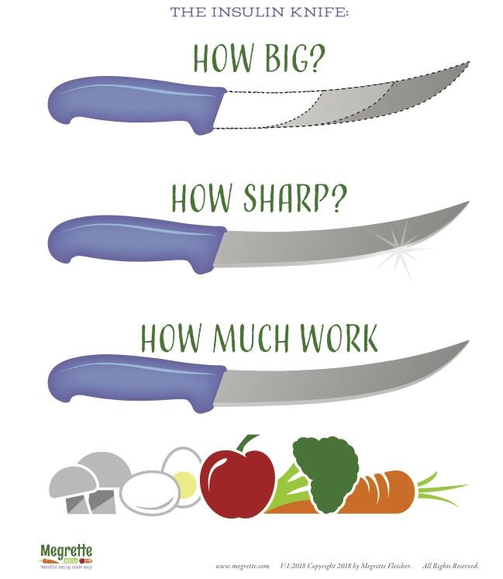
The Insulin Knife Concept
This handout is available for download.

Slide 42
Using the “Insulin Knife”
Before using this handout, the educator will set the stage to help the client imagine that insulin is like a knife.

Slide 43
Counseling dialog
“You understand that the nutrition that you eat is trapped in the blood stream and can’t move into the cells unless there is insulin.” [agrees/affirm]
“To understand diabetes better, imagine that insulin is like a knife.”
[agrees/affirm]

Slide 44
Using the “Insulin Knife”
“When you are diagnosed with diabetes, your provider has to answer three questions to manage your blood sugar.
How BIG is your Insulin Knife?
How SHARP is your Insulin Knife?
HOW MUCH WORK are you asking your
Insulin Knife to do?”

Slide 45
Meet Robert
The message he hears: “Restrict your carbs and eat more protein”.
You learn that he is a former college athlete, and he "binges" and sometimes doesn't take his insulin.
He is very dissatisfied with his body (body dysmorphia)
He states that he is eating very few carbs (recall shows about 50g per day
Notes:
You learn that he is a former college athlete,
Patient explains that he "binges" and sometimes doesn't take is insulin.
He is very dissatisfied with his body (body dysmorphia)
He states that he is eating very few carbs (recall shows about 50g per day
How can you counsel without harping on weight or worsening the underlying eating disorder

Slide 46
Insulin Function Declines

Slide 47
“How Big” is your knife?

Slide 48
Counseling Robert
Simple Reflection
“You’re thinking that if you eat less, than your diabetes will improve.”
Open Ended Question
“What would be the benefit of understanding how insulin production changes with diabetes. IE: learning how big your insulin knife is.”

Slide 49
Meet Stacey
The message she hears: “Eat less and move more for health.”
Infertility notes state: infertility from 20-pound weight loss and lack of menses 3 years
Notes:
Infertility notes state: infertility from 20-pound weight loss and lack of menses 3 years
What you don't realize is: She has undiagnosed "atypical" anorexia; binges1 x week on weekends, laxative abuse, depression.
(I would walk the audience thru how to use the insulin knife)
How can you counsel without harping on weight or worsening the underlying eating disorder?

Slide 50
What you don't realize is:
She has undiagnosed "atypical" anorexia;
Binges 1 x week on weekends, laxative abuse, depression.
How can you counsel without harping on weight or worsening the underlying eating disorder?
Notes:
It’s important to know - amenorrhea (absence of period) can occur in women who are overweight and can be directly linked to calorie restriction or exercise patterns as a means of weight control. A woman does not need to be under normal weight range for this to occur.
You might say something like…
I love to support all my patients with learning a healthy relationship to food and body, it really can help your diabetes management.
Do you ever feel out of control when eating? Would you say the food or body image concerns take up a lot of your mental energy? What percentage of your waking thoughts do you think are tied to food, body, or weight concerns? Would you like a referral to speak with someone who specializes in disordered eating who can help?

Slide 51
“How Sharp”
looks at insulin resistance

Slide 52
Counseling Stacey
Simple Reflection
“You think that losing weight is the only way to address your infertility”
Open Ended Question
“What are the advantages of focusing on sharpen your insulin knife instead of your weight?”

Slide 53
What might dull your knife?
Insulin resistance is caused by many factors.
Age
Inactivity
Medication
Stress
Pain
Illness
Diet high in saturated fats vs high fat diet
Sleep
Hormones
Infection (dental is common)

Slide 54
Meet Mary
The message she hears: “Keep up the good work”.
From obtaining a 24 hour recall you learn she restricts all fruit, grains, legumes and dairy to limit carbs.
She complains about her bowels (suffers chronic constipation)
Notes:
Mary is showing signs of disordered eating: With some questioning around her nutrition, you can identify rigid food rules, cutting out major food groups with no flexibility, fear of eating foods that are not harmful to her body, emotional distress related to eating certain foods, signs of harm from this diet pattern.
Pathological nutrition seeks health, but in actuality, deteriorates it.

Slide 55
What you don't realize is:
She is expressing fear of eating and is avoidance of all social eating, anxiety about food.
What you don't realize is: She has restrictive disordered eating patterns
Notes:
In this case, Mary’s restrictions are eliminating essential food groups, likely her undereating and low fiber intake causing slow GI motility and constipation.

Slide 56
“How Much Work” is Insulin Load

Slide 57
Teaching Insulin Load
Background - What is Insulin Load
Insulin is released in two phases. The first-phase release is rapidly triggered in response to increased blood glucose levels, and lasts about 10 minutes.
The second phase is a sustained, slow release that peaks in 2 to 3 hours.

Slide 58
Teaching Insulin Load Background
What is Insulin Load
Insulin is released in two phases. The first-phase release is rapidly triggered in response to increased blood glucose levels, and lasts about 10 minutes.
The second phase is a sustained, slow release that peaks in 2 to 3 hours.

Slide 59
Teaching Insulin Load Background
What is Insulin Load
Reduced first-phase insulin release may be the earliest detectable beta cell defect predicting onset of type 2 diabetes. (Prato, 2002)

Slide 60
“How Much Work” is the insulin load
What is Insulin Load
This is looking at the total amount of carbohydrates
The distribution of carbohydrates
The composition of the carbohydrates (fiber vs low fiber)(less processed vs more processed)

Slide 61
Counseling Mary
Simple Reflection
“You’re really concerned that you are asking your insulin knife to do too much work.”
Open Ended Question
“How would learning about eating foods that don’t overwhelm your insulin knife and can improve constipation help you?”

Slide 62
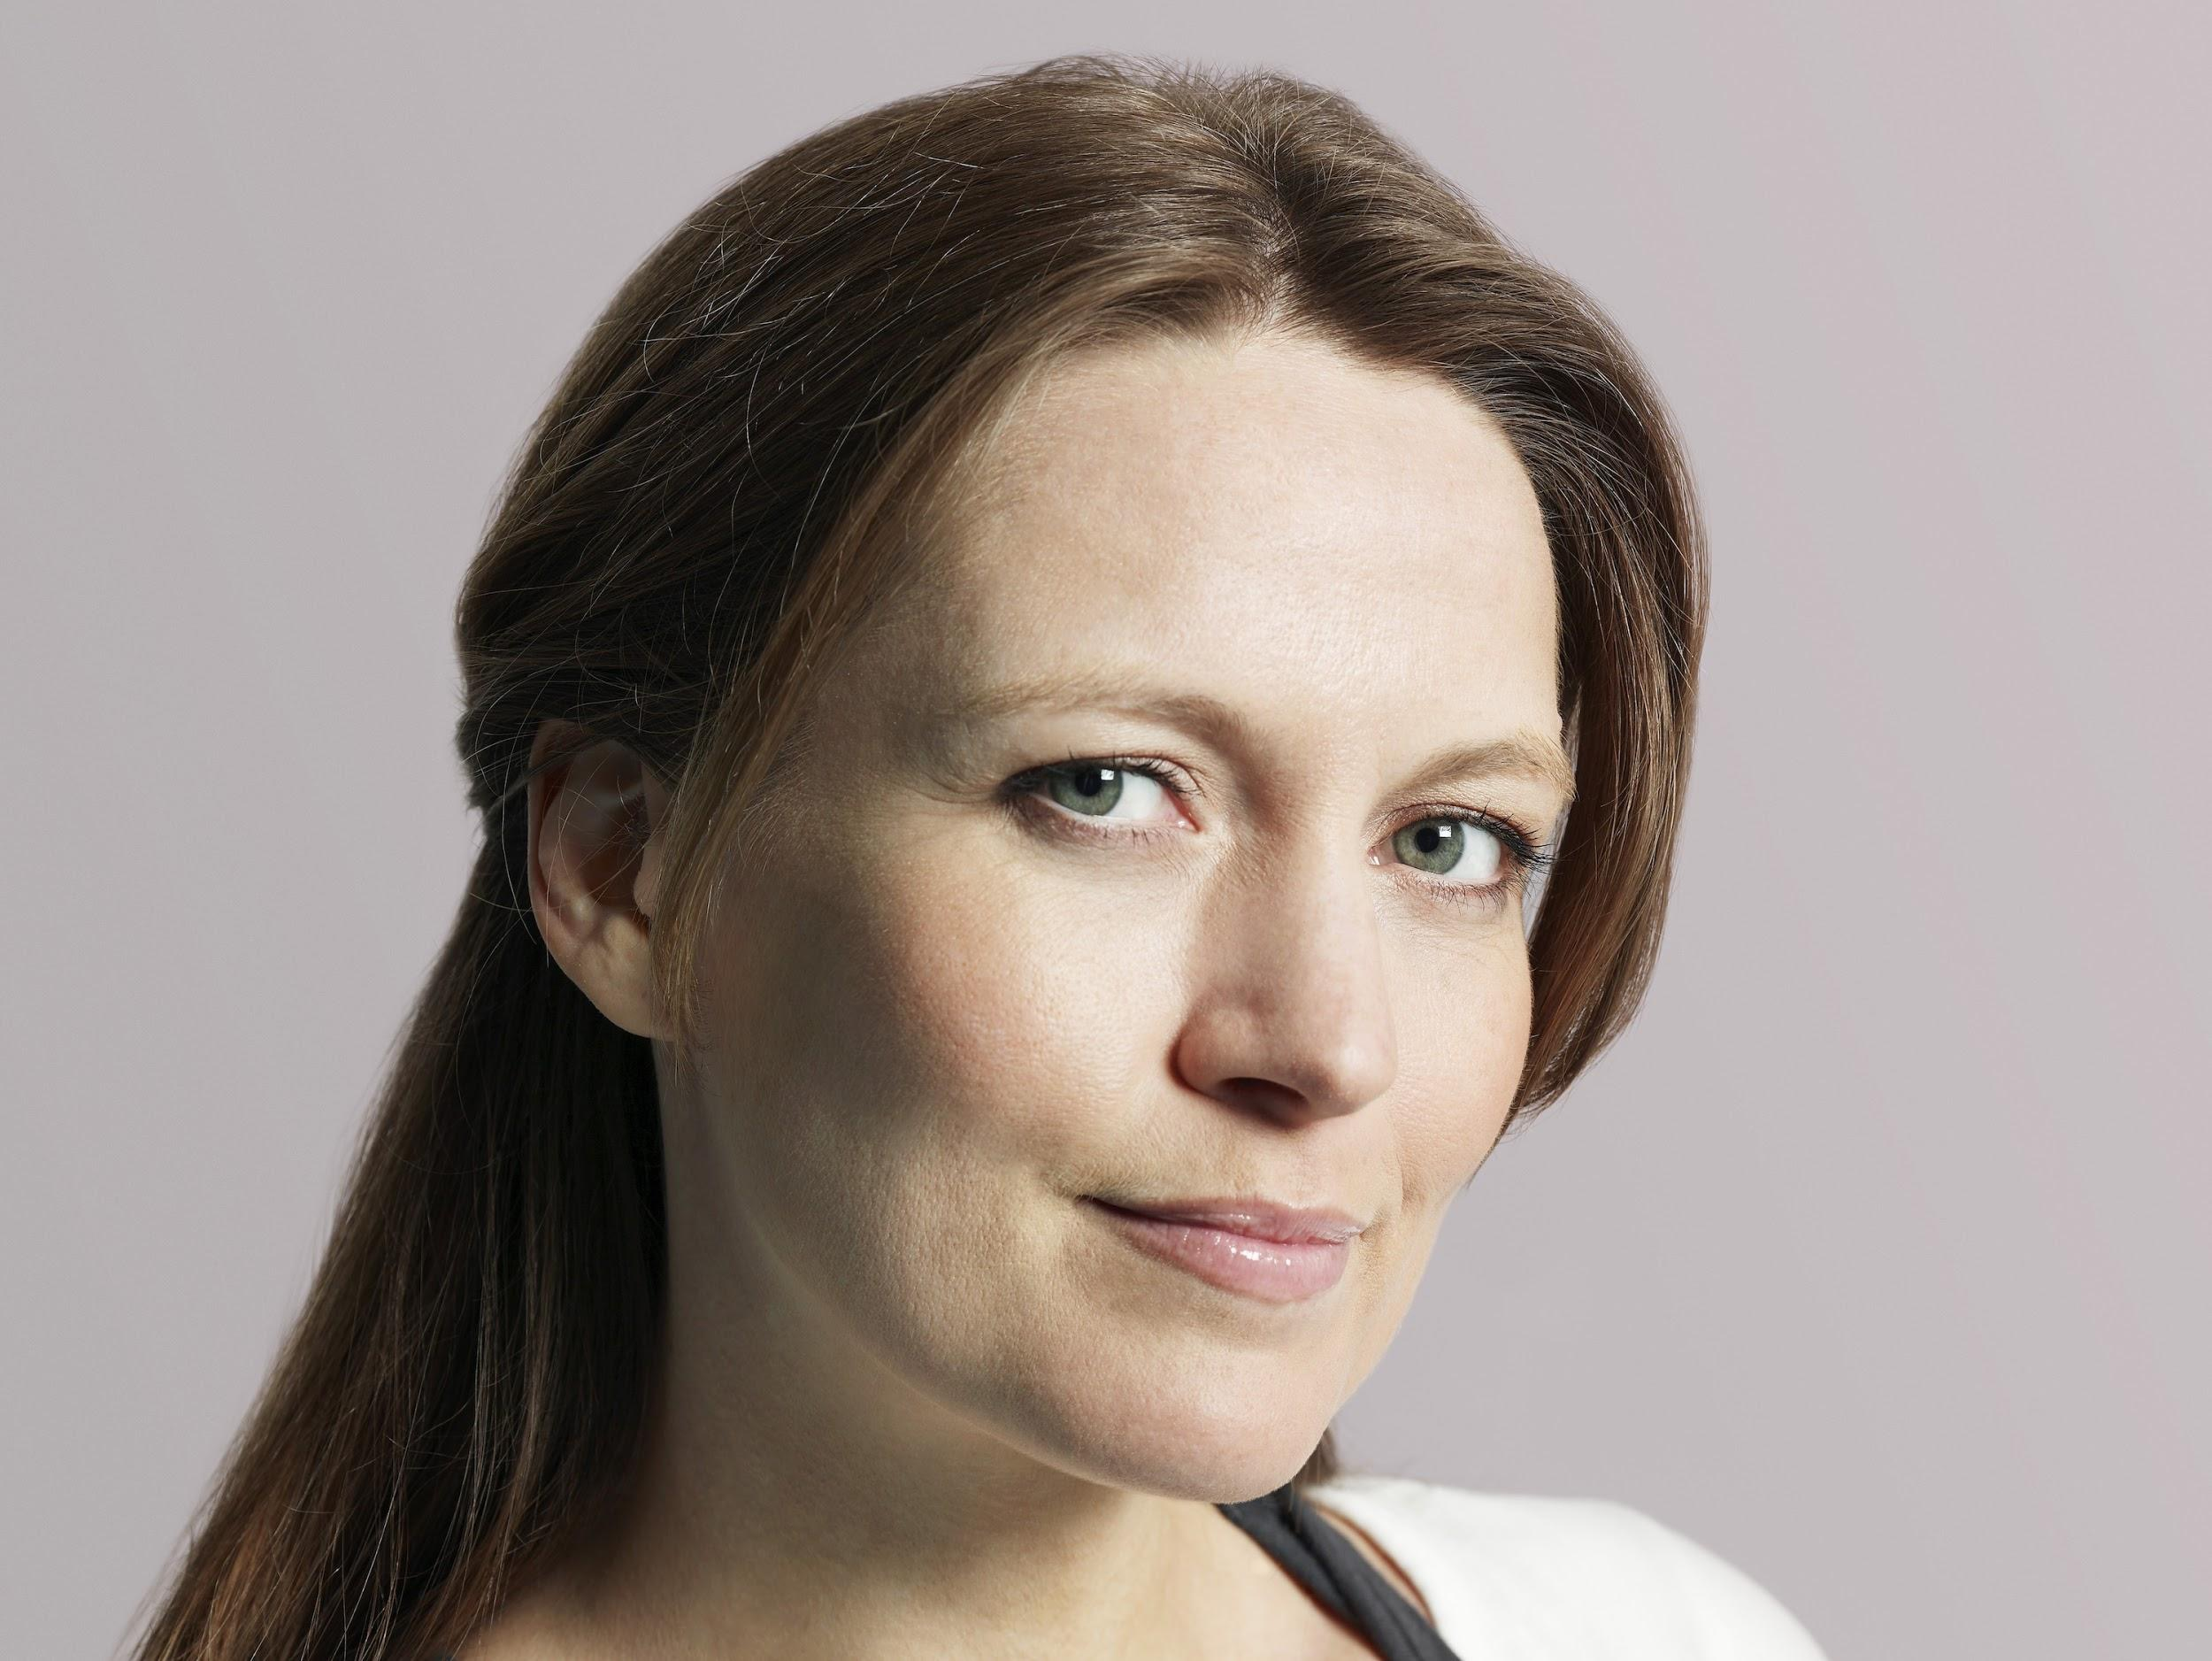
Navigating Counseling Challenges
Addressing a client’s emotional response which can be triggered by past eating disorders.

Slide 63
Navigating Counseling Challenges
This is best accomplished by NOT talking about weight, weight loss, or body size.
Weight-neutral is not “obesity promoting” nor is it “anti-weight loss.”

Slide 64
Navigating Counseling Challenges
Remain nonjudgmental regarding options. This can be demonstrated by encouraging autonomy, a technique in Motivational Interviewing

Slide 65
What IS Weight-neutral Diabetes Care?
It is the best possible diabetes care, regardless of a person’s weight.

Slide 66
Learning Objectives - Answered
State three defects of prediabetes and diabetes -
Decreased insulin production, increased insulin resistance, and insulin load.

Slide 67
Learning Objectives--Answered
Compare and contrast two ways a weight-neutral education differs from a weight biased educational session
It does not talk about weight, weight loss, the benefit of weight loss. The focus is promoting consistent and sustainable behaviors vs discussing outcomes.

Slide 68
Learning Objectives-- Answered
Compare and contrast two ways a weight-neutral education differs from a weight biased educational session
It focuses efforts on reducing weight stigma in the healthcare setting

Slide 69
Learning Objectives-- Answered
Recognize three warnings signs of disordered eating as it might present in prediabetes or diabetes care
Some signs of disordered eating examples include: reports of binge eating or uncontrolled eating, restrictive eating, restrict-binge cycle, emotional distress about weight and food, amenorrhea, compensatory restriction or laxative use, rigid food rules, overvaluation of weight and shape

Slide 70
Ask yourself:
Would you have heard this message any differently if I were in a different body? ~Lucy Aphramor

Slide 71
Learn more about the Weight Normative vs Weight Inclusive Paradigm Using the Contemporary Evidence Base
Free video access on exploring the research by Laura Thomas PhD
EDRDpro.com/freevideo

Slide 72
Learn more about Weight Neutral Approach to Diabetes
Join the FREE Weight-Neutral for Diabetes Care closed Facebook group for professionals: search for WN4DC

Slide 73
References
Alberga, Angela S., et al. “Weight Bias: a Call to Action.” Journal of Eating Disorders, vol. 4, no. 1, 2016, doi:10.1186/s40337-016-0112-4.
Ashmore, Jamile A., et al. “Weight-Based Stigmatization, Psychological Distress, & Binge Eating Behavior among Obese Treatment-Seeking Adults.” Eating Behaviors, vol. 9, no. 2, 2008, pp. 203–209., doi:10.1016/j.eatbeh.2007.09.006.
Frank, Guido K. W. “The Perfect Storm - A Bio-Psycho-Social Risk Model for Developing and Maintaining Eating Disorders.” Frontiers in Behavioral Neuroscience, vol. 10, 2016, doi:10.3389/fnbeh.2016.00044.
Friedman, Kelli E., et al. “Weight Stigmatization and Ideological Beliefs: Relation to Psychological Functioning in Obese Adults.” Obesity Research, vol. 13, no. 5, 2005, pp. 907–916., doi:10.1038/oby.2005.105.
Greg, E.W.; Chen, H.; Wagenknecht, L.E.; et al. “Association of an Intensive Lifestyle 9 Intervention with Remission of Type 2 Diabetes.” American Medical Association. 2012; Vol 308:23:2489-2496.
Holman RR: Assessing the potential for α-glucosidase inhibitors in prediabetic states. Diabetes Res Clin Pract40 (Suppl.):S21 –S25,1998
Marek, Ryan J., et al. “Impact of Using DSM-5 Criteria for Diagnosing Binge Eating Disorder in Bariatric Surgery Candidates: Change in Prevalence Rate, Demographic Characteristics, and Scores on the Minnesota Multiphasic Personality Inventory - 2 Restructured Form (MMPI-2-RF).” International Journal of Eating Disorders, vol. 47, no. 5, 2014, pp. 553–557., doi:10.1002/eat.22268.
Mensinger, Janell L., et al. “A Weight-Neutral versus Weight-Loss Approach for Health Promotion in Women with High BMI: A Randomized-Controlled Trial.” Appetite, vol. 105, 2016, pp. 364–374., doi:10.1016/j.appet.2016.06.006.
Mensinger, Janell L., et al. “Mechanisms Underlying Weight Status and Healthcare Avoidance in Women: A Study of Weight Stigma, Body-Related Shame and Guilt, and Healthcare Stress.” Body Image, vol. 25, 2018, pp. 139–147., doi:10.1016/j.bodyim.2018.03.001.
Prato, S. Del, et al. “Phasic Insulin Release and Metabolic Regulation in Type 2 Diabetes.” Diabetes, vol. 51, no. Supplement 1, 2002, doi:10.2337/diabetes.51.2007.s109.
Tomiyama, A. Janet. “Weight Stigma Is Stressful. A Review of Evidence for the Cyclic Obesity/Weight-Based Stigma Model.” Appetite, vol. 82, 2014, pp. 8–15., doi:10.1016/j.appet.2014.06.108.
Tylka, Tracy & Annunziato, Rachel & Burgard, Deb & Danielsdottir, Sigrun & Shuman, Ellen & Davis, Chad & Calogero, Rachel. (2014). The Weight-Inclusive versus Weight-Normative Approach to Health: Evaluating the Evidence for Prioritizing Well-Being over Weight Loss. Journal of obesity. 2014. 983495. 10.1155/2014/983495.

