Slide 1
Notes:
Headings Arial 35
Bullets = Arial 31
Sub-Bullets = Arial 27

Slide 2
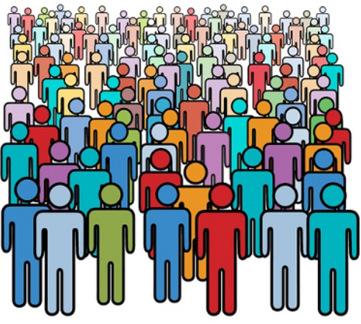
Turning Passion into Action:
Population Health, Diabetes and the (Certified) Diabetes Educator - Why Me?
Notes:
Segue from previous speaker—supportive statement about the CDE role now and future

Slide 3
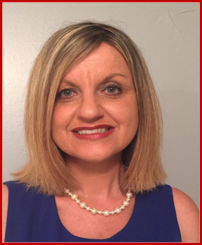
Kellie Rodriguez
RN, MSN, MBA, CDE
Director, Global Diabetes Program
Parkland Health & Hospital System
Dallas, TX

Slide 4
Joan Olveda
RN, BSN, CDE
Sutter Health
Sacramento, Ca

Slide 5
Disclosure to Participants
Notice of Requirements For Successful Completion
Please refer to learning goals and objectives
Learners must attend the full activity and complete the evaluation in order to claim continuing education credit/hours
Conflict of Interest (COI) and Financial Relationship Disclosures:
Kellie Rodriguez, MSN, MBA, CDE – No disclosures
Joan Olveda, RN, BSN, CDE – No disclosures
Non-Endorsement of Products:
Accredited status does not imply endorsement by AADE, ANCC, ACPE or CDR of any commercial products displayed in conjunction with this educational activity
Off-Label Use:
No off-label use

Slide 6
Presentation Objectives
Describe core elements of a Population Health framework
Discuss the inherent roles of the Certified Diabetes Educators (CDE) / Diabetes Educator within a Population Health framework for diabetes care and education
Outline strategies for the CDE to drive change

Slide 7
How many of you
currently have roles in
Population Health Management?

Slide 8
About us……
19,500+ CDEs
13,700+
AADE members
27,000+
‘known’
TOTAL
Nurses
Dietitians/Nutrition.
Pharmacists
Providers/ Specialists
Clinical Psych.
Social Workers
PT / OTs
Exercise Physiols.
Dentists/ Optoms.
Para Profess.
Discipline
Commitment
Educator Commitment
Notes:
Numbers from NCBDE & AADE May 2018
Physical Therapist

Slide 9
AADE Strategic Plan 2016-2018
www.diabeteseducator.org

Slide 10
The 7 Cs in Leadership
It’s what we do as diabetes educators
Weismuller, PC et al. NASN School Nurse. January 2016: 34-39.

Slide 11
So What do we do… really?
Risk mitigation
Safety
Quality improvement
Care coordination
Inter-disciplinary collaborator / Work force leveraging
System / care design & re-design
Strategic planning
Embrace the same 7 Cs in leadership for system education as we do with patient education.

Slide 12
Language of Diabetes Educators
How we talk as and about diabetes educators plays an important role in engagement, conceptualization of diabetes educators and our management, treatment outcomes and psychosocial well-being. For diabetes educators, language has an impact on motivation, behaviors and outcomes.
Dickinson, JK et al. Diabetes Care 2017 Dec; 40(12): 1790-1799
Notes:
The way that people think, behave, approach work and life as a result of having worked with you – is your leadership legacy.
What is YOUR leadership legacy?

Slide 13
Population Health
The health outcomes of a group of individuals, including the distribution of such outcomes within the group
The efforts to use health care resources effectively & efficiently to improve the lifetime health and wellbeing of a specific population
It’s what we do as diabetes educators
Kindig D, Stoddart G. Am J Public Health 2003;93:380–383
Nash, E. Deloitte’s Life Sciences & Health Care; 2015.
Notes:
Driving growth are changes mandated by the Affordable Care Act, such as Meaningful Use, the Hospital Readmissions Reduction Program, and the shift to patient-centric care, and an aging population.
Among the areas getting most of the attention are chronic conditions and obesity, infant mortality, frail elders, and mental and behavioral health.
Healthy People 2020 - DHHS

Slide 14
The Chronic Care Model
Delivery System Design
Self-Management Support
Decision Support
Clinical Information Systems
Community Resources & Policies
Health Care organization
Informed Activated Patient
Prepared Pro-active Practice Team
Productive Interactions
http://www.improvingchroniccare.org
Notes:
To address a delivery system that is often fragmented, lacks clinical information capabilities, duplicates services and is poorly designed for coordinated delivery of chronic care.
Health Systems
Create an organization that provides safe, high quality care
A health system’s business plan reflects its commitment to apply the CCM across the organization. Clinician leaders are visible, dedicated members of the team.
Visibly support improvement at all levels of the organization, beginning with the senior leader
Promote effective improvement strategies aimed at comprehensive system change
Encourage open and systematic handling of errors and quality problems to improve care
Provide incentives based on quality of care
Develop agreements that facilitate care coordination within and across organizations
The Community
Mobilize community resources to meet needs of patients Community resources, from school to government, non-profits and faith-based organization, bolster health systems’ efforts to keep chronically ill patients supported, involved and active.
Encourage patients to participate in effective community programs
Form partnerships with community organizations to support and develop interventions that fill gaps in needed services
Advocate for policies that improve patient care
Self-Management Support
Empower and prepare patients to manage their health care Patients are encouraged to set goals, identify barriers and challenges, and monitor their own conditions. A variety of tools and resources provide patients with visual reminders to manage their health.
Emphasize the patient’s central role in managing his or her health
Use effective self-management support strategies that include assessment (physician or self?), goal-setting, action planning, problem-solving and follow-up
Organize internal and community resources to provide ongoing self-management support to patients
Delivery System Design
Assure effective, efficient care and self-management support Regular, proactive planned visits which incorporate patient goals help individuals maintain optimal health, and allow health systems to better manage their resources. Visits often employ the skills of several team members.
Define roles and distribute tasks among team members
Use planned interactions to support evidence-based care
Provide clinical case management services for complex patients
Ensure regular follow-up by the care team
Give care that patients understand and that agrees with their cultural background
Decision Support
Promote care consistent with scientific data and patient preferences Clinicians have convenient access to the latest evidence-based guidelines for care for each chronic condition. Continual educational outreach to clinicians reinforces utilization of these standards.
Embed evidence-based guidelines into daily clinical practice
Share evidence-based guidelines and information with patients to encourage their participation
Use proven provider education methods
Integrate specialist expertise and primary care
Clinical Information Systems
Organize data to facilitate efficient and effective care Health systems harness technology to provide clinicians with an inclusive list (registry) of patients with a given chronic disease. A registry provides the information necessary to monitor patient health status and reduce complications.
Provide timely reminders for providers and patients
Identify relevant subpopulations for proactive care
Facilitate individual patient care planning
Share information with patients and providers to coordinate care
Monitor performance of practice team and care system

Slide 15
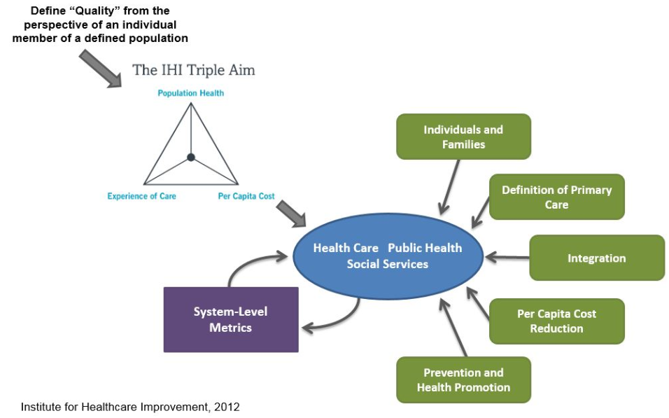
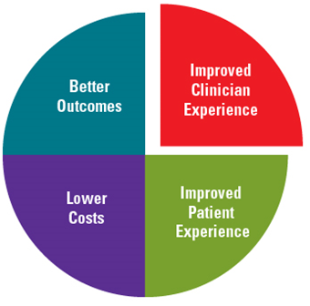
IHI Triple (Quadruple) AIM Enterprise
Notes:
When IHI first developed the Triple Aim framework in 2007, the idea of trying to improve the patient care experience, improve the health of a population, and reduce per capita health care costs at the same time was considered somewhat radical. It took years for such an ambitious concept, and the words used to describe it, to enter the health care mainstream.

Slide 16
3 Core Components | Key elements
Creating the right foundation for population management | Identifying a relevant population
 | Creating leadership & governance structures
 | Purpose with which stakeholders will coalesce
Managing services at scale for the population | Population segment on which to focus
 | Needs and assets assessment / Service redesign
 | Develop portfolio projects
 | Develop plan for delivering services at scale
Establishing a learning system to drive and sustain work over time | Using Population level measures
 | Using informative cases
It’s what we do as diabetes educators

Slide 18
It’s what we do as diabetes educators

Slide 19
Population Health framework…..
Care Continuum Alliance 2012

Slide 20
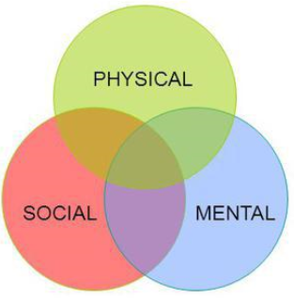
Health Assessment
Health is a state of complete physical, mental and social well-being and not merely the absence of disease or infirmity.
WHO Definition since 1946

Slide 21
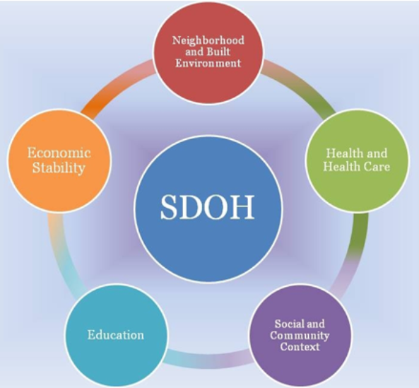
Social Determinants of Health
“The economic, environmental, political, and social conditions in which people live and are responsible for a major part of health inequity worldwide”
HealthyPeople.gov – Healthy People 2020 – Understanding Social Determinants of Health

Slide 22
Health Disparities and Health Equity
Health disparity “a particular type of health difference that is closely linked with social, economic, and / or environmental disadvantage”
Health equity “attainment of the highest level of health for all people”
Education: Higher education/Literacy
Economic: Food insecurity/Access to nutritious food
Social/Community Context: Civic participation
Neighborhood: Quality housing; Affordable transportation
Health care: Access; Cultural literacy; Health insurance
Notes:
Throughout the next decade, Healthy People 2020 will assess health disparities in the U.S. population by tracking rates of illness, death, chronic conditions, behaviors, and other types of outcomes in relation to demographic factors including:
Race and ethnicity
Gender
Sexual identity and orientation
Disability status or special health care needs
Geographic location (rural and urban)

Slide 23
Question…
Is zip code may more relevant to health than genetic code?

Slide 24
Risk Stratification
Foundation for achieving Triple Aim components
A risk score is a standardized metric for the likelihood that an individual will experience a particular outcome
A risk stratification framework may combine several individual risk scores to create a broader profile of a patient and his or her complex, ongoing needs
Help providers establish the complexity of need of their patients
https://healthitanalytics.com
Notes:
One of the most famous and well-developed examples of a scoring methodology is the Framingham Risk Score for cardiovascular disease (CVD).
a risk score is a standardized metric for the likelihood that an individual will experience a particular outcome

Slide 25
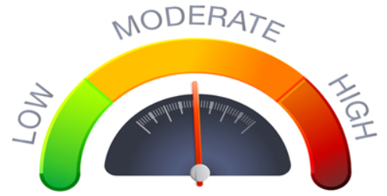
Risk Stratification
Stratify Patient
Right patient
Right care
Right place
Right time
Stratify System
Effective and Efficient Resource Utilization
Stratify Team

Slide 26
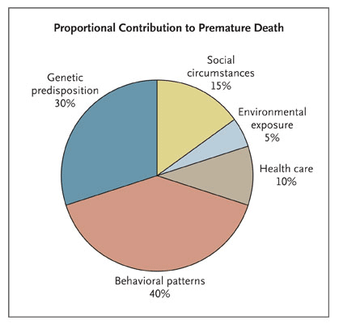
Stratification Criteria
Population health extends to the 90 percent of factors that make us sick.
McGinnis et sl. Health Affairs, 2002;21:78-93.
Notes:
A comprehensive portrait of total risk should include the social and behavioral determinants of health along with traditional clinical and claims data
Achieving success on any level of intervention in the pyramid depends upon partnerships among public health proponents, medical centers, business entities, communities and citizens.
We now have inescapable evidence that illness is bad for business. We know that illness produces absenteeism, presenteeism (showing up but being unproductive), and greater rates of disability.
We know that 1 percent of patients in a large group of people account for about 20 percent of medical costs; that 5 percent of patients account for 50 percent of costs; and that 10 percent of patients account for 75 percent of costs.

Slide 27
Key Stratification considerations
Socio-economic Status
Pharmacy use
Food access
.
Educational status & capacity
Transportation
Available community resources
May account for 70 percent of data that contributes to better health
EMR
Patient Surveys
Claims Data
County Data
https://healthitanalytics.com
Notes:
They may also include basic socioeconomic circumstances, such as race, income level, and ethnicity, that hinder access to care or produce deeply entrenched cultural responses to certain lifestyle choices.
With OptumIQ, the Next Best Action strategy leverages advances in machine learning, deep learning and rules-based models to customize
the recommended treatment for each patient based on:
• Attitudinal data
• Clinical data
• Behavioral data
• Demographic data
• Geographic data
• Medical claims
• Pharmacy claims
• Psychographic data
• Response data
• Technographic data

Slide 28
Disease Registries
A system for uniform patient information collection
Identification & tracking of patients with a specific chronic condition
Facilitates health outcome management at both the individual and clinic level
Individual disease management through notification of abnormal test results, missed test results, appointments
Tracks progress of high risk patients
Promotes use of evidence-based care
Monitoring the effectiveness & quality of tmt.
Improving treatment chains
Analyzing
clinical data
Hummel, J. Clin. Diab; 2000 18(3)
Notes:
What is a patient registry?
A clinical data registry, or patient registry, is a system for uniform information collection. This information helps evaluate specified outcomes for a patient population defined by a certain disease, condition, or exposure
Use registries to:
Describe the natural history of disease
Determine clinical effectiveness of health care products and services
Determine cost-effectiveness of health care products and services
Measure or monitor safety and harm
Measure quality of care
Outcomes Registries
Predictive analytics
care disparity
Risk prediction-ER/hospital admission
Evidence based decision support/standard of care
Scheduling-E based
Lab scheduling
Care coordination
Collaboration
Med adherence
HIN-Allscripts
But the question is where to focus, what outcomes, and that is where the CDE can assist in determining the focus of their populations
Question to attendees: A1C lowering is the standard utilized, does this equal quality in a value based care environment?
Personal engagement in one’s health: “Engagement in health when an individual performs sustained actions towards achieving optimal health and well-being” according to the population health alliance.
How do we outreach and engage our patients and continue to meet the needs of the population
What is the role of diabetes educators in this format
Thinking outside the box is crucial
How do we drive technology based on science and impart accurate information to our patients
What about, Prevention, intervention,
System integration

Slide 29
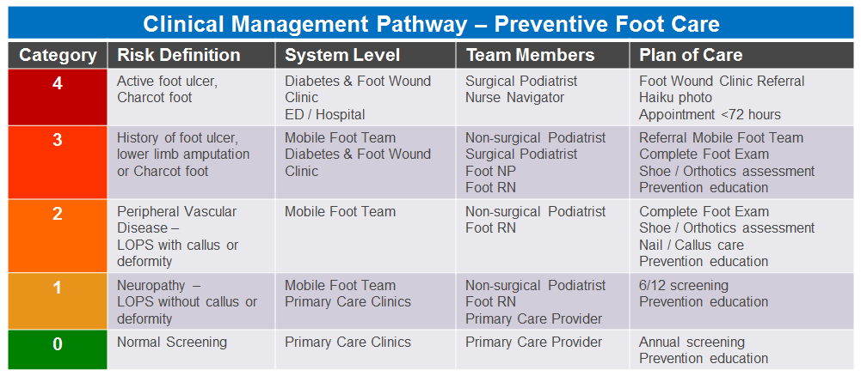
Clinical Management Pathways
Standardized evidence-based multi-disciplinary health care to create optimal patient and system outcomes
Mould, G et al. IJCC 2011. 15 (3): 90–97

Slide 30
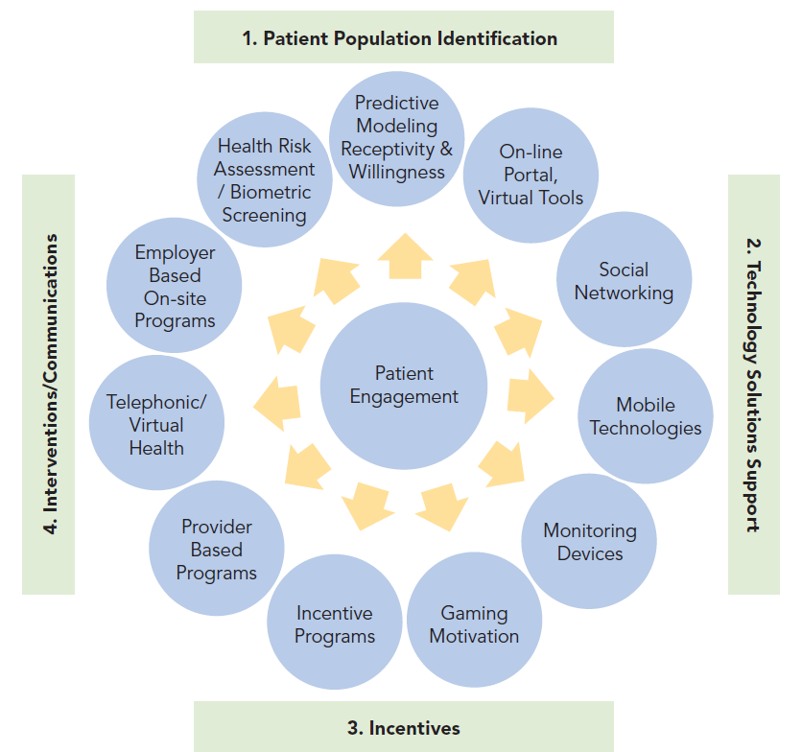
Engagement
Patient engagement: The interventions designed to increase activation.
Patient activation: Understanding one’s role in the care process & having the knowledge, skill and confidence to manage one’s health & health care.
PAM: Patient Activation Measure
Notes:
But experts, government officials and corporate buyers cannot succeed without individuals and families coming to believe that their interests will be served, their lives improved and their personal budgets spared by taking their health seriously. Changing habits is among the most daunting of endeavors for any of us. But we now have behavioral interventions like Motivational Interviewing (4) and Screening and Brief Intervention and Referral for Treatment — SBIRT (5). We have smart phone apps (and other technologies) for monitoring and managing just about everything human from the food we ingest to the moods we have. Peer influences are helping to reduce smoking and excessive sugary drinks. Insurance incentives to live healthy can add leverage for prevention and self-care. No single intervention works here either but when bundled together people do change.

Slide 31
For engagement success….
No population health management intervention can
be successful unless the patient wants it to be
Need to develop & communicate interventions based on education, social context, language, gender and other relevant data
Requires meeting patients where they are, rather than providing cookie-cutter solutions that patients must conform to for treatment
Need to go beyond the four walls of the organization to get to a truly longitudinal and personal level of patient care
https://healthitanalytics.com

Slide 32
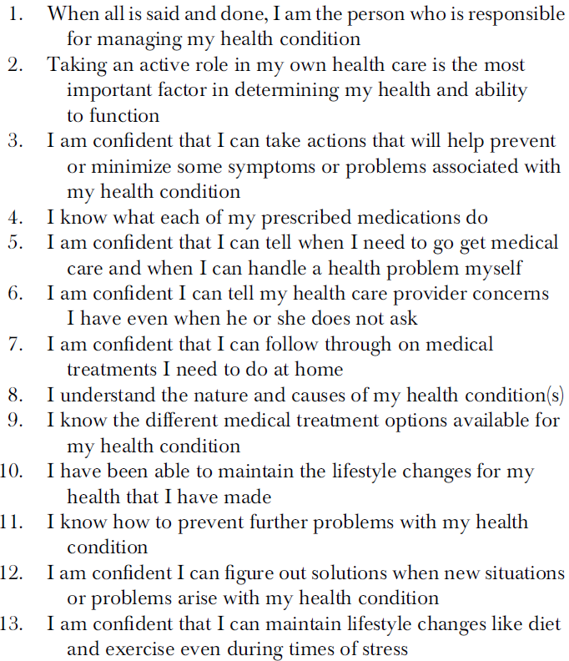
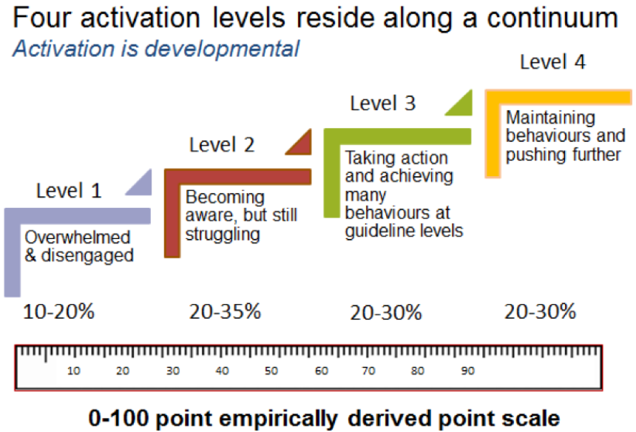
PAM
Hibbard, JH et al. Health Research and Educational Trust DOI: 10.1111/j.1475-6773.2005.00438.x

Slide 33
Population Health Patient Centered Care
CDE Roles:
DSME classes
DSMES
Health coaching
Care/Case Management
Educator: Other health professionals and community service workers
Supportive Services
Community health workers
Community health navigators
Public Health Practitioners
Teachers
Churches
Peer support programs:
Advocacy Groups, Mental Health, Women’s, Men’s and Youth Groups
Where:
Education Centers
Hospitals
Clinics
Primary Care
Mobile/Virtual Education
Within the Community
Notes:
1.CDE role current
2 Where current vs future:
Recommendation for Strategies (Discussion Paper –National Academy of Medicine) to meet future demands of diabetes population growth:
Recommendation interventions to be effective in improving diabetes care on the health care side: patient education and support; provider role changes, such as expanding the roles of pharmacists or nurses using multidisciplinary teams; and telemedicine
Expanded public health roles including:
I think we are all well aware of what we do as clinicians but there aren’t enough of us to go around. When we look at the social disparities and the need for cultural literacy I think we need to turn our focus the community and the role of the community health worker.
The ADA scientific sessions this year highlighted the role of the community health worker ….
Reference:
https://nam.edu/wp-content/uploads/2016/02/A-Population-Health-Strategy-for-Diabetes-New-Partners-New-Opportunities.pdf

Slide 34
Question…
Do you work with community health workers, navigators, health coaches or any other supportive roles?

Slide 35
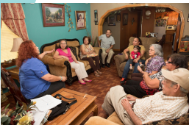
Community Health Workers
Goal: Improve Diabetes self-management behaviors
Frontline public health worker
Trusted member of the community
Close understanding of the community served.
Liaison/link/intermediary between health/social services and the community
Facilitate access to services
Improve the quality and cultural competence of service delivery.
Interventions:
Screening and health education
Outreach, enrollment, and information
Member of a care delivery team
Patient navigation
Community organizers
For more information: https://www.cdc.gov/dhdsp/pubs/toolkits/chw-toolkit.htm
https://www.thecommunityguide.org/content/community-health-workers-help-patients-manage-diabetes
Notes:
The Community Preventive Services Task Force (CPSTF) recommends interventions that engage community health workers to help patients manage their diabetes.
Goal: Improve Diabetes self-management behaviors
Interventions:
Screening and health education
Outreach, enrollment, and information
Member of a care delivery team
Patient navigation
Community organizers
CPSTF: Outcomes show improved A1C and reduction of healthcare use. Self reported improvements in lifestyle changes such as physical acivity and improved nutrition
Additionally, the available economic evidence suggests these interventions are cost-effective.
For more information: https://www.cdc.gov/dhdsp/pubs/toolkits/chw-toolkit.htm
https://www.thecommunityguide.org/content/community-health-workers-help-patients-manage-diabetes
Let move on to technology, the CDE and populatiaon health

Slide 36
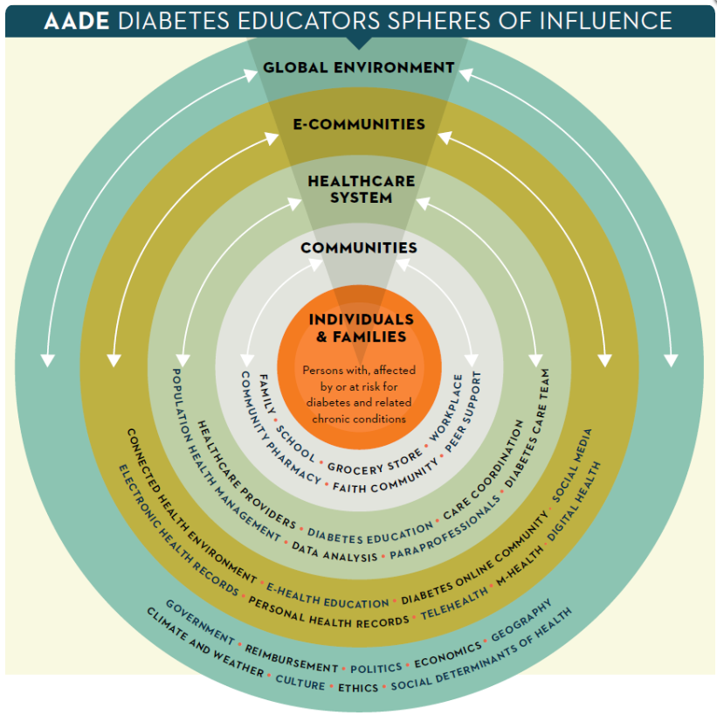
Technology + Feedback + Support
= Connected Health
Connected Health Environment
Electronic Health Record
Personal Health Records
E-health Education
Telehealth
Diabetes Online community
M-Health
Social Media
Digital Health
Notes:
Multiple technological modalities for patient engagement promote diabetes self-management through montoring feedback and support.
Brick and mortar –traditional
What choices can we offer our patient’s besides brick and mortar... That expand our reach and improve population health goals
NIH Consensus Group (www.hrsa.gov/healthit/mhealth.html)
“mHealth is the use of mobile and wireless devices to improve health outcomes, healthcare services and health research.”
E health-use of digital information and communication to improve health and health care, includes internet mobile devices
Connected Health =wireless digital electronic mobile and telehealth- conceptual model for health management utilizing such devices to promote service and interventions based on the patient needs---health information is shared
So, what are the Connected health models, what does it look like? How do we utilize the technology to reach people with diabetes and provide quality service?
The AADE DE Spheres if influence E-communities are
Connected Health Environment
E-Health Education
Diabetes On-line Communities
Social Media
EHR/Personal health records
Telehealth
M Health
Digital Health
How do we utilize connected health modalities and is there science to support the use of m-health?
Some evidence suggests there is are small benefits on glycemic control with the use of computer-based diabetes programs but a larger A1C reduction effect with mobile phone-based interventions. The jury is still out, we have much to learn!
Goal: wide spread communication and outreach
Shah and Garg Clinical Diabetes and Endocrinology (2015) 1:16
DOI 10.1186/s40842-015-0016-2-Managing Diabetes in the digital age
_ Large EHR systems in the US include: EPIC, Kaiser and VistaA (USD of Vet. Affairs)
Allowing patients to access medical records has the potential to improve self care and shared clinical decision making
Many options :
∙Online
∙Text
∙Smart phone app
∙Video Conferencing
∙Blogging
∙Social media
∙Video Games
∙Technology and patient records for data collection, etc

Slide 37
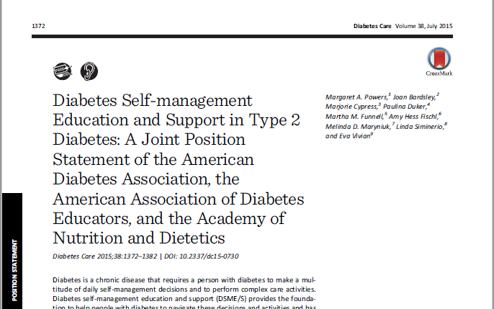
Connected Health COMMUNITIES
AADE/ADA/AND 2015 DSMES Joint Position Statement
Guiding Principles and Key Elements of Initial and Ongoing DSME
Engagement
Information Sharing
Psycho-Social and Behavioral Support
Integration with other Therapies
Coordination of care across specialty care, facility-based care, and community organizations. Ensure collaborative care and coordination with treatment goals
It’s what we do as diabetes educators
Notes:
The joint position statement guides us:
Diabetes Self-management Education and Support in Type 2 Diabetes A Joint Position Statement of the American Diabetes Association, the American Association of Diabetes Educators, and the Academy of Nutrition and Dietetics (2015)
Guiding Principles and Key Elements of Initial and Ongoing DSME/S
Coordination of care across specialty care, facility-based care, and community organizations. Ensure collaborative care and coordination with treatment goals. • Understand primary care provider and specialist’s treatment targets • Provide overview of DSME/S to referring providers • Follow medication adjustment protocols or make necessary recommendation to primary care provider • Correspond with referring provider about education plan, progress toward treatment goals, and needs to coordinate education and support from entire clinical team; ensure documentation in the health record • Ensure provision of culturally appropriate care • Use evidence-based decision support • Use performance data to identify opportunities for improvement
https://www.diabeteseducator.org/docs/default-source/practice/practice-resources/position-statements/dsme_joint_position_statement_2015.pdf?sfvrsn=0
What are the tools:
Connected health communities, that is E-communities and M health go hand in hand with these guiding principles
What about the people we serve, are the e/m/connected health-communities reachable?

Slide 38
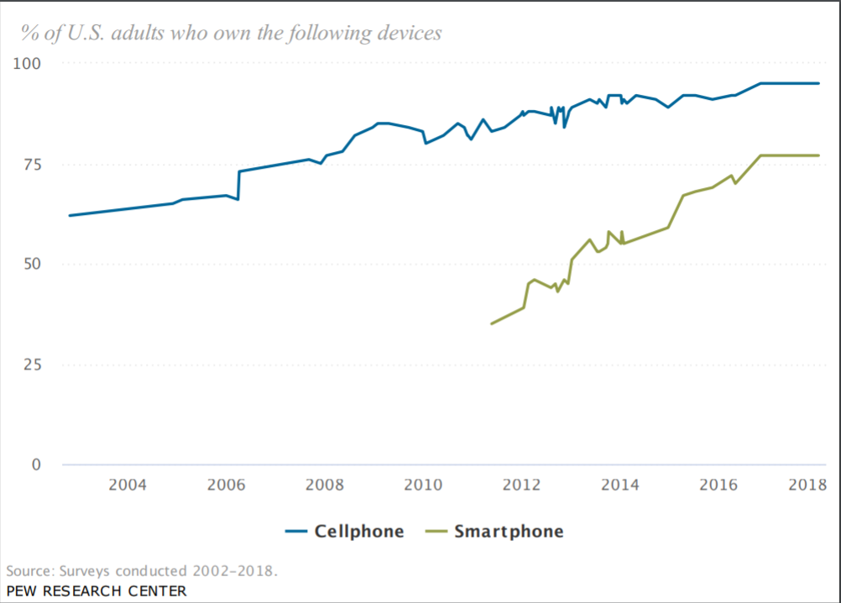
How Connected Are WE?
Notes:
The vast majority of Americans – 95% – now own a cellphone of some kind. The share of Americans that own smartphones is now 77%, up from just 35% in Pew Research Center’s first survey of smartphone ownership conducted in 2011.
http://www.pewinternet.org/fact-sheet/mobile/
Smartphone dependency over time
Today just over one-in-ten American adults are “smartphone-only” internet users – meaning they own a smartphone, but do not have traditional home broadband service.

Slide 39
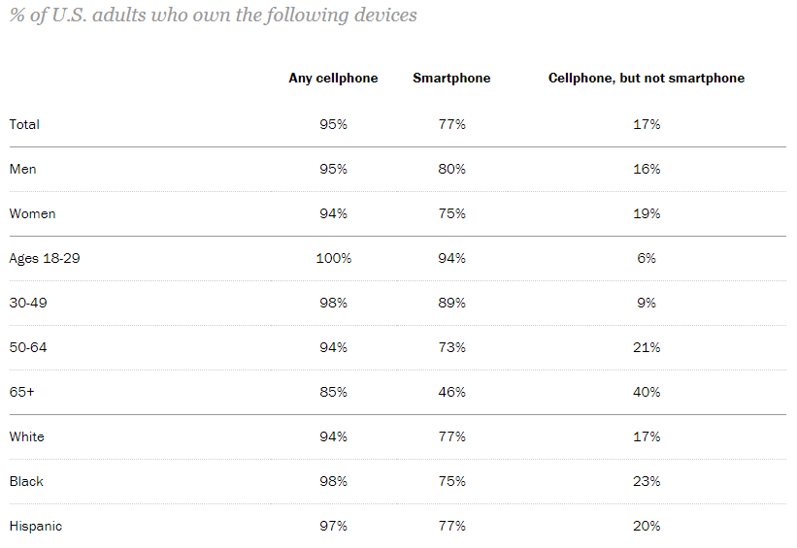
Cell Phone Usage
Notes:
Who is smartphone dependent
Reliance on smartphones for online access is especially common among younger adults, non-whites and lower-income Americans.
Ownership of other devices
Along with mobile phones, Americans own a range of other information devices. Nearly three quarters of U.S. adults now own desktop or laptop computers, while roughly half now own tablet computers and around one-in-five own e-reader devices.

Slide 40
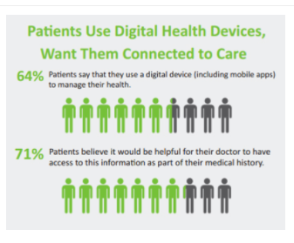
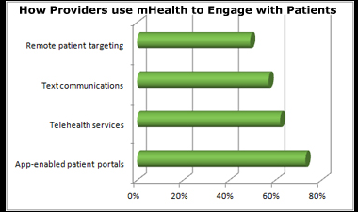
Digital Health Forecast
http://www.mobihealthnews.com/content/survey-64-percent-patients-use-digital-device-manage-health
Notes:
The wireless broadband and smartphone market totals
1.5 billion globally as of 2013 which is expected
to rise to 6.5 billion by 2018
http://www.mobihealthnews.com/content/survey-64-percent-patients-use-digital-device-manage-health
We see the forecast, we know the diabetes statistics and predictions as well. What are the payment models, why is that important to the CDE
https://www.brookings.edu/blog/usc-brookings-schaeffer-on-health-policy/2014/07/23/the-beginners-guide-to-new-health-care-payment-models/
We also have a sea change underway in the financing of health care. Buyers of health care (federal and state governments and large employers in the private sector — the vast predominance of the purchasers of medical services) are now putting in place payments that will reduce reimbursing medical providers for doing more and instead incentivize them to economically contain the health costs of their subscribers. When health plans and medical practices are put at financial risk for not managing to a fixed budget or, even better, create arrangements where savings are shared by purchasers and providers together, the marketplace can add its muscle to achieving health. Penalties like not paying for inpatient readmissions within 30 days also drive better health. They force hospitals to be partners with communities and with patients (and families) since what happens after a hospital stay usually has little to do with what happened in the hospital and everything to do with follow-up care and the attention patients give to their health.

Slide 41
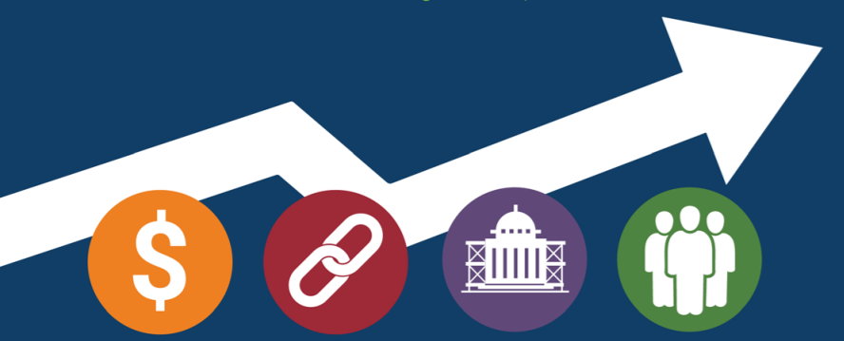
Payment Models
Health Care Payment Learning and Action Network-LAN
Notes:
I spoke 3 years ago and many of you asked how telemangement was reimbursed,
The system I am familiar with is brick and mortar diabetes education, referral from the physician, paid for by the insurance plan, more like the traditional fee for service. The tele-management program is similar to a population based payment program, a set fee to outreach and intervene with a particular insurance based population.
I think it is important for the CDE to have some familiarity in order to lead the way in the future and to drive payment models that include not only brick and motor but also payment for virtual-remote diabetes education.
LAN: Health Care Payment Learning and Action network, created to accelerate APM adoption
The LAN was launched in March 2015 to accelerate the adoption of alternative payment models (APM) and drive alignment in payment reform approaches across the public and private sectors

Slide 42
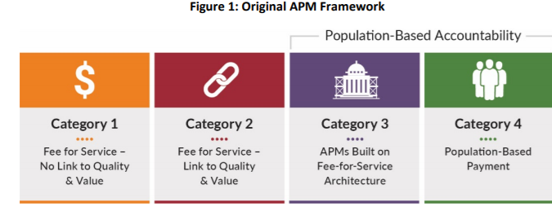
Alternative Payment Models
GOAL: High quality care, spend dollars wisely
Capitated payment
Per member per month
Bundled Payment
Episode based payment
For more information:
http://hcp-lan.org/workproducts/apm_measurement_report_2017.pdf
https://hcp-lan.org/groups/apm-fpt-work-products/apm-report/
Notes:
APM-Alternate Payment model: Alternative payment models (APMs) have the potential to realign treatment and payment incentives to improve health care quality while containing cost.
Category 1 Fee for service-not linked to quality measure Direct payment from insurance company, direct patient contrating-concierge primary care
Category 2 Fee for service lined to quality –bonus payments for quality reporting, quality performance, and possible penalties for quality performance
Category 3 Bundled payment, episode based payment, PCHMs, may have shared savings alone or shared savings and losses
Category 4 Population based payments ; Capitated paid for condition-specific payment, via ACO, PCHM,
http://hcp-lan.org/workproducts/apm_measurement_report_2017.pdf
https://hcp-lan.org/groups/apm-fpt-work-products/apm-report/
Under a bundled payment model, providers and/or healthcare facilities are paid a single payment for all the services performed to treat a patient undergoing a specific episode of care. An “episode of care” is the care delivery process for a certain condition or care delivered within a defined period of time. (https://revcycleintelligence.com/news/understanding-the-basics-of-bundled-payments-in-healthcare)
Capitation is a fixed amount of money per patient per unit of time paid in advance to the physician for the delivery of health care services
Preventive, diagnostic, and treatment services
Injections, immunizations, and medications administered in the office
Outpatient laboratory tests done either in the office or at a designated laboratory
Health education and counseling services performed in the office
Routine vision and hearing screening (https://www.acponline.org/about-acp/about-internal-medicine/career-paths/residency-career-counseling/guidance/understanding-capitation)
ACO
What is an ACO?
ACOs are groups of doctors, hospitals, and other health care providers, who come together voluntarily to give coordinated high-quality care to their Medicare patients.
The goal of coordinated care is to ensure that patients get the right care at the right time, while avoiding unnecessary duplication of services and preventing medical errors.
When an ACO succeeds both in delivering high-quality care and spending health care dollars more wisely, the ACO will share in the savings it achieves for the Medicare program
https://www.cms.gov/Medicare/Medicare-Fee-for-Service-Payment/ACO/
What is a PCMH-Interdisciplinary approach
5 functions:
Comprehensive care, patient centered, coordinated care, accessible services, quality and safety
https://pcmh.ahrq.gov/page/defining-pcmh

Slide 43
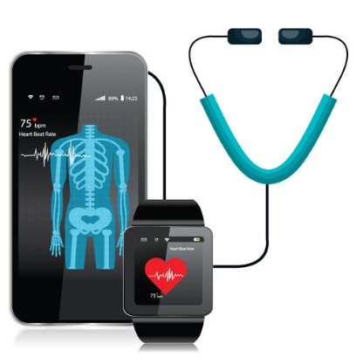
Connected Health Initiative
CHI works to clarify outdated health regulations, incentivize the use of connected health technologies, and ensure an environment in which patients and consumers can see improvement in their health.
http://www.connectedhi.com/#aboutus
Notes:
The way we seek and pay for health care is changing, connected health is not just the new buzz word!
The connected health initiative, supported by HC Providers, payers, vendors and tech companies make up the CHI
The group is
http://www.connectedhi.com/#aboutus
CHI works to clarify outdated health regulations, incentivize the use of connected health technologies, and ensure an environment in which patients and consumers can see improvement in their health.
https://www.healthcare-informatics.com/news-item/telemedicine/connected-health-initiative-outlines-federal-policy-recommendations
The organization also recommends that CMS (Medicare and Medicaid)offer waivers and incentive payments more broadly to Medicare providers to optimize multiple provider types and support virtual Diabetes Self-Management Training (DSMT) and include CDC-recognized virtual diabetes prevention program providers in the Medicare Diabetes Prevention Program (MDPP).
CHI recommends that CMS use an outcome-based approach to support the inclusion of telehealth and remote monitoring within the Quality Payment Program
If we look at the population based accountabilities and the up and coming (hopefully) inclusion of connected health payment we the need for technology to promote patient/provider engagement, thus we look to the electronic medical record.

Slide 44
Question…
How many of you are utilizing a connected health system and / or an Electronic Health Record?

Slide 45
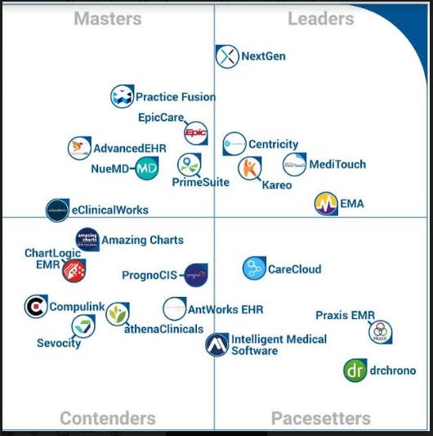
Electronic Health Record
Notes:
We can see the multitude of venders at work to provide electronic health records. EPIC is the one I am most familiar with and have worked with in the past 17 years. Vista A is not representative but some of you may know this VA system.
Not all of these systems speak/communicate with each other and this of course can be a challenge to maintain coordinated patient care. In Northern Ca. alone there are multiple major health systems and hospitals, in the past year we have gained inter-system access to some of the patient records which may streamline and help with coordinating care.
An electronic health record (EHR) is a digital version of a patient’s paper chart. EHRs are real-time, patient-centered records that make information available instantly and securely to authorized users. While an EHR does contain the medical and treatment histories of patients, an EHR system is built to go beyond standard clinical data collected in a provider’s office and can be inclusive of a broader view of a patient’s care. EHRs can:
Contain a patient’s medical history, diagnoses, medications, treatment plans, immunization dates, allergies, radiology images, and laboratory and test results
Allow access to evidence-based tools that providers can use to make decisions about a patient’s care
Automate and streamline provider workflow
As of 2015EHR prevalence,
Percent of office-based physicians using any EMR/EHR system: 86.9%
Percent of office-based physicians with a basic system: 53.9%
https://www.cdc.gov/nchs/fastats/electronic-medical-records.htm
Value:
CDE and Interdisciplinary communication
Population Health Management Tools

Slide 46
Functionality
Health Information
Data Collection Networks
Registries
Quality Measures and Reporting
Predictive Analytics
Outcomes
Clinical decision support
Patient decision support
Artificial Intelligence
Notes:
Value based and care-incentive based payments for quality require technology for: Data collection, analyzing, quality measures-hundreds, outcomes measurement
Outcomes: such attendance to classes, Lab reporting, med adherence, Health Maintenance tracking
Registries
Predictive analytics: ER/Hosp risks scoring,
Clinical Decision Support: Guideline driven algorithms and work flows
Patient Decision Support: guideline driven tools and approved educatiaon materials
AI

Slide 47
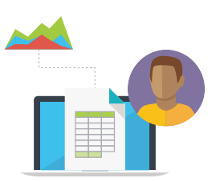
Population Health Registries
Provide a list of all the patients in the practice with the target condition(s) (e.g., diabetes, asthma, hypertension, etc.)
Where do you start?
Brainstorm-what do you need for your practice?
Build the framework-work with your EHR team
Develop workflows, training, support staff needs
Implement – start with small scale testing
Evaluate your findings and adjust care accordingly
Show a “snapshot” of the EHR to detail important clinical parameters and identify the gaps in recommended care
Aggregate the results from all patients in the practice with the specific condition to assess the overall quality of care provided, such as the percentage of patients with diabetes who have their blood pressure controlled
Produce support for outreach and follow-up (e.g., easily identify all patients with diabetes who have not had an eye exam or who are not taking aspirin). Integrate clinical quality reporting into the process of care and rather than as a separate endeavor.
For more information:
https://www.stepsforward.org/modules/point-of-care-registry
Notes:
What is a patient registry?
A clinical data registry, or patient registry, is a system for uniform information collection. This information helps evaluate specified outcomes for a patient population defined by a certain disease, condition, or exposure
Use registries to:
Describe the natural history of disease
Determine clinical effectiveness of health care products and services
Determine cost-effectiveness of health care products and services
Measure or monitor safety and harm
Measure quality of care
Outcomes Registries
Predictive analytics
care disparity
Risk prediction-ER/hospital admission
Evidence based decision support/standard of care
Scheduling-E based
Lab scheduling
Care coordination
Collaboration
Med adherence
HIN-Allscripts
(But the question is where to focus, what outcomes, and that is where the CDE can assist in determining the focus of their populations
Question to attendees: A1C lowering is the standard utilized, does this equal quality in a value based care environment?
Personal engagement in one’s health: “Engagement in health when an individual performs sustained actions towards achieving optimal health and well-being” according to the population health alliance.
How do we outreach and engage our patients and continue to meet the needs of the population)
What is the role of diabetes educators in this format
Thinking outside the box is crucial
How do we drive technology based on science and impart accurate information to our patients
What about, Prevention, intervention,
System integration
https://www.stepsforward.org/modules/point-of-care-registry

Slide 48
Population Health Outcomes
Clinical & Health Status
Psychosocial Outcomes
Behavior Change
It’s what we must do as diabetes educators
Look at the whole picture from the patient at the center to the system level in order to promote high quality, affordable care
Patient & Provider Productivity, QOL & Satisfaction
System Utilization
Financial Outcomes
Notes:
Risk stratification, predictive analytics and the utilization of registries are the precursors to outcomes.
Clinical and Health Status: A1C, BP. Lipid Adequate control of intermediate outcomes such as A1C, BP, and LDL levels have been included in most diabetes quality measurement sets.
However we need to look beyond clinical measures
It has been shown that control of risk factors is related to improved outcomes, although this is dependent on patient factors as well as the strategies used to modify the risk factors.
These can be used to measure quality efforts of health systems improvement and health care delivery but not necessary improve patient outcomes.
Future recommendations suggest new opportunities for measuring outcomes in diabetes, such as personalized risk-based quality measures, health care costs, clinical action measures, adherence.
EHR driven data collections will be required to extract the outcomes.
https://www.ajmc.com/journals/evidence-based-diabetes-management/2016/march-2016/measuring-the-quality-of-diabetes-care
https://www.ajmc.com/journals/evidence-based-diabetes-management/2016/december-2016/diabetes-educators-in-accountable-care-organizations-meeting-quality-measures-through-diabetes-self-management-education-and-care-coordination

Slide 49
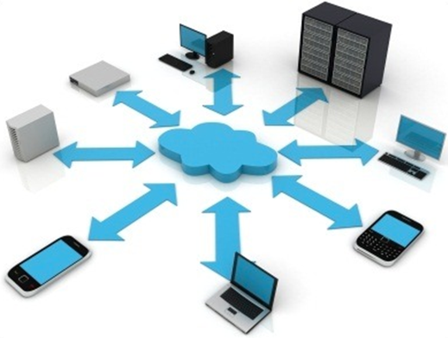
Communication Delivery Modalities
Social Media
Patient portals
Apps
Webinars
E-mail
Text messaging
CGM
Telehealth DSMES/Health Coach
One on one
Video conferencing
Notes:
Telehealth—value/barriers
Text
Webinar
Social media
Apps
E-mail
CGM

Slide 50
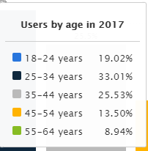
Connected Health And Social Media
30.2 million users in 2017
Eight percent of internet users, or about 12 million American adults, keep a blog.
Notes:
Value added: Community partnerships
Facilitate communication
Improve health literacy
Increase social interaction
Create awareness of risks
http://www.pewinternet.org/fact-sheet/social-media/
Today around seven-in-ten Americans use social media to connect with one another, engage with news content, share information and entertain themselves.
Such as
Social media
Blogging
Video Games
Wearables
Blog
http://www.pewinternet.org/2006/07/19/bloggers/
Thirty-nine percent of internet users, or about 57 million American adults, read blogs – a significant increase since the fall of 2005.
Most bloggers say they cover a lot of different topics, but when asked to choose one main topic, 37% of bloggers cite “my life and experiences” as a primary topic of their blog.
http://www.pewinternet.org/2018/03/21/the-science-people-see-on-social-media/
Wearables
https://www.statista.com/outlook/319/109/wearables/united-states#market-users

Slide 51
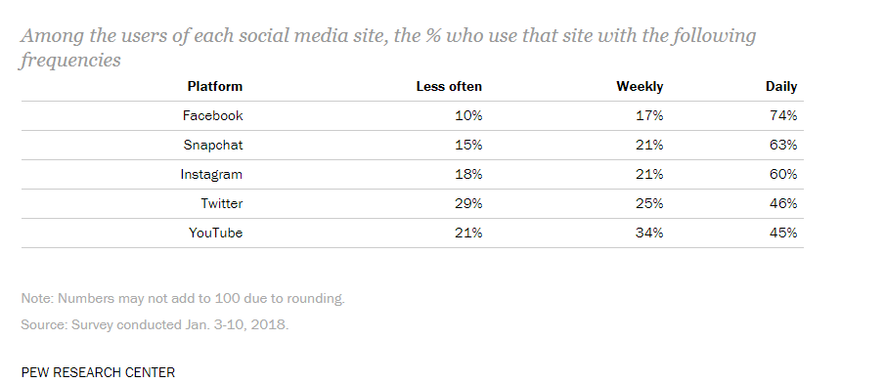
Connected Health and Social Media
Around seven-in-ten Americans use social media to connect with one another, engage with news content, share information and entertain themselves.
About half of American adults (49%) “ever play video games”
Notes:
http://www.pewinternet.org/2018/03/21/the-science-people-see-on-social-media/
Video games:
http://www.pewinternet.org/2015/12/15/gaming-and-gamers/
About half of American adults (49%) “ever play video games on a computer, TV, game console, or portable device like a cellphone,” and 10% consider themselves to be “gamers.”
Equal numbers of men and women ever play video games, although men are twice as likely to call themselves “gamers

Slide 52
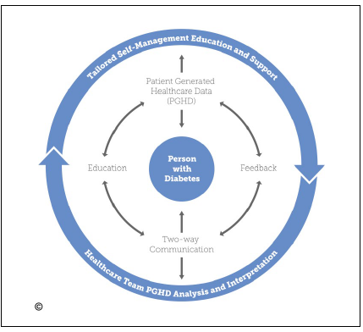
Diabetes Apps
“Ideally, the best solutions have four key items: the ability to have two-way communication, use and analysis of patient-generated health data to tailor education, and the opportunity for feedback,” Deborah A. Greenwood, PhD, RN, BC-ADM, CDE, FAADE
For more information:
http://journals.sagepub.com/doi/10.1177/1932296817713506
Notes:
Researchers found that 77% of apps were designed to support healthy eating behaviors, 76% supported monitoring, 58% supporting taking antidiabetes medications and 45% supported being active. However, only 31% of eligible apps in 2017 were designed to provide features that support problem-solving, 10% supported healthy coping and 5% supported reducing risk
https://www.healio.com/endocrinology/diabetes-education/news/in-the-journals/%7b2fc95648-1ee0-4ab8-b3c5-48a927e672f4%7d/most-diabetes-apps-fail-to-meet-all-aade-self-care-criteria
“Ideally, the best solutions have four key items: the ability to have two-way communication, use and analysis of patient-generated health data to tailor education, and the opportunity for feedback,” Deborah A. Greenwood, PhD, RN, BC-ADM, CDE, FAADE,
https://www.healio.com/endocrinology/news/online/%7B1b2559e3-2438-4af8-a797-98772a508483%7D/diabetes-apps-evolve-to-address-individual-health-issues-goals
The Tailored Self-Management Education and support model is patient centered

Slide 53
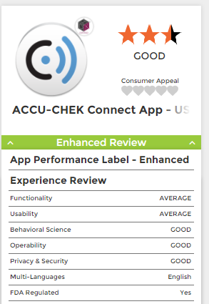
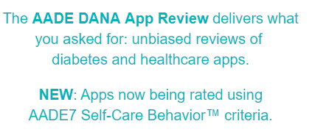
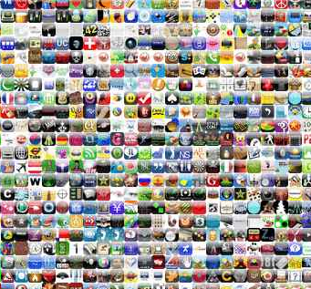
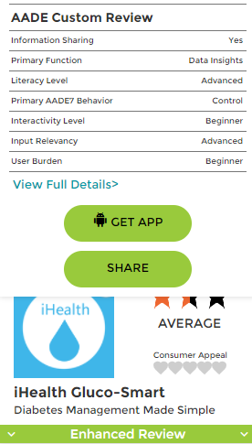
App Evaluation
AADE 7
Healthy Eating
Being Active
Monitoring
Taking Medication
Problem solving
Reducing Risks
Healthy coping
http://www.danaapps.org
Notes:
A recent review of a
major electronic database for clinical trials including 16
randomized controlled trials with 3,578 adult participants
with type 2 diabetes mellitus by Pal and colleagues showed
small benefits on glycemic control (pooled effect on
HbA1c: −0.2 %) with the use of computer-based diabetes
self-management interventions. In a subgroup analysis on
mobile phone–based interventions, they found a larger
effect on A1c reduction (pooled effect on HbA1c
was −0.50 %). Nevertheless, they did not find benefits of
computer- or mobile-based interventions on improving
depression, quality of life, or weight. In addition, the authors
highlighted deficiencies such as selection bias and
inadequate randomization procedure)
http://www.danaapps.org

Slide 54
Diabetes Outreach Communities
The Population Health Practice Area Discussion Group provides diabetes educators with the opportunity to share approaches for managing populations of people living with diabetes from both diabetes educator and health system perspectives.
Notes:
https://www.diabeteseducator.org/news/aade-blog/aade-blog-details/aade/2018/03/15/understanding-population-health-where-does-the-diabetes-educator-fit

Slide 55
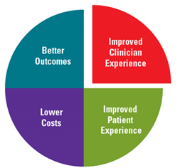
Key CDE Strategies to Drive Change
Be prepared to change
Look at your current role(s) across the 6 Population Health framework categories
Take a system approach to your services
Review your ‘language’ & align with health care / system ‘language’
Target elements of the Quadruple Aim
Keep your eyes and ears broadly open
Optimize peer & public policy / advocacy networks
Think diversely – payment models, communication, interventions, community

Slide 56
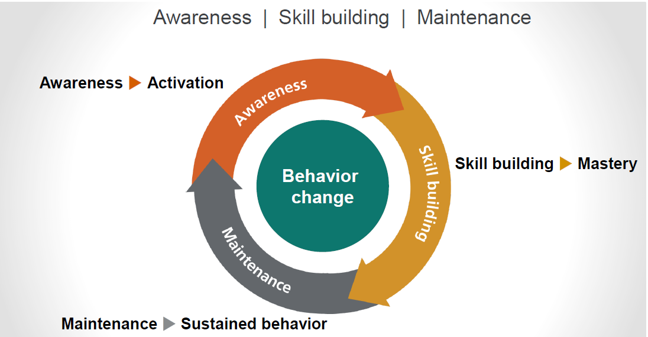
Apply our Skillsets to Ourselves….
https://www.optum.com/2015/2_ConsumerEngagement_S.Serxner.pdf
Notes:
OPTUM - Our mission - To help people live healthier lives and to help make the health system work better for everyone.
With our industry-leading health care data — 180 million lives of claims and 85 million lives of clinical data — and technology and analytics expertise, Optum is delivering predictive analytics that help customers take action.
Optum serves the unique needs of a population by delivering effective and sustained consumer engagement with our comprehensive clinical and financial services, targeted through deep population health analytics.

Slide 57
How many of you
currently have roles in
Population Health Management?

Slide 58
Population Health Resources
Each other!
www.diabeteseducator.org
www.ihi.org
www.himss.org
Population Health / Data Analytics resources – eg Athena Health, Health Catalyst, Optum
State Departments of Health
www.rchnfoundation.org

Slide 59
Thank you!
Questions?

