Slide 1


Slide 2

Donna P. Stevens
DNP, FNP-C, BC-ADM, CDE
Nurse Practitioner
Inpatient Glycemic Management Team
University of Alabama at Birmingham
Birmingham, AL

Slide 3
Disclosure to Participants
Notice of Requirements For Successful Completion
  Please refer to learning goals and objectives
  Learners must attend the full activity and complete the evaluation in order to claim continuing education credit/hours
Conflict of Interest and Financial Relationship Disclosures:
  None
Non-Endorsement of Products:
  Accredited status does not imply endorsement by AADE, ANCC, ACPE or CDR of any commercial products displayed in conjunction with this educational activity
Off-Label Use:
  None

Slide 4
Diabetes and Kidney Disease
You Don’t Know Diddly...or Do You?

Slide 5

Other Team Members
Nutrition Solutions
Job Title:
Nutrition Solutions
Job Title:
Andrew S. Narva, MD, FASN
National Institute of Health
Bethesda, Marilyn
Director of The National Kidney Disease Education Program
Mary M. Julius, RD, LD, CDE
Louis Stokes
Cleveland, Virginia
Lois Hill, MS, RD, LD, CSR, LDE
Nutrition Solutions
Lexington, Kentucky

Slide 6
Objectives
Identify and monitor for DKD
Educate on strategies utilized to slow progression of DKD
Discuss the role of the CDE in the interdisciplinary team and provide teaching strategies that promote self-management of diabetes in those with DKD.

Slide 7

Why is it important?
DKD develops in approximately 40% of patients who are diabetic and is the leading cause of CKD worldwide.
ESRD is the most recognizable consequence of DKD, the majority of patients actually die from cardiovascular diseases and infections before needing kidney replacement therapy.
Between 1990 and 2012, the number of deaths attributed to DKD rose by 94%.
This dramatic rise is one of the highest observed for all reported chronic diseases.
Most of the excess risk of all-cause and cardiovascular disease (CVD) mortality for patients with diabetes is related to the presence of DKD.

Slide 8
Overview
Introduction
  Evidence of the Link Between Diabetes and Kidney Disease
    Hallmark Studies
  Anatomy and Physiology
    Functions of the kidneys
    Measuring albuminuria
  Prevalence
  Risk Factors
  Natural History of the Disease
Diagnosis of DKD
  Early Recognition
    Stages of CKD
    Other tests needed
    Stages of CKD

Slide 9
Overview cont.
Management of DKD
  Control Blood Pressure
  Reduce Albuminuria
  Identify and Manage Complications
  Educate Patients / Prep for Renal Replacement Therapy
4. The Role of the CDE
  Identify and Monitor People with DKD
  Support Treatment of Risk Factors for Cardiovascular Disease
  Collaborate with Other Team Members to Identify and Monitor Complications
  Promote Self Management

Slide 10
Overview
Case Study
Additional information
Test Your Knowledge

Slide 11
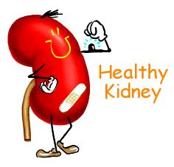
Introduction

Slide 12
History of DKD
Diabetic Nephropathy became more widely recognized in the 1920’s after insulin began to be utilized for treatment of diabetes.
Paul Kimmelstiel and Clifford Wilson detailed nodular renal lesions in 8 maturity-onset (48-68 year old) people with diabetes in 1935 . They barely noted the association with diabetes.
However, in 1941, Arthur Allen clarified the association diabetes and kidney disease.
Cameron JS., The discovery of diabetic nephropathy: from small print to center stage. J Nephrology. 2006 May-Jun;19 Supplement 10:S75-87.

Slide 13
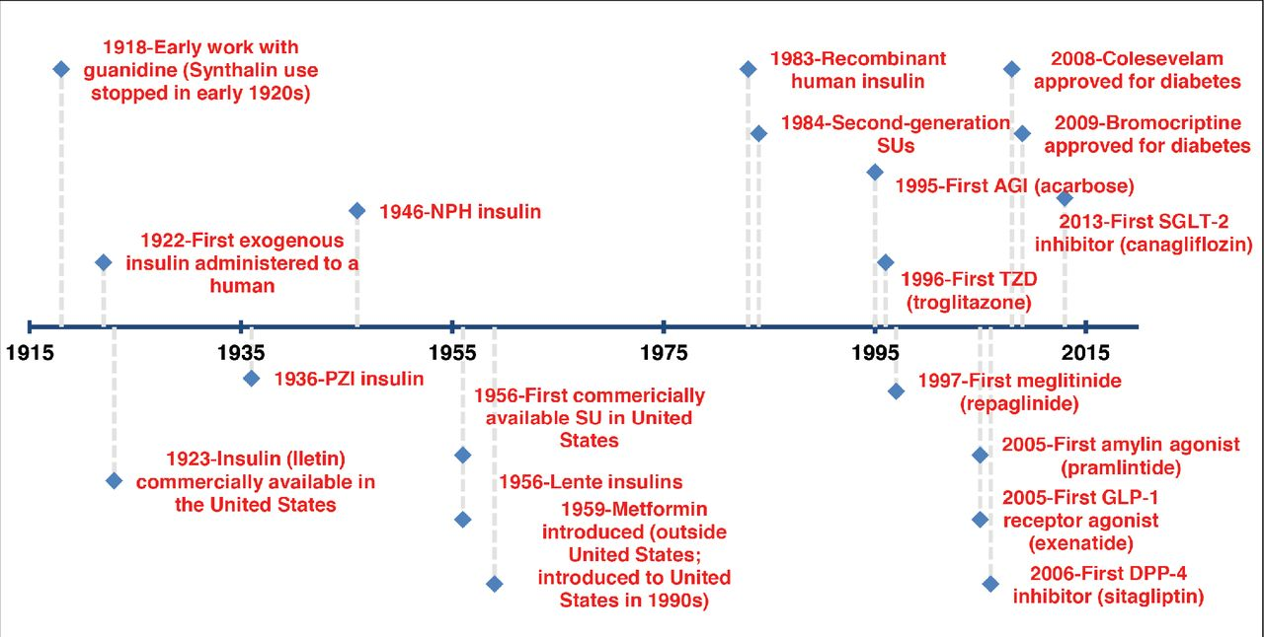

Slide 14
History of DKD
It took more than three millennia from the first description of diabetes in 1552 BC to the recognition of an association between diabetes and kidney disease
It took only several decades DKD to become the leading cause of ESRD in the United States

Slide 15
Hallmark Studies
Trial | n | Design | FU | Renal outcome
DCCT | 1441 T1DM | Intensive versus standard glycemic control | 6.5 years | Intensive glycemic control versus standard control (HbA_{1c} 7.3 versus 9.1%) reduced incident micro- and macro-albuminuria by 39 and 54%.
EDIC/DCCT | 1441 T1DM | Intensive versus standard glycemic control | 18 years | Renoprotective efficacy of intensive glycemic control persisted and resulted in 45% risk reduction of micro-albuminuria at 18 years
UKPDS 33 | 3867 T2DM | Intensive versus standard glycemic control | 10 years | Intensive glycemic control versus standard control (HbA_{1c} 7.0 versus 7.9%) led to 33% risk reduction for micro-albuminuria.

Slide 16
ADVANCE | 11 140 T2DM | Intensive versus standard glycemic control | 5 years | Intensive glycemic control versus standard control (HbA_{1c} 6.5 versus 7.3%) reduced risk of micro-, macro-albuminuria and ESRD by 9, 30 and 65%. For those with macro-albuminuria, number needed to treat to prevent one ESRD = 41.
ACCORD | 10 251 T2DM | Intensive versus standard glycemic control | Terminated at 3.5 years | Targeting HbA_{1c} 6.0 versus 7.0–7.9% resulted in excess mortality (HR 1.22; 95% CI 1.01–1.46; P = 0.04).

Slide 17
Hallmark Drug Studies
RENAAL | 1513 T2DM | Losartan versus placebo | 3.4 years | Multivariate analysis: every 10 mmHg SBP rise increased risk of ESRD or death by 6.7%. Losartan led to decrement of proteinuria (35%; P < 0.001), risk reduction of serum creatinine doubling (25%; P = 0.006) and ESRD (28%; P = 0.002).
CANTATA-SU | 1450 T2DM | Canagliflozin versus glimepiride | 52 weeks | Canagliflozin caused initial decrease in GFR but subsequently stabilized while individuals in the glimepiride arm had progressive GFR decline (–1.7 versus –5.1 mL/min/1.73 m² after 52 weeks).

Slide 18
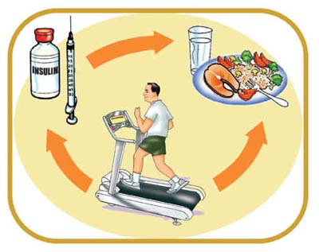
Prevention
Early Control of Diabetes is Critical!

Slide 19
Legacy Effect or Metabolic Memory
Two landmark trials, the DCCT and UKPDS, conducted with patients with early-stage DM1 or DM2 showed that intensive blood glucose control early in the course of disease exhibited a long-lasting favorable effect on the risk of DKD development.
This “legacy effect,” also named “metabolic memory,” suggests that early intensive glycemic control can prevent irreversible damage, such as epigenetic alterations, associated with hyperglycemia.

Slide 20
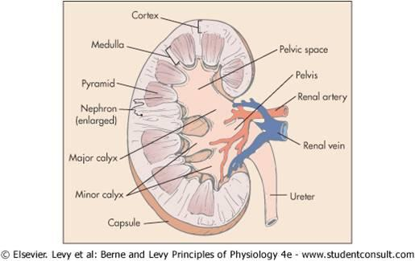
Anatomy of the kidney
Notes:
The kidneys are a pair of bean-shaped organs found along the posterior wall of the abdominal cavity in the retroperitoneal space next to the vertebral column. They sit next tore located between the T12-L3 vertebrae. The left kidney is located slightly higher than the right kidney because the right side of the liver is much larger than the left side. They perform several functions; we will discuss in a moment. The hylum is the indention of the kidneys and is where nerves, lymphatics and arteries and viens enter and exit the kidneys. The outer portion of the kidney is the cortex and the inner portion is the medulla. The Medulla is made up of 10-18 pyramids. The pyramids form minor calyces and then major calyces. Urine collects in the pelvis and then exits out of the ureter.

Slide 21
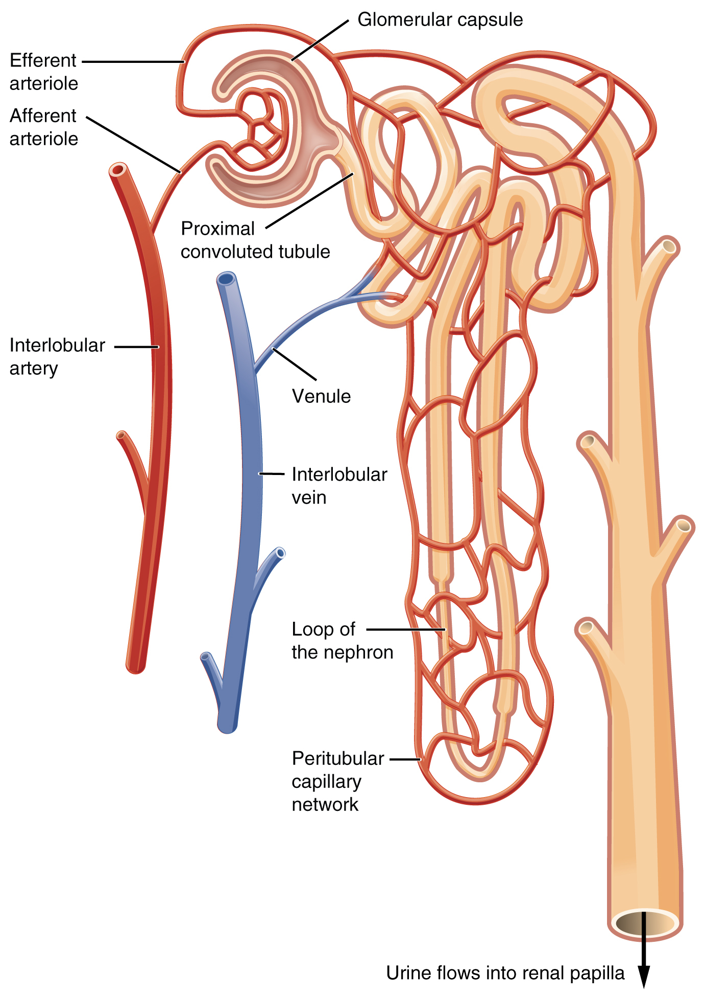
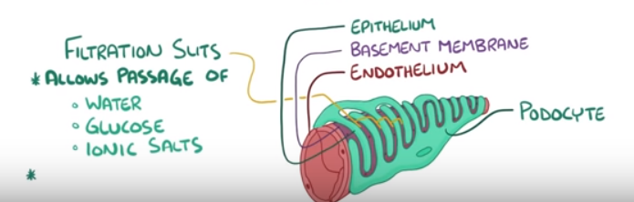
The Nephron
Notes:
The kidneys filter about 150 liters of blood per day. We have about 5 liters of blood. So, the kidneys filter the entire blood volume 30 times per day. This is more than once every hour. Blood flows into the kidney by the afferent arteries and then divides into submental, interlobar, and arcurate arteries. Cortical ratiate arteries supply blood to the cortex of the kidney where capillary bundles are located. These capillaries are called glomeruli. The glomerulus is where filtration occurs. The nephron is the filtering unit. There are about 1 million nephrons in each kidney. Each nephron is made up of the renal corpusle and the renal tubule. The renal corpuscle contains the capillaries and boman’s capsule which is where filtration begins. As blood passes through the capillaries, water and sodium are filtered and go into renal capsule. Renal cells surround the glomerulus. Once blood flows into the glomerulus, water and sodium as well as some other solutes pass through the endothelial lining of the capillary and into Boman’s capsule. The epithelium of the lining is surrounded by finger-like projections called podocytes; which will become an important component of the anatomy; we will talk about this more in a few moments. Between the podocytes are spaces that only allow small particles to pass through and blocks large particles such as proteins and red blood cells. The filtrate then goes through the proximal tubule, the loop of henle and the distal tubule before going into the calyces to be excreted. This is where the filtrate becomes fine-tuned.

Slide 22
Functions of the kidneys
Homeostasis
  Fluid and electrolyte balance
  Acid Base balance
Excretory Function
  Removal of waste including nitrogenous waste
Hormonal Functions
  Renin production – BP control
  Erythropoiesis
  Mineral balance – bone health

Slide 23
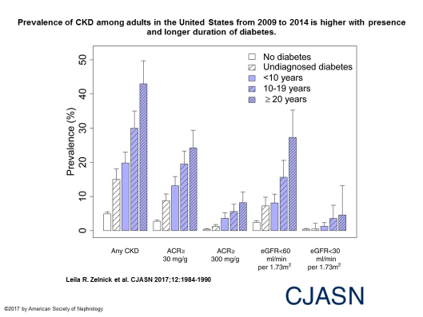

Slide 24
Risk Factors for DKD
Major risk factors for kidney disease:
  High blood pressure
  Diabetes
  Cardiovascular disease
  Family history of kidney failure
Additional risk factors:
  Obesity
  Autoimmune diseases
  Urinary tract infections
  Systemic infections
  Kidney loss, damage, injury or infection

Slide 25
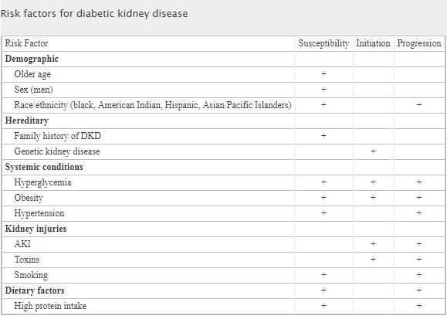
Risk Factors For CKD

Slide 26
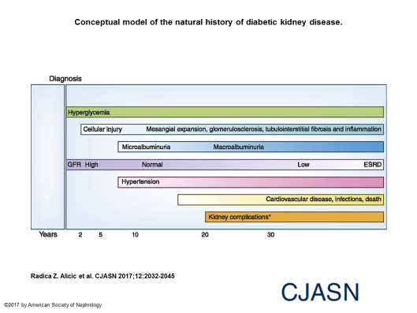

Slide 27

Step 1: Early Recognition of Chronic Kidney Disease (CKD)

Slide 28
How To Determine If There is CKD
CKD: An on-going change in renal function for at least three months.
eGFR is used to measure renal function
  Is a creatinine-based measurement. It is NOT the actual GFR; it is estimated. It is +/- 30% of the actual GFR in 85% of patients
  MDRD calculation and CKD-EPI
Limitations of creatinine-based calculations
  Does not take into account age, race, muscle mass
  If the creatinine is rapidly changing (AKI)
  Some dietary changes
  Some medications

Slide 29
Do not be misled by a “normal” creatinine levels
A young muscular male with a creatine of 1.2 would have a clearance of >60
An elderly woman with a creatinine of 1.2 would have a clearance of <45
Why?: muscle mass
Always calculate the eGFR

Slide 30
Urine Tests Used to Monitor for Protein
Urine dipstick
  Highly variable and dependent on concentration of urine
  1+ = about 30 mg/day of protein
Urine Protein/Creatinine Ratio
  Measures all proteins in the urine; not just albumin
Urine Albumin/Creatinine Ratio (UACR)

Slide 31
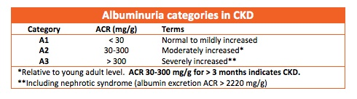
Albuminuria
An abnormal urine albumin is a marker for glomerular disease, including diabetes. It is also a marker for cardiovascular disease and it is thought that it is a marker for endothelial dysfunction.
Because of the significance of urine albuminuria, it was recommended by the 2013 Practice Advisory Committee for DKD that tests be done to confirm albuminuria over a 2-3 month period after discovery.
Notes:
Used to assess urine albumin in a spot urine sample Assumption: the ratio of albumin to creatinine in the spot urine correlates to the amount excreted in 24 hours
Expressed as mg of albumin per gm of creatinine. (There is about 1 gm of creatinine in the urine in 24 hours.) So, the result of the albumin level is expressed in mg/day
UACR < 30 mg/g is “normal”, Microalbuminuria is 30-300 mg, Macroalbuminuria >300 mg/g,

Slide 32
Management of DKD
Ensure Diagnosis is Correct
Implement Appropriate Therapy
  Blood Pressure Control
  Blood Glucose Control
  Cardiovascular Disease Risk Factors
Monitor Progression / Set Goals
  Slow eGFR decline
  Reduce albuminuria
Screen for CKD Complications
  Anemia
  Hyperkalemia
  Hypoalbuminemia
  Metabolic Acidosis
Abnormal Bone and Mineral Metabolism
Educate
Prepare for Renal Replacement Therapy

Slide 33
Diagnosis
The presence of albuminuria and diabetes does not mean that CKD is caused from diabetes.
DKD is likely if:
  Diabetes present for at least 10 years
  There is albuminuria
  There is Diabetic Retinopathy

Slide 34
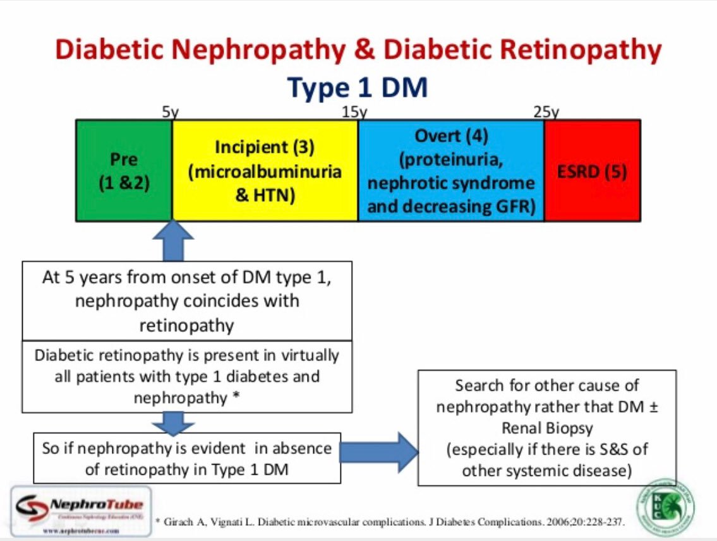

Slide 35
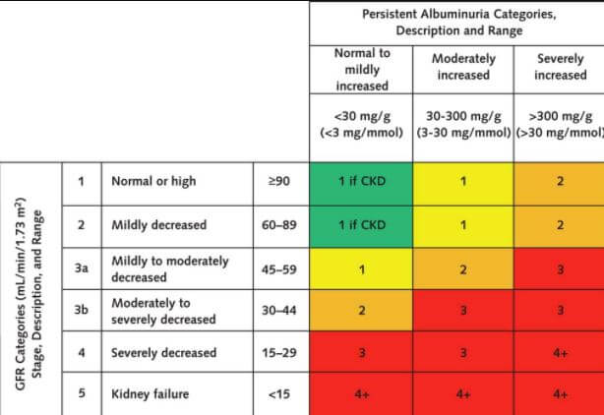
Stages of CKD

Slide 36
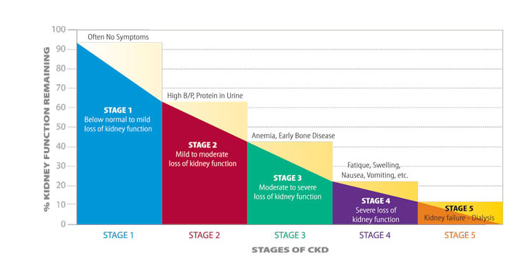

Slide 37
Monitor Progression
Review and discus eGFR and UACR
  eGFR estimates kidney function.
    Persistent levels < 60 are considered CKD.
  UACR > 30 mg/g is considered as kidney damage.
    An elevated UACR should be confirmed in the absence of urinary tract infection with 2 additional tests collected over the next 3 to 6 months.
    Patients with high levels of urine albumin, also known as albuminuria, are at greatest risk of rapid progression to kidney failure.
Notes:
Other common names for UACR include microalbumin, urine albumin, albumin-to-creatinine ratio and microalbumin/creatinine ratio.

Slide 38
More Tests Are Needed When CKD Identified
Electrolytes and Ca, Phos levels
Fasting Lipid Panel
CBC
A1C
Renal U/S
Ua, ACR
Dilated Retinal Exam
Others: Vitamin D, Iron Studies, PTH

Slide 39
Avoid Acute Kidney Injury
Avoid NSAIDS
No OTC medications unless approved
Medications dosages may need to be adjusted

Slide 40
Management of DKD
Ensure Diagnosis is Correct
Implement Appropriate Therapy
  Blood Pressure Control
  Blood Glucose Control
  Cardiovascular Disease Risk Factors
Monitor Progression / Set Goals
  Slow eGFR decline
  Reduce albuminuria
Screen for CKD Complications
  Anemia
  Hyperkalemia
  Hypoalbuminemia
  Metabolic Acidosis
  Abnormal Bone and Mineral Metabolism
Educate
Prepare for Renal Replacement Therapy

Slide 41
BP Control
Monitor BP -**key to slowing progression
JNC8 rec <140/90
Recommend limiting dietary sodium to 2300 mg/day
  Do no replace with salt substitutes as they contain KCL
Educate re: ACE-I and ARB’s to slow progression
  Monitor K+ levels
  Limit K+ in diet if serum level is elevated
Multiple BP meds may be needed to control the BP

Slide 42
Glucose Control
Help patient achieve optimal glucose management
  A1C individualized; An A1C of <7% in newly diagnosed patients may delay the onset or progression of DKD.
  If has long duration of DM, achieving target may not slow progression
  Some oral hypoglycemic agents may need to be adjusted or discontinued
  An unexplained improvement in glucose control may reflect DKD progression
  Insulin requirements may need to be lowered
  Treat hypoglycemia appropriately – use low-potassium juices such as apple or cranberry juice when hyperkalemia present
Once DKD has been established, tight control of glucose levels have not shown to slow progression of disease
  A1C level of <8 may be appropriate if there is recurrent hypoglycemia, multiple co-morbidities are present, or if there is limited life expectancy

Slide 43
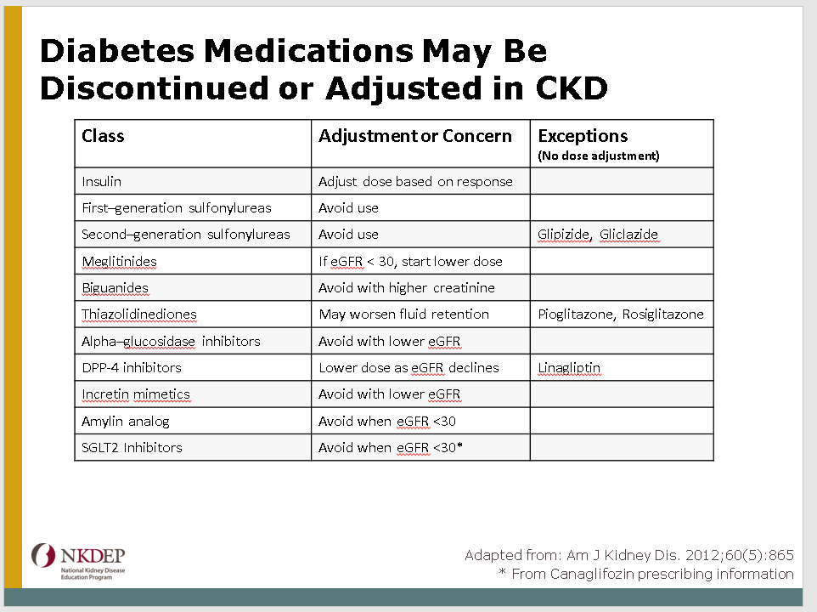

Slide 44
Treatment of Risk Factors for CV Disease
Treat risk factors for cardiovascular disease, the leading cause of mortality for those with DKD
  Medications and diet for treatment of dyslipidemia
  Patients may be prescribed meds – watch for muscle toxicity or elevated liver function tests
  Management of nontraditional risk factors
    Anemia
    Urine albumin
    Abnormal mineral and electrolyte metabolism (calcium, phosphorus, and potassium)
  Educate patients that the degree of risk of CV events or progression to ESRD increases as albuminuria levels rise, and as eGFR falls.

Slide 45
Management of DKD
Ensure Diagnosis is Correct
Implement Appropriate Therapy
  Blood Pressure Control
  Blood Glucose Control
  Cardiovascular Disease Risk Factors
Monitor Progression / Set Goals
  Slow eGFR decline
  Reduce albuminuria
Screen for CKD Complications
  Anemia
  Hyperkalemia
  Hypoalbuminemia
  Metabolic Acidosis
  Abnormal Bone and Mineral Metabolism
Educate
Prepare for Renal Replacement Therapy

Slide 46
Reduction of Albuminuria
Control Blood Pressure
Reduce Sodium Intake
Diabetes Control
Reduce Weight
Stop Smoking
Reduce Protein Intake, if Excessive
Notes:
Exercise recommendation is unchanged for those with CKD

Slide 47
Management of DKD
Ensure Diagnosis is Correct
Implement Appropriate Therapy
  Blood Pressure Control
  Blood Glucose Control
  Cardiovascular Disease Risk Factors
Monitor Progression / Set Goals
  Slow eGFR decline
  Reduce albuminuria
Screen for CKD Complications
  Anemia
  Hyperkalemia
  Hypoalbuminemia
  Metabolic Acidosis
  Abnormal Bone and Mineral Metabolism
Educate
Prepare for Renal Replacement Therapy

Slide 48
Identify and Monitor DKD Complications
Anemia
  May develop due to reduced erythropoietin synthesis by kidneys
  Assess hemoglobin and iron indices
  Supplemental iron may be required
Hyperkalemia
  May develop earlier in people with diabetes
  Angiotensin converting enzyme inhibitors and angiotensin receptor blockers increase risk of hyperkalemia, however, the PCP may continue use due to their anti-proteinuric effect
  Limit dietary potassium when serum level is elevated

Slide 49
Identify and Monitor DKD Complications
Hypoalbuminemia
  Common and multifactorial in DKD
  The patient may report an aversion to meat as the eGFR declines. Evaluate protein and calorie intake
  Poor oral health is associated with inflammation and poor intake. Refer for dental care if appropriate
Metabolic acidosis
  Defined as serum CO2 < 22 mEq/L, may develop
  Maintain serum CO2 > 22 mEq/L may be beneficial
  Reduce animal protein intake may result in an increase in serum bicarbonate, as animal protein is a source of metabolic acids
  Acidosis may be treated with supplemental bicarbonate
  Monitor blood pressure closely when sodium bicarbonate is used to treat acidosis

Slide 50
Identify and Monitor DKD Complications
Abnormal mineral metabolism and bone disease
  Abnormal mineral metabolism and bone disease are common
  Monitor calcium, phosphorus, vitamin D, parathyroid hormone
  Vitamin D supplementation may increase risk of hypercalcemia and hyperphosphatemia

Slide 51
Management of DKD
Ensure Diagnosis is Correct
Implement Appropriate Therapy
  Blood Pressure Control
  Blood Glucose Control
  Cardiovascular Disease Risk Factors
Monitor Progression / Set Goals
  Slow eGFR decline
  Reduce albuminuria
Screen for CKD Complications
  Anemia
  Hyperkalemia
  Hypoalbuminemia
  Metabolic Acidosis
  Abnormal Bone and Mineral Metabolism
Educate
Prepare for Renal Replacement Therapy

Slide 52
Promote Self-Management
Talk to patients about their kidneys, DKD, and their risk.
Communicate the importance of testing and how DKD is diagnosed.
Explain the progressive nature of DKD and the basics of treatment.
Make patients aware of the risks of using non-steroidal anti-inflammatory drugs (NSAIDS) especially in association with volume depletion and concurrent use of RAAS antagonists.
Teach patient to save their nondominant arm – no lab sticks or BP monitoring.

Slide 53
Healthy Coping
Patients with chronic disease are at risk for depression
Multiple chronic health conditions increases the risk for depression
Always assess for depression and make appropriate referral if needed

Slide 54
AADE Practice Paper on DKD
https://www.diabeteseducator.org/docs/default-source/practice/practice-documents/practice-papers/diabetes-and-kidney-disease.pdf?sfvrsn=2
Reviews content broken down into categories: AADE 7 self-care behaviors

Slide 55
More Information:
NKDEP developed a four-module training program in partnership with the AADE
The program covers implementation of the AADE Practice Advisory for DKD, with each of the four modules focused on a specific aspect of kidney disease management
  identification
  slowing progression
  addressing complications
  educating patients
Additionally, the program reviews content from the perspective of the AADE 7 self-care behaviors.

Slide 56
Case Study
A 60 year old patient presents for diabetes education. She has a diagnosis of pre-diabetes.
Family history: Mother with ESRD and Father with Hypertension
Her A1C is 5.8, creatinine 1.3, and eGFR is 55 with a ACR of 70. Her BP is 170/106, weight 205.

Slide 57
Case Study
1. Ensure diagnosis is correct
What medical diagnoses does this patient have; based on the information given?
Obesity, Pre-Diabetes, Hypertension, and CKD, stage 3a-2 (see next slide)

Slide 58
Stages of CKD

Slide 59
Case Study
2. Implement Appropriate Therapy
  BP control, BS control, CV Dz risk factors
3. Monitor Progression / Set Goals
  Slow eGFR decline and Reduce albuminuria
What medications are indicated for this patient?
  ACE – for BP control and to control albuminuria
  Baby Aspirin – prevention
  ? Statin – if cholesterol is high
  Can this patient take Metformin? Does she need Metformin?

Slide 60
Case Study
4. Screen for CKD Complications
  Anemia, Hyperkalemia, Hypoalbuminemia, Metabolic Acidosis, Abnormal Bone and Mineral Metabolism
What labs are needed?
  Anemia – Hgb and Hct, Iron Studies, Ferritin
  Hyperkalemia- Electrolytes
  Metabolic Acidosis- Electrolytes
  Bone Disease- Ca, Phos, Vitamin D level, and PT
Does she had Diabetic Kidney Disease? Why or Why not?

Slide 61
Case Study
5. Educate and Prepare for Renal Replacement Therapy
What education should this patient receive?
  Diabetes Education with dietary instruction utilizing sodium restriction and any other recommendations based on labs (potassium).
  Encourage exercise based on recommendations for all people with diabetes
  Communicate the importance of testing and how DKD is diagnosed.
  Explain the progressive nature of DKD and the basics of treatment.
  Make patients aware of the risks of using non-steroidal anti-inflammatory drugs (NSAIDS) especially in association with volume depletion and concurrent use of RAAS antagonists.
  Ask patient to save the non-dominant arm from lab draws (saving the arm for dialysis access)

Slide 62
Utilize 7 self-care behaviors

Slide 63
Case Study
At the next visit…
BP 136/78, eGFR 60, ACR 28, A1C 5.6 and weight 190, Potassium 4.6
She is taking all medications as prescribed

Slide 64
So…..Now You Know Diddly

Slide 65

Questions

