Slide 1


Slide 2
Addressing Social Determinants of Health for Diabetes Population Health
Felicia Hill-Briggs, PhD; Patti Ephraim, MPH; Tiffany Gary-Webb, PhD

Slide 3
Overview
The Social Determinants of Health: Definitions, Constructs, and Recommendations
Measurement of Social Determinants of Health in Clinical Practice and Use of Population Social Determinants of Health Data in Diabetes Programming
Addressing Social Determinants of Health
Social Determinants as Stressors and Implications for Psychosocial Care

Slide 4
The Social Determinants of Health: Definitions, Constructs, and Recommendations
Felicia Hill-Briggs, PhD, ABPP
Professor of Medicine, Johns Hopkins School of Medicine
Senior Director, Population Health Research and Development, Johns Hopkins HealthCare LLC
ADA President of Health Care and Education

Slide 5
Disclosures for Dr. Hill-Briggs
Officer and Member of the ADA Board of Directors
Consultant, Johnson & Johnson, Educational webinar on social determinants of health
Royalties, Eli Lilly licensure of Health Problem-Solving Scale intellectual property

Slide 6
Diabetes Population Health
Current Diabetes Reports, 2017;17(7): 51-82.

Slide 7
World Health Organization (WHO) Definition of Social Determinants of Health
The social determinants of health are the conditions in which people are born, grow, work, live, and age, and the wider set of forces and systems shaping the conditions of daily life. These forces and systems include economic policies and systems, development agendas, social norms, social policies and political systems.
http://www.who.int/social_determinants/en/

Slide 8
Related Phenomena
A type of difference in health that is closely linked with social or economic disadvantage. Health disparities negatively affect groups of people who have systematically experienced greater social or economic obstacles to health. These obstacles stem from characteristics historically linked to discrimination or exclusion such as race or ethnicity, religion, socioeconomic status, gender, mental health, sexual orientation, or geographic location. Other characteristics include cognitive, sensory, or physical disability differences.
U.S. Dept. of Health and Human Services
Socioeconomic Status or Class
Socioeconomic status is the social standing or class of an individual or group. It is often measured as a combination of education, income and occupation. Examinations of socioeconomic status often reveal inequities in access to resources, plus issues related to privilege, power and control.
American Psychological Association
Health Disparities
Copyright © Hill-Briggs 2017

Slide 9
Socioeconomic Status or Class
Social Determinants of Health
Health Disparities
Copyright © Hill-Briggs 2017

Slide 10
Evolution of Social Determinants
Literacy, Health Literacy
Educational Attainment (Quantity)
Educational Achievement (Quality)
Occupation
Income
Residence
Education
Employment Status
Job Classification
Socioeconomic
Status
Household Income
Poverty Status
Economic insecurity
Food Deserts
Access (e.g. education, health care)
Neighborhood, Built Environment
Environmental Exposures
Household Income
Poverty Status
Economic insecurity
Copyright © Hill-Briggs 2017

Slide 11
Healthy People 2020
The Social Determinants of Health topic area is designed to identify ways to create social and physical environments that promote good health for all. The Healthy People 2020 Approach is based on five (5) key areas of social determinants of health:
Economic Stability
Education
Social and Community Context
Health and Health Care
Neighborhood and Built Environment
https://www.healthypeople.gov/2020/topics-objectives/topic/social-determinants-of-health
Notes:
Healthy People 2020 is another declaration, within U.S. of awareness of SDOH and the need to improve those determinants

Slide 12
Impact of Social Determinants on Health Outcomes: U.S. Trends
MEASURES
Life expectancy (in years of age)
Child mortality rates
Disease prevalence
Health-related quality of life
Copyright © Hill-Briggs 2017

Slide 13
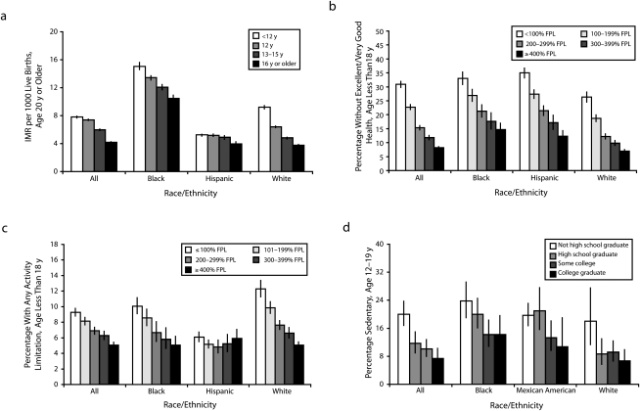
Infant Mortality Rate, By Child Age
Low Health Status in Children, By Poverty Level
Disability in Children, By Poverty Level
Sendentary Behavior in Teenagers, By Years of Schooling
Braveman PA, et al. Copyright © American Public Health Association 2010. All Rights Reserved. Used With Permission.

Slide 14
Life Expectancy at Age 25, By Poverty Level Status
Excellent-Very Good Health, By Years of Schooling
Coronary Heart Disease, By Years of Schooling
Diabetes, By Poverty Level Status
Braveman PA, et al. Copyright © American Public Health Association 2010. All Rights Reserved. Used With Permission.

Slide 15
Diabetes Prevalence By Years of Education
Centers for Disease Control and Prevention, National Diabetes Statistics Report, 2017
Notes:
Education is associated with diabetes. Years of Education is directly and independently associated with rates of diabetes, in a step-wise fashion.
Here you see rates of diabetes in the population for people with More than HS, HS. And Less than HS education.

Slide 16
Recommendations for Intervention from Global and (U.S.) National Expert Panels
Committee | Organization
Commission on Social Determinants of Health | World Health Organization
Committee on Recommended Social and Behavioral Domains and Measures for Electronic Health Records | Institute of Medicine/National Academies of Sciences, Engineering, and Medicine
Committee on Educating Health Professionals to Address the Social Determinants of Health | Institute of Medicine (IOM) Board on Global Health/National Academies of Sciences, Engineering, and Medicine
Copyright © Hill-Briggs 2017

Slide 17
WHO Commission Recommendations
1. Improve Daily Living Conditions
  Put major emphasis on early child development and education. Improve living and working conditions. Create social protection policy supportive of all.
2. Tackle the Inequitable Distribution of Power, Money, and Resources
  Create a strong public sector that is committed, capable, and adequately ﬁnanced. Ensure legitimacy, space, and support for civil society, for an accountable private sector, and for the public to agree to reinvestment in collective action.
Measure and Understand the Problem and Assess the Impact of Action
  Acknowledge there is a problem. Ensure that health inequity is measured. Develop national and global health equity surveillance systems for routine monitoring of health inequity and the social determinants of health. Evaluate the health equity impact of policy and action. Ensure stronger focus on social determinants in public health research.
  Source: http://www.who.int/social_determinants/thecommission/finalreport/en/
Copyright © Hill-Briggs 2017

Slide 18
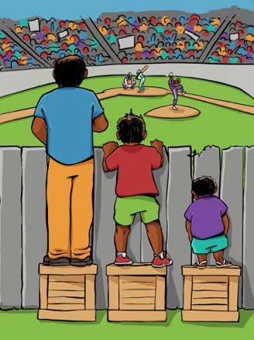
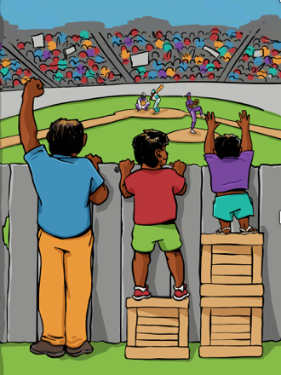
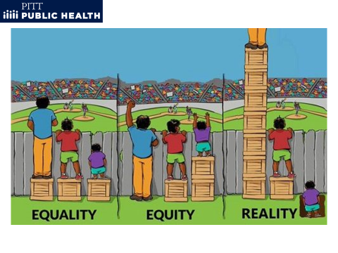
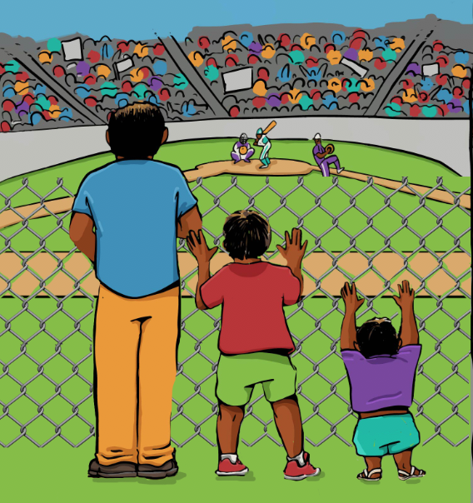
Evolving Framework
Systemic Barrier Removal/ Root Cause (WHO Goal)
Equality
Equity (Current Goal)
It is assumed that everyone will benefit from the same supports. They are being treated equally.
Individuals are given different supports to make it possible for them to have equal access to the game. They are being treated equitably.
All three can see the game without any supports or accommodations because the cause of the inequity was addressed. The systemic barrier has been removed.
Credit: Chris Froehle, PhD. and Interaction Institute for Social Change, Artist: Angus Maguire. 4th panel modified by T. Garnero
Notes:
NOTE: This is a depiction that is freely available on the internet. There is no copyright. The Hopkins researchers have traced it to the named artist here to credit (Chris Froehle, PhD).
http://interactioninstitute.org/illustrating-equality-vs-equity/ is where the Interaction Institue for Social Change grants free use

Slide 19
IOM Recommendations: Measures for Electronic Medical
Records (EMRs), 2014
Finding: Standardized data collection and measurement are critical to facilitate use and exchange of information on social and behavioral determinants of health.
Recommendation: The Office of the National Coordinator for Health Information Technology and the Centers for Medicare & Medicaid Services should include in the certification and meaningful use regulations the recommended measures.
CORE SOCIAL AND BEHAVIORAL DOMAINS/ MEASURES | FREQUENCY
Current Common Domains Alcohol Use Race and Ethnicity Residential Address Tobacco Use | Screen and follow up At entry Verify every visit Screen and follow up
Additional Domains Census Tract-Median Income Depression Education Financial Resource Strain Intimate Partner Violence Physical Activity Social Connections & Social Isolation Stress | Update on address change Screen and follow up At entry Screen and follow up Screen and follow up Screen and follow up Screen and follow up Screen and follow up
https://www.nap.edu/catalog/21923/a-framework-for-educating-health-professionals-to-address-the-social-determinants-of-health

Slide 20
IOM Recommendations: Health Professional Education, 2016
RECOMMENDATION 1.
Health professional educators should create lifelong learners who appreciate the value of relationships and collaborations for understanding and addressing community-identified needs and for strengthening community assets.
RECOMMENDATION 2.
To prepare health professionals to take action on the social determinants of health in, with, and across communities, health professional and educational associations and organizations at the global, regional, and national levels should apply [frameworks for] partnering with communities to increase the inclusivity and diversity of the health professional student body and faculty.
https://www.nap.edu/catalog/21923/a-framework-for-educating-health-professionals-to-address-the-social-determinants-of-health

Slide 21
IOM Recommendations: Health Professional Education, 2016
RECOMMENDATION 3.
Governments and individual ministries (e.g., signatories of the Rio Declaration), health professional and educational associations and organizations, and community groups should foster an enabling environment that supports and values the integration of the social determinants framework principles into their mission, culture, and work.
RECOMMENDATION 4.
Governments, health professional and educational associations and organizations, and community organizations should use [a social determinants] framework and model to guide and support evaluation research aimed at identifying and illustrating effective approaches for learning about the social determinants of health in and with communities while improving health outcomes, thereby building the evidence base.

Slide 22
SDOH as Stressors and Implications for Psychosocial Care: Socioecological Stress

Slide 23
Social Determinants of Health
The social determinants of health are the conditions in which people are born, grow, work, live, and age, and the wider set of forces and systems shaping the conditions of daily life. These forces and systems include economic policies and systems, development agendas, social norms, social policies and political systems.
World Health Organization

Slide 24
Socioecological Stressors
[Social determinant conditions] generate problem situations requiring adaptation more often and with less resources for solution than more organized areas [non social-determinant areas]. The rates of certain critical social conditions in given socioecological areas reflect the probability of inducing disequilibria in the local organisms. For example, low socio-economic status (income and education, high crime, high density, high residential mobility, and high rates of marital break-up must be considered in estimating relative degree of stress-inducing conditions.
Harburg E. et al. J Chron Dis 1973, Vol. 26, pp. 595-611
Harburg E. et al. Psychosomatic Medicine,1973

Slide 25
Socioecological Stress
The emotional and/or physiological toll (disequilibrium) on the individual or population due to socioecological stressors and living under social determinant conditions.

Slide 26
Mental Health Disorders vs. Normative Stress Response (Distress)
Challenge of diagnostic accuracy
Roles of cultural misunderstandings and clinician bias
Examples: In African American (AA) patients:
  Anger mislabeled as emotional dyscontrol or personality disorder (patient-provider communication studies)
  Depression and anxiety misdiagnosed as schizophrenia, paranoia, or other psychotic symptomatology (medication studies)
Impact of over-medicating and medication hypersensitivity
  At doses used in Whites, AA higher sensitivity to psychotropic medications
    Faster and higher metabolic response
    More severe side effects, delirium
David Satcher, MD, PhD
  In inpatient settings, clinicians tend to prescribe both more and higher doses of oral and injectable antipsychotic medications to AA than to whites
U.S. Department of Health and Human Services (DHHS 2001). Rockville, MD.
Notes:
There is also the question of how we distinguish MH disorders from a normative range of response to socioecological stressors (distress).
Have a major challenge of diagnostic accuracy.
No room for distress—normal emotional responses to life circumstances.
New example:
FBI – new designation of new threat: Black Identity Extremists. Over-identifying with our race.
(Not White Nationism, Neo Nazi-ism)

Slide 27
Role of Diabetes Educator
Listen and hear the nature of the distress.
Probe for how patient is coping with the distress.
  Emphasize productive, action-oriented coping (overcome suppression of anger)
Be a patient advocate
  Be aware of implications for treatment
  If patients are on psychiatric medications, help monitor for symptom improvement and for adverse reactions or side effects
Address the source of distress when due to diabetes care and management
  Target supports to address SDOH as sources of distress complicating diabetes self-management and
  Become an advocate for systemic change

