Slide 1


Addressing Social Determinants of Health- Interventions using Community-Clinic Linkages
Tiffany L. Gary-Webb, PhD, MHS
Associate Professor
Behavioral and Community Health Sciences
Epidemiology
Graduate School of Public Health
University of Pittsburgh
Notes:
TYPEFACE: Calibri, lined up under the Ps of Pitt and Public
HEADING: 44/exactly44, bold, U/lc, flush left; turquoise theme color
TEXT: 32/single, regular wgt, U/lc, flush left; darkest gray or navy theme colors

Slide 2
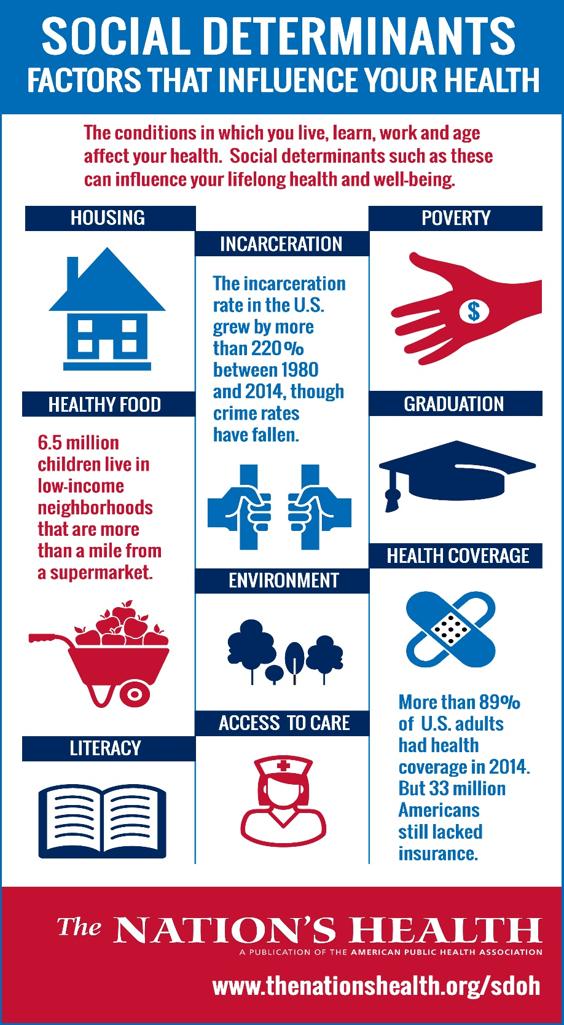
Neighborhoods/Environment
Housing
Education
Literacy
Healthcare coverage
Access to health care
Incarceration
Poverty
Discrimination

Slide 3
Outline of the Talk
Interventions addressing community-clinic linkages
  Team approach using ancillary care providers- Project Sugar 2
  Accountable Health Communities
  Community-based settings with linkage or referral to evidenced-based services- Feeding America FAITH DM & DPP projects
Interventions at the community-level

Slide 4
  Team approach using ancillary care providers

Slide 5
Gary et al., Archives of Internal Medicine 2009, 169(19): 1788-1794

Slide 6
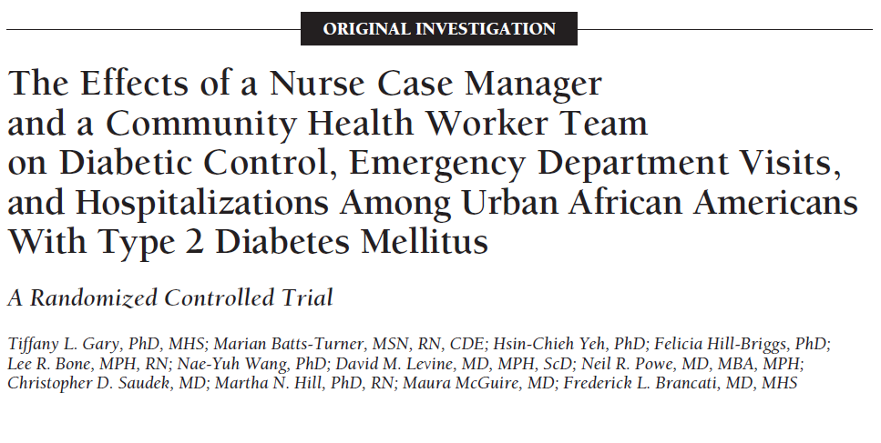
Gary et al., Archives of Internal Medicine 2009, 169(19): 1788-1794

Slide 7
Project Sugar 2 - Interventionists
 | Minimal Intervention | Intensive Intervention
 | Phone | NCM | CHW
Education | High School Grad | BSN, RN | High School Grad
Setting | Telephone | Clinic | Home, Community
Intervention | Usual Care Preventive screening calls 2X yearly Quarterly newsletter Provider feedback -Written only | Usual Care Algorithms/action plans 1 Clinic visit yearly Quarterly newsletter Provider feedback - Written - Verbal | Usual Care Algorithm/action plans 3 Home visits yearly Quarterly newsletter Provider feedback - Written - Verbal
Notes:
Our minimal intervention was conducted by a lay educator who was a high school graduate. She conducted calls twice yearly to remind participants of their diabetes-related preventive screenings. Written feedback of call was sent to the participant’s primary care provider.
The Intensive intervention was conducted by a nurse case manager who implemented standardized algorithms and intervention action plans and saw patients in the clinic at least once per year. Information from the visit and recommendations were sent to the provider and verbal contact was initiated as necessary.
The community health workers were high school grads and members of various communities within Baltimore City. They met with participants at their homes or in the community at least 3 times per year. Similar to the NCM, they implemented algorithms and intervention action plans to guide the intervention, although they focused more on the social environment and family support.
For individuals in the intensive intervention, additional contacts were scheduled as needed.
All participants received the quarterly newsletter, Sweet talk

Slide 8
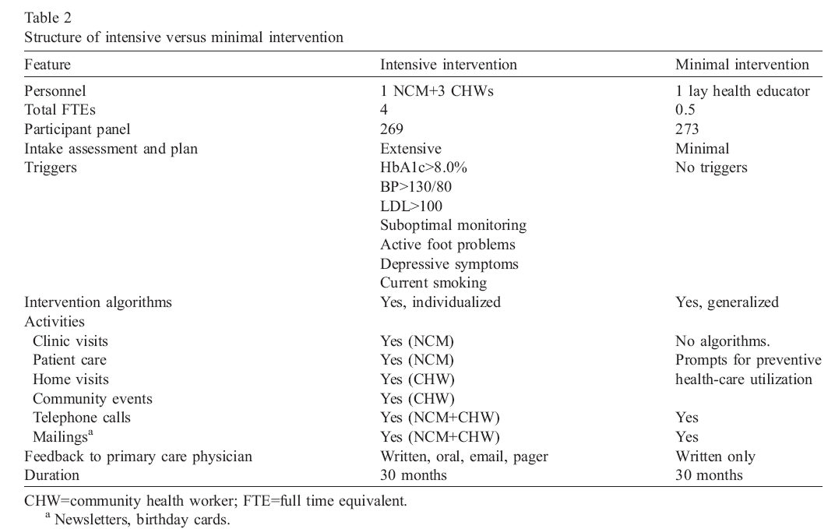

Slide 9
Application of Precede-Proceed to Project Sugar Diabetes Interventions
Behaviors
Foot care
Blood glucose self-monitoring
Medication adherence
Dietary adherence
Physical activity
Smoking
Alcohol consumption
Predisposing Factors
Knowledge and perceptions about diabetes
Diabetes health beliefs
Self-image
Project Sugar
Interventions
Nurse-case manager clinic visits
Community health worker home visits
Telephone follow-up
Primary care physician feedback
Health Problem
HbA1c
Blood pressure
Lipids
Weight
Health status
Diabetes-related complications
Reinforcing Factors
Primary care physician advice
Family social support
Environmental Factors
Availability of resources
Concerns about money, housing, family problems
Enabling Factors
Skills to conduct glucose monitoring and foot care
Access to supplies
Difficulty controlling diabetes

Slide 10
HbA1c over 24 Months By Intervention Intensity (compared to Minimal Care)
*
Gary et al., Archives of Internal Medicine 2009, 169(19): 1788-1794
NCM=nurse case-manager, CHW=community health worker,*=P<0.05

Slide 11
ER Visits over 24 Months By Intervention Intensity (compared to Minimal Care)
*
*
*
*
Gary et al., Archives of Internal Medicine 2009, 169(19): 1788-1794
NCM=nurse case-manager, CHW=community health worker,*=P<0.05

Slide 12
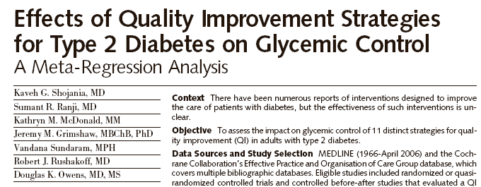
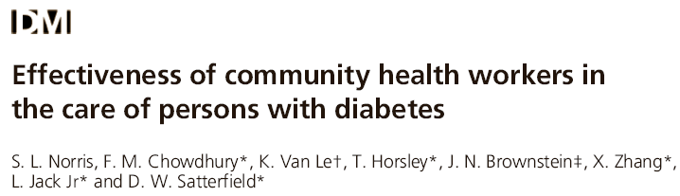
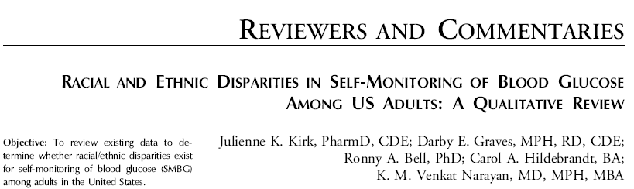
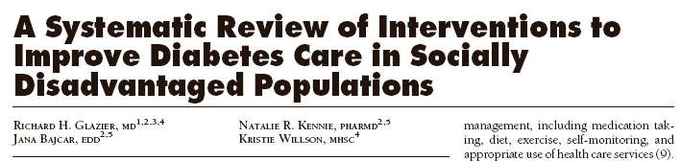

Slide 13



Slide 14
  Accountable Health Communities

Slide 15
Accountable Health Communities
“Most clinicians are familiar with the stories behind the[se] statistics: the child with asthma whose substandard housing triggers repeated emergency department visits; the patient with repeated visits for severe abdominal pain caused by her violent home life; the older adult with diabetes forced to choose between paying for heat and buying groceries. But in our current system, patients’ health-related social needs frequently remain undetected and unaddressed. Despite calls for obtaining an expanded social history at the point of care, most health care systems lack the infrastructure and incentives to develop comprehensive, systematic screening-and-referral protocols and relationships with the array of community service providers that would be required to address their patients’ health-related social needs.”
Alley DE et al. Accountable Health Communities—Addressing Social Needs through Medicare and Medicaid. N Engl J Med 2016;374: 8-11.

Slide 16
Accountable Health Communities (cont’d)
Track | Question
Track 1. Awareness | Will increasing awareness of community services through information dissemination (inventory of community services) and referral reduce health care costs?
Track 2. Assistance | Will providing community service navigation to assist beneficiaries (Medicaid, Medicare) with overcoming barriers to access to services reduce health care costs?
Track 3. Alignment | Will a combination of navigation to community services (at the individual beneficiary level) and partner alignment at the community level reduce health care costs?
Alley DE et al. Accountable Health Communities—Addressing Social Needs through Medicare and Medicaid. N Engl J Med 2016;374: 8-11.

Slide 17
Community-based settings with linkage or referral to evidenced-based services

Slide 18
Food Insecurity- lack of consistent access to nutritious food
What we know today
Across the lifespan, food insecurity is associated with:
Poorer dietary intake
Poorer physical, psychological, and behavioral health
Poorer disease management
What we think we know
Improving food security results in:
Better dietary intake & lower weight
Improved disease management
Lower health care costs
Better health

Slide 19
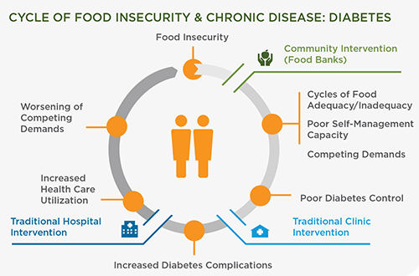
Food Insecurity and Chronic Disease

Slide 20
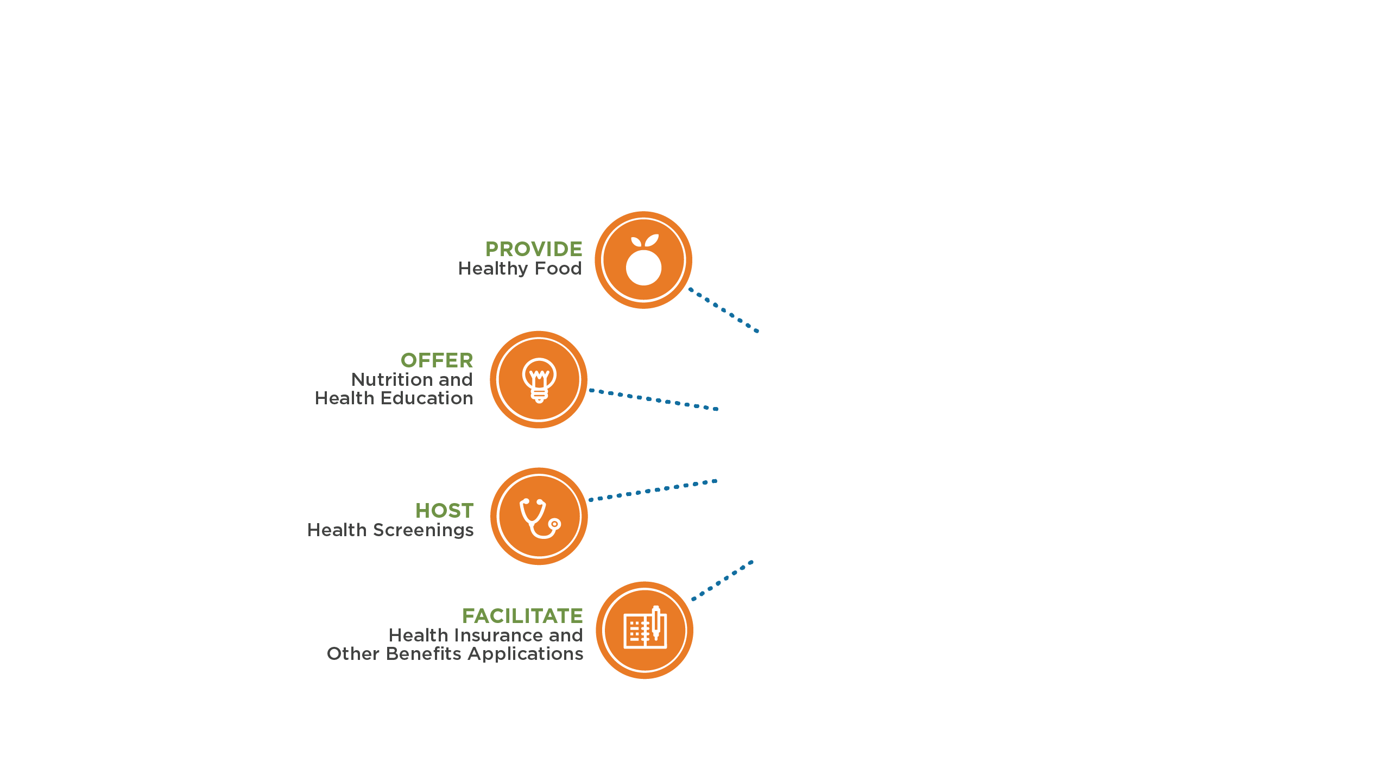
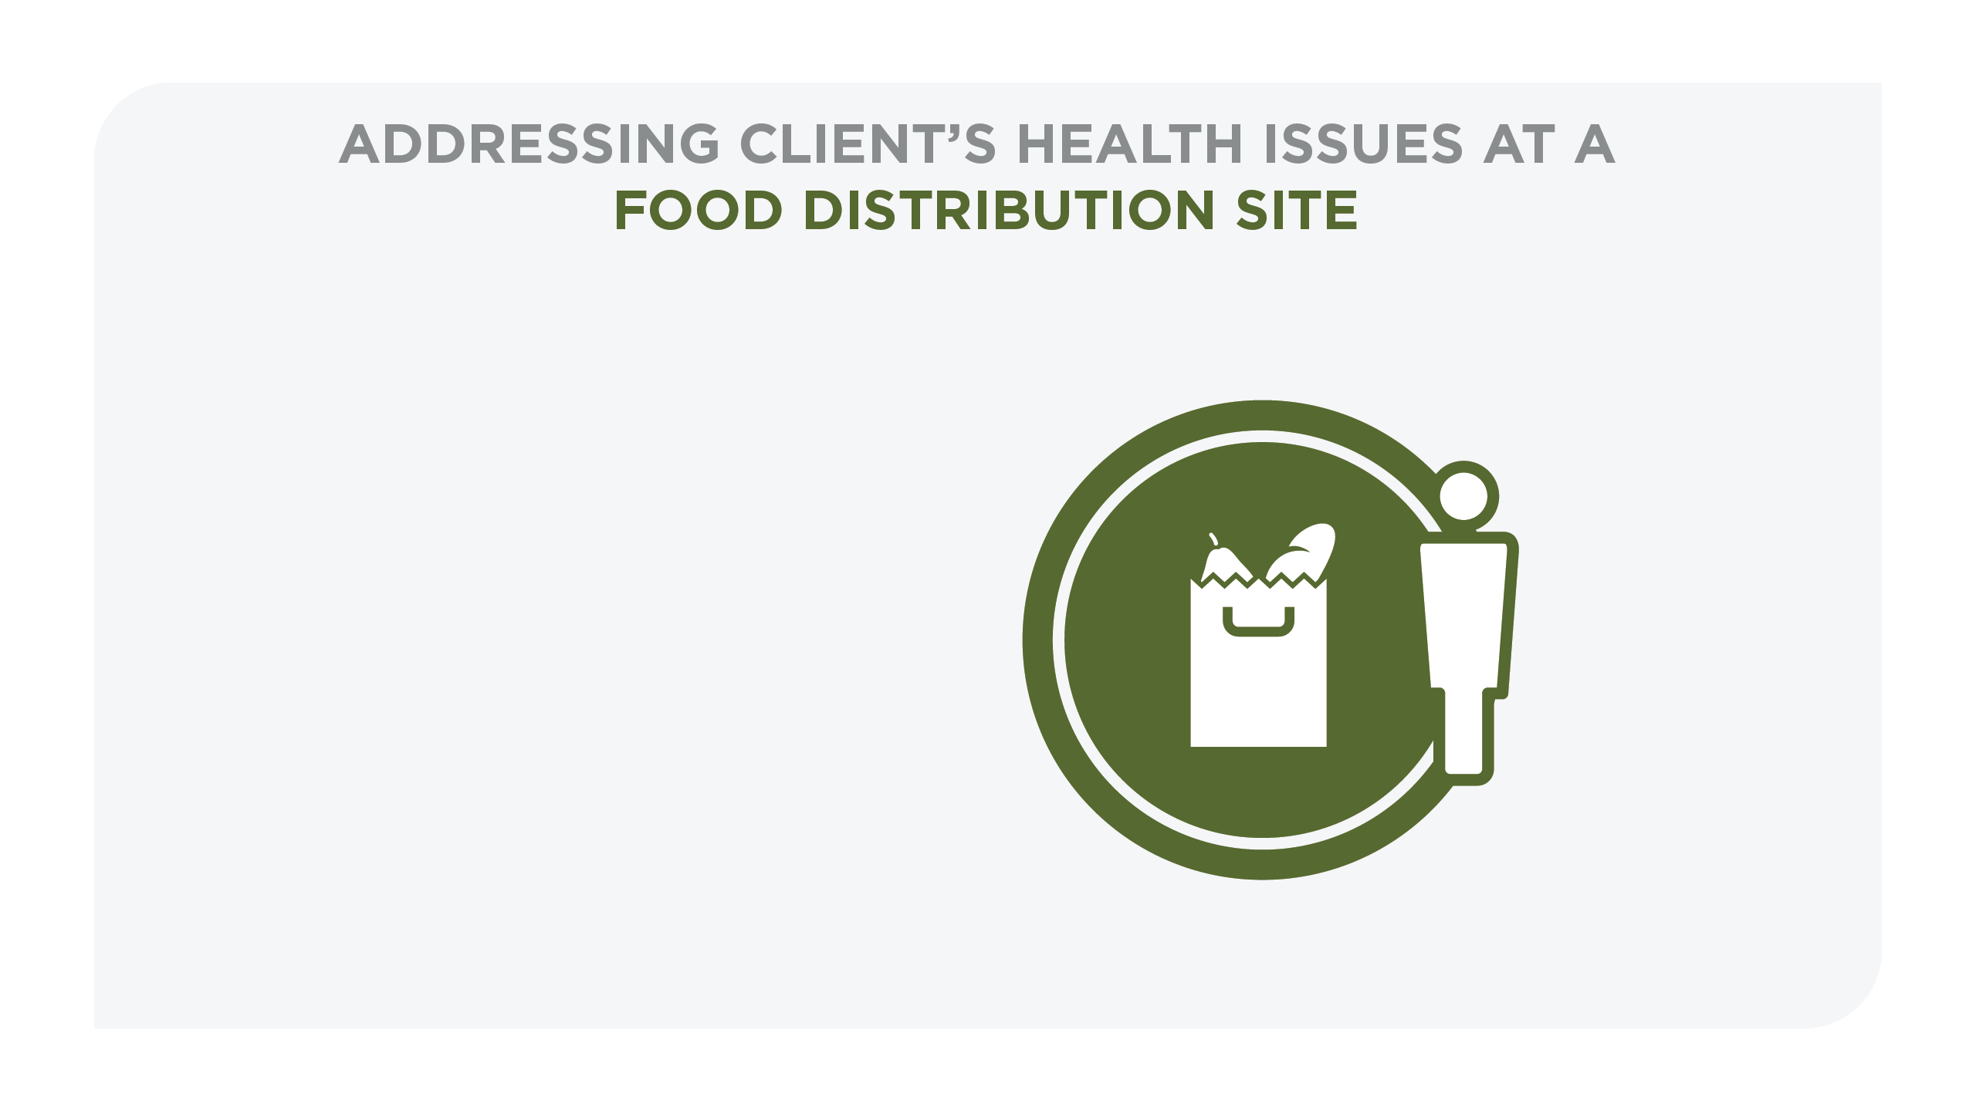
Feeding America Health & Wellness Strategy

Slide 21
Study Results
Seligman HK, Smith M, Rosenmoss S, Marshall MB, Waxman E.
AJPH 2018

Slide 22

(2015 – 2017)
Randomized, controlled trial design: how effective is the intervention?
Hypothesis: adults with poorly controlled T2DM who participate in a food bank intervention (food distributions, diabetes education, glycemic monitoring, and healthcare referrals) would experience significant improvements in HbA1c over a 6-month timeframe.
Secondary outcomes: food security, fruit and vegetable intake, diabetes distress, severe hypoglycemic events, depressive symptoms, medication adherence, tradeoffs (food vs medication/supplies), and food stability
  6- and 12-month follow-up for primary and secondary outcomes

Slide 23
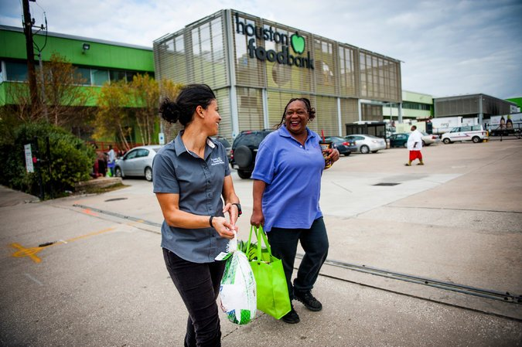
FAITH-DM Work: ACCFB, GCFB, HFB
Screened: 5,329 adults (9/15 – 10/16)
  906 eligible by A1C
  Final enrollment: 568 participants
  Randomized at enrollment
Study A1Cs completed: 1,677
Surveys completed: 1,322
Intervention: food distributions, formal and informal DSME, referrals, HCUA communication
  Challenges with engagement

Slide 24
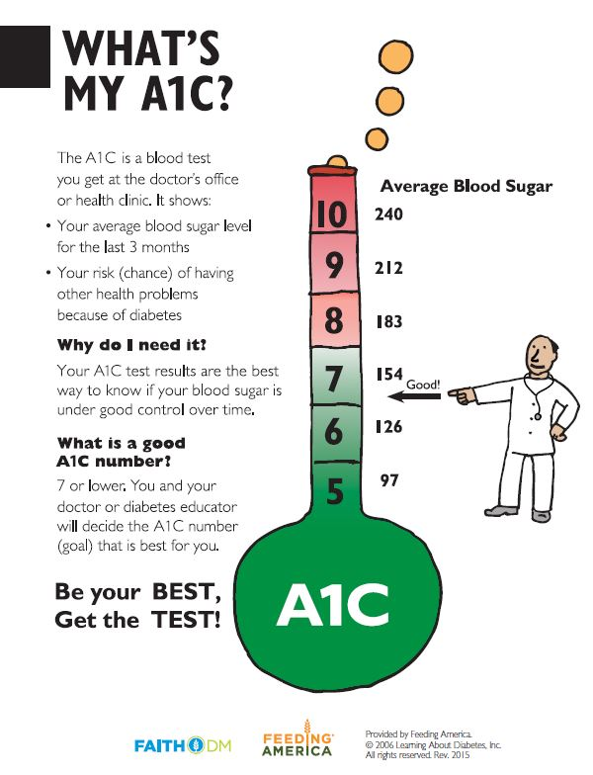
Baseline Data
Diverse sample, highly vulnerable population**
  74% food insecure
  73% reported poor or fair health; 93% reported a diabetes history
  52% Hispanic / Latino, 33% African American, 13% White
  Mean age = 55 years; 67% female
  48% had some high school or less; 45% HS degree, GED, or some college
  55% unemployed / retired; 12% working PT; 13% working FT; 18% disabled
  92% had a PCP
Baseline A1C: 9.75% (Control = 9.74%, Intervention = 9.75%)
**Population characteristics indicate potential challenges with engagement and retention

Slide 25
Primary Six-Month Follow-up Results
Outcome | Intervention | Control | RD / RR / p-value
HbA1c, mean | 9.12 | 8.88 | RD: 0.24 (–0.09, 0.58)
Food insecure, % low or very low | 60.0 | 69.4 | RR: 0.85 (0.73, 0.98)
F/V intake, mean servings per day | 4.2 | 3.9 | p = .04
Food instability*, % responding affirmatively | 54.9 | 69.4 | RR: 0.77 (0.64, 0.93)
Food/supply tradeoffs, dichotomous, % | 31.9 | 68.1 | RR: 0.62 (0.40, 0.95)
Depressive symptoms, % w/severe or mod. severe | 9.4 | 6.7 | RR: 1.18 (0.60, 2.32)
Diabetes distress, % | 48.4 | 49.7 | RR: 0.98 (0.80, 1.2)
Medication non-adherence, % responding affirmatively | 17.0 | 18.5 | RR: 0.88 (0.56,1.37)
Diabetes self-care, mean score (range 1-100) | 76.3 | 75.5 | RD: 0.77 (–2.68, 4.21)
Diabetes self-efficacy, mean (range 1-10) | 7.4 | 7.2 | RD: 0.24 (–0.12, 0.61)
Hypoglycemia, % self-reporting ≥ 1 severe event | 11.8 | 11.0 | RR: 1.02 (0.56, 1.86)
Food/med tradeoffs, % responding affirmatively | 15.7 | 24.1 | RR: 0.70 (0.46,1.07)
* “Do you ever run out of the food you need to take care of your diabetes?”

Slide 26

Key Message #1
FAITH-DM improved food security and dietary intake in adults with diabetes
Intervention was most successful in the primary domain of food bank work
  Food security, F/V intake, food stability, tradeoffs
  First randomized evidence of a food bank intervention’s effectiveness on these outcomes
  Strong evidence that increasing access to healthier foods improves nutrition
  Reduces need to adopt tradeoffs each month; high satisfaction

Slide 27
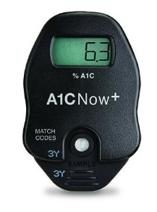
Key Message #2
The intervention was not helpful enough to significantly lower A1Cs. Why not?
  With mean baseline A1C of 9.75%, both groups improved after 6 months
  A1Cs move slowly; robust clinical interventions may/may not move A1Cs in 6 months
  Within the Intervention Group, fully engaged participants improved more than less engaged participants in the group [8.67% vs. 9.23%, p=0.04]
Other possibilities?
  Enrolling in the study affected both groups (control group influenced by study entry)?
  Carbohydrate increased as result of additional project food (need for medication titration)?

Slide 28

Key Message #3 - #4
Healthcare needs to invest in partnerships with food banks to reach highly vulnerable populations
  Food banks can address food security and nutrition needs
  Healthcare needs to better engage with patients to deliver clinical care
Tighter linkages and feedback loops are needed
  Food banks can not alone shoulder the burden of improving clinical outcomes for (diabetes) patients
  Increased access to nutritious foods may be critical for effective diabetes management, but that increased access on its own is not enough

Slide 29



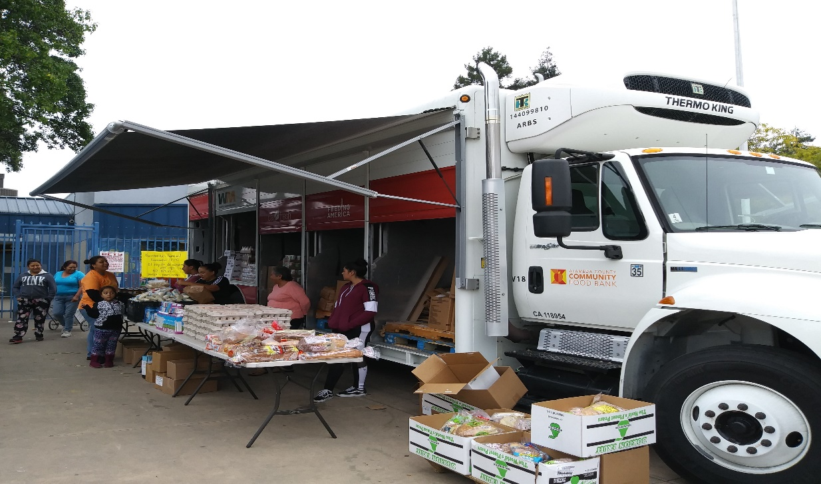
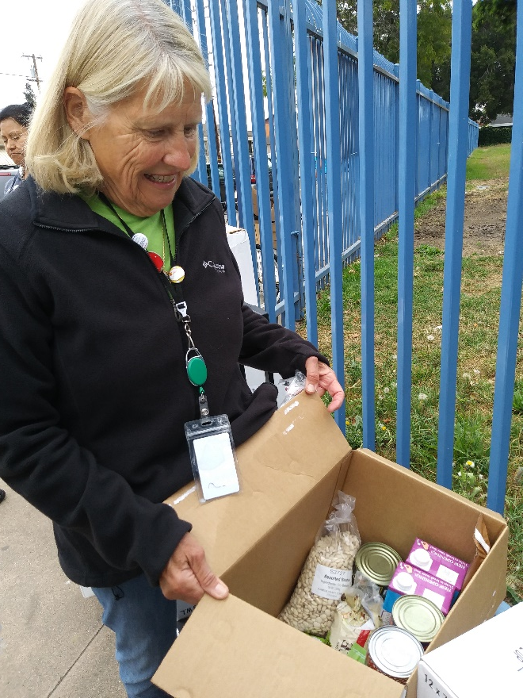
Feeding America Diabetes Prevention Pilot in Food Banks

Slide 30
Diabetes Prevention Pilot Project (2017-2019)
2-year project funded by Cargill
How can food banks best support adults at high risk for diabetes through providing healthy supplemental food and making referrals to healthcare and community-based Diabetes Prevention Programs?
Focus on food and partnerships (healthcare and DPPs)

Slide 32
Key Implementation Messages from the Field
Demand for prediabetes screening and services is high
DPP model has excellent reach in identifying high-risk, vulnerable populations
Implementation challenges- working with community organizations for referral

Slide 33
Interventions at the community-level

Slide 34
Neighborhood and Health
Neighborhood physical environments
Housing and business development
Food store resources
Parks/Recreational facilities
Aesthetic quality/natural spaces
Residential segregation
by race/ethnicity and
socioeconomic position
Behavioral
Mediators
Diet
Exercise
Sleep
Smoking
Alcohol
Health
Neighborhood social environments
Perceived safety
Social connections/ cohesion
Neighborhood noise
Perceived stress
Inequalities in
resource
distribution
Individual-level characteristics
Socio-economic status
Psychosocial resources
Adapted from Diez-Roux and Mair, 2010

Slide 35
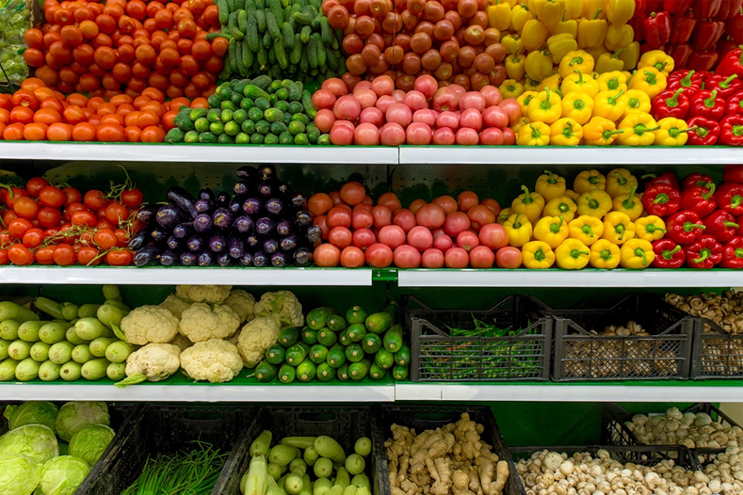
Introducing New Retailers of Fruits and Vegetables into Communities
Supermarkets, farmers’ market produce stands, and mobile markets
Overall, most reported small improvements in fruit and vegetable intake among shoppers
Results were less consistent for neighborhood changes in fruit and vegetable intake
Woodruff RC et al. Public Health Nutrition 2017

Slide 36

Greenspace Exposure & Health Outcomes
103 observational and 40 interventional studies show exposure to greenspace associated with lower/better:
  Salivary cortisol
  Diastolic blood pressure
  HDL cholesterol
  Type 2 diabetes
  All-cause mortality
Twohig-Bennett et al. Environmental Research 2018

Slide 37
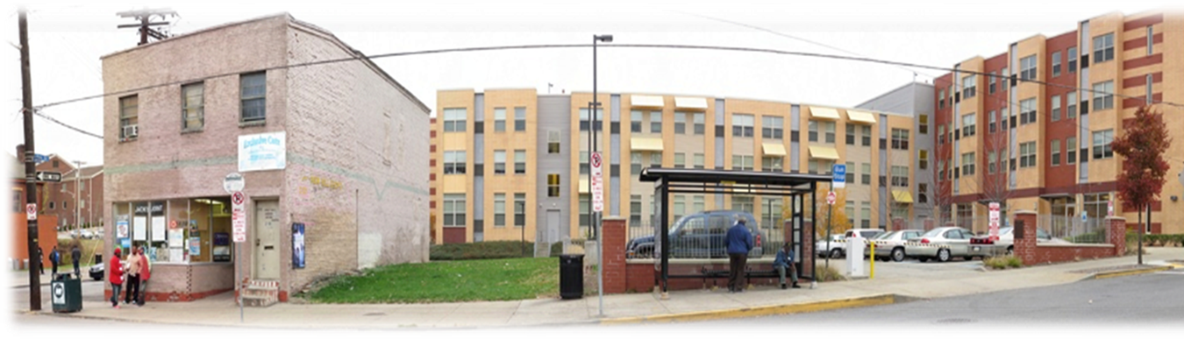
Housing & Health Outcomes
Relocation strategies which move residents to lower poverty neighborhoods
  Moving to Opportunity Study showed improvements in HbA1c and obesity over time for residents who relocated
Strategies which improve existing housing structure and quality
  Few studies evaluate health outcomes

Slide 38
Summary
Professional organizations, agencies and non-profits are giving more attention to the social determinants of health
Evidence-based models of community-clinic linkages exist and various innovative models are currently being tested
In addition to these interventions, those which alter the structural barriers to good health (social determinants) are desperately needed

Slide 39
Thank you! tgary@pitt.edu

