Slide 1


Slide 2

DAVID C. KLONOFF, MD
MEDICAL DIRECTOR, DIABETES RESEARCH INSTITUTE
MILLS-PENINSULA MEDICAL CENTER
SAN MATEO, CALIFORNIA
CLINICAL PROFESSOR OF MEDICINE, UCSF

Slide 3
DISCLOSURES
Consultant for Ascensia, AstraZeneca, EOFlow, Intarcia, Lifecare, Novo, Roche, Voluntis

Slide 4
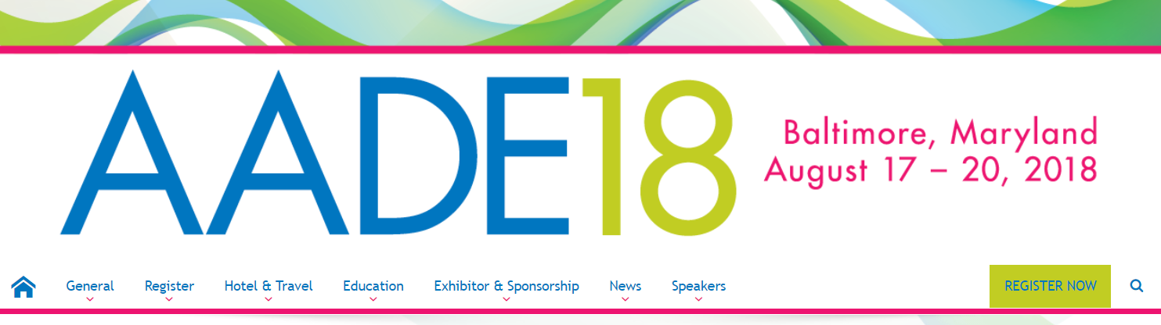
Baltimore, Maryland
August 19, 2018
HOW SECURE ARE
DIABETES DEVICES?

Slide 5
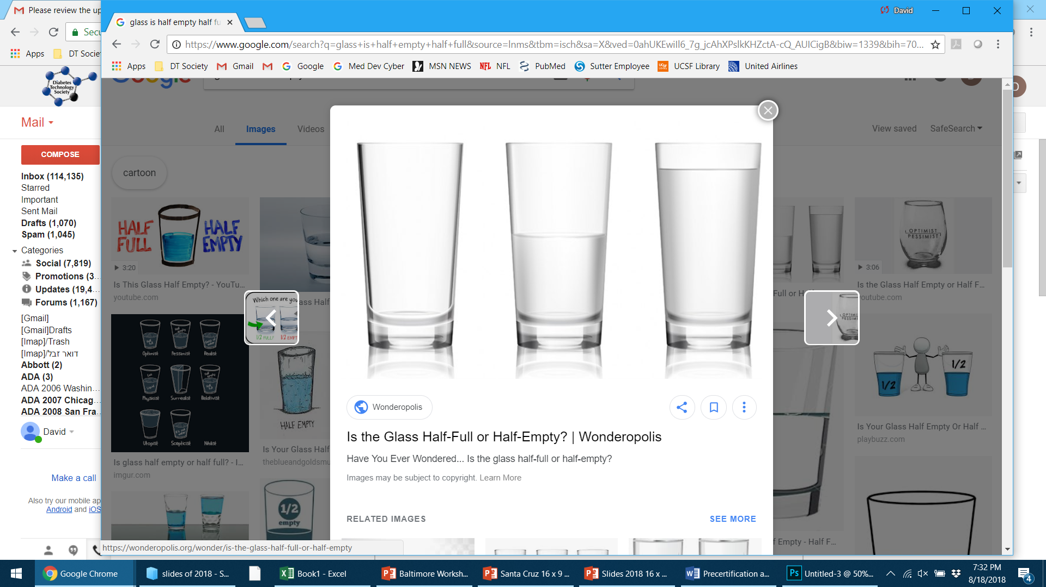
INADEQUATELY
INSECURE
ADEQUATELY
SECURE

Slide 6
INADEQUATELY
INSECURE
HOW MUCH CYBER RISK
ARE
YOU WILLING TO TAKE?
ADEQUATELY
SECURE

Slide 7
INADEQUATELY
INSECURE
HOW MUCH CYBER RISK
ARE
YOU WILLING TO TAKE?
LITTLE RISK
A LOT OF RISK
A BREACH IS LIKELY AND DANGEROUS
A BREACH IS UNLIKELY AND NOT DANGEROUS
ADEQUATELY
SECURE

Slide 8
Baltimore, Maryland
August 19, 2018
WHAT SHOULD WE BE DOING TO INCREASE DIABETES DEVICE SECURITY?

Slide 9
MEDICAL DEVICE
CYBERSECURITY IS THE
NUMBER ONE HEALTHCARE
PROBLEM IN THE US,
POTENTIALLY AFFECTING
THE SAFETY AND PRIVACY
OF EVERY AMERICAN

Slide 10
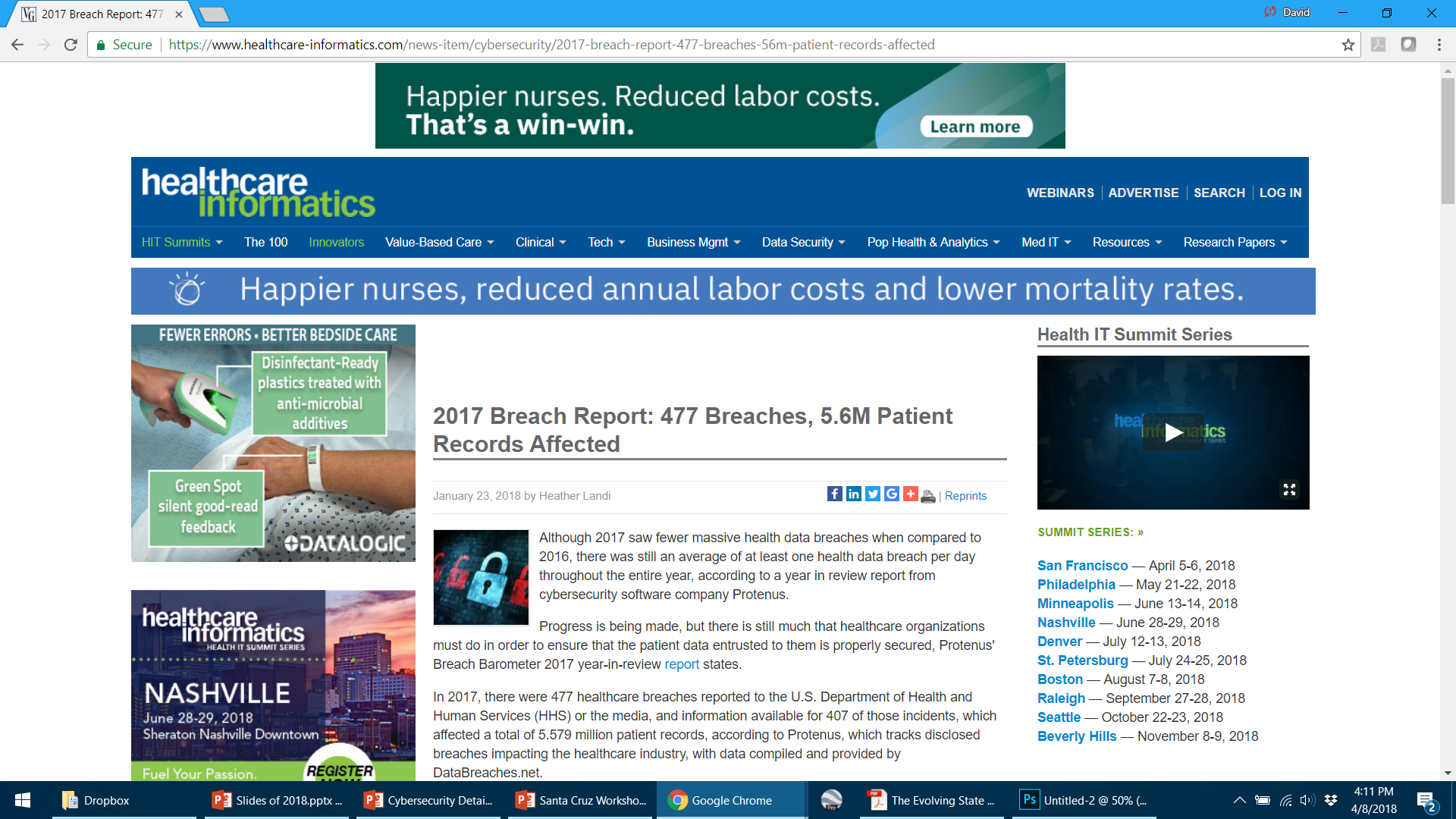

Slide 11

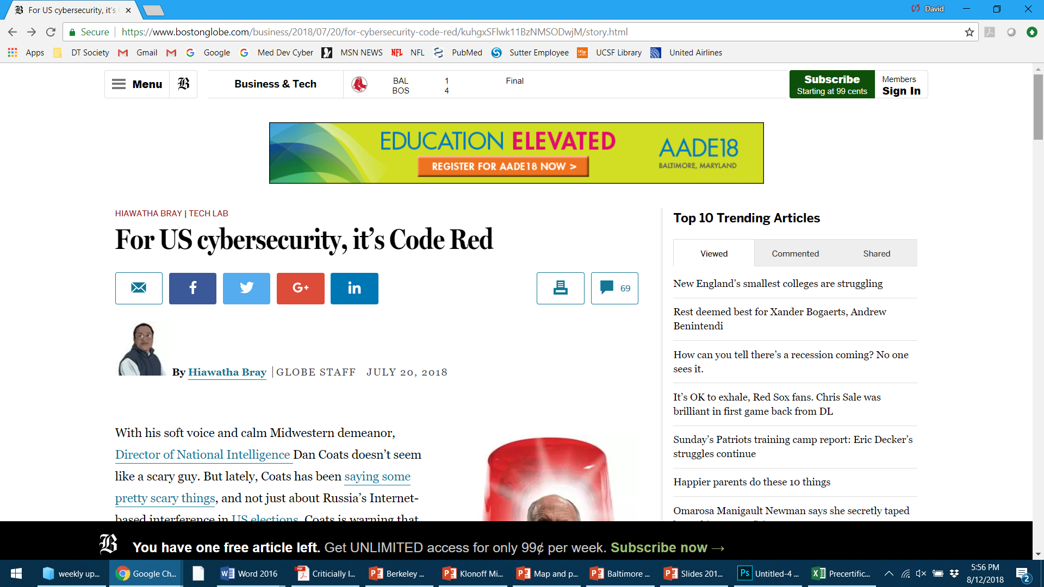

Lately, Director of National Intelligence, Dan Coats has been saying some pretty scary things. Coats is warning that weaknesses in US cybersecurity could be setting us up for a high-tech replay of the devastating terror attacks of Sept. 11, 2001.

Slide 12

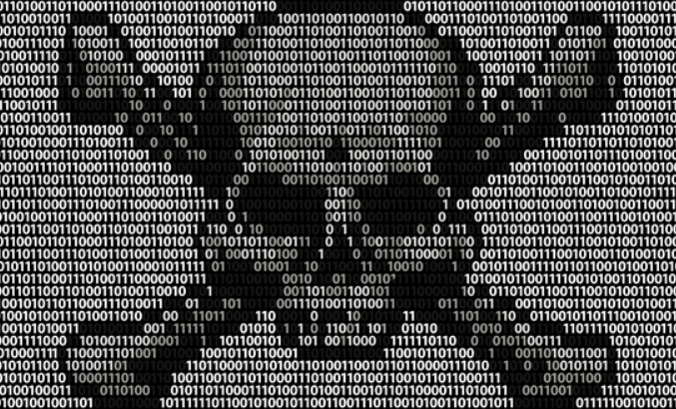
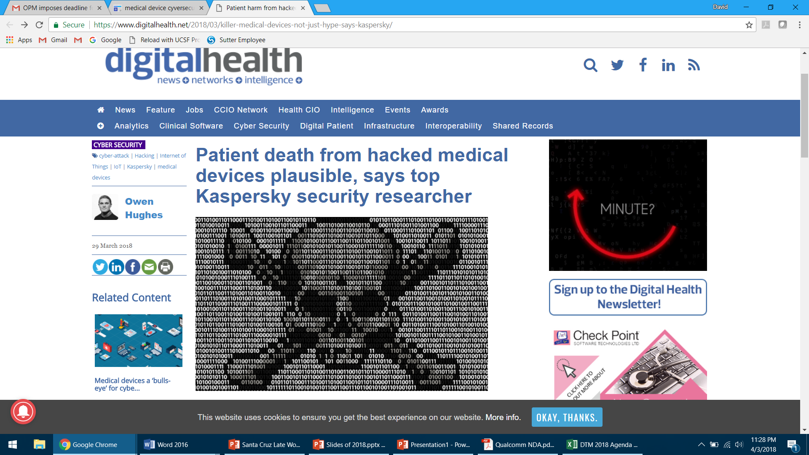
Patient death from hacked medical devices is
plausible, says top Kaspersky security researcher
March 29, 2018

Slide 13

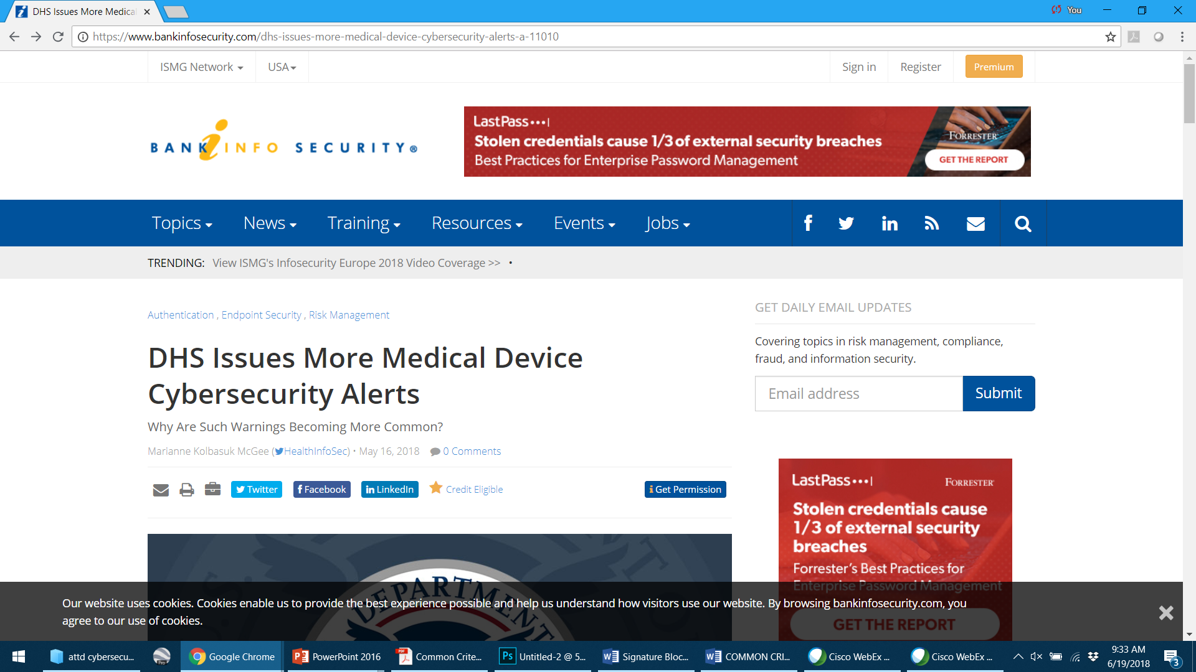
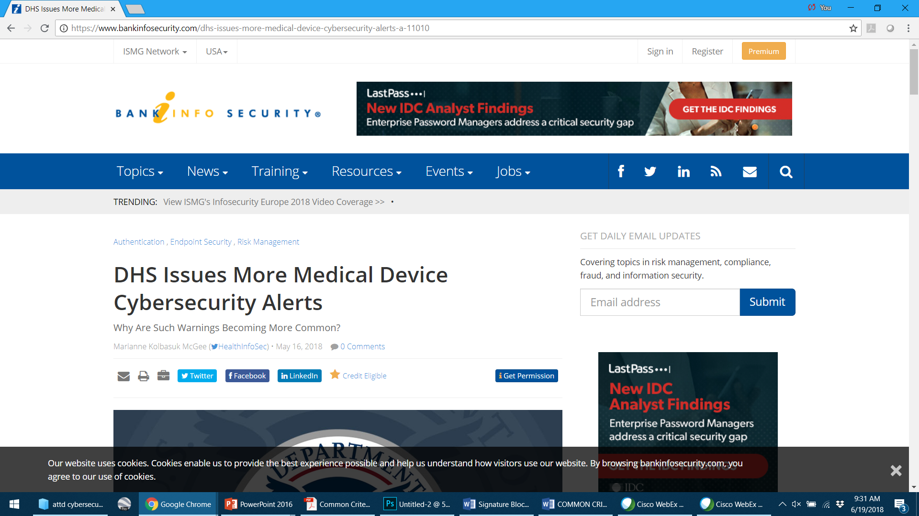

Slide 14


Notes:
Emergency Care Research Institute

Slide 15
NUMBER 1 HAZARD:
CYBERECURITY THREATS TO HEALTHCARE
DELIVERY

Slide 16
CONNECTED MEDICAL
DEVICES CONTAIN
VALUABLE ASSETS
REQUIRING EFFECTIVE
CYBERSECURITY
FOR PROTECTION

Slide 17
ASSETS THAT HOSPITALS AND MEDICAL DEVICE COMPANIES MUST PROTECT FROM SECURITY BREACHES
Patients’ health
Patients’ health records (includes PHI)
Availability of healthcare services
Intellectual property (research data)
Reputation of the hospital, staff, & co.

Slide 18
DEFINITION OF CYBERSECURITY
Protection of data and command
information transmitted between
connected medical devices from unauthorized disclosure,
modification, and loss of function.

Slide 19
THE CIA TRIAD
Confidentiality
Integrity
Availability
Protection from unauthorized disclosure
Protection from unauthorized modification
Protection from loss of function

Slide 20
Cybersecurity is one feature of a
connected medical device –
in addition to safety, effectiveness,
cost, and privacy.
IMPACT OF CYBERSECURITY

Slide 21
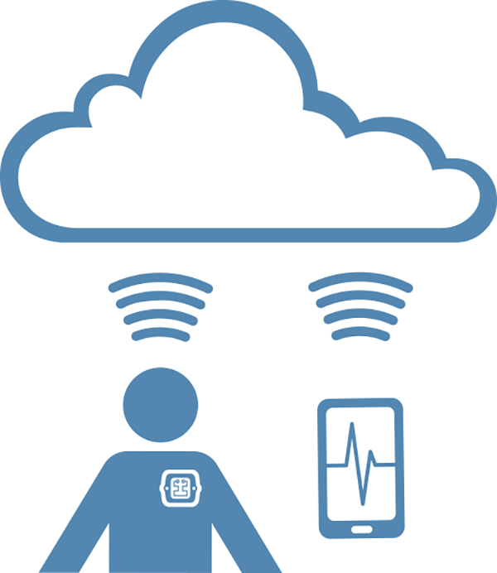
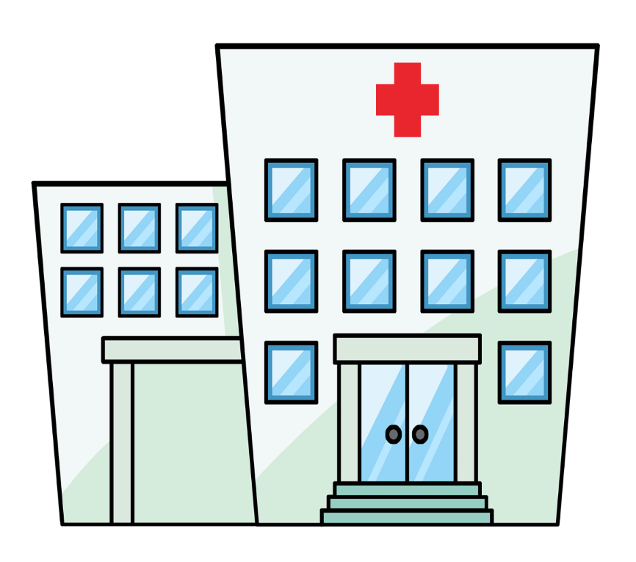
WEARABLE
DIABETES DEVICES
HOSPITAL
DIABETES DEVICES

Slide 22
CYBERSECURITY OF WEARABLE AND HOSPITAL DIABETES DEVICES
OUTLINE
Why wearable/implanted diabetes devices must be secure
How to achieve cybersecurity for wearable/implanted diabetes devices
Why hospital diabetes devices must be secure
How to achieve cybersecurity for hospital devices

Slide 23
WHY WEARABLE
OR IMPLANTED DIABETES DEVICES MUST BE SECURE

Slide 24
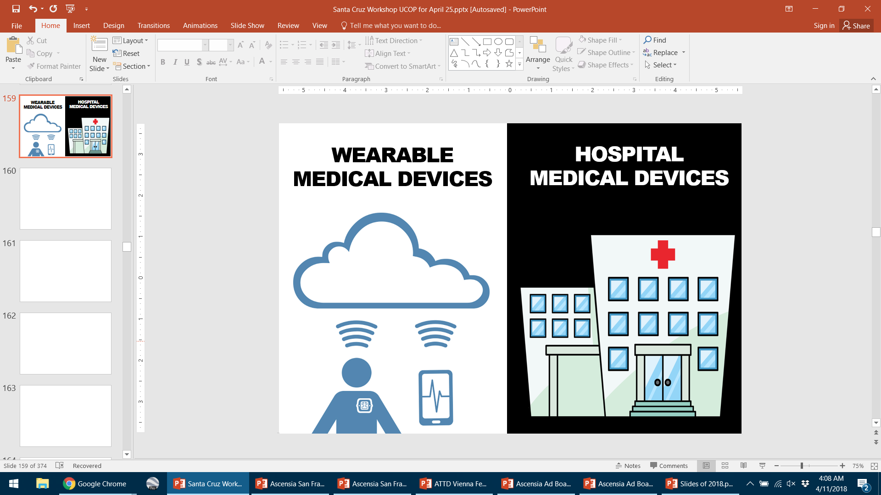
WEARABLE
DIABETES DEVICES

Slide 25

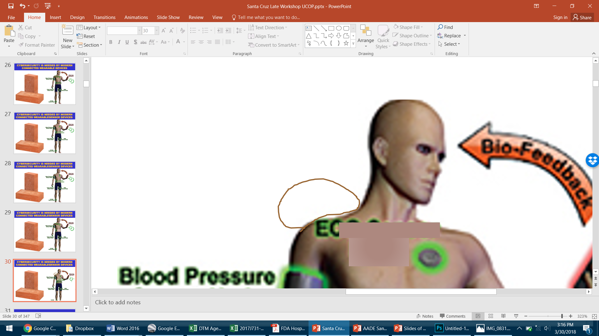
MEDICAL DEVICES HAVE TRADITIONALLY BEEN READ AND CONTROLLED MANUALLY
Data & Info
SENSOR
Cardiac
Sensor
Smartphone
Hub
Blood
Pressure
Sensor
Continuous
Glucose
Monitor
Pulse
Oximeter
EMG
Sensor
EFFECTOR
Accelerometer
Position Sensor

Slide 26
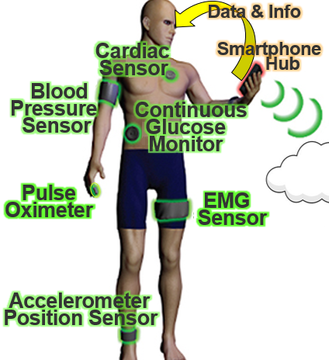


WIRELESSLY CONNECTED WEARABLE OR IMPLANTED SENSOR DEVICES
Data & Info
Cardiac
Sensor
Smartphone
Hub
SENSOR
Blood
Pressure
Sensor
Continuous
Glucose
Monitor
Pulse
Oximeter
EMG
Sensor
EFFECTOR
Accelerometer
Position Sensor

Slide 27
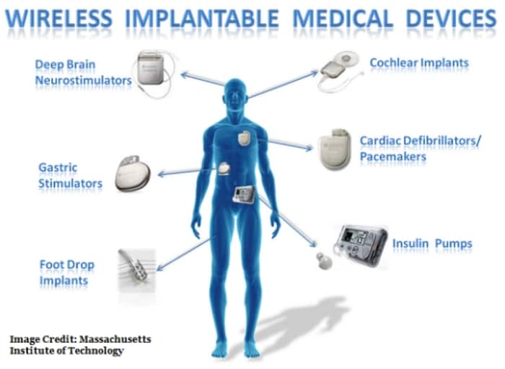
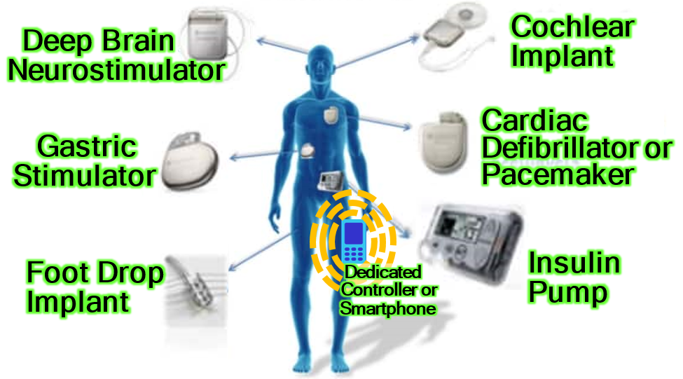
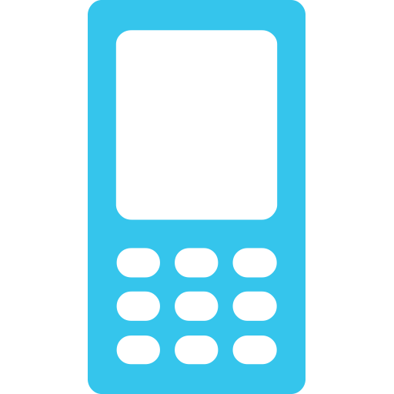
WIRELESSLY CONTROLLED WEARABLE OR IMPLANTED THERAPEUTIC EFFECTOR DEVICES
Cochlear
Implant
Deep Brain Neurostimulator
Cardiac
Defibrillator or
Pacemaker
Gastric Stimulator
Foot Drop
Implant
Insulin
Pump
Dedicated
Controller or
Smartphone

Slide 28
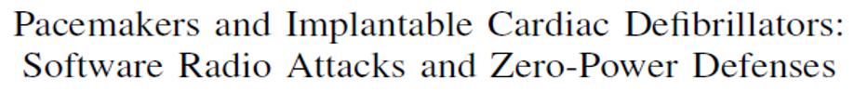
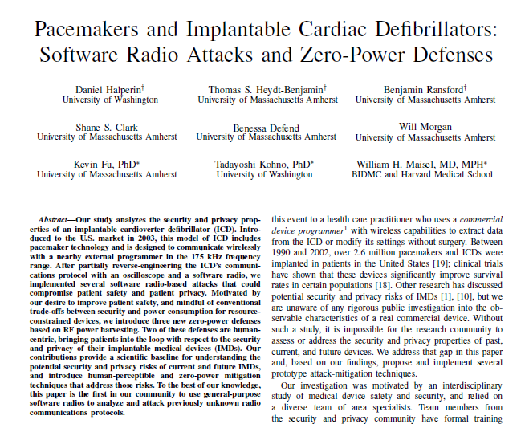

Slide 29
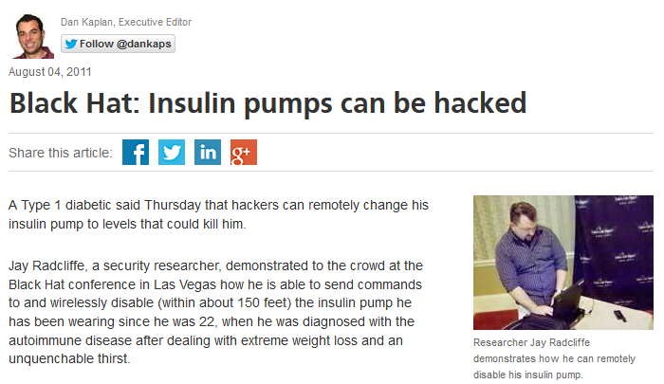
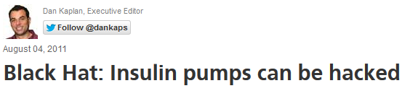

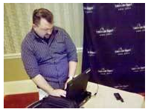
August 4, 2011
Researcher Jay Radcliffe demonstrates how he can remotely disable his insulin pump.

Slide 31


Season 2, Episode 10

Slide 32
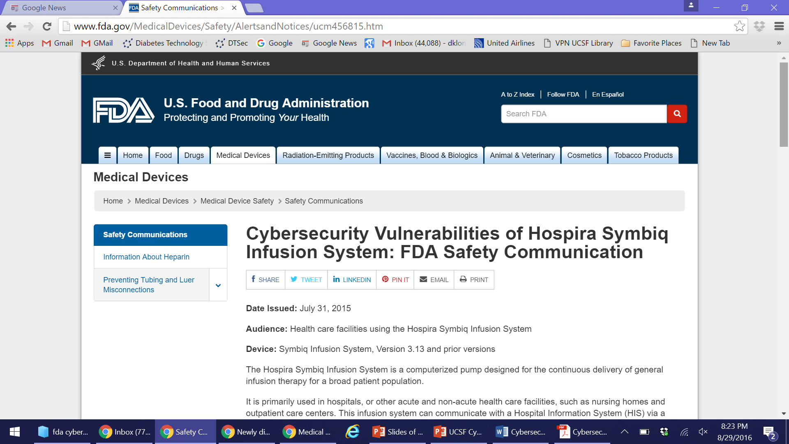
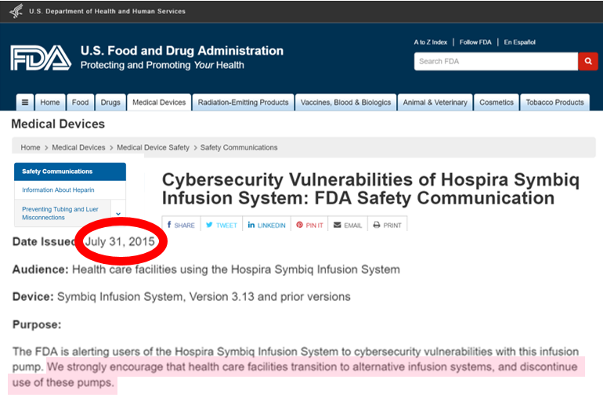

Slide 33
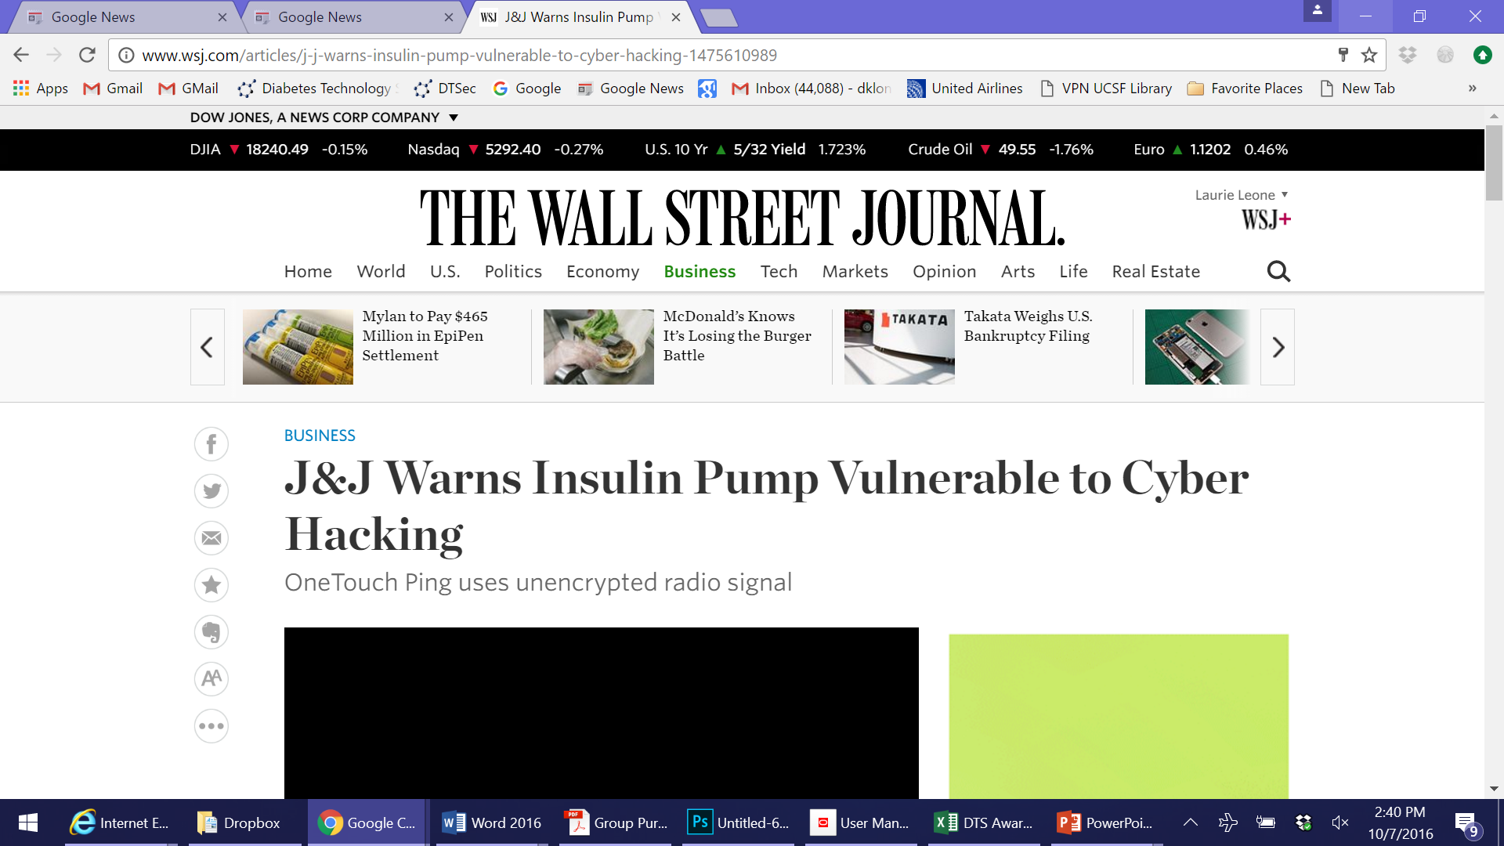
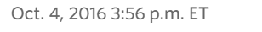
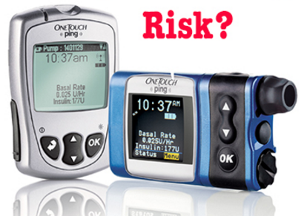
BUSINESS
J&J Warns Insulin Pumps Vulnerable to Cyber Hacking
COORDINATED
DISCLOSURE
BY RAPID7
Johnson & Johnson has announced that one of its insulin pumps is vulnerable to cyber hacking. A hacker in close proximity to the OneTouch Ping insulin pump system could use sophisticated equipment to find the unencrypted radio signal and program the pump to supply insulin. The risk to patients is extremely low, according to J&J.

Slide 34
BUSINESS
J&J Warns Insulin Pumps Vulnerable to Cyber Hacking
COORDINATED
DISCLOSURE
BY RAPID7
REMEDIES
TURN OFF REMOTE CONTROL
LIMIT SIZE OF A BOLUS
ENABLE VIBRATION WITH BOLUS
REGULARLY REVIEW BOLUS DOSING

Slide 35
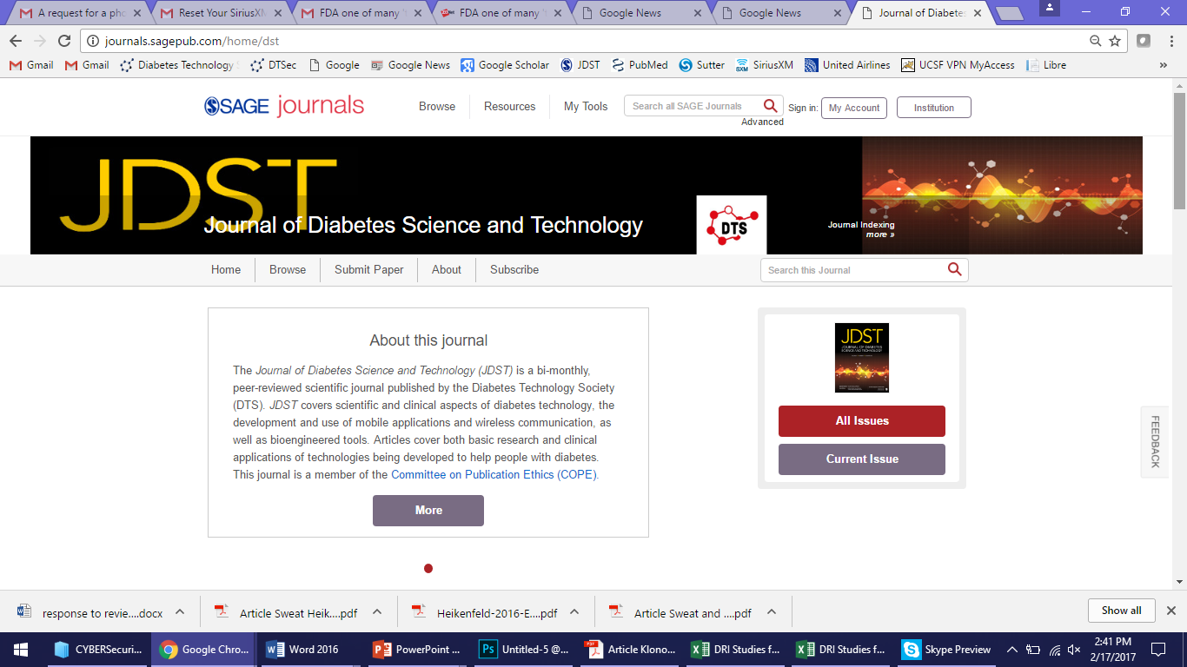
MARCH, 2017 ISSUE
SPECIAL SECTION ON CYBERSECURITY FOR DIABETES DEVICES

Slide 36
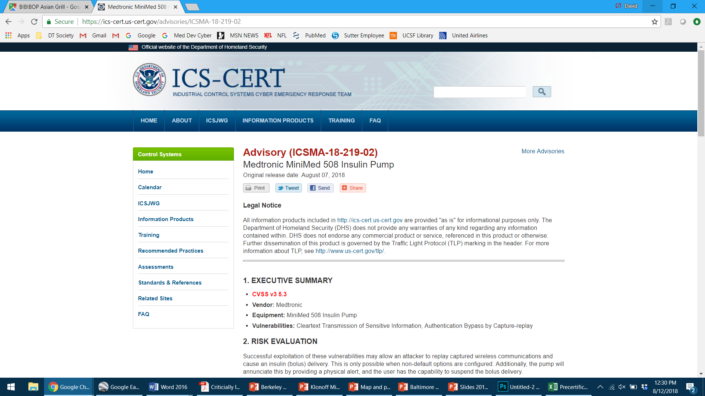

Slide 37
RISK FACTORS
Remote option and Easy Bolus are enabled
Remote controller ID is registered to pump
Hacker is near with a sniffer during a bolus
User ignores the bolus alert (beep / vibrate)

Slide 38
RISK FACTORS
Remote option and Easy Bolus are enabled
Remote controller ID is registered to pump
Hacker is near with a sniffer during a bolus
User ignores the bolus alert (beep / vibrate)
RISK MINIMIZATION STEPS
Turn off Easy Bolus when it is not needed
Be attentive to Easy Bolus dosing alert

Slide 39
HOW TO ACHIEVE CYBERSECURITY FOR WEARABLE DEVICES

Slide 40
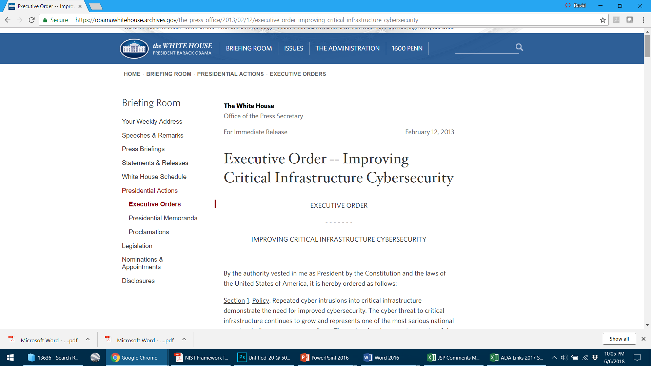
“NIST shall lead the development of a framework to reduce cyber risks to critical infrastructure (the Cybersecurity Framework).”

Slide 41
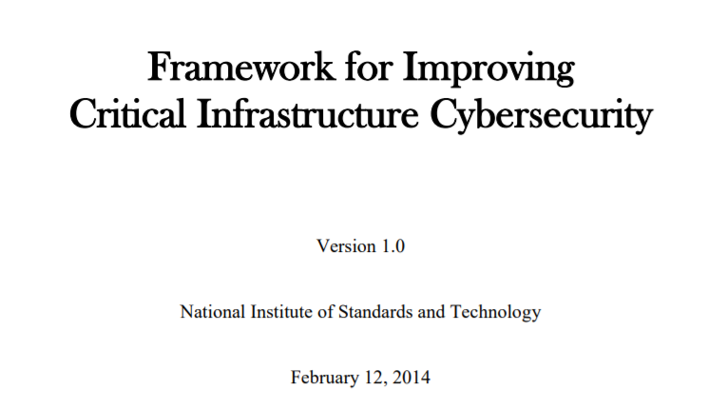
CYBERSECURITY ACTIVITIES AND OUTCOMES ACROSS
CRITICAL INFRASTRUCTURE SECTORS

Slide 42
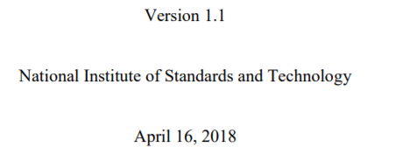
CYBERSECURITY ACTIVITIES AND OUTCOMES ACROSS
CRITICAL INFRASTRUCTURE SECTORS

Slide 43
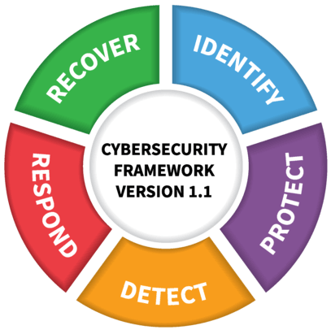
FRAMEWORK CORE
CYBERSECURITY ACTIVITIES
NIST

Slide 44
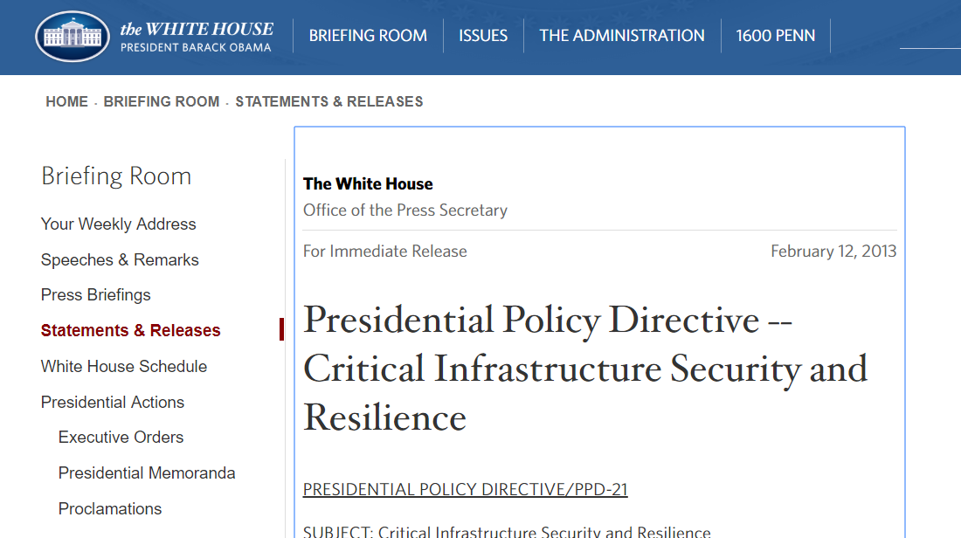

Slide 45


16 CRITICAL INFRASTRUCTURE SECTORS
WHICH ARE VITAL TO THE UNITED STATES

Slide 46
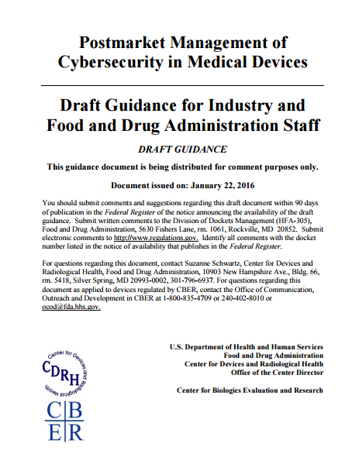

Slide 47
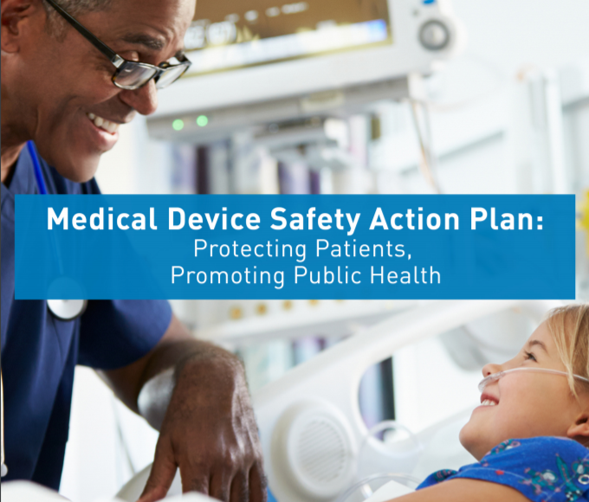

APRIL 12, 2018
FDA 2018 PLANS
Patch updates
Software bill of materials
Coordinated disclosures
Cyber Safety Board

Slide 48
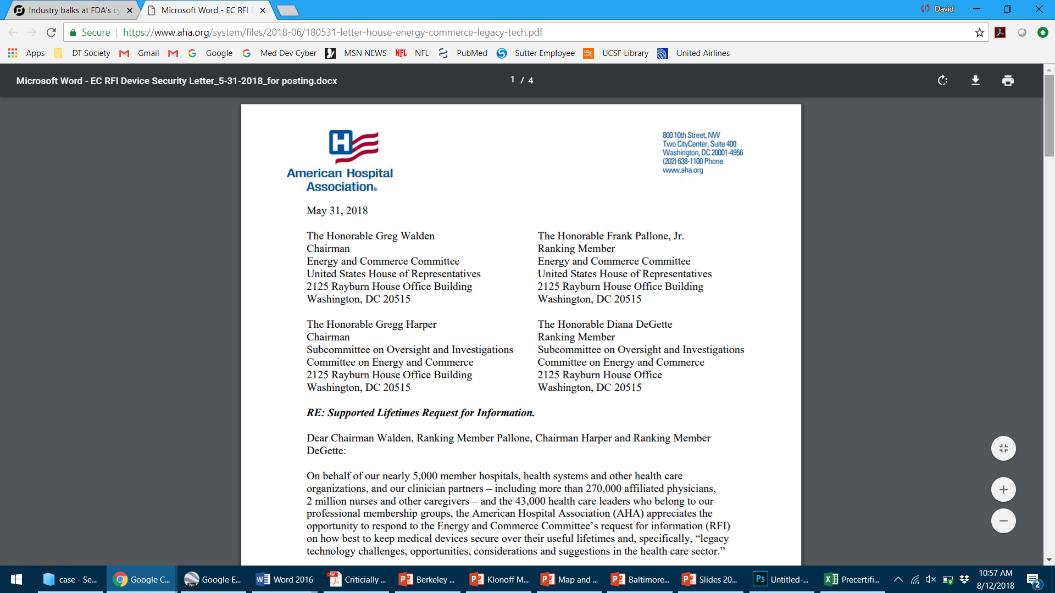

Slide 49
AHA RESPONSE
“Supported lifetime” idea for new devices
Mfrs must build capability to update and patch device security into product design
FDA must ensure security of legacy devices
FDA to coordinate coordinated disclosures

Slide 50
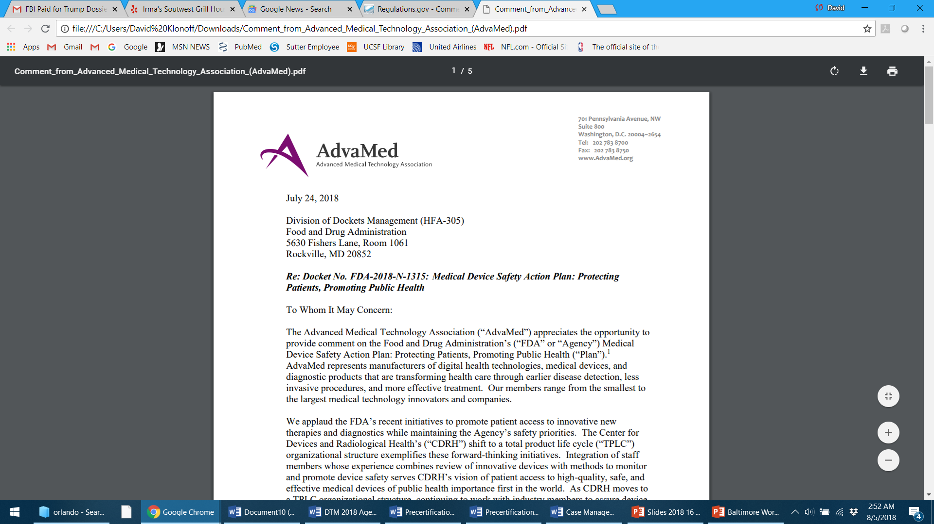

Slide 51
ADVAMED RESPONSE
APRIL 12, 2018
ADVAMED RESPONSE
Patching is a shared duty of mfrs and Health Delivery Orgs
Software BOMs must be secure
Real world data – not surveillance data for safety
Cyber Safety Board members could have conflicts of interest
FDA 2018 PLANS
Patch updates
Software bill of materials
Coordinated disclosures
Cyber Safety Board

Slide 52

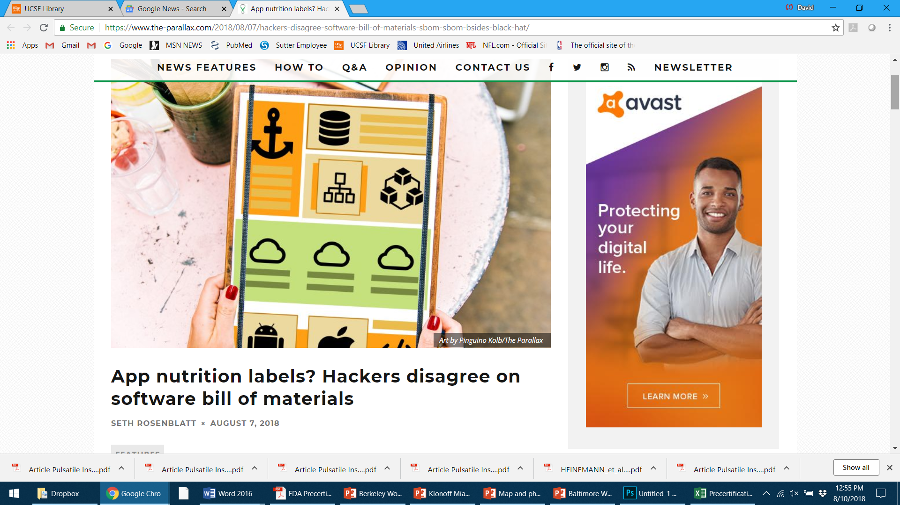
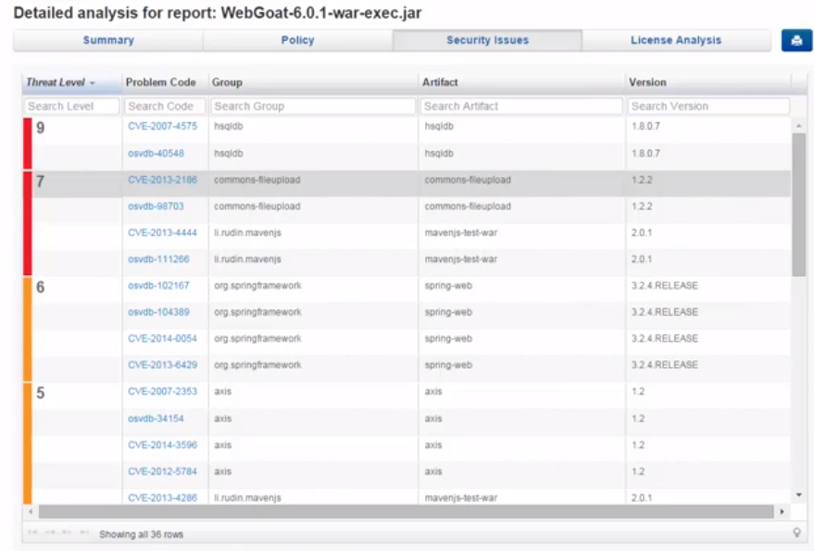
What if software came with a list of ingredients, a
digital equivalent of gluten or peanuts? This list would indicate vulnerability to
hackers.
App nutrition labels? Hackers disagree on software bill of materials

Slide 53
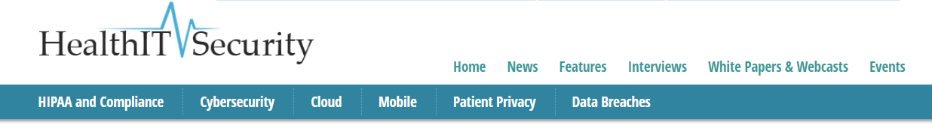

Medical Device Security Requires
Collaborative Action from Industry
August 10, 2018
“Manufacturers ought to be able to tell their customers what software is in the product being sold. This will enable the security teams at the customer to better manage their security as part of their asset management program,” said Greg Garcia.

Slide 54
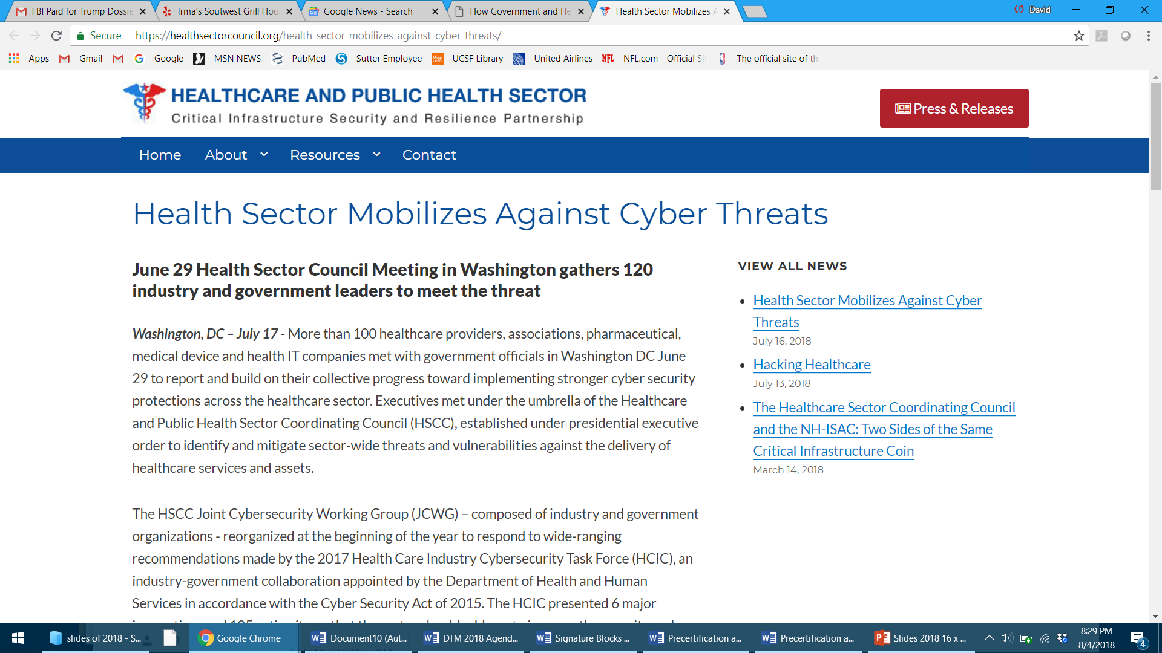

Slide 55
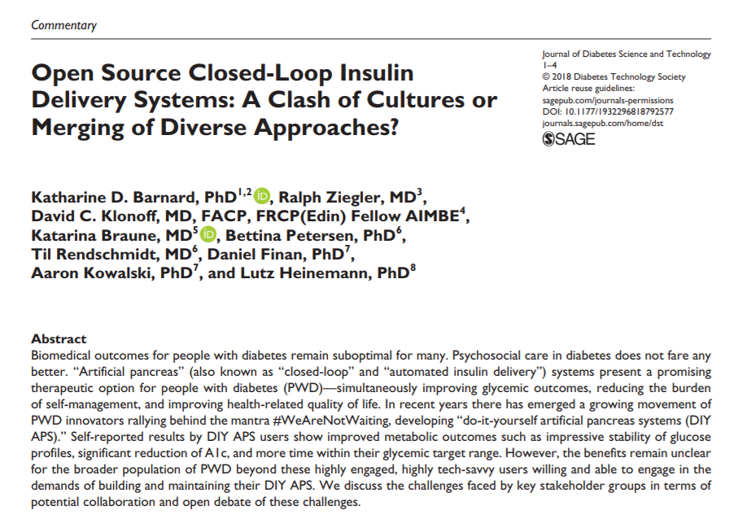
First Published August 6, 2018

Slide 56
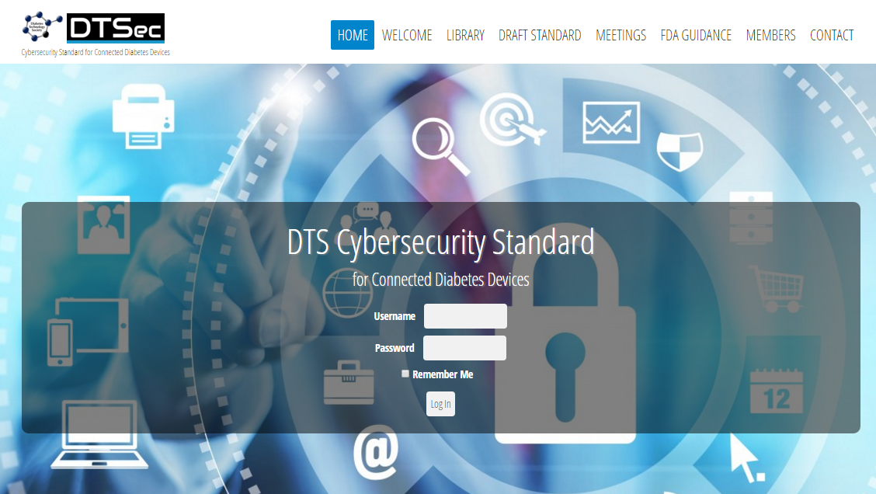

Slide 57
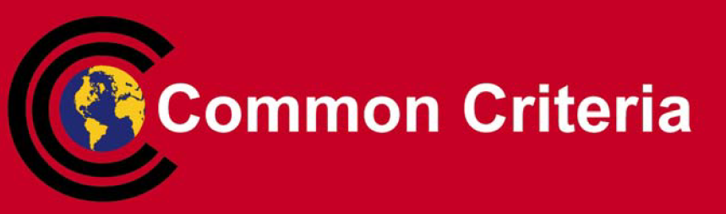

Slide 58
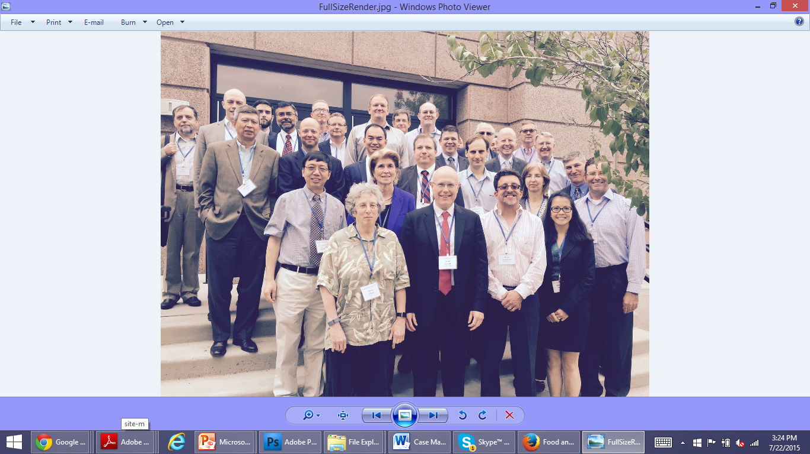
DIABETES TECHNOLOGY CYBERSECURITY STANDARD FOR CONNECTED DEVICES

Slide 59
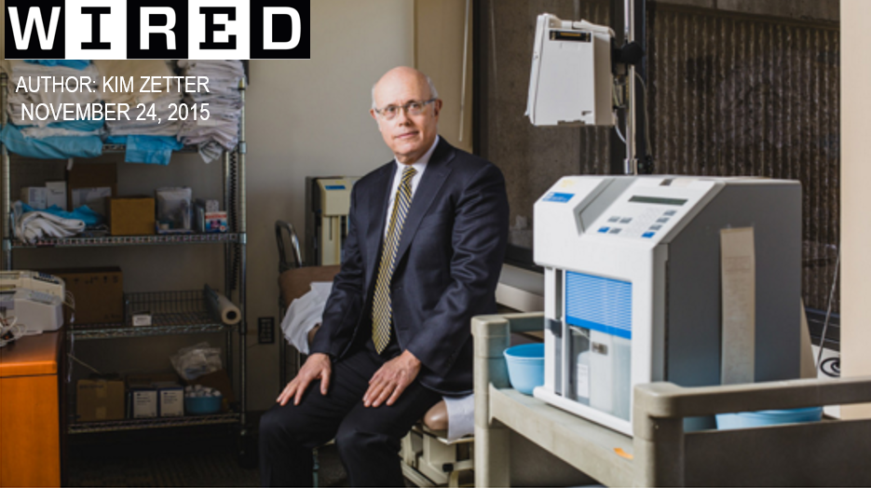

THE DOCTOR ON A QUEST TO SAVE OUR MEDICAL DEVICES FROM HACKERS

Slide 60
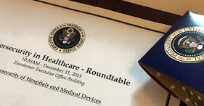
WHITE HOUSE HEALTH AND CYBERSECURITY
ROUNDTABLE FOR HOSPITALS AND MEDICAL DEVICES DECEMBER 11, 2015

Slide 61
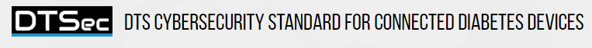
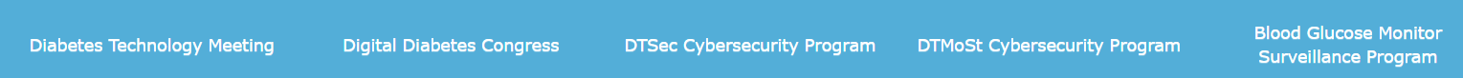
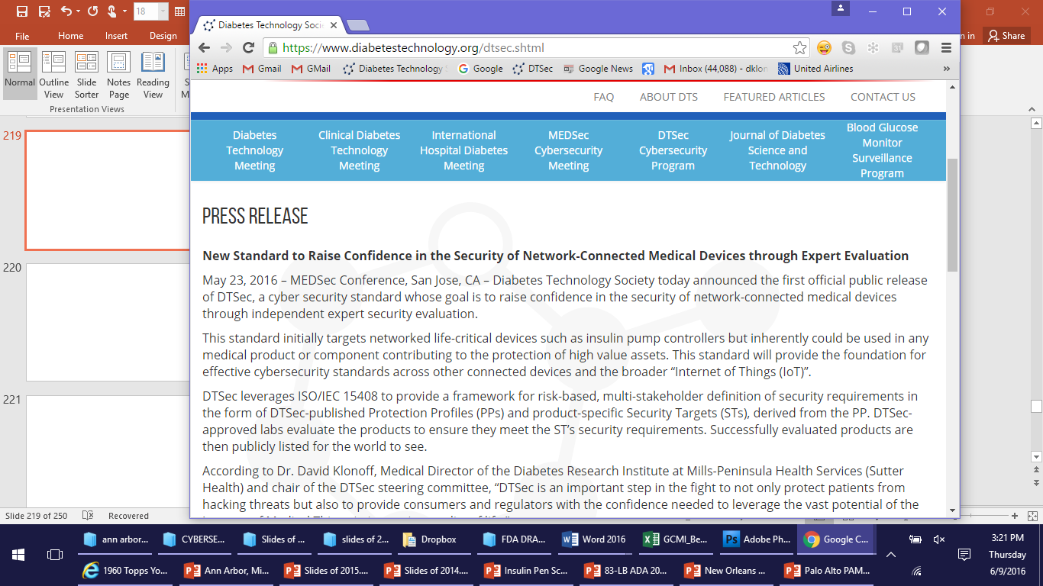
PRESS RELEASE
New Standard to Raise Confidence in the Security of
Network-Connected Medical Devices through Expert Evaluation

Slide 62



Slide 63


Slide 64


Slide 65
New Standard Provides Security Guidance for Consumer
Mobile Phones Controlling Diabetes Devices
May 22, 2018 - Diabetes Technology Society (DTS) is pleased to announce
that the Steering Committee members of the Diabetes Technology Society
Mobile Platform Controlling a Diabetes Device Security and Safety
Standard (DTMoSt) project have developed the DTMoSt Guidance for Use
of Mobile Devices in Diabetes Control Contexts.

Slide 66


Slide 67

DTMoSt Diabetes Technology Society Mobile Platform
Controlling a Diabetes Device Security and Safety Guidance

Slide 68
Whitelisting CMDs
Real Time Control
Resource Availability
Personal Area Network

Slide 69





The Institute of Electrical and Electronics Engineers
Underwriters
Laboratories Inc.

Slide 70
HEALTHCARE
PROFESSIONALS
PATIENTS
PAYERS
DTSec & DTMoSt
PROVIDE
ASSURANCE
HOSPITALS
REGULATORS

Slide 71

BEST SELLING AUTHOR OF DATA AND GOLIATH

Slide 72
It’s only a matter of time before hackers kill people directly by causing malfunctions in Internet-connected medical devices with catastrophic results. Government-mandated standards for all Internet-connected devices are needed with easy upgrades for newly discovered security flaws.
BEST SELLING AUTHOR OF DATA AND GOLIATH

Slide 73
WHY HOSPITAL DIABETES
DEVICES MUST
BE SECURE

Slide 74






SECURITY BREACH

Slide 75
MORBIDITY
SECURITY BREACH

Slide 76
SECURITY BREACH
LITIGATION

Slide 77
SECURITY BREACH
GOVERNMENT
PENALTIES

Slide 78
SECURITY BREACH
INSURANCE COSTS

Slide 79
SECURITY BREACH
BAD PUBLICITY

Slide 80

RANSOMWARE

Slide 81

WannaCry Ransomware on a
Bayer Radiology System: May 13, 2017

Slide 82



RANSOMWARE HACK NETS $45,000

Slide 83



The medical-testing giant Laboratory Corp. of America is dealing with a broad cyberattack, people familiar with the matter said, the latest breach to disrupt companies that hold sensitive information.

Slide 84
HOW TO ACHIEVE CYBERSECURITY FOR HOSPITAL DEVICES

Slide 85
SEVEN STEPS TO PREVENT HOSPITAL CYBERSECURITY BREACHES
1)
2)
3)
4)
5)
6)
7)
Train all employees to promote security
Inventory all devices and prioritize by risks and PHI content
Control access (password & physical security)
Protect devices with updated software, patches, AVS, and network firewalls
Have a plan in case of attack
Include security specifctns in vendor contracts
Join an information sharing organization
1)
2)
3)
4)
5)
6)
7)

Slide 86

Managing health information security
goes beyond IT to INFORMATION GOVERNANCE, which shifts the.. focus from technology.. to people, processes,
and policies.

Slide 87



CONGRATULATIONS!
You didn’t take the bait!
You have successfully recognized
a phishing test message. Your ability
to identify suspicious messages will
help protect our patients, organization,
and your own information.

Slide 88

DETERMINATION OF RISK SEVERITY
IMPACT
LIKLIHOOD

Slide 89




MULTIFACTOR
ACCESS CONTROL
Biometric
Biometric
Password
Card or Tag

Slide 90

Don’t Touch That Flash Drive!
You Have No Idea Where It’s Been.
Notes:
60% plugged in flash drives from a DHS parking lot. 45% plugged in flash drives U of Illinois. Stuxnet. Edward Snowden.

Slide 91



Slide 92

Software maintenance =
Jet Engine maintenance

Slide 93

A RESPONSE PLAN, ACTIVITIES, AND SYSTEM OUTCOMES FOR A CYBER ATTACK

Slide 94


Vendor Contracts
“Articulating a set of minimum medical
device cybersecurity requirements across
the life cycle, will give manufacturers and health delivery organizations a common baseline to build, buy, and
operate against.”

Slide 95

NATIONAL HEALTH INFORMATION SHARING AND ANALYSIS CENTER

Slide 96


January 5, 2017

Slide 97
January 5, 2017
The best time to prepare for a disaster is before it occurs.

Slide 98


Slide 99
MEDICAL DEVICE
CYBERSECURITY IS THE
NUMBER ONE HEALTHCARE
PROBLEM IN THE US,
POTENTIALLY AFFECTING
THE SAFETY AND PRIVACY
OF EVERY AMERICAN

Slide 100
THE TIME FOR MANUFACTURERS TO BUILD
SECURE SYSTEMS AND FOLLOW CYBERSECURITY STANDARDS IS OW
NOW

Slide 101


