Slide 1


Slide 2
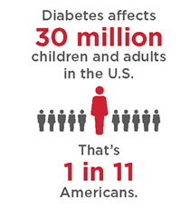
Type 2 Diabetes (T2D) Physiology to Care Plan:
A Case Study Approach

Slide 3

Chris E. Memering
BSN, RN, CDE
Inpatient Diabetes Educator
CarolinaEast Medical Center
New Bern, NC

Slide 4

Nathan A. Painter
PharmD, CDE
Associate Clinical Professor
UC San Diego Skaggs School of Pharmacy
San Diego, CA

Slide 5
Disclosure to Participants
Notice of Requirements For Successful Completion
  Please refer to learning goals and objectives
  Learners must attend the full activity and complete the evaluation in order to claim continuing education credit/hours
Conflict of Interest (COI) and Financial Relationship Disclosures:
  Presenter: Dr. Painter, PharmD, CDE –
  Presenter: Ms. Memering, BSN, RN – No COI/Financial Relationship to disclose
Non-Endorsement of Products:
  Accredited status does not imply endorsement by AADE, ANCC, ACPE or CDR of any commercial products displayed in conjunction with this educational activity
Off-Label Use:
  Participants will be notified by speakers to any product used for a purpose other than for which it was approved by the Food and Drug Administration.

Slide 6
Objectives
Pathophysiological changes leading to diagnosis
Risk factors
Educator care prevention
Treatment based on Guidelines
Diabetes and the systems of the body as they related to tertiary care prevention
Notes:
We will be talking about the pathophysiological changes occurring leading to the diagnosis of diabetes, the changes due to diabetes on the various systems of the body, modifiable and non-modifiable risk factors for diabetes and the associated complications, nursing care as it relates to primary, secondary, and tertiary prevention strategies, and include the use of technology as it pertains to care intervention, as well as current recommendations of treatment.
I find that one of the easiest ways to help understand interventions and build a plan of care, especially for a chronic disease such as diabetes, is to follow a person with diabetes along their lifespan in a case study type format. So with that in mind, meet Winona

Slide 7

Winona – Age 26
Native American
Mom had gestational diabetes with Winona’s pregnancy, and now has T2D
Works as a computer programmer
Sees her doctor once a year
Latest Vitals:
Fasting Glucose 98 mg/dL, HgbA1c 5.3%,
Total Cholesterol 165 mg/dL, HDL 39 mg/dL, Triglycerides 116 mg/dL, BP 117/73,
BMI 26.9 (5’8”, 177lbs)
Notes:
This is Winona. She is a 28 year old computer programmer. She is Native American. Her mom had gestational diabetes when she was pregnant with Winona, and now has T2D. Winona was taught in school that T2D is very prevalent in the Native American population, but that it isn’t an absolute, so she sees her PCP every year and asks to be monitored for T2D, especially since mom has diabetes. So far, so good. But she is young, and her FPG has been gradually increasing. What is the underlying pathophysiologic changes in this at risk individual? Let’s explore.

Slide 8
Prevention Interventions
Primary
Secondary
Tertiary
Rehab
prevent disease or injury
reduce the impact of a disease process, once at diagnosis
softens the impact of the disease that can have lasting effects (major complications)
further interventions when severe complications have occurred
Notes:
According the Institute for Work & Health, primary, secondary, tertiary, and rehab prevention terms are a way for health experts, such as ourselves, to to map out interventions to prevent or delay a particular disease process. Nursing/Educators cannot do all of the prevention interventions, and as such, it is important to know about some of these interventions that we can advocate for in our communities, workplaces, states and federal government. Health communities help to build healthier people and help to bring a shift of prevention instead of the general health care attitude of reaction, which in diabetes care, may be too late to prevent complication.
“The diagnosis of type 2 diabetes (and often indeed prediabetes as well) is often delayed, being made at a time when evidence of complications is already present” (AADE, 2014).

Slide 9
T2D; General Pathophysiological Changes
Insulin Resistance
Overproduction of glucose Decrease in glucose uptake
Overproduction of insulin
Failure of 𝛃-cells
Hyperglycemia - Diagnosis of Diabetes
Decrease in levels of insulin
Notes:
The first thing to remember about T2D is that this is a multifactorial and progressive disease, both prior to diagnosis and after.
The general pathological changes occurring in the body start with insulin resistance in the liver, muscle, and adipose tissue cells. Due to this insulin resistance, there is both a decrease of glucose uptake by the muscles (seen as an increase in postprandial glucose levels) and an increase of hepatic glucose production (seen as an increase in Fasting Plasma Glucose (FPG) despite the overproduction of insulin). This leads to an overproduction of insulin to maintain euglycemia. This overproduction by the 𝜷-cells of the pancreas leads to an eventual failure (about 80% by the time of diagnosis) to the 𝜷-cells to produce enough insulin, leading to overt Hyperglycemia. (DeFronzo et al. 2013)
Diagnosis is made once the laboratory findings (as established by the ADA) show: a HgbA1c value of greater than or equal to 6.5% (eAG 139 mg/dL); a casual plasma glucose of ≥200 mg/dL in the presence of acute symptoms (stated above); a fasting plasma glucose of ≥126 mg/dL on two separate occasions; or a glucose level of ≥200 mg/dL at the 2 hour mark (postload) during an oral glucose tolerance test (OGTT) with a 75 gram glucose load (Vivian, 2017)
ADA = American Diabetes Association
HgbA1c = Hemoglobin A1C, a 3 month measure of the glycosylation of the hemoglobin molecule
eAG = estimated Average Glucose
T2D progresses, at a rate in general depending on the the management of glycemia by the person with diabetes, and eventually, there is a further decrease in the circulating insulin levels, and thus the person with T2D, must then use insulin to maintain euglycemia.

Slide 10
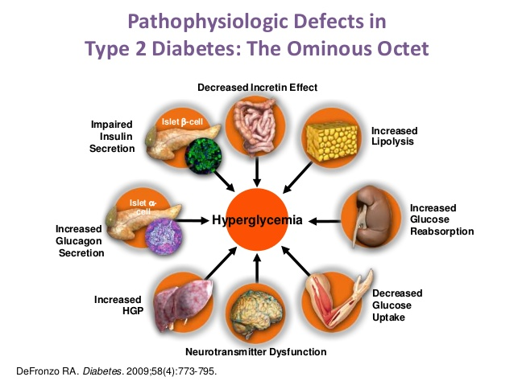
DeFronzo’s Ominous Octet
Notes:
There are 5 other physiologic changes in what Dr. Ralph DeFronzo calls the Ominous Octet. These are: 1) resistance to insulin’s antilipolytic effect by adipose cells which increased plasma Free Fatty Acid concentrations, 2) decreases in incretin levels and severe β-cell resistance to these incretin hormones which help to regulate appetite, 3) increased glucagon secretion in the α-cells and increased hepatic sensitivity to glucagon, 4) enhanced reabsorption of glucose by the kidneys (increased the renal threshold of spilling glucose into the urine from 180 mg/dL to 240 mg/dL), and 5) appetite dysregulation, weight gain, and insulin resistance secondary to resistance in the central nervous system insulin and other hormones (DeFronzo et al. 2013)
Understanding the various areas of dysfunction in T2D allows the practitioner to help determine medication classes to use for a PWD. For the nurse or educator, it helps to be able to teach about the various medications used to treat T2D. The other teaching pearl is that it helps the PWD understand that this is not just about sugar and insulin, especially as many PWD, especially T2D feel like if they just stop eating sugar that their blood sugar will be better. Helping a patient understand the multi-facets of dysfunction in T2D can help them to understand the need for multiple lifestyle interventions, as well as multiple medications.
A brief understanding of these changes that occur as part of normal physiology in the development of T2D can often help PWT2D, understand that sometimes there are forces that just work against them and eventually they develop T2D. There is a lot lifestyle involved in the development of T2D, but there is also the genetic component that is just not able to change. This understanding, may help people at risk for developing T2D seek diagnosis earlier or at least screening for diagnosis, and be better able to participate in secondary and tertiary care prevention throughout the course of their disease. Early intervention helps to protect metabolic memory. And when there is “good” metabolic memory, the risk for complications is reduced.
PWD = Person with Diabetes

Slide 11
Risk Factors
Modifiable
Nonmodifiable
Development of Type 2 Diabetes
Notes:
So, with the understanding of the underlying physiology, specifically the insulin resistance, or to patients I say that their insulin doesn’t work well, it doesn’t hit the right receptors of the cell to “open” the cell to allow glucose to enter and be turned into energy, it is important to understand risk factors which can lead to the development of T2D.
Most all disease processes have both modifiable and nonmodifiable risk factors. Primary prevention focuses on those that are modifiable. For those that are not modifiable, understanding the potential risk that a person has based on these risk factors may help them to avoid or modify those risks that they can. It may also lead to earlier screening as with our patient Winona.

Slide 12
Non-modifiable Risk Factors
Genetic predisposition to insulin resistance
Family history
Polycystic Ovarian Syndrome (PCOS)
Ethnicity
Medications i.e. steroids
Age
History of Gestational Diabetes
Environmental exposure to Endocrine Disrupting Chemicals (EDCs)
Depression
Stress
History of Cardiac Artery Disease (CAD)
Notes:
Non-modifiable risk factors include:
the genetic predisposition toward insulin resistance, seen as impaired fasting glucose or impaired glucose tolerance (Albright & Gregg, 2013),
specific known genetic markers,
age 45 and over, (we all “like” to get older each day, better above ground than below it, right?)
family history, and particularly if mom had diabetes or gestational diabetes,
ethnicity, spcifically Hispanic, Native American including Native Alaskans, African American, and Pacific Islander
history of gestational diabetes, for the individual, or child of
polycystic ovarian syndrome (PCOS), increasing the insulin resistance found in the body, can be helped with the use of metformin
depression,
history of cardiovascular disease (Waddell, 2017, Albright & Gregg, 2013).
Lower socio-economic status, including less access to better food choices, such as fresh fruits and vegetables, and less access to options for physical activity (Albright & Gregg, 2013), have also been shown to be a non-modifiable risk factor for the development of T2D, leading to cultural and societal risk factors. Many states have attempted to address this within their call to primary prevention. We will discuss this in a moment.
Depression, Stress, and avoiding a history of CAD are somewhat modifiable risk factors, as well as limiting exposure to EDCs in some cases.
Exposure to environmental toxins known to as endocrine disrupting chemicals (EDCs) (Alonso-Magdelena, Quesada, & Nadal, 2011), can be considered both a non-modifiable and a modifiable risk factor. Alonso-Magdelena, Quesada, & Nadal (2011) describe EDCs as exogenous chemicals which consist of at least 4 widespread organic pollutants, persistent organic pollutants (POPs), Dioxins, polychlorinated biphenyls (PCBs), and bisphenol A (BPA), that can induce insulin resistance and are accumulated in the adipose tissue of the body. As a non-modifiable risk factor, this can be seen in the exposure of veterans of the Vietnam War who were exposed to Agent Orange (TCDD, a dioxin) and their high rate of T2D, as a modifiable risk, the exposure to BPA can be reduced with lowering the usage of plastic containers.
I’ve modified the color of the 3 non-modifiable risk factors that our case study Winona currently has in her history and are reasons her PCP is monitoring her fasting glucose, blood pressure, and HgbA1c.

Slide 13
Modifiable Risk Factors
Risk Factor
Hypertension
Dyslipidemia
Smoking
Increased Caloric Intake
Obesity
Inactivity
Physiologic Change/Body System
Increase in risk of ASCVD
Increases hepatic glucose production, increases insulin resistance
Potentially due to neurotransmitter dysfunction
Lipolysis increased
Decreases glucose
uptake in the muscle cells
Notes:
Modifiable risk factors include:
smoking (Spijkerman, van der A, Nilsson, Ardanaz, Gavrila, Agudo, et al. 2014),
overweight or obesity,
prehypertension or hypertension,
dyslipidemia specifically low levels of HDL and elevated triglycerides,
sedentary lifestyle (Waddell, 2017),
high caloric intake such as that related to secular trends of increased portion sizes, refined carbohydrates, high caloric sweetened beverages (Albright & Gregg, 2013).
Venditti (2016) describes behavior change in relation to self-management skills of lifestyle choices as having a “positive impact on energy balance, body weight, and body composition, which, in turn, leads to improvements in blood glucose control, cardiometabolic risk factors, and health-related quality of life” (p603). She further states “robust behavioral lifestyle interventions exemplify the potential for human health and well-being across the life span and convey a hopeful message” (Venditti, 2016, p605).
Primary Prevention Interventions work on reducing the modifiable risk factors for developing T2D. The National Diabetes Prevention Program (NDPP) is a great example of this.
With Winona, the questions that need to be asked are related to lifestyle. Her BMI is 26.9, and thus falls in the Overweight category. Her job looks to be one that can be quite sedentary. What are her modifiable risk factors?

Slide 14
Winona’s Risk Factors
Non-Modifiable
  Positive family history
  Mother had gestational diabetes with this pregnancy
  Native American
Modifiable
  Sedentary job
  High caloric diet
  Smokes
  Overweight
Notes:
After talking more with Winona and asking some questions about her current lifestyle, we find that she is “tied to a computer all day” with her work. We also find out that when she isn’t working, she is planning her wedding and it is a high stress situation, so she is eating whenever she can get to it, and usually grabbing fast food. Any exercise plans she has are taking a back seat. And because of the stress and amount of work to be done, she is finding herself turning to her favorite blended coffee drink and smoking as her fiancé smokes.

Slide 15
Primary Prevention Strategies
Continue annual screenings: FPG and HgbA1c
SMART Goals
  Discuss action of smoking on insulin resistance and increasing her fasting glucose
  Diet choices, understanding fast foods that may decrease caloric intake
  Looking at ways to decrease sitting
    Fitbit can alarm every hour to get people moving
Notes:
Currently, she has some lifestyle areas that could work well with SMART goals. Remember these are Specific, Measurable, Attainable, Relevant, and Time Based. As she is in a high stress time period, she may not be in a time of readiness to make changes. However, even small changes, such as finding a way to move every hour while at work can be helpful.

Slide 16
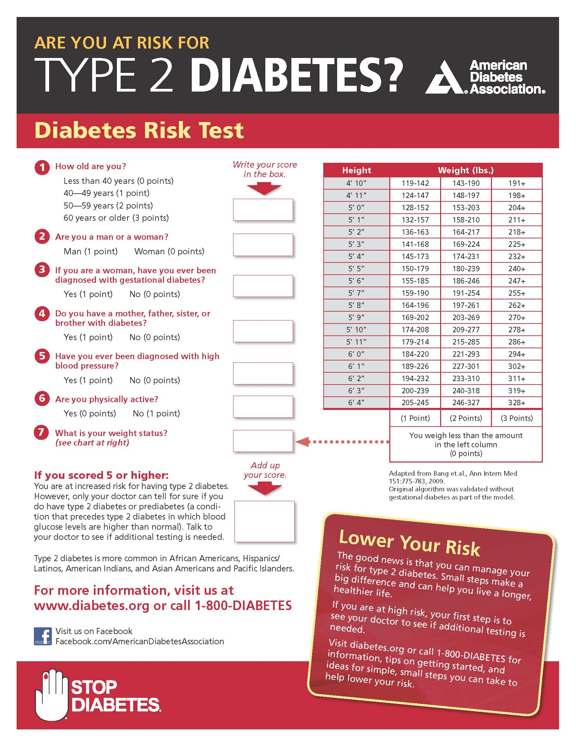
Primary Prevention
Education
Early Screening
Risk Assessments
CDC commercials for Prediabetes risk
Eat Smart, Move More, Weigh Less
Healthy Communities
Healthy People 2020 - has a focus on nutrition, physical activity, and obesity
Notes:
Primary prevention, as noted by the CDC, is interventions to help prevent T2D from occurring. This can occur through the nursing interventions of public education and screening. This education starts with assisting the individual in knowing their overall risk for the development of T2D. Using a tool like the Diabetes Risk Test pictured can help people understand their potential for developing T2D and discuss with the PCP how and when to be tested, what symptoms to look for at home to prompt earlier assessments, and potentially areas to focus on before even Prediabetes.
Once this risk is known, then further education interventions are aimed at helping to prevent/delay the onset of T2D through lifestyle modifications. The Lifestyle Intervention arm of the clinical trial of the Diabetes Prevention Program and Outcomes Study (as seen in Figure 2, Venditti, 2016), showed a cumulative reduction in incidence of T2D by 58% in the first follow up period of 2.8 years, and a 27% reduction at 10 years after beginning the DPP (Venditti, 2016) with the interventions of behavior therapy that helped people at risk for diabetes make changes to caloric intake, activity level, and reduced weight.
The CDC has created public service announcements (click word Prediabetes) to help people quickly understand their risk for having Prediabetes, as 86 million adults in the US have Prediabetes with most not being aware of having Prediabetes. The importance of helping people to become more aware of this modifiable risk, is that the risk of developing T2D with 5 years ranges from a 9-25% incidence with a HgbA1c of 5.5-6%, and to 25-50% with a HgbA1c of ≥6%. Further this relative risk of 20 times of developing T2D than that of someone with a HgbA1c <5%, has helped promote the recommendation of the NDPP. (AADE Practice Synopsis, 2014) These commercials are available on YouTube, and can be connected to internet and social media profiles. They did air as PSAs also.
Different programs like Eat Smart, Move More, Weigh Less and the establishment of Healthy Communities which promote farmers markets and more physical activity can aid in Primary Prevention.
Healthy People 2020 has been providing 10-year national objective to improve the health of people in the US for the past 3 decades. Currently the open comment period for the development of the Healthy People 2030 goals is open.

Slide 17
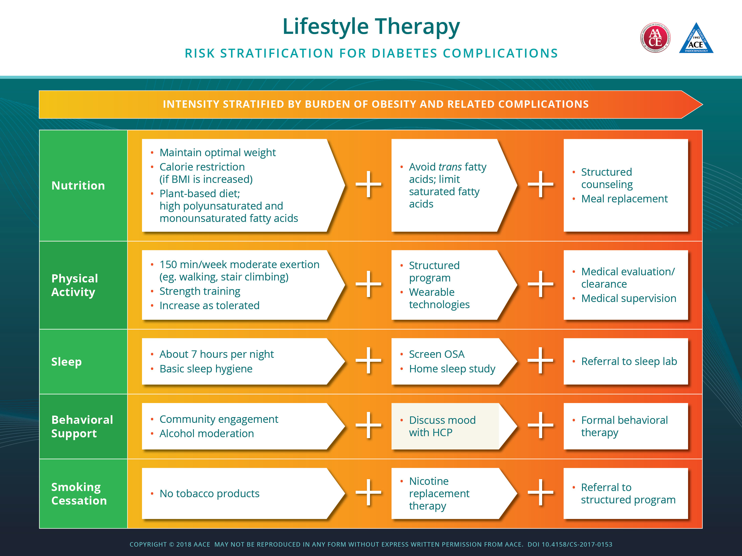

Slide 18
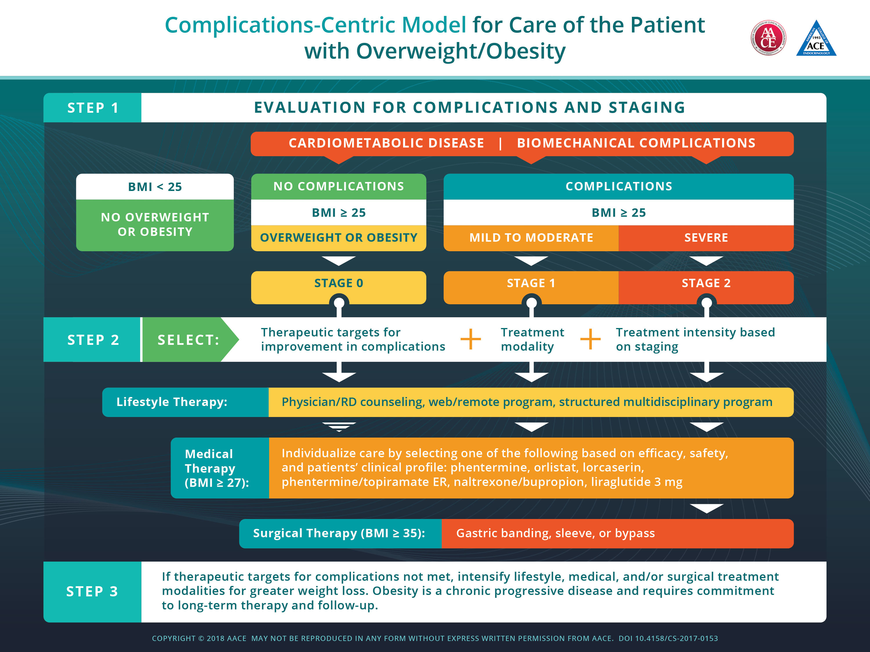

Slide 19

Winona – Age 32
Not diagnosed with gestational diabetes, but her baby was 9.5 lbs when born
Quit smoking, when she was pregnant, but started again
Current set of vital information:
  FPG 113 mg/dL, HgbA1c 5.9%
  Total Cholesterol 199 mg/dL, HDL 39 mg/dL, Triglycerides 210 mg/dL
  BP 127/73
  BMI 28.9 (5’8”, 190lbs)
Notes:
It’s been a few years. Let’s revisit Winona, now at 32 years old. She has had a child and was not diagnosed with gestational diabetes, but her baby was big at 9.5 lbs when born. She did quit smoking when she was pregnant, but started again. And she has gained 13 lbs, her blood pressure and cholesterol values have increased somewhat, in particular her Triglycerides, but of most concern on the diabetes continuum is that her FPG and her HgbA1a have increased into the Prediabetes diagnostic criteria. Lucky for Winona, there is a local Special Diabetes Program for Indians Diabetes Prevention (SDPI-DP) which has translated the National Diabetes Prevention Program with specific culturally relevant information for the Native American Population.

Slide 20
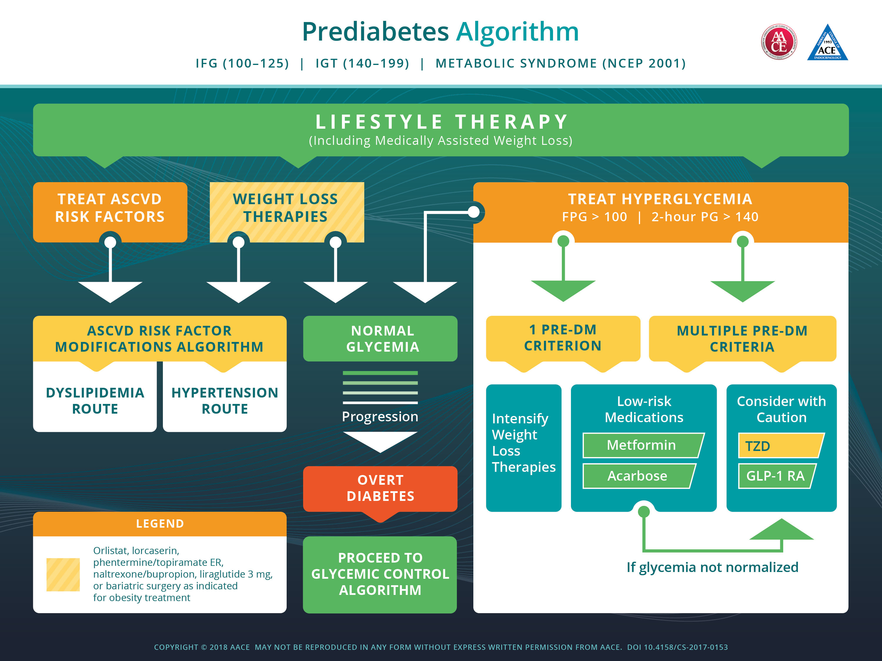

Slide 21
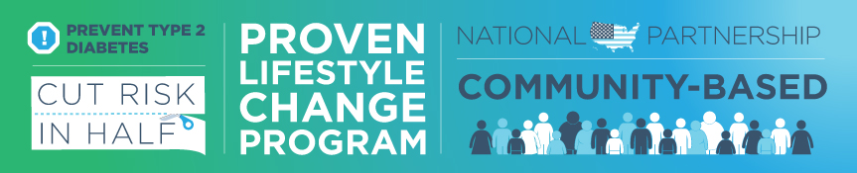
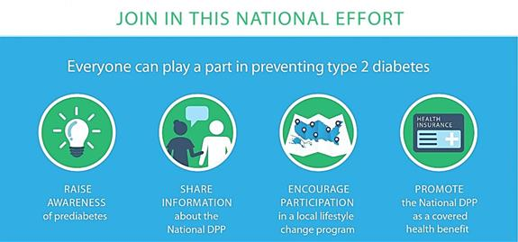
Notes:
The National Diabetes Prevention Program came about after the Lifestyle Intervention arm of the clinical trial of the Diabetes Prevention Program and Outcomes Study (as seen in Figure 2, Venditti, 2016), was able to show a cumulative reduction in incidence of T2D by 58% in the first follow up period of 2.8 years, and a 27% reduction at 10 years after beginning the DPP (Venditti, 2016). With this reduction, a huge impact can be made on the 114 million American’s who are at risk (2017 National Practice Standards).
This impact was seen with lifestyle interventions that focused on a change in diet to reduce total dietary intake, total saturated fat intake, increase fiber intake in some cases, and increase in physical activity to 150 minutes per week, using behavioral principles and diaries to record diet and exercise as a form of self-monitoring (Albright & Gregg, 2013). The primary finding of the DPP showed that “weight loss [even modest of 5-7% of the participant’s body weight] was the single most important factor in reducing type 2 diabetes incidence” (Albright & Gregg, 2013, pS347). And these lifestyle interventions are what the programs in the NDPP are designed around.

Slide 22
Primary Prevention:
Standards for the NDPP
Focus on Lifestyle Interventions
Given through a set curriculum
Year long program
16 sessions over the first 6 months (intense)
6 sessions during the last 6 months (maintenance)
Data submitted on attendance, weight loss, & physical activity
Notes:
As was mentioned previously, The National Diabetes Prevention Program falls into the Primary Prevention of T2D. People who are eligible for the NDPP programs are those with a diagnosis of Prediabetes due to their risk of developing T2D. Prediabetes is defined by:
A HgbA1c of 5.7-6.4%
FPG of 100-125 mg/dL
IGTT at the 2 hour mark of 140-199 mg/dL
And so our friend Winona is now elidgiable to be part a participant in her local NDPP.
The SDPI-DP program was able to achieve an incidence rate of about 4% each year, similar to the previous findings in the DPP study, compared to the placebo of the DPP of 12.9% in AI/AN and the 6.6% of those with prediabetes in the Strong Heart Study (Jiang et al. 2013). Thus the impact of behavior changes on modifiable risk factors in the Native American population, which create pathophysiological changes leading to T2D, specifically diet changes and increase in activity level, even with a somewhat smaller weight reduction, is 70% reduction in progression to T2D diagnosis. This is similar to the reduction seen in the NDPP of 40-50% reduction in progression of pathophysiological changes (Jiang et al. 2013).

Slide 23
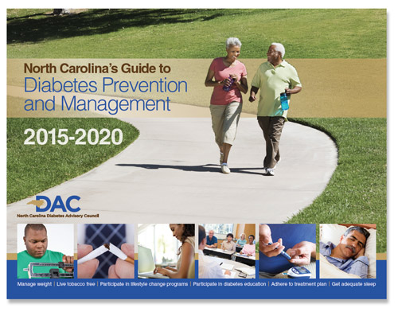
Primary Prevention - Broad Citizenship
Manage Weight
Follow Healthy Eating Guidelines
Participate in Regular Physical Activity
Live Tobacco Free
Get Adequate Sleep
Participate in DPP Education
Notes:
However, it is not just the programs involved in the NDPP that can be involved in Primary Prevention and not the only places that nurses and educators can help.
State governments can assist in primary prevention through Diabetes Action Plans which help to advocate for policies and programs that promote the health and wellbeing of the state’s citizens. Nursing/Diabetes Educators can be part of creating these plan, promoting and advocating for them.
The above is the cover of the DAP developed by the state of North Carolina. This plan discusses the primary prevention strategies of:
Manage weight
Follow healthy eating guidelines
Participate in regular physical activity
Live tobacco free
Get adequate sleep
When the risk is higher, the strategies include participation in diabetes prevention education programs.
The beauty of this action plan is the suggestions for various groups within the state to be able to help their communities be healthier in working toward prevention of T2D. These are areas that Albright and Gregg (2013) discuss when describing the need for prevention on a globalized scale as they state “type 2 diabetes is often thought of as a common-source epidemic that has been rooted in culture and society as much as individualized behaviors” (p S350).
The NCDAP includes such measures as:
Incentivizing the building of supermarkets in low-income food deserts.
Establishment of walking clubs or walkable communities
Promotion of worksite policies that encourage physical activity
Advocating for alternative tobacco advertising
Employer subsidization of gym memberships
Posting of nutrition information in cafeterias

Slide 24

Technology in Primary Prevention
Apps – Check out the DANA App Review
SideKick Health
Health Monitors
Translation of DPP to Social Media Platform
Notes:
Technology is everywhere and in so much that we do. For many people, they are using technology to participate in making better lifestyle choices. How many people have or have used a FitBit to count their total daily steps, or challenge their friends to see who could get more steps in a week or a day?
So we know that the NDPP has been a great success in initial trials and to the areas that have been able to bring the programs in. But could there be another way, using technology to help disseminate the NDPP to people, or does technology just act as the nurse/educator’s sidekick and provide support to those using it?
Omada Health in San Francisco found that this was a bit of both. They were able to translate the curriculum of the NDPP to 16 week core online class and a private support social network of 10-15 people and a professional health coach, framed around the small group sessions of other DPPs. Each week the new lesson was posted to the group, and the participants could view it as they were able (like our on-line classes, right?), answer a post lesson questions that the group and coach could see to help understand the level of engagement and understanding of the lesson. Participants could also give feedback, ask questions, request a one-on-one of the health coach. Along with the online lessons, participants used a wireless scale (sent to them at the start) to record their weight at least weekly and a digital pedometer (sent for week 5) to record activity and sleep. More technology!
Once the first 16-week core sessions were finished, participants could continue into the post-core phase which consisted of 9 monthly lessons and now large group social network interaction to help with maintaining the lifestyle interventions.
What Omada Health found was:
68.4% of participants completed all 16 core lessons
After the first 16 weeks, 5% weight loss was achieved, and at 12 months, weight loss was at 4.8% for those only participating in the core 16 week program, but for those who completed the core and post-core program their weight loss was 5.4% at the 16 week mark, and 5.2% at the year mark. (correlated to lesson completion)
The average HgbA1c dropped from Prediabetes (5.7-6.4%) to below 5.7% by 12-month mark
All of these outcomes show the adaptability of the NDPP curriculum to a technology platform, still using a the health coach as a deliverer of care and resource and support. (Sepah, Jiang, & Peters, 2014)
Other DPP are enhancing their behavior change education with apps like SideKick Health to incentivize and help to further engage their participants. This brings participants into the field of behavioral economics (Thorgeirsson & Kawachi, 2013)

Slide 25

Winona - Diagnosis
Age 56
Completed the Diabetes Prevention Program and was able to lose 20 lbs and as they had partnered with a YMCA, she was able to keep exercising and keep the 20 lbs off.
Quit smoking
Latest vitals:
  FPG 130 mg/dL, HgbA1c of 6.8%
  Ht 5’8”, Wt 170 lbs, BMI 25.8
  Total Cholesterol 184 mg/dL, HDL 52 mg/dL, Triglycerides 180 mg/dL
  BP 127/73
Notes:
A few more years down the road and we meet Winona again, now at age 56, and with lab values that are diagnostic for T2D.
Laboratory findings established by the American Diabetes Association for diagnosis of diabetes include:
a HgbA1c value of greater than or equal to 6.5%;
a casual plasma glucose of ≥200 mg/dL in the presence of acute symptoms (stated above);
a fasting plasma glucose of ≥126 mg/dL on two separate occasions;
a glucose level of ≥200 mg/dL at the 2 hour mark (postload) during an oral glucose tolerance test (OGTT) with a 75 gram glucose load (Vivian, 2017).
These all do not have to be present for diagnosis.
And thus Winona is now diagnosed with diabetes.
Again lucky for her (good thing she lives in the ideal world of education), her PCP is well read and has read the joint position statement from the American Diabetes Association (ADA), American Association of Diabetes Educators (AADE), and the Academy of Nutrition and Dietetics (AND) and has referred Winona to the same clinic where she learned about preventing diabetes for full scale Diabetes Self Management Education & Support (DSMES).
She has been started on medications based on the AACE and ADA guidelines which we will explore in a moment, specifically metformin ER (less GI side effects), and is set up with an appointment to come back and see her PCP in 3 months to see her progress, understand her goals of treatment, and see where she is with these goals. Winona is given the assistance of some technology to help her understand what effects her blood sugars at home, as well as some other technology during her DSMES program.

Slide 26
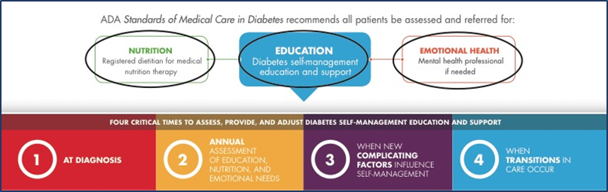
Diabetes Self Management Education and Support (DSMES)
Notes:
In 2015, the American Diabetes Association (ADA), American Association of Diabetes Educators (AADE), and Academy of Nutrition and Dietetics (AND) came together to help assess the effectiveness of DSMES and determine key times along the lifespan of someone with the diagnosis of T2D. The first two of these times, at diagnosis and an annual assessment of needs, fit within the label of Secondary Prevention, and the third, when new complicating factors influence self-management, fits within Tertiary Prevention. The fourth time, with transitions in care, can be found within both prevention types.
The findings were presented as a Joint Position Statement on DSMES in Type 2 Diabetes (Powers, Bardsley, Cypress, Duker, Funnell, Fischl, et al. 2015).
From the Joint Position Statement:
Diabetes Self-Management Education and Support involves:
An ongoing process of facilitating the knowledge, skill, and ability necessary for diabetes self-care
Guided by evidence-based research
Uses the needs, goals, and experience of the PWD
Is Patient-centered care
Uses Shared Decision Making
Imparting the knowledge, skills, and abilities needed to perform self-care of diabetes to help reach goals of care is where nursing/educators can be most impactful in secondary prevention. AADE calls this the AADE 7 Self Care Behaviors™. This includes Healthy Eating, Being Active, Monitoring, Taking Medication, Problem Solving, Reducing Risks, and Healthy Coping. All of these interventions/education are incorporated when providing DSMES for PWD.
One key point of the Joint Position Statement was the effect of DSMES on the HgbA1c value. Previous research had concluded that DSMES could in fact reduce the HgbA1c 1%, which is in line with most oral hypoglycemic agents, and with better side effects. “DSME has a positive effect on other clinical, psychosocial, and behavioral aspects of diabetes. DSME/S is reported to reduce the onset and/or advancement of diabetes complications, to improve quality of life, and lifestyle behaviors” (Powers et al. 2015).
These lifestyle changes can promote better insulin sensitivity and help to reduce hyperglycemia associated with T2D, especially early in diagnosis. Better management early in the disease process helps to promote metabolic memory, and preserve 𝛃-cell function, helping to reduce and delay the onset of complications.

Slide 27
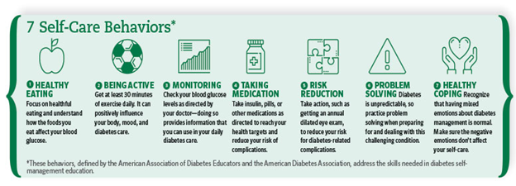
Secondary Prevention
Diabetes Self-Management Education and Support (DSMES)
Treat to Target - medication management
Prevention of complications: ACE inhibitors for renal perfusion, Statin even without DLP, HTN management, ASA, vaccines, routine follow-up, meet psychological needs
Notes:
The aim of secondary prevention in diabetes is at reducing burden of disease, lessening impact of disease on quality of life, and slowing progression.
For treatment in T2D, it is recommended to follow the American Diabetes Association guidelines which are published and revised each January and the American Association of Clinical Endocrinologist Consensus Statement and Treatment Algorithm. Both of these outline glycemic targets, and interventions to obtain these targets, as well as the prevention complications by also having targets of care related to blood pressure, lipids, CVD, and microvascular complications. These include (unless contraindicated for another problem):
ACE inhibitors to aid in renal perfusion and reduce progression to kidney disease
Low dose Statin even without DLP, to help keep vascular wall motility and prevention of plaque build up, which is more comples in those with T2D
Aspirin
Vaccines for annual flu, pneumonia (down to age 18), hepatitis B, especially in the presence of self monitoring of blood glucose (SMBG)
Routinue follow-up with a HgbA1c checked every 3-6 months
Meeting psychological needs to help prevent burnout, or address depression and stress early
Key to both of these Standards is Lifestyle Intervention which includes nutrition, physical activity, sleep, behavioral support, and smoking cessation. These can all be accomplished through the intervention of DSMES as discussed on the previous slide.
The ADA and the AADE co-chair the revision of the National Standards of DSMES every 5 years. These standards were revised this year and will be published this fall, but are available on-line prior to publication. There are 10 standards that programs must adhere to to be accredited by the ADA or AADE, which is needed to obtain reimbursement for services. New this year was the inclusion of the encouragement of the use of technology, including e-health tools and online peer support.

Slide 28
Treatment of T2D - AACE Guidelines
Always starts with Lifestyle Therapy, including medically assisted weight loss
Medication treatment options depend on level of HgbA1c at diagnosis, as well as the presence of absence of symptoms.
Level of HgbA1c shows progression of disease
Monotherapy agents and Dual Therapy agents work on underlying cause of T2D, insulin resistance: metformin as first line medication (also used in Prediabetes)
Monotherapy and dual therapy agents also help to preserve 𝛃-cell function
Other agents, GLP-1 antagonist and SGLT-2 inhibitors can also cause weight loss, improving insulin resistance
HgbA1c Goals need to be individualized based on comorbidities or at risk for hypoglycemia
Notes:
DiFronzo, Eldor, & Abdul-Ghani (2013) discuss the previous guidelines of medication management. However, within the context of Secondary Prevention and delaying the progression of T2D or presenting complications, these bear discussion. Their recommendation for starting medication therapy includes:
Medications chosen should be able to help the PWD achieve their goal HgbA1c
Combination therapy will likely be needed to reach these goals
Combo therapy should have an additive effect, correcting disturbances in pathophysiology
Help to preserve 𝛃-cell function, as the progression of T2D is dependent on the progressive failure of 𝛃-cell function
Medications should also target insulin resistance, as insulin resistance exacerbates the decline of 𝛃-cell function
Medications which benefit Cardiovascular health are desired as ASCVD is highly associated with T2D
Medications needs to be at least weight neutral, if not able to promote weight loss
Therapy should be safe, individualized to not cause harm when comorbid disease exists (i.e. GLP-1 agonist are contraindicated for those with gastroparesis or history of pancreatitis)
Helping to delay progression of T2D through medication that promotes a decrease in insulin resistance and a decrease in the loss of 𝛃-cell function, will help prevention of the complications of diabetes.
AACE has laid out an algorithm of treatment taking into account those medications which help to preserve 𝛃-cell function as well as decreasing insulin resistance as front line medications. They also take into account side effects, in particular the risk of hypoglycemia and weight gain, as well as helping practitioners to understand cost burden.
Nursing/Educator interventions with medication management, are to help the PWD understand how the medications work, how they are prescribed to be taken, how to incorporate these into the daily life of the PWD, why the medications work, and what part of T2D pathophysiology they work on, potential barriers the PWD may face in taking these medications, including side effects, cost, or cultural beliefs to help with adherence. Remember that adult learner in general need the “why”, the “how”, the “what to expect”, and the “what’s in it for me” answers before they will just take a medication.

Slide 29
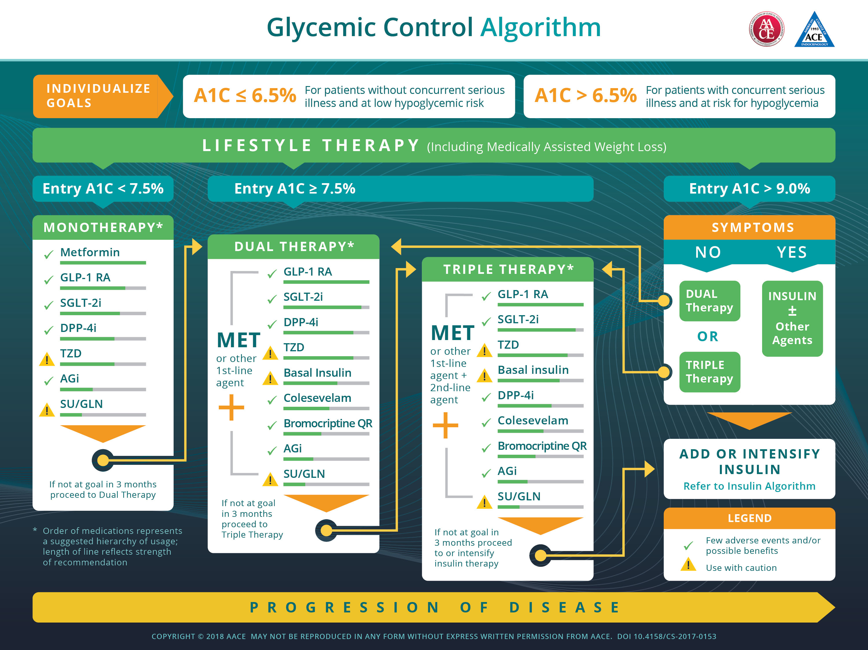

Slide 30
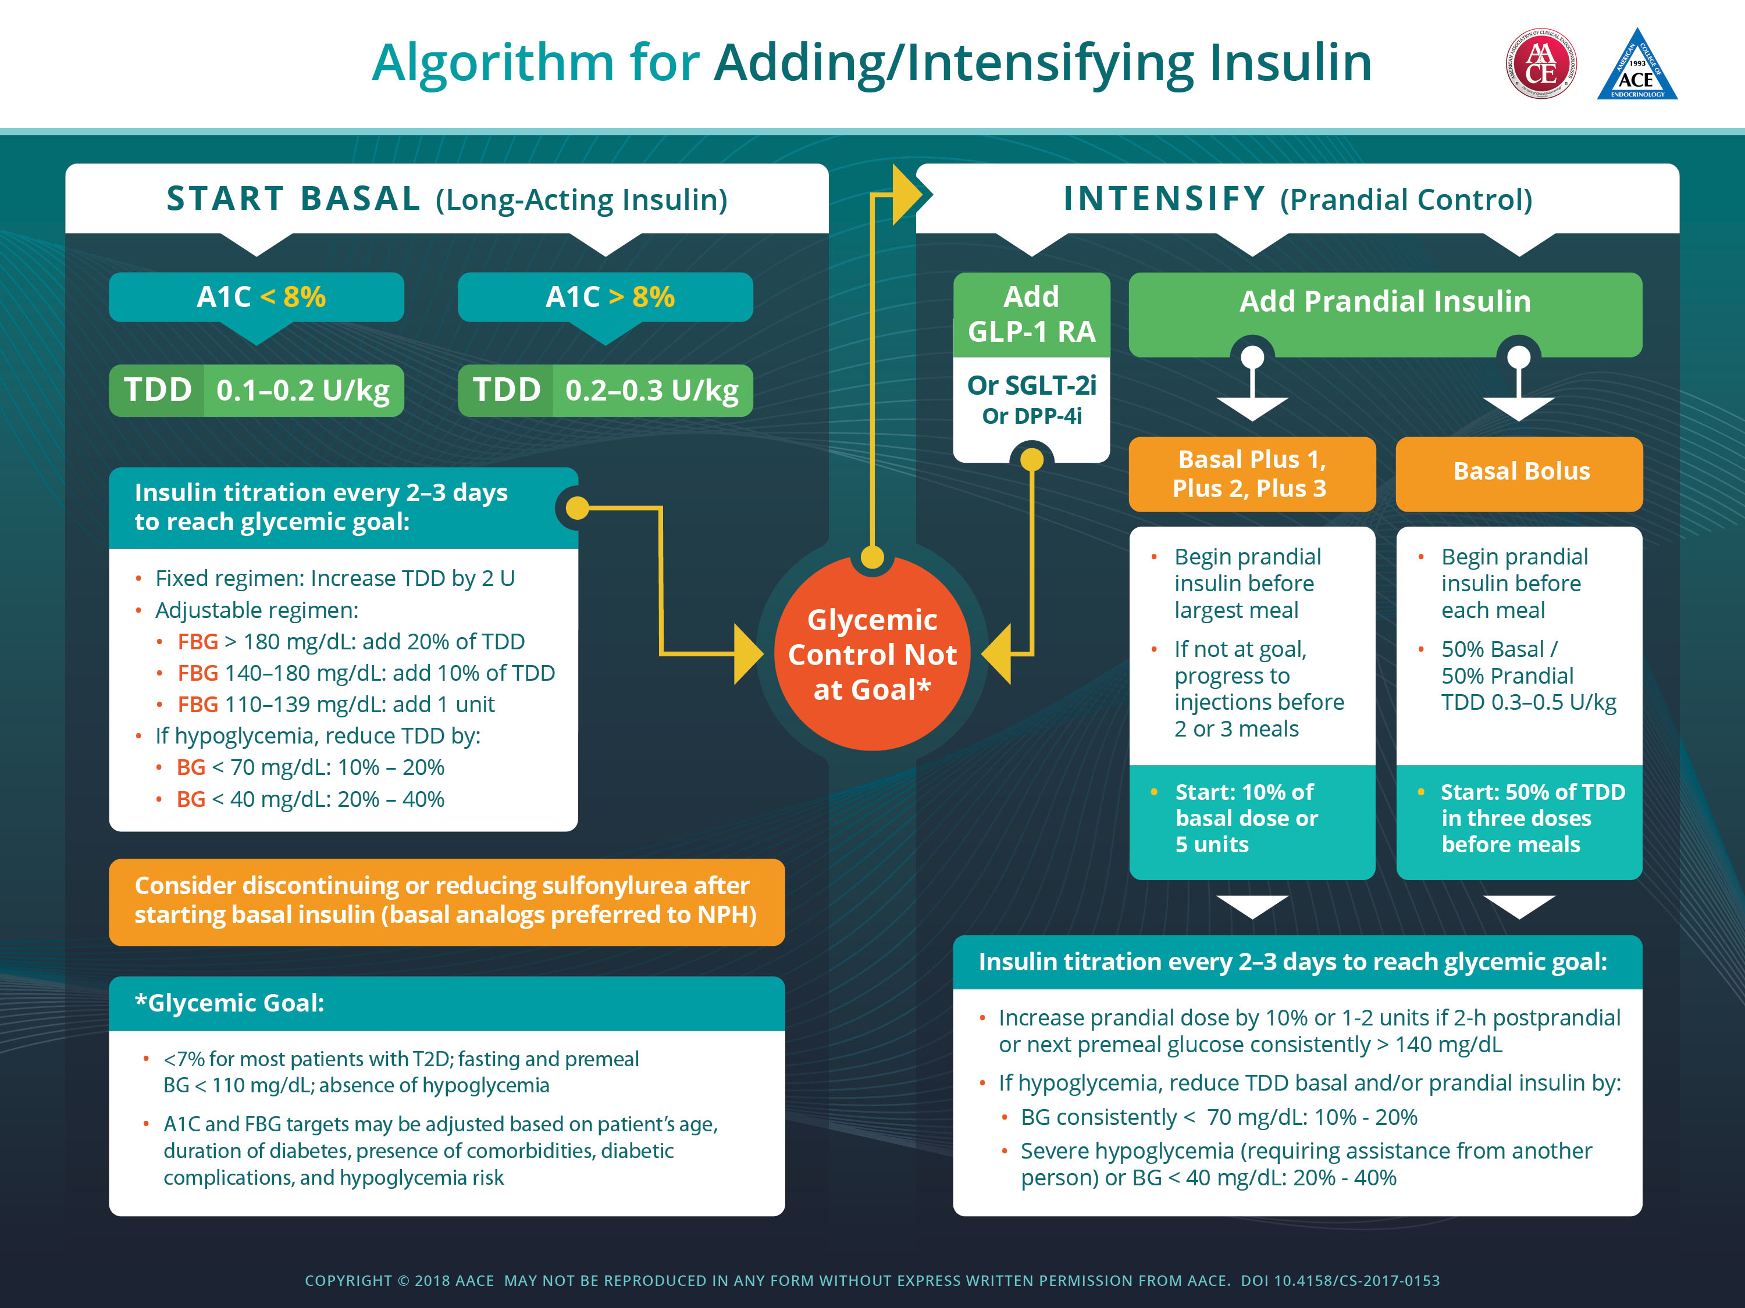

Slide 31
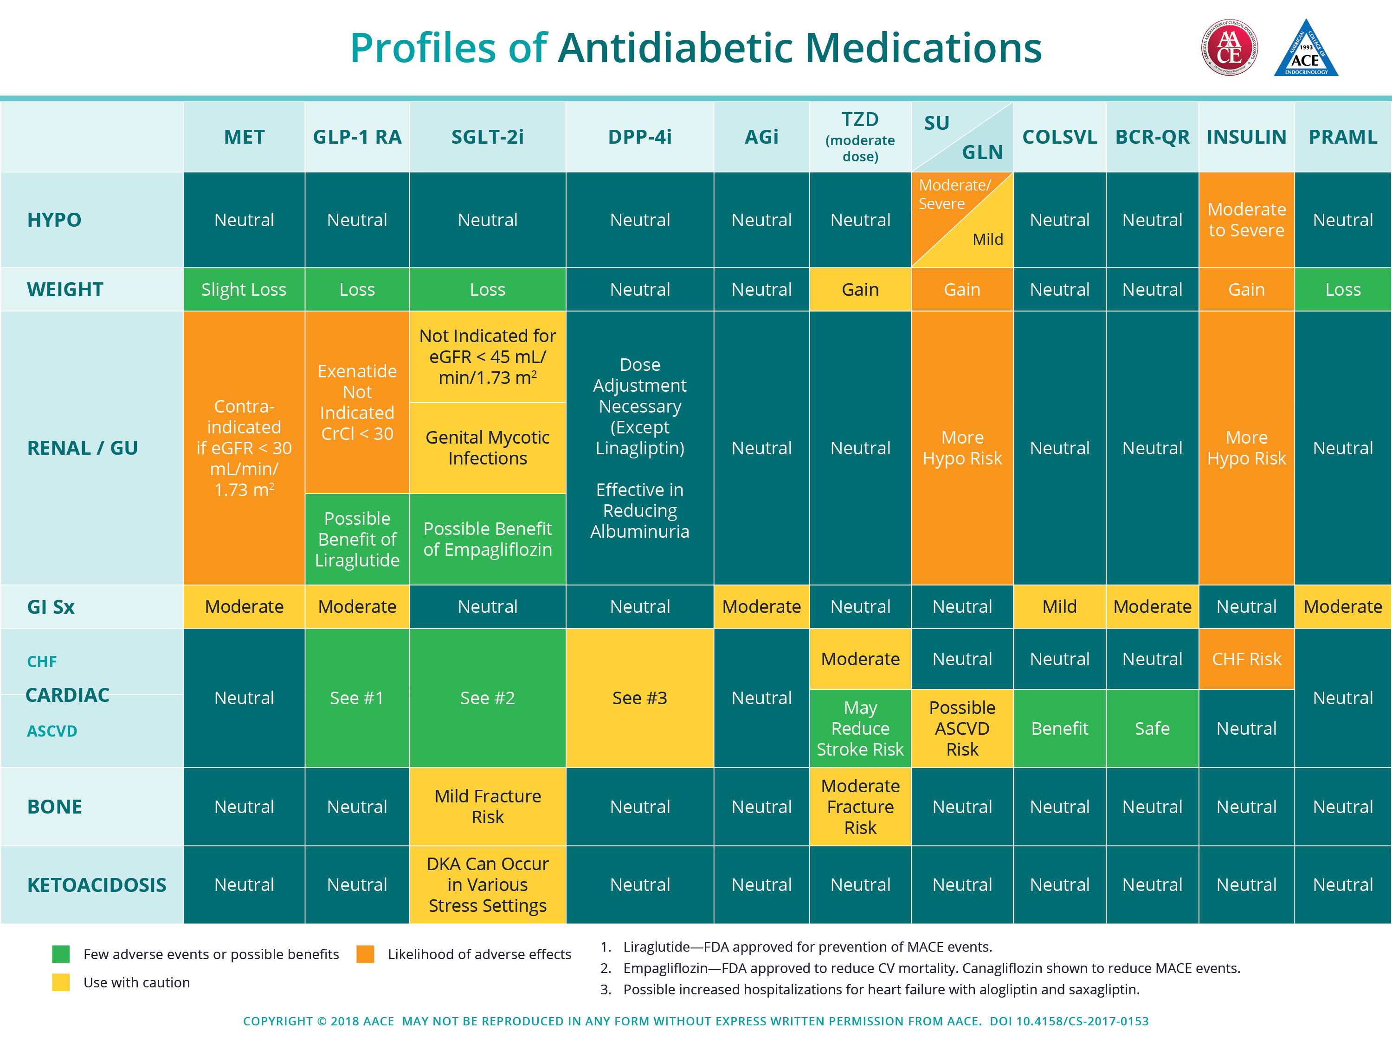

Slide 32
Technology and Secondary Prevention
Similar work as with Primary Prevention
Apps to help with monitoring of
Blood sugars
Food diaries
Activity levels
Wearable Fitness
The Diabetes Online Community
dLife.com
Diabetes Sisters
Not all DSMES needs will be met with brick and mortar programs
Well Doc
One Drop
Livongo
The National Standards for DSMES
Notes:
Having the National Standards for DSMES address the need to incorporate technology and on-line support paves the the way for incorporating of technology in secondary prevention interventions. (Beck, Greenwood, Blanton, Bollinger, Butcher, Condon, Cypress, et al. 2017).
Once there is a diagnosis of T2D, there is a general influx of technology, even at it’s most simple form, which isn’t all that simple in this day and age beyond how to use it, in the use of a glucose meter to self monitor blood glucose (SMBG) during daily life. SMBG allows a PWD to know at any given time what their blood sugar is, and to confirm any associated symptoms of hypo- or hyperglycemia. However, some of these meters are highly sophisticated and able to help PWD determine glucose patterns of hypo- or hyperglycemia, time in range, and weekly and monthly averages that can help the PWD know when to seek further care, again to maintain management over their glucose values to help prevent complications. Some companies use a meter the uploads information to the cloud to share with healthcare providers (the VA system and their telemonitoring programs) or CDE coaches. Others can upload this information as the patient wants to be able to send it ahead of appointments to their PCP to be able to have a meaningful interaction about their glucose values and if they are well enough within range to help with the prevention of complications and delaying the progression of T2D.
As nurses/educators, we need to be familiar with the use of this technology, but also work with the PWD to see patterns in the glucose values to see where changes can be made in lifestyle interventions, or where certain interventions are showing an improvement in glucose values.
For example, the person with COPD who has exercise intolerance issues, but attends pulmonary rehab 3 times a week, should see lowered glucose values the day of and through the next morning after an exercise session. Pointing out these patterns may help to encourage to person to include exercise outside of the pulmonary rehab program, which may get the person closer to the recommended goals of activity to help delay progression of T2D.
Companies have incorporated DSMES into their products for people with T2D. Well Doc has been able to license the AADE 7™ and make this into a digital platform for providing the education of DSMES. Livongo and One Drop have Certified Diabetes Educators available to patients for virtual coaching, both at the request of the PWD, as well if blood sugar values are not being checked or are well out of range, particularly hypoglycemic events. In these instances, a CDE calls the PWD to check that they are okay or offer support to the person caring for the PWD. Some of the meters can help alert family members and friends that a glucose value has been checked and it’s value. This can become important with preventing complications related to severe hyperglycemia and hypoglycemia.
One of the unspoken complications of diabetes deals with diabetes burnout. This is where the Diabetes Online Community can be very helpful to PWD. It is utilized more by people with T1D, but could in the same effect help people with T2D. When Michelle Litchman, PhD, FNP-BC, FAANP, she found that the DOC helped 79% of the PWD to feel understood and 76% said it helped them feel less alone (Litchman, Gable, Head, & Gee, 2017). Litchman also found that using an on-line “virtual” support system also improved Health-Related QOL. There are many places where this support can be found, the DOC is one them and includes places open forums like dLife.com, Twitter, and Facebook communities, as well as online (and sometimes in person) newsletters and blogs like Diabetes Sisters, diaTribe, DiabetesMine.com, Scott’s Diabetes, and Diabetic Connect.
The use of technology in management of T2D can be very successful, and can help people with reduction in their HgbA1c. For Winona, while in her DSMES program, she states she was able to keep the 20lbs off through exercise, but that her food choices of late have been all over the place, and she isn’t sure she is making great decisions. To help her with this, her Certified Diabetes Educator (CDE), encourages her to use (since her phone is always with her, just like her FitBit) the food diary part of her FitBit app. At first, the CDE just wants Winona to record her food and amounts, and not worry about the calories, etc., but that at her next session, they will look at her diary and discuss and strategize changes together. Winona agrees that this is a piece of technology she can use.
Greenwood , Gee, Fatkin, & Peeples (2017) in their systematic review conclude that “effective technology solutions must be designed with the TES feedback loop to integrate into the clinician workflow and improve efficiencies to provide the health care team with information for decision-making in the most cost-effective manner for both the person with diabetes and the team” (p9) and in this way, help to ease the burden of disease instead of adding more work to the management of an already very complex disease.

Slide 33
T2D Effects
Severe Life Altering Complications
by Body System
Notes:
T2D affects every system of the body. Let’s explore some of the more life altering complications of T2D and the tertiary and rehab interventions for the nurse/educator.

Slide 34

Tertiary Prevention
CVA
Blindness
Deafness
Loss of Dentition
MI/CABG/CHF
Autonomic Neuropathies/CAN
ESRD/Dialysis
Amputations
Notes:
Tertiary Prevention in T2D care focuses on the prevention of life altering and potentially high mortality rates associated with particular complications. To explore these, let’s look at them by body system with the pathophysiologic changes associated and measures of T2D care that can help to slow progression toward these complications.
With comorbidities, tertiary prevention means continued work toward managed blood sugars, time in range, and goal level of HgbA1c through lifestyle interventions and medical management, may need very intensified treatment. Management of other cardiovascular health such as HTN and DLP need to be addressed. Further management to help with insulin resistance, especially in the presence of comorbidities, may include options such as gastric bypass surgery. The intervention of reassessment and planning in a DSMES program has been found to be other great help with delaying severe complications in T2D.
The following slides will help us understand the pathophysiologic changes happening in the various body systems and how these severe complications come about in the presence of T2D. They will also help us understand the impact that these severe complications can have on QOL for someone with T2D. Nursing can continue to help the person with T2D at risk for these complications, understand their risk, and understand strategies to help prevention these risks through education.

Slide 35
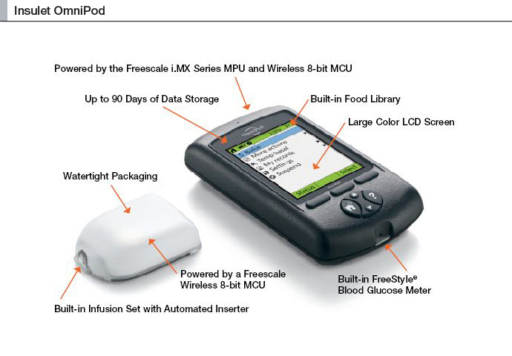
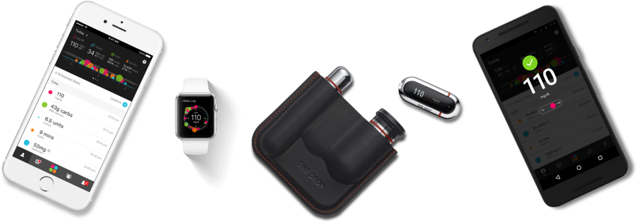
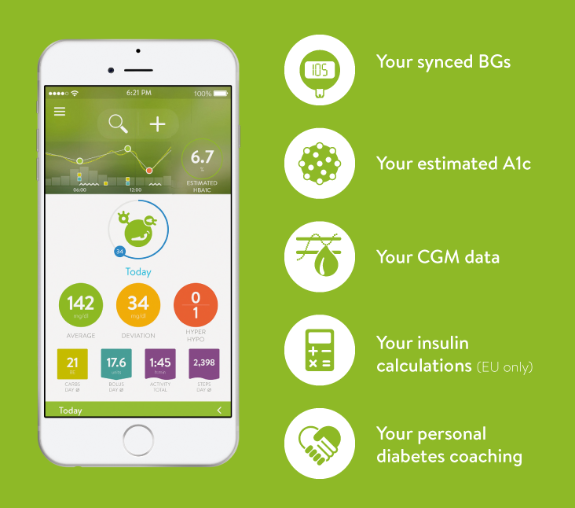
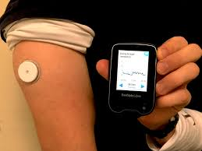
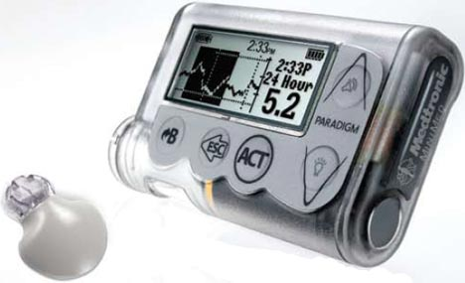
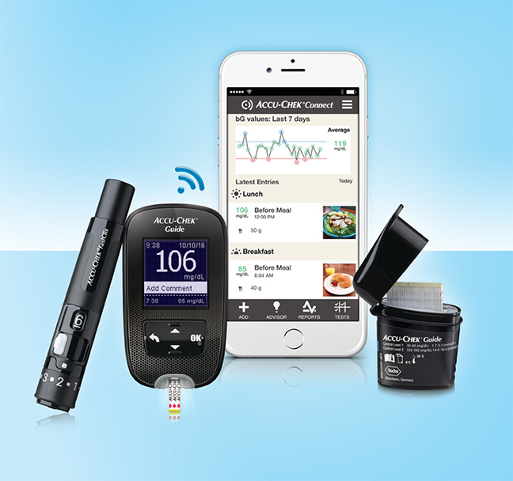
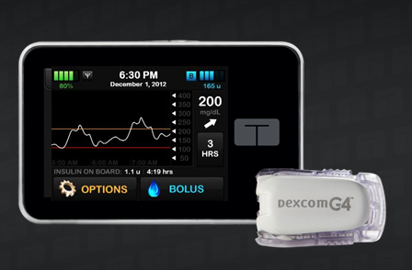
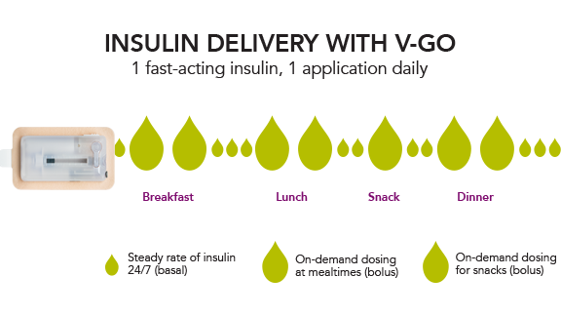
Technology in Tertiary Prevention
Notes:
Many of these complications come with a progression of T2D. As there is increase in 𝛃-cell failure, there is the need to replace the insulin the body can no longer make, and as there is the underlying problem of insulin resistance, the amount of insulin to treat a person with T2D can be high. For many, the use of the technology of insulin pumps and continuous glucose monitors can be very helpful. Insulin pumps help to deliver a basal dose of insulin and allow the PWD to deliver insulin based on their carbohydrate intake and glucose value, as well as adjust how this bolus is given, as either a short and quick bolus, or as a longer bolus over a period of time based on type of food or amount of food consumption. Newer technology has combined the insulin pump and the CGM to give a semi-closed loop system which can allow the pump to suspend automatically (as opposed to manually by the user – also possible) if there is a problem with hypoglycemia.
Endocrinologist are using technology such as the Freestyle Libre, which is a CGM the size of a quarter (seen here on the person’s arm), to see a good picture and overall trend of person’s glucose values over 2 weeks. Many patietns with T2D are not checking blood sugars often throughout the day, and feel like they have a good amount of “control” based on the numbers they do see, and are not understanding why their HgbA1c may be high. The read out of a CGM can help with this a lot. Currently this is in FDA land waiting on approval for patient use, beyond professional use, and will allow more access to data which can help reduce disease burden, allow those with T2D to see in real-time what is happening with their blood sugars and help with their management.
For some of the severe complications, avoiding hypoglycemia is one of the tertiary prevention strategies. Technology such as this can assist the PWD in being able to either reduce the amount of insulin they are receiving, know faster when hypoglycemia is occurring, be able to adjust the amount of insulin needed (smart meters and pumps) based on a low blood glucose, but still a full meal, or help themselves and their practitioners understand their glucose trends and patterns (pumps, meters, apps like MySugr).
Sometimes the need is just to have the insulin in an easier way to take it. The V-go insulin delivery device, specifically for the person with T2D, does that by being a reservoir of insulin changed each day that delivers a set basal dose (cannot adjust amount throughout the day, very similar to a dose of a basal insulin such as Lantus), as well as allow the PWD to give a bolus dose in 2 unit increments up to 36 units/day. Personally, I have seen this used very well by a person who was legally blind secondary to retinopathy.

Slide 36
Cardiac & Vascular Changes
Noted changes due to:
Hyperglycemia - endothelial dysfunction, oxidative stress
Insulin Resistance - proinflammatory state, plaques
DM Dyslipidemia - high triglycerides and low HDL
Inflammation - different type of T-cell in T2D
Hypercoagulability - Elevated coag factors, low Protein C
Vascular Calcification - elevated levels of arterial inflammation → increase TNF-alpha → calcified lesions
Manifestation:
ASCVD
Stroke
CAD
CHF
PVD/PAD
Hypertension
Notes:
For our patient, Winona, she is at an increased rick of CVD with T2D. She shows some mild hypertension, and has a history of dyslipidemia. She also has a history of smoking.
T2D impact the cardiovascular system through the microvasculature of the body. Having T2D increases the risk of a stroke, MI or sudden death 2-3 times over the person without diabetes (Sperl-Hillen, 2017). With this, you may have heard that the person with T2D and CAD has the same risk of having an MI, as someone who has already had one. And when we discuss effects on the neurological system, Cardiovascular Autonomic Neuropathy (CAN) enters the mix, which has a mortality risk rate of 25-50% within 5-20 years (Vinik & Vinik, 2017).
ASCVD, or Athresclerotic Cardiovascular Disease, advances earlier (by about 14.6 years) in the presence of T2D, and is more severe than without T2D (Wang, Hess, Hiatt, & Goldfine, 2016). The changes are seen as such:
Hyperglycemia: has a direct effect on endothelial dysfunction, creating more complex and severe atheroclerotic lesions, and increases plaque burden; increases in reactive oxygen species (ROS) which leads to cellular changes and oxidative stress which manifests as hypertension. This Oxidative stress can be seen in many cellular changes in the body that manifest as complications of T2D.
Insulin Resistance/Hyperinsulinemia: creates a proinflammatory state, and contributes to creation of atherosclerosis, and plaque vulnerability
Diabetes Mellitus Dyslipidemia (elevated triglycerides, low HDL): secondary to insulin resistance, free fatty acid levels are increased, thus triglycerides elevate; VLDL metabolism is regulated by insulin and with insulin resistance, VLDL is overproduced and the hepatic uptake of VLDL is reduced and thus the clearance of VLDL is reduced
Inflammation: The T cells of atherosclerotic plaques in those with diabetes carry a proinflammatory phenotype. Inflammation increased risk of hypertension and cardiovascular disease.
Endothelial Dysfunction (secondary to hyperglycemia): promotes leukocyte and platelet adhesion, inflammation, and thrombosis
Hypercoagulability: “Patients with diabetes mellitus are more thrombogenic and have elevated concentrations of plasminogen activator inhibitor-1 antigen, von Willebrand factor;antigen, and fibrinogen, which are exacerbated by poor glycemic control” (Wang et al. 2016, p2464). Elevated coag factors and decreased anticoagulant Protein C are also noted (Kim, Kim, Park, Kim, Nam-Goong, & Kim, 2014).
Vascular Calcification: increase levels of arterial inflammation leading to increase in tumor necrosis factor-alpha leading to calcified atherosclerotic lesions, which generally are found in more advanced and complex lesions; This further plays a role in peripheral vascular disease experienced by those with diabetes with an increased risk of amputation.
PAD with T2D, occurs in distal arteries, such as the femoral-popliteal and tibial arteries. With severe PAD, the risk of amputation is 30% and after an amputation, the 5 year mortality rate is high (Sperl-Hillen, 2017).
The changes previously discussed are not only happening in the heart, but also in the arteries to the brain, thus increasing the risk of CVA and TIA. Microvascular changes in the eyes leading to retinopathy and the leading cause of blindness in those age 20-74 (Kiss, 2017).
And thus again, interventions such as lifestyle modifications, medication intensification, goal setting, management of hyperglycemia, reduced variability of glucose extremes can all help in the tertiary prevention of severe complications.
If there are CVD complications:
Rehab interventions include comprehensive CVA rehab services, including Speech Therapy, OT and PT, inpatient Rehab programs to help regain abilities, including more DSMES if possible
Cardiac Rehab to help return endurance to the heart muscle after MI or CABG (Pulmonary Rehab for CHF) including more DSMES if possible

Slide 37
Cardiac Autonomic Neuropathy (CAN)
Hyperglycemia, genetics, impaired insulin signaling, dyslipidemia
Creation of reactive oxygen and nitrogen (RONS) molecules
Pro-inflammatory cascade
Increases in oxidative stresses
Damage the smooth muscle of the heart & cause denervation of the system
Microvascular changes of T2D lead to nerve dysfunction and apoptosis
Mortality Rate of 25-50% within 5-20 years
Tertiary intervention
Rehab intervention- supportive care
Notes:
CAN is the complication with the highest mortality risk, giving the person with T2D a 3 fold increase of mortality at a rate of 25-50% within 5-20 years (Vinik & Vinik, 2017). The manifestations of CAN are seen as alterations in the sympathetic tone of the cardiac muscle starting at the apex moving toward the base impairing ventricle function and the end result being cardiomyopathy. Cardiovascular reflex test changes can bee seen in the first years after diagnosis (Verrotti et al. 2014). These changes can be seen as an increased resting heart rate, “reduced heart rate variability during deep breath, prolongation of QT interval, temporally followed by resting tachycardia, impaired exercise tolerance, and decreased barorflex sensitivity with consequent abnormal blood pressure regulation, and orthostatic hypotension” (Verrotti et al. 2014, p1). The prevalence is about 44% in the age group of 40-70, but increases depending on the length of diabetes to up to 65% (Verrotti et al. 2014). Sudden cardiac death is also seen in these patients. There is also a bidirectional relationship between CAN and diabetic nephropathy, which has been seen across ethnicities (Wheelock, Jaiswal, Martin, Fufaa, Weil, Lemley et al. 2016).

Slide 38
Renal
Changes
Hyperglycemia
Alterations in tubuloglomerular feedback system
Renal vasodilation/Hyperfusion
Increase in microalbuminuria
Macroalbuminuria
Decreased GFR & Increased BP
ESRD
T2D - Leading cause of Renal Failure
Once Diabetic Kidney Disease (DKD) is present → risk of CVD increase
Leading cause of death with DKD is cardiovascular in nature
Notes:
Secondary Prevention of renal disease in those with T2d involves the use of an ACE inhibitor (or ARB if ACE is not tolerated) to help with renal perfusion, along with management of hyperglycemia. However, once there is a degree of renal impairment tertiary prevention strategies take over. This includes an attempt to more tightly manage glucose levels without causing hypoglycemia. Some medications are no longer recommended depending on the stage of chronic kidney disease (CKD). Sulfonylureas are eliminated through the kidneys and can build up causing severe and prolonged hypoglycemia. Most DPP4 inhibitors need to have reduced doses. SGLT-2 inhibitors require there to be some kidney function (GFR >45) to work, and otherwise are costing the PWD a lot of money.
Once at a ESRD, Rehabilitation interventions deal with assisting the PWD to avoid hypoglycemia, as the only medication available for those with T2D and ESRD is insulin, and dialysis can drop blood sugars due to the light weight of glucose if hemodialysis, or increase blood sugars with peritoneal dialysis. Further nursing/educator tertiary/rehab care interventions include support in the impact of dialysis on quality of life. Of note, once Renal Replacement Therapy (RRT) is initiated in the setting of Diabetic Kidney Disease, the 5 year survival rate is quite poor (Smith-Ossman, 2017). CVD risk is 30 times higher with T2D and CKD (Smith-Ossman, 2017).

Slide 39
Gastrointestinal Changes
Major complication : Gastroparesis
Form of autonomic neuropathy
Hyperglycemia causing problems with vagal denervation of the stomach
Leads to gastric stasis → inability to eat or vomiting meal → changes in glucose level, especially depending on medications
Tertiary Interventions - early diagnosis and management of glucose values
Rehab interventions - education to learn early signs of acute exacerbation, frequent glucose monitoring, change in medications to prevent hypoglycemia
Notes:
Those with diabetes can experience, normal, accelerated, or slowed gastric emptying, the extreme case of this is gastroparesis. Gastroparesis is a form of autonomic neuropathy “thought to be due to vagal denervation of the stomach and smooth muscle loss” (Morrison & Weston, 2015), with the smooth muscle damage related to glucose levels. These changes lead to gastric stasis, which the person experiences as abdominal bloating, feeling of fullness, nausea & vomiting, heartburn, weight loss, stomach wall spasms, and erratic blood glucose levels (Morrison & Weston, 2015). Morrison & Westin (2015) further describe the physiologic changes in gastroparesis as “multiple motor and sensory abnormalities of the upper gut function, [including] antral hypomotility, altered intragastric distribution of ingested food, abnormal intestinal contractions, increased fundic compliance and abnormal gastric sensation” (p13). Gastroparesis has a higher prevalence in women over men, and in general, the rate of gastric emptying is slower in women than men, potentially related to estrogen (Dickman, Wainstein, Glezerman, Niv, & Boaz, 2014). There is also a huge psychological toll that gastroparesis can take of people, as it affects quality of life and can interfere with a person’s ability to work or care for family.
Rehab interventions will include education on eating small frequent meals, helping the PWD to understand how more frequent glucose monitoring may be needed to help prevent hypo or hyperglycemia. Use of an insulin pump or CGM can be very helpful for these patients with the ability to more closely monitor their glucose, but also change their insulin infusions depending on exacerbation of gastroparesis.

Slide 40
Integumentary
Changes in the immune system related to T2D
increase risk of infections
increase severity of infection
increased healing time & need for more intense treatment
Body Defenses
Hyperglycemia & AGE formations
inflammatory cascades
changes in collagen properties
skin breakdown
Notes:
The integumentary pathophysiology changes are related to hyperglycemia and the AGEs (advanced glycation end products). The AGEs are formed from glycation of proteins, lipids and nucleic acids and cause the same inflammatory cascades. In the skin this alters “collagen properties, decreasing flexibility and solubility and increasing rigidity”, and the AGEs “participate in the development of fibrosis in DM, in skin aging, and even in diabetes-related immunosuppression” (de Macedo, Nunes, & Barreto, 2016, p3).
Abu-Ashour, Twells, Valcour, Randell, Donnan, Howse, & Gamble (2017) discuss the dysfunction of the immune system due to several factors including “impaired migration, phagocytosis, intracellular killing, and chemotaxis” (p1). They continue describing these changes secondary to T2D; whereas “hyperglycemia affects coagulation, fibrinolytic function, lipid metabolism and endothelial function...decreases function of neutrophils and monocytes by way of impaired chemotaxis, adherence” (Abu-Ashour et al, 2017, p8).
GU and yeast infections are also highly seen in those with T2D. The presences of “glycosuria can enhance bacterial growth and impair phagocytosis” (Abu-Ashour et al., 2017, p9) as well as problems with urinary stagnation in the presence of neurogenic bladder problems can increase these incidents. Periodontal disease is also common in those with T2D, especially with hyperglycemia with the pathophysiology changes of “higher salivary glucose, low salivary pH, microangiopathy, and abnormal collagen metabolism” (Abu-Ashour et al., 2017, p9). Viral infections in those with T2D are seen due to impaired cell-mediated immunity, especially with longer standing diabetes (Abu-Ashour et al., 2017).
Skin Changes
Insulin Resistance
Acanthosis Nigricans
Skin tags
Opportunistic infections:
yeast, thrush
UTI
URI
skin
Morbidity and mortality are increased secondary to infections with those with T2D, and these patients frequently need stronger interventions and hospitalizations. And due to these changes in the immune system, there is a push for better glycemic management going into surgeries and after to help reduce the risk of post-op infections and reduce healing times.
Ulcerations and infections, particularly if it is infections to the bone may require rehab interventions including dressing changes, or home IV antibiotic therapies. Teaching ways to prevent further infections, and of course glycemic management strategies.

Slide 41
Peripheral Neuropathy & Amputations
Amputations secondary to:
Musculoskeletal System changes
Neural and Sensory Function changes
PVD/PAD
Integumentary System changes
Infections
Diabetes and complications of ulcerations lead to 50-75% of the non-traumatic amputations
5 year mortality rate after one amputation: about 70%
Notes:
Peripheral Neuropathy occurs in about 50% of people with diabetes (Smith & Singleton, 2013) and is noted to be “the presence of symptoms and/or signs of peripheral nerve dysfunction in people with diabetes after the exclusion of other causes” (Verrotti, Prezioso, Scattoni, & Chiarelli, 2014, p1).
This polyneuropathy, is usually symmetrical (occurring on both side of the body in the same extremities) in presentation, and is length dependent (Vinik & Vinik, 2017). Currently, the known changes in the nerves are a decrease in intraepidermal nerve fiber density (IENFD) (conducted through a skin biopsy) affecting the small nerve fibers and decrease in nerve conduction (seen through testing touch, vibration, pressure, pinprick, and temperature) affecting the large myelinated fibers (Smith & Singleton, 2013).
These losses in protections, put the person with T2D and neuropathy at high risk of morbidity related to foot ulcerations (Vinik & Vinik, 2017). There is also a “decrease in non-contractile tissue extensibility, and intrinsic muscle atrophy and fatty infiltration” (DiLiberto, Tome, Baumhauer, Quinn, Houck, & Nawoczenski, 2015, p 3688) that can further lead to deformities of the foot putting the person at further risk of ulcerations. Unfortunately, this leads to 50-75% of the non-traumatic amputations (Vinik & Vinik, 2017). This loss of limb can have a huge impact on quality of life, not to mention the economic impact in both direct and indirect costs. Pain and paresthesias are considered “positive” symptoms of peripheral neuropathy and also have a large impact on quality of life, problems with activity and sleep, emotional disturbances including anxiety and depression, and potentially non-adherence with treatments such as exercise, ask they can be at an increased risk for falling (Vinik & Vinik, 2017).
Once neuropathy develops, it is unlikely for the symptoms to reverse, though the pain can be managed with certain medications. Tertiary interventions include glycemic management to help reduce the progression of neuropathy and loss of protective sensation, as well as good foot care, including monitoring feet for areas of pressure, injury, taking shoes and socks off at all doctor visit to have another set of eyes look at the feet, not trying to perform any bathroom surgeries when caring for their feet, and seeking prompt treatment for injuries and ulcerations. For the most part, amputations can be prevented with good management of T2D.
Rehab interventions, however, would include adjustments to limb loss, PT, OT, inpatient Rehab stays to help adjustments to ADLs. Connection with resources like the Amputee Coalition and National Ability Center. There may be a large amount of psychosocial needs and referral to a therapist is highly encouraged.

Slide 42

Winona – Age 84
Now age 84
Completed her initial DSMES training (10 hours in the first year)
Saw her CDE every year for a few years
Needed to care for her ailing mother, and stopped seeing her PCP for a few years
Had an MI at age 67 when her HgbA1c reached 10.8%
  Attended Cardiac Rehab
  Went back to seeing her PCP regularly and returned to DSMES
  Was started on insulin
Latest Vitals
  FPG 135, HgbA1c 8.2%
  Ht 5’6”,Wt 189 lbs, BMI 30.5
  BP 130/80, GFR 52, Cholesterol 197, HDL 46, Triglycerides 142
Current worries are numbness in the bottom of her feet and wanting to see her grandson’s wedding in 2 years
Notes:
After her MI, Winona was able to only have stents placed, but it helped her remember why she had originally been so careful about seeing her PCP and monitoring her diabetes. She attended Cardiac Rehab and returned to her DSMES program, where she relearned some of the intense lifestyle interventions, and incorporated some more for heart health. She also needed more help with how to exercise safely.
As Winona’s HgbA1c had risen to a level where the AACE states insulin is general needed. She did well with this and has continued on insulin. However, she has been having problems with hypoglycemia lately and her CDE and PCP are working with her on testing more frequently, and using a professional CGM to see if they can help determine trouble times to see where adjustments can be made in her daily plan.
Her kidneys are being closely monitored as her GFR has fallen and her creatinine is at 1.9. She has been referred to a nephrologist. Winona and her team have all talked about the potential use of an SGLT-2 inhibitor to potentially help with some weight loss, the need for less insulin (which may help with less hypoglycemia), and with Jardiance, could help with her heart health and reduce her risk of CHF or at least mortality if CHF is involved. Her CDE is helping her to understand the side effects of this medication, particularly the need to stay hydrated with water, as it can cause a lowering of her BP, as well as increase her risk for yeast infections, so good pericare is also being discussed. Winona is also taught about the mechanism of action, and the biofeedback the medication can give when a heavy carbohydrate (CHO) meal is consumed, i.e. increased urination, which may help Winona to decrease her CHO intake.
In relation to her peripheral neuropathy, her PCP is checking her feet at each office visit, as well as she is being referred to a podiatrist to be fitted for some protective foot wear, and encouraged to report any skin breakdown or areas of persistent redness and pain as soon as it is noticed to her PCP or podiatrist. She is taught that amputations in relation to problems with her feet can be avoid with early interventions.

Slide 43
Links Throughout Presentation
American Diabetes Association
  www.diabetes.org
American Association of Diabetes Educators
  www.diabeteseducator.org
Academy of Nutrition and Dietetics
  www.eatright.org
Healthy People 2020
  https://www.healthypeople.gov/2020/About-Healthy-People
Diabetes Risk Assessment
  http://main.diabetes.org/dorg/PDFs/risk-test-paper-version.pdf
Eat Smart, Move More, Weigh Less
    https://esmmweighless.com/
Smart Glucose Meters: Accu-Chek Aviva Expert
  https://www.accu-chek.com/meters/aviva-expert

Slide 44
More Links Throughout Presentation
Insulin Delivery Devices, Pumps, and CGMS
  V-go
    https://www.go-vgo.com/
  Tandem
    https://www.tandemdiabetes.com/
  OmniPod
    https://www.myomnipod.com/
  Medtronic
    http://www.medtronicdiabetes.com/home
  Animas
    https://www.animas.com/
  Freestyle Libre Pro
    http://www.freestylelibrepro.us/blood-glucose-monitoring-device.html
  DexCom
    https://www.dexcom.com/
Apps
  FitBit
    https://www.fitbit.com/home
  Sidekick Health
    https://www.sidekickhealth.com/#section-features
  MySugr
    https://mysugr.com/

