Slide 1


Slide 2

Qing Tong
MD, PhD
Founder
My Glucolife
Shanghai, China

Slide 3
Disclosure to Participants
Notice of Requirements For Successful Completion
  Please refer to learning goals and objectives
  Learners must attend the full activity and complete the evaluation in order to claim continuing education credit/hours
Conflict of Interest (COI) and Financial Relationship Disclosures:
  Presenter: Qing Tong, MD, PhD– No COI/Financial Relationship to disclose
Non-Endorsement of Products:
  Accredited status does not imply endorsement by AADE, ANCC, ACPE or CDR of any commercial products displayed in conjunction with this educational activity
Off-Label Use:
  Participants will be notified by speakers to any product used for a purpose other than for which it was approved by the Food and Drug Administration.

Slide 4
Effects of carb counting skill training with a mobile-phone-based tool on Type 1 diabetes self management

Slide 5
Learning Objectives
Identify culturally popular Asian foods for diabetes patients in China
Explain how carb counting skill training combining a mobile-phone-based tool can affect self management in patients with type 1 diabetes
Create an applicable online teaching strategy in terms of carb counting for insulin-dependent patients

Slide 6
T1 patients in China
Annual growth rate in incidence: 9% ¹
Estimated total population : 400,000 to 700,000 ¹
Strong willingness
Wang et al. Lancet. (2016)

Slide 7
Lived Experience of T1 patients in China
“Ten years after diagnosis, I found out I were gonna die early and have complications.”
“I don’t know what is the right decision. I always tried.”
“I know more about my insulin pump than my doctors.”
“Besides my parents, there is no one else who can help me.”
“I have regular visit to hospitals just for picking up drugs. I do dose adjustment myself. But most of the time, I am puzzled.”

Slide 8
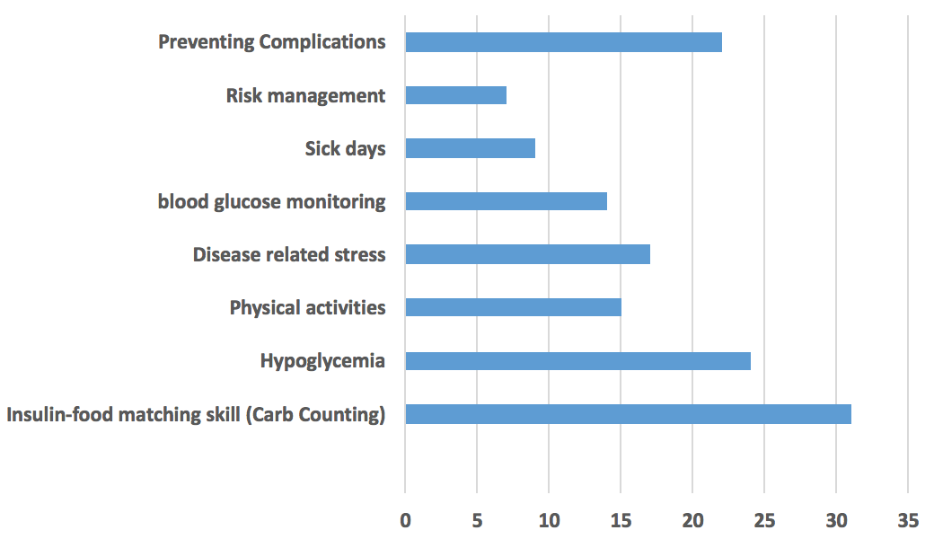
Top topics T1 patients are willing to learn more
N=139

Slide 9
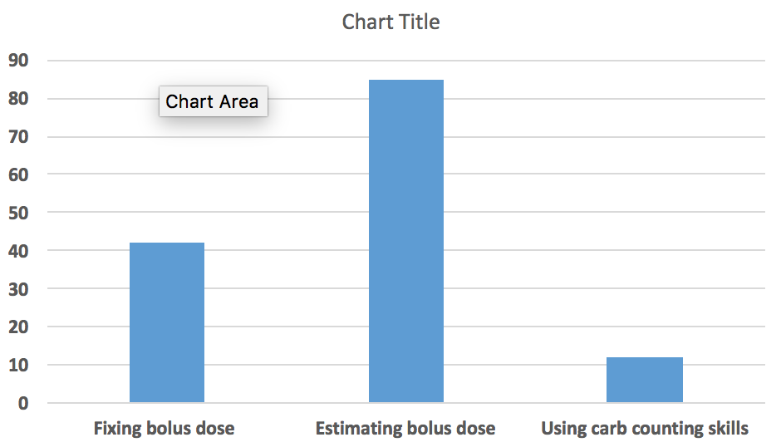
Insulin-food matching reality
N=139

Slide 10
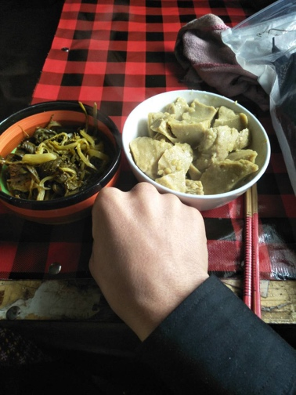
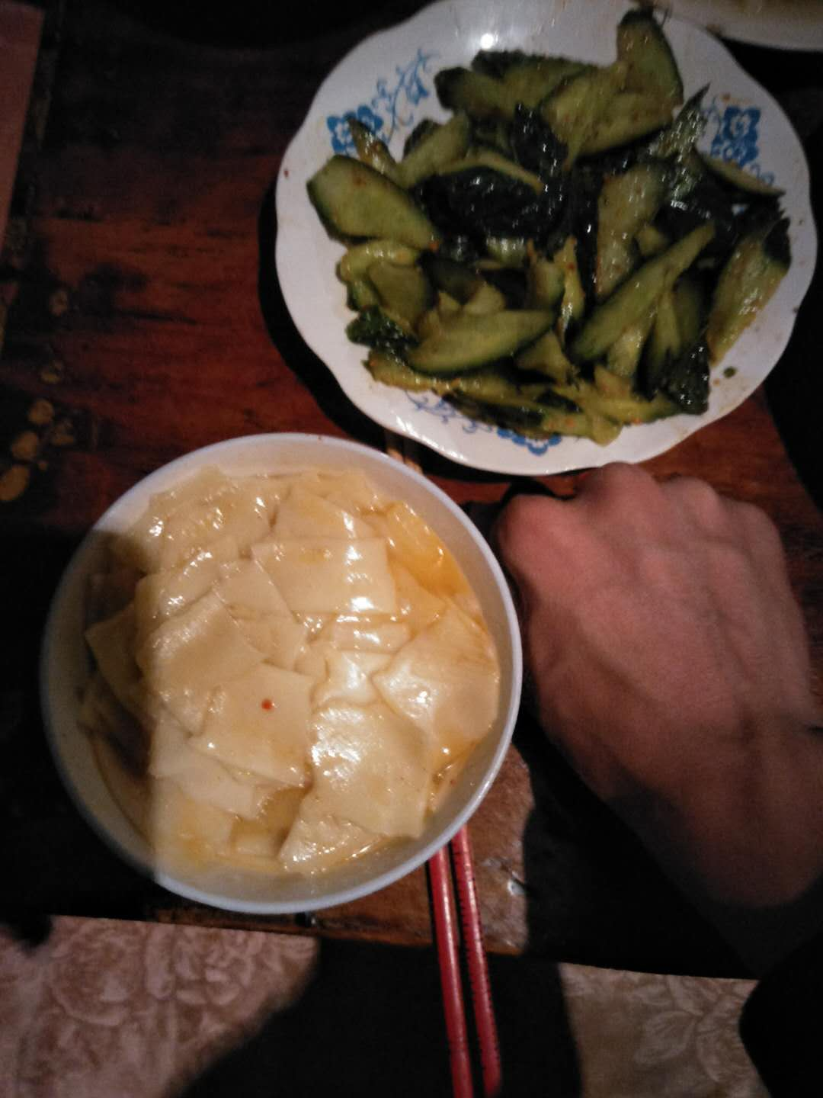
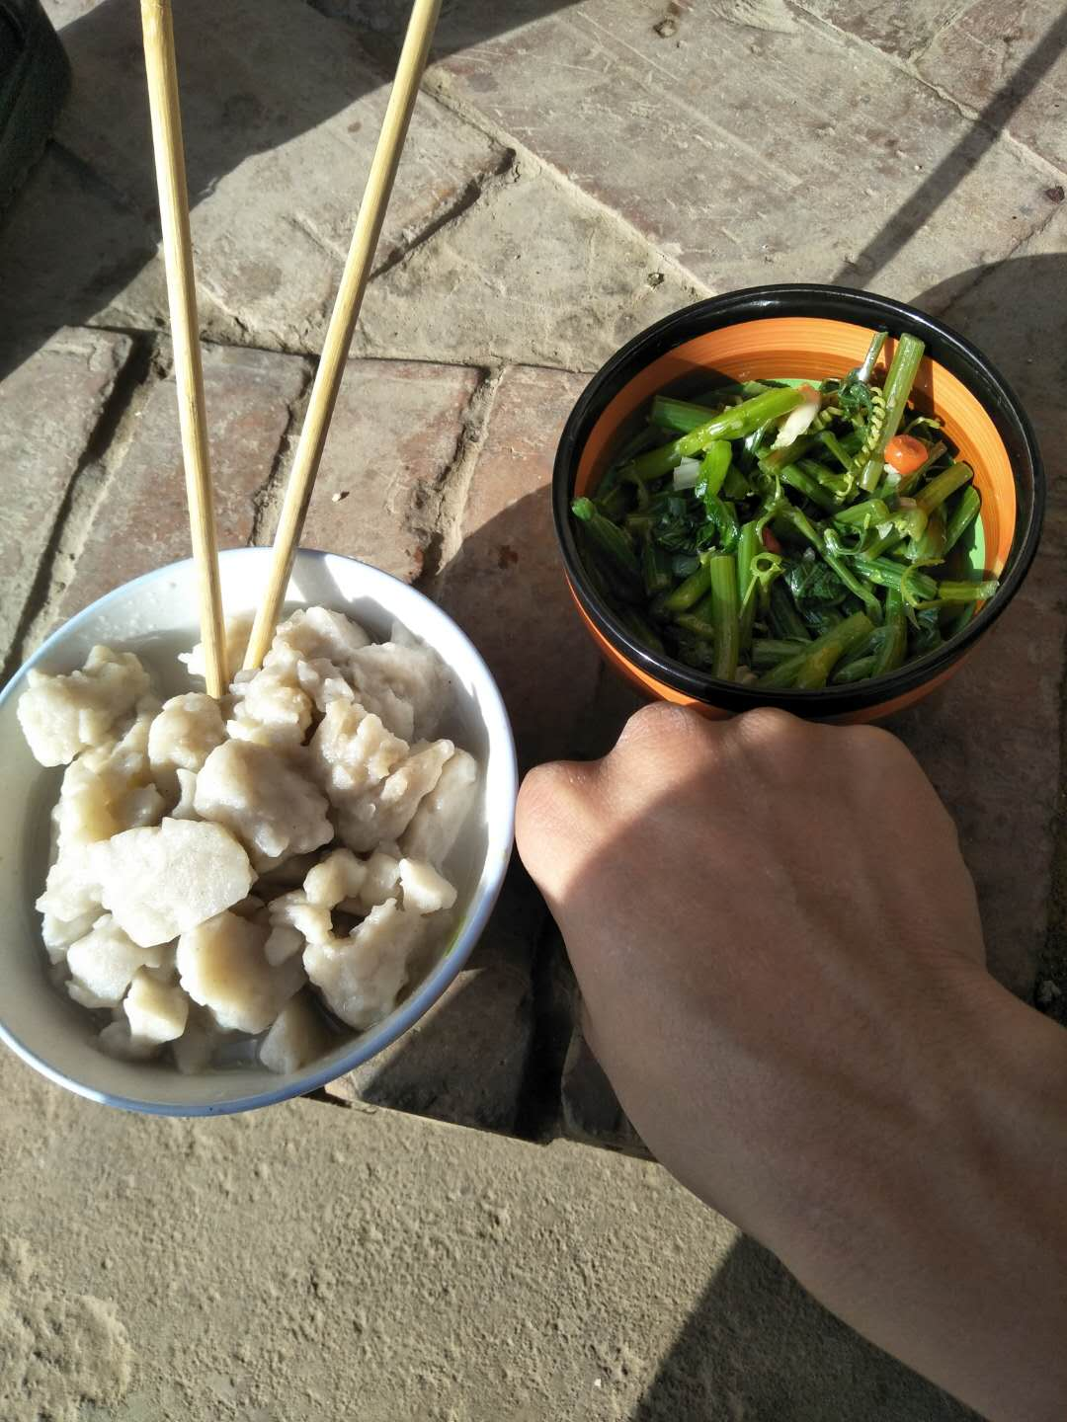
Carb Counting VS Chinese Diet
Restricted access to the specific knowledge
Complexity of Chinese diet

Slide 11
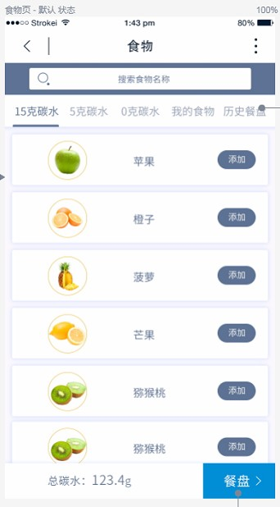
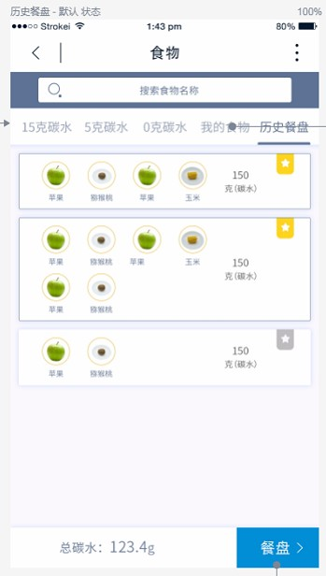
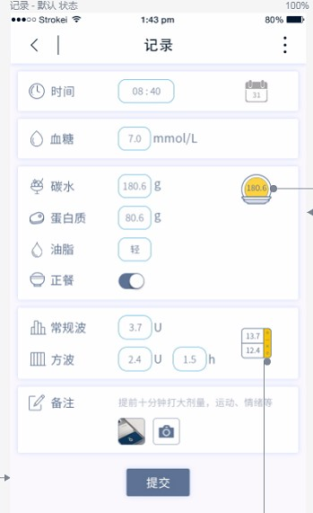
Bolus and glucose
record with calculator
food pool
Dietary record

Slide 12
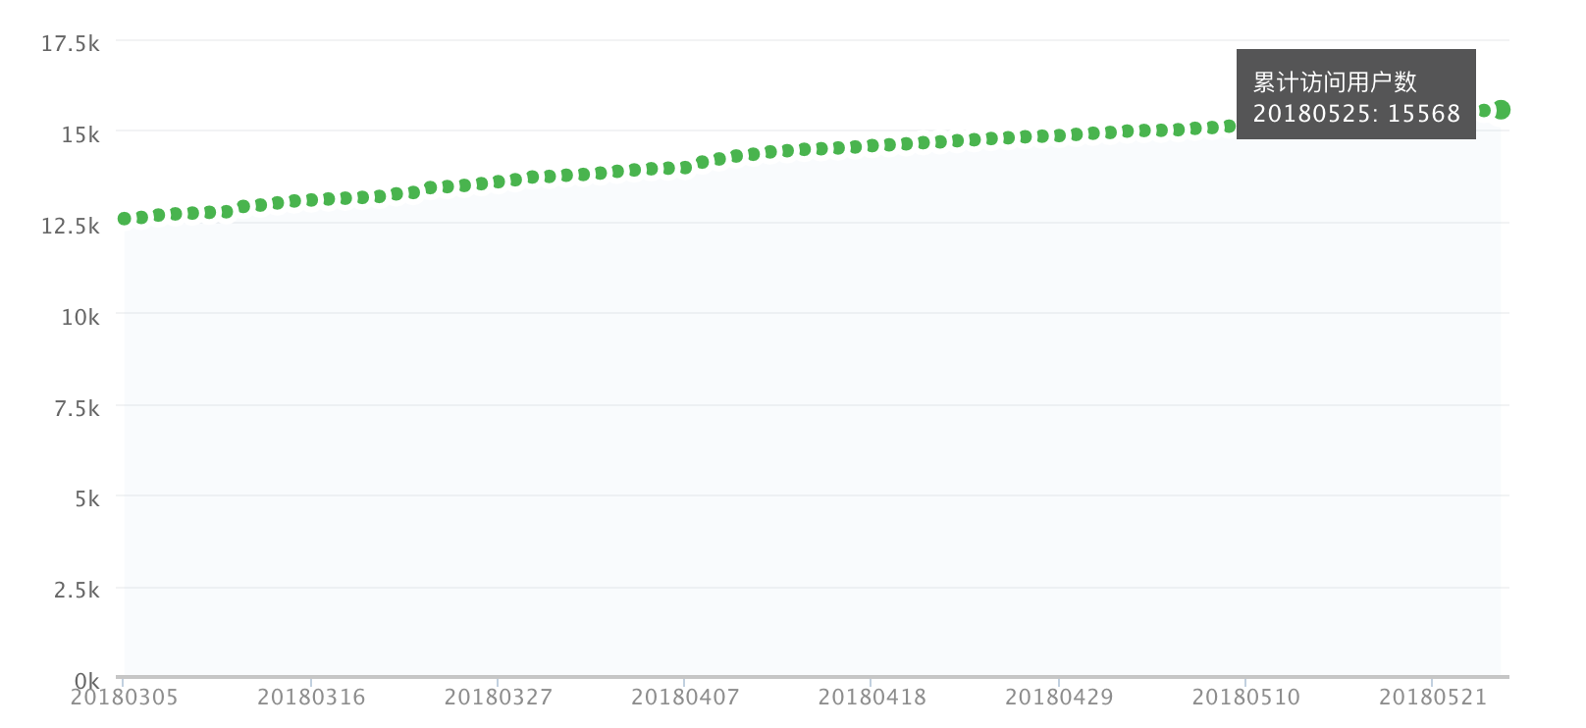
Mobile-phone-based Tool
Overall users: 15,568¹
based on 2018/05/25 wechat background data

Slide 13
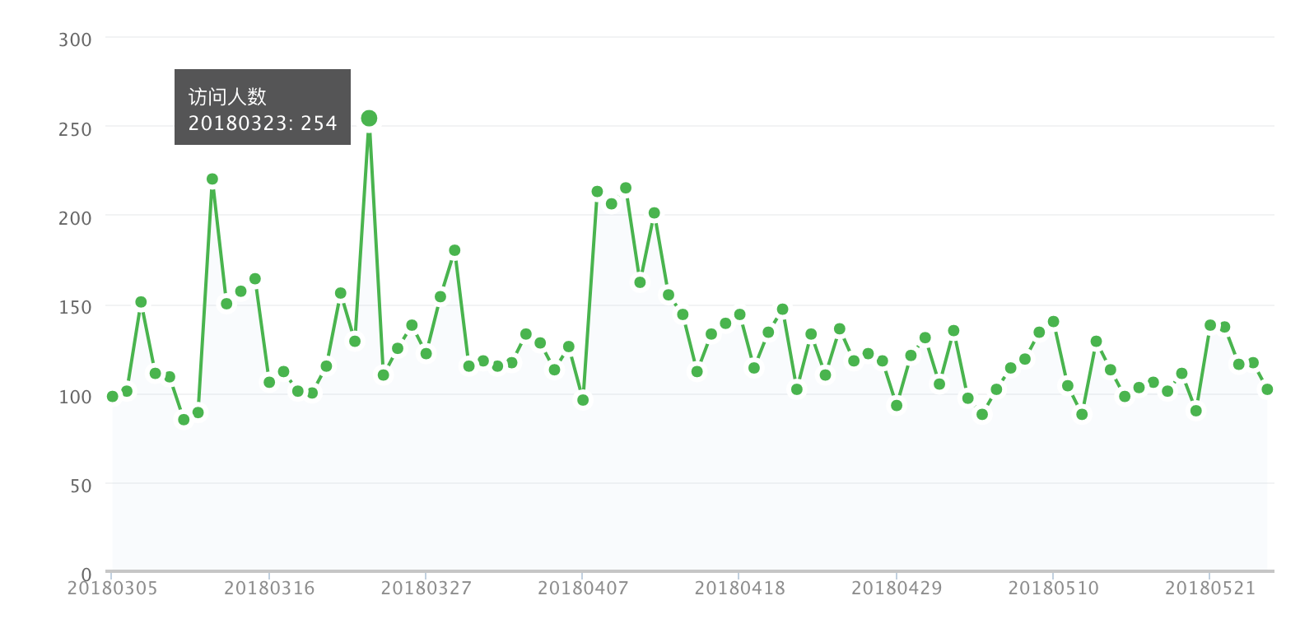
Mobile-phone-based Tool
Active users per day : about 150¹
based on 2018/05/25 wechat background data

Slide 14
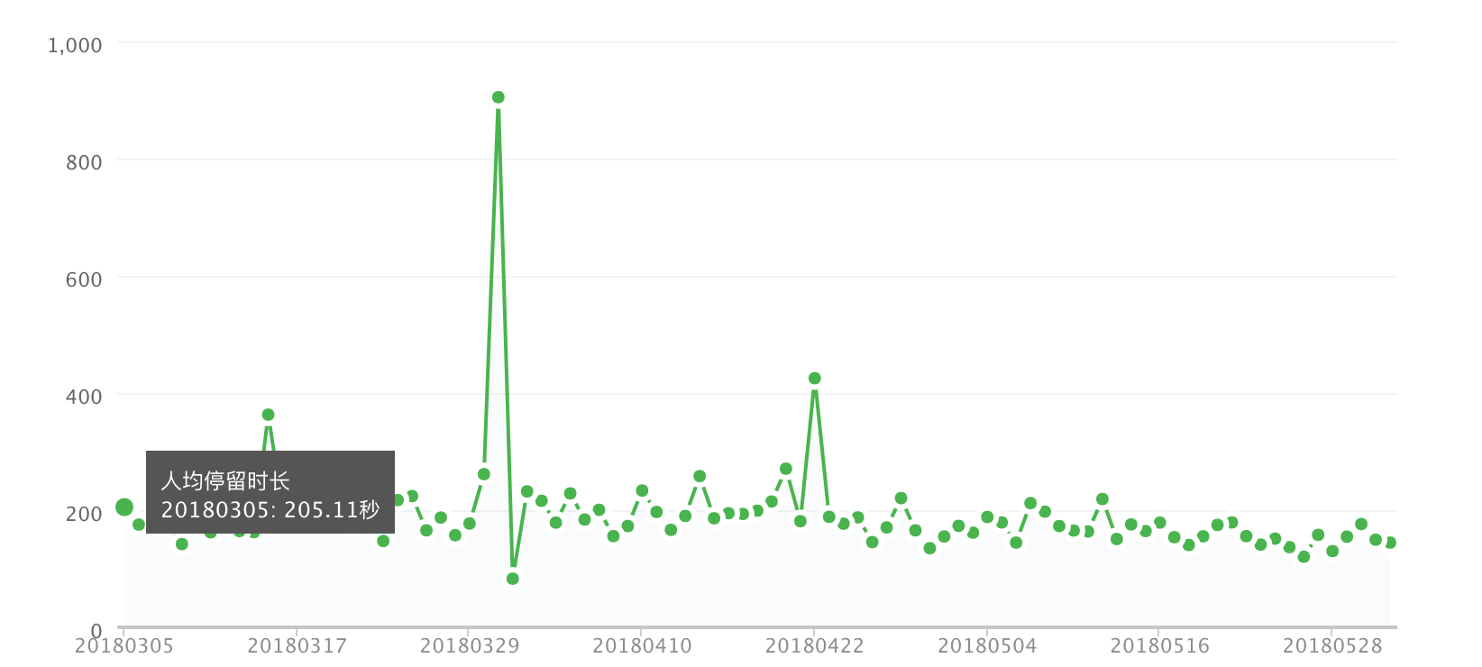
Mobile-phone-based Tool
Open twice and spend 200s daily on average¹
based on 2018/05/25 wechat background data

Slide 15

Mobile-phone-based Tool
4 Visit Peak:
7-8am
11-12am
6-7pm
9-10 pm
based on 2018/05/25 wechat background data

Slide 16
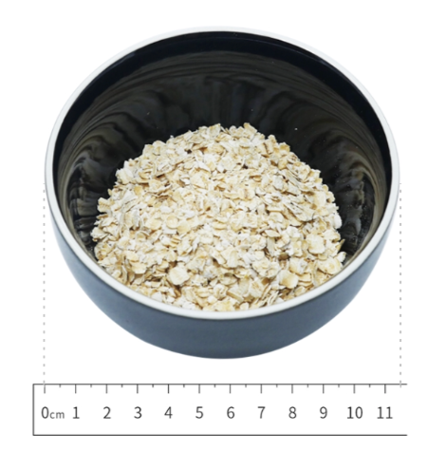
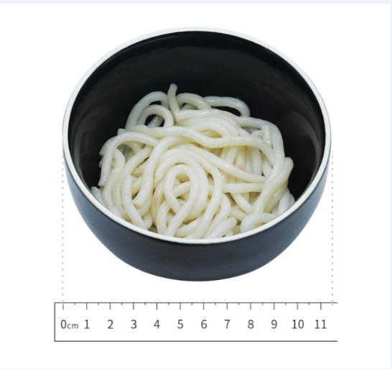
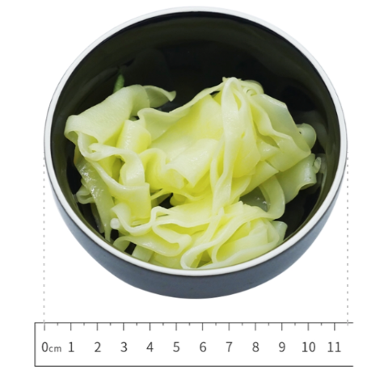
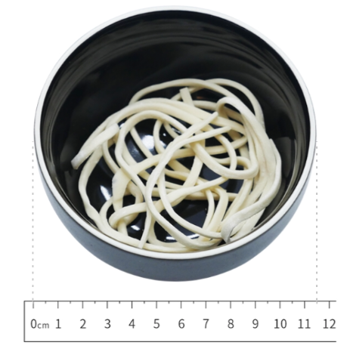
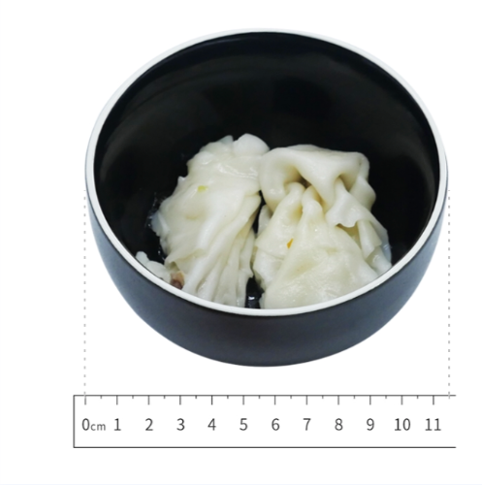
The staple food among top 10 search list
white rice
whole grain steamed bread
noodle
Chinese dry noodle
oatmeal
whole grain steamed bread
sweet potato
gruel
whole grain rice
steamed bread

Slide 17
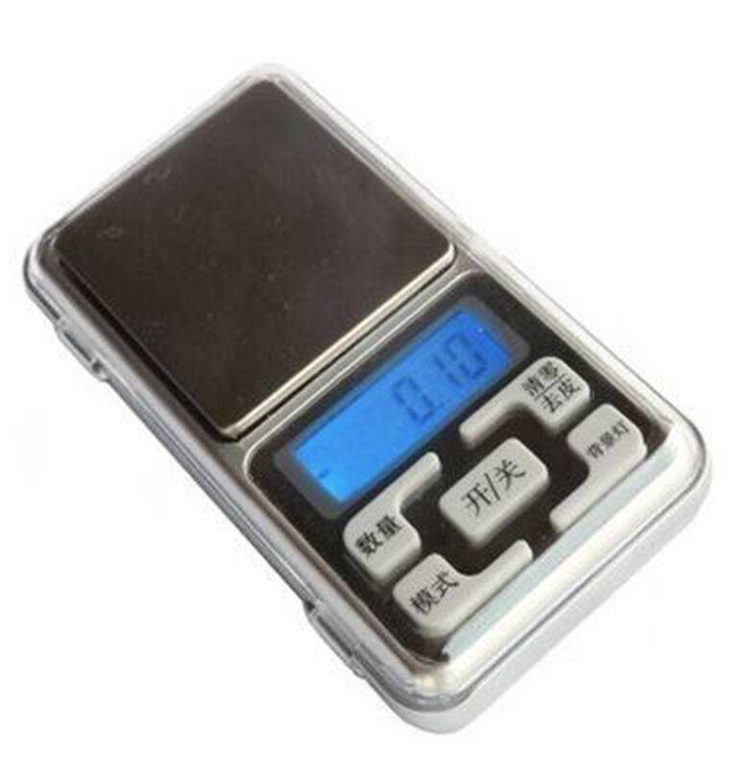
Carb Counting Skill Training
15 patients
4 interactive one-on-one online course
45 minutes at weekly intervals in one month

Slide 18
Carb Counting Skill Training
to improve carb counting related dietary knowledge
to enable patients to count CHO in a variety of settings with the help of mobile-phone-based tool
to build confidence and proper independence for the patients to adjust insulin to suit their desired carbohydrate intake

Slide 19
Results
improved carb counting related dietary knowledge
increased blood glucose monitoring/recording
persisted behavior change
reduction in patient self-reported hyperglycemia and hypoglycemia episodes by 45% and 37% respectively
Improved DSQOLS score related to diet restrictions

Slide 20
Results
No significant changes in HbA1C after 3 month
Why？

Slide 21
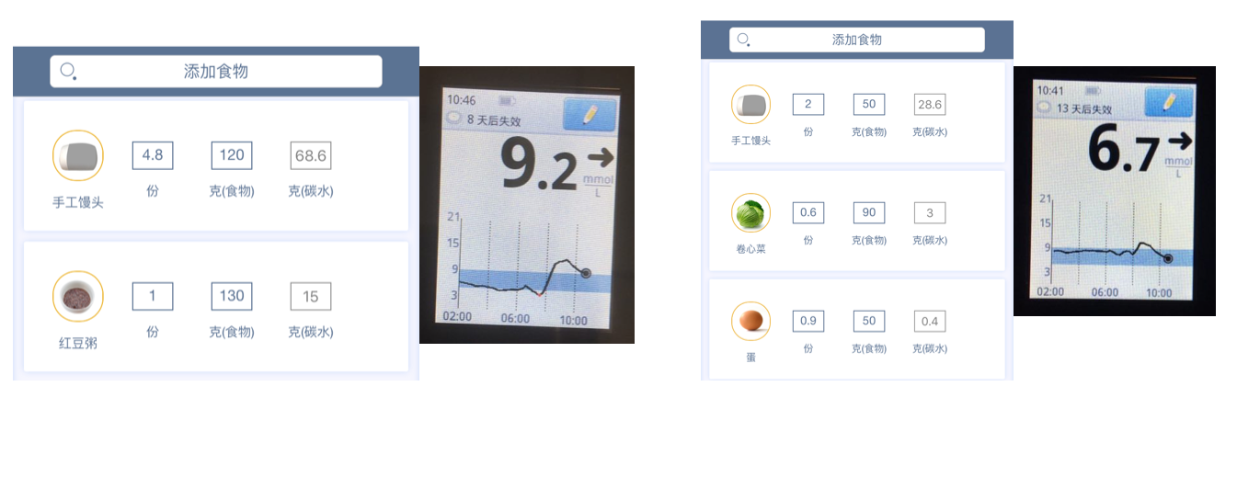
Case Study

Slide 22
Thank you

