Slide 1


Slide 2

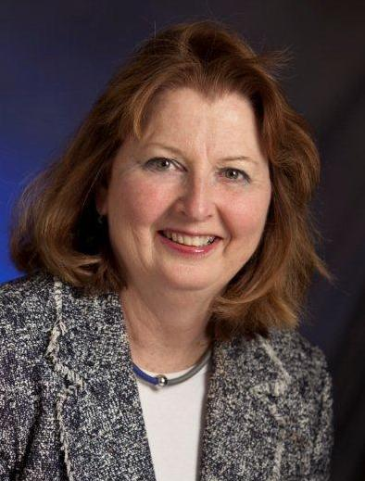
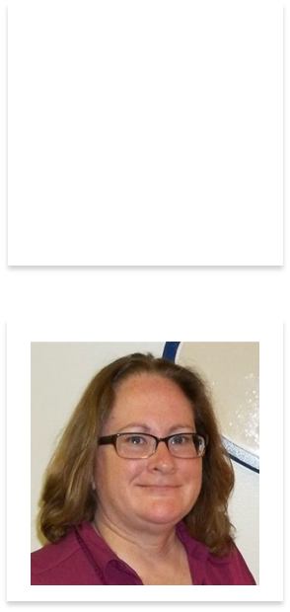
Joan Bardsley
MBA, RN, FAADE, CDE®
2018 Board Chair
National Certification Board for Diabetes Educators (NCBDE)
Sheryl Traficano
MBA, CAE
CEO
NCBDE
Arlington Heights, IL

Slide 3
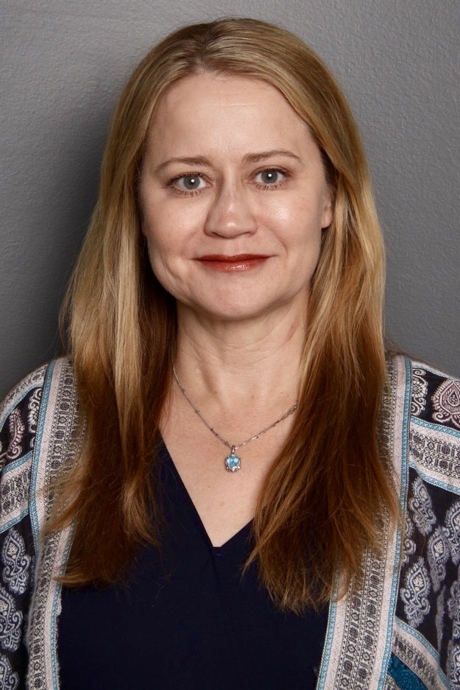
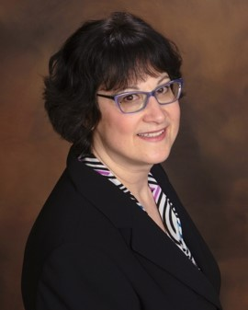

Melissa Young
PharmD, BC-ADM, CDE
Chair, AADE BC-ADM Credential Oversight Committee

Slide 4
Disclosure to Participants
Notice of Requirements For Successful Completion
  Please refer to learning goals and objectives
  Learners must attend the full activity and complete the evaluation in order to claim continuing education credit/hours
Conflict of Interest (COI) and Financial Relationship Disclosures:
  Presenter: Jodi Lavin-Tompkins, MSN, RN, CDE, BC-ADM-Employee of AADE
  Presenter: Melissa Young, Pharm.D., BC-ADM, CDE– No COI/Financial Relationship to disclose
  Presenter: Joan Bardsley, MBA, RN, CDE, Chair of NCBDE
  Presenter: Sheryl Traficano, MBA, CAE - Employee of NCBDE
Non-Endorsement of Products:
  Accredited status does not imply endorsement by AADE, ANCC, ACPE or CDR of any commercial products displayed in conjunction with this educational activity
Off-Label Use:
  Participants will be notified by speakers to any product used for a purpose other than for which it was approved by the Food and Drug Administration.

Slide 5
Objectives
Explain the difference between the BC-ADM and CDE® eligibility requirements.
Describe study and test taking tips for exam preparation.
Differentiate the renewal criteria for each certification.

Slide 6
BC-ADM Overview
In 2001, AADE introduced the concept of developing an advanced-practice nursing credential with a specialty in diabetes
Dietitians, Pharmacists, MD/DO’s, PA’s added later
  AADE became sole owner in 2010
Currently 1120 BC-ADM holders
Each year approximately 200 candidates take the exam
  100 per test window in June and December
Pass rate is ~ 72%
2018 is item writing year, so new test form in December
Notes:
2001 – Inception of the BC-ADM exam – collaboration between ANCC/AADE
*BC-ADM has been fully accredited as a national certifying exam since 2001
Originally there were four separate exams (but all combined since 2010): clinical nurse specialists, NPs, RDs and pharmacists, then combined into one exam in 2009
AADE purchased from AANC in 2010 – 2011, so since 2011, AADE is the full managing body.
In 2012, the BC-ADM Oversight Committee made the decision to add physician assistants, medical doctors, and doctors of osteopathic medicine to the group of qualified candidates.

Slide 7
Functions of the BC-ADM
The BC-ADM skillfully manages complex needs, and assists people with diabetes (PWD) with therapeutic problem-solving. Within their scope of practice, healthcare professionals with a BC-ADM certification may perform the following functions:
  Adjust medications
  Treat and monitor acute and chronic complications and comorbidities
  Counsel PWDs on lifestyle modifications
  Address psychosocial issues
  Participate in research and mentoring
Notes:
Board Certification – Advanced Diabetes Management (BC-ADM) has been a recognized advanced practice certification examination since 2001. Those who have earned the BC-ADM under the American Nurses Credentialing Center (ANCC).

Slide 8
Eligibility
Eligibility Criteria | Registered Nurse Includes NP’s, CNS’s | Registered Dietitian | Pharmacist | Physician Assistant | Physician
Licenses/Registration | Current, active RN license | Current, active dietitian registration (RD/RDN) | Current, active pharmacist registration/ licensure Pharm D or RPh, MS | Current active physician assistant license | Current active MD/DO license
Advanced Degree | Specific discipline’s degree, Master’s or higher degree in a relevant clinical, educational, or management areas | Specific discipline’s degree, RD’s with a Master’s or higher degree in a relevant clinical, educational, or management | Specific discipline’s degree, Master’s or higher degree in a relevant clinical, educational, or management | Specific discipline’s degree, Master’s or higher degree in a relevant clinical, educational, or management | Specific discipline’s degree, MD/DO degree
Experience | 500 clinical practice hours within 48 months prior to taking certification examination. (Clinical hours must be after relevant licensure and advanced degree was obtained)
Level of Practice | Skillfully manages complex patient needs and assists patients with therapeutic problem‐solving. Within their discipline's scope of practice, healthcare professionals who hold the BC‐ADM certification adjust medications, treat and monitor acute and chronic complications and other comorbidities, counsel patients on lifestyle modifications, address psychosocial issues, and participate in research and mentoring.

Slide 9
Qualifying Clinical Practice Hours in Advanced Diabetes Management
  Within your discipline’s scope of practice:
  Adjusting medications
  Treating and monitoring acute and chronic complications and comorbidities
  Counseling PWDs on lifestyle modifications
  Addressing psychosocial issues
  Participating in research and mentoring
  Directly supervising students in clinical practice performing advanced diabetes management

Slide 10
Domains
Exam Content Outline
Category | Domains of Practice | No. of Questions | Percent
I | Assessment and Diagnosis | 47 | 31%
II | Planning and Intervention | 48 | 32%
III | Evaluation and Follow-up | 37 | 25%
IV | Leadership and Advanced Professional Practice | 18 | 12%
 | Total | 150 scored items | 100%
Notes:
Four general content domains were identified and within each domain content sub-domains were established to further specify the critical knowledge required for competent practice within each domain.
In addition, the panelists developed knowledge statements for each of the subdomains to describe the specific body of factual or procedural information for successful function within the subdomain of practice.

Slide 11
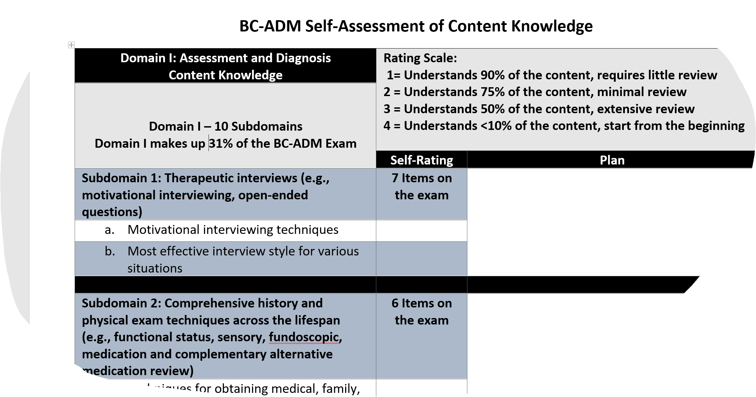
Exam Content Outline-Study Sheets
https://www.diabeteseducator.org/education/certification/bc_adm/resources
Notes:
There is a study sheet for each domain. Each has a rating scale for self rating. Pay close attention to the number of exam questions that fall in the domains you will be reviewing. For example, if you rated yourself as "3", requires extensive review, in an area that has a low percentage of exam questions but rated yourself as "4", start from the beginning, in an area with a high percentage of questions, your study plan should start with the resources provided in the area with the highest percentage of questions.

Slide 12
Certified Diabetes Educator® (CDE®) Overview
National Certification Board for Diabetes Educators (NCBDE)

Slide 13

NCBDE – The Organization
National, nongovernmental, not-for-profit certification organization
Autonomous specialty board overseen by a Board of Directors (BOD)
BOD made up of volunteer CDEs & public member
Committees & Task Forces – volunteer CDEs & public members
Responsible for maintaining NCCA program accreditation for CDE® program
Mission - Promote comprehensive and ongoing quality diabetes education and support by defining, developing, maintaining, and protecting the certification and credentialing processes
Notes:
NCBDE received National Commission for Certifying Agencies (NCCA) accreditation of its CDE program by demonstrating the program’s compliance with the NCCA’s Standards for the Accreditation of Certification Programs.
NCCA is the accrediting body of the Institute for Credentialing Excellence.
Since 1977, the NCCA has been accrediting certifying programs based on the highest quality standards in professional certification to ensure the programs adhere to modern standards of practice in the certification industry.

Slide 14

Certified Diabetes Educator® (CDE®)
Program
A CDE® is a health professional who:
possesses comprehensive knowledge of and experience in diabetes prevention, prediabetes, and diabetes management
educates, supports, and advocates for people affected by diabetes, addressing the stages of diabetes throughout the lifespan
promotes self-management to achieve individualized behavioral and treatment goals that reduce risks and optimize health outcomes
®
Notes:
A CDE serves as mentor, confidant, cheerleader, and coach the person with diabetes, as well as case manager.
Valuable and respected members of the health care team
Make a difference for people living with diabetes and in their communities

Slide 15
Certified Diabetes Educator® (CDE®) Program
19,897 CDEs
As of 5/2018
Notes:
1st exam - 10/1986 – 1,200 CDEs

Slide 16

Becoming a CDE® - Short & Sweet
Four steps to achieve CDE certification:
Step 1 - Meet disciplinary requirement – various license and registrations qualify
Step 2 – Work (or volunteer)
  Step 2a – 2 years general experience (full time/part time)
  Step 2b – 1,000 hours diabetes education experience, with at least 400 hours in last 12 months
Handbook info: http://www.ncbde.org/certification_info/examination-handbook/
Notes:
CDE credential one of very few multidisciplinary certifications – especially in the health care arena. Opens up lots of possibilities, as well as lots of confusion.
“Mastery-level”: accrual of sufficient practice experience to “master” knowledge about diabetes, critically analyze a situation and apply the associated learning to guide individuals toward positive outcomes.
Practice req – 2 components – 2 years and 1000 hours
Both must be met after meeting discipline requirement and prior to applying for exam
2 years – e.g., if you are applying under the discipline requirements as a RD, 2 years experience working as a RD is needed.
DOES NOT have to be diabetes related, but certainly can be. It also does not have to be full-time – can be part-time. Can be volunteer or employment role.
1,000 hours
How do you track your hours?
No logs are required when you apply – individuals attest to the fact they meet ALL of the requirements when submitting an application.
However, a random audit process exists, so you’ll need to be able to provide proof of all requirements, including DSME practice hours if you are audited.
Therefore, before you apply – or even better – as soon as you begin to think about applying - talk with your supervisor to be sure you both are on the same page with your role and your DSMES hours.
Come to an agreement with your supervisor on how you’ll track your hours. Note: NCBDE does not have a required format.
Be sure to follow through…
Full time estimate for one year: 50 weeks/year x 40 hours/week = 2,000 hours.

Slide 17
Becoming a CDE® - Short & Sweet
Step 3 – Accrue 15 hours of continuing education applicable to diabetes within last 2 years
  Steps 2a, 2b & 3 – can all be done at the same time
Step 4 – Apply for, take, and pass the exam
®
Handbook info: http://www.ncbde.org/certification_info/examination-handbook/
Notes:
Mention Unique Qualifications pathway
Pass exam – 5 year certification cycle

Slide 18
Exam Content Outline – CDE® Program
Category | Domain | No. of Questions/Percent
I | Assessment | 60 (34% scored)
II | Intervention | 89 (51%)
III | Disease Management | 26 (15%)
Total Scored Items |  | 175 (100%)
Pre-test Unscored Items |  | 25 (any above category)
Exam Content Outline:
https://www.ncbde.org/assets/1/7/ContentOutline2014_effective_05-2014.pdf
Notes:
Based on 2013 practice analysis
200 items total on the exam; 175 scored & 25 pretest items
Pretest items – not scored until meet stats that identify item is performing appropriately

Slide 19
Exam Content Outline – CDE® Program
Category/Section | Domain | Number of Questions (% of Scored Items)
I.A. | Assess Learning/Self-Care Behaviors | 20
I.B. | Assess Medical/Health/Psychosocial and Economic Status | 20
I.C. | Assess Current Knowledge and Self-Management Skills | 20
II.A. | Collaborate with Patient/Family/Caregiver/Healthcare Team to Develop: Individualized diabetes education plan based on assessment Instructional methods Behavioral goals | 16
II.B. | Teach/Counsel Regarding Principles of Care | 50
II.C. | Evaluate, Revise and Document | 17
II.D. | Referral and Follow-Up | 6
III.A. | Education and Program (Service) Standards | 8
III.B. | Clinical Practice | 16
III.C. | Engage in Diabetes Advocacy | 2
Notes:
OPTIONAL – NOT SURE WE NEED

Slide 20

Studying For and Taking the Exam

Slide 21
Test Preparation
Develop study plan
Know amount of content
Develop time line
Organize content
Prioritize content on your strengths and weaknesses
Study in short bursts
Take breaks

Slide 22

Prep Tips
Review Exam Content Outline (ECO)
Responsible for knowledge over all of ECO
Consider your population – be sure to study aspects of the ECO outside of that profile
Notes:
Bullet 1 – found in handbooks and program’s web site
Bullet 1a – look at the ECO in terms of questions that may not be a part of your day to day experience - do you mainly work with adults w T2? Look over ECO when thinking about other populations, e.g., children w T1 or women w gestational diabetes
Bullet 1b
– also think about areas of weakness related to your background/training - e.g., perhaps medications if you are a dietitian or wound care if you are a pharmacist, etc.

Slide 23

Prep Tips
Review Handbook information on studying for the exam and references
Check around for other resources e.g., continuing education activities, review courses and materials
Consider forming a study group
Notes:
NCBDE does not sponsor or endorse other organization’s materials, but many organizations/companies have review materials. Just be sure the content meets learning needs in relation to weaker areas on ECO. AADE has review materials for the CDE but because they own the BC-ADM certification, it would be a conflict of interest to provide a review course.

Slide 24


Prep Tips
BC-ADM Program
Reference list: https://www.diabeteseducator.org/education/certification/bc_adm/resources
BC-ADM online practice area discussion group (for AADE members) http://www.myaadenetwork.org/p/cm/ld/fid=1
Test taking tips in candidate handbook
CDE ® Program
  Visit our exam preparation page at https://www.ncbde.org/certification_info/preparing-for-the-exam/
  Read Exam Suggestions & Tips brochure at https://www.ncbde.org/assets/1/7/ExamTipsBrochure_Current.pdf
Notes:
Brochure speaks to study tips, planning and preparing for the exam, exam day, and exam results.
(Brochure link on our exam preparation page)

Slide 25
Anatomy of a test item
The color of the sky at midnight is:
Green
Orange
Blue
Black
Stem
Distractors
Answer

Slide 26
Test Taking Strategies
Focus on the stem
Read every option
Look for strategic words
  Best, first, immediately, most appropriate, most likely, initial,
  next, primary
  Look for absolutes, such as always, never
  Safety issues
Silvestri, L.A. (2014). Saunders Comprehensive Review for the NCLEX-RN Examination (6th ed.).

Slide 27
Working the Test
Pace yourself:
  Estimate amount of time per question
  Know where you are at halftime
Use ALL the time allowed
No blanks- answer all – guess
Changing answers?
Avoid careless errors
Notes:
From: http://www.socialpsychology.org/testtips.htm
Even though first answers are often correct, you shouldn't be afraid to change your original answer if, upon reflection, it seems wrong to you. Dozens of studies over the past 70 years have found that students who change dubious answers usually improve their test scores. For example, a May, 2005, study of 1,561 introductory psychology midterm exams found that when students changed their answers, they went from wrong to right 51% of the time, right to wrong 25% of the time, and wrong to a different wrong answer 23% of the time (Journal of Personality and Social Psychology, Vol. 88, 725-735).

Slide 28
Working the Test: Common Errors
Avoiding the easy answer; thinking you need a
complicated answer
Missing an important word (“most important”, “best”, “usually”)
Ignoring the patient's characteristics
Being thrown by a technical term
Looking for a “right” answer which is not among the choices
Selecting a response which is idealistic, controversial,
or unrealistic
Notes:
From AADE Test handbook (p. 26):
Pay close attention to key words such as “best,” “most,” “primary,” or “usually.” These words
indicate that other options may at times be correct, but given the wording or situation in the
test question, you must judge which option is the best.
From: http://sarc.sdes.ucf.edu/docs/learning_skills/test_taking/mcstrate.pdf
1. Choose the most general answer when other choices are specific.
2. Choose the longest answer when others are much shorter.
3. Choose the answer with a middle value when other answers are higher or lower.
4. Choose neither of the similar answers.
5. Choose one of two opposite answers.
6. Choose the answer that agrees grammatically. For ex: a, and an = singular, are = plural.
7. Choose the answer most synonymous with key words in the question or statement.
8. Count the number of blanks in fill-in questions or statements.
9. Choose from among familiar answers. Avoid unknown options.
10. Choose the most logical answer to you.
11. Avoid answers with absolutes in them. Examples are always, never, every, none, all, only.)

Slide 29

Working a Test Item
What is a common symptom of cardiovascular autonomic neuropathy ?
Fixed heart rate
Tachycardia with exercise
Headaches
Burning and numbness in feet
Heart =Autonomic
(not feet) complications
Notes:
From: AADE Test handbook (p. 26):
Do not overanalyze or try to “read into” a question. Questions are not written to be tricky. Do
not assume additional information beyond what is given in the test question. All information
necessary to answer the question will be given in the text of the question or scenario.
From: http://www.glencoe.com/sec/teachingtoday/downloads/pdf/Strategies_MC_tests.pdf
1. Employ a “cover-up” strategy by trying to answer a question before looking at the choices.
2. Treat each answer choice as a true or false response. Select the “most true” answer.
3. Rephrase a question as a statement using ea ch answer in the sentence. Which seems most true?

Slide 30
Prep Tips-Practice Exams
Still nervous about exam day? Consider making use of a practice examination
BC-ADM Program - Learn more at: https://www.diabeteseducator.org/education/certification/bc_adm/resources
CDE® Program - Learn more at: https://www.ncbde.org/certification_info/studying-for-the-examination/#PracticeExam
Notes:
Bullet 3 – CDE
Developed by NCBDE and available through PSI/AMP. PE is taken via the internet – provides “feel” for actual exam experience; 50 questions - $55 fee.

Slide 31
FAQs and Myths
Initial Certification

Slide 32
BC-ADM Initial Certification: FAQs & Myths
How do I document my Clinical Practice Hours?
Once I take the exam how long before I get the results and how will I be notified?
Myth: To practice, you need to have both credentials, the CDE an the BC-ADM
Myth: Having the BC-ADM certification changes scope of practice
Myth: Clinical practice hours while in training count towards the 500 required hours
Myth: If I was grandfathered in when practice changed to require a Master’s degree, I am still eligible despite not having a Master’s degree, as I am practicing at the same level as someone with the degree
Myth: I will get my test results right away and can ask for them over the phone
Notes:
First time candidate: minimum of 500 clinical practice hours (after licensure) within 48 months prior to applying for this certification exam
The scope of advanced diabetes management includes patient management skills such as medication adjustment, MNT, exercise planning, counseling for behavior management and psychosocial issues
On the application, you can provide the Institution, Supervisor, Start/End date and Clinical practice hours for the 500 total clinical hours you are reporting.
Only candidates selected for audit will be asked to provide supporting documentation to verify the information provided in the application.
Exam results will be mailed within 6 – 8 weeks from the close of the testing window.
The exam in offered in June and December and the close of the testing window is the first day of the following month, i.e., the June test window closes on July 1st and the December test window closes on January 1st.
Examination results will be released only in writing by mail, not by telephone or fax.
No certification changes scope of practice
Licensure comes from state
CDE is a Level 2 Diabetes Educator – Focus is on education
BC-ADM is a Level 3 Diabetes Educator – Focus is on Management of the person with diabetes
You do not need both

Slide 33
CDE® Initial Certification: FAQs & Myths
  What counts for experience? https://www.ncbde.org/certification_info/professional-practice-experience/
  How do I track experience?
  Myth: RNs need a bachelor’s degree
  Myth: Two years of practice must be: a) in diabetes or b) full time
  Myth: Work/volunteer role must be full-time diabetes education positions
  Myth: Work/volunteer diabetes education hours don’t count unless doing a minimum of 4 hours per week
Notes:
CDE
Counts – review definition
Track – talk with supervisor – be sure to follow their lead, but keep track for yourself as needed; discuss audit process
Myth – license as RN only
Myth – 2 yr - neither true
Myth – FT - 4 year window allows pt experience to count; can combine jobs and/or volunteer experience also
Myth – 4 hours – True prior to 2010

Slide 34
Renewing BC-ADM Certification
Requirements

Slide 35
BC-ADM Practice Hours for Renewal
A minimum of 1000 practice hours related to your role as an advanced diabetes manager must be completed within the 5 years preceding the postmark on your renewal application submission

Slide 36
6 Professional Development Categories-
BC-ADM Renewal
  Category 1 CEU’s
  Category 2 Academic Credits
  Category 3 Presentations
  Category 4 Publications/Research
  Category 5 Preceptor
  Category 6 Professional Service
  https://www.diabeteseducator.org/education/certification/bc_adm/renewal
  https://www.diabeteseducator.org/docs/default-source/education-and-career/certification/practice-hours-explained.pdf?sfvrsn=0

Slide 37
Renewing the CDE® Credential
Requirements

Slide 38


Renewing the CDE® Credential
Important Info About Renewal
1. Know your expiration date and accrual dates
2. Review the renewal practice requirement
3. Be sure NCBDE has your current contact info
Notes:
Sheryl start here…
– with a time frame of every 5 years and with all the licenses and other credentials you might hold, can get lost
- But do need to be aware of the date - where is that date?
On your certificate and wallet card
Log in to the NCBDE CDE portal
Call or email the NCBDE national office
- Like other situations, you must renew prior to your expiration date to keep the credential continuous
- Want to be aware of the accrual dates for your own renewal process and deadlines for the different renewal options
2. Why?
- Courtesy reminders are sent via mail and email beginning the fall before you renew (e.g., expiration date is 12/2018, the first official reminder was sent by mail in October 2017 with all the pertinent details, with email and postcard reminder in Spring 2018)
- With above, be aware that it’s important to read email messages and correspondence from NCBDE
2. How update?
- Use record update form available in annual newsletter or 24/7 via web site
- call or email the office
- be sure to contact NCBDE directly with your change
3. Why?
- Need to know if you will meet it before being able i.e. renewal options

Slide 39
Renewing the CDE® Credential
What’s New for Renewal of Certification?
Reminder– Retired status available – for those no longer practicing in diabetes education (volunteer or employment) – small one time fee, recognition on NCBDE web site
Practice Requirement – no changes
Notes:
Retired status – for those truly retired, CDE for at least 10 years, recognition via certificate and web site page.
We will review Practice requirement and how to document it in a future slide.
.

Slide 40
Renewing the CDE® Credential
What’s New for Renewal of Certification? (continued)
  Exam Option – year-round testing in approximately 300 exam sites
  Continuing Education Option – Expanded CE Activities
  Accrual period for accruing CE stays at Dec 15 Grace period available from December 16 – March 31 via special app
Notes:
Exam Option: Examination – now can be done year-round (no more application windows). Register online and test at your convenience.
Continuing Education Activities (we’ll talk later on the updates)
Grace period – accrual period for practice/CE still stays at Dec 15, but can apply (via special app) between Dec 16-March 31 for grace period CE – additional fee, only via paper, see HB for full details
.

Slide 41
Renewing the CDE® Credential
Renewal: Eligibility Requirements
Maintain original license/registration held at the time of your initial certification
Accrue minimum of 1,000 hours of professional practice experience during five-year certification cycle
Document 75 hours of continuing education activities or pass exam.
Apply and pay application fee for renewal method chosen
Notes:
License/reg – must be current, active unrestricted while holding credential
Review practice requirement and how they document. Talk on renewal professional practice expanded vs. initial certification.
75 hours of continuing education – can mix and match with the Formal and Expanded categories…we’ll get into that later
Be sure you earn your hours prior to applying

Slide 42
Renewing the CDE® Credential
Renewal: Eligibility Requirements Professional Practice
  What it is?
    Providing direct/indirect professional contribution to the care and self-management education of people with diabetes
  What it is not?
    Employment in manufacture, direct sales or distribution of diabetes-related products or services
Notes:
What it is:
Also includes prediabetes and diabetes prevention
Meant to be as inclusive as possible
Includes volunteer activities, clinical roles in diabetes industry, etc.
Not:
Plus jobs/volunteer activities unrelated to diabetes

Slide 43
Renewing the CDE® Credential
Renewal: Continuing Education Option - Expectations
  Health professionals specializing in diabetes education will demonstrate through renewal of certification: knowledge and skills are up-to-date, ability to practice proficiently, safely, and in a manner consistent with current National Standards of Diabetes Self-Management Education and Support (NSDSMES).
  All CDEs who select renew by continuing education will engage in a personal assessment to identify professional needs and participate in appropriate activities that are inclusive of the Examination Content Outline in the current Handbook.

Slide 44
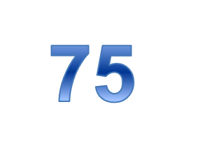

Renewing the CDE® Credential
75
75
Renewal: Continuing Education Option
Minimum total of 75 clock hours of continuing education in content areas applicable to diabetes within your accrual cycle. You can earn hours through both the Formal and Expanded Continuing Education Activities.
Formal CE:
  Activities need to be related to Diabetes
  At professional level that enhances the quality and effectiveness of diabetes education practice
  Does NOT have to be discipline-specific, nor does it have to be in any specific area of concentration.
Notes:
NEW – started with CDEs renewing last year
The addition of Expanded activities for CE hours. One does NOT need to earn through the Expanded, but the expanded give our CDEs with additional options of which to earn CE hours. (more to come later).
FORMAL ACTIVITIES:
At professional level that enhances the quality and effectiveness of diabetes education practice. Professional level: E.g., Basic Life Support (BLS) course for health care providers would not be considered an acceptable activity. Does not enhance the quality of DSME practice
Does NOT have to be discipline-specific, nor does it have to be in any specific area of concentration. Not specific: E.g., RD, CDE may attend a diabetes-related activity about wound management approved for nursing CE hours. Often areas of weakness, knowledge-wise, are outside normal discipline – encouraged to “cross-train” or find CE to help bolster areas of weakness.

Slide 45
Renewing the CDE® Credential
Renewal: Continuing Education Option – Formal Activities
  Formal Continuing Education Activities (Traditional CEs)
  Need to be approved by a provider on the NCBDE List of Recognized Providers
  A minimum of 45 of the 75 hours must be earned from this Formal Activities categories (remaining 30 under the Expanded Activities).
  Not required to earn hours under the Expanded.
  Note that if you are NOT using hours from the Expanded Activities, you will need to earn all the hours under the Formal Activities.
Notes:
Formal Continuing Education Activities – the ‘traditional way to earn’.
Must be approved by a provider on our list. And keep copies (either electronic or paper) of your supporting documentation for these activities.
You still can earn all 75 hours from the Formal activities.

Slide 46
Renewing the CDE® Credential
Renewal: Continuing Education Option – Expanded Activities
  Expanded Activities
  Includes taking academic courses, giving presentations, writing publications, and Service as Mentor in NCBDE mentorship program
  Maximum of 30 hours can be used from the Expanded. See Table B in the renewal handbook for individual limits for each Expanded Category.
  Using Expanded CE hours is not required to renew.
  If you will not be using hours from the Expanded Activities, then all your CE will need to be earned from the Formal Activities.
  Expanded activities need to be related to diabetes
Notes:
Expanded activities are NOT required. Again, the expanded provides additional opportunities for CDEs to earn CE hours.
The expanded include— and, of course, need to be related to diabetes
Academic courses
Giving presentations
Writing publications (not to be confused with just READING) publications
Service as a mentor in the NCBDE mentorship program
NOTE; There are Categry limits on the Expanded – you can use only a maximum of 30 hours from Expanded. Also note that there are also limits on the individual expanded categories. If you are going to consider Expanded Activities, be sure to review the limitations.
(link on next slide)

Slide 47
Renewing the CDE® Credential
Renewal: Continuing Education Option - Guidelines
  For additional details on the Formal and Expanded Activities Categories, please refer to Tables A and B in the:
  Renewal by Continuing Education Update for CDEs Renewing in 2017 and Later: Guidelines for Reporting Continuing Education Activities or the current Renewal Handbook.
  Download available on the NCBDE web site at:
  https://www.ncbde.org/assets/1/7/RenewalGuidelinesExpDoc_final.pdf

Slide 48

Renewing the CDE® Credential
Want to: 1) Track CE activities or 2) If Renewing in 2018,
Access the Online Renewal Form?
Access the CDE Portal
Notes:
Let’s review…
You’ll need to log into the CDE portal of the NCBDE web site (www.ncbde.org)

Slide 49
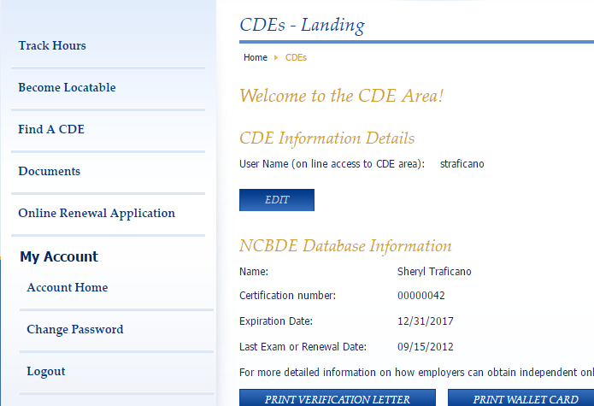
Renewing the CDE® Credential
Click here to enter ce activities (optional)
Click here for online renewal by ce application
Notes:
Track hours – optional for tracking renewal by ce activities
Online tracking option – 1.5 hours on certificate = 1:30 hours:minutes
Audit - PDF fillable or hard copy summary form – 1.5 hours on certification can be marked down as 1.5 hours
Online Renewal Application – This will only appear in the year your CDE is due to be renewed after window opens. For example, we are in the 2018 renewal cycle. If your CDE is up for renewal next year (2019) you will not see ‘Online Renewal Application’ in your CDE portal.

Slide 50
FAQs and Myths
Renewal of Certification

Slide 51
BC-ADM Renewal FAQs, Myths and Facts
Myth-I can accumulate my CE’s over 6 years
Myth-I will pay the member fee if I join at any time
Myth-The number of practice hours to renew is the same as for the initial application

Slide 52
CDE® Renewal of Certification: FAQs & Myths
  How do I track renewal experience?
  Myth – Working in industry is not acceptable.
  Myth – Must accrue 200 hours/yr.
  Myth – I have to be working full time as a diabetes educator to renew.
  Myth – I have to be directly providing DSMES to people living with diabetes for experience to count for renewal.
  Myth – The word “diabetes” must be in the ce activity’s title to count.
Notes:
BC-ADM
CDE
How track – You will be asked to sign a statement that attests to meeting all of the current eligibility requirements, including the 1000 hour practice requirement. If an application is chosen for audit, you will need to have a supervisor (or for those in private practice, another health professional) sign a similar statement that confirms you have fulfilled the practice requirement. Of course, if you are renewing by the continuing education pathway, you will need to maintain copies of your continuing education credits/certificates in the event they need to be submitted as part of an audit.
Myth – working in industry - not acceptable – NOT True. Clinical roles in industry related to diabetes ARE acceptable
Myth – 200 hrs/yr – NOT True - 1,000 hours ANY TIME over the cycle is acceptable
Myth - full- time – 1,000 hours over 5 year cycle – means do not have to be working full-time; also volunteer experience counts
Myth – people vs. health professionals – INITIAL ONLY is with PWD
Myth – title – Refer to ECO above w/ a caveat - reviewers need to be able to identify content from title, e.g., “Annual Conference” – rather than “Annual Diabetes Conference of SE States” or “In It To Win It” vs. “In It To Win It – How to Help People Lower their Blood Pressure”.

Slide 53
How to Apply
CDE and BC-ADM

Slide 54
How to Apply - CDE® Program
Be sure you’ve reviewed the appropriate handbook before starting the application process.
Initial Certification & Renewal of Certification by Exam:
PSI/AMP administers the examination process for NCBDE, including application submission. Reach them at www.goamp.com, info-AMP@goamp.com, 913-895-4600.
Renewal of Certification by Continuing Education:
NCBDE oversees the renewal by continuing education application process: www.ncbde.org, info@nbde.org, 877-239-3233.

Slide 55
How to Apply-BC-ADM
Be sure you’ve reviewed the candidate handbook before starting the application process
Castle WorldWide administers the examination process for AADE, including application submission. Reach them at ibt@castleworldwide.com, 919-572-6880
Online application can be accessed here: https://castleworldwide.com/aade/public/Welcome.aspx?AppSystemID=6

Slide 56
AADE
bcadm@aadenet.org
www.diabeteseducator.org
1-800-338-3633
National Office:
200 West Madison St, Suite 800, Chicago, IL 60606
https://www.facebook.com/diabeteseducator/

Slide 57
NCBDE
www.ncbde.org • info@ncbde.org
Voice 877-239-3233 (toll free) or 847-228-9795
Fax: 847-228-8469
National office:
330 E. Algonquin Rd, Suite 4
Arlington Heights, IL 60005
Facebook page: CertifiedDiabetesEducators

