Slide 1
A Risk Reduction Strategy to Lower Rates of
Hypoglycemia by Determining Root Causes
Quality University –
Department of Medicine
Co-PI’s
Naina Sinha Gregory MD
Jane Jeffrie Seley DNP MPH
Notes:
Our project is entitled “

Slide 2


Jane Jeffrie Seley
DNP, MSN, MPH, GNP, BC-ADM, CDE, CDTC
FAADE, FAAN
Program Manager & Diabetes NP
Inpatient Glycemic Control Program
NewYork-Presbyterian/Weill Cornell Medicine
New York, NY

Slide 3
Disclosure to Participants
Conflict of Interest (COI) and Financial Relationship Disclosures:
  Jane Jeffrie Seley: No relevant COI/Financial Relationship to disclose

Slide 4
Background
What inspired our study…
Adverse Drug Events (ADEs):
Most common cause of inpatient complications
Represent 1/3 of hospital acquired conditions
Increases both cost & length of stay
INSULIN IS #1 DRUG ERROR
Notes:
This project was inspired by the fact that Adverse drug events are the most common cause of inpatient complications and Insulin is always ranked as one of the top two high risk medications.
Insulin is responsible for more than half of adverse drug events
It is estimated that 50%...
A study at an academic medical center showed that the most powerful…

Slide 5
Background (Cont.)
Insulin & other anti-hyperglycemic agents:
57% of Adverse Drug Events
50% of hypoglycemic events (BG<70 mg/dL) and up to 80% of severe hypoglycemic events (BG<40 mg/dL) are preventable
Most powerful predictor for hypoglycemic event is a prior hypoglycemic event during the same stay
Notes:
This project was inspired by the fact that Adverse drug events are the most common cause of inpatient complications and Insulin is always ranked as one of the top two high risk medications.
Insulin is responsible for more than half of adverse drug events
It is estimated that 50%...
A study at an academic medical center showed that the most powerful…

Slide 6
Project Goal #1: PDSA Cycle
RN discusses risk factors with team
Conduct
RN Survey of hypo causes
Auto-Launch tool in EMR when BG<70
Create hypo event tool
in EHR
Identify Root Causes of hypos on two
medicine units
Plan
Do
Study
Act
P
D
A
S
Notes:
Our first project goal was to identify the root causes of hypoglycemia on 5 North and 5 Central.
We then conducted a survey of the RNs on both shifts.
We created a hypoglycemia tool using the data we collected from the RN survey and launched it in the in the electronic medical record automatically whenever a BG was less 70.
The nurse would then complete the tool identifying why their patient went low. The nurses were trained to communicate this information to the primary care team so that action could be taken.

Slide 7
Project Goal #2: PDSA Cycle
Change RN practice to lower rate of hypos
Review surveys, find top hypo cause
Review pre/post
POCT Blood Glucose
Data
Plan & implement educational intervention
Design educational intervention to implement strategies to lower rate of hypos
Plan
Do
Study
Act
P
D
A
S
Notes:
Our second project goal was to develop and launch an educational intervention targeted based on the top causes of hypoglycemia the nurses identified in the tool.

Slide 8

Phase 1:
Intervention
RN Survey
Notes:
We surveyed 38 nurses which represented slightly more than half of the current staff with equal representation from day and night shifts.

Slide 9

RN Survey Part 1
What do you think are the reasons why patients have hypoglycemia in the hospital?
Notes:
The nurses were asked an open-ended question….
They were then instructed to turn the survey over and look at a validated list of causes of hypoglycemia from UCSD to see if there were any additional causes on that list that they agreed with but hadn’t thought of on their own.

Slide 10
RN Survey Part 2: UCSD Data
Circle all of the reasons listed that may contribute to patients having hypoglycemia in the hospital
  Poor Nutrition (poor appetite, nausea or vomiting)
  NPO for a procedure or test
  Interruption in Nutrition (e.g. Tube feeds or TPN being held)
  Incorrect dose of Insulin:
    Basal insulin (NPH, glargine)
    Bolus (correction) or mealtime Insulin (aspart)
  Failure to adequately treat prior hypoglycemia event
  Impaired renal and/or hepatic function
Notes:
The nurses were asked an open-ended question….
They were then instructed to turn the survey over and look at a validated list of causes of hypoglycemia from UCSD to see if there were any additional causes on that list that they agreed with but hadn’t thought of on their own.

Slide 11
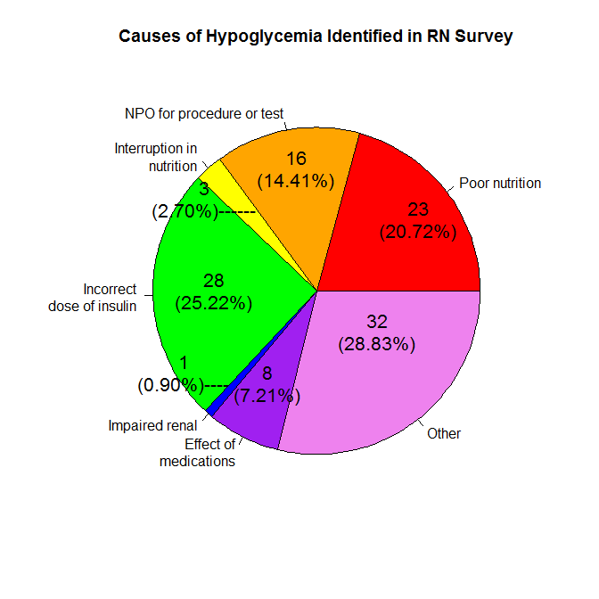
Notes:
The most common causes identified by the RNs in the survey were being NPO for procedure (14%), poor nutrition (20%) and insulin 25%.
The 28% in the category OTHER was comprised of responses that occurred at a very low frequency.

Slide 12
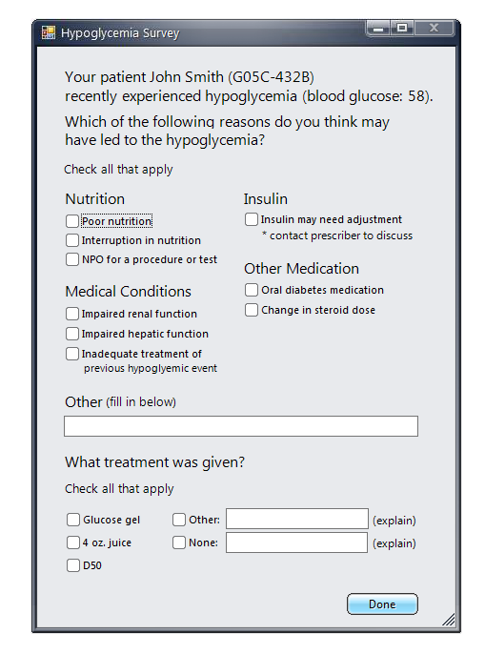
Created Electronic Health Record Survey Tool
Notes:
This is the tool that auto-launched in the EMR when the Nurse assigned to that patient logged in to the EMR after that patient had a BG < 70.
As you can see, the tool was very simple to complete
All they needed to do was to check at least one reason why they think the patient went low.

Slide 13
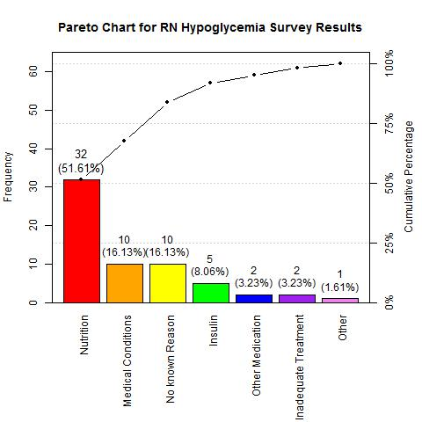
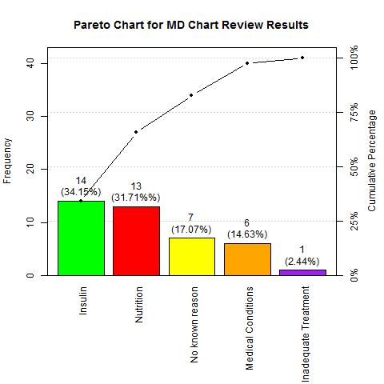
Causes of Hypoglycemia Identified
Using EHR Survey Tool vs Chart Review
RN Data
MD Data
Notes:
Two months after data collection began, we analyzed the responses from the
hypoglycemia tool where the nurses identified why their patient went low.
Next our two second year endocrine fellows performed chart reviews of all patients that had a hypoglycemic episode during the same time period.
In both cases, the top two modifiable causes were related to insulin and nutrition.
Of note, the nurses selected nutrition as the top cause yet the chart review revealed that insulin and nutrition as root causes were equivalent.

Slide 14

Phase 2:
Educational Intervention
Reducing Hypoglycemia
by Targeting a Root Cause:
Too Much Basal Insulin
Notes:
The next phase was to develop an educational intervention to address the top cause of hypoglycemia. Although the data identified insulin & nutrition as the top causes with about the same frequency, we decided to target insulin first since an insulin adverse drug event results in harm to the patient 24% of the time.
Insulin was implicated in 33% of medical errors that caused death within 48 hours of the error. (Hellman, 2004)
2011 review of more than 16,000 patient safety incidents involving insulin showed that 24% resulted in patient harm (Cousins et al, 2011).
2011 study of emergency hospitalizations for adverse drug events in older Americans reported that insulin was one of four medications implicated in 67% of all emergency admissions due to adverse drug events (Budnitz et al, 2002).
-Hellman R. A systems approach to reducing errors in insulin therapy in the inpatient setting. Endocr Pract. 2004;10 (Suppl 2):100-8.
-Cousins D, Rosario C, Scarpello J. Insulin, hospitals and harm: a review of patient safety incidents reported to the National Patient Safety Agency. Clin Med. 2011;11(1):28-30.
-Budnitz DS, Lovegrove MC, Shehab N, Richards CL. Emergency hospitalizations for adverse drug events in older Americans. N Engl J Med. 2011;365(21):2002-12.

Slide 15
NYP/WC Insulin Dose Adjustment Guidelines for Prescribers
Dose Adjustments Based on Blood Glucose
BG (mg/dL) | Dose Adjustment
< 50 | Decrease by 50%
50 – 69 | Decrease by 20%
70 – 99 | Decrease by 10%
100 – 180 | No Changes
181 – 250 | Increase by 10%
> 250 | Increase by 20%
Notes:
This is the NYP Cornell validated titration algorithm from a previous QIPS project.
Our two 2nd year endocrine fellows, Jenny Ukena & Sona Shah, educated the nurses and prescribers in the glycemic targets and when and which insulin to adjust. The key take away message to prevent hypoglycemia was to lower the basal insulin when the fasting BG was <100.

Slide 16

Results
Notes:
We compared all ranges of glycemia: low , high and in target in the same two months in 2016 & 2017

Slide 17
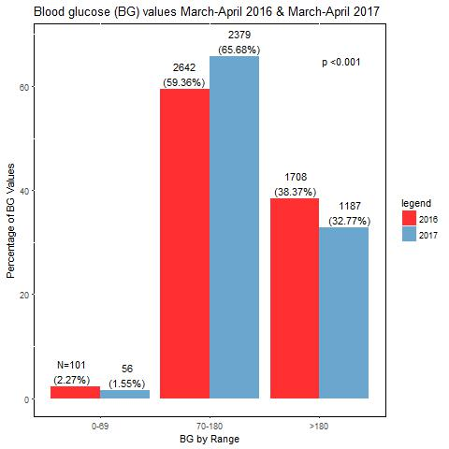
p<.001
p<.001
Notes:
The rates of hypoglycemia and hyperglycemia were significantly reduced (p<.001), and the number of patients in the target range increased from 59.36% to 65.68%.

Slide 18
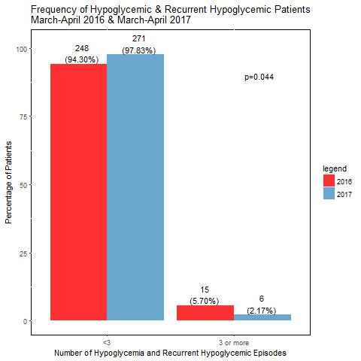

Slide 19
Lessons Learned
Top 2 modifiable causes of hypoglycemia (nutrition and insulin) were identified by RN survey & confirmed by MD chart review
Targeted educational intervention addressing safe & effective insulin dosing resulted in significant decrease in hypoglycemia and recurrent hypoglycemia
Decrease in hypoglycemia was associated with improvement in glycemic control (BG 70-180mg/dL) & DECREASE IN HYPERGLYCEMIA

Slide 20
Future Directions
Ongoing house-wide RN & prescriber education to heighten awareness of root causes of hypoglycemia to inform & promote prevention strategies
Promoting discussions between RNs & prescribers to address each episode of hypoglycemia in real-time

Slide 21
Future Directions (Continued)
Launch new educational intervention targeting interruptions in nutrition:
  Second most common cause of hypoglycemia
  Include recommendations for insulin adjustments in education plan for prescribers: Updated Pocket Card

Slide 22
Acknowledgements
Medicine Floors – 5 Central and 5 North
Asmin Brown DNP RN (5C) & Natalie Mohammed MSN RN (5N), Patient Care Directors… With Gratitude to the entire Nursing Staff !!
Division of Endocrinology, Diabetes & Metabolism
Sona Shah MD & Jenny Ukena MD, 2016 2nd Year Endocrine Fellows
Information Technology
Matt Fred MD, IT Physician Liaison
Healthcare Policy & Research
Elizabeth Mauer MS, Research Biostatistician
QuDOM: Quality University, Weil Cornell Department of Medicine
Robert Kim MD & Jennifer Lee MD
Savira Dargar MS, Research Project Manager

Slide 23
Selected References
Cobaugh, D. J., Maynard, G., Cooper, L., Kienle, P. C., Vigersky, R., Childers, D., ... & Blum, F. (2013). Enhancing insulin-use safety in hospitals: practical recommendations from an ASHP Foundation expert consensus panel. American Journal of Health-System Pharmacy, 70(16), 1404-1413.
Cruz, P., Blackburn, M. C., & Tobin, G. S. (2017). A Systematic Approach for the Prevention and Reduction of Hypoglycemia in Hospitalized Patients. Current diabetes reports, 17(11), 117.
Kulasa, K., & Juang, P. (2017). How Low Can You Go? Reducing Rates of Hypoglycemia in the Non-critical Care Hospital Setting. Current diabetes reports, 17(9), 74.
Milligan, P. E., Bocox, M. C., Pratt, E., Hoehner, C. M., Krettek, J. E., & Dunagan, W. C. (2015). Multifaceted approach to reducing occurrence of severe hypoglycemia in a large healthcare system. American Journal of Health-System Pharmacy, 72(19), 1631-1641.
Sinha Gregory, N., Seley, J. J., Ukena, J., Shah, S., Fred, M. R., Dargar, S. K., ... & Kim, R. J. (2018). Decreased Rates of Inpatient Hypoglycemia Following Implementation of an Automated Tool in the Electronic Medical Record for Identifying Root Causes. Journal of diabetes science and technology, 12(1), 63-68.
Sinha Gregory, N., Seley, J. J., Gerber, L. M., Tang, C., & Brillon, D. (2016). Decreased rates of hypoglycemia following implementation of a comprehensive computerized insulin order set and titration algorithm in the inpatient setting. Hospital Practice, 44(5), 260-265.
The Glycemic Control Implementation Guide: Improving glycemic control, preventing hypoglycemia and optimizing care of the inpa- tient with hyperglycemia and diabetes: Society of Hospital Medicine; 2015 Available from: http://tools. hospitalmedicine.org/resource_rooms/imp_guides/GC/GC_ Workbook.pdf.

Slide 24


