Slide 1


Slide 2

Carrie Nagy-Marsh, RN
Senior Director of Clinical Services & Population Health
Sutter Health
Sacramento, CA

Slide 3
“Population Health: Following the Journey in a Technology-Driven World”
Agenda
Background
Population Health Strategies
Leveraging people, process and technology
Action
Notes:
Background
Population Health Strategies-Care to a larger population
Can we think out side of the box-Leveraging people, process and technology
Action

Slide 4

Sutter Health Overview
Serving more than
100 communities with:
12,000+ doctors
24 acute care hospitals
50,000+ employees
$12 billion in revenues (2016)
Home health and hospice services throughout Northern California
Outpatient surgery and specialty care centers
Medical research and medical education/training
Notes:
We help drive local economies, providing employment opportunities with competitive pay and benefits to 50,000+ people. Our hospitals are among the largest employers in many Northern California communities.
Over 14 clinical calls/month , over 120 nurses

Slide 5
Audience Survey
What is your main role at your organization?
Educator
Manager
Administrator or Executive

Slide 6
Audience Survey
Is your organization currently providing population health services?

Slide 7
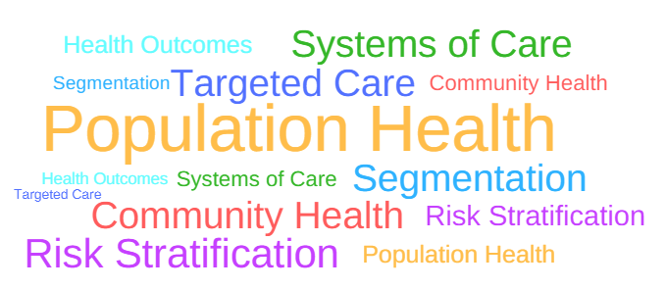
What is Population Health?
Notes:
The health outcomes of a group of individuals, including the distribution of health outcomes within the group*

Slide 8

ADA Population Health
“The health outcomes of a group of individuals, including the distribution of health outcomes within the group”
Notes:
Measured in terms of health outcomes (mortality, morbidity, health, and functional
status), disease burden (incidence and prevalence), and behavioral and metabolic
factors (exercise, diet, A1C, etc.)
Clinical practice recommendations for health
care providers are tools that can ultimately improve health across populations; however,
for optimal outcomes, diabetes care must also be individualized for each patient.
Efforts to improve population health requires system-level and patient-level approaches

Slide 9

Sutter Population Health Services
Aims to enhance the well-being and improve the health outcomes of the communities we serve. This is accomplished by proactively managing the health risk of individuals within a population. By supporting coordinated, standard care in a systematic,
cost-effective manner, our team connects patients with the appropriate healthcare interventions needed at the right place, right time, and across the care continuum.

Slide 10
Audience Survey
Is your organization currently providing population health services?

Slide 11
The Environment

Slide 12




The Perfect Storm
A Tsunami of Change
The Tip of the Iceberg
The Burning Platform

Slide 13
Healthcare Reform Timeline
HMO
Act
HIPAA
ACA
HVBP
HRRP
HACRP
VM
SNF-VBP
COBRA
1965
2011
2012-
2018
1973
1983
1986
1990
1996
2003
2010
NCQA
accredits
MCOs
Medicare Part D
(Rx added)
Medicare
Medicaid
TE&FRA
ACOs
TE&FRA: Tax Equity and Fiscal Responsibility Act
HAC: Hospital-Acquired Condition Reduction Program
HRRP: Hospital Readmissions Reduction Program
HVBP: Hospital Value-Based Purchasing Program
SNF-VBP: Skilled Nursing Facility Value-Based Purchasing Program
VM: Value Modifier or Physician Value-Based Modifier
Source: Kaiser Family Foundation
Notes:
Lyndon Johnson in 1965 with aim at significant inequities in healthcare especially poor and elderly
Now Medicare is 56 million 17% of population and Medicaid 71 million 24% of population- 1 out of 3
Prior to 2011 Medicare reimbursed hospitals solely on diagnosis-related groups and volume or quantity of care
Regardless of the outcomes, like hospitals were reimbursed in the same manner.
Affordable Care Act Medicare reimbursement shifted from volume to value. “Hospital Value-Based Purchasing (VBP) restructured Medicare’s payment system to reward providers for the quality care they provide
This program adjusts payments to hospitals under the Inpatient Prospective Payment System (IPPS), based on the quality of care they deliver
4 domains 1)clinical care 2) patient and caregiver centered experience of care and care coordination 3)safety, and efficiency 4) cost reduction
Medicare Access and CHIP Reauthorization Act of 2015 (MACRA)-Ambulatory Quality Payment Program (QPP)

Slide 14
Progress Toward Value-Based Care
Survey of Health Plan Executives and Physicians
Question: Does the U.S. have a Fee-for-Service or Value-Based Care health system?
Little progress has been made toward value-based in the last year.
Source: Quest Diagnostic Survey, July 2018.
Annual survey conducted by Regina Corso Consulting for Quest Diagnostics of physicians affiliated with health systems and health plan executives (451 respondents).
Notes:
Only 18 % are of polled systems are dedicated or participating in VB care

Slide 15





Healthcare Landscape
Continuum of Medicare Risk Models
Pay-for-Performance
Bundled Payments
Shared Savings
Shared
Risk
Full
Risk
Hospital VBP Program
Hospital Readmissions Reduction Program
HAC Reduction Program
Merit-Based Incentive Payment System
Bundled Payments
for Care
Improvement
Initiative (BPCI)
Comprehensive Care for Joint Replacement
(CJR) Model
MSSP Track 1
(50% sharing)
MSSP Track 1+¹
MSSP Track 2
(60% sharing)
MSSP Track 3
(up to 75% sharing)
Next Generation
ACO Model
(80-85% shared savings option)
Comprehensive Primary Care Plus
Next Generation
ACO Model
(full risk option)
Medicare
Advantage (provider-sponsored)
Increasing Financial Risk
Source: Advisory Board, 2018
Notes:
Affordable Care Act legislation has caused shifts from volume-to value-based, and how practices have been impacted and are adapting
Shared Savings Programs are voluntary alternative payment model that encourages groups of doctors, hospitals and other healthcare providers to come together to give coordinated, high quality care to their Medicare patients
Per CMS.gov-goal of coordinated care is to ensure the patient gets the right care at the right time, while avoiding unnecessary duplication of services and preventing medical errors.

Slide 16
Audience Survey
Where is your organization on the journey of Accountable Care?
Predominately fee-for-service
Some value risk contracts
Full risk

Slide 17









Price / Cost Pressures Decrease Margins
Downward Pricing Pressure
Direct
reimbursement
pressure
Federalism and
state-based
coverage reform
Dilution of
commercial
coverage
Deregulation
and the new era
of competition
Shifting
demographics and payer mix evolution
Provider Margins
Upward Cost Pressure
Rising pharmaceutical costs
Uncontrolled
labor spending growth
Increasing
reliance on IT enablement
Growth in purchased
services
Source: Advisory Board
Notes:
Dr. Allan Hamilton spoke at the CMSA-where did we go wrong? We have simply outgrown the current healthcare system
Competition surgery centers, mobile doc and live doc visits

Slide 18

Cost of Healthcare
2002 Cost
$9,235
2016 Cost
$25,825
300% Increase
Source: Girod, Weltz & Hart, 2016
Notes:
In 2002 average OOP expenses for a family of 4 =$9235 in 2016=$25, 825 –up 300% in 15 years (Girod, Weltz & Hart, 2016)

Slide 19

Average Hospital Cost
1958 Cost
$134
2 Full Time Employees
2012 Cost
$8,953
15 Full Time Employees
6,500% Increase
Source: Forbes Magazine – December 22, 2012
Notes:
Forbes Magazine Dec 22, 2012 1958 Average hospital cost $134 and it took 2FTEs, 2012 average cost $8953 (increase of 6,500%) average FTE 15

Slide 20


Electronics Technology
2017 Cost
$2,300
$1.78 PPSI
1954 Cost
$11,875
$110.20 PPSI
81% Decrease
Notes:
TV 1954 Westinghouse $11,875 or $110.20 PPSI, 1960s dropped to $495 or $4,440 today 21.02 PPSI to 2017 $2,300 or $1.78 PPSI
Health care cost continue to rise-The Hastings Center estimates costs are increasing at an annual rate of 7%-this is mainly due to technology

Slide 21
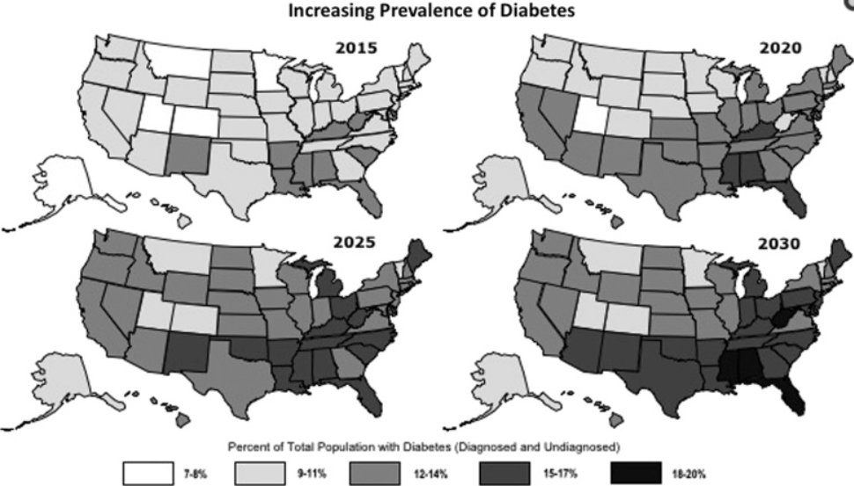
Diabetes Epidemiology: Projections
Source: Population Health Management magazine, February 2017.
Notes:
Add the prevalence and [projected prevalence of diabetes

Slide 22
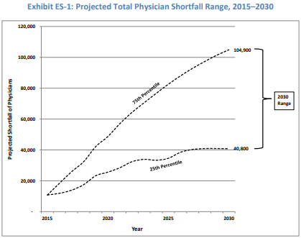
Resource Shortage: Provider Shortfall
Projected Nurse Shortfall, 2030
Region | Nurse Shortage
South | 420,691
West | 358,637
Midwest | 76,170
Northeast | 68,133
Total | 923,631
Source: American Journal of Medical Quality
United States Registered Nurse Workforce Report Card and Shortage Forecast, 2012
Source: Association of American Medical Colleges, The Complexities of Physician Supply and Demand Projections, February 2017
Notes:
Association of American Medical Colleges projects that by 2025 there will be a shortfall between 46,100 to 90,400 doctors with 12,500 and 31,100 in primary care-Age 30 with over $300,000 in debt
Others speculate that our current model of training and care model is outdated

Slide 23
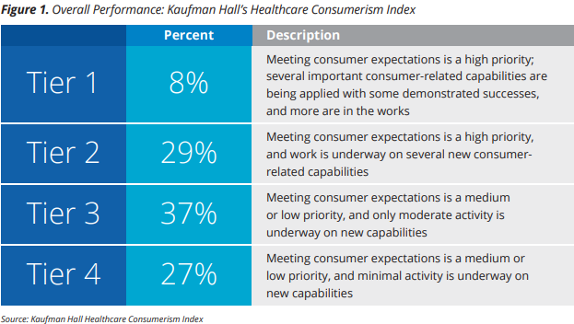
Consumerism
Healthcare is slow to meet expectations
< 1 in 10 consistently apply consumer-centric capabilities
Source: Kaufman Hall State of Consumerism in Healthcare, 2017
Notes:
64% have only moderate to minimal activity .
Will consumerism continue to pressure the shift in healthcare from interventional to prevention
Key Findings in Consumerism
Priority and capability gap
Value propositions out of sync
Consumer access is a work in progress
Consumer experience viewed too narrowly
Pricing strategy is a blind spot

Slide 24
Population Health Strategies

Slide 25




ADA Recommendations
Diabetes and Population Health
Timely Treatment Decisions
Evidence-based, Made Collaboratively
Chronic Care Model (CCM)
Patient Centric, Proactive, Individual Activation
Care Systems
Team-based care, Patient Registries, Decision Support Tools
Quality of Care
Data and Outcomes
Notes:
January 2018 ADA Standards of Medicare Care in Diabetes
Timely Treatment Decisions
Rely of evidence-based guidelines
Made collaboratively with patients based on individual preference, prognosis and comorbidities
Chronic Care Model
Emphasis on prepared care team and informed activated patients
Care Systems
Facilitate based-care, patient registries, decisions support tools, and community involvement to meet the patients needs
Assess quality
Reliable data
Quality improvement based on reliable data
Reiterate IHI Triple AIM-patient experience, outcomes and decreased cost

Slide 26
ADA’s CCM Core Elements
Proactive delivery system
Self-management
Decision support based on evidence
Clinical information systems
Community resources and policies
Health systems of quality-oriented care
Notes:
1. Delivery system design (moving from a reactive to a proactive care delivery system where planned visits are coordinated through a team-based approach) Whilemany diabetes processes
of care have improved nationally in the past decade, the overall quality of care for patients with diabetes remains suboptimal. Expand the role of teams to implement more intensive disease mgt strategies
2. Self-management support
3. Decision support (basing care on evidence based, effective care guidelines)
4. Clinical information systems (using registries that can provide patient-specific and population-based support to the care team)
5. Community resources and policies (identifying or developing resources to support healthy lifestyles) Providers should assess social context, including potential food insecurity, housing stability, and financial barriers, and apply that information
to treatment decisions. Connecting with community resources when possible
6. Health systems (to create a quality oriented culture)

Slide 27
ADA 2018 Guidelines
Lifestyle Management
Individual and group settings
Technology-Assisted Tools and Platforms
Delivery of effective diabetes self-management education and support
Notes:
Lifestyle management-diabetes self-management education and support (DSMES), medical nutritional therapy (MNT), physical activity, smoking cessation and psychosocial care
Technology-assisted tools including Internet-based social networks, distance learning, and mobile applications that incorporate bidirectional communication may be useful elements of effective lifestyle modification to prevent
Diabetes. Especially important with diabetes prevention programs

Slide 28
Understanding the Population
Risk Stratification
Probability of succumbing to a disease or having an event
Segmentation
Dividing the population into meaningful categories
Notes:
Example of segmenting a population by status of health those in good health, acute conditions, stable chronic conditions, failing health near death….
Cost, Risk inside risk-social determinants

Slide 29
Understanding the Population
Less Specific
More Specific
Laboratory & Diagnostic
Utilization
High-Risk
Medication
Social Determinants of Health
Artificial Intelligence &
Predictive Analytics

Slide 30
Patient Centered Care

Slide 31

Person Centered Care
More than a Graphic
Respect of values, needs, traditions, preferences
Collaboration
Care with dignity and respect
Transparency
Shared decision making

Slide 32
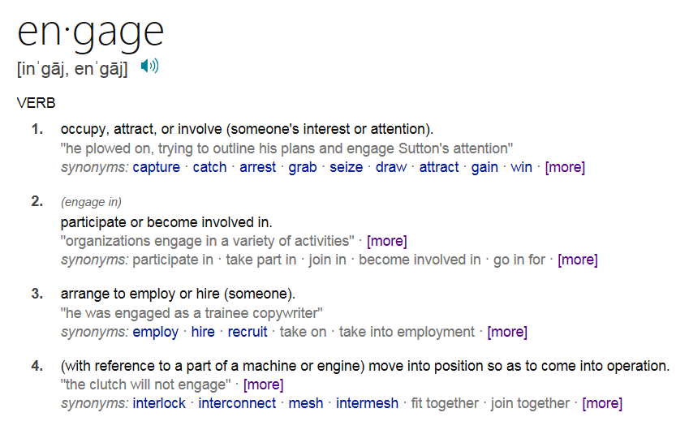
What is Patient Engagement?
Source: Oxford Online Dictionary

Slide 33
Patient Engagement vs. Experience
Patient Engagement
Patient Experience
Goals
Drive better health and outcomes
Empower patients and their loved ones to be active in their own care
Reduce costs
Drive better health and outcomes
Exceed expectations
Reduce suffering
Brand differentiation
Context
Patients own health
All-encompassing (access, communication, food, etc.)
Patient Involvement
(Behaviors and Ownership)
Required
Not required (though in an ideal experience, patients are presenters and co-designers)
Time
Transactional or longitudinal
Transactional or longitudinal
Use of Health Self-Management
Tools/Services
Yes
No
Boissey, A. (2017). Patient engagement versus patient experience. New England Journal of Medicine-Catalyst. Retrieved from
https://catalyst.nejm.org/patient-engagement-vs-patient-experience/
Validated Measurement
Patient Activation Measure (PAM), PROMIS, Patient Health Engagement (PHE) scale
HCAPHS, CGCAHPS, etc.

Slide 34
Engagement
How do we know if we have it?
What if I don’t want it?
Is there a happy medium in the value-based world?
Notes:
Stages of Change-Pre-contemplation, contemplation, determination, action, maintenance, and recurrence

Slide 35
Person Centered Goals
Goal Before:
A1C < 7.0 %
Goal Now:
Able to join ROMEO (Retired Old Men Eating Out) group for lunch once a week
Adapted from Sutter Health Integrated Care Management Training

Slide 36
Health Literacy
The degree to which individuals have the capacity to obtain, process, and understand basic health information and services needed to make appropriate health decisions
U.S. Department of Health and Human Services-Healthy People 2010
Notes:
According to the National Assessment of Adult Literacy only 12 % of adults have proficient health literacy-that means 9 out of 10 adults may lack the skills needed to manage their health.
Low literacy is linked to poor health outcomes-less rates of prevention, higher rates of hospitalization and complications
At risk-older adults, racial and ethnic minorities, low-income, non-native speakers of English, compromised health condition and less than a high school degree
Simple questions-do you have trouble completing medical forms
Plain language and health literate tools

Slide 37



Health Literacy Video
3rd grade reading level
2nd grade reading level
5th grade reading level
Trouble with Dosages
Terminology Confusion
Overwhelmed by Paperwork
Source: youtube.com/watch?v=BgTuD7l7LG8

Slide 38
Health Literacy
Affects Ability to:
Navigate the healthcare system
Share personal information and health history
Engage in self-care and chronic-disease management
Understand mathematical or complex concepts

Slide 39

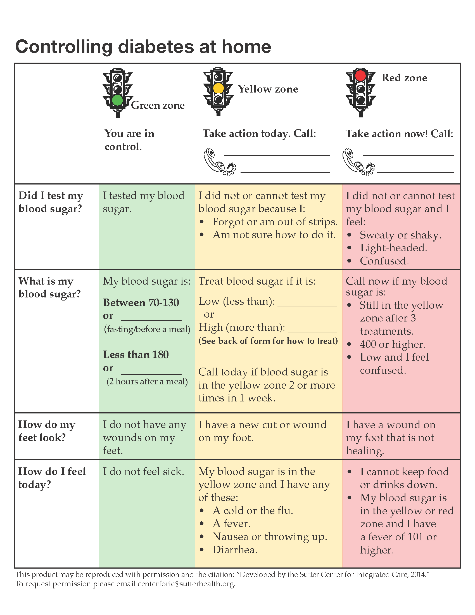

Health Literacy
New Approach
Old Approach
Notes:
Transition – old way is booklet (60 page)
New page is one page document (Health literate)

Slide 40

Motivational Interviewing
Originated as method of therapy for alcohol addiction
Addresses ambivalence to change
Conversational approach
Notes:
Does 2 things:
accurately and nonjudgmentally reflects and explores the concerns and emotions of the patient through specific skills
provides insight or new information to address those concerns in a nonjudgmental and nonthreatening manner
7 steps-Listen (make sure patient knows you are listening), clarify, reflect, identify (incorrect or needed info), address the issues (with permission),invite the patient to consider new information, summarize
Open ended questions to get a “sense” of how it makes patients feel, impact, barriers-this takes practice
Patient: My doctor says I have sugar. I feel fine, so I don’t think I need to do anything about it
Reflect: So you doctor says you that your blood sugar is up, since you feel ok you are thinking you won’t have to do anything until it gets worse?
Address the issues with permission: Though this is your decisions, do you mind if I share some thoughts with you and you could tell me what you think?

Slide 41
Teach Back
Method of confirming we explained things in a manner that is understandable to the patient
It is not a test
“Chunk and check”

Slide 42
Better Outcomes Require Us to Change
Health Literate Care
Self-Management Support
Plain language
Clear clinical picture
Patient activated learning
Teach-back
Assess patient knowledge, skill and confidence
Actionable options and elicits questions
Motivational interviewing
Identifies and reduces barriers
Goal setting

Slide 43
Social determinants & Disparities

Slide 44

Social Determinants of Health
Economic stability
Education
Social and community context
Health and healthcare
Neighborhood and built environment
Notes:
Economic stability-finances as it relates to basic-food and shelter-stability = access- health disparities form along several societal fault lines, but the deepest and most persistent divide surrounds income- when economic instability exists choices between basic needs and medicine -over 14% (1 of every 7 people) in the US is food insecure. Gain understanding of employment history and “within the last 12 months did you worry that food would run out before you got more money?
Education-The most impactful is the potential to earn a higher income which correlates to financial stability
Health People 2020 outlines four key areas that define social and community context- civic participation, discrimination, incarceration, and social cohesiveness. Gain understanding by participation, attitudes and relationship to the community
Health and healthcare-literacy access and barriers to access and deductibles
Neighborhood- access to healthy food, crime and violence, environmental conditions, and quality of housing Gain understanding by how safe they feel in their home. Education, income and neighborhood are intertwined. Less prosperous neighborhood expose residents to harmful air quality, toxic materials in the home, dangerous streets, and pervasive advertising promoting harmful substances, limited options for healthy food (lack of full-service grocery stores farmers markets and healthy food choice-great abundance of convenience stores and fast food) and safe leisure physical activity, and few opportunities for education and high-quality employment-all which can damage health

Slide 45
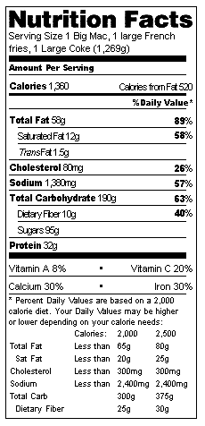

How Do We Combat the
“Value Meal”?
Cost
$3.57
1,360
Calories
58g
Fat
1,380mg
Sodium

Slide 46
Disparities in Diabetes Care
Disparities in research, treatment and education:
  Latino/Hispanics, African Americans, Asian Americans, Native Hawaiians and Pacific Islanders, and American Indian/Alaskan Natives
Higher risk of complications:
  Lower limb amputations, retinopathy, and kidney failure
American Diabetes Association. (n.d). Health disparities
Notes:
Disparities in research, treatment and education:
Latino/Hispanics, African Americans, Asian Americans, Native Hawaiians and Pacific Islanders, and American Indian/Alaskan Natives
Higher risk of complications such as lower limb amputations, retinopathy and kidney failure

Slide 47
The Times they are a Changing
Case Study

Slide 48

“1990 Something”

Slide 49
What Can We Enhance?
Patient Experience, Engagement and Outcomes
15,000 managed care patients with diabetes
Limited budget
Four passionate healthcare providers

Slide 50



2001 Strategy
Maximize Resources
Leverage Technology
Patient Segmentation
RNs, CDE and paraprofessionals
Access Database
A1C, cardiac risk, overdue for lab testing or health maintenance
Evidence-Based Interventions
National Care Standards
Order-sets, motivational interviewing
National Committee for Quality Assurance (NCQA) and The Joint Commission

Slide 51
2018 Strategy
Evidence-Based Interventions
National Care
Standards
Order-sets, motivational interviewing, care pathways and navigation, teach-back, patient-center care and goals
National Committee for Quality Assurance (NCQA) and The Joint Commission, MACRA and ACO

Slide 52
2018 Strategy
Maximizing Resources and Leveraging Technology
Coaches, paraprofessional and targeted use of CDE and RNs
Automated interactive communication
App connection
Push and pull information
Improved patient segmentation with predictive analytics

Slide 53


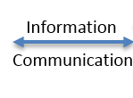
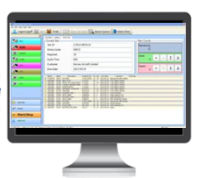
Better Outcomes
Remote Care Team
Information
Platform
Communication

Slide 54

Better Outcomes are Possible
Remote Care Team

Slide 55
What Can You Do?
Evidence-based interventions
National care standards
Maximize resources
Patient segmentation
Leverage technology
Notes:
Step away from yourself, look at things differently,
Be an agent for change
Align healthcare team (share ideas, start the conversation) and help to think of the team in a different way
Patient empowerment

Slide 56
Questions?

