Slide 1


Slide 2
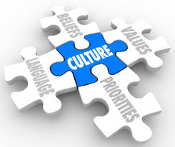
Meeting the needs of culturally diversified patients and growing your cultural competences in providing DSME

Slide 3
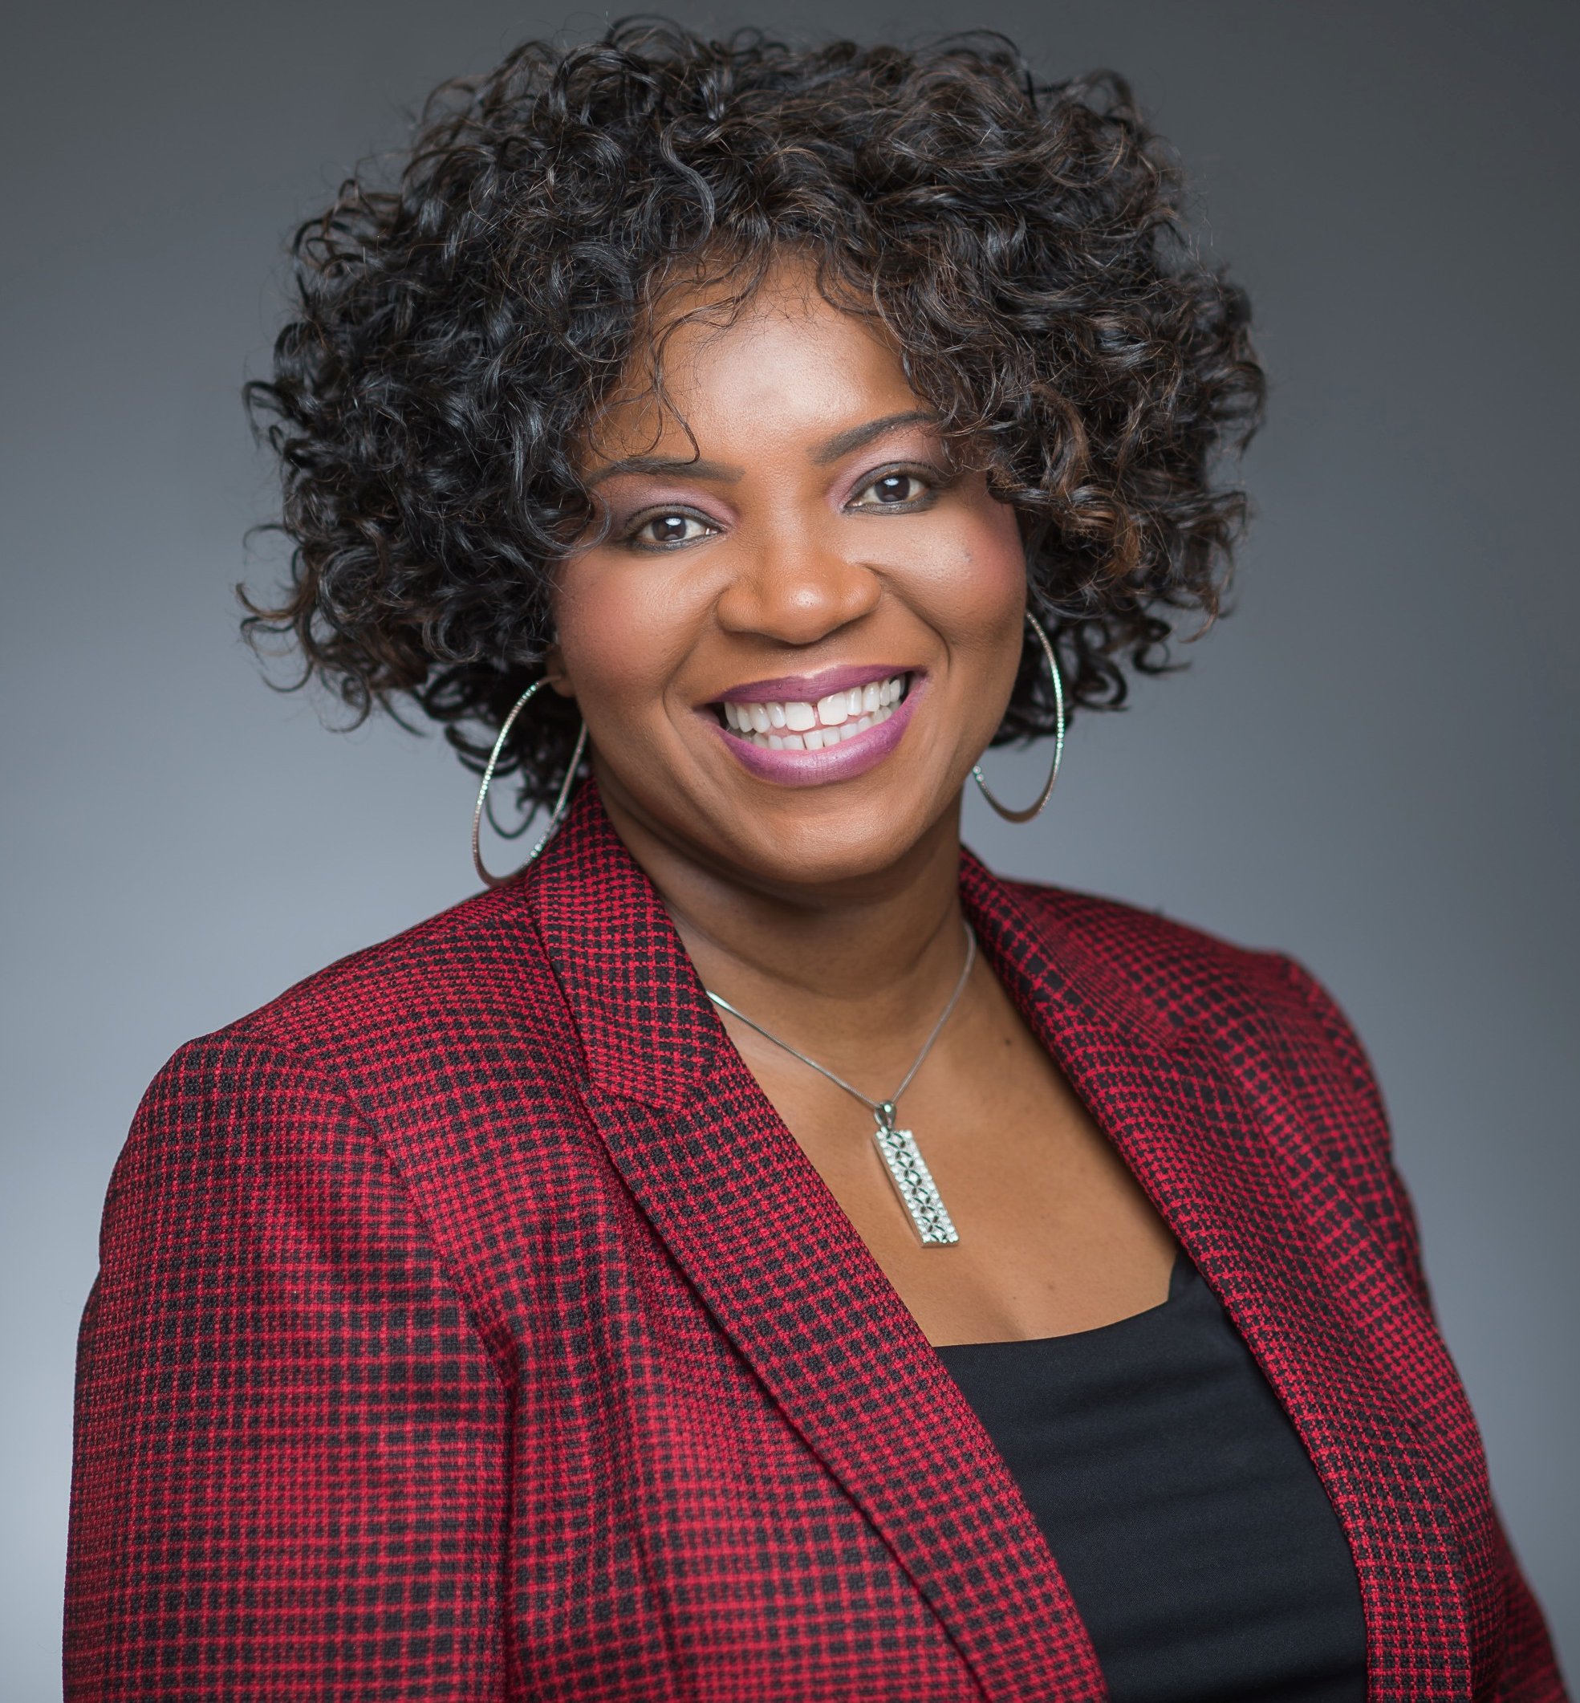
Adeola Akindana
DNP, CRNP, CDE
Diabetes Nurse Practitioner/Diabetes Program Coordinator
Joslin Diabetes Center Education Affiliate @ Doctors Community Hospital
Lanham, MD

Slide 4
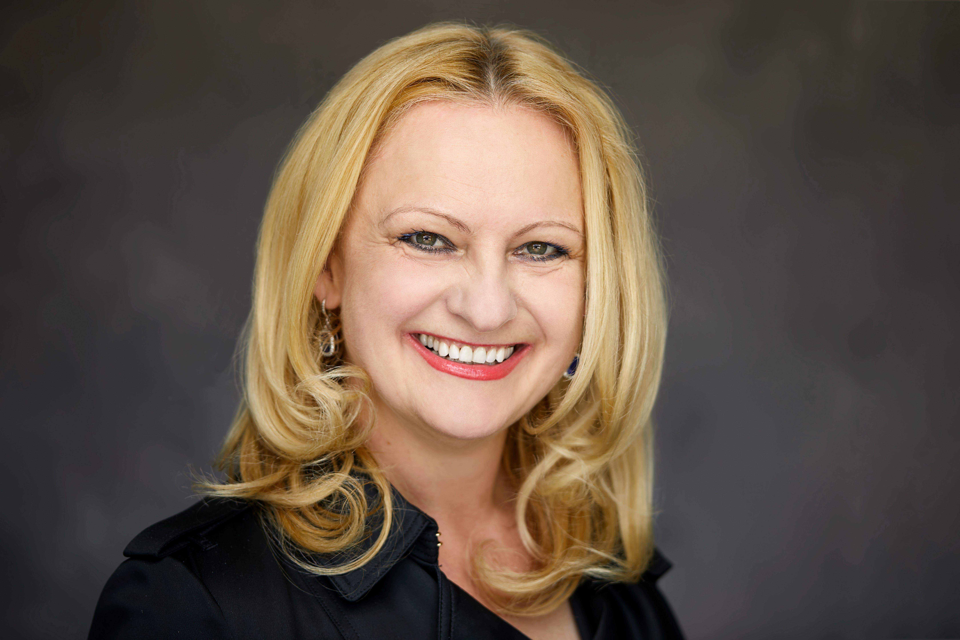
Barbara Eichorst
MS, RD, CDE
Diabetes Clinical Liaison
Voluntis
Chicago, Illinois

Slide 5
Learning Objectives
Define changing cultural dynamics and cultural nuances of caring for multi-ethnic patients
Identify challenges of providing DSMES for diverse populations and provide strategies to overcome them
Integrate the process of Cultural Competence Model in culturally sensitive DSMES when working with diverse patient populations
Exemplify effective communication and education strategies using the Cultural Competence Model

Slide 6
Outline
1. Review cultural realities among PWD

Slide 7
Diabetes Self-Care
Self-management education or training is a key step in improving health outcomes and quality of life either in a group setting or individually
Self care should be a collaborative process between the diabetes educators and patient with or at risk for diabetes to gain the knowledge, problem-solving and coping skills needed to successfully self-manage the disease and its related conditions
  Center for Disease Control; National Diabetes Fact Sheet, 2007
Notes:
As diabetes educators we have to be educated and prepared to care for these patients.

Slide 8

Demographics of PWD in the U.S.
Growth of population vs Prevalence of diabetes by year 2050:
Asian Americans- 212.9% / 8.4%
Hispanics -187.9% / 11.58%
African American- 71.3% /12.6%
Whites- 32.4% / 7.1%
Notes:
There is a changing of demographics of the American population

Slide 9
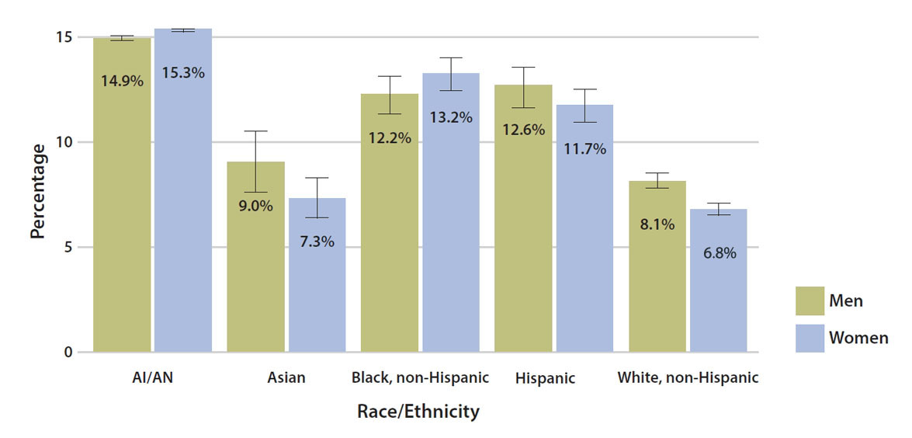
Demographics of PWD in the U.S.
American Indian/Alaska Native
Men: 14.9%
Women: 15.3%
Asian
Men: 9.0%
Women: 7.3%
Black, non-Hispanic
Men: 12.2%
Women: 13.2%
Hispanic
Men: 12.6%
Women: 11.7%
White, non-Hispanic
Men: 8.1%
Women: 6.8%
Estimated age-adjusted prevalence of diagnosed diabetes by race/ethnicity and sex among adults aged ≥18 years, United States, 2013–2015
Note: Error bars represent upper and lower bounds of the 95% confidence interval.
Data source: 2013–2015 National Health Interview Survey, except American Indian/Alaska Native data, which are from the 2015 Indian Health Service National Data Warehouse.
https://www.cdc.gov/media/releases/2017/p0718-diabetes-report-infographic.html

Slide 10

Cultural Competency
Cultural competency is “awareness of and sensitivity to cultural differences; knowledge of cultural values, beliefs, and behaviors; and skill in working with culturally diverse populations”
Supplement to The Journal of Family Practice. Vol 56, No 9 / September 2007.
Building Cultural Competency for Improved Diabetes Care:
http://www.jfponline.com/uploadedFiles/Journal_Site_Files/Journal_of_Family_Practice/supplement_archive/PCEC-J-2.pdf

Slide 11
Cultural Competency cont.
Each individual has a unique personal history, belief system, communication style and health status.
People from same country could still be different
Avoid Stereotyping
Stereotyping can lead to misconceptions about the individual seeking care.
Notes:
What may be true in a particular region or country may not be true of all individuals from that region or country.
There are important intra-region and intra-group variations among people from the same country.
Economic status and education can vary greatly among people from the same country.
People from rural areas may have been living a more traditional lifestyle than those who emigrated to the U.S. from urban areas.

Slide 12
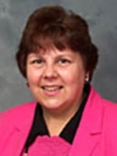

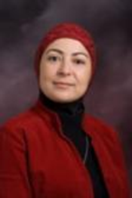
The content of this presentation is derived from the original work of University of Michigan-Flint faculty conducting a Train-the-Trainer Cultural Competence Program as part of a federally funded HRSA Grant Number D11 HP09759:
Dr. Margaret Andrews
Developing Nurses’ Cultural Competencies: Evidence-Based and Best Practices
Dr. Marilyn McFarland
Culture Care Theory and Ethnonursing Research Method
Dr. Hiba Wehbe-Alamah
Assessing the Cultural Health Care Beliefs and Practices of People from Diverse Cultural Backgrounds and Implications for Clinical Practice and Curriculum Development
For more information, please contact project manager
Mr. John Collins at (810) 424-5650 or johcolli@umflint.edu

Slide 13

Stereotype Activity: Who am I?
Picture Number- 3
Picture Number- 1
Picture Number -2
Picture Number- 4

Slide 14
Stereotype Activity: How well do you know me?
Picture number | Person’s name | Educational background | Employment status and/or job description | Would you be friends with this person?
1
2
3
4
Do you really know these people?

Slide 15
I am…..
Cat Stevens today- His current name is Yusuf Islam- Singer, Elementary school owner, and philanthropist. Married, 2 children
Cat Stevens, British Singer, when he was single
© 2011 Wehbe-Alamah

Slide 16
I am…..
Ted Bundy, serial killer, used his good looks to prey on women
Pediatric doctor, loves kids, married, 4 children, sings at local church
© 2011 Wehbe-Alamah

Slide 17
Outline
2. Surface challenges and ways to overcome them

Slide 18
Cultural Competence Challenges
Challenges with categorical (list of traits) approach:
‘dos and don'ts’ for each group
Cultural competence (categorical or multicultural)
Culture is multidimensional/dynamic
Culture comprises multiple variables, affecting all aspects of experience
Cultural processes frequently differ within the same ethnic or social group because of differences in age cohort, gender, political association, class, religion, ethnicity, personality
Culture is like art: elusive and nebulous concept
The multicultural approach to cultural competence might result in stereotypical thinking
Attitudes
Values
Beliefs
Behaviors of certain cultural groups
Broad ethnic, racial, religious
National groups, such as ‘African American’, ‘Hispanic’, or ‘Asian’

Slide 19
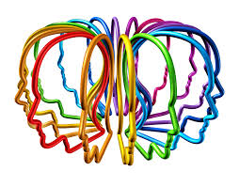
Potential Solution: Cross Cultural Approach
Cross cultural approach to culturally competent clinical practice focuses on:
foundational communication skills
awareness of cross-cutting cultural and social issues
health beliefs that are present in all cultures
Patient centered approach:
identify and negotiate different styles of communication
decision-making preferences
roles of family, sexual and gender issues
issues of mistrust, prejudice, and racism
universal human beliefs, needs, and traits
Epner DE, Baile WF. Wooden's pyramid: building a hierarchy of skills for successful communication, Med Teach, 2011, vol. 33 (pg. 39-43)

Slide 20
Outline
3.Define Cultural Competence Model

Slide 21
Models of Effective Cross-cultural Communication and Negotiation
What do you think has caused your diabetes?
Why do you think it started when it did?
What do you think your diabetes does to you?
How severe is your diabetes? Will it have a short or long course?
What kind of treatment do you think you should receive?
What are the most important results you hope to receive from this treatment?
What are the chief problems your diabetes has caused for you?
What do you fear most about your diabetes?
Beliefs about diabetes (What caused your illness/problem?)
Explanation (Why did it happen at this time?)
Learn (Help me to understand your belief/opinion.)
Impact (How is this illness/problem impacting your life?)
Empathy (This must be very difficult for you.)
Feelings (How are you feeling about it?)
QUESTIONS
BELIEF
Kleinman A, Eisenberg L, Good B. Culture, illness, and care: clinical lessons from
anthropologic and cross-cultural research, Ann Intern Med, 1978, vol. 88 (pg. 251-258
Dobbie AE, Medrano M, Tysinger J, et al. The BELIEF Instrument: a preclinical teaching tool
to elicit patients' health beliefs , Fam Med, 2003, vol. 35 (pg. 316-319)

Slide 22

Models of Effective Cross-cultural Communication and Negotiation
Eliciting patient information and negotiating
Identify core cross-cultural issues
Explore the meaning of the illness
Determine the social context
Engage in negotiation
LEARN
Listen with sympathy and understanding to the patient's perception of the problem
Explain your perceptions of the problem
Acknowledge and discuss the differences and similarities
Recommend treatment
Negotiate treatment
CarrilloJE, Green AR, Betancourt JR. Cross-cultural primary care:
a patient-based approach , Ann InternMed, 1999, vol. 130 (pg. 829 -834)
Berlin EA, Fowkes WC Jr . A teaching framework for cross-cultural health care. Application in family practice , West J Med , 1983 , vol. 139 (pg. 934 -938)
Notes:
A newer approach to culturally competent clinical practice focuses on foundational communication skills, awareness of cross-cutting cultural and social issues, and health beliefs that are present in allcultures. We can think of these as universal human beliefs, needs, and traits. This approach relies on identifying and negotiating different styles of communication, decision-making preferences, roles of family, sexual and gender issues, and issues of mistrust, prejudice, and racism, among other factors.

Slide 23

Elements of Cultural Competencies
Desires
Encounters
Skills
Awareness
Knowledge
The Process Of Cultural Competence In The Delivery Of Healthcare Services. Accessed on July 31,018. http://transculturalcare.net/the-process-of-cultural-competence-in-the-delivery-of-healthcare-services/
Notes:
The Process of Cultural Competence in the Delivery of Healthcare Services,” is a culturally consciously model of care that defines cultural competence as “the process in which the healthcare professional continually strives to achieve the ability and availability to effectively work within the cultural context of a client” (family, individual or community). It is a process of becoming culturally competent, not being culturally competent. This model of cultural competence views cultural awareness, cultural knowledge, cultural skill, cultural encounters and cultural desire as the five constructs of cultural competence. Cultural awareness is defined as the process of conducting a self-examination of one’s own biases towards other cultures and the in-depth exploration of one’s cultural and professional background. Cultural awareness also involves being aware of the existence of documented racism and other “isms” in healthcare delivery. Cultural knowledge is defined as the process in which the healthcare professional seeks and obtains a sound educational base about culturally diverse groups. In acquiring this knowledge, healthcare professionals must focus on the integration of three specific issues: health-related beliefs practices and cultural values; disease incidence and prevalence (Lavizzo-Mourey, 1996). Cultural skill is the ability to conduct a cultural assessment to collect relevant cultural data regarding the client’s presenting problem as well as accurately conducting a culturally-based physical assessment. Cultural encounters is the process which encourages the healthcare professional to directly engage in face-to-face cultural interactions and other types of encounters with clients from culturally diverse backgrounds in order to modify existing beliefs about a cultural group and to prevent possible stereotyping. Cultural desire is the motivation of the healthcare professional to “want to” engage in the process of becoming culturally aware, culturally knowledgeable, culturally skillful and seeking cultural encounters; not the “have to.” Cultural encounters is the pivotal construct of cultural competence that provides the energy source and foundation for one’s journey towards cultural competence.

Slide 24
Outline
Awareness

Slide 25
What is Culture?
Culture is a learned set of shared interpretations about beliefs, values, and norms which affect the behavior of a relatively large group of people.
Culture is dynamic:
One of the most important aspects of culture is what is not seen that which controls values and thought patterns.
Cultural factors includes:
Geography, Age, Socioeconomic Status, Religion, Gender, Education, Language, Politics, Sexual Orientation, not just race, language and ethnicity.
Clowes, Lynn. Cultural Effectiveness http://nhcebis.seresc.net/document

Slide 26
Cultural Awareness
Developing sensitivity and understanding of another ethnic group usually involves internal changes in terms of attitudes and values
Requires self-examination of one’s own bias towards others culture
…and being aware existence of racism and other “isms” in healthcare delivery
Sources: Center for Effective Collaboration and Practice. How does Cultural Competency differ from Cultural Sensitivity/Awareness? http://cecp.air.org/cultural/Q_howdifferent.htm
The Process Of Cultural Competence In The Delivery Of Healthcare Services
http://transculturalcare.net/the-process-of-cultural-competence-in-the-delivery-of-healthcare-services/

Slide 27
Cultivating Cultural Awareness
Communication
Verbal and non-verbal
Understanding the person’s culture
Observation and sensitivity
Being tuned in to your level of sensitivity
Observation/Cultural humility
Flexibility
Accepting subtle differences and nuances

Slide 28

Cultivating Cultural Awareness
When in doubt, ask:
Don’t be afraid to ask questions
Shows interest in wanting to learn and are accepting of others’ culture
Often willing to share about their culture
Developing Your Cultural Awareness: https://www.notredameonline.com/resources/intercultural-management/developing-your-cultural-awareness/#.W19X6dJKiM8

Slide 29
Outline
Knowledge

Slide 30

Cultural Knowledge
Process by which healthcare professionals seek and obtains sound educational base about culturally diverse groups
Familiarization with selected cultural characteristics, history, values, belief systems, and behaviors of the members of another ethnic group.

Slide 31

Cultural Differences and Nuances in Belief System
Hispanics/Latinos
Region covers an enormous area of more than 40 countries.
Have a rich array of spiritual traditions, including the traditional beliefs and practices of African cultures.
Eye contact is valued.
Touching the shoulder or upper arm, is common.
May send money back home to support family members.

Slide 32
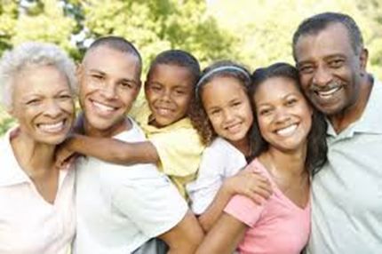
Cultural Differences and Nuances in Belief System
African Americans:
Involved in religious institutions
Discomfort with and mistrust of the health care system
Fear life-threatening or debilitating disease or illness.
Perception that diagnostic procedures are an invasion of privacy.
Feel less guilt about over-eating and accepts larger body sizes
Notes:
Are heavily involved in key religious institutions, such as churches or mosques.
Often discomfort with and mistrust of the health care system (the Tuskegee Syphilis Experiment is a major reason for the mistrust) .
Fear of being diagnosed with a life-threatening or debilitating disease or illness.
A common perception that diagnostic procedures are an invasion of privacy.
Feel less guilt about over-eating and accepts larger body sizes

Slide 33
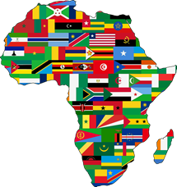
Cultural Differences and Nuances in Belief System
Sub Saharan Africa
Has a variety of distinct languages (over 450) and cultural traditions.
Religious traditions and practices are also highly diverse; Many follow indigenous African religion.
Family is defined broadly
Greeting requires shaking hands and asking about the health of the individual and his/her family.
Family ties may imply extensive monetary and other obligations.
Notes:
Official language and educational activities in English, French, Portuguese, German, Italian, and Arabic.
Family is defined broadly and may encompass people from the same village of origin, friends, and even distant blood relatives.

Slide 34
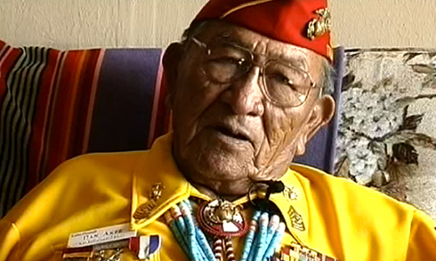
Cultural Differences and Nuances in Belief System
Native Americans/American Indian/Alaska Natives:
Have rich cultural variations among the groups and subgroups of Native Americans and Alaskan Natives.
Have a holistic perspective on life and on health in particular.
Make great efforts to integrate physical, social, psychological, and spiritual ways of healing.

Slide 35

Cultural Differences and Nuances in Belief System
Asians
World's largest and most diverse continent.
Different religions in the region and many traditional faiths.
Acceptance of what life brings, has respect for nature, and self-control.
Numbers 3(life) and 8 (prosperity) are considered lucky, while 4 (death) is considered unlucky (consider when prescribing insulin regimen).
Smiling expresses a great variety of emotions. (1) Can express happiness or pleasure. (2) Can mask anger, frustration, embarrassment, disappointment, lack of knowledge, or unhappiness.

Slide 36
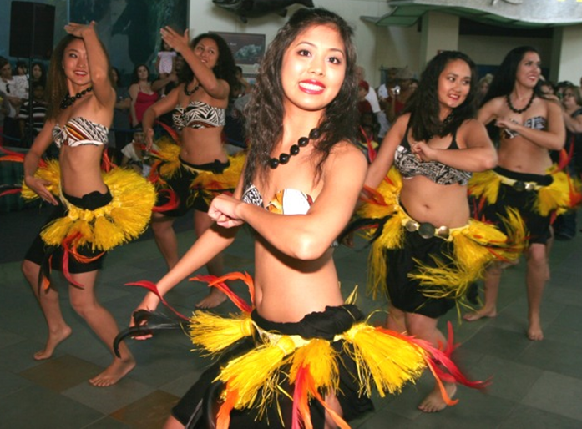
Cultural Differences and Nuances in Belief System
Pacific Islanders
More than 19 different ethnic groups with different histories, languages, and cultural traditions.
Ascribe to a holistic world view.
Emphasis is on interconnectedness of: (1) The individual, family, environment, and spiritual world.(2) Family, village or community, and church may play a prominent role
Have a basic distrust of western approaches to health care and treatment.
May respond negatively to health education and treatment based on scare tactics.
Notes:
Rarely respond positively to health education and treatment based on scare tactics to motivate behavior change.

Slide 37
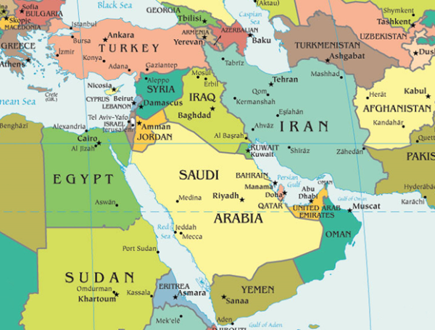
Cultural Differences and Nuances in Belief System
Western Asia/Middle East
An immense geographical area, from Pakistan and Afghanistan to Egypt.
Islam is the most common religion but have other religious groups.
Family pride and honor may be very high.
Prefer to be treated by a medical practitioner of the same sex.
Fasting is required of devout Muslims during the holy month of Ramadan
Use their left hand for toilet hygiene, and thus avoid using the left hand to touch another person or to touch food.
People from this region do not like to be touched on the head.

Slide 38

Cultural Differences and Nuances in Belief System
Eastern Europeans
Religions in the region include: Orthodox Christianity, Roman Catholicism, Islam, and Judaism.
Relatives give moral and physical support to each other.
Several generations may live together.
A sick person is often encouraged to communicate her/his suffering with others.
May not feel comfortable about being asked too many personal questions

Slide 39
Outline
Skills

Slide 40
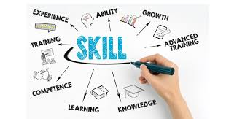
Cross-Cultural Clinical Skills
Knowledge, respect, and validation of differing values, cultures, and beliefs, including sexual orientation, gender, age, race, ethnicity, and class
Understanding language barriers and working with interpreters
Dealing with hostility/discomfort as a result of cultural discord
Eliciting a culturally valid social and medical history
Diagnosis, management, and patient-adherence skills leading to patient compliance
Negotiating and problem-solving skills
Communication, interaction, and interviewing skills
Epner DE, Baile WF. Wooden's pyramid: building a hierarchy of skills for successful communication, Med Teach, 2011, vol. 33 (pg. 39-43)
Notes:
Epner DE, Baile WF. Wooden's pyramid: building a hierarchy of skills for successful communication, Med Teach, 2011, vol. 33 (pg. 39-43)

Slide 41

Principles of Patient-centered Cultural Competence and Relevant Skills
Preparation
establish the right frame of mind and plan before seeing the patient
Environment
create a comfortable setting for the patient and family
Presentation
represent the profession and the work we do
Respect
show respect, since patients can be vulnerable and might need our assistance

Slide 42
Outline
Encounters

Slide 43
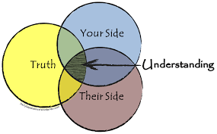
Everyone wants to be understood
Listen attentively when the patient talks
Explore: ‘Tell me more’
Allow silence in the conversation
Use open ended questions
Invite the patient narrative
Please tell me what you understand about your condition
What would you like to discuss today?
Tell me about your family
Epner DE, Baile WF. Wooden's pyramid: building a hierarchy of skills for successful communication, Med Teach, 2011, vol. 33 (pg. 39-43)
Notes:
Inviting the patient to tell the story of his illness is itself therapeutic.
Exploring the patient's concerns gets you tuned in to his agenda
Taking a personal history allows the patient to feel as if you are interested in him as a person, not only as a patient.

Slide 44
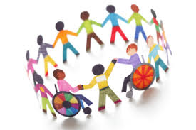
Everyone wants to be cared about
Create the right atmosphere:
be friendly, greet everyone in the room, sit at eye level
Respond to emotion with empathy
I wish things were different
This must be very difficult for you
I can see you were hoping for better news
Epner DE, Baile WF. Wooden's pyramid: building a hierarchy of skills for successful communication, Med Teach, 2011, vol. 33 (pg. 39-43)
Notes:
All people really care about is being cared about
Telling the patient and her family you will treat them as if they were part of your family, and then doing so, builds trust and rapport.
Responding to emotion with empathy allows a patient to feel you are tuned in to her.

Slide 45
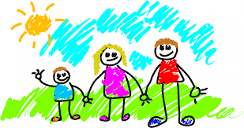
Everyone has a family
Acknowledge the work of the family:
I am impressed by the love between you and your family
You have done a great job supporting your wife through her treatment
What do your children understand about your illness?
Partner with patient and family
Epner DE, Baile WF. Wooden's pyramid: building a hierarchy of skills for successful communication, Med Teach, 2011, vol. 33 (pg. 39-43)
Notes:
Family is an extension of the patient. Almost all people have a profound love for and loyalty to family, especially immediate family. Asking a patient about his family opens an emotional window.

Slide 46

Words can harm or heal
Harmful: ‘there is nothing more we can do for you’
Healing: ‘I wish we had better treatments for you. I think we need to focus on your quality of life’
Be clear, avoid jargon, and keep explanations geared to the patient. People need the truth … delivered sensitively
Balance optimism with credibility
Epner DE, Baile WF. Wooden's pyramid: building a hierarchy of skills for successful communication, Med Teach, 2011, vol. 33 (pg. 39-43)
Notes:
Words can harm and words can heal [20].As the cliché goes, ‘It is not what you say but how you say it.’
Giving information in a way that a patient understands strengthens your connection to him.

Slide 47
Words can harm or heal
If you are a man, try not to extend your hand to a woman unless she extends hers first
If you do not know how to greet someone, simply smile and nod respectfully
Maintain modesty during the visit
Epner DE, Baile WF. Wooden's pyramid: building a hierarchy of skills for successful communication, Med Teach, 2011, vol. 33 (pg. 39-43)
Notes:
Physical touch is a powerful force that can be destructive or healing

Slide 48
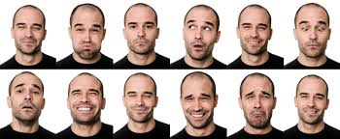
Non-verbal cues matter
Be perceptive and adaptive. Strong emotions, such as fear, sadness, pain, and anxiety, are usually obvious
Address the patient’s frustration first if they obviously appear to be frustrated
Establish eye contact with the patient that is commensurate with their eye contact with you. If they avert your gaze, establish less eye contact
Epner DE, Baile WF. Wooden's pyramid: building a hierarchy of skills for successful communication, Med Teach, 2011, vol. 33 (pg. 39-43)
Notes:
Non-verbal cues are powerful People transmit as much or more information by non-verbal cues as they do by words

Slide 49
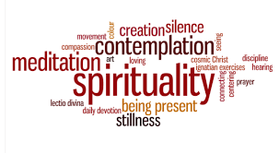
Spirituality matters
Explore:
‘What role does spirituality play in your life?’
‘How has faith helped you during challenging times?’
‘Has your clergy been involved in your spiritual care during your illness?’
Respect: ‘I respect your faith. Faith is
powerful medicine.’
Epner DE, Baile WF. Wooden's pyramid: building a hierarchy of skills for successful communication, Med Teach, 2011, vol. 33 (pg. 39-43)
Notes:
Spirituality is important to nearly everyone. One's faith in a higher power often becomes increasingly important during times of duress and vulnerability. This can also be stated as ‘There are no atheists in fox holes.’
Validating someone's faith shows respect and support.
Telling a religious person ‘we are praying for you’ is very therapeutic.

Slide 50

Give patient control
Explore
‘What is your understanding of your diabetes?’
‘What would you like to discuss (or what are your goals) today?’
‘What are your goals if we can’t manage your diabetes with weight loss?’
When the patient needs guidance, confidently help him make well informed decisions
Partner with patient and family
Epner DE, Baile WF. Wooden's pyramid: building a hierarchy of skills for successful communication, Med Teach, 2011, vol. 33 (pg. 39-43)
Notes:
Allow the patient and family as much control as possible. Focus immediately on the issue the patient is most concerned about. For instance, discuss results of restaging studies first if the patient is worried about them
Negotiate the content and flow of the conversation to give the patient control over the meeting.
Respect patient's needs and priorities as long as they are reasonable, and sometimes even if they are unreasonable.

Slide 51
Outline
Desires

Slide 52
Cultural Desire
Is when the healthcare professional is motivated to want to engage in becoming culturally aware, culturally knowledgeable, culturally skillful and seek to have cultural encounters with their patients.
Source: The Process Of Cultural Competence In The Delivery Of Healthcare Services
http://transculturalcare.net/the-process-of-cultural-competence-in-the-delivery-of-healthcare-services/

Slide 53
AADE Position Statement
Diabetes Educators must be aware that:
Failure to incorporate important aspects of culture into direct patient care and diabetes education targeting ethnically diverse populations may result in less than optimal patient satisfaction in these populations.
Integral to health, culture profoundly affects the way people define and experience health and disease.

Slide 54
Showing Cultural Sensitivity
Treat people as individuals.
Understand who you serve.
Be sensitive to their needs.
Understand their expectation of excellent care.
Understand their beliefs about disease and causes.
Notes:
Economic status may be more important than culture/ethnicity:
Lack of money
Wealthy being waited upon
Does not prepare food (rich, male)
Don’t just label patients non-compliant instead try to:
Understand their traditional foods and what they like to eat.
Look up ingredients that make up the foods.
Understand that people’s background shapes their beliefs.
Set goals with patient on what they are willing to work on.

Slide 55
Showing Cultural Sensitivity cont.
Be open minded
Realize people are different from you
Adjust your behavior
Learn to be an effective communicator
Learn something about your patient’s culture
Ask language preference

Slide 56
Showing Cultural Sensitivity cont.
Prevent conflicts by:
Explaining what you want them to do.
Asking patient to explain objectives.
Respecting patients decisions.
Being an observant and active listener.
Explaining importance of what you are asking them to do (work with your patient).
Having patient repeat the information to you.
Telling them what you are doing.

Slide 57

Adaption to Life in the U.S and its Implication on Health Care
Cultural adjustment can have real impact on the patients’ mental, emotional, and physical health.
Some may choose to use folk or traditional treatments before or concurrently with modern health care.
Be sensitive to the role folk or traditional medicine may play in patient’s health strategy.
Show tolerance of and respect for diversity in order to elicit and fully understand the patient’s story and provide appropriate treatment.
BE PATIENT AND HAVE EMPATHY!!!

Slide 58
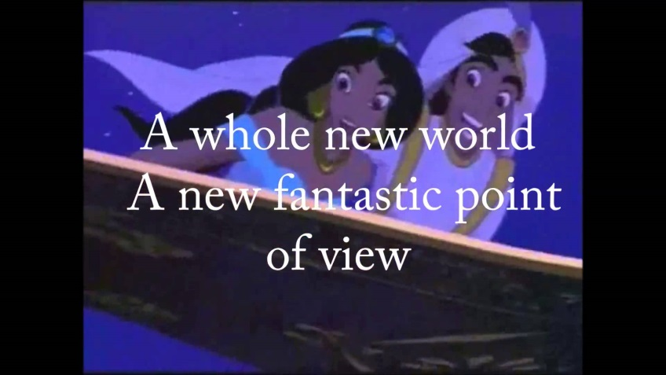
Thank you!
Questions

Slide 59
Disclosure to Participants
Notice of Requirements For Successful Completion
  Please refer to learning goals and objectives
  Learners must attend the full activity and complete the evaluation in order to claim continuing education credit/hours
Conflict of Interest (COI) and Financial Relationship Disclosures:
  Adeola Akindana, DNP, CRNP, CDE- No COI/Financial Relationship to disclose
  Barbara Eichorst, MS, RD,CDE – No COI/Financial Relationship to disclose
Non-Endorsement of Products:
  Accredited status does not imply endorsement by AADE, ANCC, ACPE or CDR of any commercial products displayed in conjunction with this educational activity
Off-Label Use:
  Participants will be notified by speakers to any product used for a purpose other than for which it was approved by the Food and Drug Administration.

