Slide 1

Referrals, Advocacy and Reimbursement for DSMES

Slide 2
Learning Objectives
Review the 4 critical times for referral for Diabetes Self Management and Support
State how DSMES aligns with the standards of medical care of type 2 DM
Explain how to file an appeal for a claim denied by Medicare and what is important to include.
Discuss how Medicare policy challenges work and what was tried for CGM coverage.
Describe the influence of district court decisions on Medicare coverage.

Slide 3

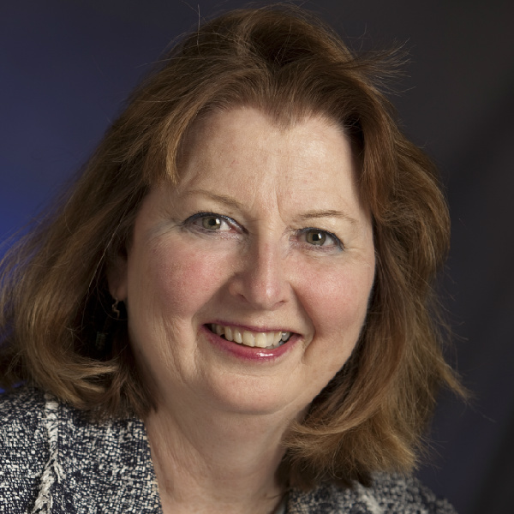
Joan Bardsley
MBA, RN, CDE, FAADE
Past President AADE 2014
Chair NCBDE 2018
AVP MedStar Health Research Institute
AVP MedStar Corporate Nursing
Hyattsville, MD

Slide 4
Disclosure to Participants
Notice of Requirements For Successful Completion
  Please refer to learning goals and objectives
  Learners must attend the full activity and complete the evaluation in order to claim continuing education credit/hours
Conflict of Interest (COI) and Financial Relationship Disclosures:
  Presenter: Joan Bardsley MBA, RN, CDE, FAADE– No COI/Financial Relationship to disclose
Non-Endorsement of Products:
  Accredited status does not imply endorsement by AADE, ANCC, ACPE or CDR of any commercial products displayed in conjunction with this educational activity
Off-Label Use:
  Participants will be notified by speakers to any product used for a purpose other than for which it was approved by the Food and Drug Administration.

Slide 5

Diabetes Self-Management Education (DSME):
Component of Standard Diabetes Care
“… Ongoing patient self-management education and support are critical to preventing acute complications and reducing the risk of long-term complications …”
ADA. Standards of Medical Care. Diabetes Care (2017)
Powers et al. Joint Position Statement on DSME. Diabetes Care, The Diabetes Educator , Journal of the Academy of Nutrition and Dietetics (2015)
Notes:
Using this slide set
This 10 slide set can be used as an overarching review of the benefits of DSME and the 4 critical times to assess, provide, adjust and refer for DSME. It can take from 10-20 minutes to present.
Consider adding case studies to the presentation that highlight each of the 4 times. Having discussion about each case helps the audience start applying the information. This could add another 10-20 minutes.
The slide set can be shared widely with anyone doing such presentations.
Main point of this slide
Diabetes self-management education (DSME) is component of standard diabetes care. If not included provider could be faulted for not providing quality care.
Talking points
The American Diabetes Association sets standards for diabetes care based on current research to provide evidence-based care recommendations. Every January the updated Standards are published as a supplement to Diabetes Care.
The introduction to the 2017 Standards of Care begins: “Diabetes is a complex, chronic illness requiring continuous medical care with multifactorial risk-reduction strategies beyond glycemic control. Ongoing patient self-management education and support are critical to preventing acute complications and reducing the risk of long-term complications. Significant evidence exists that supports a range or intervention to improve diabetes outcomes…”
This presentation will provide an overarching review of the benefits of DSME and the 4 critical times to assess, provide, adjust and refer for DSME.
Resources
American Diabetes Association
www.diabetes.org
Link to Diabetes Care supplement on Standards of Care 2017

Slide 6
Definitions
Diabetes Self-management Education (DSMES) Ongoing process to facilitate the knowledge, skills, and ability necessary for diabetes self-care as well as activities that assist a person in implementing and sustaining the behaviors needed to manage their condition on an ongoing basis
Medical Nutrition Therapy (MNT) Application of nutrition care process; includes individualized nutrition assessment, nutrition diagnosis, intervention and monitoring and evaluation; if not included in DSME program, refer to registered dietitian
Beck J, Greenwood DA, Blanton L, et al. 2017. National standards for diabetes self-management education and support, Diabetes Educ. 2017
Powers MA et al. DSME/S Position Statement. Diabetes Care, The Diabetes Educator, Journal of the Academy of Nutrition and Dietetics (2015)

Slide 7
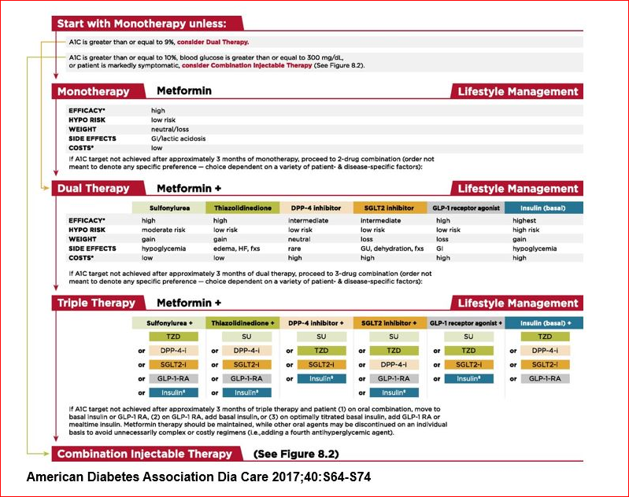
Diabetes Self-Management Education:
Component of Standard Diabetes Care
ADA Standards of Medical Care. Diabetes Care 2016;39(Supp1):52-59
Notes:
Main points of this slide
Lifestyle management is an integral component of any pharmacological management.
This is a well recognized comparison of medications utilized in diabetes management. It compares medication by drug class using a 5-point scorecard to provide an objective comparison.
Talking points
The American Diabetes Association’s Standards of Care provide guidance on initiating and advancing diabetes medications. This slide shows the algorithm of recommendations. The recommendations are based on an objective comparison of each drug class using a 5-point scorecard. Each class is rated on: efficacy, hypoglycemia risk, weight, side effects and cost.
Lifestyle management is an integral component of any pharmacological management as noted in the algorithm. However, note there is no comparison of lifestyle management using a similar scorecard.
Resources
American Diabetes Association
www.diabetes.org
Link to Diabetes Care supplement on Standards of Care 2017

Slide 8
If DSME was a pill, would you prescribe it?
Notes:
Main points of this slide
The medication 5-poing scorecard rating system was applied to DSME to provide an objective comparison to metformin. Metformin was selected as it is a commonly used first line, low cost therapy.
The ratings scorecard for DSME is impressive and confirms the benefits and value of DSME.
The scorecard challenges providers to rethink the inclusion of not-pharmacologic therapy in their treatment plans.
Talking points
A 2016 paper in Diabetes Care raised the question ‘ If DSME was a pill, would you prescribe it?” The medication 5-poing scorecard rating system was applied to DSME to provide an objective comparison to metformin. Metformin was selected as it is a commonly used first line, low cost therapy.
Efficacy: rated high as research shows DSME lowers A1c by 1 or more percentage points. Metformin has the same rating.
Hypoglycemia risk: rated low; this rating was selected as hypoglycemia may occur as better control is achieved and further adjustments are made. Metformin was rated low hypo risk.
Weight: A number of studies show that weight loss is achievable and sustainable through lifestyle intervention, even when insulin is being initiated. Improvement in glycemic control also occur with weight maintenance. Weight change was rated as neutral or loss with DSME. Metformin had the same rating.
Side effects: There have been no reported side effects with DSME. There are potential side effects with metformin, most notably related to GI disturbances. Although rare, lactic acidosis is also noted.
Cost: Medicare reimburses for recognized and accredited DSME programs and many private insurers follow suit. Research shows that longer term cost savings are realized through decreased hospitalizations, emergency room visits, and better control. Metformin is rated low because of its generic status resulting in low out of pocket cost.
Psychosocial benefits: This was included in the scorecard as many benefits are realized through DSME. DSME --
Increases or improves quality of life, self-efficacy, empowerment, healthy coping, knowledge, self-care behaviors, adherence to a fool plan, healthier food choices, increased physical activity, and use of glucose monitoring data
Reduces blood pressure and lipids, problems managing diabetes, the incidence of acute complications, and the risk of long-term complications.
The ratings scorecard for DSME is impressive and confirms the benefits and value of DSME in addition to challenging providers to rethink the inclusion of not-pharmacologic therapy in their treatment plans.
Resources
Powers – if DSME were a pill
SOC – 2017
Inzucchi – position statement

Slide 9
Sorry State of DSMES
1. 5% Of Medicare beneficiaries with newly diagnosed diabetes used DSMT benefit¹
2. 6.8% Of individuals with newly diagnosed T2D with private health insurance received DSME/S within 12 months of diagnosis²
6.8%
5%
(1) Strawbridge. Health Edu Behav. (2015) (2) Li. MMWR Morb Mortal Wkly Rep. (2014))
Notes:
Main points of this slide
DSME is a covered benefit through Medicare and private insurers.
Medicare covers DSME due to its impact on overall diabetes care and health outcomes
DSME is an underutilized benefit.
Talking points
Diabetes is a complex and burdensome disease that requires the person with diabetes to make numerous daily decisions regarding food, physical activity, and medications. It also necessitates that the person be proficient in a number of self-management skills. In order for people to learn the skills necessary to be effective self-managers, DSME is critical in laying the foundation with ongoing support to maintain gains made during education. Despite proven benefits and general acceptance, the numbers of patients who are referred to and receive DSME/S are disappointingly small.
There is robust data demonstrating that the vast majority of people with either Medicare or private insurance coverage do not receive DSME in the first year they are diagnosed.
Medicare provides coverage for 10 hours of DSME (using DSMT codes; T is for training) in the first year of using the benefit. The data from Strawbridge et al. show that those participating in the year in which they are diagnosed, engaged in 1.5 hours. 30% only participated for a half hour.
Resources
Li et al. MMWR. (2014)
Strawbridge et al. Health Education & Behavior (2015)

Slide 10
Diabetes Self-Management Education
Algorithm of Care and Action Steps
Position Statement on Diabetes Self-Management Education describes 4 critical times when to assess, adjust and provide DSME and what is included at each time point.
Powers MA et al. DSME/S Position Statement.
Diabetes Care, The Diabetes Educator, Journal of the Academy of Nutrition and Dietetics (2015)
Notes:
Main points of this slide
The Joint Position Statement on DSME describes when, what and how DSME is best provided.
An algorithm is included that is a visual depiction of the concepts discussed in the statement.
Talking points
Representatives from four organizations (American Diabetes Association, the American Association of Diabetes Educators, the Academy of Nutrition and Dietetics, and the National Diabetes Education Program) collaborated and developed a Position Statement on DSME of when to identify and refer individuals with type 2 diabetes to DSME/S. Additionally, other key stakeholders and organizations provided input throughout the process.
The statement defines when DSME should be provided for type 2 diabetes, what is included at each of the time points for quality diabetes care, and how best to provide DSME in a patient-centered manner.
The four critical time points to assess, provide, adjust and refer for DSME are:
Upon diagnosis
Annual assessment of education, nutrition, emotional issues
When new complicating factors influence self management
When transitions in care occur
The DSME position statement includes a diabetes self-management and support algorithm, part of which is shown on this slide. Key successes to DSME, nutrition, education and emotional health are included to show the comprehensive scope of self-management.
The algorithm is a visual depiction of the concepts discussed in the statement. You are encouraged to reproduce it as a stand alone document and distribute widely.
The position statement and algorithm can be used by health care systems, staff, or teams, as well as individuals with diabetes, to guide when and how to refer to and deliver/receive diabetes education:
Resources
American Diabetes Association
www.diabetes.org
Link to Diabetes Care supplement on Standards of Care 2017
Link to position statement
Link to algo
Link to list of DSME programs
American Association of Diabetes Educators
www.diabeteseducator.org
Link to position statement
Link to algo
Link to list of DSME programs
Academy of Nutrition and Dietetics
www.eatiright.org
Link to position statement
Link to algo
Link to list of dietitians
National Diabetes Education Program
www.ndep.nih.bov

Slide 11
When
What
1
2
3
4
Powers MA et al. DSME/S Position Statement.
Diabetes Care, The Diabetes Educator, Journal of the Academy of Nutrition and Dietetics (2015)
Notes:
Main points of this slide
Shows the two parts of the algorithm and describes how they compliment each other.
Provides specific details of focus areas for both the provider and educator during the 4 critical times
Talking points
There are two parts to the algorithm.
The first, shown on the left, is the Algorithm of Care. This is the ‘when’ to assess, adjust, provide and refer to DSME.
This portion of the algorithm summarizes and provides a checklist for determining if it is ‘time’ for DSME to be assessed, adjusted and provided. If yes, this typically means a referral to DSME.
Although four distinct time-related opportunities are listed, it is important to recognize that type 2 diabetes is a chronic condition and situations can arise at any time that require additional attention to self-management needs. Whereas patient’s needs are continuous , these four critical times demand assessment and, if needed, intensified re-education and self-management planning and support. This breakdown helps to illustrate the chronicity of the disease state.
The second part is shown on the right and is the ‘what’ of DSME. This is the Algorithm Action Steps.
This section summarizes action steps and provides a checklist for identifying what topic/information/support is needed at each of the 4 critical times.
The top portion is for the primary care provider/endocrinologist/clinical care team and the lower portion for the diabetes education team.
This provides guidance on areas of focus during the 4 critical times. This helps outline what type of assessment and focus to help structure the visit. In addition it gives the provider a better sense of the focus areas that can be expected from the education referral.
Resources
The presenter should have a copy of the algorithm, specifically the Action Steps to provide more information to the attendees.

Slide 12
Evidence for Greatest Impact of DSME
Engaging adults with type 2 diabetes in DSME results in statistically significant and clinically meaningful improvements in A1c. The greatest improvements are achieved when DSME:
  Involves both group and individual education
  Is provided by a team vs a singe individual
  Participants attend more than 10 hours
  Is tailored to the individual participant
  Is focused on behaviors and engages the participant rather than didactic interventions

Slide 13
Summary
There are many evidence-based benefits of DSMES. Of note are the many psychosocial benefits and behavioral improvements
DSMES is grossly under utilized
The position statement describes the 4 critical times to assess, adjust, provide and refer for education
The algorithm checklists provide objective criteria for times when referrals for DSMES are needed
Provides clear expectations of the focus areas of DSMES at each of the 4 critical times

Slide 14
But ………
How is this covered by insurance?
What is AADE doing to work with regulators to ensure access to this benefit as needed?
What can each of us do?
The answers………

Slide 15
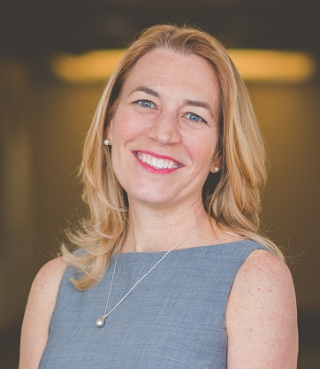
Debbie Parrish
BSE, JD
Partner
Parrish Law Offices
Pittsburgh, PA

Slide 16
Disclosure to Participants
Notice of Requirements For Successful Completion
  Please refer to learning goals and objectives
  Learners must attend the full activity and complete the evaluation in order to claim continuing education credit/hours
Conflict of Interest (COI) and Financial Relationship Disclosures:
  Presenter: Debbie Parrish, BSE, JD – No COI/Financial Relationship to disclose
Non-Endorsement of Products:
  Accredited status does not imply endorsement by AADE, ANCC, ACPE or CDR of any commercial products displayed in conjunction with this educational activity
Off-Label Use:
  Participants will be notified by speakers to any product used for a purpose other than for which it was approved by the Food and Drug Administration.

Slide 17
Medicare Beneficiary Advocacy
Medicare Administrative Appeals Generally
Medicare Administrative Appeals for CGM
Medicare Policy Challenges
District Court Cases for CGM

Slide 18
Medicare Administrative Appeals
Percentage that appeal
Levels of appeal
  Redetermination
  Reconsideration
  Admin. Law Judge
  Council
  District Court
Time for resolution at Admin. Law Judge – 1200 v 60

Slide 19
Administrative Appeals and CGM
Article stating CGM were precautionary
Medicare beneficiaries reaching out to Medicare medical directors
Medicare beneficiaries appealing – winning
Council reversing saying no medical purpose

Slide 20
Medicare Coverage Policies
Peer-reviewed literature
Consensus of experts
Adoption by the relevant medical community

Slide 21
Medicare Policy Challenge
Only a Medicare beneficiary can file
Need a letter from clinician
Discovery and Delivery
Judge - invalid under the reasonableness standard
Council’s technical objection

Slide 22
District Court Cases
Wisconsin x 2 - Whitcomb
Massachusetts x 2 – Lewis, Finigan
Vermont - Bloom

Slide 23
Lessons Learned
Medicare beneficiary most powerful advocate
Medical directors noted the decisions
Help each other leverage wins
Society statements
Medicare Ombudsman
The Courts can be helpful but it requires endurance

Slide 24

Leslie E Kolb
RN, BSN, MBA
Chief Science and Practice Officer
American Association of Diabetes Educators
Chicago, Il

Slide 25
Disclosure to Participants
Notice of Requirements For Successful Completion
  Please refer to learning goals and objectives
  Learners must attend the full activity and complete the evaluation in order to claim continuing education credit/hours
Conflict of Interest (COI) and Financial Relationship Disclosures:
  Presenter: Leslie E. Kolb RN, BSN, MBA– No COI/Financial Relationship to disclose
Non-Endorsement of Products:
  Accredited status does not imply endorsement by AADE, ANCC, ACPE or CDR of any commercial products displayed in conjunction with this educational activity
Off-Label Use:
  Participants will be notified by speakers to any product used for a purpose other than for which it was approved by the Food and Drug Administration.

Slide 26
Advocacy at AADE
Advisory Committee
Diabetes Advocacy Alliance
Science and Practice Connection

Slide 27
Advocacy Committee - Purpose
To ensure the advocacy functions of the organization meet the highest standards and serve both the members needs and the AADE mission. The committee is tasked with ensuring that the advocacy initiatives of AADE align with the mission and policies and advance the profession and quality of patient care

Slide 28

Advocacy Committee - Members
Kathy Gold (Chair)
Lisa Laird
Garth Reynolds
Bridget Jennings
Manny Hernandez
Ann Constance
Suzanne Lohnes
Rosane Ainscough
Lisa Ranes
Teresa Martin
Courtney Slater
Kate Thomas (Director of Advocacy)

Slide 29
Diabetes Advocacy Alliance™ (DAA)
Coalition of 24 members - formed in 2010
Together we work to inform and educate legislators and other policy makers about:
  The enormous challenges that diabetes and prediabetes pose to US health and prosperity.
  How legislation and public policy can help change the course of significant growth in the population of people with type 2 diabetes and complications associated with the disease expected in the coming decades.
Notes:
(DAA) is a coalition of 24 members, representing patient, professional and trade associations, other nonprofit organizations, and corporations, all united in the desire to change the way diabetes is viewed and treated in America. The DAA was formed and began activities in January 2010. Three members of the DAA serve as co-chairs: American Diabetes Association; Pediatric Endocrine Society; and Novo Nordisk Inc

Slide 30
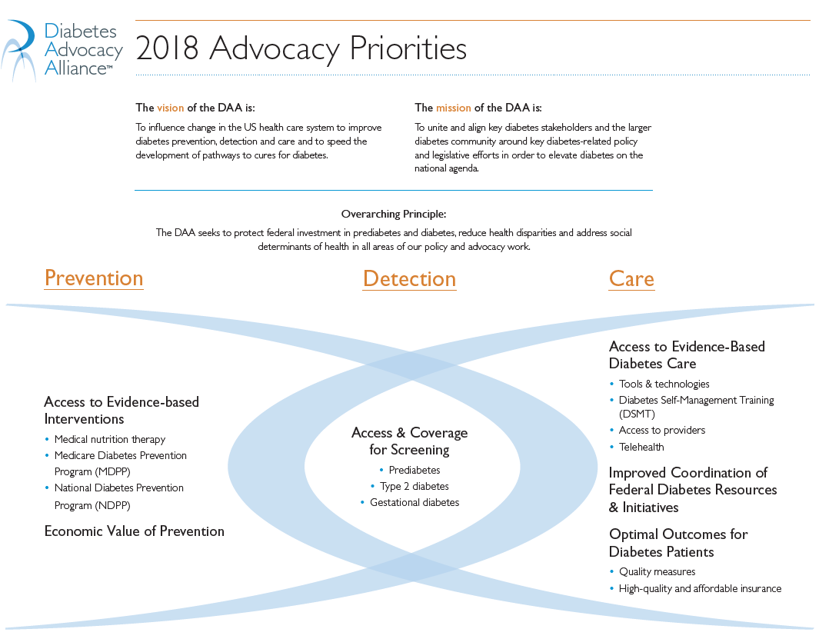
https://www.diabetesadvocacyalliance.org/index.html

Slide 31
DAA Regulatory Position Statement
Diabetes Self-management Training (DSMT): Reducing Barriers and improving Utilization
Policy Recommendations:
  Extend the initial 10 hours of DSMT covered by Medicare beyond the first year
  MNT and DSMT on the same day
  Remove Cost-sharing
  Broaden referral Providers
  Clarify HOPD – Community based locations

Slide 32
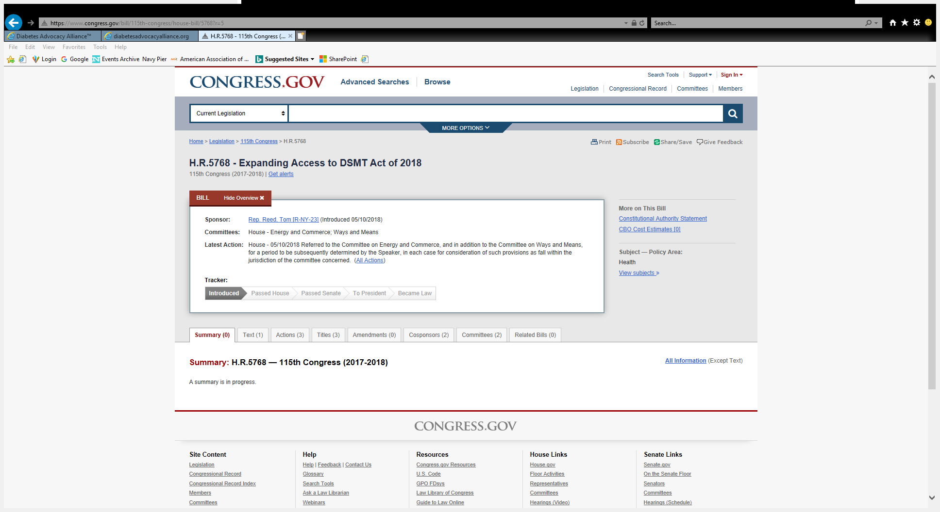
H.R.5768 – Expanding Access to DSMT Act of 2018

Slide 33

Science and Practice
National Accrediting Organization (NAO)
Diabetes Education Accreditation Program (DEAP)
Reimbursement !!!

Slide 34
Common Mistakes
RN cannot provide DSMT
Initial and follow up Individual visit needs medical necessity documentation
RD cannot bill for DSMT service if a RN instructs
DSMT requires a multi-disciplinary team
Pharmacy's cannot bill for DSMT service

Slide 35
Advocating by Collaborating
G-Codes went through an RVS Update Committee (RUC) in 2017
RUC – multispecialty committee describes resources required to provide physician services which CMS considers in developing Relative Value Units (RVUs)
CMS makes final recommendations
Notes:
Relative Value Units (RVUs)
G0108 1.51 to 1.59
G0109 .41 - .44

Slide 36
2019-Physician Fee Schedule
G0108 – $57.31 (increase from $54.19)
G0109 - $15.86 (increased from $14.71)

Slide 37
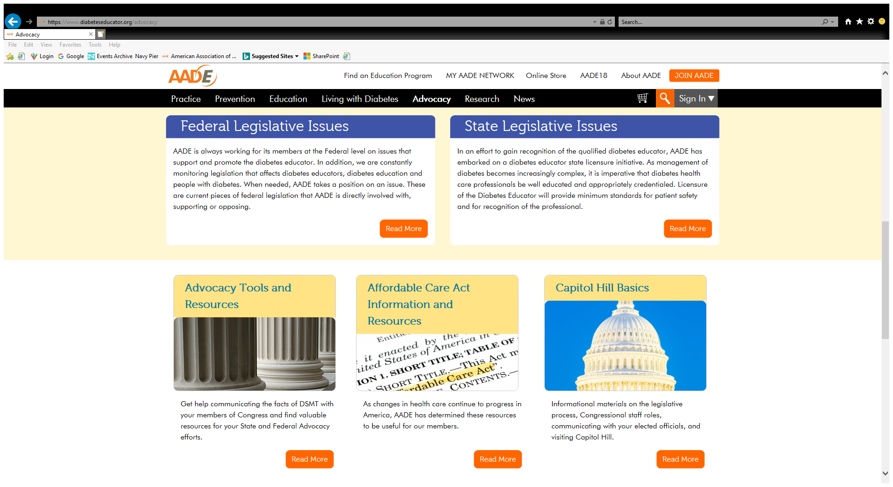
So Much More…
Public Policy Forum
Diabetes Action Plan
  Indiana
Competitive Bidding
  Secret Shopper
https://www.diabeteseducator.org/advocacy

Slide 38



