Slide 1


Slide 2
Supplements and Micronutrients for Diabetes Care: Which Work and Why?
Jim Painter, PhD, RDN

Slide 3

Jim Painter
PhD, RDN
Emeritus Professor
Eastern Illinois University
Charleston, IL

Slide 4
Disclosure to Participants
Board Member/Advisory Panel/Consultant
Present
  University of Texas, Sun-Maid Raisins, National Dairy Council, United Sorghum Checkoff Board, Sugarwise.
Past
  American Heart Association healthier diet business committee. Eastern Illinois University, University of Illinois –Champaign, American Heart Association Eat Well Task Force, California Raisin Marketing Board, Wonderful Pistachios, White Wave Foods, Davidson’s Safest Choice Eggs, Chic-fil-A, Tree Top Apples, Bush’s Beans,
Honoraria
  Honorarium underwritten by Today’s Dietitian, Atkins Nutritionals Inc.
  Dietitians of Canada, Exxon Mobil, Frito Lay, Midwest Dairy Council, Pennsylvania Nutrition Network, California Raisin Marketing Board, Alaska Tanker Company, Dairy Max, Texas AND, California AND, Florida AND, MINK, NY AND, South Carolina AND, Iowa AND, Nebraska AND, Manitoba Dairy Farmers, Dairy Farmers of Canada, Davidsons Safest Choice Eggs, National Dairy Council, New Products Conference, the Flavor Experience, BNP Media, and Cooper Vision.

Slide 5
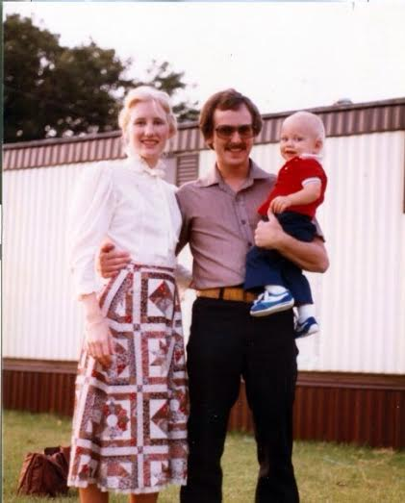
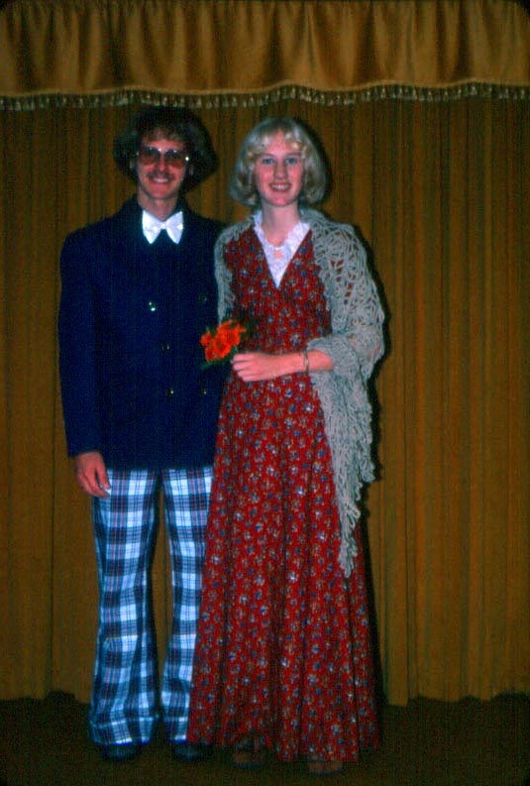
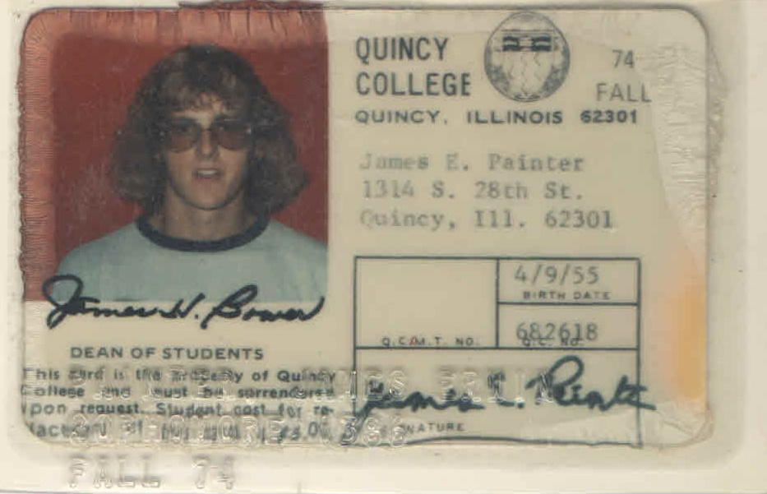
Speaker Credentials

Slide 6
Outline
Introduction
Ginseng
Curcumin
Ginger
Cinnamon
Berberine
Ayurvedic formulations

Slide 7
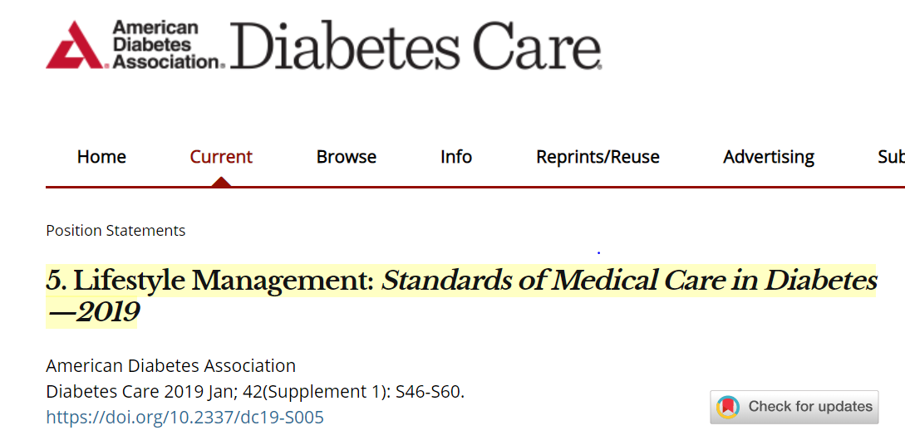
“There continues to be no clear evidence of benefit from herbal or nonherbal (i.e., vitamin or mineral) supplementation for people with diabetes without underlying deficiencies (35). Metformin is associated with vitamin B12 deficiency, with a recent report from the Diabetes Prevention Program Outcomes Study (DPPOS) suggesting that periodic testing of vitamin B12 levels should be considered in patients taking metformin, particularly in those with anemia or peripheral neuropathy (123). Routine supplementation with antioxidants, such as vitamins E and C and carotene, is not advised due to lack of evidence of efficacy and concern related to long-term safety. In addition, there is insufficient evidence to support the routine use of herbals and micronutrients, such as cinnamon (124), curcumin, vitamin D (125), or chromium, to improve glycemia in people with diabetes (35,126). However, for special populations, including pregnant or lactating women, older adults, vegetarians, and people following very low-calorie or low-carbohydrate diets, a multivitamin may be necessary.
For select groups of individuals such as the elderly, pregnant or lactating women, vegetarians, and those on calorie-restricted diets, a multivitamin supplement may be necessary (196).
Notes:
http://care.diabetesjournals.org/content/36/11/3821

Slide 8
Top 10 Herbal Supplements By Sales
 | Supplement | Sales
1 | Cranberry | $65,000,000
2 | Garlic | $35,000,000
3 | Saw palmetto | $32,000,000
4 | Soy | $28,000,000
5 | Ginkgo | $26,000,000
6 | Milk thistle | $21,000,000
7 | Black Cohosh | $17,000,000
8 | Echinacea | $16,000,000
9 | St. John’s Wort | $12,000,000
10 | Ginseng | $11,000,000
Lindstrom, A, et al.(2013).Herbal Supplement Sales increase 5.5% in 2012.

Slide 9
Basic Four Food Groups
Everything that is bad for you tastes good
Everything that is good for you tastes bad
Was good for you but not any more
If you eat that it you will kill you

Slide 10
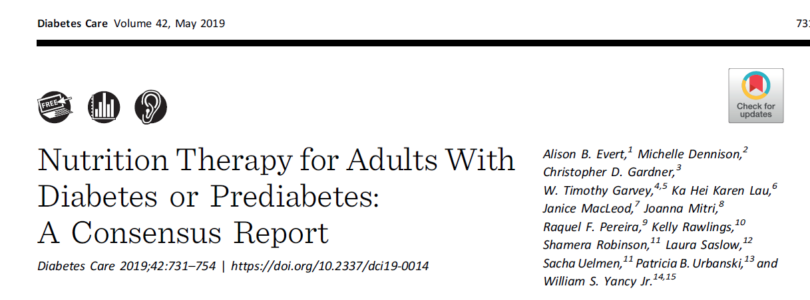

Slide 11
Consensus Recommendations
“The routine use of chromium or vitamin D micronutrient supplements or any herbal supplements, including cinnamon, curcumin, or aloe vera, for improving glycemia in people with diabetes is not supported by evidence and is therefore not recommended.”

Slide 12
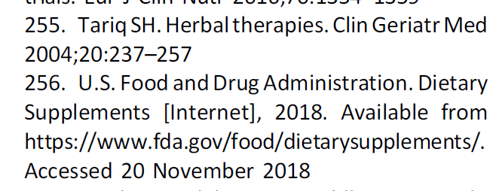
What is the role of herbal supplementation in the management of diabetes?
“It is important to consider that nutritional supplements and herbal products are not standardized or regulated (255,256).
Health care providers should ask about the use of supplements and herbal products…., To date, there is limited evidence supporting the addition of herbal supplements to manage glycemia….”

Slide 13
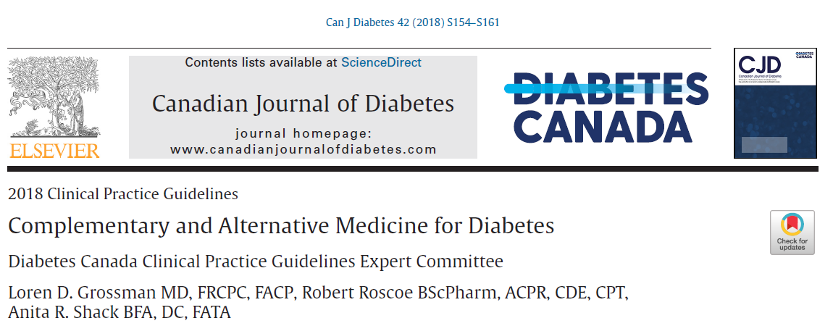
“Some natural health products have shown a lowering of A1C by ≥0.5% in trials lasting at least 3 months in adults with type 2 diabetes, but most are single, small trials that require further large-scale evaluations before they can be recommended for widespread use in diabetes.
A few more commonly used natural health products for diabetes have been studied in larger randomized controlled trials and/or meta-analyses refuting the popular belief of benefit of these compounds.
Health-care providers should always ask about the use of complementary and alternative medicine as some may result in unexpected side effects and/or interactions with traditional pharmacotherapies.
Although some of these therapies may have the potential to be effective, they have not been sufficiently studied and others can be ineffective or even harmful”

Slide 14
“In adults with T2DM, the following NHP have been shown to lower A1C by at least 0.5% in randomized controlled trials lasting at least 3 months:”
Ayurveda polyherbal formulation
Citrullus colocynthis
Coccinia cordifolia
Eicosapentaenoic acid
Ganoderma lucidum
Ginger (Zingiber officinale)
Gynostemma pentaphyllum
Hintonia latiflora
Lichen genus Cladonia BAFS “Yagel-Detox”
Marine collagen peptides
Nettle (Urtica dioica)
Oral aloe vera
Pterocarpus marsupium (vijayasar)
Salacia reticulata
Scoparia dulcis porridge
Silymarin
Soybean-derived pinitol extract
Touchi soybean extract
Berberine
Fructus Mume
Gegen Qinlian Decoction (GQD)
Jianyutangkang (JYTK) with metformin
Jinlida with metformin
Sancaijiangtang
Shen-Qi-Formula (SQF) with insulin
Tang-Min-Ling-Wan (TM81)
Xiaoke (contains glyburide)
Zishentongluo (ZSTL)
Trigonella foenum-graecum (fenugreek)
“These products are promising and merit consideration and further research, but, as they are mostly single, small trials or meta-analyses of such, it is premature to recommend their widespread use.”

Slide 15
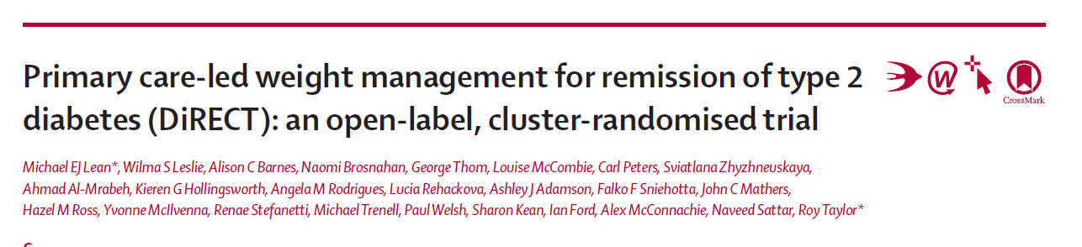
2018

Slide 16
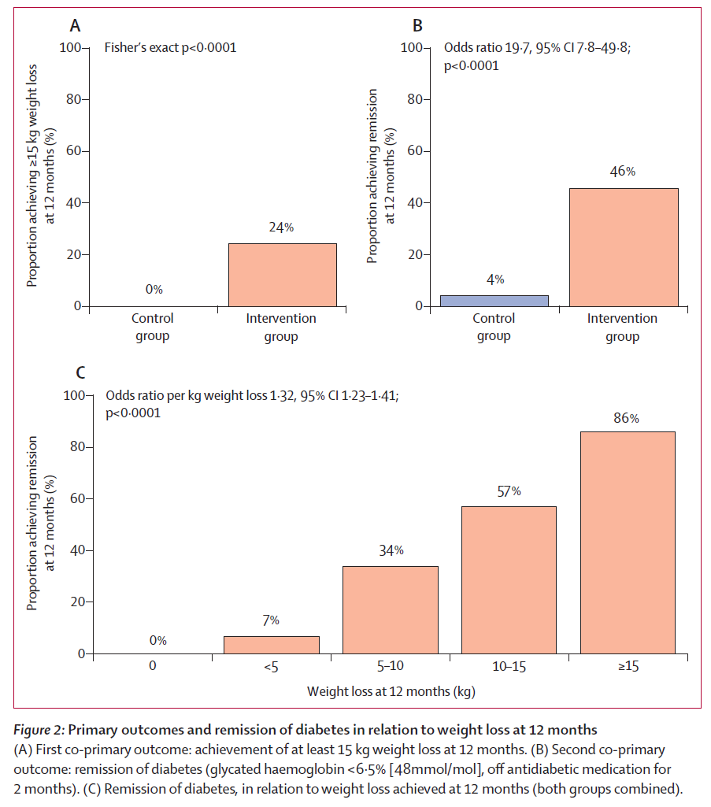

Slide 17
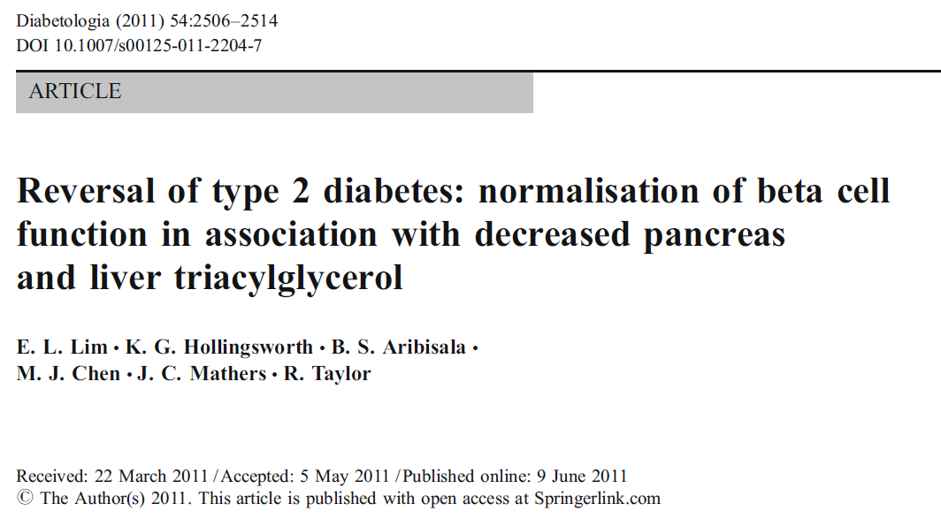

Slide 18
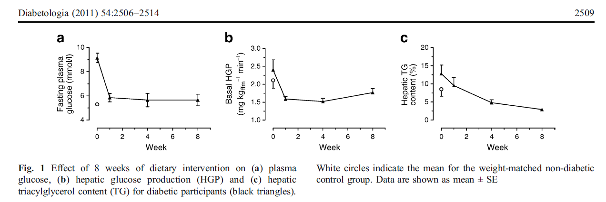

Slide 19
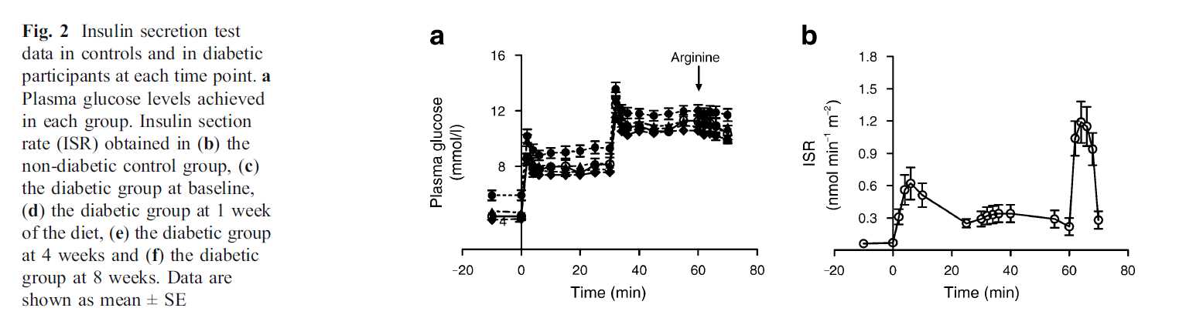
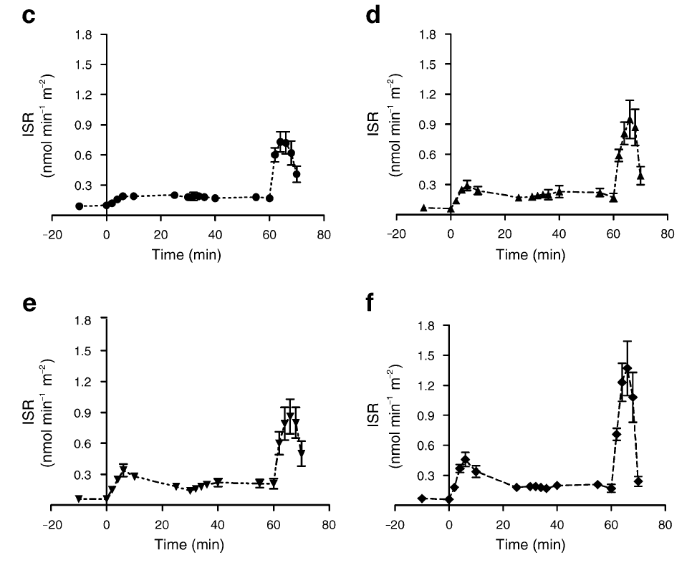

Slide 20
Ginseng

Slide 21
Ginseng
Mayo Clinic: Set up grading system based on level of scientific evidence
Key to Grades
  A –Strong scientific evidence for use
  B –Good scientific evidence for use
  C –Unclear scientific evidence for use
  D –Fair scientific evidence for use
  F Strong scientific evidence against this use

Slide 22
Ginseng Claims Grades
Health Claim | Grade | Basis
Mental Performance | B | Several studies show modest improvement in thinking and learning w/ doses of 200-400mg
Type 2 Diabetes | B | May lower bg levels in fasting and postprandial states.
Cancer prevention | C | Small # of studies oral ginseng intakes may <risk of various cancers, mostly preliminary studies, all done by same research group
Exercise performance | C | mixed results in published studies
Fatigue | C | Preliminary results show improvement in pts with fatigue of various causes, future research for pts with moderate fatigue may be of value
Immune system enhancement | C | Small # of studies show stimulation of immune cells, all research done by same lead author,

Slide 23
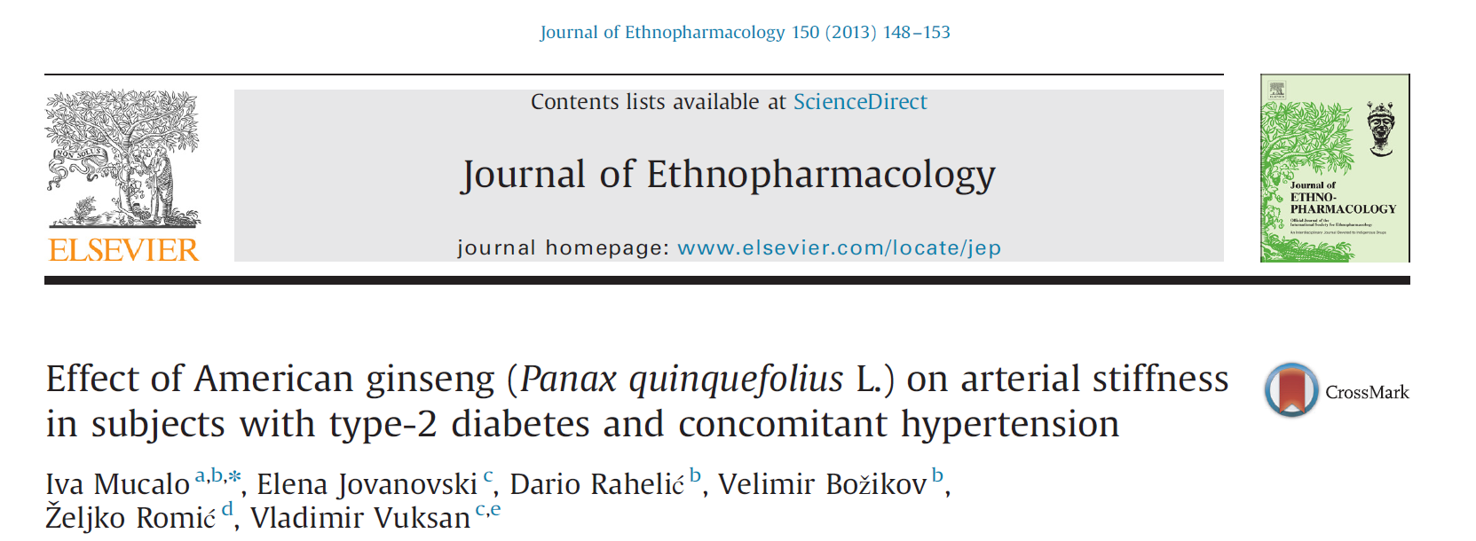
“Results: 64 individuals with well-controlled essential hypertension and type 2 diabetes
Compared to placebo, 3 g of American ginseng (AG) significantly lowered radial augmentation index by 5.3% (P¼0.041) and systolic BP by 11.7% (Po0.001) at 12 weeks.
Conclusions: Addition of AG extract to conventional therapy in diabetes with concomitant hypertension improved arterial stiffness and attenuated systolic BP…”

Slide 24
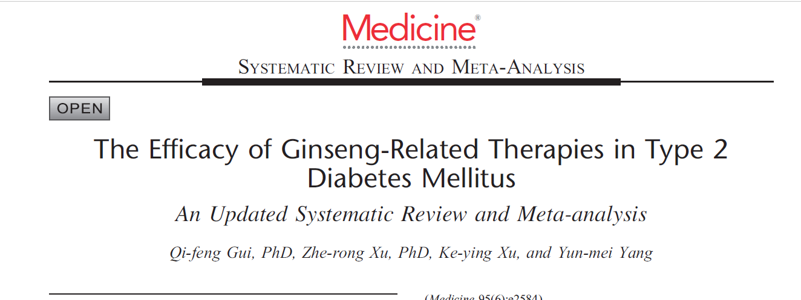
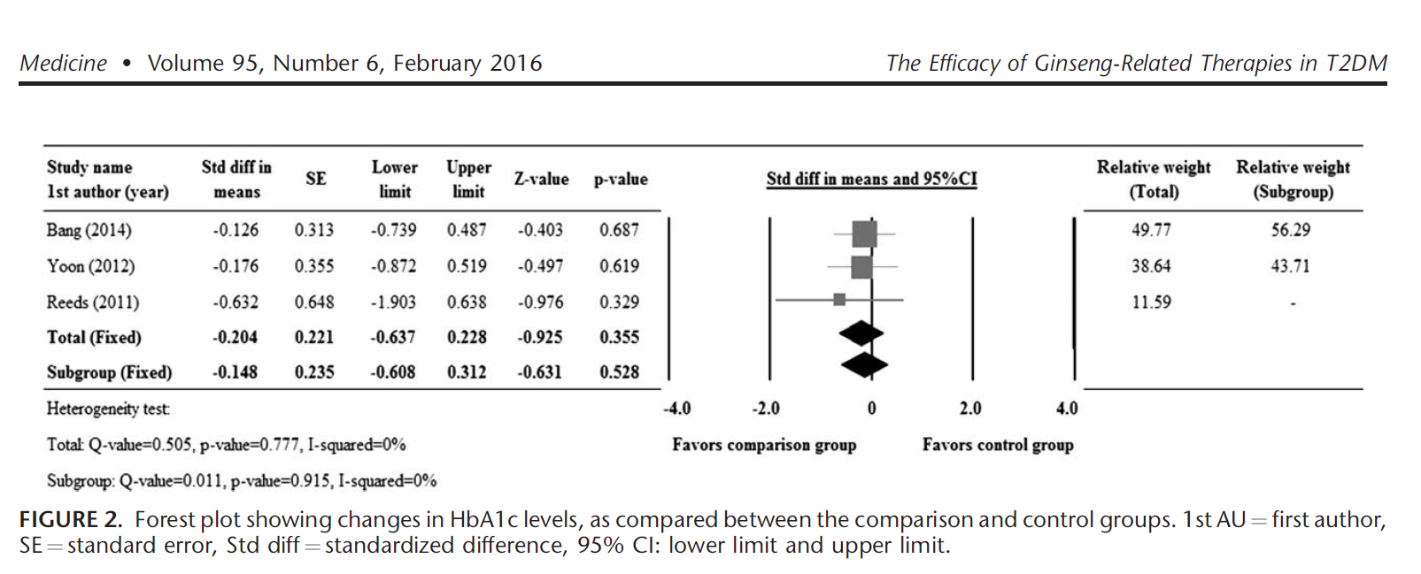
“Ginseng supplementation improved fasting glucose, postprandial insulin, and HOMA-IR levels, though no difference in postprandial glucose or fasting insulin was observed among the groups.”
2015

Slide 25
Curcumin

Slide 26
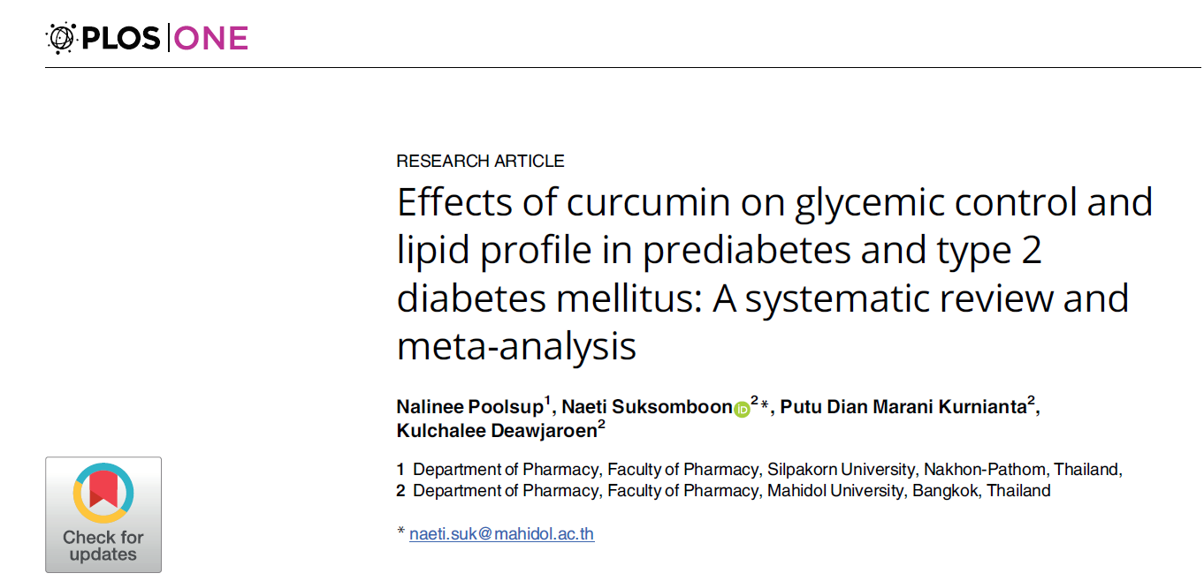

Slide 27
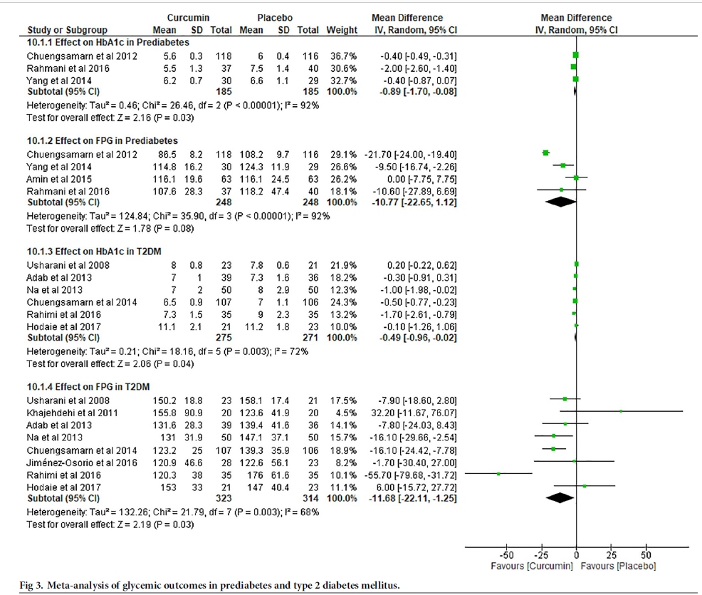
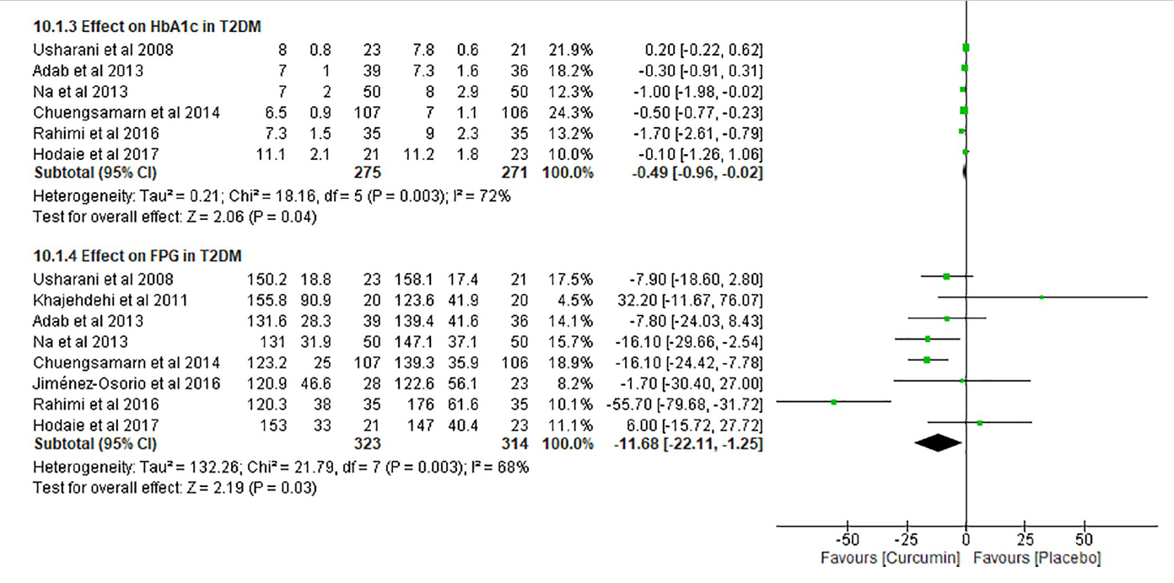

Slide 29
Ginger

Slide 30
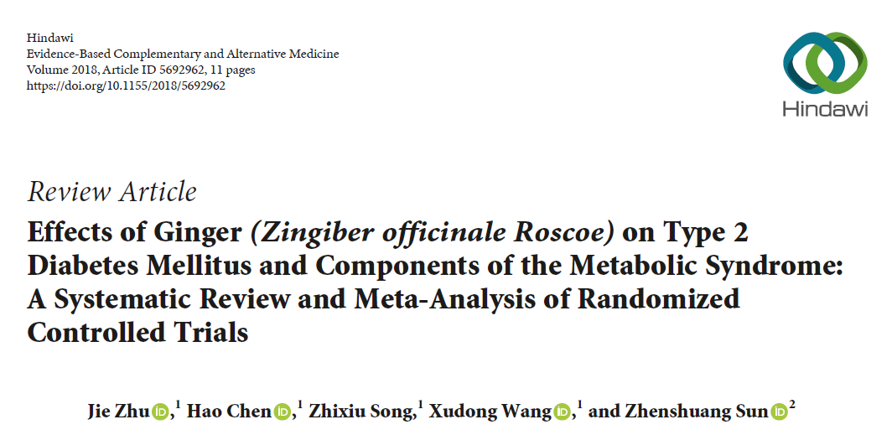
2018

Slide 31
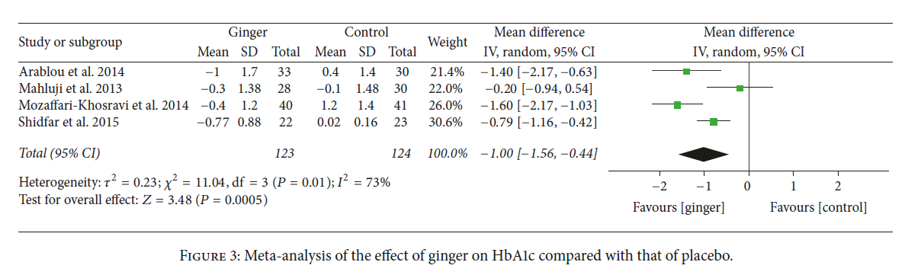

Slide 32
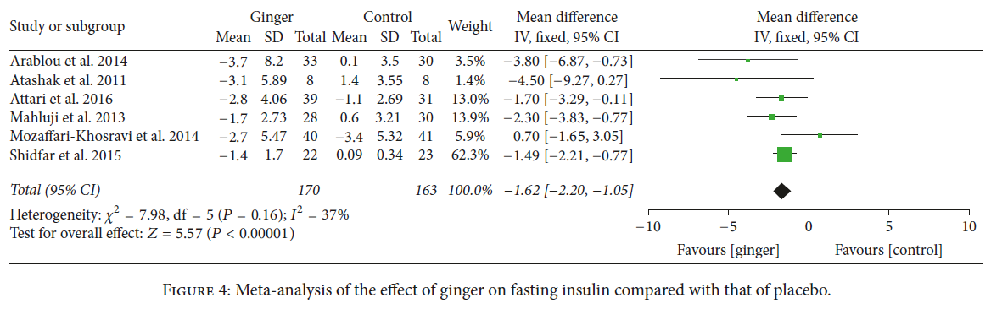
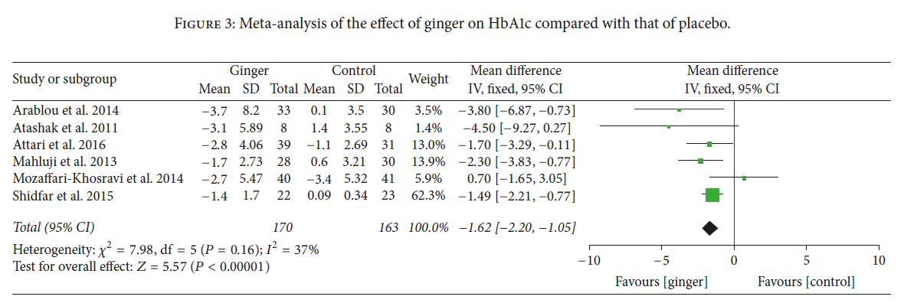

Slide 33
Cinnamon

Slide 34
Cinnamon – True Ceylon Cinnamon
Arthritis – Reduces uric acid production
Heart Health – reduce lipids/platelet adhesion
Type 2 Diabetes – lower blood glucose
Blood Pressure – Reduced blood pressure

Slide 35
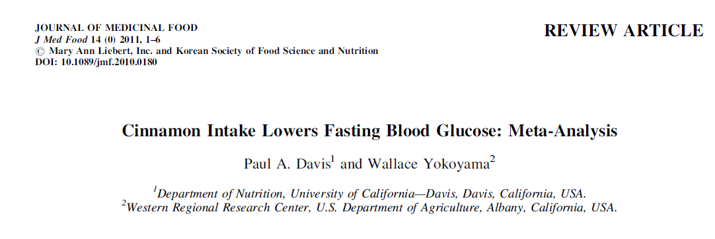

Slide 36
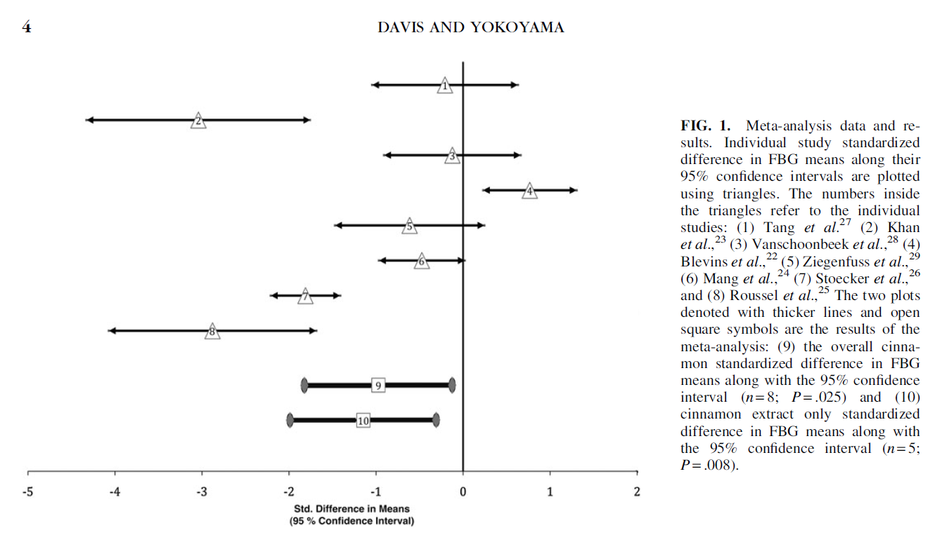

Slide 37
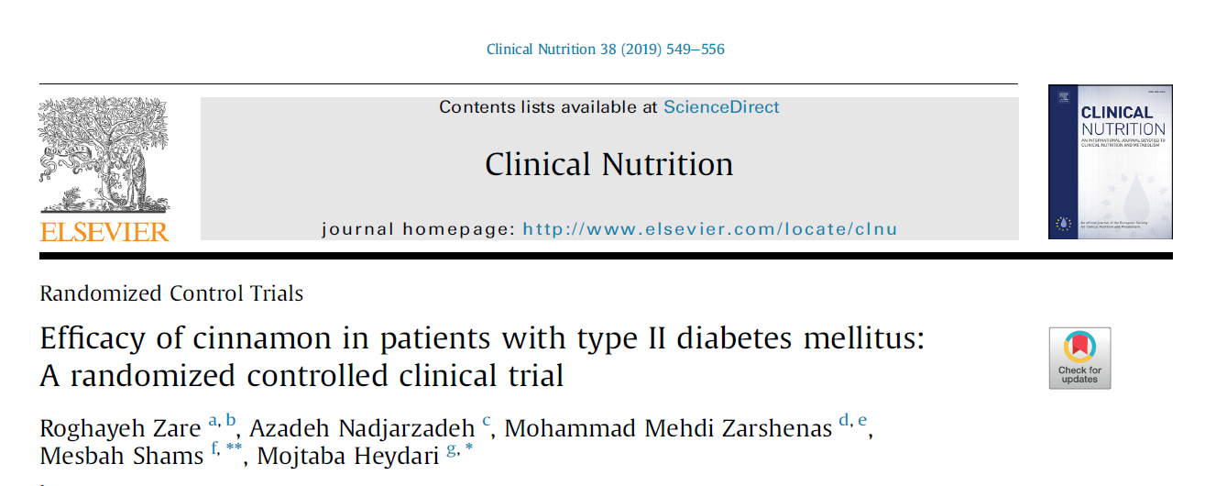

Slide 38
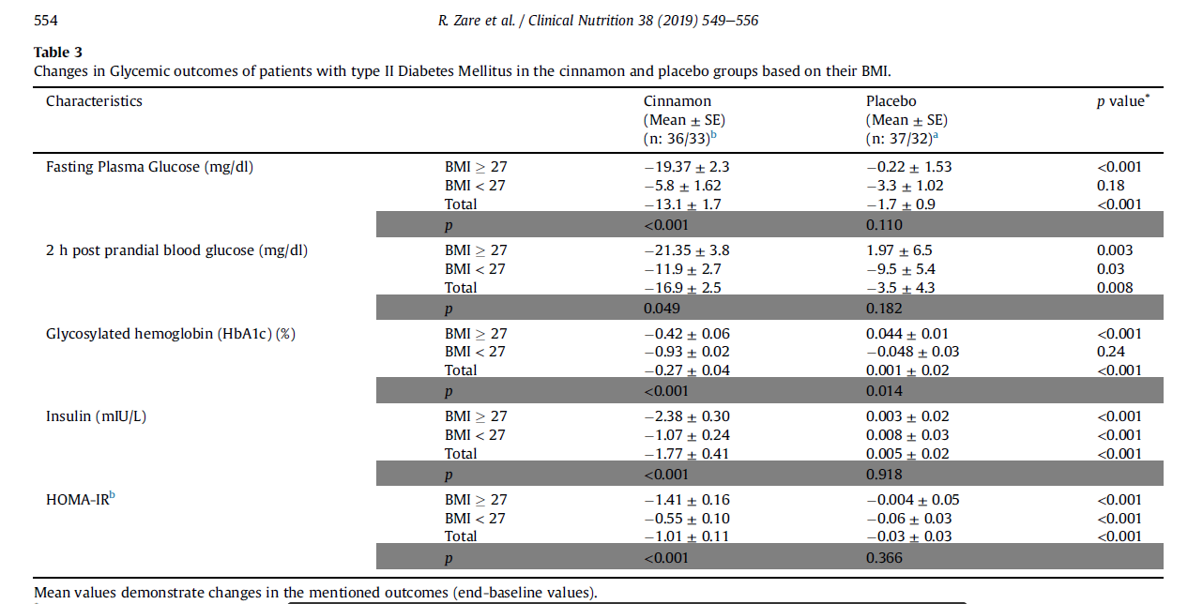

Slide 39
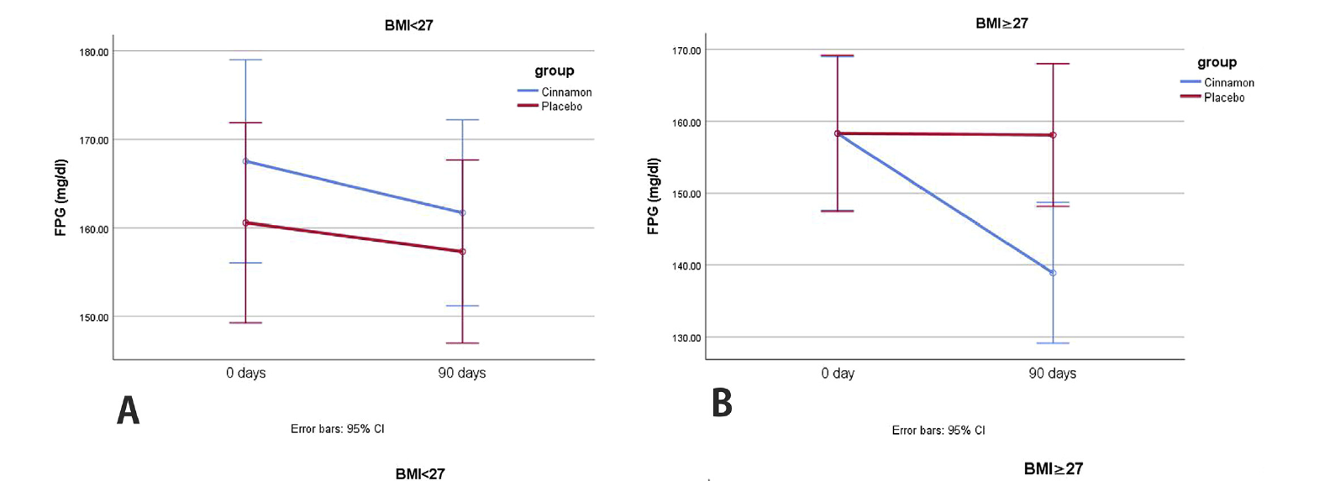

Slide 40
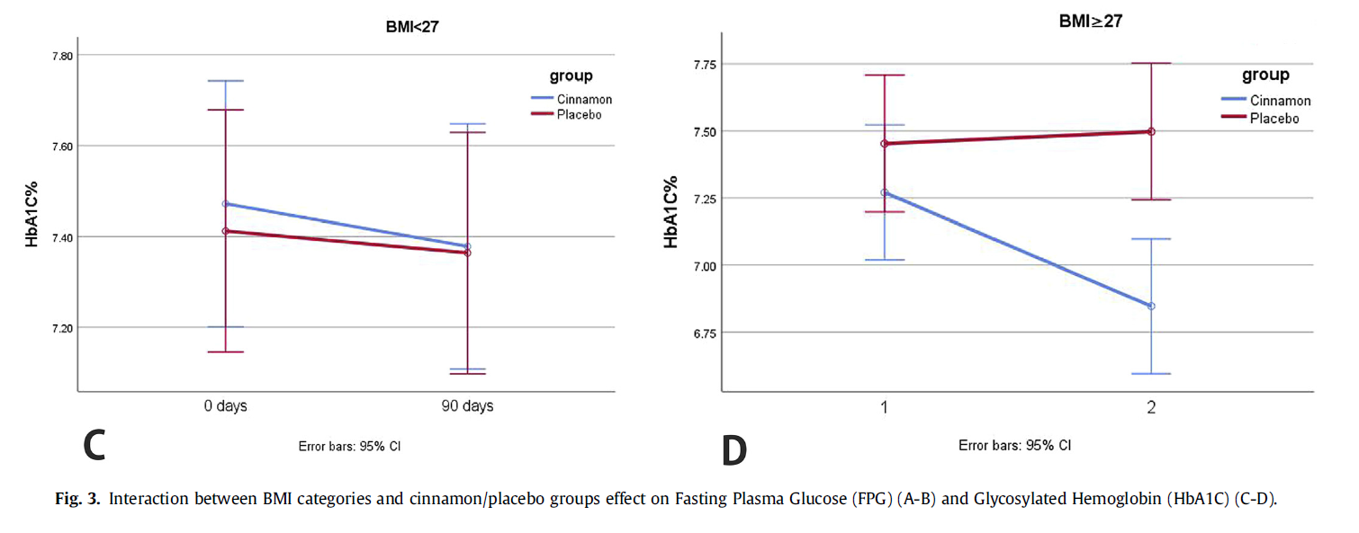

Slide 42
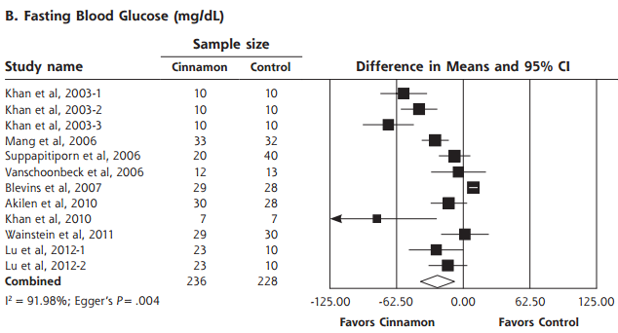
Meta-analysis: Cinnamon & A1C
Allen, R. W., Schwartzman, E., Baker, W. L., Coleman, C. I., & Phung, O. J. (2013). Cinnamon Use in Type 2 Diabetes: An Updated Systematic Review and Meta-Analysis. Annals Of Family Medicine, 11(5), 452-459. doi:10.1370/afm.1517
Notes:
Forest plot depicting the meta-analyses results of randomized controlled trials evaluating
cinnamon on serum levels of fasting blood glucose.
CONCLUSIONS The consumption of cinnamon is associated with a statistically significant decrease in levels of fasting plasma glucose, total cholesterol, LDL-C, and triglyceride levels, and an increase in HDL-C levels; however, no significant effect on hemoglobin A1c was found. The high degree of heterogeneity may limit the ability to apply these results to patient care, because the preferred dose and duration of therapy are unclear.

Slide 43
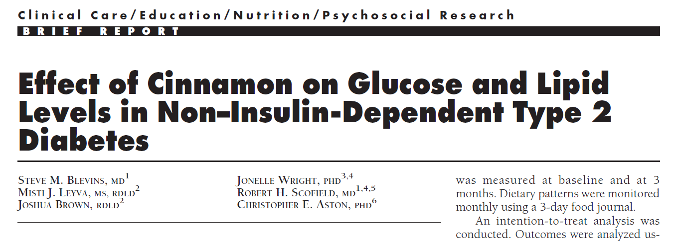
2007
“This is the first U.S. study to evaluate the effects of cinnamon on blood glucose … with type 2 diabetes.
We found that cinnamon taken at a dose of 1 g daily for 3 months produced no significant change in fasting glucose.”

Slide 44
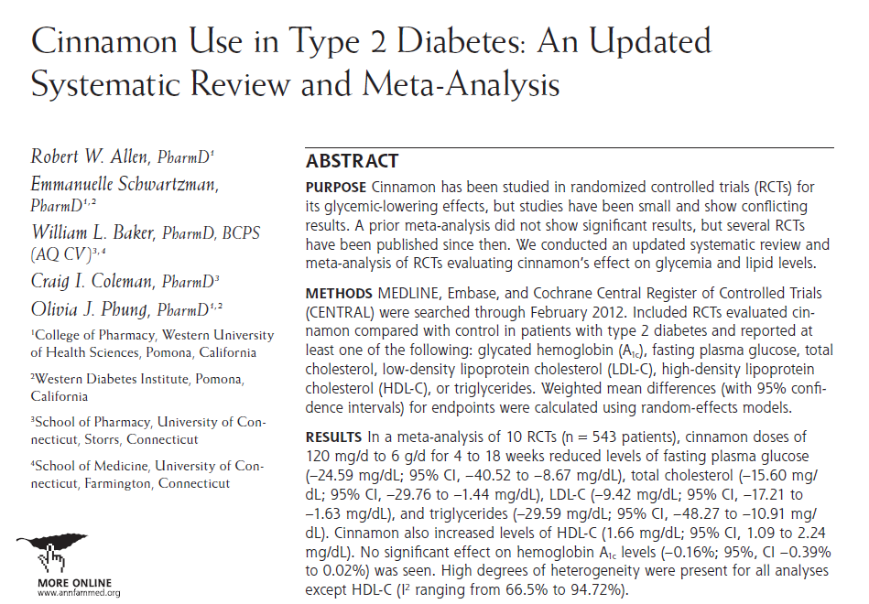
2013

Slide 45
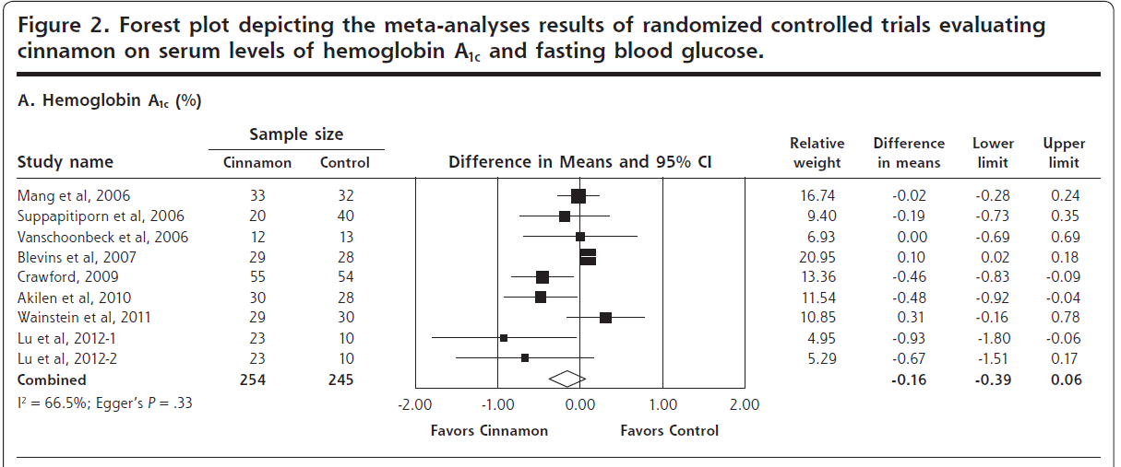

Slide 46
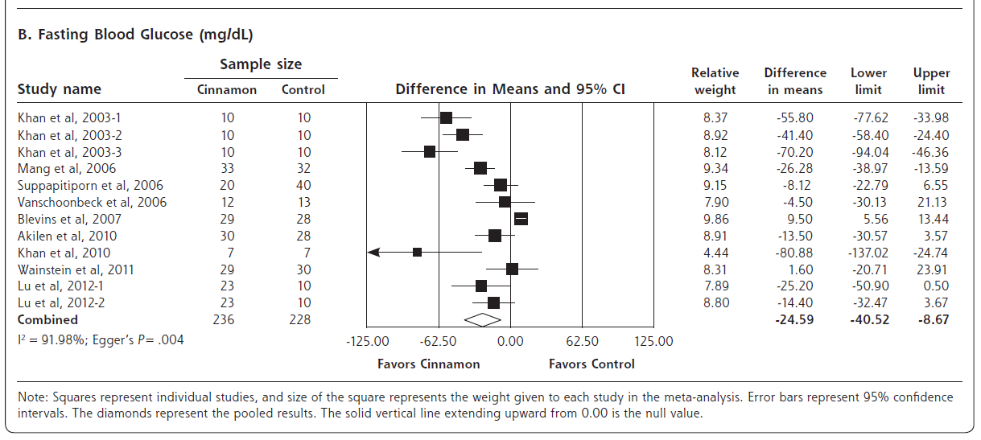

Slide 47
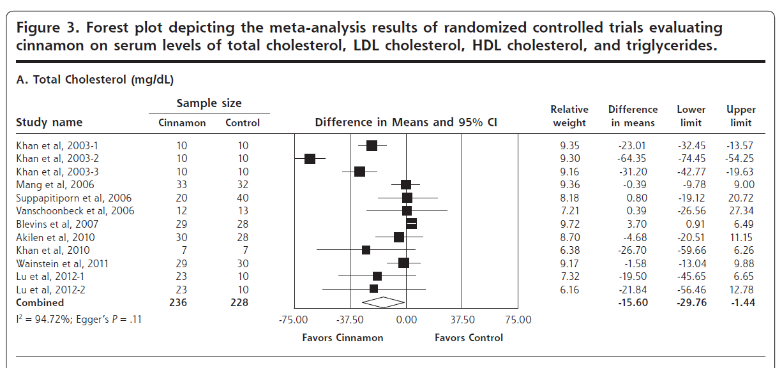

Slide 48
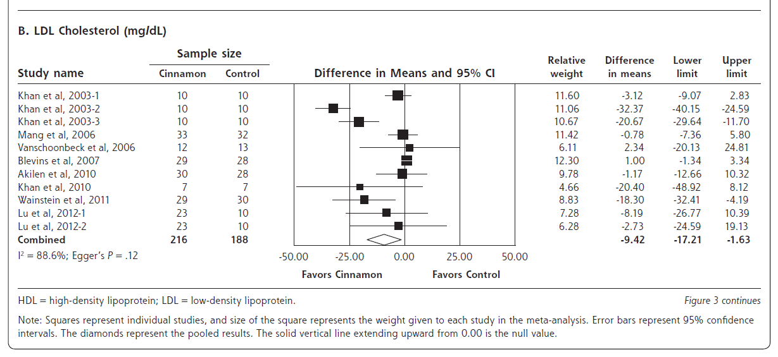

Slide 49
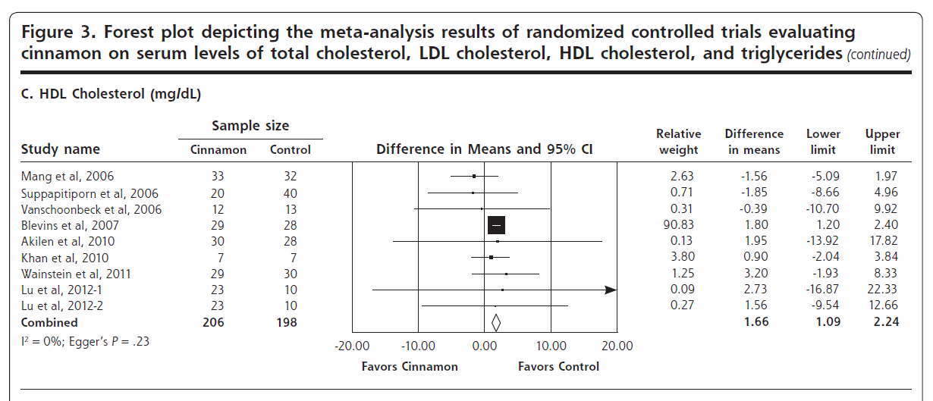

Slide 50
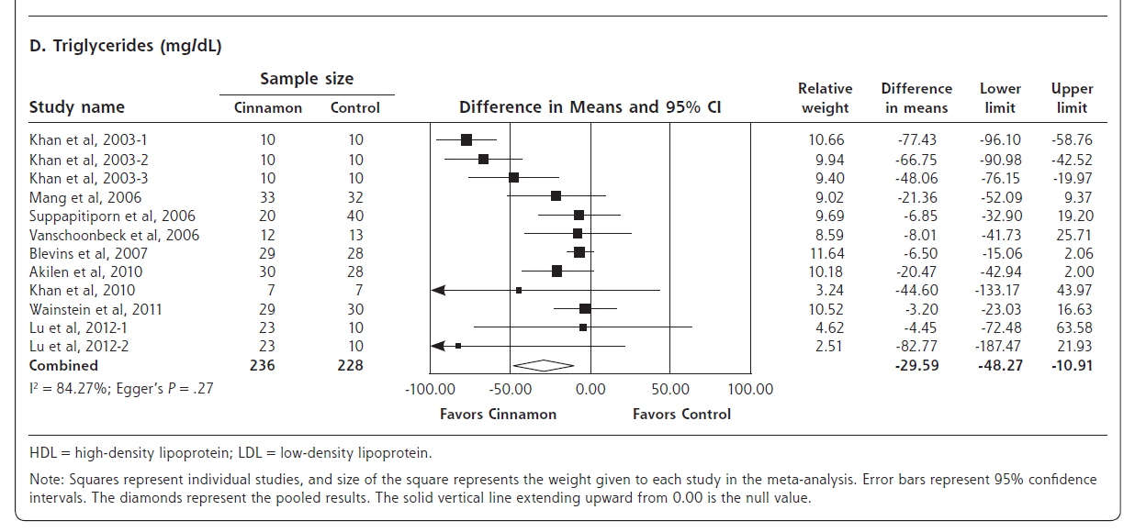

Slide 51
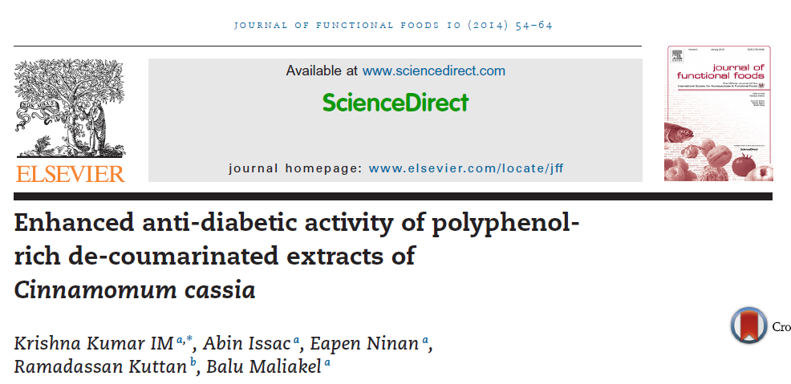
2014

Slide 52
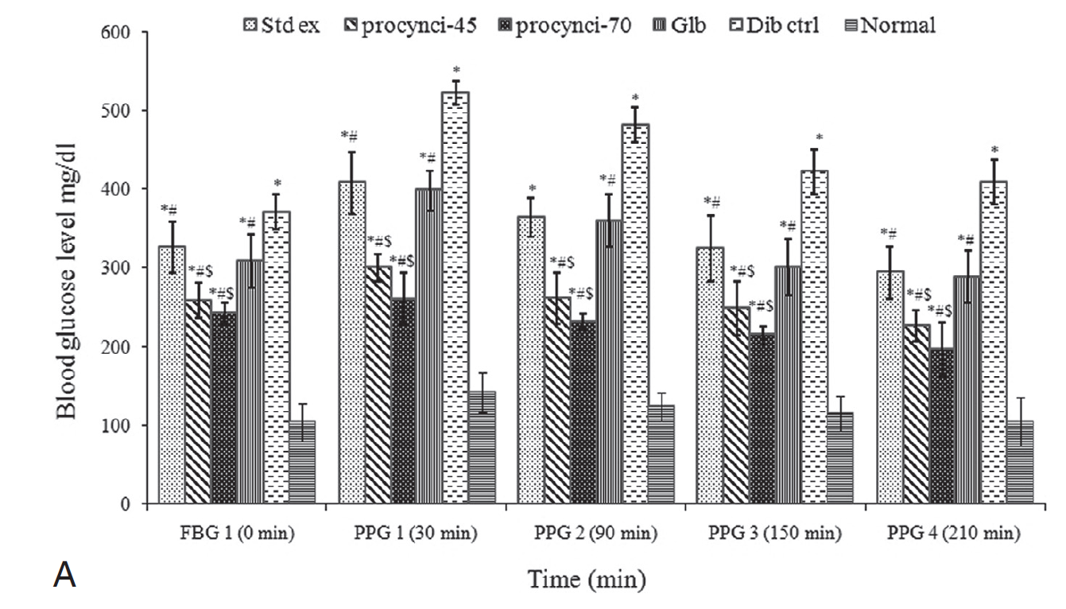
glibenclamide
FBG and PPG levels of diabetic rats after 30 days of cinnamon polyphenol extract administration. Values are expressed as the mean ± SD, n = 6 in each group; where P < 0.05 significantly different from *normal group; #diabetic control and $standard extract group.
Notes:
glibenclamide

Slide 53
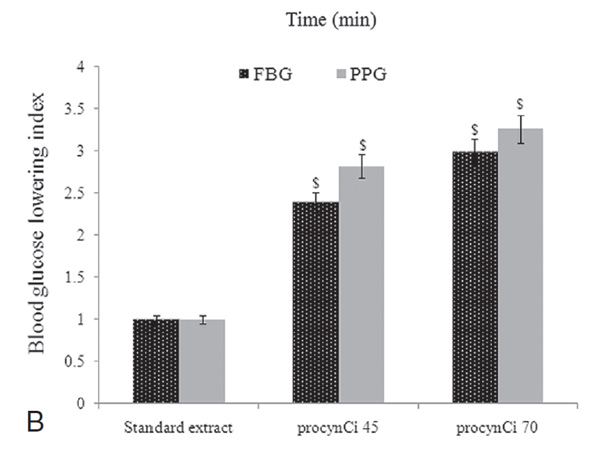
The relative blood sugar lowering efficacy of de-coumarinated polyphenol-rich extracts (procynCi-45 and procynCi-70) after 30 days of oral supplementation; which is depicted with respect to standard cinnamon extract containing 17.4% polyphenol as ‘blood sugar lowering index’ of the various extracts. Values are expressed as the mean ± SD, n = 6 in each group; where P < 0.05 significantly different from *normal group, #diabetic control and $standard extract group.

Slide 54
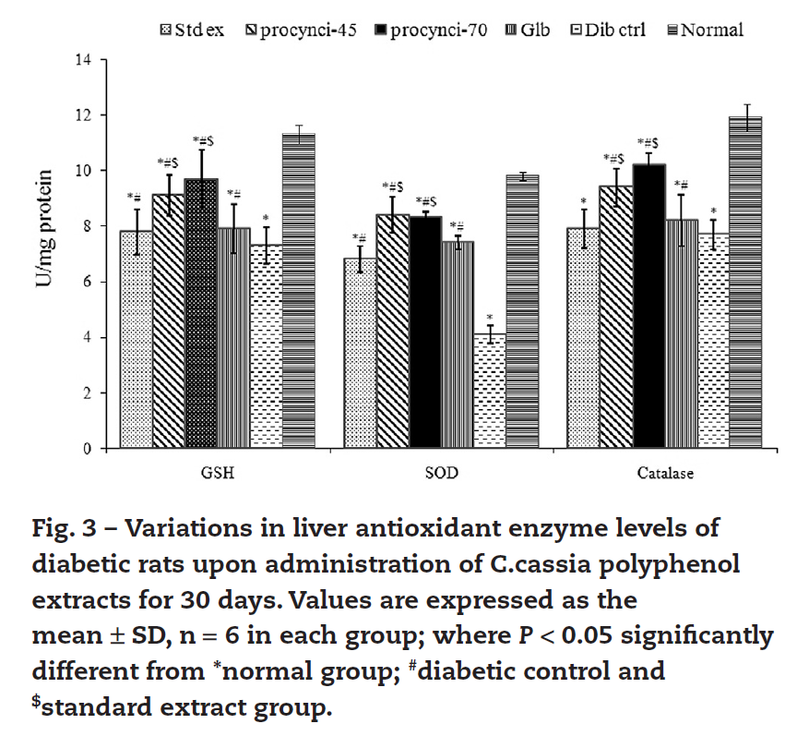

Slide 55
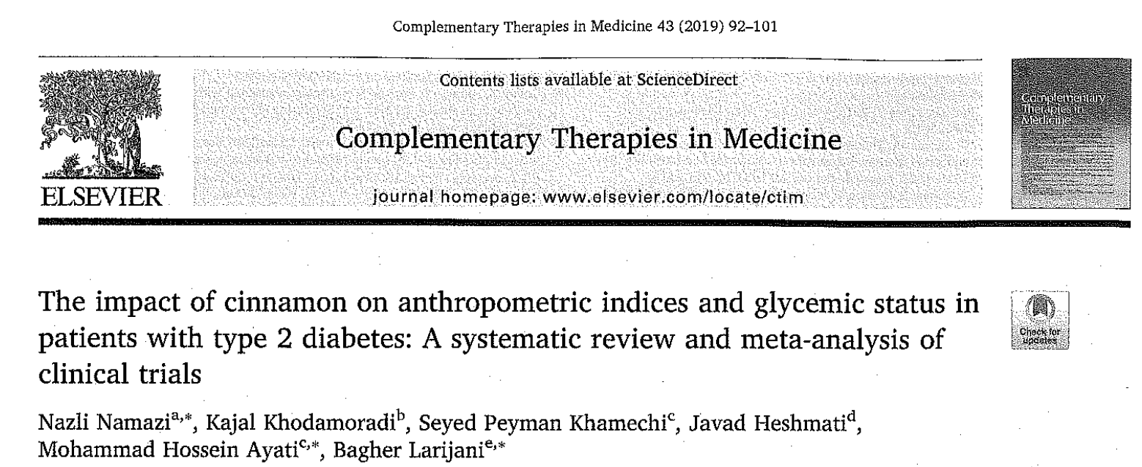

Slide 56
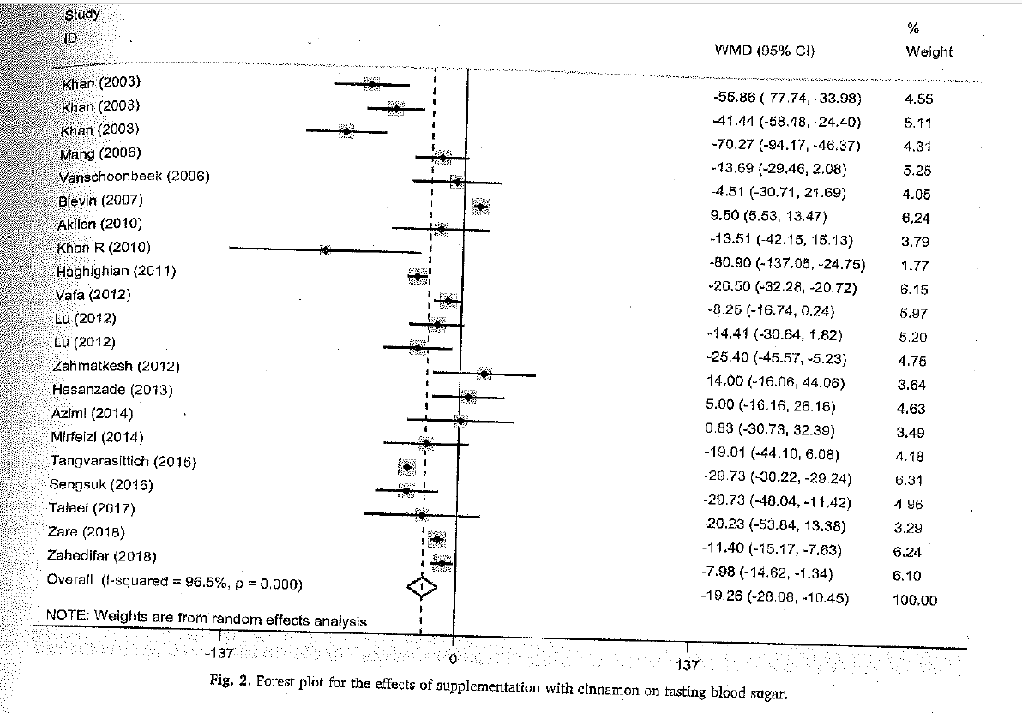

Slide 57
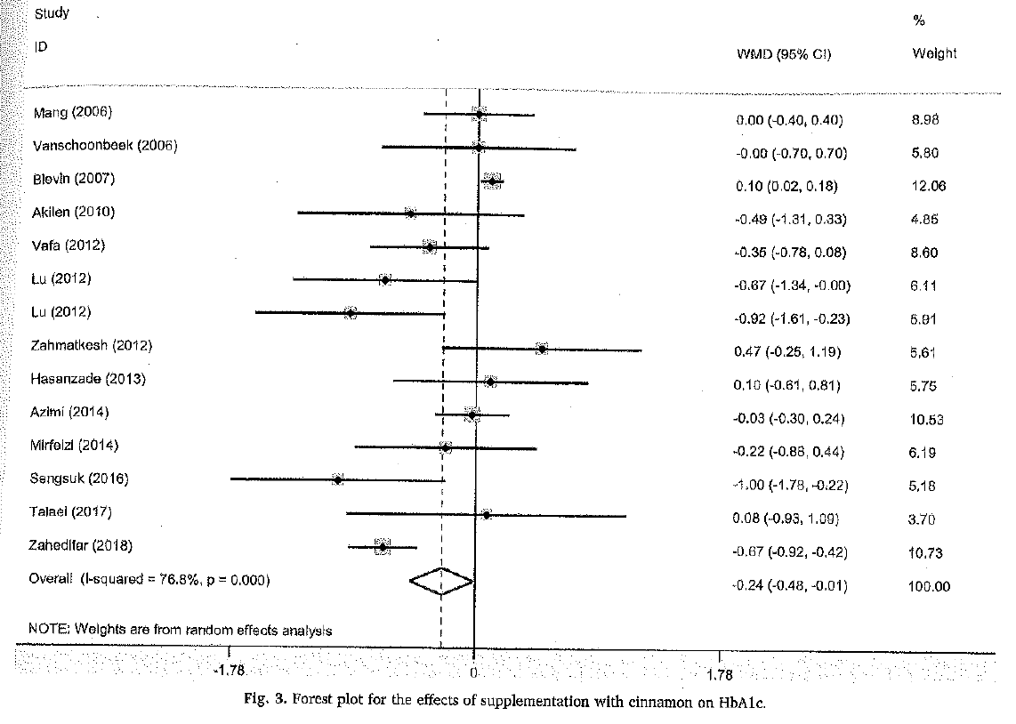

Slide 58
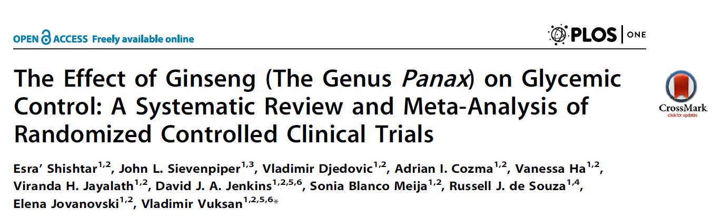

Slide 59
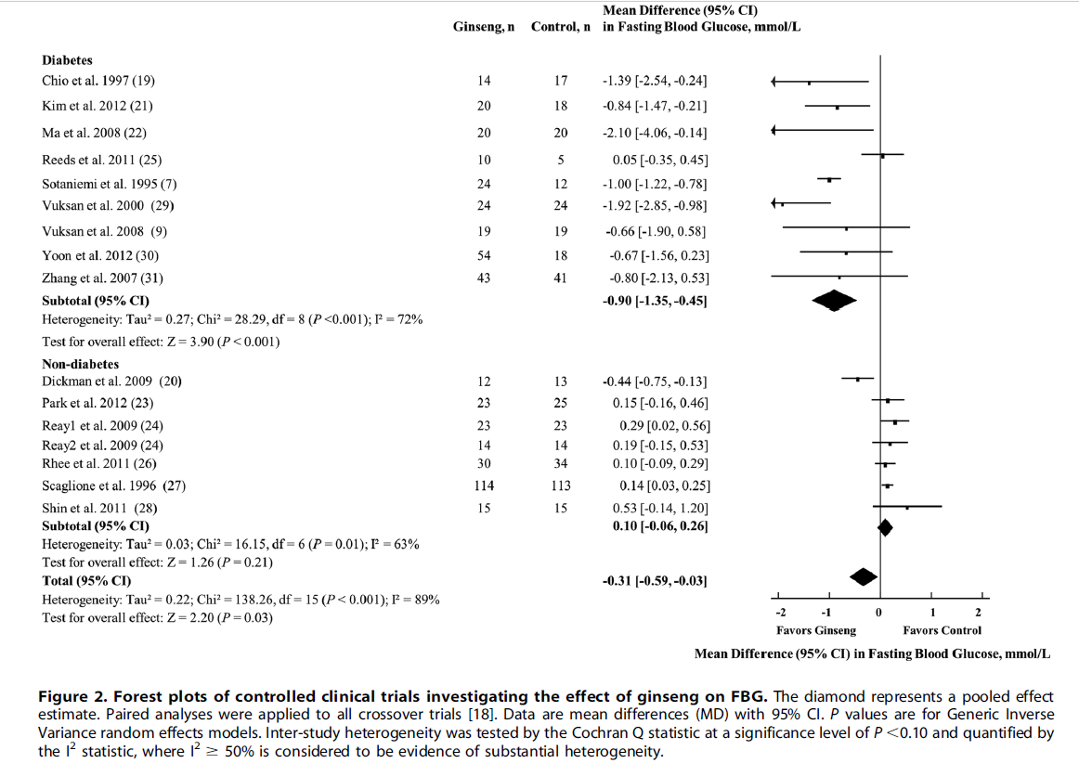

Slide 60
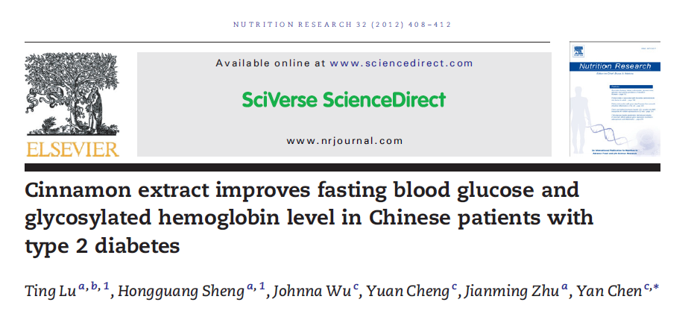

Slide 61
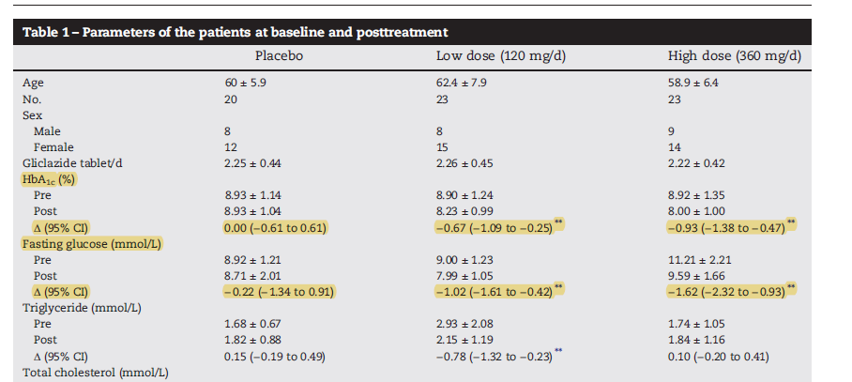

Slide 62
Berberine

Slide 63
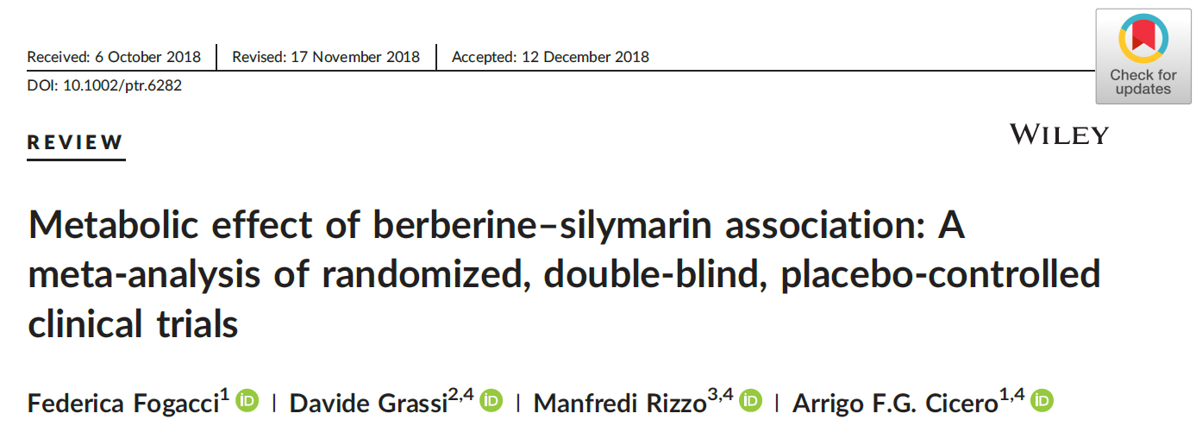

Slide 64

Notes:
Plot showing leave‐one‐out sensitivity analysis [Colour figure can be viewed at wileyonlinelibrary.com]
IF THIS IMAGE HAS BEEN PROVIDED BY OR IS OWNED BY A THIRD PARTY, AS INDICATED IN THE CAPTION LINE, THEN FURTHER PERMISSION MAY BE NEEDED BEFORE ANY FURTHER USE. PLEASE CONTACT WILEY'S PERMISSIONS DEPARTMENT ON PERMISSIONS@WILEY.COM OR USE THE RIGHTSLINK SERVICE BY CLICKING ON THE 'REQUEST PERMISSIONS' LINK ACCOMPANYING THIS ARTICLE. WILEY OR AUTHOR OWNED IMAGES MAY BE USED FOR NON-COMMERCIAL PURPOSES, SUBJECT TO PROPER CITATION OF THE ARTICLE, AUTHOR, AND PUBLISHER.

Slide 65
Phytotherapy Research, Volume: 33, Issue: 4, Pages: 862-870, First published: 10 January 2019, DOI: (10.1002/ptr.6282)
Notes:
Plot showing leave‐one‐out sensitivity analysis [Colour figure can be viewed at wileyonlinelibrary.com]
IF THIS IMAGE HAS BEEN PROVIDED BY OR IS OWNED BY A THIRD PARTY, AS INDICATED IN THE CAPTION LINE, THEN FURTHER PERMISSION MAY BE NEEDED BEFORE ANY FURTHER USE. PLEASE CONTACT WILEY'S PERMISSIONS DEPARTMENT ON PERMISSIONS@WILEY.COM OR USE THE RIGHTSLINK SERVICE BY CLICKING ON THE 'REQUEST PERMISSIONS' LINK ACCOMPANYING THIS ARTICLE. WILEY OR AUTHOR OWNED IMAGES MAY BE USED FOR NON-COMMERCIAL PURPOSES, SUBJECT TO PROPER CITATION OF THE ARTICLE, AUTHOR, AND PUBLISHER.

Slide 66


Slide 67


Slide 68


Slide 69

2012

Slide 70

Berberine with lifestyle modification versus lifestyle modification alone or plus placebo

Slide 71

Berberine with lifestyle modification versus lifestyle modification alone or plus placebo

Slide 72
Berberine with Lifestyle Modification Versus Lifestyle Modification Alone or Plus Placebo

Slide 73

Berberine with Lifestyle Modification Versus Lifestyle Modification Alone or Plus Placebo

Slide 74

Berberine vs. Oral Hypoglycemics

Slide 75

Berberine vs. Oral Hypoglycemics

Slide 76

Berberine vs. Oral Hypoglycemics

Slide 77

Berberine vs. Oral Hypoglycemics

Slide 78

Berberine Combined with Oral Hypoglycemics vs. the Same Hypoglycemics

Slide 79

Berberine Combined with Oral Hypoglycemics vs. the Same Hypoglycemics

Slide 80

2013

Slide 81


Slide 82


Slide 83


Slide 84


Slide 85


Slide 86


Slide 87

Mono-therapeutic Effects Of Metformin and Berberine

Slide 88
Ayurvedic Formulation

Slide 89

Contains: Gallic Acid, berberine, quercetin

Slide 90


Efficacy of Polyherbal Formulation in Comparison to Metformin after a 6 Month Study

Slide 91
Additional References
Natural Medicines Comprehensive Database: www.naturaldatabase.com
Natural Standard Database: www.naturalstandard.com
National Toxicology Program: http://ntp.niehs.nih.gov/

Slide 92






Thank You!

Slide 93
Questions?
Thank you!
jimpainterphd@gmail.com
@DrJimPainter

