Slide 1


Slide 2



Natalie Blum
MPH
The National DPP working toward equal access for all populations at high risk for type 2 diabetes
Manager of Prevention
AADE
Chicago, IL

Slide 3
Disclosure to Participants
Notice of Requirements For Successful Completion
  Please refer to learning goals and objectives
  Learners must attend the full activity and complete the evaluation in order to claim continuing education credit/hours
Conflict of Interest (COI) and Financial Relationship Disclosures:
  Presenter: Natalie Blum, MPH- No COI/Financial Relationship to disclose
  Presenter: Pamela Price, BS- No COI/Financial Relationship to disclose
  Presenter: Angela F. Ford, PhD, MSW, Certificate in Gerontology– No COI/Financial Relationship to disclose
  Presenter: LaQuisha Umemba, MPH, BSN, RN, CDE - No COI/Financial Relationship to disclose
Non-Endorsement of Products:
  Accredited status does not imply endorsement by AADE, ANCC, ACPE or CDR of any commercial products displayed in conjunction with this educational activity
Off-Label Use:
  Participants will be notified by speakers to any product used for a purpose other than for which it was approved by the Food and Drug Administration.

Slide 4
Health Equity Among African Americans in Diabetes Prevention
The National DPP working toward equal access to the lifestyle change program for all populations at high risk for type 2 diabetes
Review best practices for working with faith-based partners and creating culturally relevant educational materials
Discuss lessons learned on addressing the growing health disparities for women of color
Describe experience engaging and providing quality DPP programming tailored to African American populations
Notes:
Recognize that under-enrollment for priority populations in prevention programs could exacerbate health disparities
Identify ways to address the infrastructure gaps and increase DPP providers to prevent health disparities
Recognize how to deliver DPP that is adapted to the unique needs of African Americans

Slide 5

40.7 Million people in the United States identify as African American
  12.7% of nation’s total population
African American audiences represent a blend of cultures and traditions that reflect their diversity, rich history and ongoing ethnic adaptations
Notes:
African Americans are the second largest minority population, Some of the fastest growing segments of our population are, in fact, from communities of color. It is very clear that the demographics of this country are changing rapidly.
The population incorporates cultural influence from Africa, the Caribbean, Latin America, Europe and North America.
Over time, the audience has created a unique culture that is ever-evolving, and both forward-thinking and reflective.

Slide 6
Diabetes Epidemic in African American Communities
More than 2.8 million African Americans have diabetes
  12.7% percent of African Americans 18 or older have diabetes
  1.8 times as likely to have diabetes as non-Hispanic whites
African Americans are more likely to have complications from type 2 diabetes
Notes:
NIDDK. National Diabetes Statistics fact sheet. HHS. NIH. 2005.
For African Americans this is a major problem because a fairly high percentages of African Americans have diabetes and they are about twice as likely to develop diabetes as are non-Hispanic whites.
In addition to shorter life span, African Americans with diabetes suffer from many preventable complications such as amputations, end-stage renal disease, blindness, hospitalizations

Slide 7
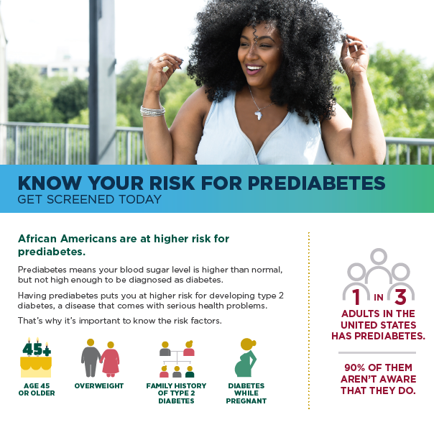
Who is at Risk for Prediabetes and Type 2 Diabetes?
An estimated 84.1 million U.S. adults have prediabetes
36% of African Americans have prediabetes
  Of those, only 10.5% are aware that they have the disease
Notes:
Having prediabetes means your blood glucose (sugar) levels are higher than normal—but not high enough to be diagnosed as diabetes. Prediabetes can lead to heart disease, stroke, and type 2 diabetes, the most common form of diabetes. Prediabetes can often be reversed.
African Americans and other priority populations are at particularly high risk for type 2 diabetes
You may be at higher risk than others for prediabetes, if you are:
Overweight.
45 years of age or older.
Have a parent or sibling has type 2 diabetes.
Are physically active fewer than 3 times per week.
Ever gave birth to a baby that weighed more than 9 pounds.
Ever had diabetes while pregnant (gestational diabetes).
Diabetes places a heavy burden on the lives of many African Americans, and preventing its onset represents a critically important public health challenge.

Slide 8
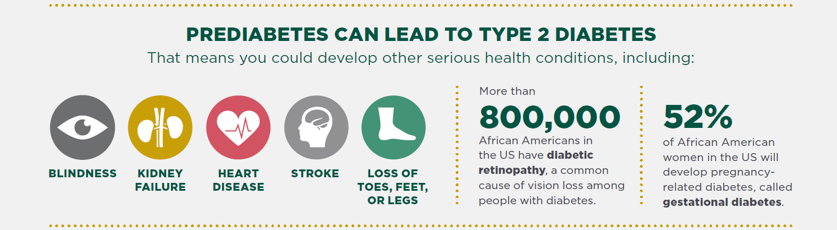
Notes:
In general, baseline A1C levels tended to run higher in the communities of color compared with the white population. This tells us that there are forces at work that are driving poorer outcomes in these communities, which are then adversely affected by higher prevalence rates of diabetes.
A1C levels are higher among U.S. racial and ethnic minority groups with IGT after adjustment for factors likely to affect glycemia. Among patients with IGT, A1C maynotbevalidforassessingandcomparingglycemiccontrolacrossracialandethnicgroupsor as an indicator of health care disparities.

Slide 9
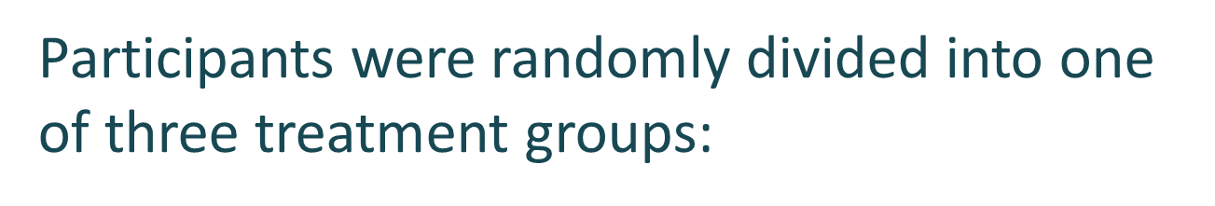
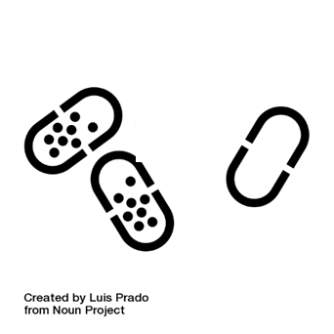
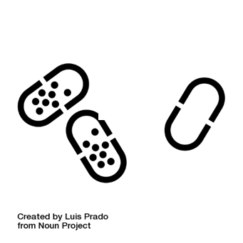
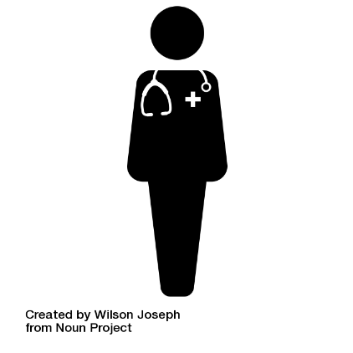
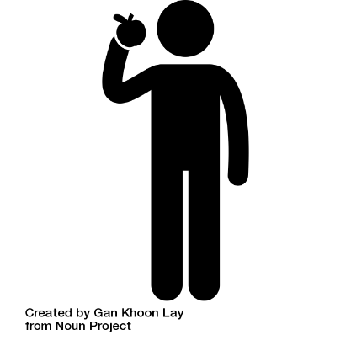
Diabetes Prevention Program
Medication (metformin 850 mg/twice daily)
Placebo with brief lifestyle counseling
Intensive one-on-one lifestyle modification program
Notes:
DPP Research Study (1996-1999) with more than 3000 participants
45% were from priority populations* with an increased risk of developing Type 2 diabetes
The Results from the study showed that this structured lifestyle change program had the largest impact!, participants achieved weight loss of 5 to 7 percent of their body weight and reduced the risk of developing type 2 diabetes by 58 percent. The medication group was also successful but only saw 31% reduction. Thus, Metformin was only about half as effective as making lifestyle changes.
The other interesting findings was that the outcomes were the same across all ethnic groups, socioeconomic statuses, men and women. However, for those 60+ it reduced there risk by 71%.
The Diabetes Prevention Program (DPP) was a major multicenter clinical research study that tried to find out whether losing some weight through improving diet and increasing physical activity, or taking the diabetes drug metformin, could prevent or delay type 2 diabetes in study participants.
After approximately 3 years of the DPP trial, the researchers found that the Lifestyle Intervention group sharply reduced their chances of developing diabetes. Overall, the Lifestyle group reduced their risk by 58% compared to the placebo group.
This finding held true for all participants, regardless of gender, age, race, or socioeconomic status.
For participants age 60 and older, the findings were even more dramatic – they reduced their risk by 71%

Slide 10
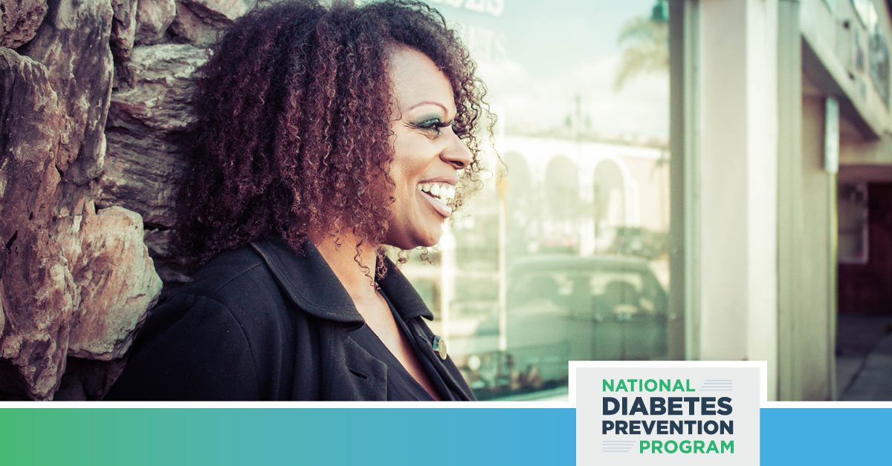
How do we reduce racial and ethnic health inequalities?
We must work together to improve our health care to make high-quality, comprehensive, affordable, and accessible programs to everyone.

Slide 11
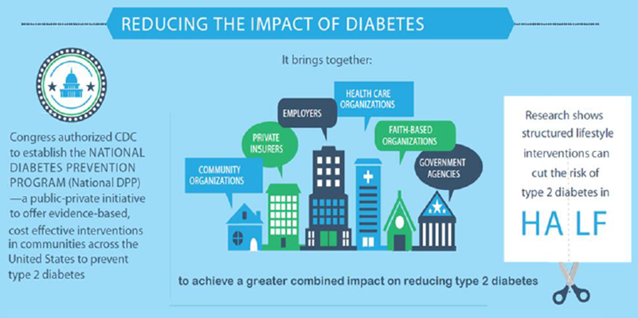
National Diabetes Prevention Program
National Diabetes Prevention program – or National DPP – is a partnership of public and private organizations working to prevent or delay type 2 diabetes.
DP17-1705 Cooperative Agreement
Priority populations have been under-enrolling relative to their disease burden and risk factors.
Expand National DPP infrastructure to close the enrollment gap
Achieve 5-7% weight loss
Reduce their risk for developing type 2 diabetes.
Notes:
Discuss 1705 grant- strong push to reach priority populations

Slide 12

Overview of the National DPP – lifestyle change program
PROGRAM GOAL: Help participants make lasting behavior changes such as eating healthier, increasing physical activity, and improving problem-solving skills
Year-long group based program:
  Phase 1- Months 1-6: 16 sessions, usually held weekly to bi-weekly (over 26 weeks)
  Phase 2- Months 7-12: monthly sessions over 6-8 months (minimum 6- at least 1 session per month )Both phase 1 and phase 2 are required for recognition and program success
Notes:
Key components of the program include:
CDC-approved curriculum with lessons, handouts, and other resources to help you make healthy changes.
A lifestyle coach, specially trained to lead the program, to help you learn new skills, encourage you to set and meet goals, and keep you motivated. The coach will also facilitate discussions and help make the program fun and engaging.
A support group of people with similar goals and challenges. Together, you can share ideas, celebrate successes, and work to overcome obstacles. In some programs, the participants stay in touch with each other during the week. It may be easier to make changes when you’re working as a group than doing it on

Slide 13
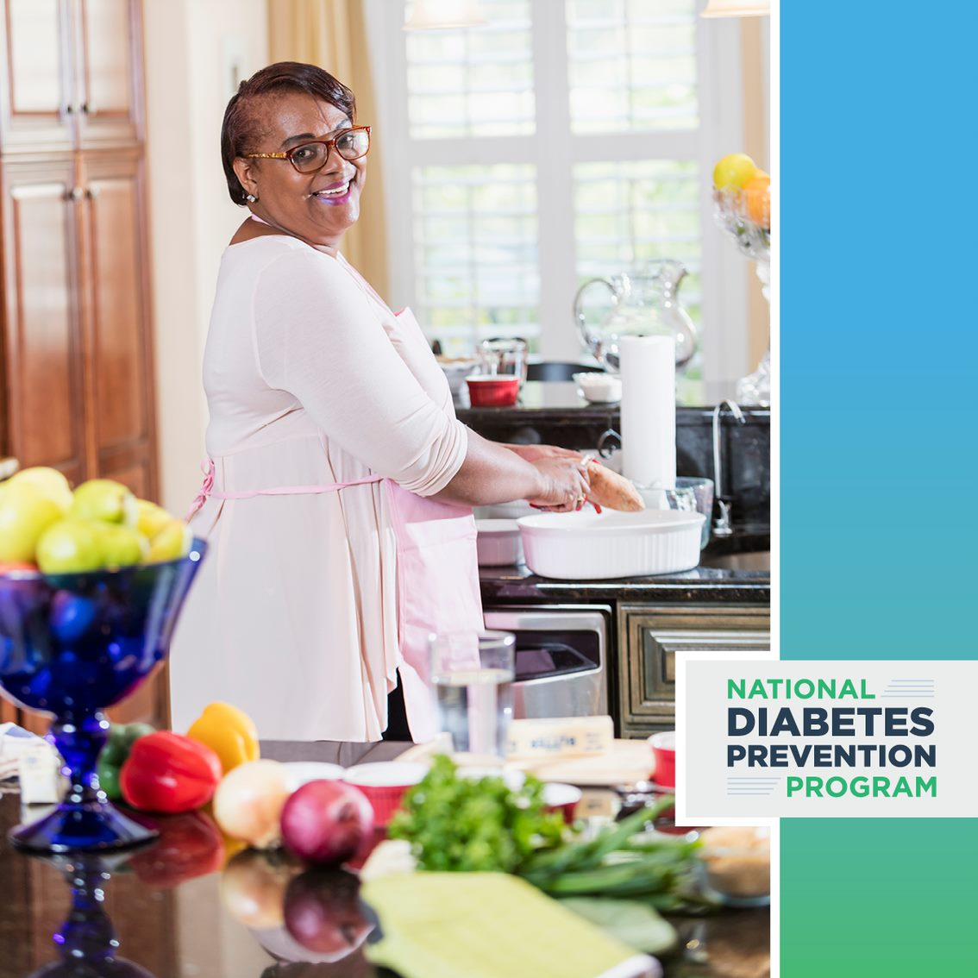
Understanding African American Audiences
Characterizes and Cultural Understanding
Education and Health Literacy
Health Behaviors
Trusted Sources and Influencers
Media Habits
Considerations for Messaging
Proven Strategies
Notes:
Effective, real-world translational research must be driven by a multifactorial approach that combines biological, cultural, social, and psychological influences.
In order to successfully engage your target audience, you must have a clear understanding of their culture, beliefs and barriers to health.
Proven strategies: including faith based outreach, focus on women's (family health gatekeepers), tailoring healthy behavior to population, leveraging community and family, marketing.

Slide 14

Pamela Price
RN, BS
Best practices for working with faith-based partners and creating culturally relevant educational materials
Public Health Deputy Director
The Balm in Gilead, Inc
Richmond, VA

Slide 15

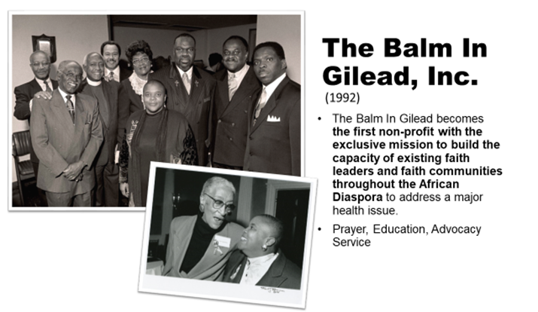
History & Mission
Celebrating 30 years of service, the mission of The Balm In Gilead is to prevent diseases and to improve the health status of people of the African Diaspora by providing support to faith and other institutions in areas of program design, implementation and evaluation which strengthens their capacity to deliver programs and services that contribute to the elimination of health disparities

Slide 16
The Balm In Gilead
Strategic Areas of Program Implementation
Mobilization
Capacity Building
Training
Resource Development
Advocacy
Evaluation

Slide 17
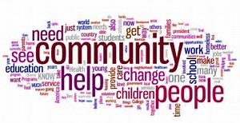
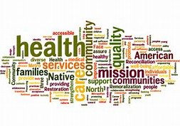
Why Do We Do This work?

Slide 18
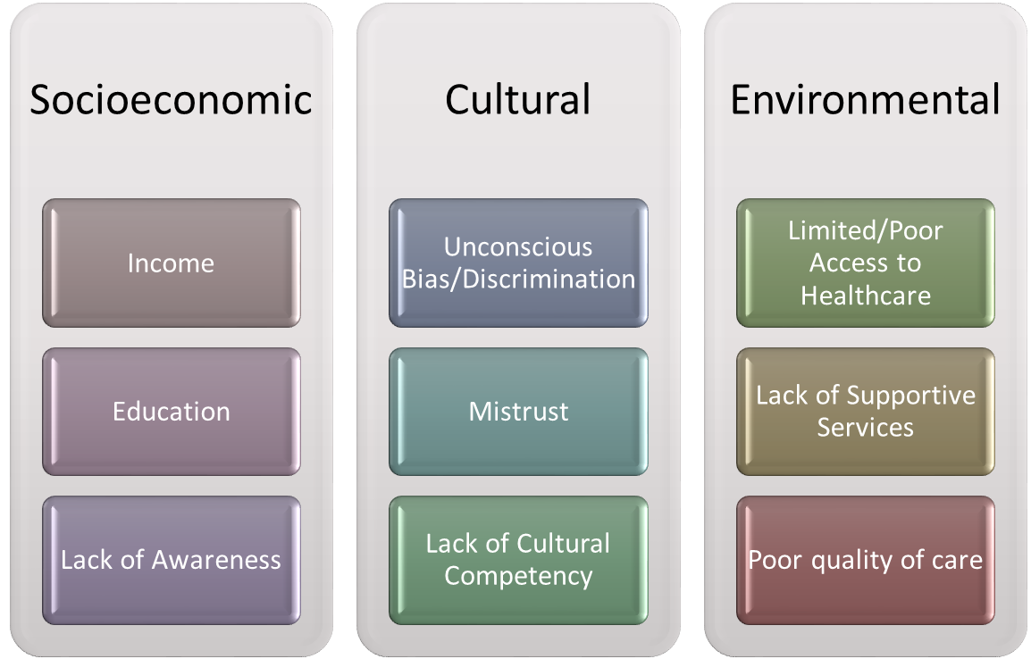
Barriers, Barriers, Barriers

Slide 19

African Americans, Faith, & Health
There is a profound relationship between faith and health, particularly in the African-American population. Studies have found that African-Americans are one of the most “religious” racial and ethnic groups in the US.

Slide 20
African Americans, Faith & Health
African Americans and Religion
  75% say religion is very important in their lives, compared to 56% among the general US population.
  More than half of African-Americans (53%) report attending religious services at least once a week, compared to 39% of the general population
  More than three quarters (76%) say they pray on at least a daily basis, compared to 58% of the general population

Slide 21
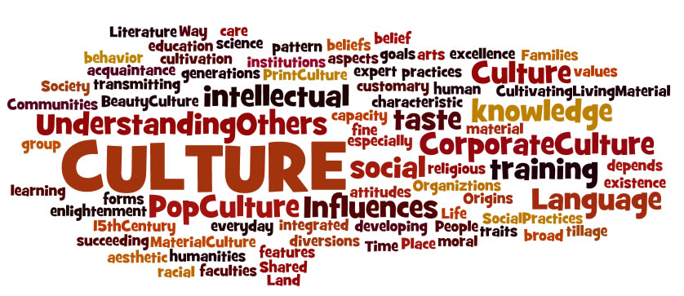
Cultural Competency = Cultural Respect

Slide 22
Why is Cultural Competency Important in Addressing Health Disparities
Cultural competence is defined as the ability of providers and organizations to effectively deliver health care services that meet the social, cultural, and linguistic needs of patients
Necessary to improve health outcomes and overall quality of care
Helps to reduce racial and ethnic health disparities
Certain aspects of culture has direct relationship to health behaviors thus impacts health statuses and risk factors associated with several chronic health conditions

Slide 23
Approaches to Culturally Appropriate Care
Comprehensive and holistic integration of cultural competency practices and policies
Cultural competency is an on-going process
Using community-participatory based approach in healthcare planning and delivery
Utilizing Community Healthcare Worker Model – this includes training and usage of faith-based healthcare coordinator and health ministry workers
Expand access to healthcare services and resources through partnerships with faith and community-based partners to increase health promotion and utilization
Intentional and meaningful diversity and inclusion of healthcare staff

Slide 24

Benefits of Faith and Community-based Partnerships
Helps to address cultural barriers to engaging with at risk and/or underserved communities
Faith and community leaders serve as “gatekeepers”
Facilitates establishment of trust and relationship with marginalized communities
Tangible, community impact

Slide 25
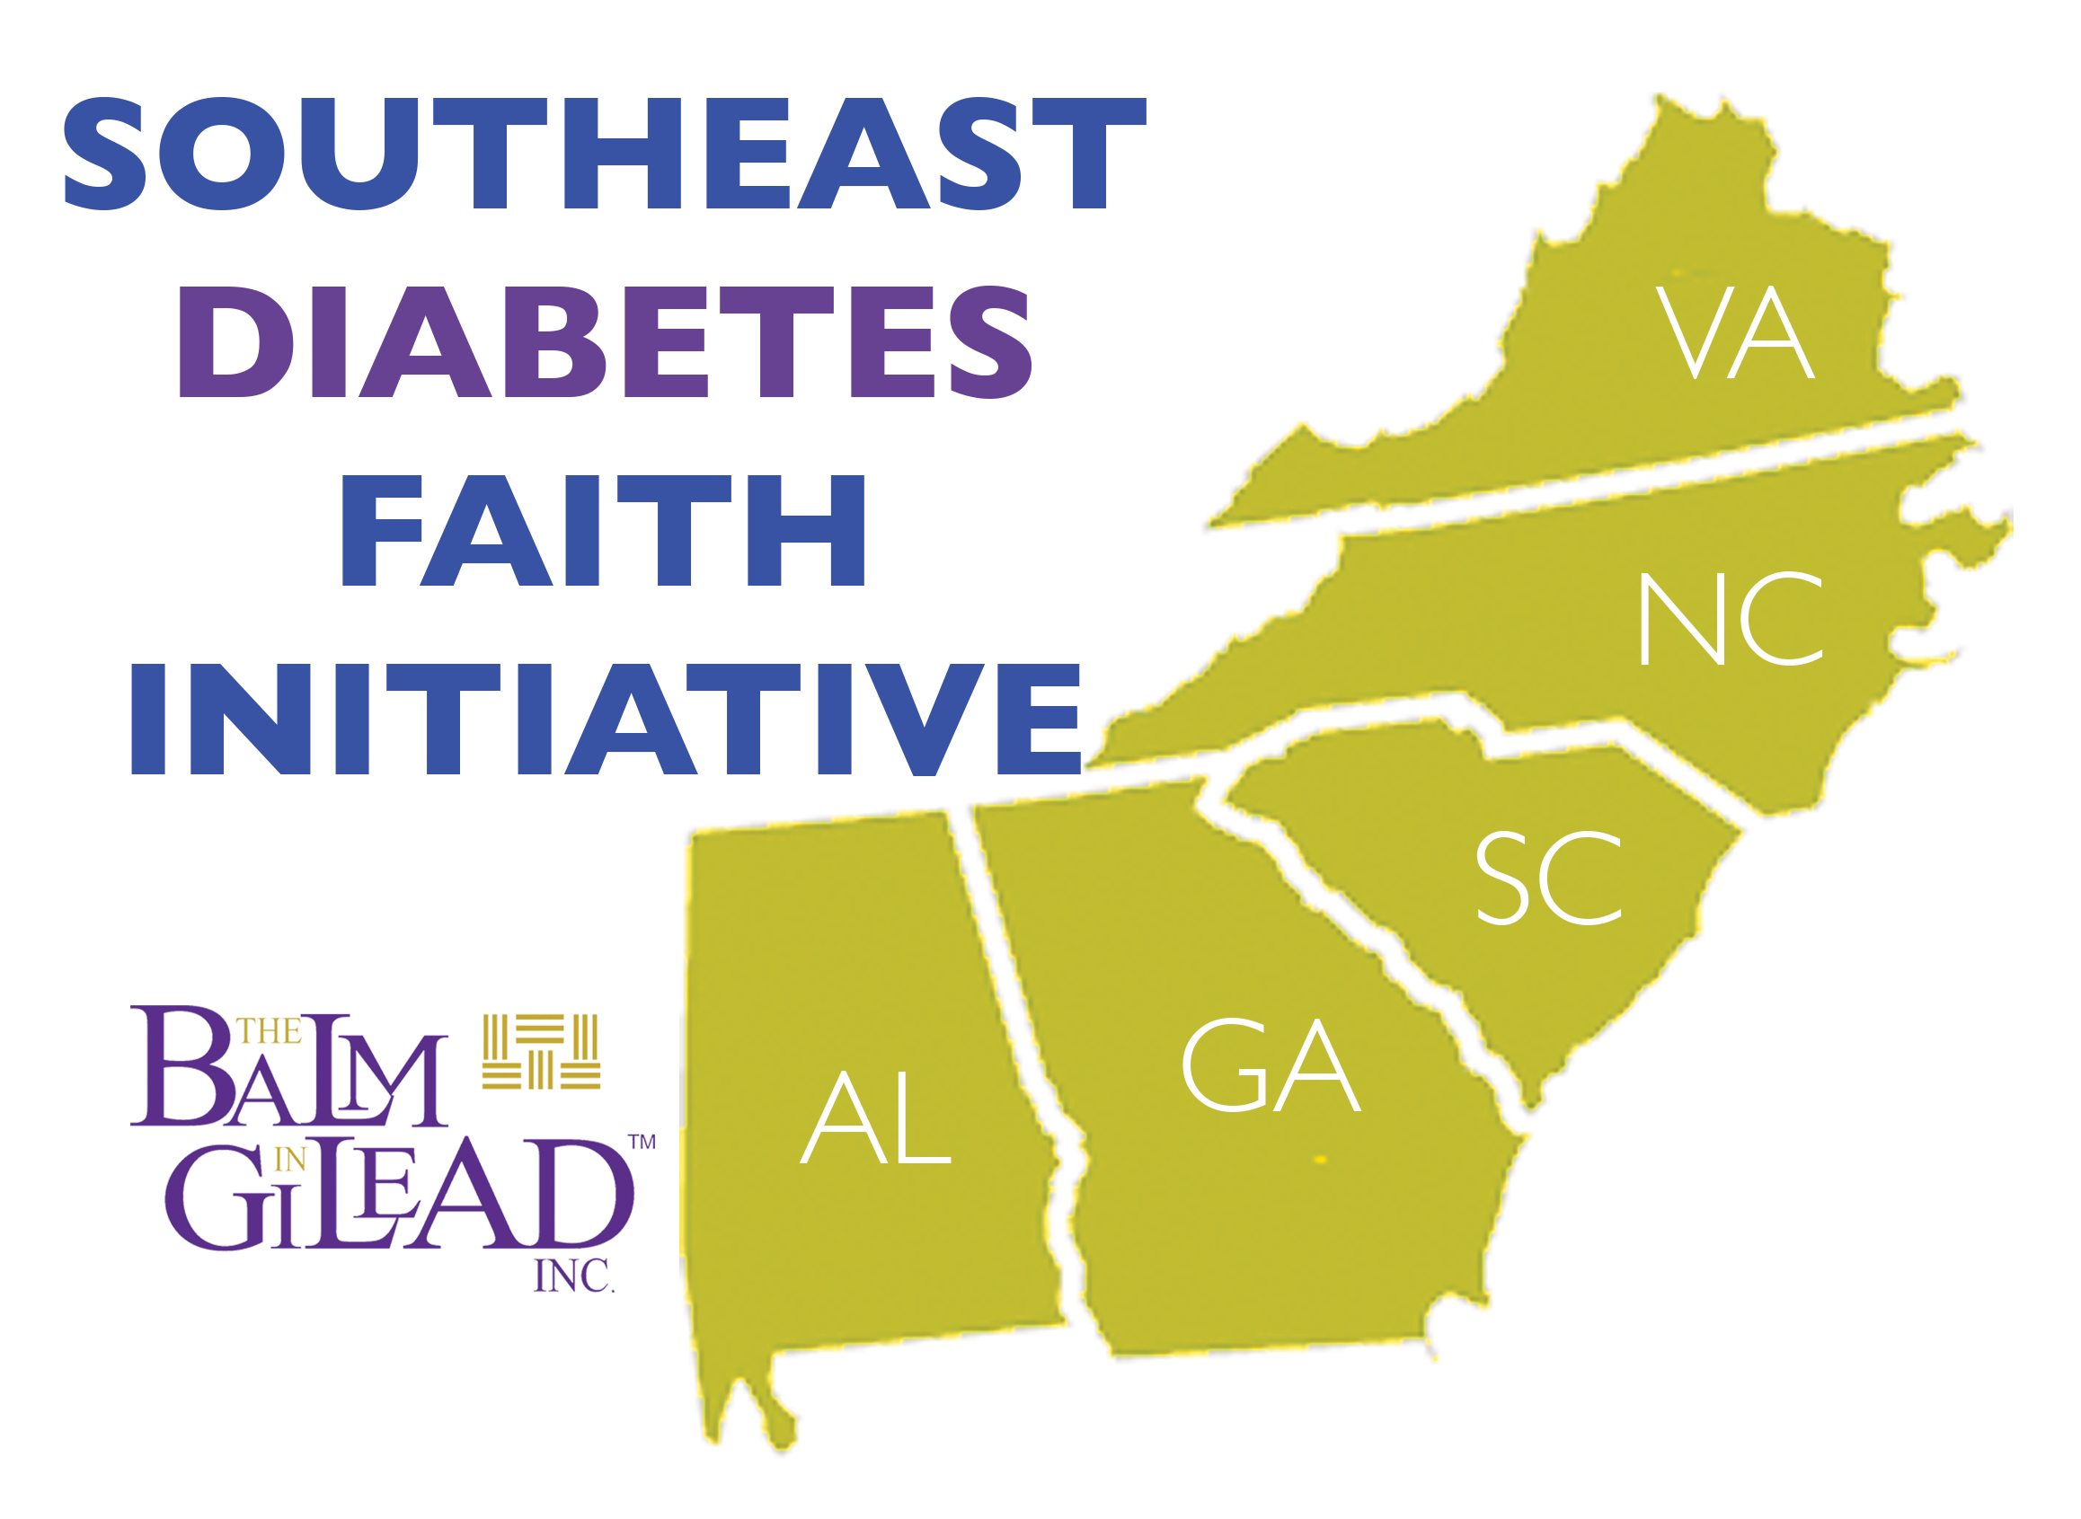
The SDFI is a national program of The Balm In Gilead. It is a 5-state faith-based project designed to expand access and utilization of the CDC’s PREVENT T2 program
In partnership with, local faith partners, healthcare providers, universities, and other key stakeholders, the SDFI supports and encourage communities and individuals to live healthier in mind, body and spirit.

Slide 26
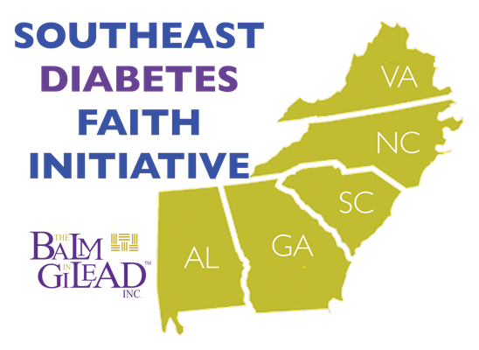
Southeast Diabetes Faith Initiative
Five (5) SDFI Organizations (by state) each with faith-based affiliate program sites (by county)
FBO-DPP sites launched in 30 counties across 5 states (AL, GA, NC, SC, VA)
Target priority populations are African Americans and underserved communities

Slide 27
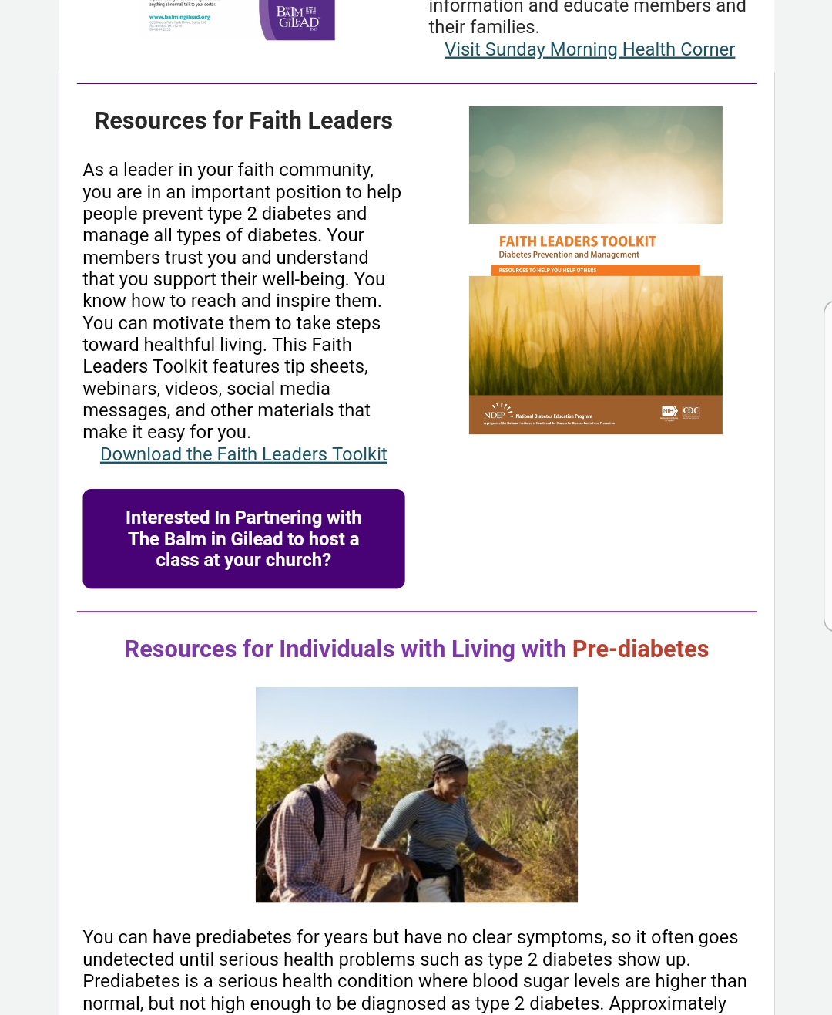
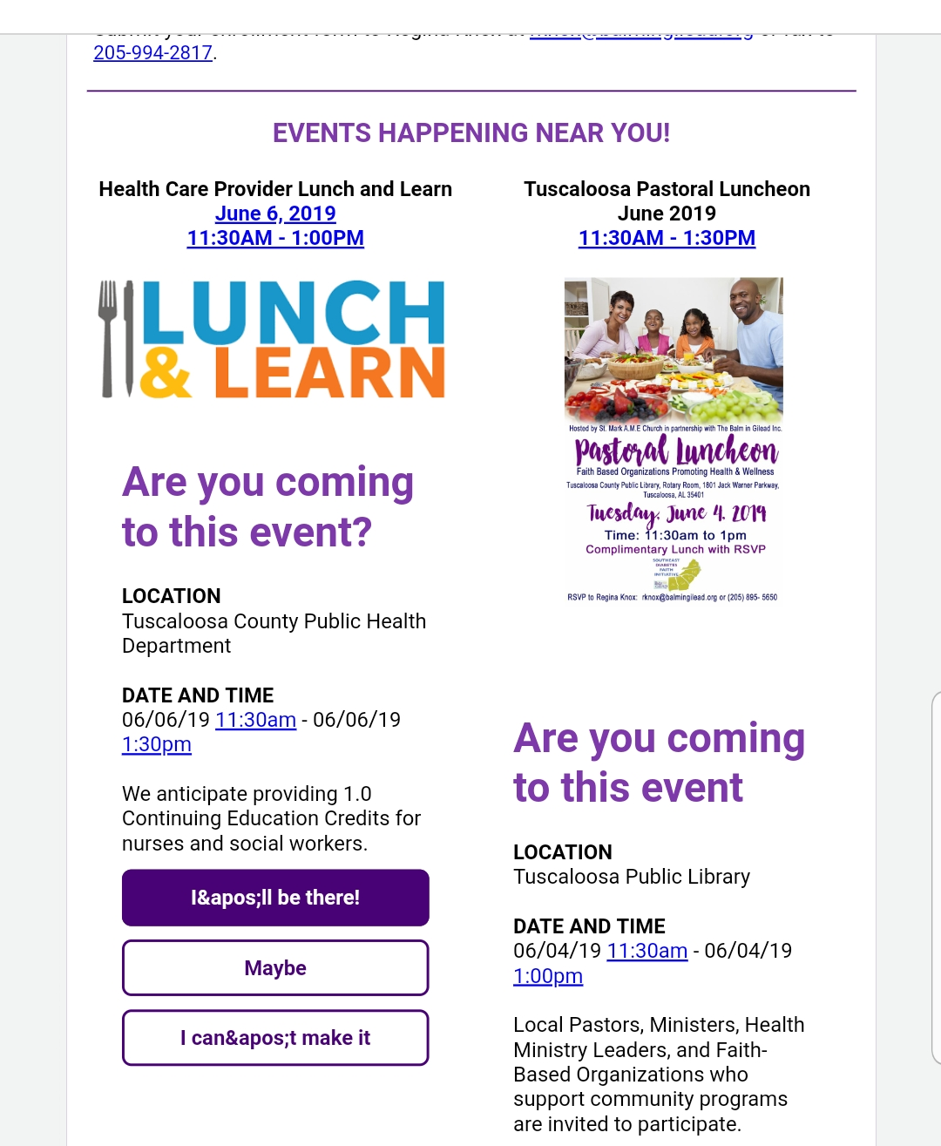
Developing Marketing Assets & Materials
Branded SDFI Brochures, Referral forms, Informational One pagers, Provider Packets
Local radio buys on FM/AM stations (PSAs, Interviews with local pastors/key influencers)
  https://youtu.be/q8SzbAGBG8E
Lifecoach/pastor newsletter
  https://conta.cc/2Hmj4ST
Social media (Groups for our affiliate sites/states) - Geo-targeted Ads & Boosted Posts
  https://www.facebook.com/sdfisc/
Feature in our monthly newsletter
  https://conta.cc/2Fx4HKv

Slide 28

Keys to Success
Faith & Community Leaders
National & Public Health Partners
Healthcare Professionals &Organizations
Strong partnerships and relationships
Consistent communication and engagement with key influencers within faith community
Grassroots, faith-based mobilization approach
Culturally tailored messaging with faith as central component
Mobilization
Communication & Engagement
Resources & Tools

Slide 29

There is a Balm In Gilead!
Questions & Comments
Thank You!

Slide 30
Angela F. Ford
PhD, MSW
Health Disparities & Women of Color:
Lessons Learned
Chief Program Officer
Black Women’s Health Imperative
Washington, DC

Slide 31
BWHI
Founded as the National Black Women’s Health Project in 1983.
Dedicated to improving the health and wellness of our nation’s 21 million Black women and girls – physically, emotionally and financially.
Top 3 Priorities: Maternal health, chronic disease prevention, reproductive and sexual health.

Slide 32
BWHI
Launched the National Diabetes Prevention Program in 2012. Funded again in 2017.
BWHI lifestyle change program branded as Change Your Lifestyle. Change Your Life. (CYL²).
12 Master Trainers (male and female), including 2 who deliver the program and train coaches in Spanish.
Priority populations: Black women and Latinas

Slide 33
BWHI PROVIDER NETWORK: EDGE
Educate, Demonstrate, Guide, Empower

Slide 34
Lessons Learned
Focus on health equity.
Stress is a major issue - Emotional wellness
Not about the disparity – About what leads to the disparity.
Language (words) is very important.
Include in research/clinical trials.
Must see themselves in the message.
Empower women to recognize and address implicit bias.
Lifestyle change must be addressed in the context of their lived experience, using a holistic and cultural lens.

Slide 35
Thank You!
For more information:
Angela F. Ford, PhD, MSW
Chief Program Officer
aford@bwhi.org
202.787.5923

Slide 36
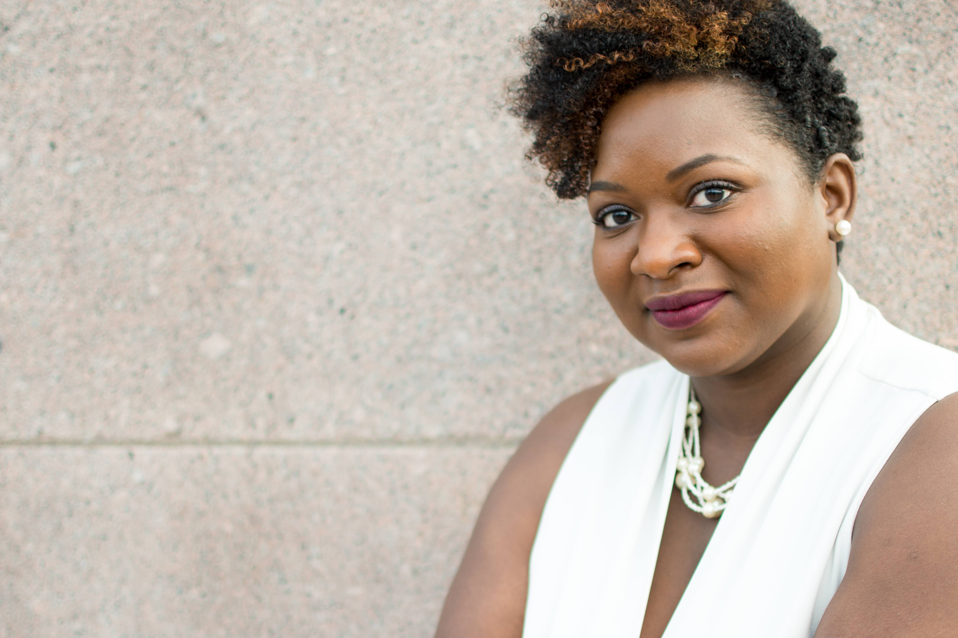
Quisha Umemba
MPH, BSN, RN, CDE
Engaging and providing quality DPP programming tailored to African American populations
Diabetes Nurse Consultant
Texas Department of State Health Services
Diabetes Prevention and Control Program
Austin, Texas

Slide 37
Cultural and Social Considerations
Use culturally-relevant (and appropriate) learning materials/curriculums
Understand that social norms can help tailor messages and curriculum appropriately
Notes:
Use culturally-relevant (and appropriate) learning materials/curriculums for marketing and when delivering curriculum
Diabetes is often perceived based on their feelings and personal experiences and filled gaps in knowledge about diet and nutrition with “self-proven” methods. Most AA’s obtain knowledge “through the grapevine” or via hearsay from fellow church members, family, friends, and neighbors so do not discredit the information they have received, instead use the opportunity to do “myths vs truths” or “facts vs fiction” learning activity.
Individual behavior is determined to a large extent by the social environment of the community norms and values. Understanding this can help instructors tailor messages and encourage social connections appropriately.

Slide 38
Building Trust and Rapport
Through Faith-based and religious organizations
Through Community Health Workers
Community-based groups
Notes:
Use of Faith-based and religious organizations
The Black church plays a significant role in the lives of African Americans, and its influence on individuals’ beliefs and daily activities continues to the current day. Due to long-standing mistrust of health care providers, AA’s can be difficult to engage in health education programs and clinical trials. As a trusted entity within the African American community, churches are uniquely positioned to facilitate the participation of this hard-to-reach population. People are more likely to establish a relationship with and accept care from a provider who has been endorsed by members of the church.
It may be more difficult to host a 12-month DPP program at the local church (discuss reasons why here), developing relationships with FBO in the local community can serve as a great way to market and refer members into the DPP program.
Use CHW’s in DPP
Using a relatable instructor who can relate to the African American experience
CHW to serve as advocate and mediator between program and other community organizations
Involve community-based groups in marketing and recruiting efforts
Involve community-based groups (outside of the local churches) to aide in marketing and recruiting efforts). Self-management of diabetes occurs outside the primary care office and organizations that are frequented by community members should be partnered with to not only increase visibility but the trust of the community.
“Employing public health approaches to increase community participation and involvement is central to improving population health in the United States” (Jack, 2010, p 192).

Slide 39
Encourage social connections
Speed friending
Accountability Partners
Group based nutrition and fitness sessions
Notes:
Speed friending (very similar to speed dating) is a great way to begin a new cohort of DPP participants. It allows participants the opportunity to meet and learn about everyone in the class.
Accountability partners is another great way to build trust and rapport among the participants of the DPP. By the 3rd or 4th class, have participants pick someone as their accountability partner that checks in with them during the week when class is not meeting.
Physical and nutrition components of the program foster a sense of community.
Individual behavior is determined to a large extent by the social environment of the community norms and values. Understanding this can help instructors tailor messages and encourage social connections appropriately.

Slide 40
One Size Does Not Fit All!
AA’s do NOT all eat the same.
Diet is most often influenced by culture, heritage, geographical area, food availability, storage, finances, health literacy, etc.
Discuss the African diaspora and traditional foods associated with each major group.
Notes:
Food availability, storage, financial independence, health literacy, and a sense of history and heritage all contribute to the ever-changing components of the widening African American diet. Audiences’ geographic region of origin within the United States or other areas of the world (e.g., African, South American, or European countries, Caribbean, etc.) and cross-cultural integration introduce a number of nuances that need to be considered when tailoring curriculum to target populations.
Discuss how DAWN implemented The African Taste of Heritage Cooking class to it’s DPP program participants and how it was received.

Slide 41

Identify barriers specific to AA’s
I’m NOT sweating my hair out!
Notes:
For example, AA women may not exercise for fear of their hairstyle getting ruined from sweat. Identifying physical activity barriers specific to African–American women and then addressing them can help them change the behavior

Slide 42
Capitalize on missed opportunities
Engage African American adults with diabetes beyond the biomedical approach.
  Consider the psychosocial experiences of the persons with diabetes.
For PWD’s that have difficulty keeping appointments, engage them in-between visits in more non-traditional ways (texting, telemedicine, phone calls, etc.).
Notes:
Providers should understand that an individual’s diabetes knowledge is derived from lived experiences as opposed to biomedically derived knowledge
Informal knowledge is not always congruent with biomedical knowledge. Sometimes informal knowledge includes folk remedies that have served African American individuals well over generations; however, sometimes informal knowledge leads to unsafe self-directed modifications in treatments. A clinician’s role is to reconcile formal and informal knowledge in ways that are respectful of personal experience yet consistent with safe practices. Reconciling this knowledge is a thin line to walk, but if knowledge about living with the disease is principally learned outside the biomedical arena, then learning how to integrate the two is essential. (Again, “myth vs truths” or “facts vs fiction” learning activity could be helpful here.
Practitioners should be mindful that in some instances the health-seeking and appointment keeping behaviors of some AA’s may be different than other ethnicities (for a variety of reasons) so it may be important to keep these individuals engaged in-between visits in more non-traditional ways (texting, telemedicine, phone calls, etc.).

Slide 43
Recommendations
Engage African American PWD’s beyond the biomedical approach. Consider the psychosocial experiences of the persons with diabetes.
Use AA CHW’s that can identify with and relate to the African American experience to build trust and rapport
Mobilize community-based partners to enhance the delivery of collaborative approaches that provide resources for diabetes care.

Slide 44
Recommendations…continued
Identify and develop formal partnerships between AA churches and local providers/ health care system.
Engage AA’s in-between visits, especially if they are prone to missing appointments.
Address barriers to physical activity and assist with modifying and tailoring interventions.

Slide 45
Recommendations…continued
Encourage social connections among participants as social norms and customs have a big impact on self-management
Tailor nutrition education appropriately remembering not all AA diets are the same.

Slide 46
References
See speaker notes section
Notes:
Holt, J., Johnson, T., Zabler, B. (2018). Engaging African American Women in Community-Based Health Promotion Programs: Key Informant Recommendations, Journal of Community Health Nursing, 35:3, 137-147, DOI: 10.1080/07370016.2018.1475800
Jack, L. (2010). Diabetes in Black America: Public Health and Clinical Solutions to a National Crisis. Hilton Publishing Company. Roscoe, IL.
Johnson, P., Thorman-Hartig, M., Frazier, R., Clayton, M., Oliver, G., Nelson, B. W., & Williams-Cleaves, B. J. (2014). Engaging Faith-Based Resources to Initiate and Support Diabetes Self-Management Among African Americans: A Collaboration of Informal and Formal Systems of Care. Health Promotion Practice, 15(2_suppl), 71S-82S. https://doi.org/10.1177/1524839914543012
Kia, S. J., Cadogan, M., Heilemann, M. V., & Phillips, L. R. (2019). Assessing informal and formal diabetes knowledge in African American older adults with uncontrolled diabetes. Journal of Gerontological Nursing, 45(2), 35-41. doi:http://dx.doi.org.ezproxy.liberty.edu/10.3928/00989134-20190111-06
Lutes, L. D., Cummings, D. M., Littlewood, K., Dinatale, E., & Hambidge, B. (2017). A community health Worker–Delivered intervention in african american women with type 2 diabetes: A 12-month randomized trial. Obesity, 25(8), 1329-1335. doi:http://dx.doi.org.ezproxy.liberty.edu/10.1002/oby.21883
Parker, M. M., Moffet, H. H., Schillinger, D., Adler, N., Fernandez, A., Ciechanowski, P., & Karter, A. J. (2012, April). Ethnic differences in appointment-keeping and implications for the patient-centered medical home--findings from the diabetes study of Northern California (DISTANCE). Health Services Research, 47(2), 572+. Retrieved from http://link.galegroup.com.ezproxy.liberty.edu/apps/doc/A284552044/HRCA?u=vic_liberty&sid=HRCA&xid=961058c0
Pekmezi, D., Marcus, B., Meneses, K., Baskin, M. L., Ard, J. D., Martin, M. Y., . . . Demark-Wahnefried, W. (2013). Developing an intervention to address physical activity barriers for african-american women in the deep south (USA). Women's Health, 9(3), 301-12. doi: http://dx.doi.org.ezproxy.liberty.edu/10.2217/whe.13.20
https://oldwayspt.org/traditional-diets/african-heritage-diet
http://drgreghall.com/2018/02/08/diet-differences-african-americans/

