Slide 1


Slide 2
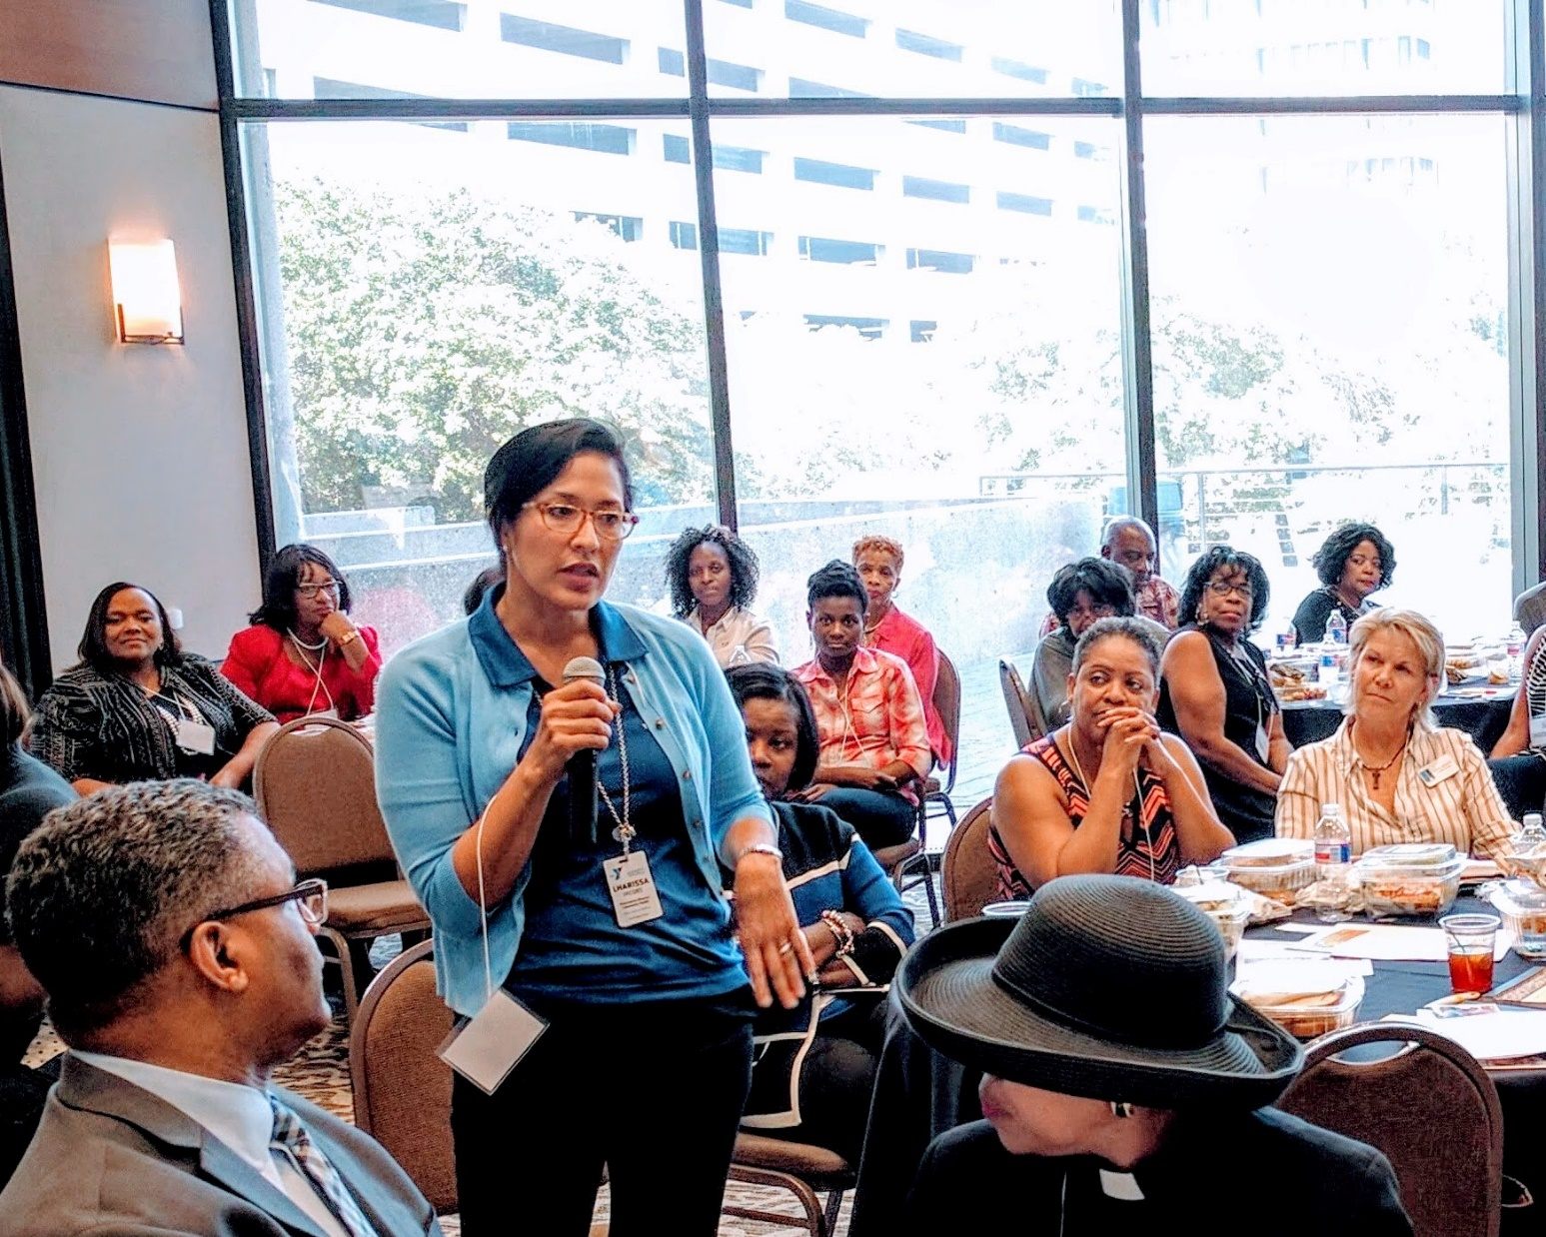
Engaging stakeholders to Address Community-Level Diabetes Vulnerabilities through Population Health Interventions: A Public-Private Partnership
AADE 2018
August 18, 2018

Slide 3

Faith Foreman
Dr. PH, MPH, LVN
Deputy Assistant Director
Office of Chronic Disease, Health Education and Wellness
Director’s Office
Houston Health Department
Houston, Texas

Slide 4
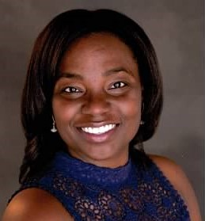
Joycelyn Ashby Cornthwaite
MS, RD, LD, CDE
McGovern Medical School at UTHealth
Department of Obstetrics and Gynecology
University of Texas Physicians Women’s Clinic
Houston, Texas

Slide 5
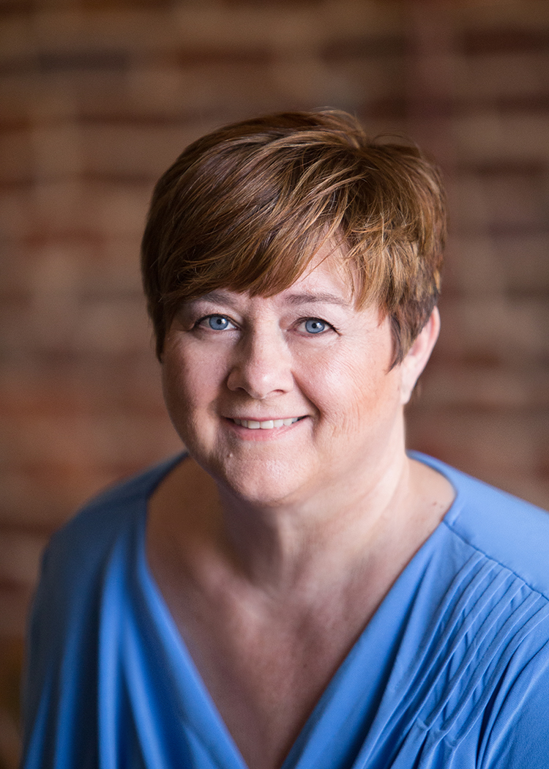
Ardis A. Reed
MPH, RD, LD, CDE, CCHWI
Health Disparities Team
Diabetes Content Expert
TMF Health Quality Institute
Austin, Texas

Slide 6
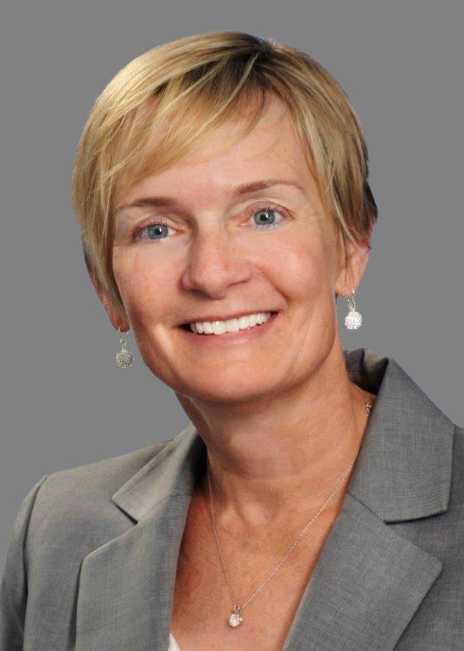
Karin Gillespie
MBA
Director, Changing Diabetes Policy
US- Project Lead, Cities Changing Diabetes
Novo Nordisk Inc.

Slide 7
Disclosure to Participants
Notice of Requirements For Successful Completion
  Please refer to learning goals and objectives
  Learners must attend the full activity and complete the evaluation in order to claim continuing education credit/hours
Conflict of Interest (COI) and Financial Relationship Disclosures:
  Dr. Faith Foreman, Dr.PH, MPH - No COI/Financial Relationship to disclose
  Karin Gillespie, MBA - Novo Nordisk employee
  Ardis A. Reed MPH RD LD CDE : – No COI/Financial Relationship to disclose
  Joycelyn Ashby Cornthwaite, RD LD CDE – Conference participation support provided by Novo Nordisk
Non-Endorsement of Products:
  Accredited status does not imply endorsement by AADE, ANCC, ACPE or CDR of any commercial products displayed in conjunction with this educational activity
Off-Label Use:
  Participants will be notified by speakers to any product used for a purpose other than for which it was approved by the Food and Drug Administration.

Slide 8

Today, two thirds of people with diabetes live in cities
2017
2045
66%
75%
OF PEOPLE WITH DIABETES LIVE IN URBAN AREAS¹
OF PEOPLE WITH DIABETES WILL LIVE IN URBAN AREAS¹
References
1. International Diabetes Federation. IDF Diabetes Atlas. 8th edn. Brussels, Belgium: International Diabetes Federation. 2017.

Slide 9
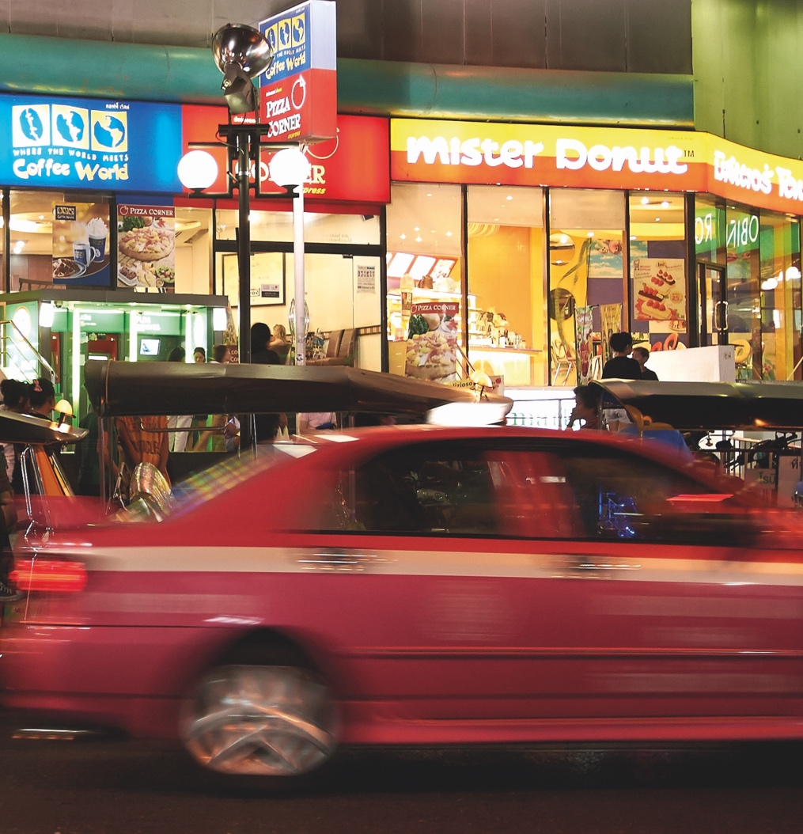
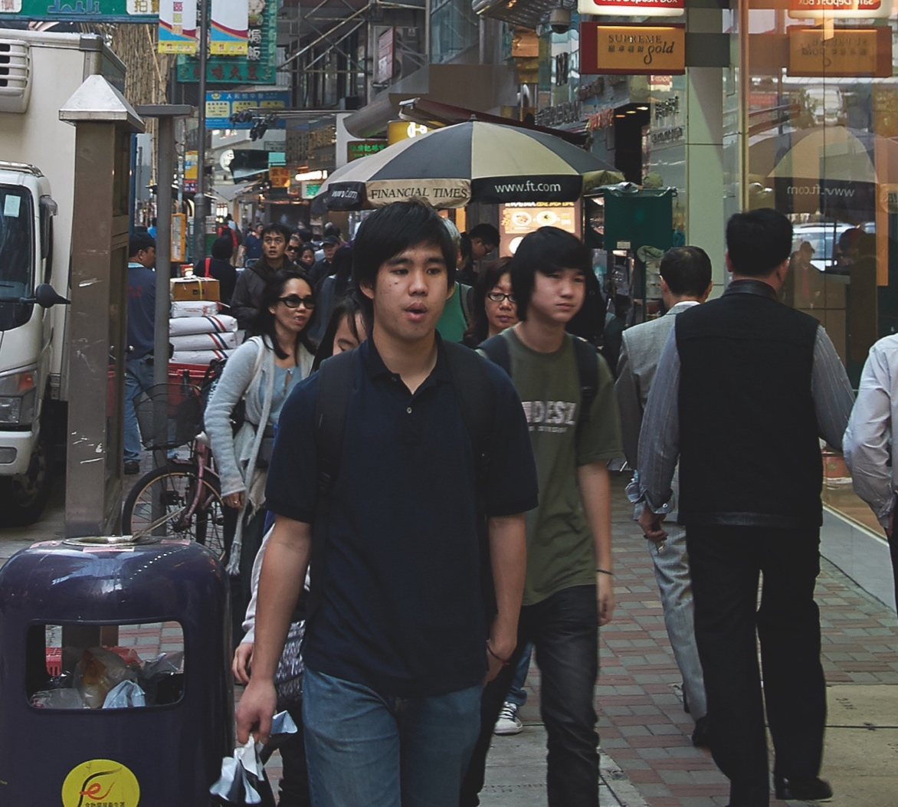
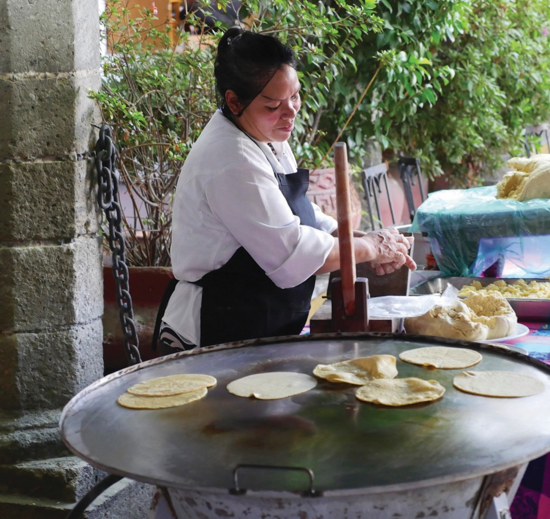





Cities influence how people live, travel and eat, which all have an impact on diabetes risk
References
1. Tellnes G. Urbanisation and health: new challenges in health promotion and prevention. Oslo academic press. 2005

Slide 10
The First 16 Cities to Change Urban Diabetes
Representing more than 120 million people
LEICESTER
COPENHAGEN
VANCOUVER
BEIJING
TIANJIN
KORIYAMA
HOUSTON
SHANGHAI
ROME
HANGZHOU
BEIRUT
XIAMEN
MEXICO CITY
MÉRIDA
JOHANNESBURG
BUENOS AIRES
Cities Changing Diabetes is a global program sponsored by Novo Nordisk in partnership with University College London and Steno Diabetes Center, in which 16 cities around the world are learning how to improve diabetes prevention, detection and care in their communities.

Slide 11

A Bold Goal for Diabetes:
No more than 1 in 10 adults globally has diabetes
Notes:
Setting a bold goal
We have worked with a set of global experts within the diabetes and obesity field to identify and verify a reasonable prevalence target for diabetes in 2045
Today, we are setting before you a bold goal that no more than 1 in 10 adults globally has diabetes in 2045. This goal may not seem bold at first glance, but let us explore what it means and what it takes to achieve it.
With this goal, it is our hope that we can keep the prevalence of diabetes at a level that is more sustainable for our societies – and where we can start to look to reducing the prevalence over time.
The target is important, but the actions we take to get there are even more important!

Slide 12

Houston Cities Changing Diabetes

Slide 13

The Change Model for Cities Changing Diabetes
MAP
ACT
Map the problem in cities across the world.
Initiate solutions to tackle diabetes in cities.
Local factsheet
Rule of Halves
Health promoting policy
Urban planning
Diabetes Q-Assessment
Vulnerability assessment
Community involvement in health
Health system strengthening
SHARE
Advocate and share solutions in order to fight urban diabetes
Media outreach
Exchange visits
Global knowledge networks
City stakeholder
Meetings
Publications
Summit
Speaker opportunities

Slide 14


Stakeholder Engagement
400+ CCD stakeholders
100+ Action work group participants
20 Key Stakeholder Organizations
12 Core Team Members
Anchor
Houston Health Department
Notes:
Anchored at Houston Health Department, the initiative is led by 12 organizations on the Core Team. In addition, about 20 individual organizations are kept close. There are five Action Work Groups who translated the research themes into interventions, developed the interventions including implementation, funding and other resources.

Slide 15
Multi Sector Participation
Employers
Medical and Public Health
Central Care FQHC
Nonprofits
Faith-Based
CHI St. Luke’s
El Centro de Corazón
Harris Health
HOPE Clinic FQHC
Houston Methodist
Kelsey-Seybold
Legacy FQHC
Memorial Hermann
Texas Childrens Hospital
Children at Risk
Día de la Mujer Latina
Gateway to Care
Houston Food Bank
Houston League of Business & Professional Women
Mental Health America
United Way
Urban Harvest
YMCA
Houston and Harris County public health depts
Northwest Alliance Ministries
American Diabetes Association
UT Medical Branch
Insurance
Blue Cross Blue Shield
UnitedHealthcare
Cigna
Community Health Choice
Humana
UT Health
BP
American Heart Association
Brown Chapel AME
Covenant Glen UMC
The Fountain of Praise
Holy Trinity Missionary Baptist Church
Islamic Society of Greater Houston
Pentecostal Missionary Baptist Church
River Pointe Church
SEWA International
Taiba USA
The Texas Annual Conference of the United Methodist Church
Chevron
Dow Chemical
Friedken Group
Harris County
Harris Health
KBR
LyondellBasell
METRO
Nobel Energy
Rice University
City of Houston
Greater Houston Partnership

Slide 16
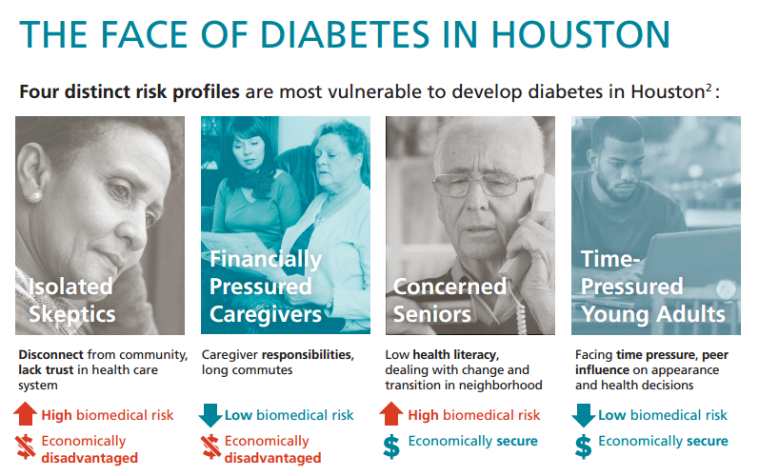
CCD Research: Understanding Vulnerability

Slide 17
Current Initiatives in CCD Houston
Houston Diabetes Resource Center
Faith & Diabetes
Disaster Prepared-ness
Employer Worksite Wellness
(DPP)
Peer Support
Notes:
These were driven by community stakeholders – not something HHD or Novo pushed.

Slide 18
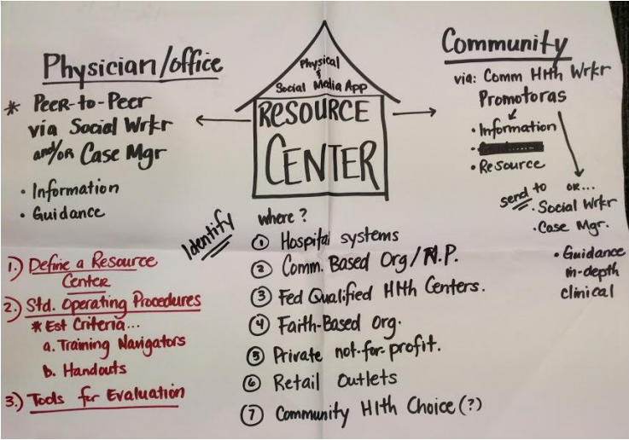

From Initial Idea to Reality
Notes:
HDRC is a one-stop-shop website that connects patients, providers and employers with educational resources, programs in the community, and navigation services
With seed funding from Novo Nordisk, Gateway to Care, a nonprofit 501c3 organizations, convened stakeholders to get their input on the development: healthcare, public health, employers and insurance

Slide 19
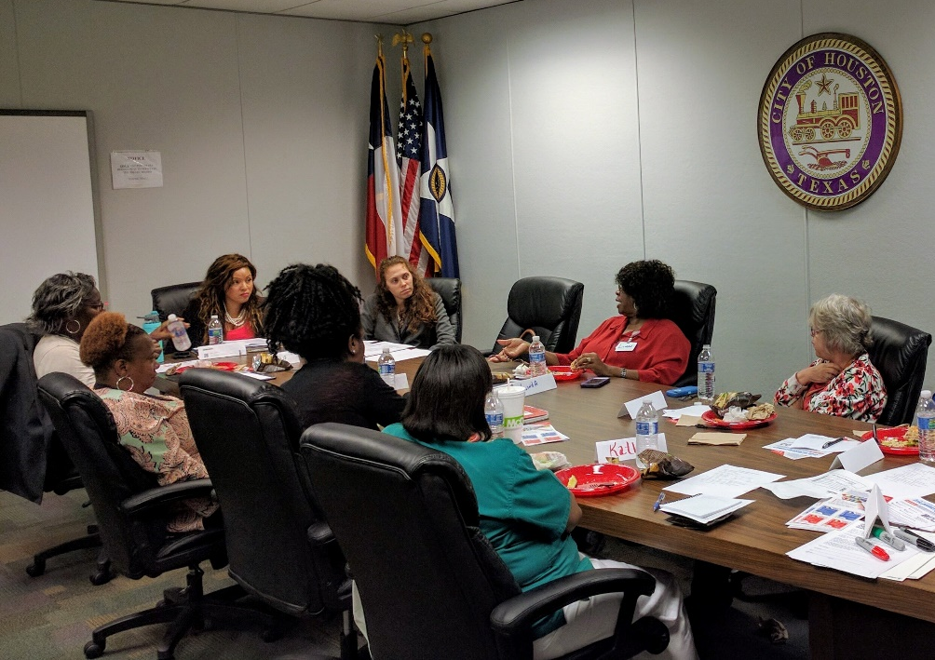
Houston Diabetes Resource Center
One-stop-shop website
Client support in multiple languages
Content and Materials
  Reviewed and Approved by Houston based Certified Diabetes Educators
  Southern Texas Association of Diabetes Educators (STADE) of AADE
Coming Soon!
  Call center staffed by Community Health Workers with AADE paraprofessional training
Notes:
The site was inspired by Kentucky Diabetes Network, which serves an important information hub for anything diabetes in the American state Kentucky
If the good people of Kentucky could do this, Houston could develop it own site
But we added important features inspired by the Vulnerability Research;
It told us that people regardless of insurance status and background are vulnerable to developing diabetes and have a very hard time navigating an increasingly fragmented healthcare system
This is why Gateway to Care was selected, it’s an organization that trains and employs State of Texas certified Community Health Workers
For HDRC, the Gateway to Care Community Health Workers received AADE Paraprofessional Training to better help with patient navigation and referral to community resources specific to diabetes
After much hard work, the site launched last week.

Slide 20
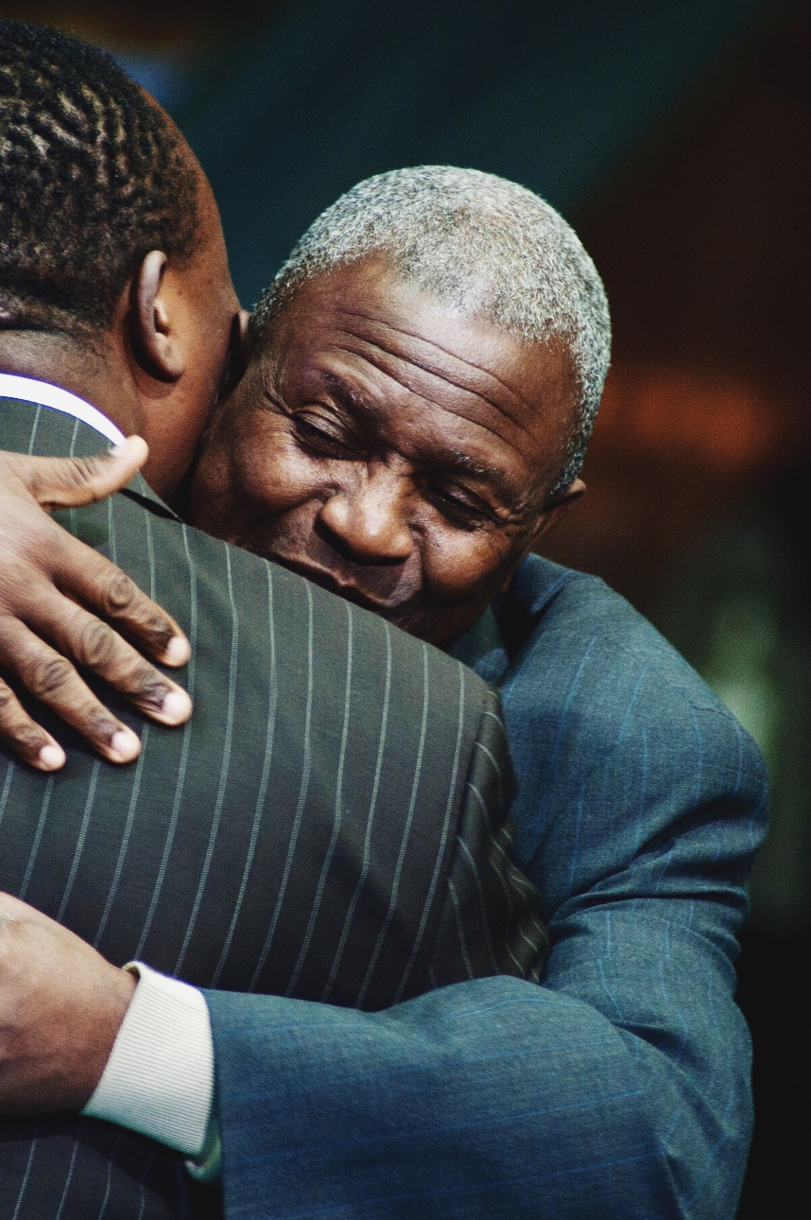

Faith and Diabetes
Diabetes and CVD curriculum culturally appropriate for houses of faith
Train-the-trainer approach
Training institute Q1 and Q3 2018
Q1 Institute: Participants from 13 faith communities representing Muslim, Christian and Hindu

Slide 21

Why Faith Communities?
Supportive, cohesive, trusted
Wide reach across regions and demographics
Critical to fight social isolation
Empowered to Use Existing Connections
Prepared to interweave beliefs, practices and community life with health and wellness
Notes:
Biko’s example of “being with my people”.
Isolated, skeptical, time poor – all solved within communities of faith.

Slide 22

Strengthening Health Ministries
Held October 2016 Faith & Diabetes Summit
Selected Evidence-Based on-the-shelf DSMES Program
Created “Religious Studies” Curriculum
Training on how faith and health align.
The “sameness” between the diversities of faith.
Bringing prevention to their surrounding communities
Learning: health ministries were not ready to support diabetes services.
Action: Action Work Group identified components for a training program
Community-based and culturally sensitive approach using participatory adult learning principals
Added Prevention Module
City of Houston and Harris County Public Health
Institute for Spirituality and Health
10 evidence-based nutrition and physical activity interventions
How-to handbook with examples from houses of faith and local resources
Gateway DM and CVD
Created Collab. Evaluation
Healthy Cities Research Hub at UTHealth- School of Public Health
Train the trainer Model- education
°

Slide 23

Gateway Diabetes and CVD curriculum from Laredo, Texas- Training by TMF Health Quality Institute
Builds on 8 Disease Management Principles:
    Active Learning
    Goal Setting
    Problem Solving
    Knowledge
    Responsibility
    Social Support
    Respect
    Skills Building

Slide 24
Result: The Congregational Health
Leadership Training Program
Curriculum developed aligning faith, diabetes self management, prevention and evaluation together to build strength to health ministry infrastructure processes.
Houses of Faith were asked to send at least 2 people to provide strength, flexibility and sustainability to their health ministry
Delivered as a 7 week workshop series in two cohorts
Trainees received 40 hours of training

Slide 25
Track Record of DSMES Train-the-Trainer Community Settings, NOT Houses of Faith
Funded by Centers for Medicare and Medicaid, “Everyone with Diabetes Counts” national initiative through TMF Health Quality Institute, Austin, Texas.
Provides evidence based DSMES curriculum in a 6 week format to allow people living with diabetes time to absorb the educational material and work on behavioral changes.
Since 2014, 225 people have become trainers and reached almost 19,000 people (80% retention in the six classes)
Relative Improvement of clinic metrics
  A1C-63%
  Lipids-135%
  Eye Exams-200%

Slide 26

Notes:
The Robert Wood Johnson Foundation recently awarded a 3-year $2.4 million grant to UTHealth to support collaboration, evaluation, and sharing best practices from Cities Changing Diabetes.
The grant will create the Healthy Cities Research Hub, a virtual hub that will focus on the social and environmental conditions that impact health in urban settings throughout North America.
The Hub will be anchored in Houston; Cities Changing Diabetes Houston Academic Lead Dr. Stephen Linder is principle investigator.
Research efforts will span three Cities Changing Diabetes cities – Houston, Mexico City and Vancouver.
Lessons learned will be shared with other cities that want to tackle urban diabetes and other health issues.

Slide 27

What’s the Secret Sauce?
Multi-sector coalition
Self-organizing Action Work Groups
Understanding and appreciating the Houston environment, including diversity
Getting competitors to collaborate on solutions
Open solution development process with strong involvement of patients since Day 1
Identification of national models that Houston could adapt and innovate further
Novo Nordisk allowed for local process to take off and didn’t steer stakeholders to solutions

Slide 28
Thank You Very Much
Q & A?

Slide 29
For More Information
Karin Gillespie KGIL@novonordisk.com
Faith Foreman faith.foreman@houstontx.gov
Ardis Reed ardis.reed@tmf.org
Joycelyn Cornthwaite Joycelyn.a.Cornthwaite@UTH.tmc.edu

