Slide 1


Slide 2
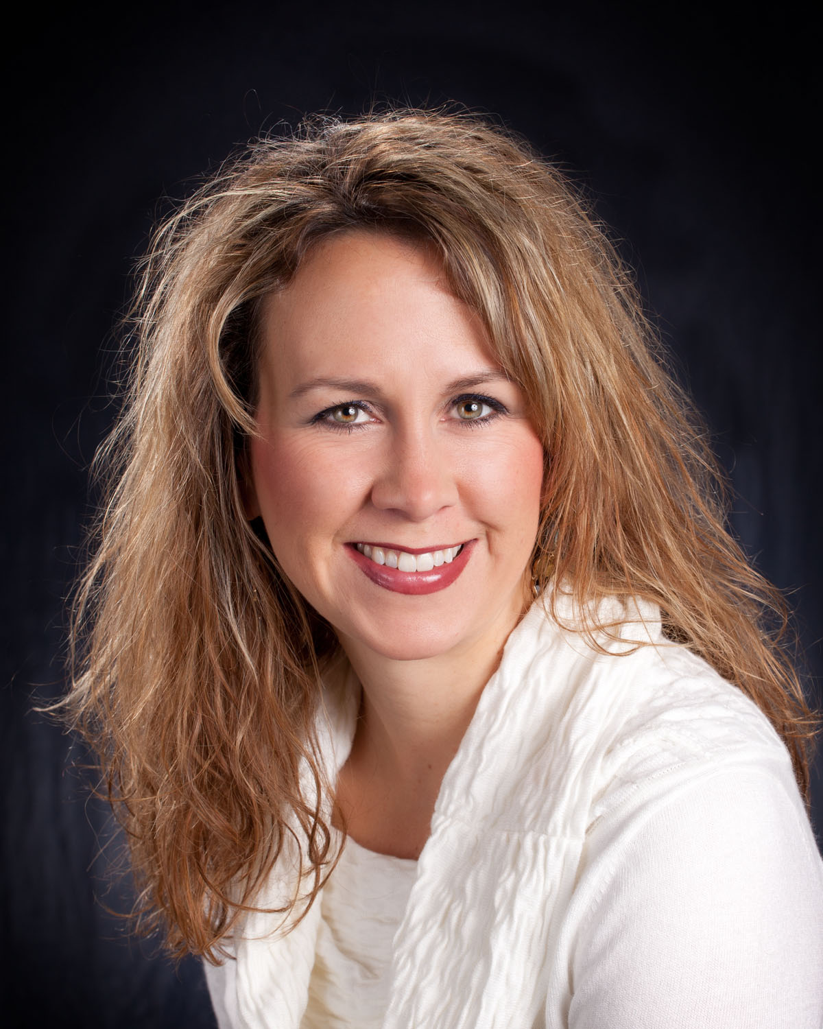
Jennifer Troupe
MS, RD, CDE, BC-ADM
Practice Manager
Providence St. Joseph Health
Endocrinology, Diabetes and Nutrition
Missoula, MT
Notes:
My history

Slide 3
Disclosure to Participants
Notice of Requirements For Successful Completion
  Please refer to learning goals and objectives
  Learners must attend the full activity and complete the evaluation in order to claim continuing education credit/hours
Conflict of Interest (COI) and Financial Relationship Disclosures:
  Nothing to disclose
Non-Endorsement of Products:
  Accredited status does not imply endorsement by AADE, ANCC, ACPE or CDR of any commercial products displayed in conjunction with this educational activity
Off-Label Use:
  Participants will be notified by speakers to any product used for a purpose other than for which it was approved by the Food and Drug Administration.

Slide 4
The Business of Diabetes Prevention
Understanding basic finance/business terms
Utilizing ROI to Increase Insurance Coverage, Implement the DPP and provide sustainability
The Providence Health System’s Story – St. Patrick Hospital, Missoula, MT

Slide 5


Slide 6

2017 Professional Practice Survey - AADE
75% provide direct patient care
13% administrative role

Slide 7



Business 101

Slide 8

Proforma
Latin term that describes a method of calculating and presenting financial results to emphasize either current or projected figures.
In the world of investing, proforma refers to a method by which firms calculate financial results.
Assumptions

Slide 9
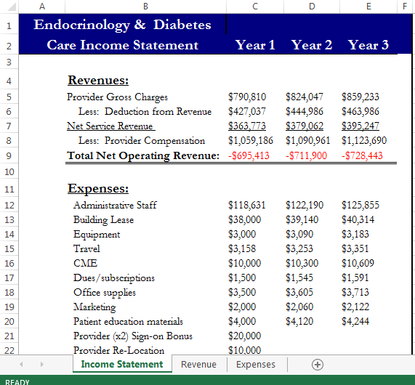
Deductions
50% deductions for Medicare/Medicaid.
Commercial typically more profitable.

Slide 10
NOI – Net Operating Income
It equals total operating revenue minus total operating expenses. Some income statements label it operating income or earnings before interest and taxes. Because net operating income excludes interest expenses, income tax expenses and other non operating items, you can use it to gauge your business’s core operating performance without the effects of these items.
Budget
Notes:
Make or lose in today’s dollars

Slide 11
ROI – Return on Investment
Measures how much money or profit is made on an investment as a percentage of the cost of the investment. ROI shows how effectively and efficiently investment dollars are being used to generate profits. Investors use ROI to determine how successful their investment is performing, but also in comparing their ROI with the performance of other investments.

Slide 12
NPV-Net Present Value
The difference between the present value of cash inflows and the present value of cash outflows over a period of time. NPV is used in capital budgeting to analyze the profitability of a projected investment or project.
Only invest in projects with a positive NPV

Slide 13
Fee for Service
Payment model where services are unbundled and paid for separately. In health care, it gives an incentive for physicians to provide more treatments because payment is dependent on the quantity of care, rather than quality of care.

Slide 14

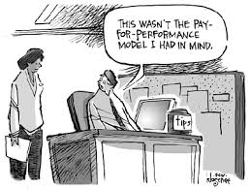
Moving from Fee for Service to Pay for Performance
Notes:
Mark’s comment regarding physician contracts

Slide 15
Value Based Care
Value-based healthcare is a healthcare delivery model in which providers, including hospitals and physicians, are paid based on patient health outcomes. Under value-based care agreements, providers are rewarded for helping patients improve their health, reduce the effects and incidence of chronic disease, and live healthier lives in an evidence-based way.

Slide 16
PCMH
The Patient-Centered Medical Home (PCMH) is a care delivery model whereby patient treatment is coordinated through their primary care physician to ensure they receive the necessary care when and where they need it, in a manner they can understand.

Slide 17
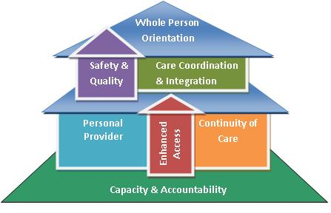


Slide 18
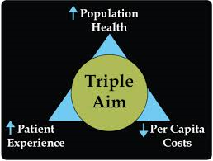
Goals of ACA
Notes:
Improve the health of defined populations, enhance patient care experience – including quality access and reliability and reduce or at least control per capita cost of care.

Slide 19
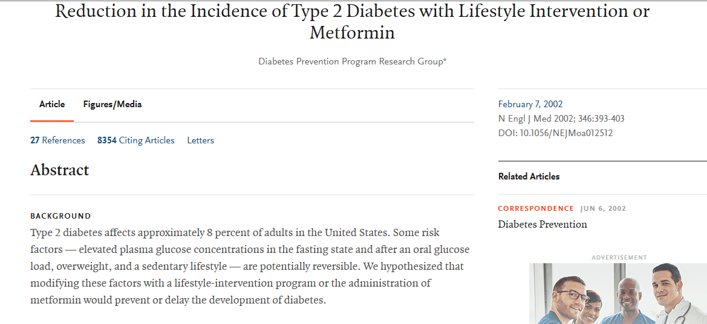
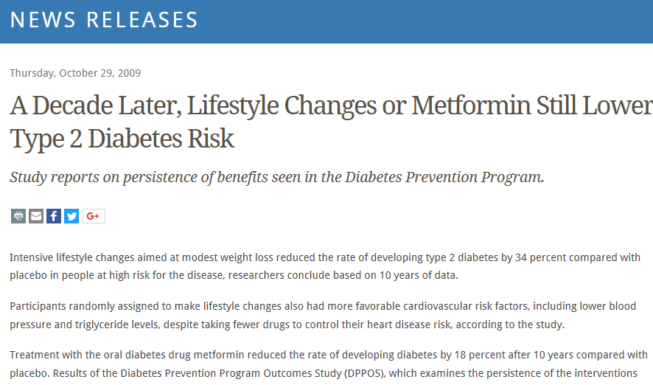
Notes:
58% risk reduction

Slide 20
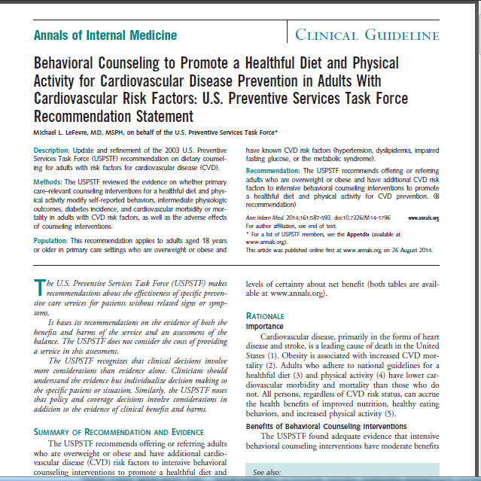
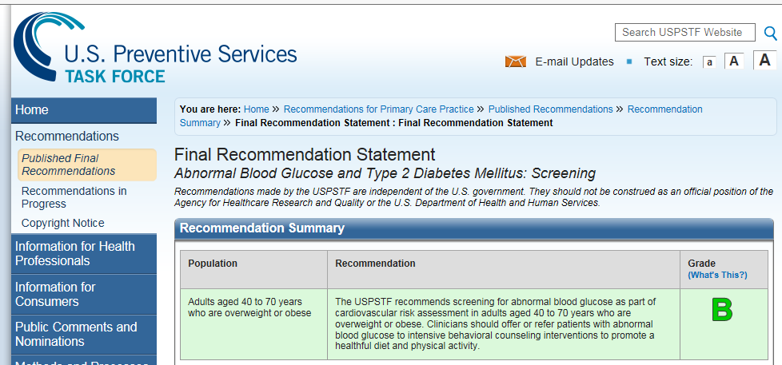
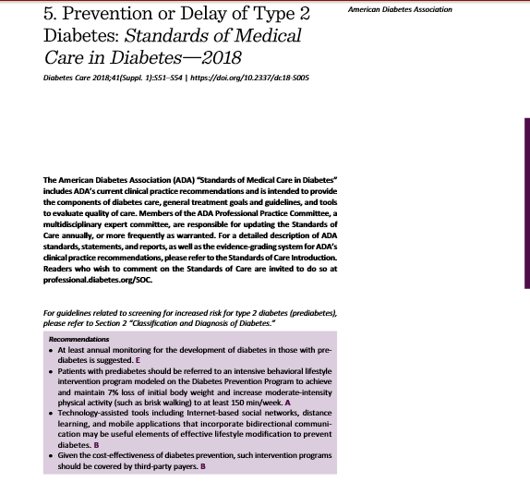
Notes:
2014 and 2015, 45 an older

Slide 21
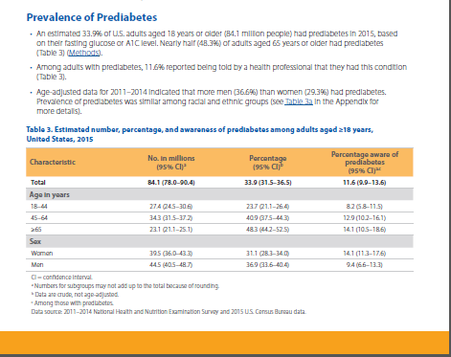
33.9% and 48.3%
2017 CDC National Diabetes Fact Sheet

Slide 22
Cost of Diabetes
Average medical expenditures of $16,752 per year
Medical expenditures approximately 2.3 times higher
1 in 4 health care dollars in the U.S
Indirect costs

Slide 23
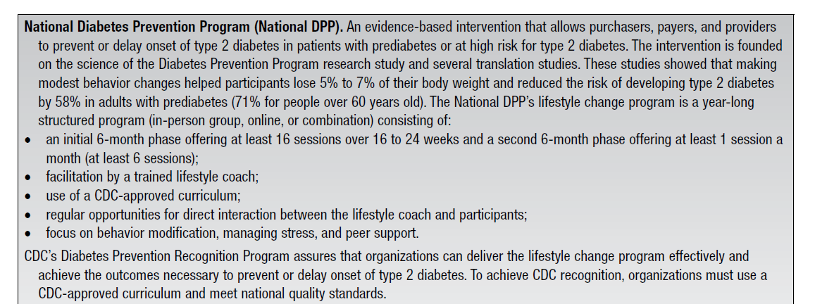
2017 National Standards

Slide 24


Slide 25


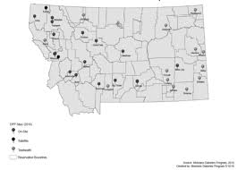
2006 to 2009

Slide 26

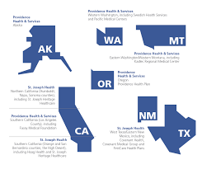
119,000 caregivers
7 states
3rd largest non profit system in the US
Mission – poor and vulnerable

Slide 27
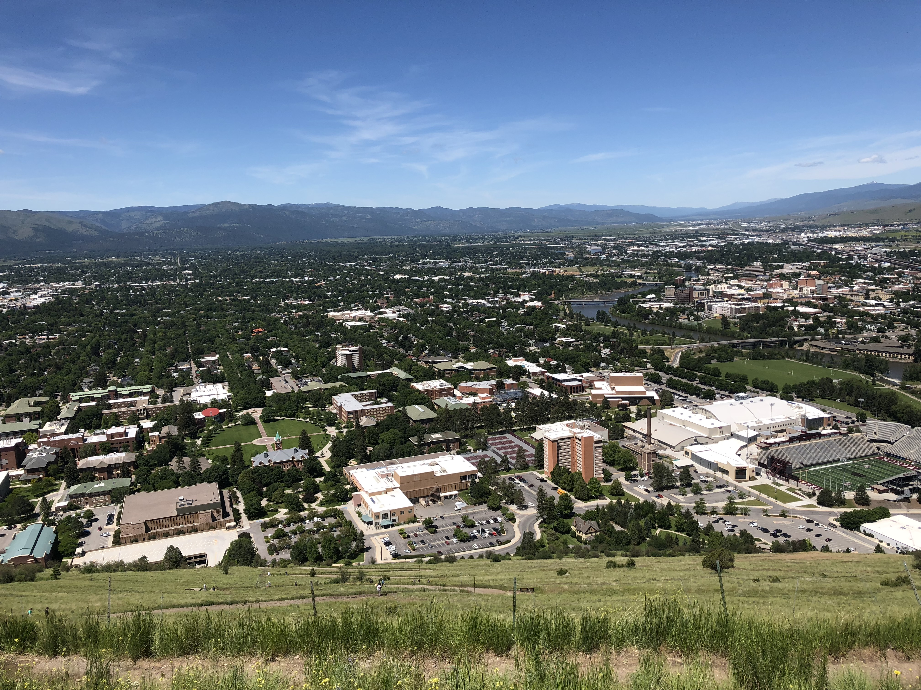
Missoula, Montana

Slide 28
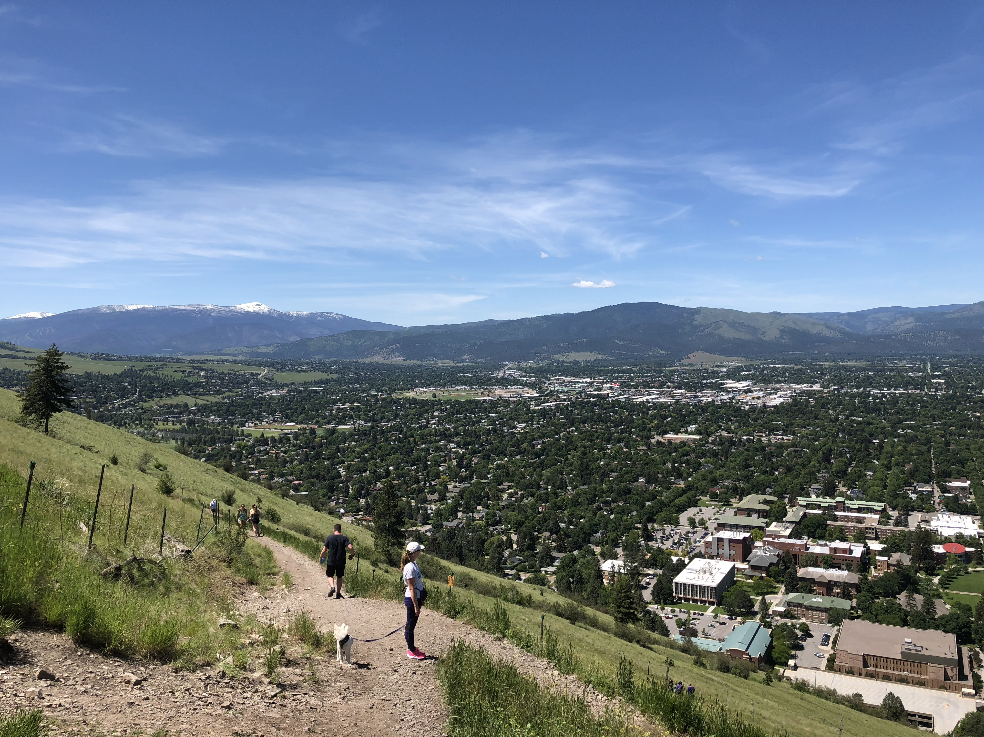
The Bitterroot

Slide 29
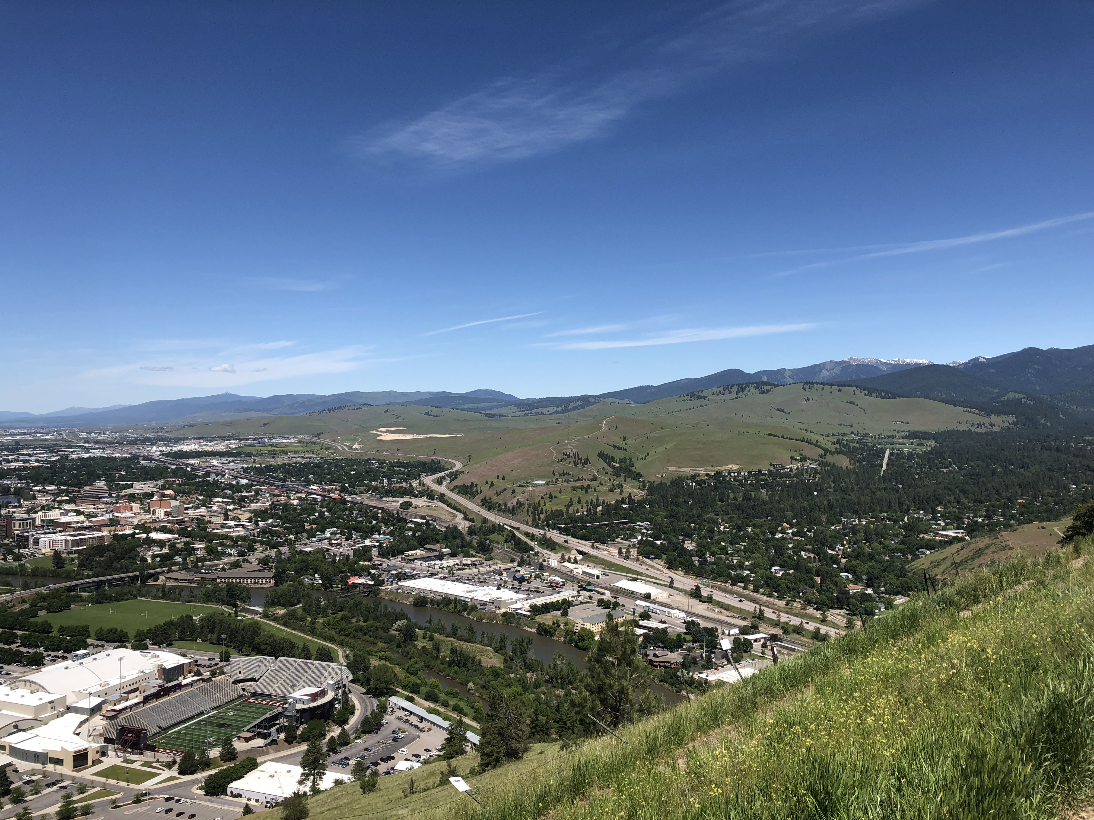
Confederated Salish Kootenai Tribe

Slide 30
The Beginning-2011
MTDPHHS - $25,000 Grant
Two cohorts of 10-20 to 4 cohorts of 10-20
RD led
Fitness Center membership
Class cost: $100 - $50 back if complete the course
Assessment of stages of change
1 hour of exercise

Slide 31


Slide 32
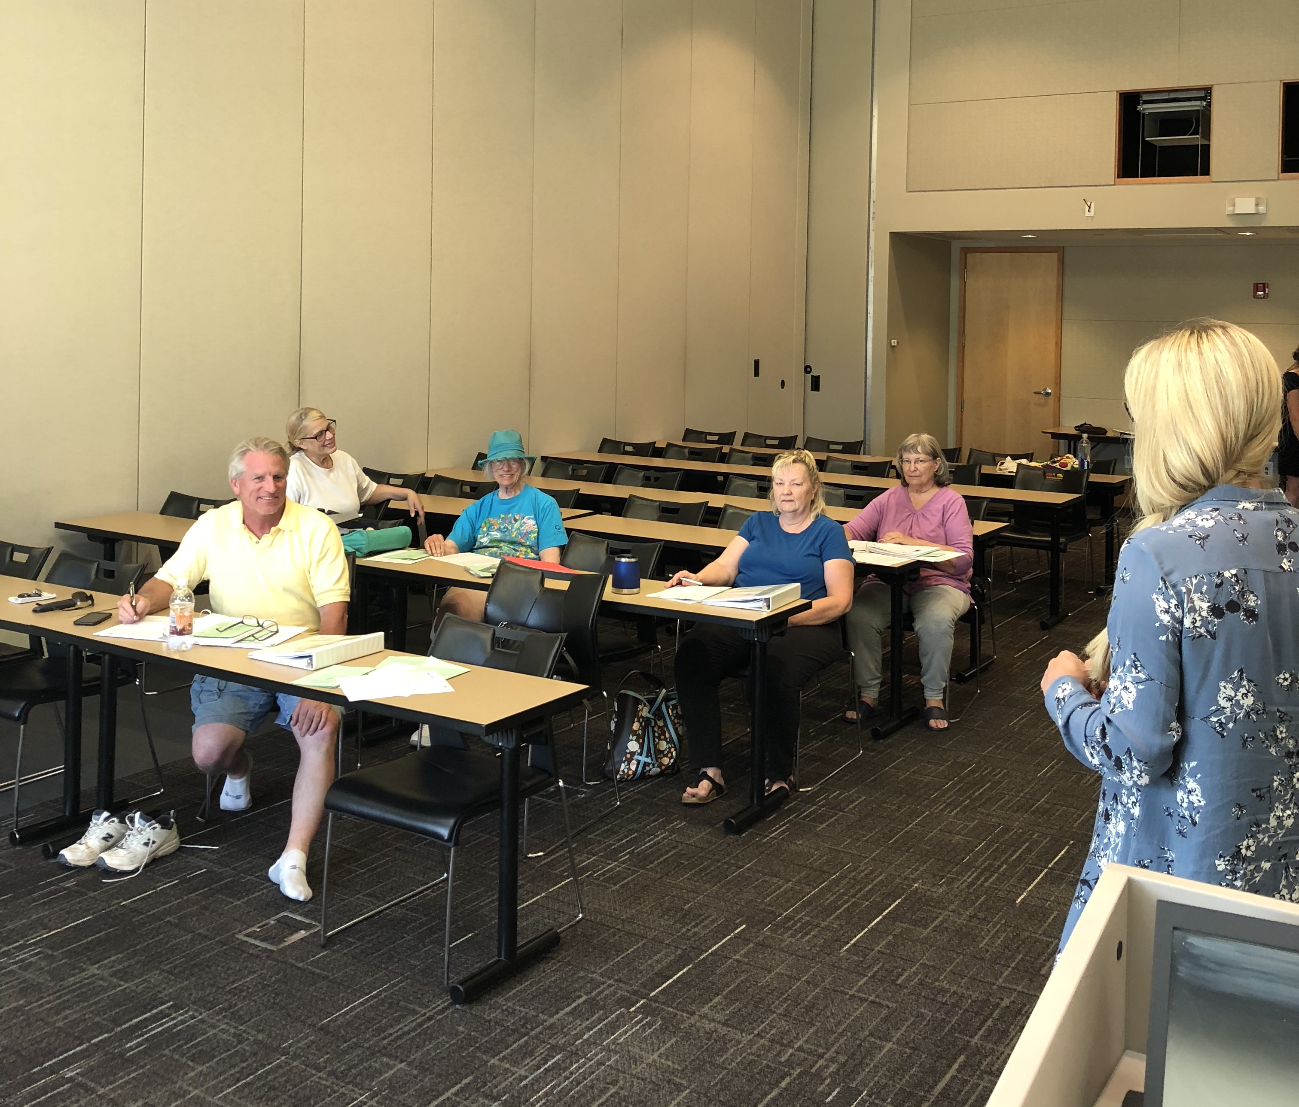
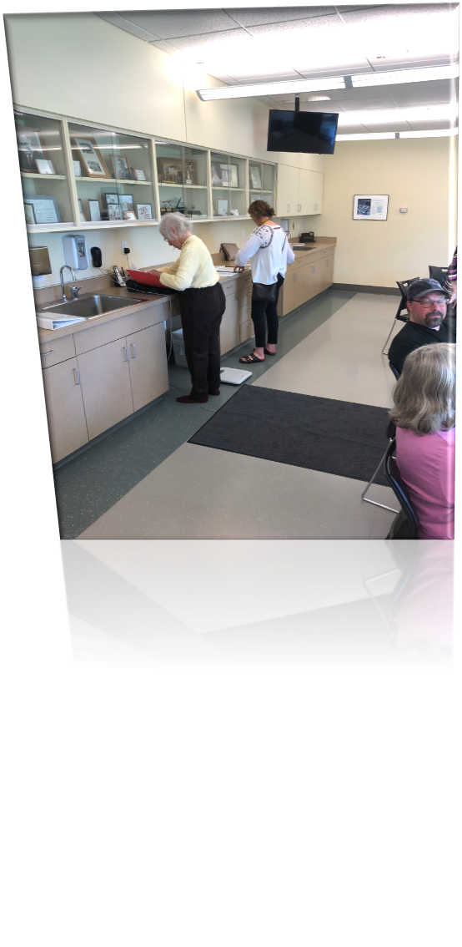

Slide 33
AADE Grant - 2013
Added five sites
CSKT – Polson, Arlee and St. Ignatius
Boldt Diabetes Center – SW Washington, Olympia and Centralia
Sent 3 RD’s, 1 Counselor, 2 RN’s, 1 LPN, 1 Health Coach to Lifestyle Coach training
Mentorship –site visit, phone calls

Slide 34
Upstream Health - 2014
Connection with statistician at the University of Montana
Predictive analytics – ROI
9 cohorts completed in Missoula
5 cohorts completed at Boldt

Slide 35
Missoula data
Age 25-85
.137 lbs/day wt. loss
End of weekly meetings = increase weight
Reversion to normoglycemia = delay
1 hour of exercise/class

Slide 36
Financial results for both…
Positive NPV, ROI and rate of return over 5 years
Missoula: NPV=$269, ROI=67.2%, Annualized 10.8%
Combined: NPV=$236, ROI=58.9%, Annualized 9.7%

Slide 37

Secured reimbursement!!!
Notes:
Foundation scholarship

Slide 38
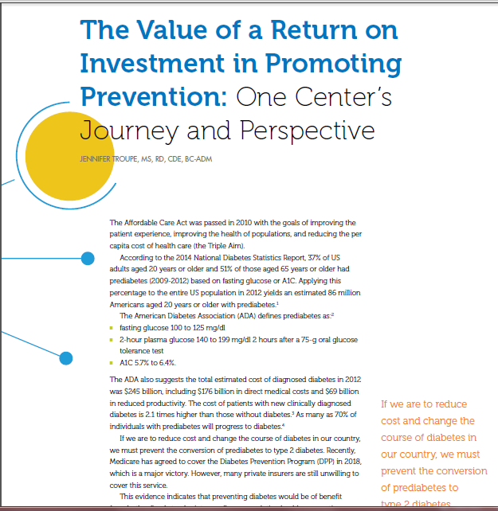
May, 2017
AADE in Practice

Slide 39
Current Model
Health Coach led
Master Trainer
Expansion to Portland, Oregon
Classes consist of 10-15
Boldt and CSKT run their own programs
Monthly calls
YMCA, Florence and Missoula are sites
Two exercise options

Slide 40
Current Model, cont.
Bill all payers (Medicaid & PHP)
Involvement of Primary Care Council
Work with Nurse Case Manager to screen patients – CDC risk form
Scholarships for those in need

Slide 41
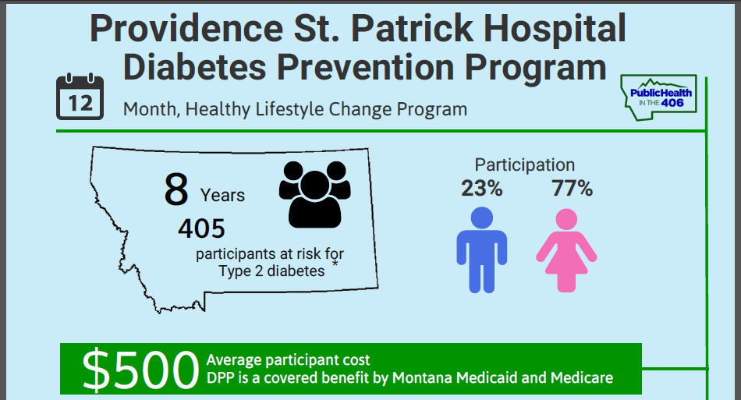
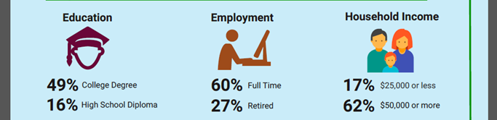

Slide 42
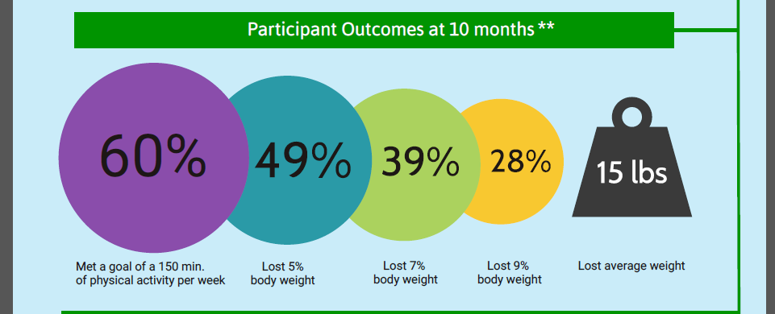
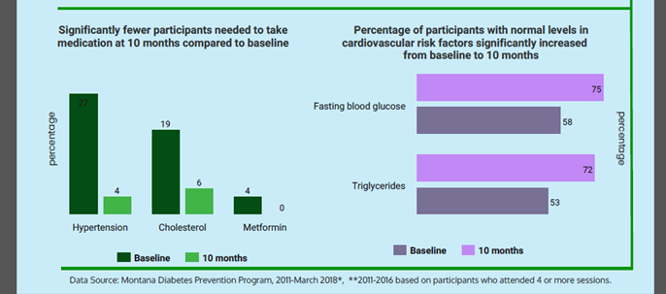

Slide 43
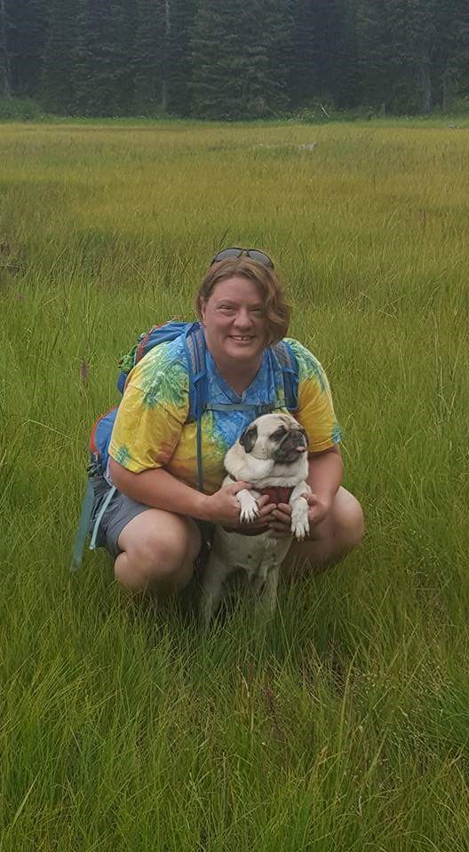
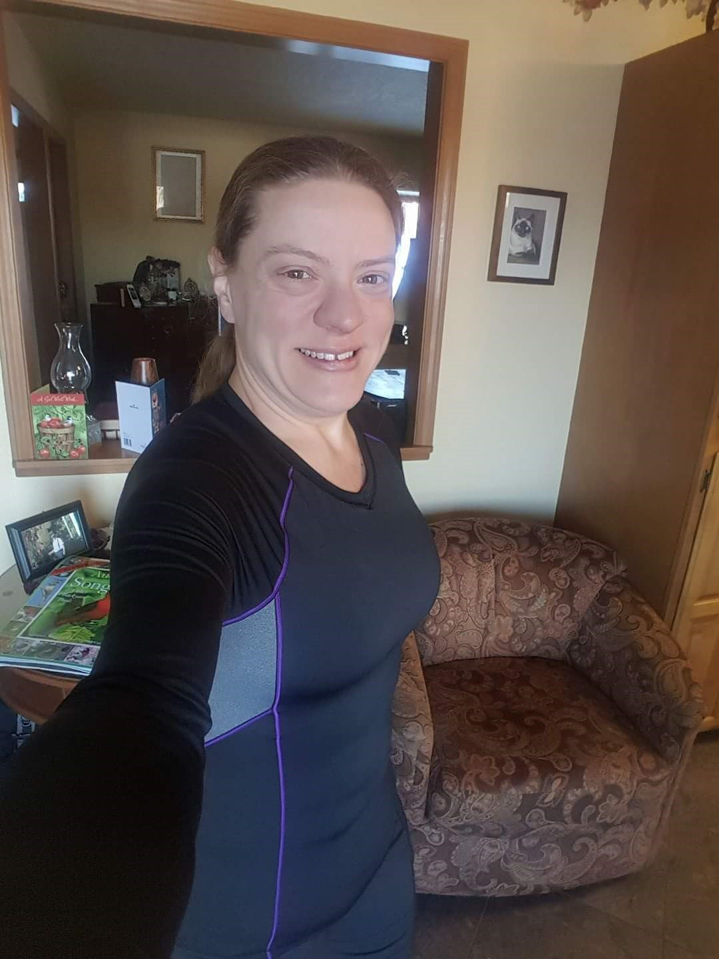
Patient Stories…

Slide 44


Slide 45
The Future
Screen for Type 2 Diabetes in all Primary Clinics anyone over 40
Utilize A1C for high risk patients (9 or greater on CDC test)
Have a DPP in all Primary Care Clinics (Virtually or in person)
Continue to utilize EMR to drive referrals and automate process
Bill Medicare in September
Ensure other insurance carriers provide coverage

Slide 46
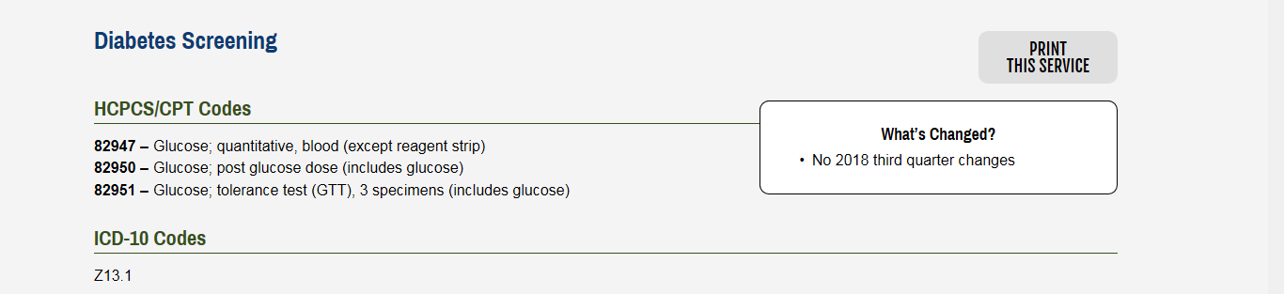
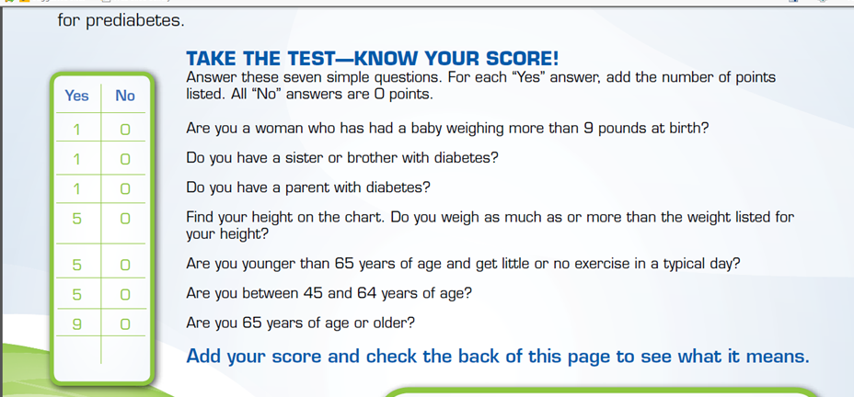
Automate the process….
Screening 45 and older or 40 and older

Slide 47
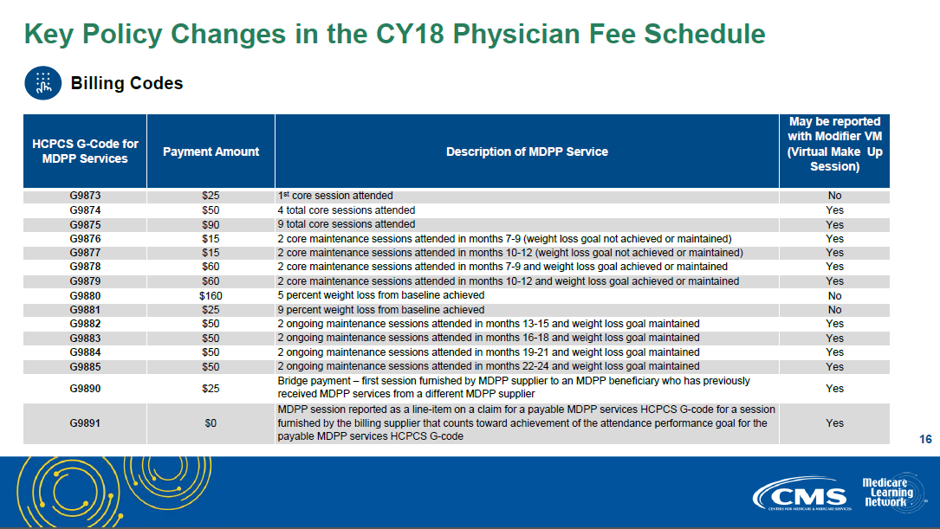

Slide 48


Slide 49
Recap
Know your Business
Speak their language
Demonstrate outcomes
Don’t be afraid to go outside your box

Slide 50
Persistence
“Nothing in this world can take the place of persistence. Talent will not; nothing is more common than unsuccessful people with talent. Genius will not; unrewarded genius is almost a proverb. Education will not; the world is full of educated failures. Persistence and determination alone are omnipotent.”
~Calvin Coolidge

Slide 51

Questions?

