Slide 1

Evaluation the Impact of Year-Long
Augmented Diabetes Self-management Support
“Together on Diabetes”

Slide 2
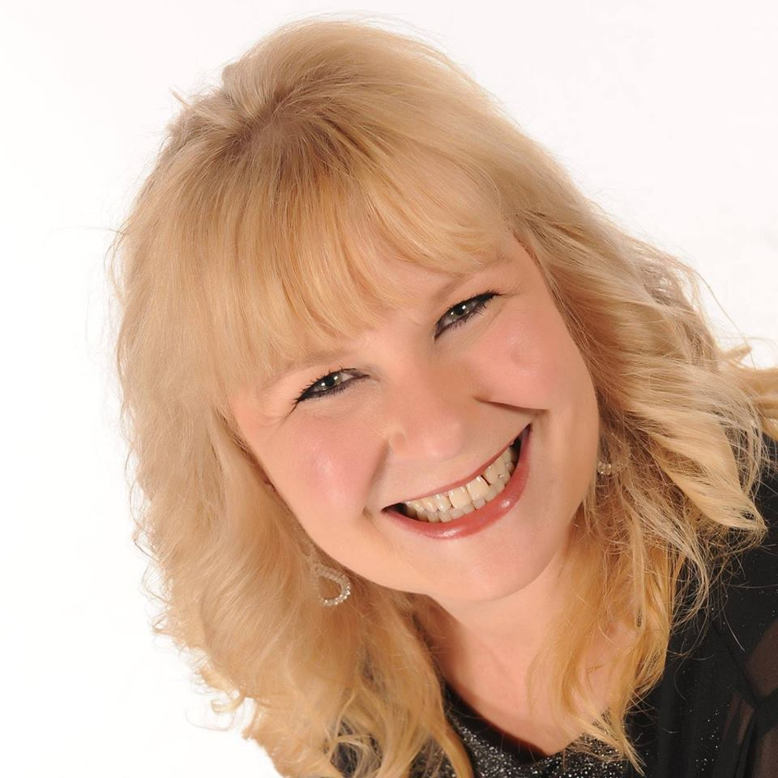
Leslie E. Kolb
RN, BSN, MBA
Chief Science and Practice Officer
American Association of Diabetes Educators
Chicago, Il

Slide 3
Disclosure to Participants
Notice of Requirements For Successful Completion
  Please refer to learning goals and objectives
  Learners must attend the full activity and complete the evaluation in order to claim continuing education credit/hours
Conflict of Interest (COI) and Financial Relationship Disclosures:
  Presenter: Leslie E. Kolb RN, BSN, MBA – No COI/Financial Relationship to disclose
Non-Endorsement of Products:
  Accredited status does not imply endorsement by AADE, ANCC, ACPE or CDR of any commercial products displayed in conjunction with this educational activity
Off-Label Use:
  Participants will be notified by speakers to any product used for a purpose other than for which it was approved by the Food and Drug Administration.

Slide 4
Learning Objectives
Describe expanded support in a DSMES service to people with type 2 diabetes in underserved communities through delivery of telephonic support provided by CHWs.
Explain the roles that AADE, FQHCs, APhA Foundation and NCFH played in the study.
Discuss the positive and unexpected results.

Slide 5
Project
Evaluating the impact of year long, augmented diabetes self-management support

Slide 6

Funded
Bristol Myer Squibb Foundation

Slide 7
Project Goals
Improve patient self-management education
Improve access/linkage to care
Improve quality of care
Engage in community organizing and mobilization
Expand and enhance community resources for diabetes management
Improve self-management behavioral and clinical health outcomes
Improve health at the population level
Improve health equity
Engage in dissemination efforts
Sustaining interventions and resources

Slide 8
Planning and Partnership Coordination
Federally Qualified Health Centers (FQHC)
  El Rio Community Health Center
  Triad Adult and Pediatric Medicine, Inc.
  Cross Trails Medical Center
  FamilyCare HealthCenter
*All sites needed AADE or ADA Medicare Certification

Slide 9
Planning and Partnership Coordination
American Pharmacists Association Foundation (APhAF)
  Project IMPACT and related technological innovations
  Training on Project IMPACT Provided to Program Coordinators at each site.

Slide 10
Project IMPACT Database Explorer
Microsoft Access ® database for Project IMPACT ™
  Diabetes data collection and reporting system.
  Provides practitioners with patient level data to track individual progress
  Produce aggregated, anonymous dataset outputs
  Overall view of how the community is progressing

Slide 11
Project IMPACT Database Explorer
Key to the development and implementation of this care coordination model for underserved persons with type 2 diabetes.
System was enhanced to ensure facilitation of communication and participant information sharing between the providers of DSME and the healthcare Navigators providing DSMS.
Notes:
For example, some of the enhancements provided each of the diabetes-educator investigators access to the healthcare navigators’ notes regarding the phone calls held with patients at the investigator’s site (DSMS recordkeeping).
(Please note that BAA’s in place also allowed the APhA Foundation [but not AADE] to see patient data at the individual level.)

Slide 12
Planning and Partnership Coordination
National Center for Farmworker Health (NCFH)
  Health Navigator(HN) provided the telephonic diabetes self-management support (DSMS)
  CHW training provided by Diabetes Educators prior to the start of the study

Slide 13
Telephonic Support Goal
Improve participants’ ability to self-manage their diabetes through additional enhanced support

Slide 14
Telephonic Support Included
Reinforce goal setting
Work with participants to improve their skills at problem solving
Help identify community resources
Engage participants in motivational interviewing to elicit participants’ own insight about possible ways to address problems they are encountering
Provide positive reinforcement for goal attainment

Slide 15
Telephonic Support Highlights
Support System
  Identifying family members, friends and colleagues
  Understanding family dynamics
  Identifying specific support activities
  Identifying external resources

Slide 16
Telephonic Support Highlights
Problem Solving
  Dealing with feelings of stress, being overwhelmed
  Identifying barriers to success
  Identifying strategies to overcome challenges
  Assisting in breaking tasks down

Slide 17
Telephonic Support Highlights
Positive Reinforcement
  Identifying small gains
  Reinforcement of positive behavior changes
  Providing accountability
  Continuity of communication

Slide 18
Telephonic Support Highlights
Education
  “No symptoms, No worries”
  Need for additional education
  Meal planning especially challenging

Slide 19
Observations from Health Navigators
Participants
  Became attached even after not opening up at the beginning
  Look forward to calls
  Feeling of someone caring
  Sharing text messaging when feeling proud of themselves

Slide 20
Challenges Participants Shared with Health Navigators
Transportation
Long wait time (30minutes or more) to speak with the operator at the health center.
Patients cannot afford Rx or strips for glucometer
Lack of health coverage to do eye exams, feet exams, and other screenings to reduce risk
Stress (family, finances, and other health issues)
Bad weather limits patient to keep active (walking) – HNs talk about other physical activities they can do at home like chair exercise, stretching, dancing (if they are able).

Slide 21
Success Stories – Shared with Health Navigators
Participant thanked Health Navigator for the support. He shared with her that just when he started not to care and not follow recommendations, he received an interactive call. The call helped him continue to try to manage his diabetes.
His wife also had diabetes; he shared with her the importance of having it under control.
Encouraged his wife to go out for walks at the park and information about eating fewer carbs.

Slide 22
Success Stories – Shared with Health Navigators
Participant showed much appreciation for DSME and interactive calls since the beginning.
A1C of 12.3 - August 2015 and by January 2016 his A1C was 6.2.
He was extremely happy and acknowledged that participating in the DSME study helped him manage diabetes.
Followed all the Diabetes Educator recommendations and it paid off.
He was very grateful for the interactive calls not only because he felt accountable but because he did not feel comfortable talking to anyone about his condition. He did not want his relatives to know he had diabetes because he was afraid of how they would react.
Talking to the Health Navigator made him feel confident that he could manage diabetes

Slide 23
Participant Perspective
Participant started the study with an A1c of 13.2% and ended the study with an A1c of 6.7%.
Lost 42 pounds from one year ago.
Met each self-management goal that was set collaboratively
Has a long term goal of swimming a total of 50 miles by the end of the year. He was in the control group, but stated that the accountability of the visits were what helped him stay on track.
When diabetes educator gave him his last $20 gift card today, he said, “I’m not using this for food. I’m going to buy a pedometer!”.

Slide 24
Participant Perspective
Middle age female patient came for the 15 months office visit. She is on insulin twice a day, no oral medications
Told diabetes educator that the monthly phone calls help:
  Cope with her stress,
  Provided tips for her to reduce stress such as set alone time, walks, and talking with her friends
Her A1c was 11.9 at the beginning of the study and it was 6.2 at the end of the study.

Slide 25
Unexpected News
Adding the telephonic intervention with call center support did not produce a statistically significant difference in clinical results between control and intervention groups.
The telephonic intervention with call center support did not produce a statistically significant difference in # of self-care goals set or achieved between control and intervention groups, except for Being Active achievement in the intervention group.

Slide 26
Positive News
Through this AADE initiative, a well-designed, randomized, controlled evaluation was implemented.
The comprehensive care in the FQHCs that was implemented for all patients, made consistent by our evaluation/documentation process, produced impressive clinical changes for all participants.

Slide 27
Key Learnings - Important Factors
Using a single IRB for all organizations ensured any changes to the protocol did not need to be approved by multiple IRB partners which conceivably could require different things in terms of protocol modification and thus cause delays in protocol modification approval.
Using a single database helped avoid complications in data analysis that likely would have been created had each site been responsible for providing its own database.
Using a single call center for telephonic DSMS delivery, which not only made DSMS delivery equivalent across the four participating sites, but also avoided the potential for disruptions such as staff turnover that might have occurred if each site had been responsible for providing DSMS.

Slide 28
Moving Forward - FQHCs
Incorporate more phone follow-ups with participants when appropriate.
Revising standard DSME practice by incorporating a more robust schedule of follow up phone calls by the diabetes educator.
BMSF-funded study contributed to decision to have a more robust schedule of health coaches’ DSMS support delivery and to make plans for implementation of diabetes patient support groups

Slide 29
Program Observations
A number of patients were availing themselves of all of the phone calls but missing DSME office visits.
  Reasons shared:
    Difficulties such as work-related schedule conflicts
    Transportation issues
    Issues with social settings
Some of these patients seemed discouraged when the call schedule switched from every two weeks to every four weeks.

Slide 30
Program Observations
Resulted in sustainable, tangible strengthening of their DSME program.
One educators role in this study was a major contributing factor in her promotion from a part-time to a full-time appointment.
Contributed to ones program decision to have:
  A more robust schedule of health coaches’ support delivery
  Make plans for implementation of diabetes patient support groups (twice a year; includes an insulin pump group, a T1D support group, and a T2D support group.)

Slide 31
Program Observations
Insight from the project lead to making tangible, sustainable changes to its standard care
Telephonic support appeared to benefit the participants with regard to the clinical outcomes of BMI and A1C
Standard DSME is being strengthened by providing email support in addition to the monthly T2D participant support groups and follow up modes already in place.

Slide 32
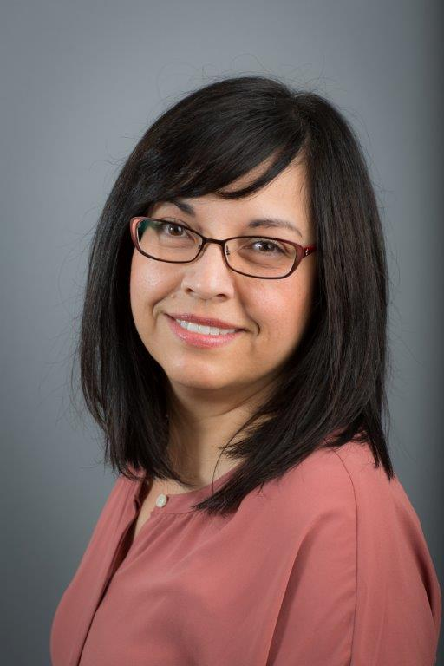
Marisa Rowen
PharmD, CDE
Associate Pharmacy Director- Advanced Practice Services
Clinical Pharmacist
El Rio Health Center
Tucson, AZ

Slide 33
Disclosure to Participants
Notice of Requirements For Successful Completion
  Please refer to learning goals and objectives
  Learners must attend the full activity and complete the evaluation in order to claim continuing education credit/hours
Conflict of Interest (COI) and Financial Relationship Disclosures:
  Presenter: Marisa Rowen, PharmD, CDE – none
Non-Endorsement of Products:
  Accredited status does not imply endorsement by AADE, ANCC, ACPE or CDR of any commercial products displayed in conjunction with this educational activity
Off-Label Use:
  Participants will be notified by speakers to any product used for a purpose other than for which it was approved by the Food and Drug Administration.

Slide 34

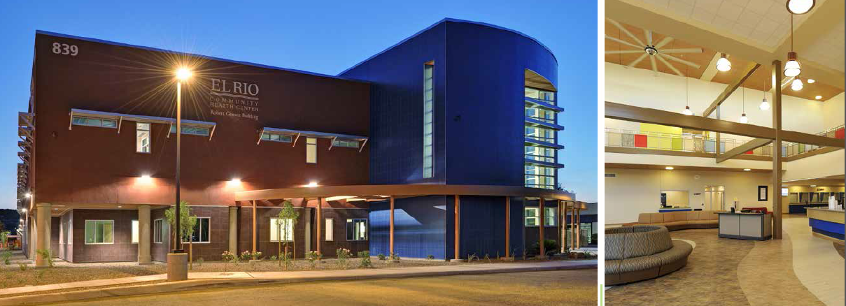
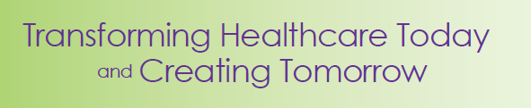
El Rio Health Center

Slide 35
El Rio Health Center
Over 100,000 patients
14 Locations in Tucson
25 Partner Organizations
28 Educational Partnerships
Over 360,000 Annual Patient Visits
  37% children
  53% adults
  10% seniors

Slide 36

Our Team
Providers
  MD, DO, PA, NP
Nursing
  MA, LPN, RN, RNCC
Pharmacy
  Out-patient
  Advanced Practice
  Hybrid
Health Builders
  Behavioral Health Consultants
  Exercise specialists
  Dietician
Social
  Eligibility
  Community Health Advisors
Specialty
  HIV/AIDS
  Psych
  Transgender
  Homeless
  OB/GYN and Midwifery
  Teen School Based
  Geriatrics
  Hepatitis C
In Training
  Students
  Residents
Outreach
  Patient Communications
  IT analysts
Foundation

Slide 37
El Rio DSME Team is Rx Driven
Started with a collaborative practice model in 2000
Includes prescriptive authority
Available at all primary care locations
Most number of bi-lingual CDE’s under one organization in Arizona
Organizational model of care focused on motivational engagement
Training site for new practitioners
  Pharmacists
  Physicians
  Nurses

Slide 38
Patients Living With Diabetes by Site and Percent Seen for DSME

Slide 39
Total DSME Encounters by Month

Slide 40
Total APP Encounters by Year

Slide 41
Study Involvement
Able to recruit all patients
Incentive a big draw for the study
Familiarity with the research tool helped
Looked at this opportunity as a way to explore expansion of services using telephone based care

Slide 42
Participant Stories
Liked engaging in conversations generated by the patient knowledge tool
  Ability to review topics never considered
  Affirmation that “I know something”
  Fun when you could say, “I think this isn’t right”

Slide 43
Participant Stories
Felt natural
Nice to have new options
At first incentive was the driver but transitioned to quality of care provided
New baby on the way!

Slide 44
Participant Stories
Enjoyed the option of care at home for those in the intervention group
  It is nice to have care where you are comfortable and when you want it
Felt researchers involved with the study really cared about their well-being (sincere)
Didn’t want the experience to end

Slide 45
Data Collection
Utilized an established tool
Double documentation was something that needed to be overcome
Tracking of interventions made easy to review
Communication between various parts of the study brought together via the database

Slide 46
Call Center Impact
Staff were sincere, helpful and attentive
Patient’s enjoyed the interactions
Convenient for participants
Messaging from call center to medical home was timely and complete
Staff responsive to feedback
Experienced staff available for backup support
Were flexible with time zone and work schedules
Motivational engagement focus of communication

Slide 47


Slide 48


