Slide 1



Slide 2


Organization Name
Name | Title
Email | Phone Number

Slide 3
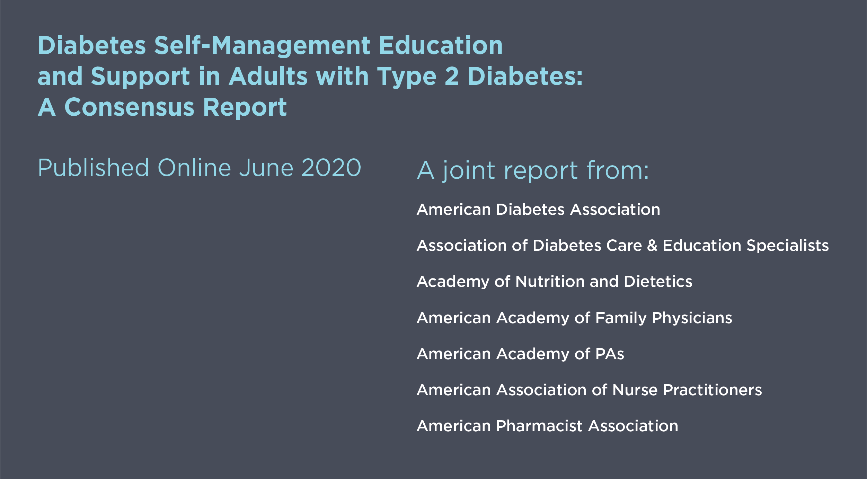
2020 DSMES Consensus Report
To access the report visit DiabetesEducator.org/ConsensusReport

Slide 4
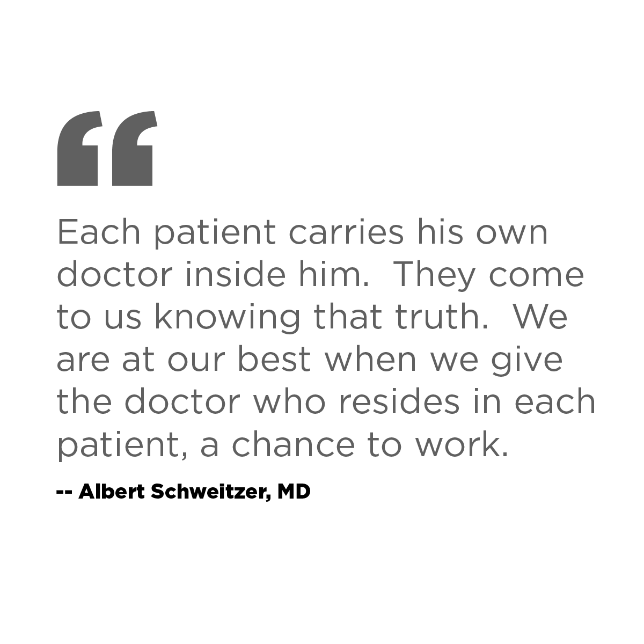
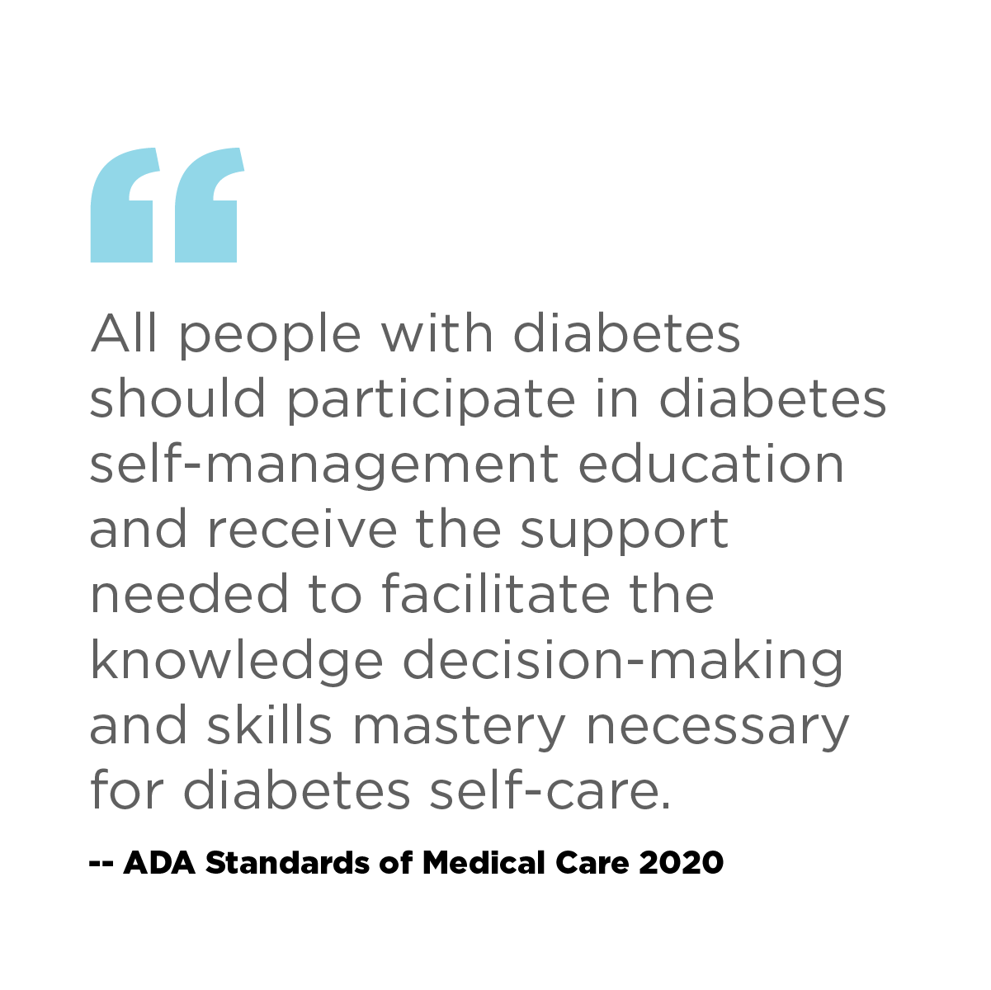

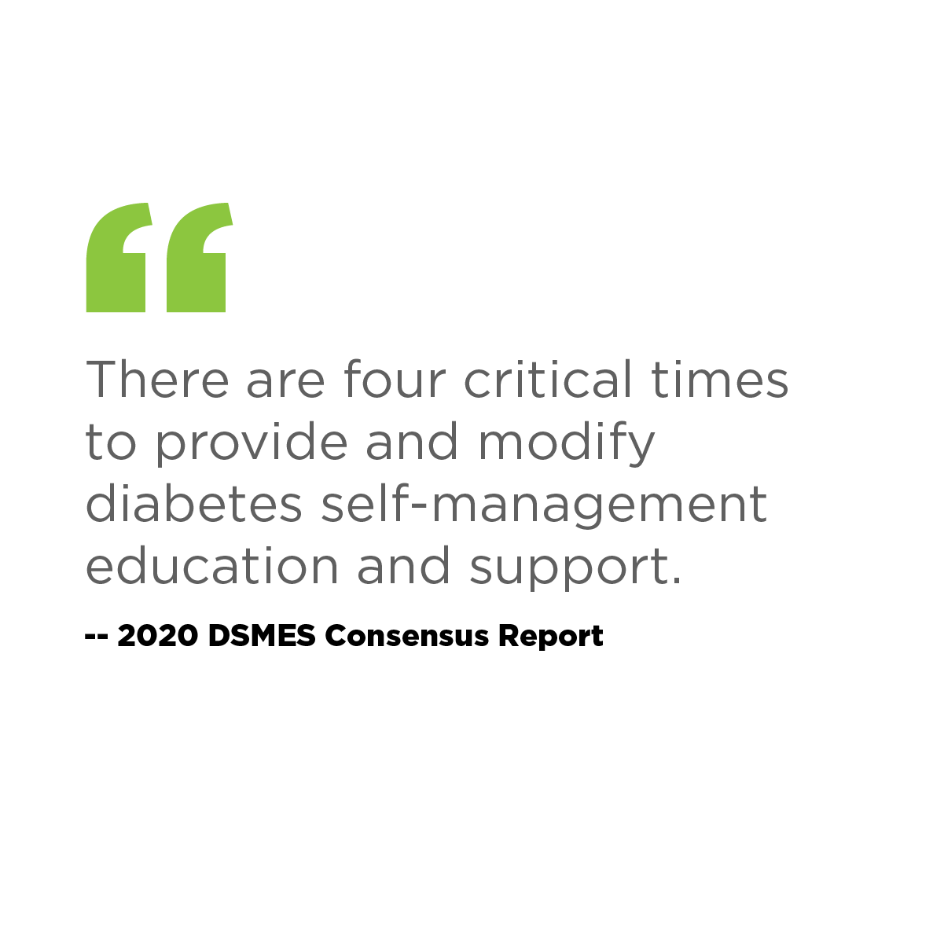

Slide 5
Presentation Goal and Objectives
GOAL
Increase the number of persons with diabetes who benefit from diabetes
self-management education and support.
OBJECTIVES
Summarize the benefits of diabetes self-management education and support.
Describe the 4 critical times to provide and modify DSMES.
Discuss recommendations to implement DSMES.

Slide 6
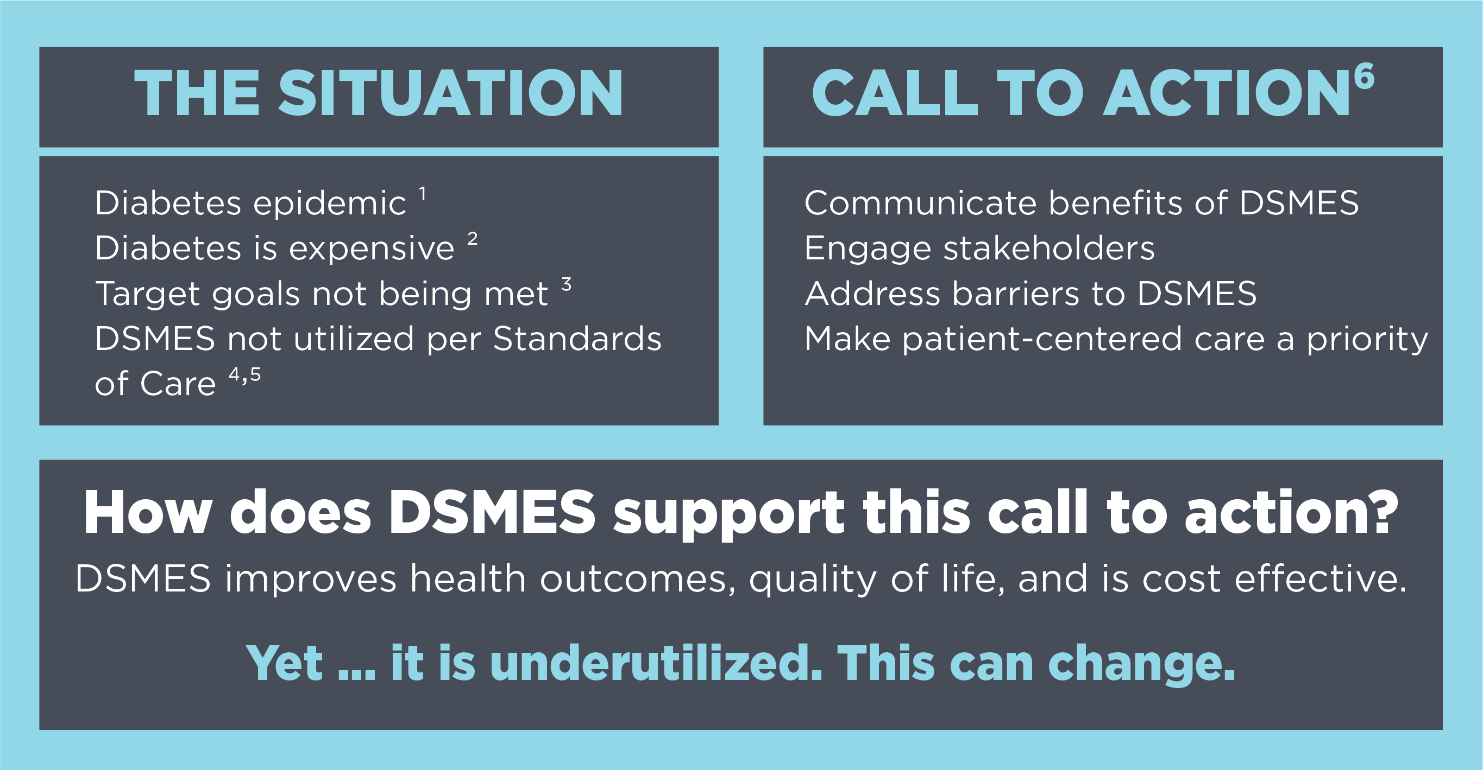
DSMES is underutilized
Lin J, et al. Population Health Metrics, 2018
ADA. Diabetes Care, 2018
Kazemian P, et al. JAMA Internal Medicine, 2019
4. ADA. Standards of Medical Care, Diabetes Care, 2020
5. Strawbridge LM, et al. Health Educator, 2015
6. Powers MA, Bardsley JK, et al. DSMES Consensus Report, The Diabetes Educator, 2020

Slide 7
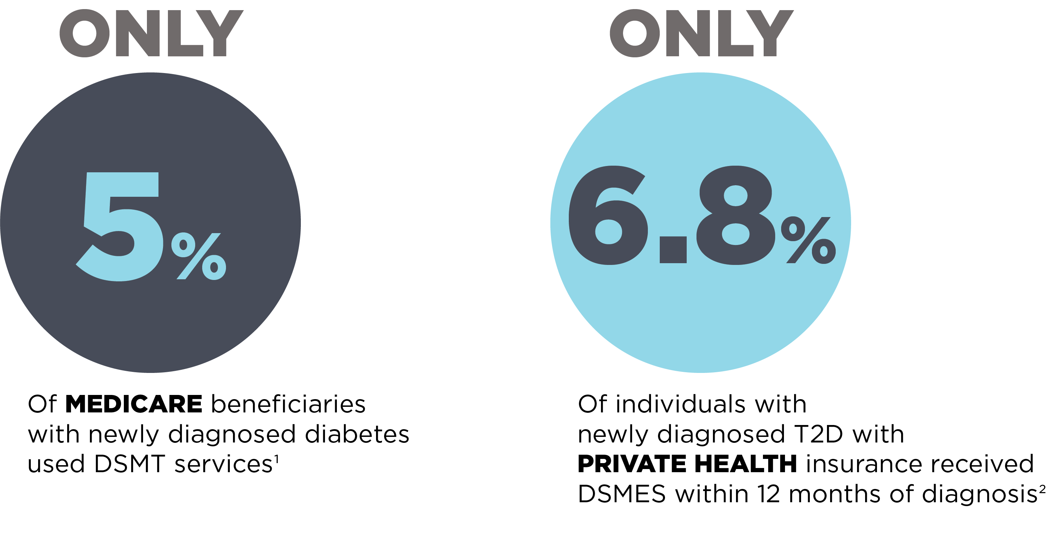
DSMES is underutilized
Li R, et al. Morbidity Mortality Weekly Report, 2014
Strawbridge LM, et al. Health Educator, 2015

Slide 8
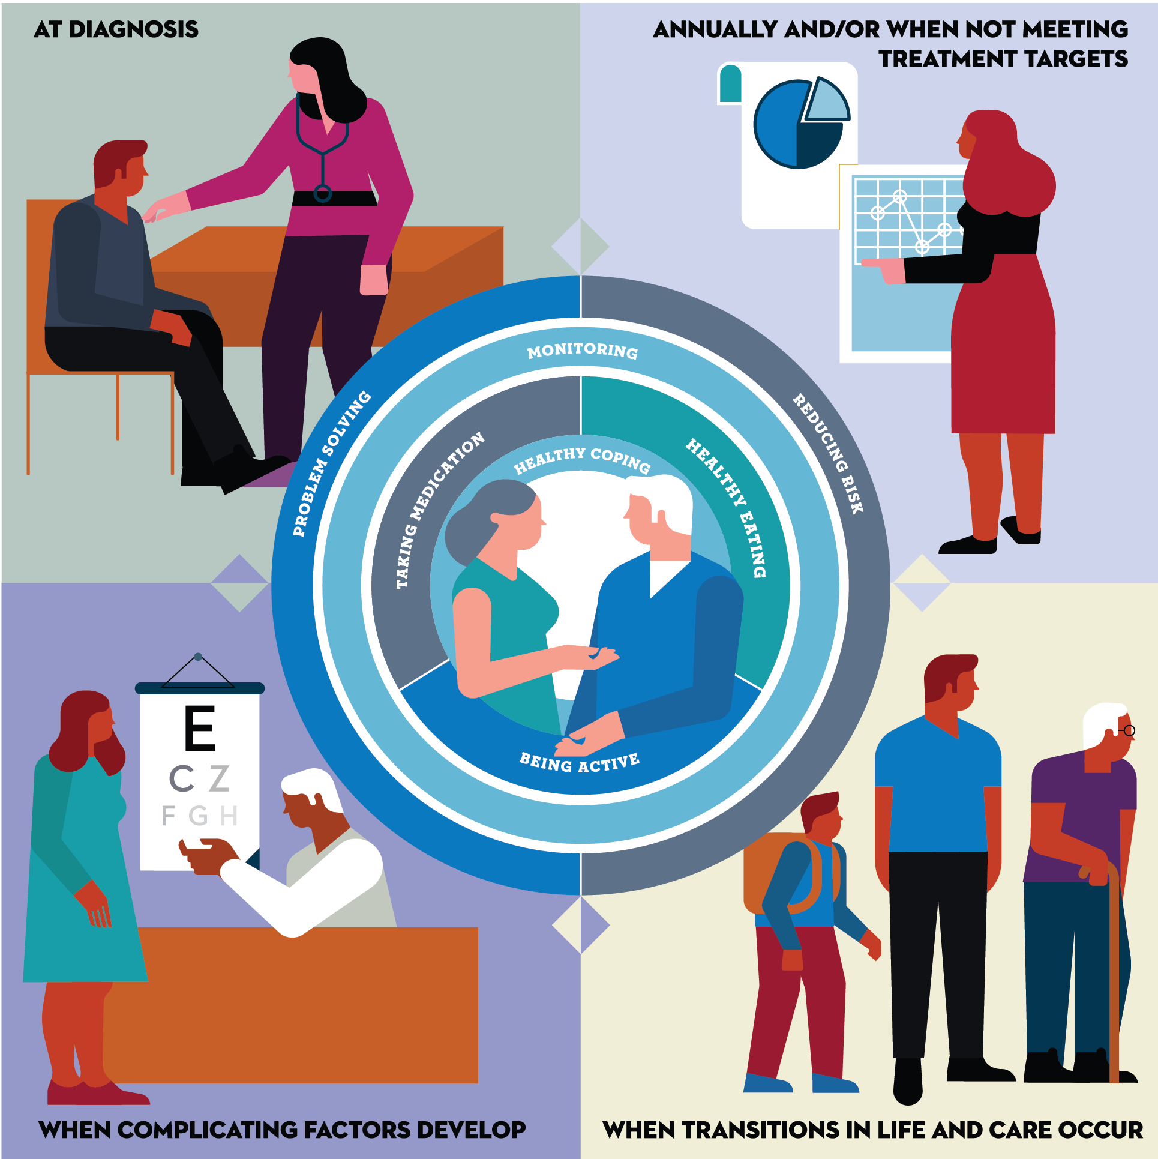
Four critical times to provide and modify DSMES
At diagnosis.
Annually and/or when not meeting treatment targets.
When complicating factors develop.
When transitions in life and care occur.
Powers MA, Bardsley JK, et al. DSMES Consensus Report, The Diabetes Educator, 2020
ADCES. AADE7 Self-Care Behaviors, The Diabetes Educator, 2020

Slide 9
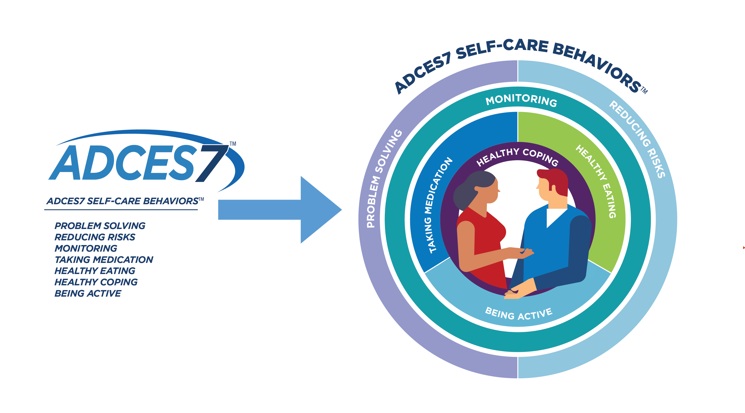
ADCES. AADE7 Self-Care Behaviors, The Diabetes Educator, 2020

Slide 10
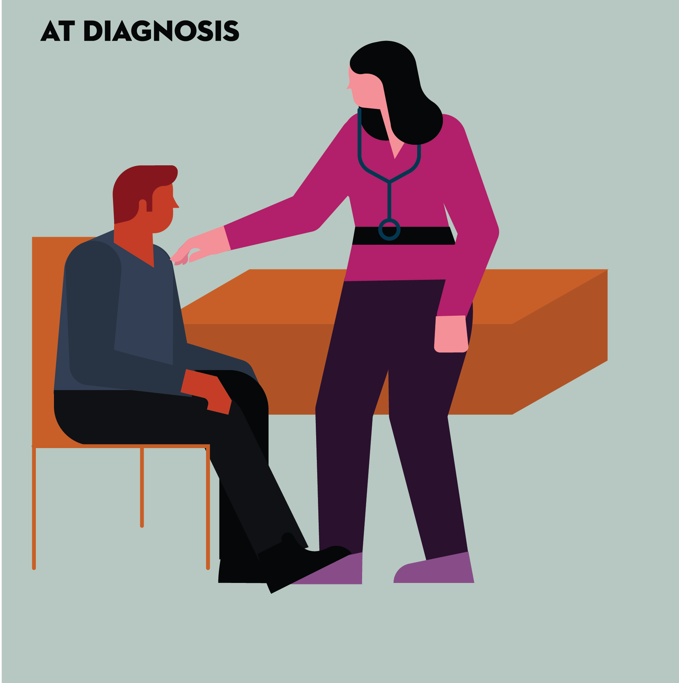
At diagnosis.
Powers MA, Bardsley JK, et al. DSMES Consensus Report, The Diabetes Educator, 2020

Slide 11
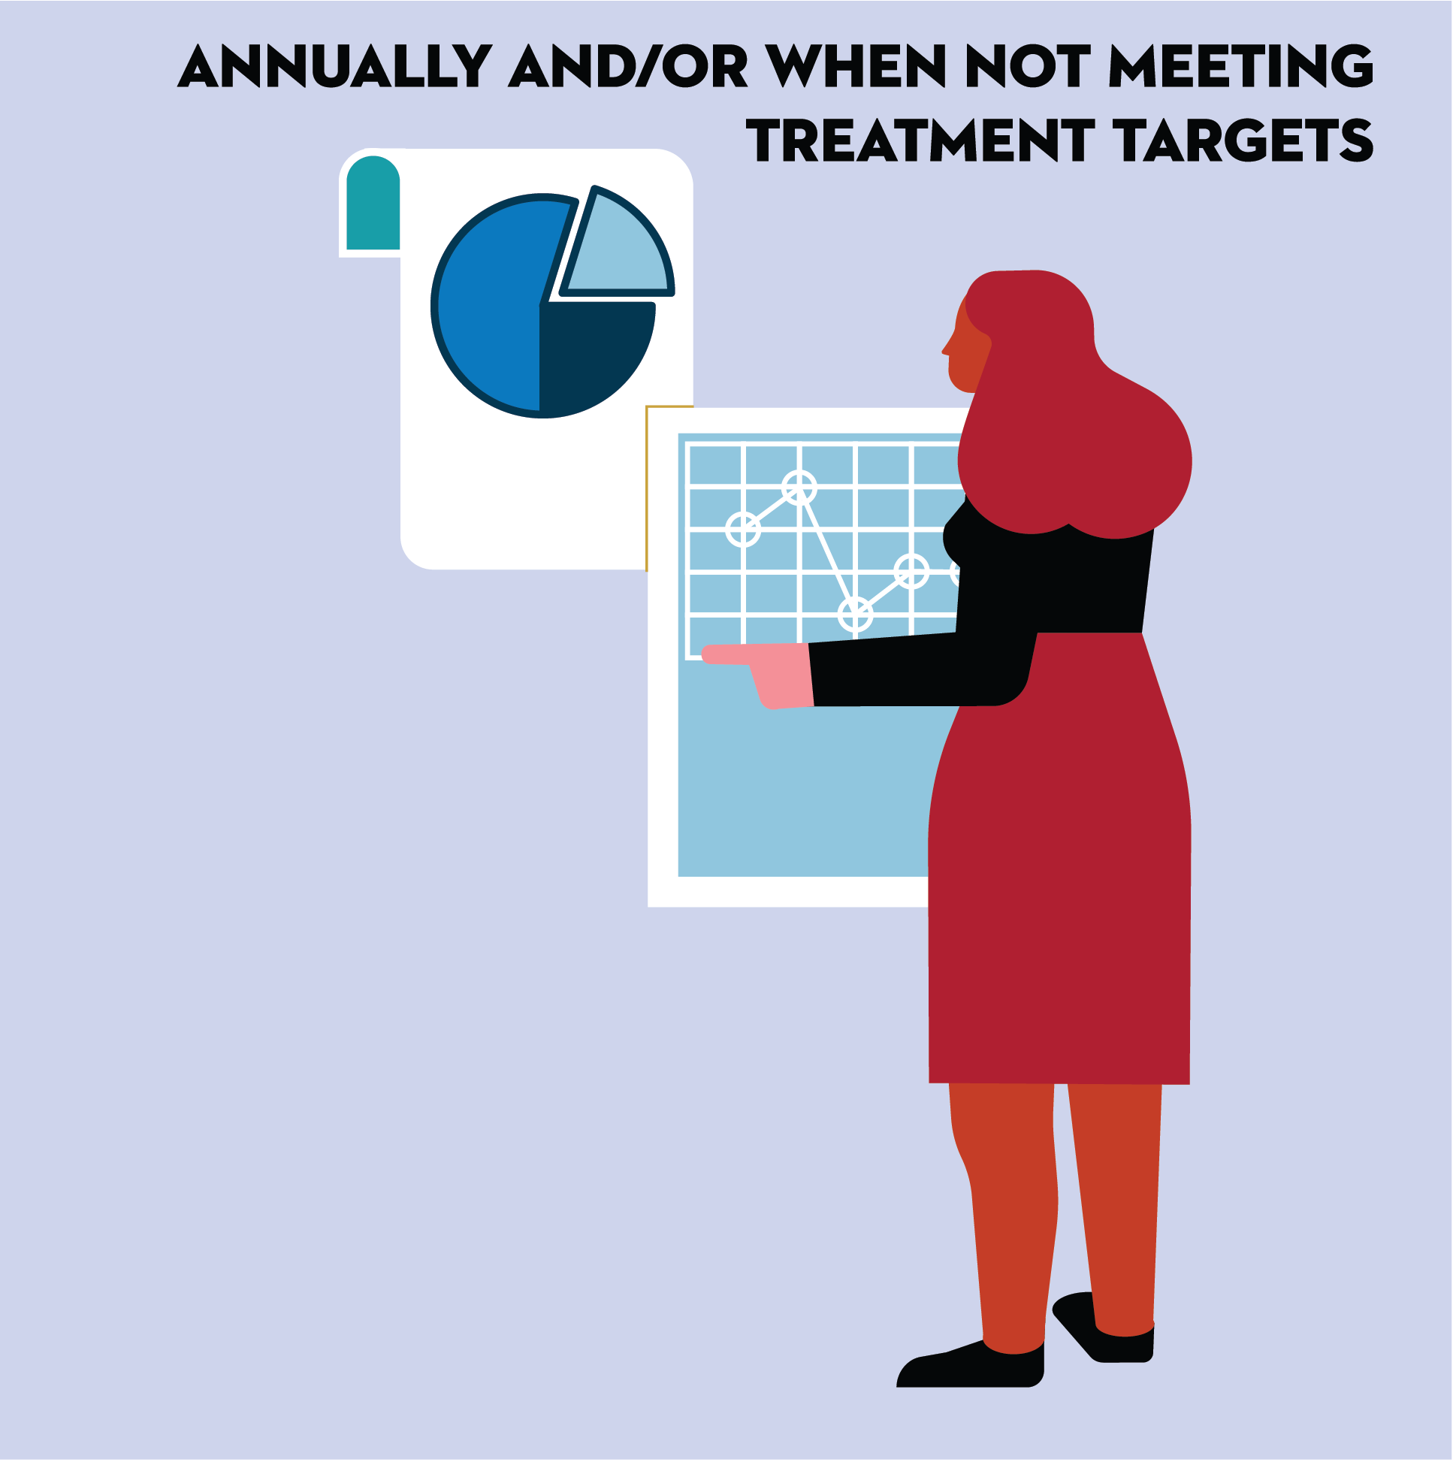
Annually and/or when not meeting treatment targets.
Powers MA, Bardsley JK, et al. DSMES Consensus Report, The Diabetes Educator, 2020

Slide 12
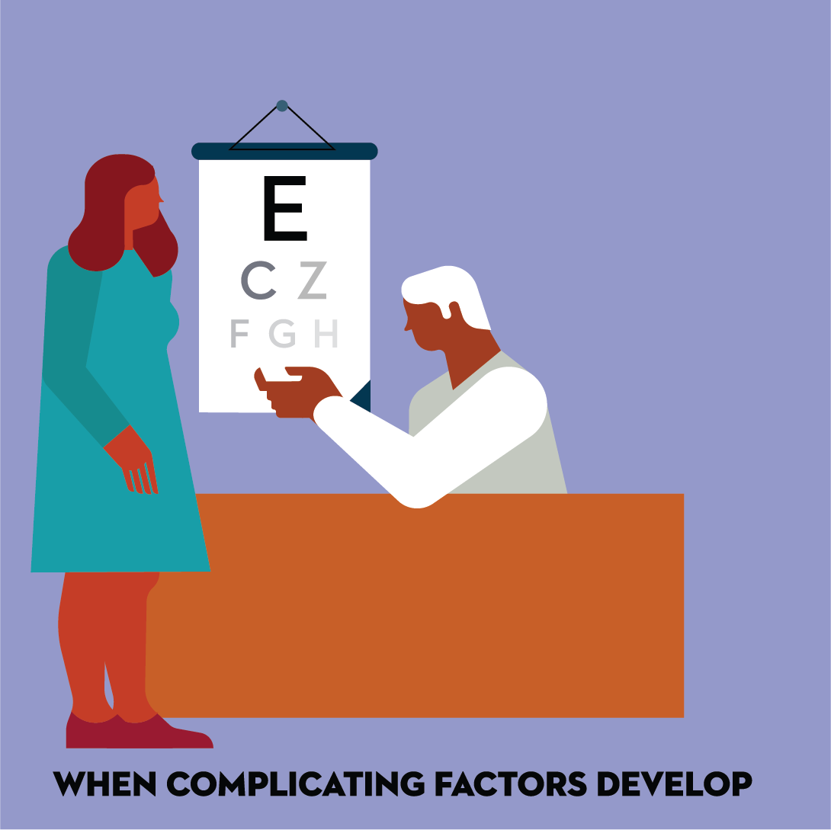
When complicating factors develop.
Powers MA, Bardsley JK, et al. DSMES Consensus Report, The Diabetes Educator, 2020

Slide 13
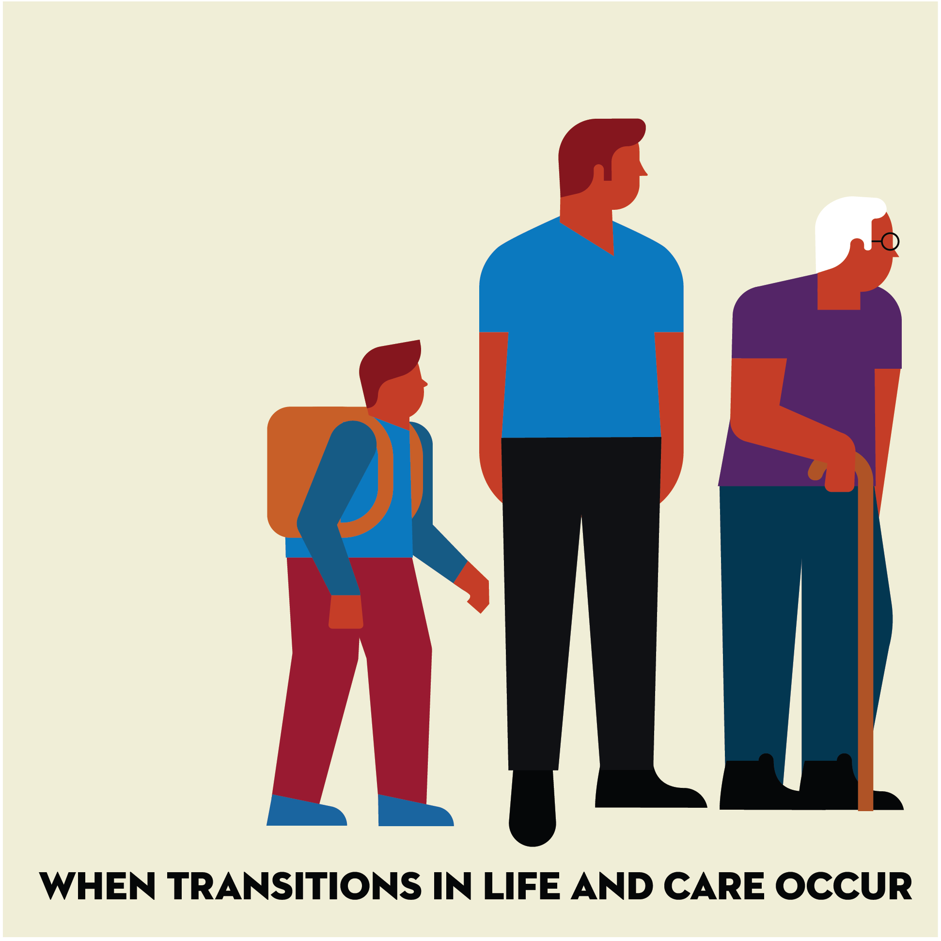
When transitions in life and care occur.
Powers MA, Bardsley JK, et al. DSMES Consensus Report, The Diabetes Educator, 2020

Slide 14
DSMES benefits
Summary of DSMES benefits to discuss with people with diabetes
Provides critical education and support for implementing treatment plans.
Reduces emergency department visits, hospital admissions and hospital readmissions.
Reduces hypoglycemia.
Reduces all-cause mortality.
Lowers A1C.
Promotes lifestyle behaviors including healthful meal planning and engagement in regular physical activity.
Addresses weight maintenance or loss.
Enhances self-efficacy and empowerment.
Increases healthy coping.
Decreases diabetes-related distress.
Improves quality of life.
No negative side effects | Medicare and most insurers cover the costs
Powers MA, Bardsley JK, et al. DSMES Consensus Report, The Diabetes Educator, 2020

Slide 15
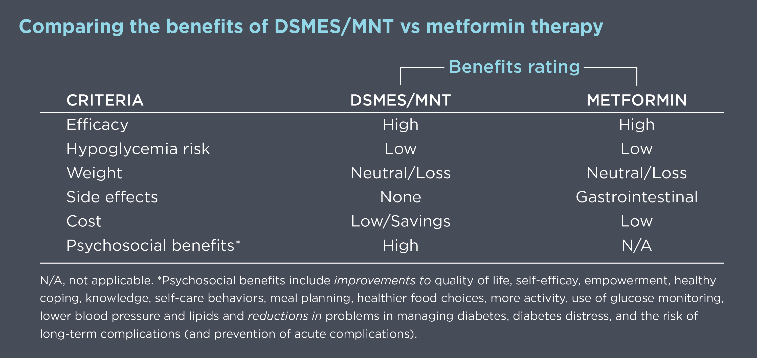
If DSMES were a pill, would you prescribe it?
Powers MA, Bardsley JK, et al. DSMES Consensus Report, The Diabetes Educator, 2020

Slide 16

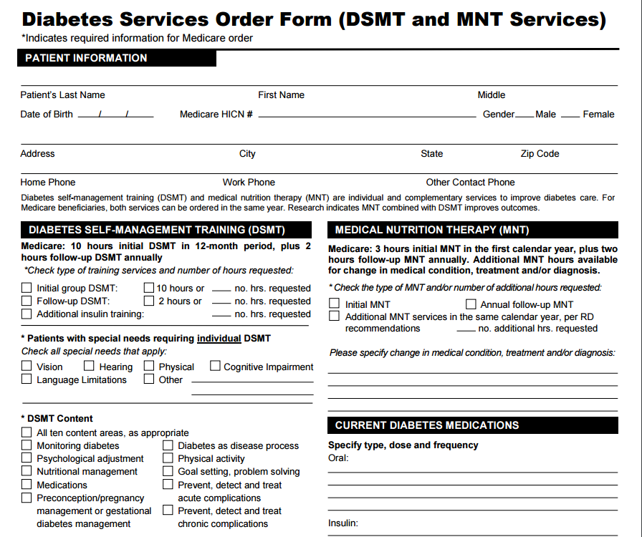
If DSMES were a pill, would you prescribe it?
Prescribe DSMES
DSMES requires a referral

Slide 17
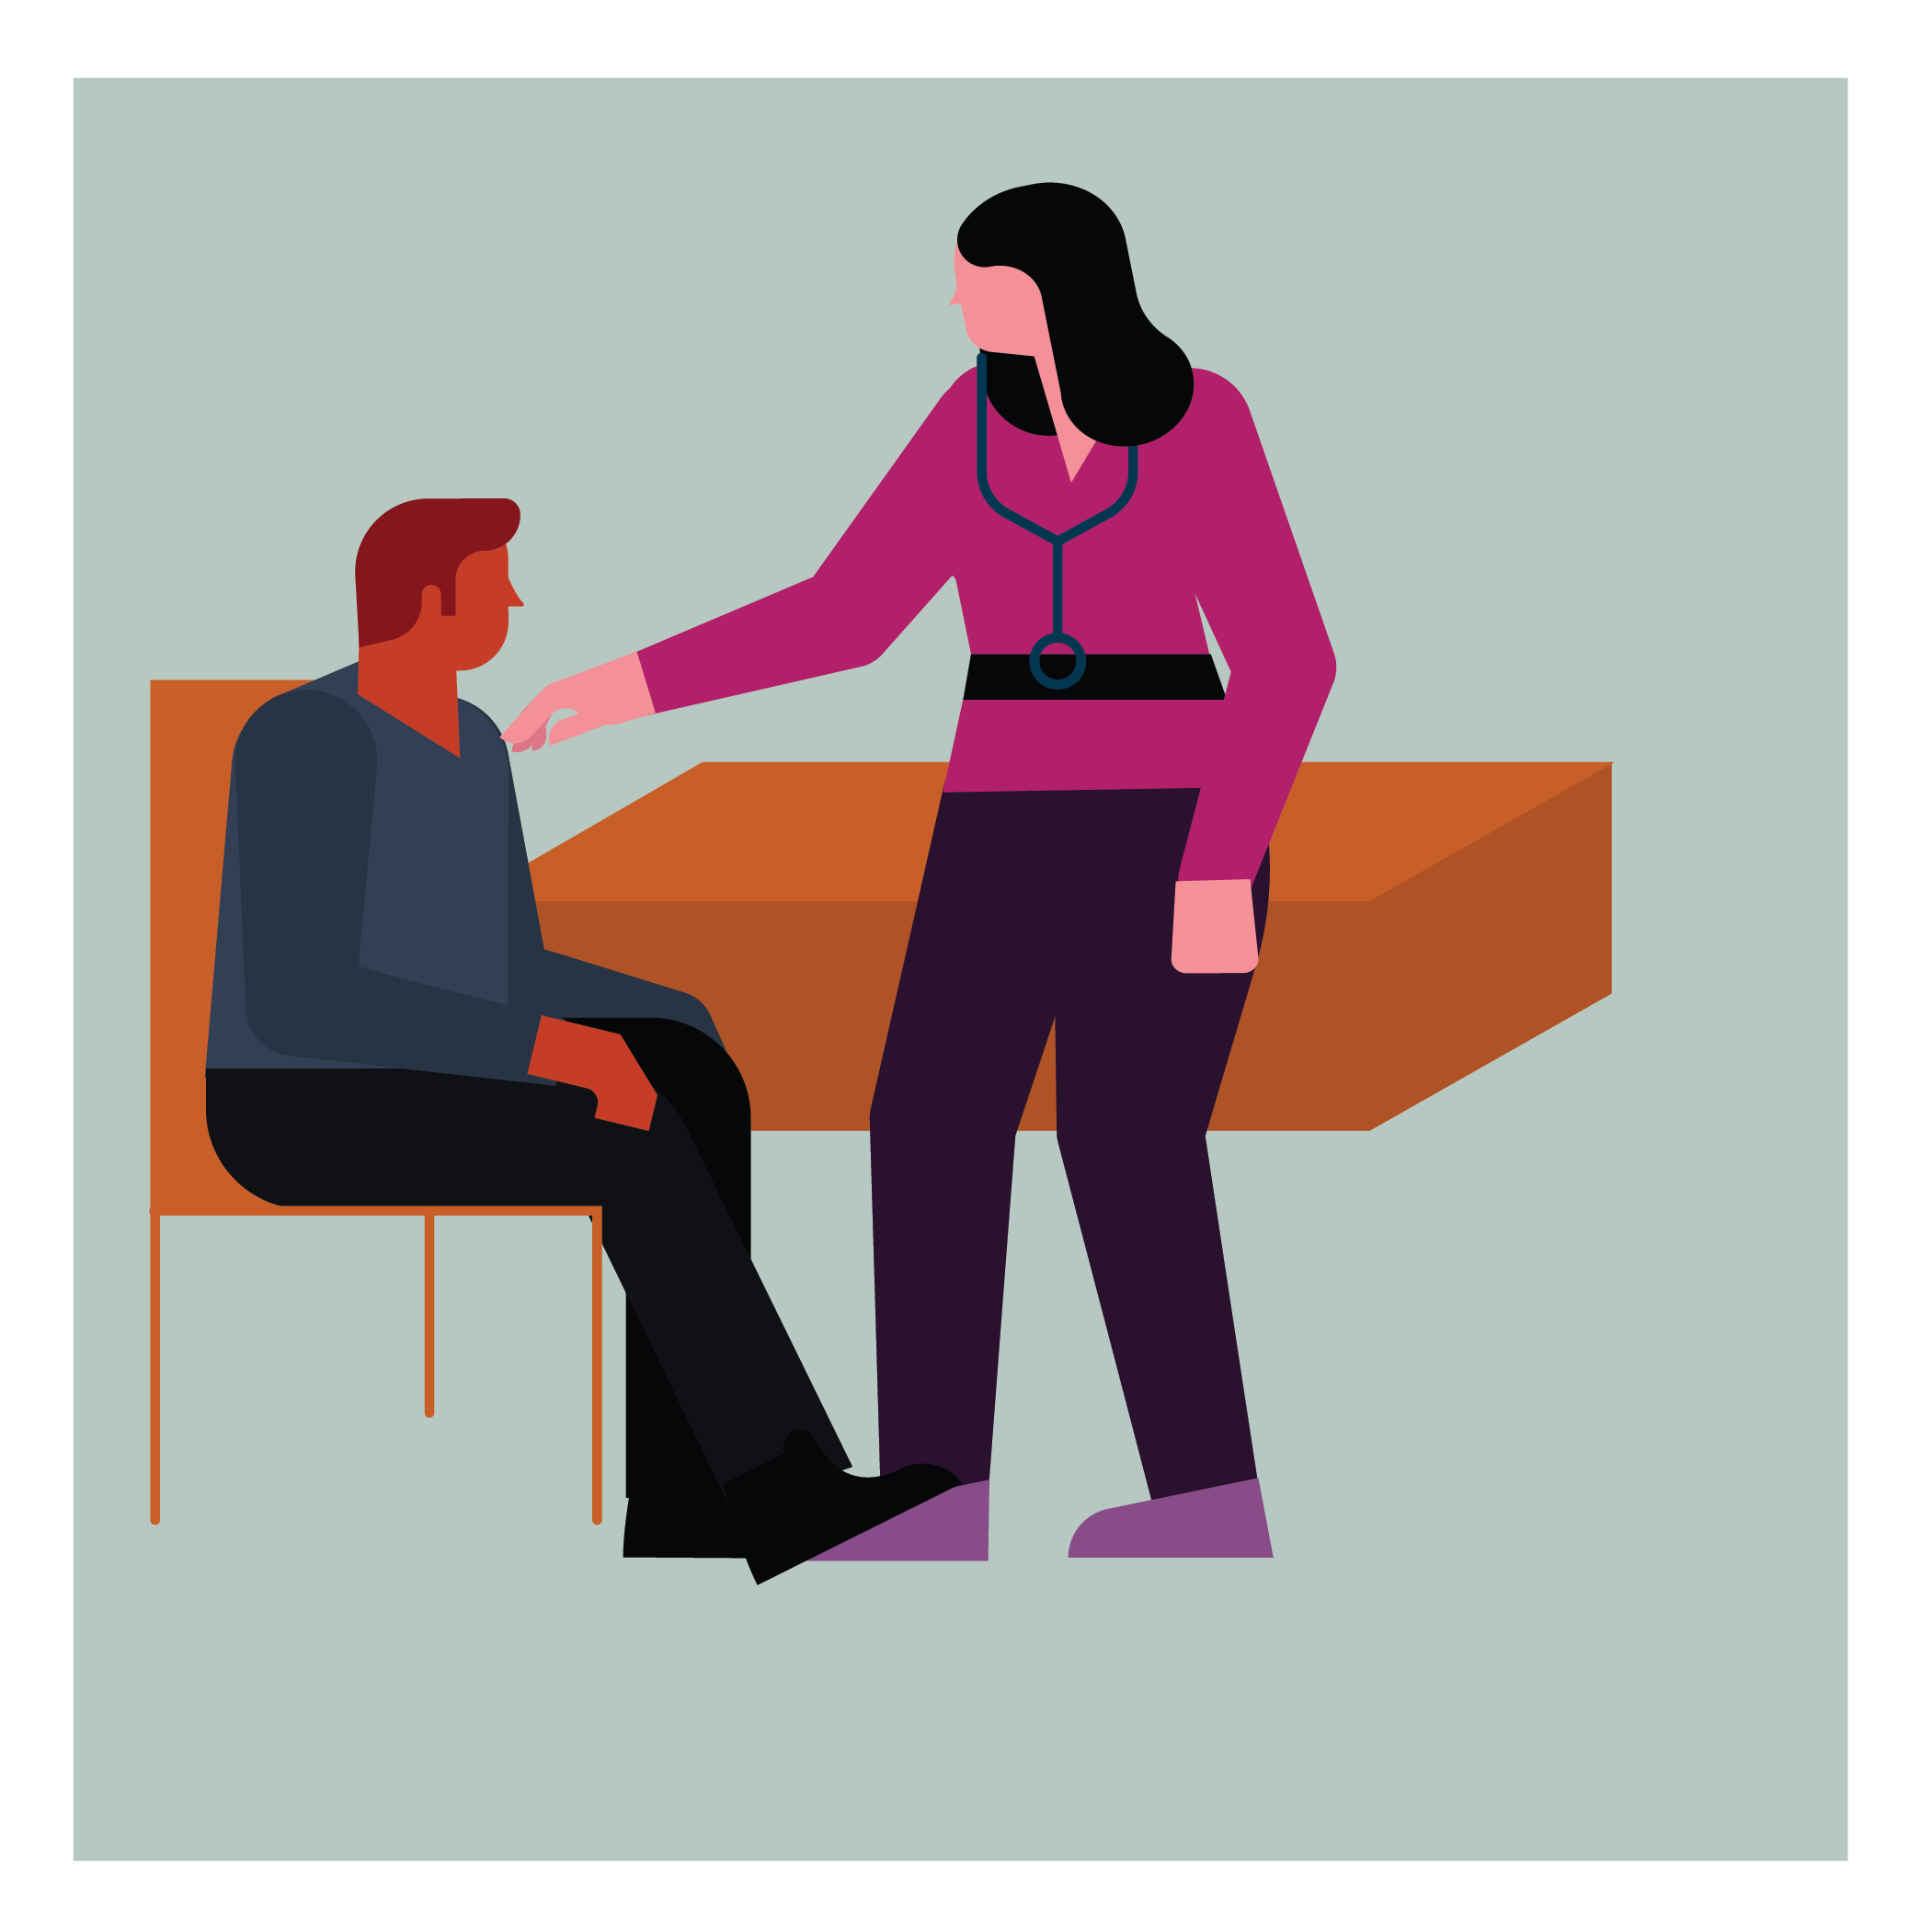
Factors that indicate referral to DSMES services
At diagnosis
All newly diagnosed.
Ensure that both nutrition and emotional health are addressed or make separate referrals.
Powers MA, Bardsley JK, et al. DSMES Consensus Report, The Diabetes Educator, 2020

Slide 18
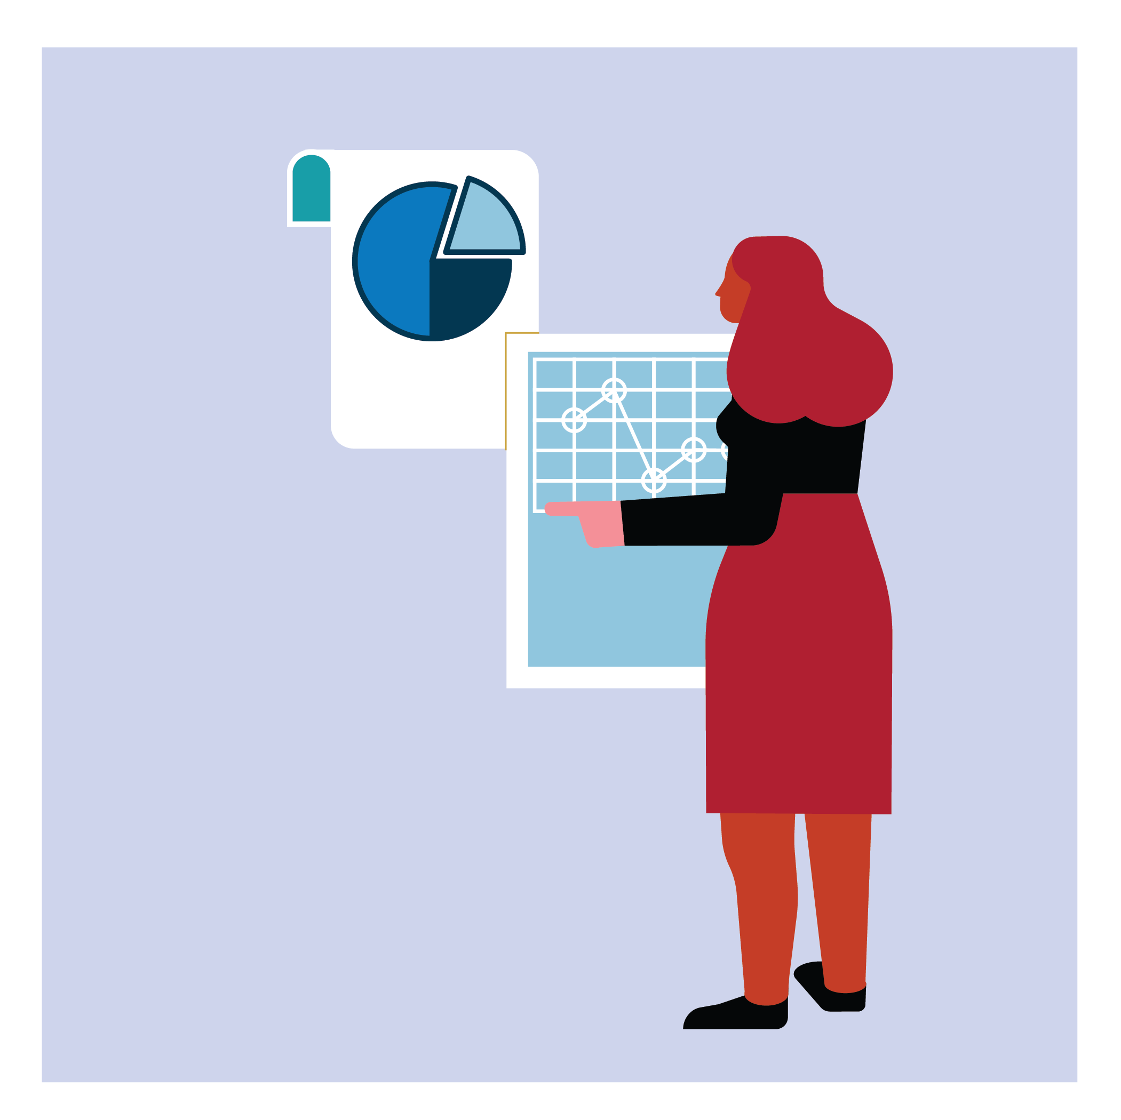
Factors that indicate referral to DSMES services
Annually and/or when not meeting treatment targets
When knowledge and skills need to be assessed.
Long-standing diabetes with limited prior education.
Treatment ineffective.
Change in medication, activity, or nutritional intake or preferences.
Maintenance of positive clinical and quality of life outcomes.
Unexplained or frequent hypo- or hyperglycemia.
When psychosocial and behavioral support is needed.
Powers MA, Bardsley JK, et al. DSMES Consensus Report, The Diabetes Educator, 2020

Slide 19

Factors that indicate referral to DSMES services
When complicating factors develop
Change in:
Health conditions or health status requiring changes in nutrition, physical activity, or medication.
Physical limitations.
Emotional well-being.
Basic living needs.
Planning pregnancy or pregnant.
Powers MA, Bardsley JK, et al. DSMES Consensus Report, The Diabetes Educator, 2020

Slide 20

Factors that indicate referral to DSMES services
When transitions in life and care occur
Change in living situation.
Discharge from inpatient to outpatient.
New clinical care team.
Initiation or intensification of medication, devices or technology.
Insurance coverage changes.
Age-related changes.
Powers MA, Bardsley JK, et al. DSMES Consensus Report, The Diabetes Educator, 2020

Slide 21
What needs to be done at the four critical times?
Check list available in DSMES consensus report.
Provides content guidance for each critical time.
Differentiates content between provider’s team and education team.
Powers MA, Bardsley JK, et al. DSMES Consensus Report, The Diabetes Educator, 2020

Slide 22
Evidence for greatest impact of DSMES
Engaging adults with type 2 diabetes in DSMES results in statistically significant and clinically meaningful improvements in A1C. The greatest improvements are achieved when DSMES:
  Involves both group and individual education.
  Is provided by a team vs a single individual.
  Participants attend more than 10 hours.
  Is tailored to the individual participant.
  Is focused on behaviors and engages the participant rather than didactic interventions.
Chrvala CA, et al. Patient Education and Counseling, 2016

Slide 23
DSMES consensus report recommendations
Recommendations for: health policy, payers, systems, providers, care teams
Expand awareness, access, and utilization of innovative and non-traditional DSMES services.
Identify and address barriers influencing providers influencing referrals to DSMES services.
Facilitate reimbursement processes and other means of financial support in consideration of cost savings related to the benefits of DSMES services.
Powers MA, Bardsley JK, et al. DSMES Consensus Report, The Diabetes Educator, 2020

Slide 24
DSMES consensus report recommendations
Recommendations: for providers
Discuss with all persons with diabetes the benefits and value of initial and ongoing DSMES.
Initiate referral to and facilitate participation in DSMES at the 4 critical times: (1) at diagnosis, (2) annually and/or when not meeting treatment targets, (3) when complicating factors develop, and (4) when transitions in life and care occur.
Ensure coordination of the medical nutrition therapy plan with the overall management strategy, including the DSMES plan, medications and physical activity on an ongoing basis.
Identify and address barriers affecting participation with DSMES services following referral.
Powers MA, Bardsley JK, et al. DSMES Consensus Report, The Diabetes Educator, 2020

Slide 25
Summary
There are many evidence-based benefits of DSMES. Of note are the many psychosocial benefits and behavioral improvements.
DSMES is grossly underutilized.
The DSMES consensus report:
    Describes the 4 critical times to provide and modify DSMES.
    Provides clear guidance as to when to refer to DSMES services.
    Includes a checklist for providers and diabetes care and education specialists providing and modifying DSMES services.
Health systems and providers should mobilize to ensure all people with type 2 diabetes have easy access to DSMES, including nutrition, physical and emotional health support.
    Consider automatic referrals for DSMT and MNT; opt-out versus opt-in.
Powers MA, Bardsley JK, et al. DSMES Consensus Report, The Diabetes Educator, 2020

Slide 26
To access the DSMES consensus report and other resources visit:
DiabetesEducator.org/ConsensusReport

Slide 27
Thank you
Name | Title
xxxx@adces.org | 800.338.3633

